Slide 1


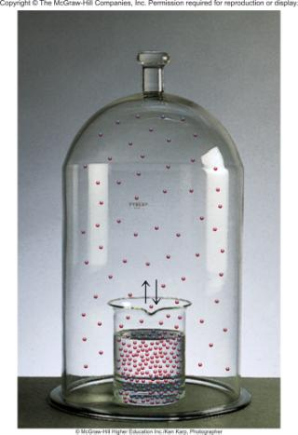
Chemical Equilibrium
Chapter 14
Copyright © The McGraw-Hill Companies, Inc. Permission required for reproduction or display.

Slide 2
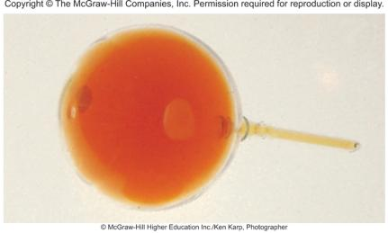
Equilibrium is a state in which there are no observable changes as time goes by.
Chemical equilibrium is achieved when:
the rates of the forward and reverse reactions are equal and
the concentrations of the reactants and products remain constant
Physical equilibrium
NO₂
H₂O (l)
H₂O (g)
Chemical equilibrium
N₂O₄ (g)
2NO₂ (g)

Slide 3
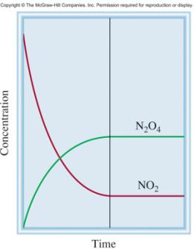
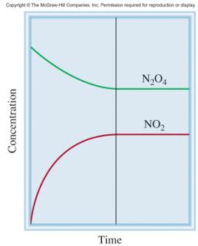
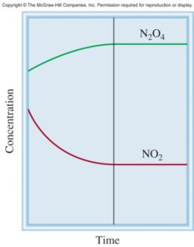
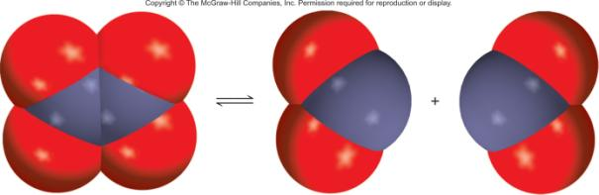
N₂O₄ (g) 2NO₂ (g)
equilibrium
equilibrium
equilibrium
Start with NO₂
Start with N₂O₄
Start with NO₂ & N₂O₄

Slide 4
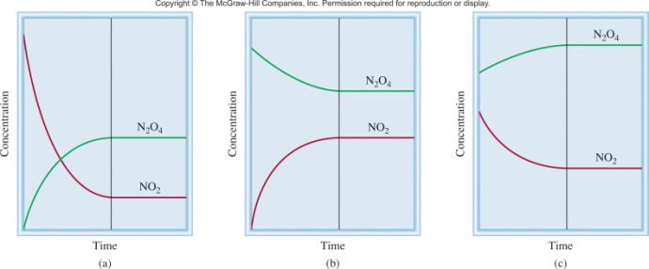
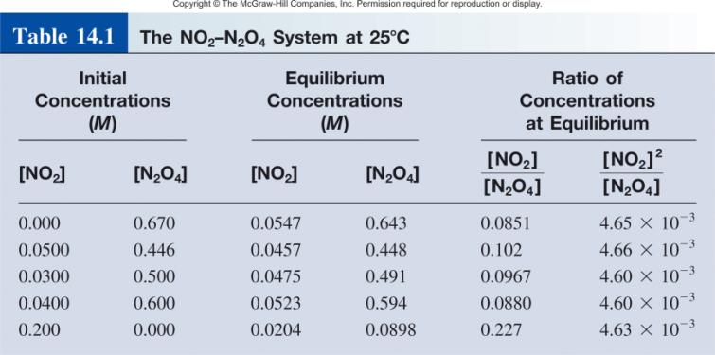
constant

Slide 5

N₂O₄ (g) 2NO₂ (g)
[NO₂]²
K =
= 4.63 x 10⁻³
[N₂O₄]
aA + bB cC + dD
[C]^{c}[D]^{d}
K =
Law of Mass Action
[A]ª[B]^{b}

Slide 6
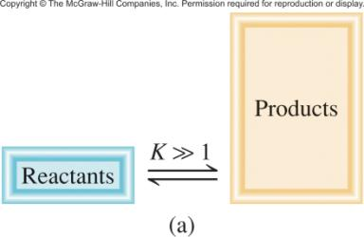
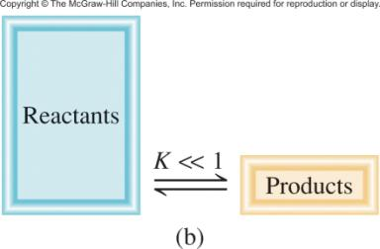
[C]^{c}[D]^{d}
K =
aA + bB cC + dD
[A]ª[B]^{b}
Equilibrium Will
K >> 1
Lie to the right
Favor products
K << 1
Lie to the left
Favor reactants

Slide 7
Homogenous equilibrium applies to reactions in which all reacting species are in the same phase.
N₂O₄ (g) 2NO₂ (g)
[NO₂]²
P ²
K_{c} =
NO₂
K_{p} =
[N₂O₄]
P
N₂O₄
In most cases
K_{c} ≠ K_{p}
aA (g) + bB (g) cC (g) + dD (g)
K_{p} = K_{c}(RT)^{Δn}
Δn = moles of gaseous products – moles of gaseous reactants
= (c + d) – (a + b)

Slide 8
Homogeneous Equilibrium
CH₃COOH (aq) + H₂O (l) CH₃COO⁻ (aq) + H₃O⁺ (aq)
′
[CH₃COO⁻][H₃O⁺]
K_{c} =
[H₂O] = constant
[CH₃COOH][H₂O]
[CH₃COO⁻][H₃O⁺]
=
′
K_{c} =
K_{c} [H₂O]
[CH₃COOH]
General practice not to include units for the equilibrium constant.

Slide 9
14.1
Write expressions for K_{c}, and K_{P} if applicable, for the following reversible reactions at equilibrium:
HF(aq) + H₂O(l) H₃O⁺(aq) + F⁻(aq)
(b) 2NO(g) + O₂(g) 2NO₂(g)
(c) CH₃COOH(aq) + C₂H₅OH(aq ) CH₃COOC₂H₅(aq) + H₂O(l)

Slide 10
14.1
Strategy
Keep in mind the following facts: (1) the K_{P} expression applies only to gaseous reactions and (2) the concentration of solvent (usually water) does not appear in the equilibrium constant expression.

Slide 11
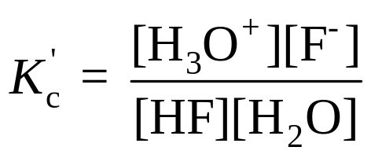
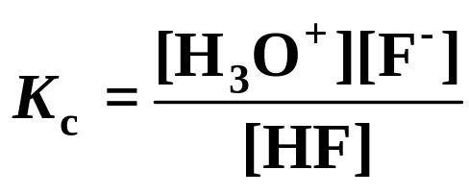
14.1
Solution
(a) Because there are no gases present, K_{P} does not apply and we have only K_{c}.
HF is a weak acid, so that the amount of water consumed in acid ionizations is negligible compared with the total amount of water present as solvent. Thus, we can rewrite the equilibrium constant as

Slide 12
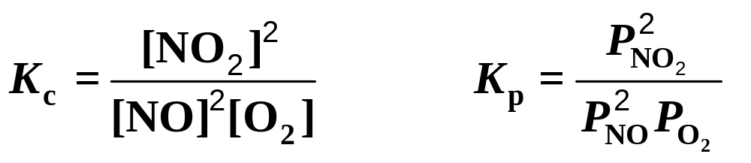

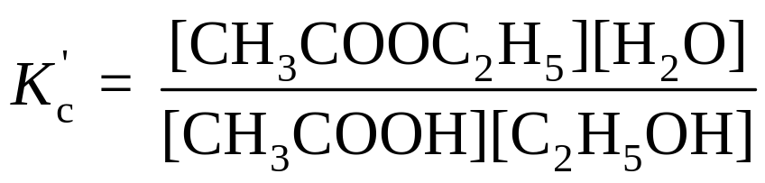
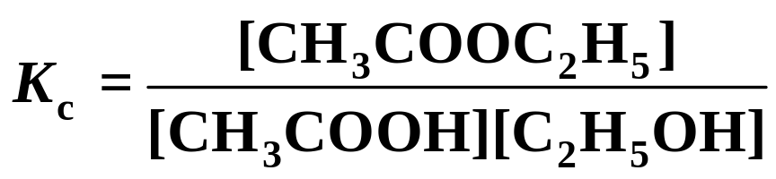
14.1
(b)
(c) The equilibrium constant is given by
Because the water produced in the reaction is negligible compared with the water solvent, the concentration of water does not change. Thus, we can write the new equilibrium constant as

Slide 13
14.2
The following equilibrium process has been studied at 230°C:
2NO(g) + O₂(g) 2NO₂(g)
In one experiment, the concentrations of the reacting species at equilibrium are found to be [NO] = 0.0542 M, [O₂] = 0.127 M, and [NO₂] = 15.5 M. Calculate the equilibrium constant (K_{c}) of the reaction at this temperature.

Slide 14
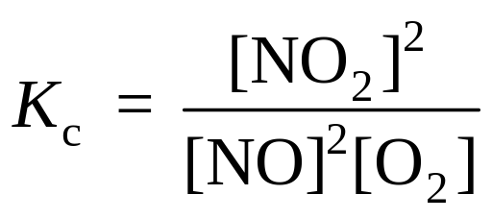
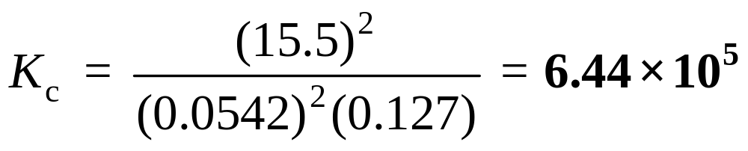
14.2
Strategy The concentrations given are equilibrium concentrations. They have units of mol/L, so we can calculate the equilibrium constant (K_{c}) using the law of mass action [Equation (14.2)].
Solution The equilibrium constant is given by
Substituting the concentrations, we find that

Slide 15
14.2
Check
Note that K_{c} is given without units. Also, the large magnitude of K_{c} is consistent with the high product (NO₂) concentration relative to the concentrations of the reactants (NO and O₂).

Slide 16
14.3
The equilibrium constant K_{P} for the decomposition of phosphorus pentachloride to phosphorus trichloride and molecular chlorine
PCl₅(g) PCl₃(g) + Cl₂(g)
is found to be 1.05 at 250°C. If the equilibrium partial pressures of PCl₅ and PCl₃ are 0.875 atm and 0.463 atm, respectively, what is the equilibrium partial pressure of Cl₂ at 250°C?

Slide 17
14.3
Strategy
The concentrations of the reacting gases are given in atm, so we can express the equilibrium constant in K_{P}. From the known K_{P} value and the equilibrium pressures of PCl₃ and PCl₅, we can solve for P_{Cl2}.

Slide 18
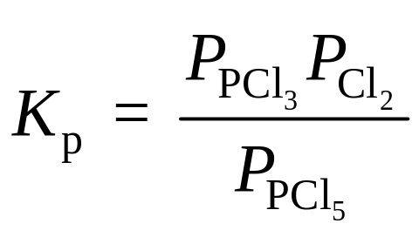
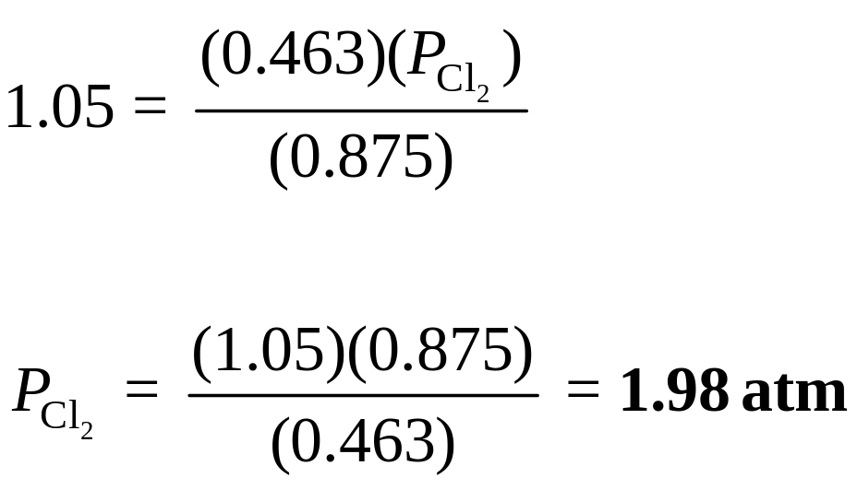
14.3
Solution
First, we write K_{P} in terms of the partial pressures of the reacting species
Knowing the partial pressures, we write
or

Slide 19
14.3
Check
Note that we have added atm as the unit for P_{Cl2}.

Slide 20
14.4
Methanol (CH₃OH) is manufactured industrially by the reaction
CO(g) + 2H₂(g) CH₃OH(g)
The equilibrium constant (K_{c}) for the reaction is 10.5 at 220°C. What is the value of K_{P} at this temperature?

Slide 21
14.4
Strategy
The relationship between K_{c} and K_{P} is given by Equation (14.5). What is the change in the number of moles of gases from reactants to product? Recall that
Δn = moles of gaseous products - moles of gaseous reactants
What unit of temperature should we use?

Slide 22
14.4
Solution
The relationship between K_{c} and K_{P} is
K_{P} = K_{c}(0.0821T )^{Δn}
Because T = 273 + 220 = 493 K and Δn = 1 - 3 = -2, we have
K_{P} = (10.5) (0.0821 x 493)⁻²
= 6.41 x 10⁻³

Slide 23
14.4
Check
Note that K_{P}, like K_{c}, is a dimensionless quantity. This example shows that we can get a quite different value for the equilibrium constant for the same reaction, depending on whether we express the concentrations in moles per liter or in atmospheres.

Slide 24
Heterogenous equilibrium applies to reactions in which reactants and products are in different phases.
CaCO₃ (s) CaO (s) + CO₂ (g)
[CaO][CO₂]
′
[CaCO₃] = constant
[CaO] = constant
K_{c} =
[CaCO₃]
[CaCO₃]
′
K_{c} = [CO₂] =
K_{c} x
K_{p} = P_{CO}
[CaO]
2
The concentration of solids and pure liquids are not included in the expression for the equilibrium constant.

Slide 25
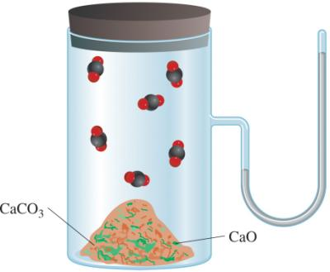
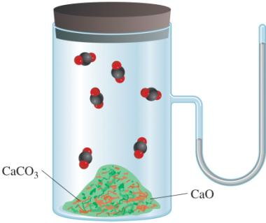
CaCO₃ (s) CaO (s) + CO₂ (g)
P_{CO}
= K_{p}
2
P_{CO}
does not depend on the amount of CaCO₃ or CaO
2

Slide 26
14.5
Write the equilibrium constant expression K_{c}, and K_{P} if applicable, for each of the following heterogeneous systems:
(NH₄)₂Se(s) 2NH₃(g) + H₂Se(g)
(b) AgCl(s) Ag⁺(aq) + Cl⁻(aq)
(c) P₄(s) + 6Cl₂(g) 4PCl₃(l)

Slide 27
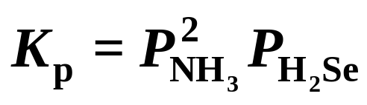
14.5
Strategy We omit any pure solids or pure liquids in the
equilibrium constant expression because their activities are unity.
Solution
(a) Because (NH₄)₂Se is a solid, the equilibrium constant K_{c} is given by
K_{c} = [NH₃]²[H₂Se]
Alternatively, we can express the equilibrium constant K_{P} in terms of the partial pressures of NH₃ and H₂Se:

Slide 28
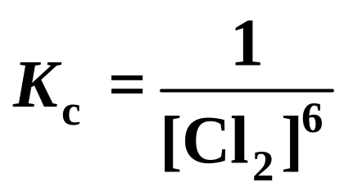
14.5
(b) Here AgCl is a solid so the equilibrium constant is given by
K_{c} = [Ag⁺][Cl⁻]
Because no gases are present, there is no K_{P} expression.
(c) We note that P₄ is a solid and PCl₃ is a liquid, so they do not appear in the equilibrium constant expression. Thus, K_{c} is given by

Slide 29
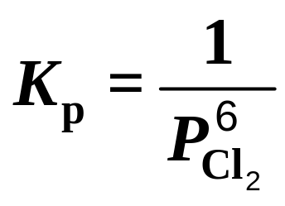
14.5
Alternatively, we can express the equilibrium constant in terms of the pressure of Cl₂:

Slide 30
14.6
Consider the following heterogeneous equilibrium:
CaCO₃(s) CaO(s) + CO₂(g)
At 800°C, the pressure of CO₂ is 0.236 atm. Calculate (a) K_{P} and (b) K_{c} for the reaction at this temperature.

Slide 31
14.6
Strategy
Remember that pure solids do not appear in the equilibrium constant expression. The relationship between K_{P} and K_{c} is given by Equation (14.5).
Solution
Using Equation (14.8) we write
K_{P} = P_{CO2}
= 0.236

Slide 32
14.6
(b) From Equation (14.5), we know
K_{P} = K_{c}(0.0821T)^{Δn}
  In this case, T = 800 + 273 = 1073 K and Δn = 1, so we
  substitute these values in the equation and obtain
0.236 = K_{c}(0.0821 x 1073)
K_{c} = 2.68 x 10⁻³

Slide 33
[C][D]
[E][F]
′
′
′
′
A + B C + D
K_{c}
K_{c} =
K_{c} =
[A][B]
[C][D]
C + D E + F
K_{c}
′′
[E][F]
A + B E + F
K_{c}
K_{c} =
[A][B]
′
′′
K_{c} =
K_{c}
x
K_{c}
If a reaction can be expressed as the sum of two or more reactions, the equilibrium constant for the overall reaction is given by the product of the equilibrium constants of the individual reactions.

Slide 34
N₂O₄ (g) 2NO₂ (g)
2NO₂ (g) N₂O₄ (g)
[NO₂]²
[N₂O₄]
1
K =
= 4.63 x 10⁻³
′
= 216
K =
=
[N₂O₄]
[NO₂]²
K
When the equation for a reversible reaction is written in the opposite direction, the equilibrium constant becomes the reciprocal of the original equilibrium constant.

Slide 35




14.7
The reaction for the production of ammonia can be written in a number of ways:
N₂(g) + 3H₂(g) 2NH₃(g)
(b) N₂(g) + H₂(g) NH₃(g)
(c) N₂(g) + H₂(g) NH₃(g)
Write the equilibrium constant expression for each formulation. (Express the concentrations of the reacting species in mol/L.)
(d) How are the equilibrium constants related to one another?

Slide 36
14.7
Strategy
We are given three different expressions for the same reacting system. Remember that the equilibrium constant expression depends on how the equation is balanced, that is, on the stoichiometric coefficients used in the equation.

Slide 37
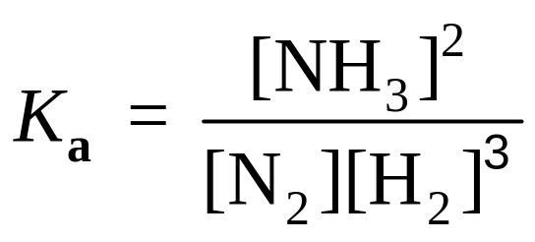
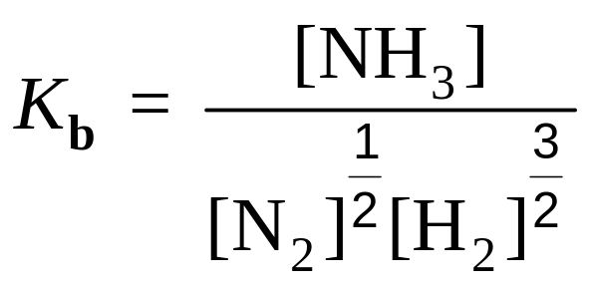
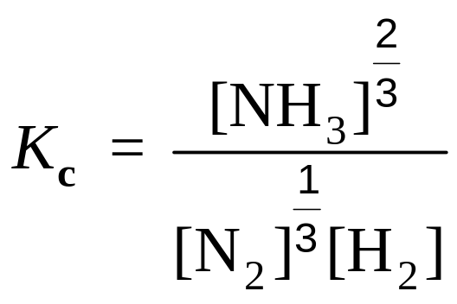
14.7
Solution
(a)
(b)
(c)

Slide 38
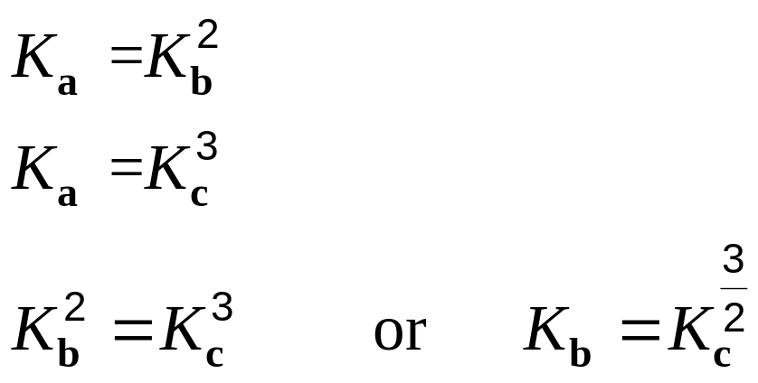
14.7
(d)

Slide 39
Writing Equilibrium Constant Expressions
The concentrations of the reacting species in the condensed phase are expressed in M. In the gaseous phase, the concentrations can be expressed in M or in atm.
The concentrations of pure solids, pure liquids and solvents do not appear in the equilibrium constant expressions.
The equilibrium constant is a dimensionless quantity.
In quoting a value for the equilibrium constant, you must specify the balanced equation and the temperature.
If a reaction can be expressed as a sum of two or more reactions, the equilibrium constant for the overall reaction is given by the product of the equilibrium constants of the individual reactions.

Slide 40
Chemical Kinetics and Chemical Equilibrium
k_{f}
rate_{f} = k_{f} [A][B]²
A + 2B AB₂
k_{r}
rate_{r} = k_{r} [AB₂]
Equilibrium
rate_{f} = rate_{r}
k_{f} [A][B]² = k_{r} [AB₂]
k_{f}
[AB₂]
=
K_{c} =
k_{r}
[A][B]²

Slide 41
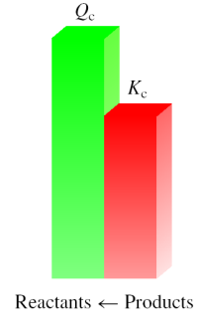
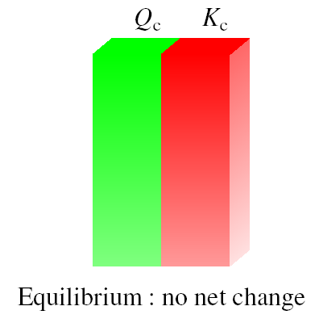
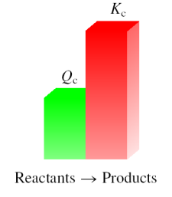
The reaction quotient (Q_{c}) is calculated by substituting the initial concentrations of the reactants and products into the equilibrium constant (K_{c}) expression.
IF
Q_{c} < K_{c} system proceeds from left to right to reach equilibrium
Q_{c} = K_{c} the system is at equilibrium
Q_{c} > K_{c} system proceeds from right to left to reach equilibrium

Slide 42
14.8
At the start of a reaction, there are 0.249 mol N₂, 3.21 x 10⁻² mol H₂, and 6.42 x 10⁻⁴ mol NH₃ in a 3.50-L reaction vessel at 375°C. If the equilibrium constant (K_{c}) for the reaction
N₂(g) + 3H₂(g) 2NH₃(g)
is 1.2 at this temperature, decide whether the system is at equilibrium. If it is not, predict which way the net reaction will proceed.

Slide 43
14.8
Strategy
We are given the initial amounts of the gases (in moles) in a vessel of known volume (in liters), so we can calculate their molar concentrations and hence the reaction quotient (Q_{c}). How does a comparison of Q_{c} with K_{c} enable us to determine if the system is at equilibrium or, if not, in which direction will the net reaction proceed to reach equilibrium?

Slide 44
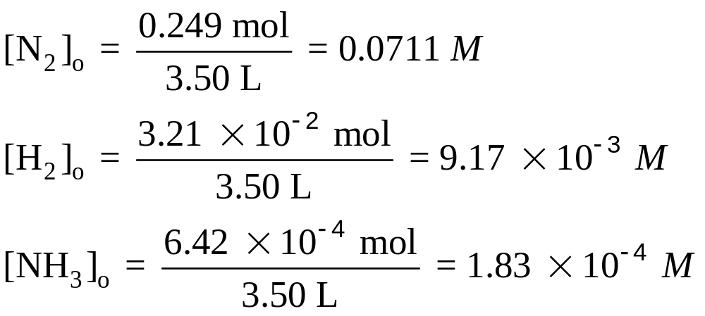
14.8
Solution
The initial concentrations of the reacting species are

Slide 45
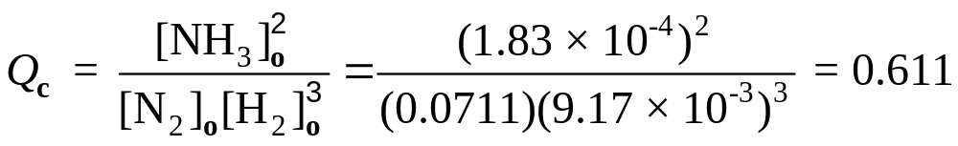
14.8
Next we write
Because Q_{c} is smaller than K_{c} (1.2), the system is not at equilibrium. The net result will be an increase in the concentration of NH₃ and a decrease in the concentrations of N₂ and H₂. That is, the net reaction will proceed from left to right until equilibrium is reached.

Slide 46
Calculating Equilibrium Concentrations
Express the equilibrium concentrations of all species in terms of the initial concentrations and a single unknown x, which represents the change in concentration.
Write the equilibrium constant expression in terms of the equilibrium concentrations. Knowing the value of the equilibrium constant, solve for x.
Having solved for x, calculate the equilibrium concentrations of all species.

Slide 47
14.9
A mixture of 0.500 mol H₂ and 0.500 mol I₂ was placed in a 1.00-L stainless-steel flask at 430°C. The equilibrium constant K_{c} for the reaction H₂(g) + I₂(g) 2HI(g) is 54.3 at this temperature. Calculate the concentrations of H₂, I₂, and HI at equilibrium.

Slide 48
14.9
Strategy
We are given the initial amounts of the gases (in moles) in a vessel of known volume (in liters), so we can calculate their molar concentrations. Because initially no HI was present, the system could not be at equilibrium. Therefore, some H₂ would react with the same amount of I₂ (why?) to form HI until equilibrium was established.

Slide 49
14.9
Solution We follow the preceding procedure to calculate the
equilibrium concentrations.
Step 1: The stoichiometry of the reaction is 1 mol H₂ reacting with 1 mol I₂ to yield 2 mol HI. Let x be the depletion in concentration (mol/L) of H₂ and I₂ at equilibrium. It follows that the equilibrium concentration of HI must be 2x. We summarize the changes in concentrations as follows:
 | H₂ + | I₂ |  | 2HI
Initial (M): | 0.500 | 0.500 |  | 0.000
Change (M): | - x | - x |  | + 2x
Equilibrium (M): | (0.500 - x) | (0.500 - x) |  | 2x

Slide 50
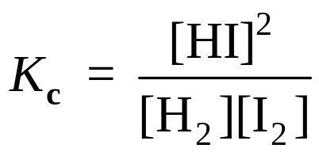
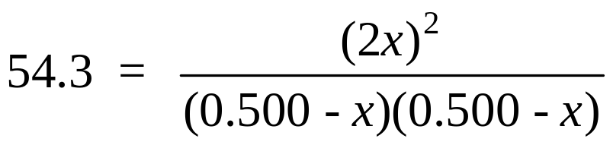
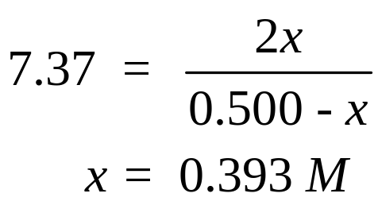
14.9
Step 2: The equilibrium constant is given by
Substituting, we get
Taking the square root of both sides, we get

Slide 51
14.9
Step 3: At equilibrium, the concentrations are
[H₂] = (0.500 - 0.393) M = 0.107 M
[I₂] = (0.500 - 0.393) M = 0.107 M
[HI] = 2 x 0.393 M = 0.786 M
Check You can check your answers by calculating K_{c} using the equilibrium concentrations. Remember that K_{c} is a constant for a particular reaction at a given temperature.

Slide 52
14.10
For the same reaction and temperature as in Example 14.9, suppose that the initial concentrations of H₂, I₂, and HI are 0.00623 M, 0.00414 M, and 0.0224 M, respectively. Calculate the concentrations of these species at equilibrium.
H₂(g) + I₂(g) 2HI(g),

Slide 53
14.10
Strategy
From the initial concentrations we can calculate the reaction quotient (Q_{c}) to see if the system is at equilibrium or, if not, in which direction the net reaction will proceed to reach equilibrium. A comparison of Q_{c} with K_{c} also enables us to determine if there will be a depletion in H₂ and I₂ or HI as equilibrium is established.

Slide 54
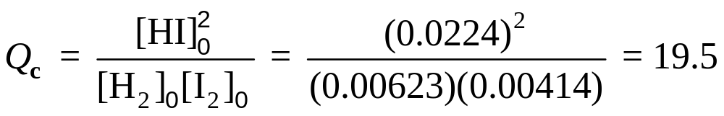
14.10
Solution
First we calculate Q_{c} as follows:
Because Q_{c} (19.5) is smaller than K_{c} (54.3), we conclude that the net reaction will proceed from left to right until equilibrium is reached (see Figure 14.4); that is, there will be a depletion of H₂ and I₂ and a gain in HI.

Slide 55
14.10
Step 1: Let x be the depletion in concentration (mol/L) of H₂ and I₂ at equilibrium. From the stoichiometry of the reaction it follows that the increase in concentration for HI must be 2x. Next we write
 | H₂ + | I₂ |  | 2HI
Initial (M): | 0.00623 | 0.00414 |  | 0.0224
Change (M): | - x | - x |  | + 2x
Equilibrium (M): | (0.00623 - x) | (0.00414 - x) |  | (0.0224 + 2x)

Slide 56

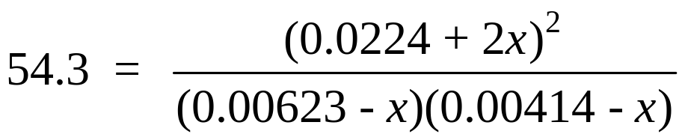
14.10
Step 2: The equilibrium constant is
It is not possible to solve this equation by the square root shortcut, as the starting concentrations [H₂] and [I₂] are unequal. Instead, we must first carry out the multiplications
54.3(2.58 x 10⁻⁵ - 0.0104x + x²) = 5.02 x 10⁻⁴ + 0.0896x + 4x²
Substituting, we get

Slide 57
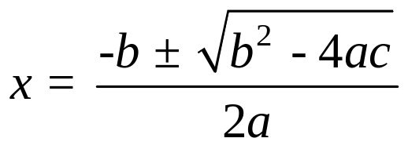
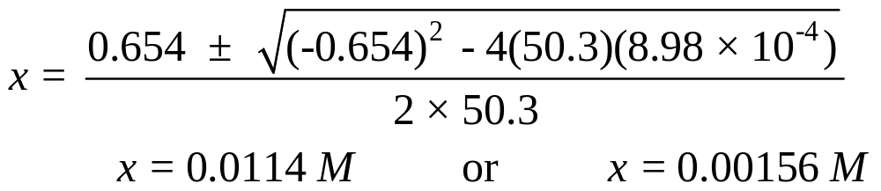
14.10
Collecting terms, we get
50.3x² - 0.654x + 8.98 x 10⁻⁴ = 0
This is a quadratic equation of the form ax² + bx + c = 0. The solution for a quadratic equation (see Appendix 4) is
Here we have a = 50.3, b = -0.654, and c = 8.98 x 10⁻⁴, so that

Slide 58
14.10
The first solution is physically impossible because the amounts of H₂ and I₂ reacted would be more than those originally present. The second solution gives the correct answer. Note that in solving quadratic equations of this type, one answer is always physically impossible, so choosing a value for x is easy.
Step 3: At equilibrium, the concentrations are
[H₂] = (0.00623 - 0.00156) M = 0.00467 M
[I₂] = (0.00414 - 0.00156) M - 0.00258 M
[HI] = (0.0224 + 2 x 0.00156) M = 0.0255 M

Slide 59
14.10
Check
You can check the answers by calculating K_{c} using the equilibrium concentrations. Remember that K_{c} is a constant for a particular reaction at a given temperature.

Slide 60
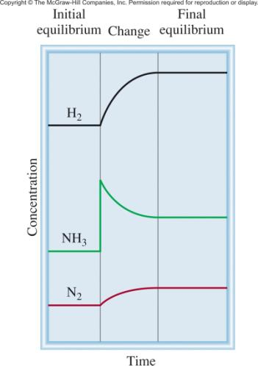
Le Châtelier’s Principle
If an external stress is applied to a system at equilibrium, the system adjusts in such a way that the stress is partially offset as the system reaches a new equilibrium position.
Changes in Concentration
N₂ (g) + 3H₂ (g) 2NH₃ (g)
Equilibrium shifts left to offset stress
Add
NH₃

Slide 61
Le Châtelier’s Principle
Changes in Concentration continued
Remove
Remove
Add
Add
aA + bB cC + dD
Change
Shifts the Equilibrium
Increase concentration of product(s)
left
Decrease concentration of product(s)
right
Increase concentration of reactant(s)
right
Decrease concentration of reactant(s)
left

Slide 62
14.11
At 720°C, the equilibrium constant K_{c} for the reaction
N₂(g) + 3H₂(g) 2NH₃(g)
is 2.37 x 10⁻³. In a certain experiment, the equilibrium concentrations are [N₂] = 0.683 M, [H₂] = 8.80 M, and
[NH₃] = 1.05 M. Suppose some NH₃ is added to the mixture so that its concentration is increased to 3.65 M. (a) Use Le Châtelier’s principle to predict the shift in direction of the net reaction to reach a new equilibrium. (b) Confirm your prediction by calculating the reaction quotient Q_{c} and comparing its value with K_{c}.

Slide 63
14.11
Strategy
(a) What is the stress applied to the system? How does the system adjust to offset the stress?
(b) At the instant when some NH₃ is added, the system is no
longer at equilibrium. How do we calculate the Q_{c} for the reaction at this point? How does a comparison of Q_{c} with K_{c} tell us the direction of the net reaction to reach equilibrium.

Slide 64
14.11
Solution
The stress applied to the system is the addition of NH₃. To offset this stress, some NH₃ reacts to produce N₂ and H₂ until a new equilibrium is established. The net reaction therefore shifts from right to left; that is,
N₂(g) + 3H₂(g) 2NH₃(g)

Slide 65
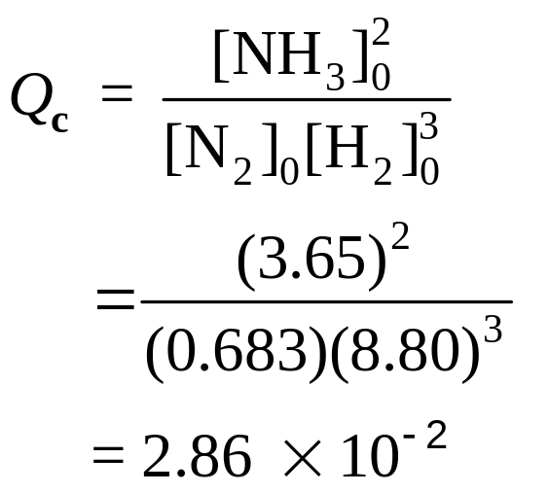
14.11
(b) At the instant when some of the NH₃ is added, the system
is no longer at equilibrium. The reaction quotient is given by
Because this value is greater than 2.37 x 10⁻³, the net
reaction shifts from right to left until Q_{c} equals K_{c}.

Slide 66
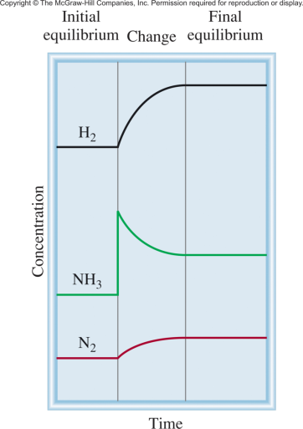
14.11
Figure 14.8 shows qualitatively the changes in concentrations
of the reacting species.

Slide 67
Le Châtelier’s Principle
Changes in Volume and Pressure
A (g) + B (g) C (g)
Change
Shifts the Equilibrium
Increase pressure
Side with fewest moles of gas
Decrease pressure
Side with most moles of gas
Increase volume
Side with most moles of gas
Decrease volume
Side with fewest moles of gas

Slide 68
14.12
Consider the following equilibrium systems:
2PbS(s) + 3O₂(g) 2PbO(s) + 2SO₂(g)
(b) PCl₅(g) PCl₃(g) + Cl₂(g)
(c) H₂(g) + CO₂(g) H₂O(g) + CO(g)
Predict the direction of the net reaction in each case as a result of increasing the pressure (decreasing the volume) on the system at constant temperature.

Slide 69

14.12
Strategy
A change in pressure can affect only the volume of a gas, but not that of a solid because solids (and liquids) are much less compressible. The stress applied is an increase in pressure. According to Le Châtelier’s principle, the system will adjust to
partially offset this stress. In other words, the system will adjust to decrease the pressure. This can be achieved by shifting to the side of the equation that has fewer moles of gas. Recall that pressure is directly proportional to moles of gas: PV = nRT
so P n.

Slide 70
14.12
Solution
Consider only the gaseous molecules. In the balanced equation, there are 3 moles of gaseous reactants and 2 moles of gaseous products. Therefore, the net reaction will shift toward the products (to the right) when the pressure is increased.
(b) The number of moles of products is 2 and that of reactants is 1; therefore, the net reaction will shift to the left, toward the reactant.
(c) The number of moles of products is equal to the number of moles of reactants, so a change in pressure has no effect on the equilibrium.

Slide 71
14.12
Check
In each case, the prediction is consistent with Le Châtelier’s principle.

Slide 72

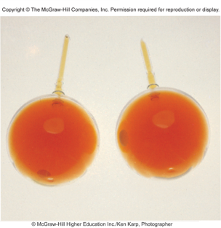
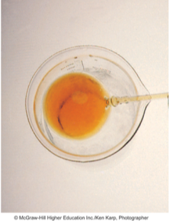
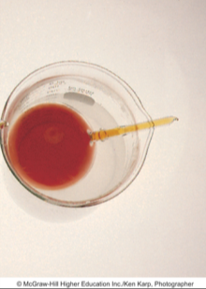
Le Châtelier’s Principle
Changes in Temperature
Change
Exothermic Rx
Endothermic Rx
Increase temperature
K decreases
K increases
Decrease temperature
K increases
K decreases
N₂O₄ (g) 2NO₂ (g)
colder
hotter

Slide 73
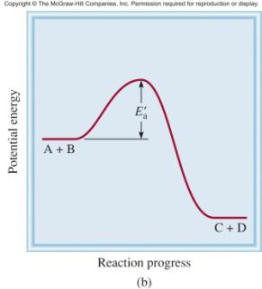
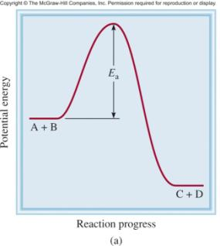
Le Châtelier’s Principle
Adding a Catalyst
  does not change K
  does not shift the position of an equilibrium system
  system will reach equilibrium sooner
Catalyst lowers E_{a} for both forward and reverse reactions.
Catalyst does not change equilibrium constant or shift equilibrium.

Slide 74
Le Châtelier’s Principle - Summary
Change Equilibrium
Constant
Change
Shift Equilibrium
Concentration
yes
no
Pressure
yes*
no
Volume
yes*
no
Temperature
yes
yes
Catalyst
no
no
*Dependent on relative moles of gaseous reactants and products

Slide 75
14.13
Consider the following equilibrium process between dinitrogen tetrafluoride (N₂F₄) and nitrogen difluoride (NF₂):
N₂F₄(g) 2NF₂(g) ΔH° = 38.5 kJ/mol
Predict the changes in the equilibrium if
the reacting mixture is heated at constant volume;
(b) some N₂F₄ gas is removed from the reacting mixture at constant temperature and volume;
(c) the pressure on the reacting mixture is decreased at constant temperature; and
(d) a catalyst is added to the reacting mixture.

Slide 76
14.13
Strategy
(a) What does the sign of ΔH° indicate about the heat change (endothermic or exothermic) for the forward reaction?
(b) Would the removal of some N₂F₄ increase or decrease the Q_{c} of the reaction?
(c) How would the decrease in pressure change the volume of the system?
(d) What is the function of a catalyst? How does it affect a
reacting system not at equilibrium? at equilibrium?

Slide 77
14.13
Solution
The stress applied is the heat added to the system. Note that the N₂F₄ → 2NF₂ reaction is an endothermic process (ΔH° > 0), which absorbs heat from the surroundings. Therefore, we can think of heat as a reactant
heat + N₂F₄(g) 2NF₂(g)
The system will adjust to remove some of the added heat by undergoing a decomposition reaction (from left to right).

Slide 78
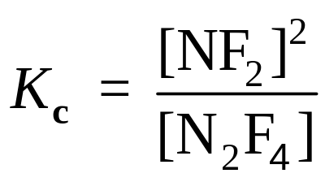
14.13
The equilibrium constant
will therefore increase with increasing temperature because the concentration of NF₂ has increased and that of N₂F₄ has decreased. Recall that the equilibrium constant is a constant only at a particular temperature. If the temperature is changed, then the equilibrium constant will also change.
(b) The stress here is the removal of N₂F₄ gas. The system will
shift to replace some of the N₂F₄ removed. Therefore, the
system shifts from right to left until equilibrium is reestablished.
As a result, some NF₂ combines to form N₂F₄.

Slide 79
14.13
Comment
The equilibrium constant remains unchanged in this case because temperature is held constant. It might seem that K_{c} should change because NF₂ combines to produce N₂F₄. Remember, however, that initially some N₂F₄ was removed. The system adjusts to replace only some of the N₂F₄ that was removed, so that overall the amount of N₂F₄ has decreased. In fact, by the time the equilibrium is reestablished, the amounts of both NF₂ and N₂F₄ have decreased. Looking at the equilibrium constant expression, we see that dividing a smaller numerator by a smaller denominator gives the same value of K_{c}.

Slide 80
14.13
(c) The stress applied is a decrease in pressure (which is accompanied by an increase in gas volume). The system will adjust to remove the stress by increasing the pressure.
Recall that pressure is directly proportional to the number of moles of a gas. In the balanced equation we see that the formation of NF₂ from N₂F₄ will increase the total number of moles of gases and hence the pressure. Therefore, the system will shift from left to right to reestablish equilibrium. The equilibrium constant will remain unchanged because temperature is held constant.

Slide 81
14.13
(d) The function of a catalyst is to increase the rate of a reaction. If a catalyst is added to a reacting system not at equilibrium, the system will reach equilibrium faster than
if left undisturbed. If a system is already at equilibrium, as in this case, the addition of a catalyst will not affect either the concentrations of NF₂ and N₂F₄ or the equilibrium constant.

Slide 82
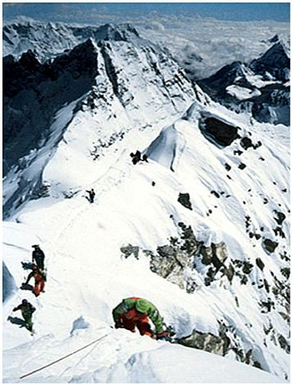
Chemistry In Action
Life at High Altitudes and Hemoglobin Production
Hb (aq) + O₂ (aq) HbO₂ (aq)
[HbO₂]
K_{c} =
[Hb][O₂]

Slide 83



Chemistry In Action: The Haber Process
N₂ (g) + 3H₂ (g) 2NH₃ (g) ΔH⁰ = -92.6 kJ/mol

