Slide 1
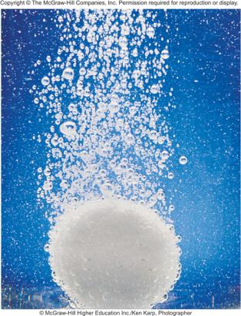
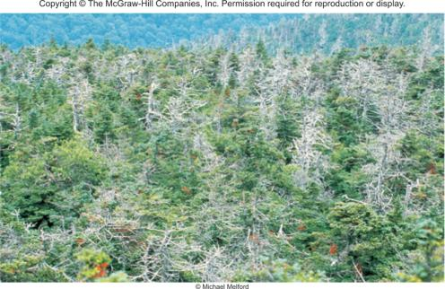

Acids and Bases
Chapter 15
Copyright © The McGraw-Hill Companies, Inc. Permission required for reproduction or display.

Slide 2
Acids
Have a sour taste. Vinegar owes its taste to acetic acid. Citrus
fruits contain citric acid.
React with certain metals to produce hydrogen gas.
React with carbonates and bicarbonates to produce carbon
dioxide gas.
Bases
Have a bitter taste.
Feel slippery. Many soaps contain bases.

Slide 3
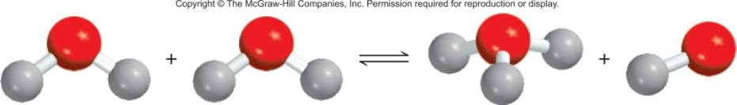
A Brønsted acid is a proton donor
A Brønsted base is a proton acceptor
base
acid
acid
base
conjugate acid
conjugate base
base
acid

Slide 4
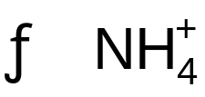
15.1
Identify the conjugate acid-base pairs in the reaction between ammonia and hydrofluoric acid in aqueous solution
NH₃(aq) + HF(aq) (aq) + F⁻(aq)

Slide 5
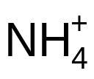
15.1
Strategy
Remember that a conjugate base always has one fewer H atom and one more negative charge (or one fewer positive charge) than the formula of the corresponding acid.
Solution
NH₃ has one fewer H atom and one fewer positive charge than . F⁻ has one fewer H atom and one more negative charge than HF. Therefore, the conjugate acid-base pairs are (1) and NH₃ and (2) HF and F⁻.

Slide 6
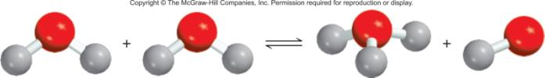
Acid-Base Properties of Water
H₂O (l) H⁺ (aq) + OH⁻ (aq)
autoionization of water
-
[
]
+
H
O
+
H
O
H
O
H
+
H
O
H
H
H
conjugate acid
base
H₂O + H₂O H₃O⁺ + OH⁻
acid
conjugate base

Slide 7
The Ion Product of Water
[H⁺][OH⁻]
H₂O (l) H⁺ (aq) + OH⁻ (aq)
K_{c} =
[H₂O] = constant
[H₂O]
K_{c}[H₂O] = K_{w} = [H⁺][OH⁻]
The ion-product constant (K_{w}) is the product of the molar concentrations of H⁺ and OH⁻ ions at a particular temperature.
Solution Is
[H⁺] = [OH⁻]
neutral
At 25⁰C
K_{w} = [H⁺][OH⁻] = 1.0 x 10⁻¹⁴
[H⁺] > [OH⁻]
acidic
[H⁺] < [OH⁻]
basic

Slide 8
15.2
The concentration of OH⁻ ions in a certain household ammonia cleaning solution is 0.0025 M. Calculate the concentration of H⁺ ions.

Slide 9
15.2
Strategy
We are given the concentration of the OH⁻ ions and asked to calculate [H⁺]. The relationship between [H⁺] and [OH⁻] in water or an aqueous solution is given by the ion-product of water, K_{w} [Equation (15.3)].

Slide 10
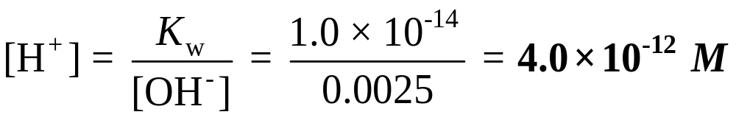
15.2
Solution
Rearranging Equation (15.3), we write
Check
Because [H⁺] < [OH⁻], the solution is basic, as we would expect from the earlier discussion of the reaction of ammonia with water.

Slide 11
pH – A Measure of Acidity
pH = -log [H⁺]
Solution Is
At 25⁰C
neutral
[H⁺] = [OH⁻]
[H⁺] = 1.0 x 10⁻⁷
pH = 7
acidic
[H⁺] > [OH⁻]
[H⁺] > 1.0 x 10⁻⁷
pH < 7
basic
[H⁺] < [OH⁻]
[H⁺] < 1.0 x 10⁻⁷
pH > 7
pH
[H⁺]

Slide 12
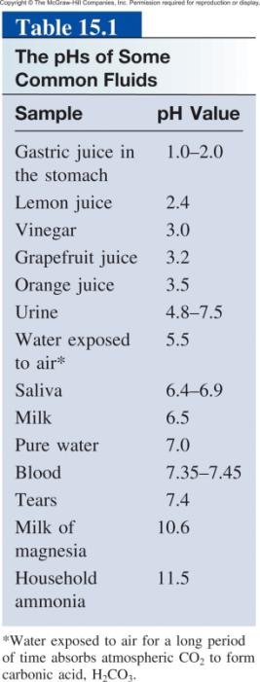
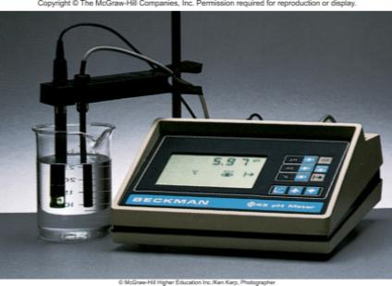
Other important relationships
pOH = -log [OH⁻]
[H⁺][OH⁻] = K_{w} = 1.0 x 10⁻¹⁴
-log [H⁺] – log [OH⁻] = 14.00
pH + pOH = 14.00
pH Meter

Slide 13
15.3
The concentration of H⁺ ions in a bottle of table wine was
3.2 x 10⁻⁴ M right after the cork was removed. Only half of the wine was consumed. The other half, after it had been
standing open to the air for a month, was found to have a hydrogen ion concentration equal to 1.0 x 10⁻³ M. Calculate the pH of the wine on these two occasions.

Slide 14
15.3
Strategy
We are given the H⁺ ion concentration and asked to calculate the pH of the solution. What is the definition of pH?

Slide 15
15.3
Solution
According to Equation (15.4), pH = -log [H⁺]. When the bottle was first opened, [H⁺] = 3.2 x 10⁻⁴ M, which we substitute in Equation (15.4)
pH = -log [H⁺]
= -log (3.2 x 10⁻⁴) = 3.49
On the second occasion, [H⁺] = 1.0 x 10⁻³ M, so that
pH = -log (1.0 x 10⁻³ ) = 3.00

Slide 16
15.3
Comment
The increase in hydrogen ion concentration (or decrease in pH) is largely the result of the conversion of some of the alcohol (ethanol) to acetic acid, a reaction that takes place in the presence of molecular oxygen.

Slide 17
15.4
The pH of rainwater collected in a certain region of the northeastern United States on a particular day was 4.82. Calculate the H⁺ ion concentration of the rainwater.

Slide 18
15.4
Strategy
Here we are given the pH of a solution and asked to calculate [H⁺]. Because pH is defined as pH = -log [H⁺], we can solve for [H⁺] by taking the antilog of the pH; that is, [H⁺] = 10^{-pH}, as shown in Equation (15.5).

Slide 19
15.4
Solution
From Equation (15.4)
pH = -log [H⁺] = 4.82
Therefore,
log [H⁺] = -4.82
To calculate [H⁺], we need to take the antilog of -4.82
[H⁺] = 10^{-4.82} = 1.5 x 10⁻⁵ M

Slide 20
15.4
Check
Because the pH is between 4 and 5, we can expect [H⁺] to be between 1 x 10⁻⁴ M and 1 x 10⁻⁵ M. Therefore, the answer is reasonable.

Slide 21
15.5
In a NaOH solution [OH⁻] is 2.9 x 10⁻⁴ M. Calculate the pH of the solution.

Slide 22
15.5
Strategy
Solving this problem takes two steps. First, we need to calculate pOH using Equation (15.7). Next, we use Equation (15.9) to calculate the pH of the solution.
Solution
We use Equation (15.7):
pOH = -log [OH⁻]
= -log (2.9 x 10⁻⁴)
= 3.54

Slide 23
15.5
Now we use Equation (15.9):
pH + pOH = 14.00
pH = 14.00 - pOH
= 14.00 - 3.54 = 10.46
Alternatively, we can use the ion-product constant of water,
K_{w} = [H⁺][OH⁻] to calculate [H⁺], and then we can calculate the pH from the [H⁺]. Try it.
Check The answer shows that the solution is basic (pH > 7), which is consistent with a NaOH solution.

Slide 24
Strong Electrolyte – 100% dissociation
H₂O
NaCl (s) Na⁺ (aq) + Cl⁻ (aq)
Weak Electrolyte – not completely dissociated
CH₃COOH CH₃COO⁻ (aq) + H⁺ (aq)
Strong Acids are strong electrolytes
HCl (aq) + H₂O (l) H₃O⁺ (aq) + Cl⁻ (aq)
HNO₃ (aq) + H₂O (l) H₃O⁺ (aq) + NO₃⁻ (aq)
HClO₄ (aq) + H₂O (l) H₃O⁺ (aq) + ClO₄⁻ (aq)
H₂SO₄ (aq) + H₂O (l) H₃O⁺ (aq) + HSO₄⁻ (aq)

Slide 25
Weak Acids are weak electrolytes
HF (aq) + H₂O (l) H₃O⁺ (aq) + F⁻ (aq)
HNO₂ (aq) + H₂O (l) H₃O⁺ (aq) + NO₂⁻ (aq)
HSO₄⁻ (aq) + H₂O (l) H₃O⁺ (aq) + SO₄²⁻ (aq)
H₂O (l) + H₂O (l) H₃O⁺ (aq) + OH⁻ (aq)
Strong Bases are strong electrolytes
H₂O
NaOH (s) Na⁺ (aq) + OH⁻ (aq)
H₂O
KOH (s) K⁺ (aq) + OH⁻ (aq)
H₂O
Ba(OH)₂ (s) Ba²⁺ (aq) + 2OH⁻ (aq)

Slide 26
Weak Bases are weak electrolytes
F⁻ (aq) + H₂O (l) OH⁻ (aq) + HF (aq)
NO₂⁻ (aq) + H₂O (l) OH⁻ (aq) + HNO₂ (aq)
Conjugate acid-base pairs:
The conjugate base of a strong acid has no measurable strength.
H₃O⁺ is the strongest acid that can exist in aqueous solution.
The OH⁻ ion is the strongest base that can exist in aqueous solution.

Slide 27
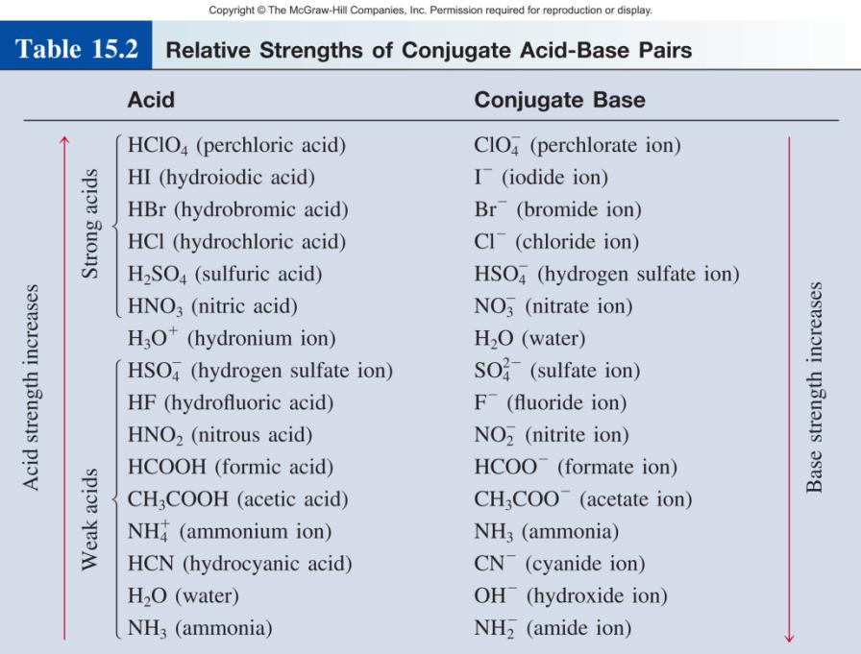

Slide 28
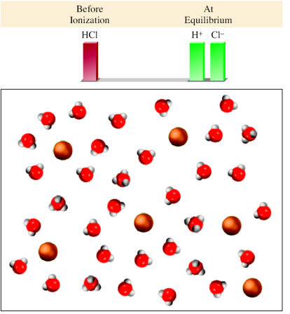
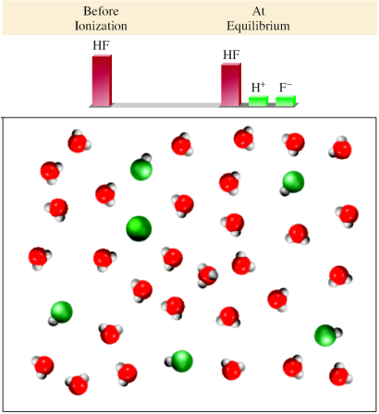
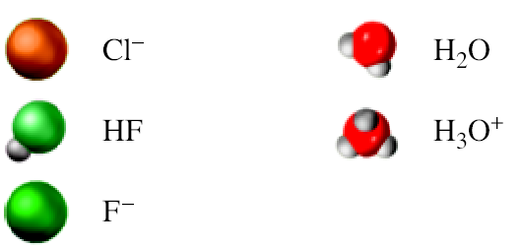
Strong Acid (HCl)
Weak Acid (HF)

Slide 29
15.6
Calculate the pH of a
1.0 x 10⁻³ M HCl solution
(b) 0.020 M Ba(OH)₂ solution

Slide 30
15.6
Strategy
Keep in mind that HCl is a strong acid and Ba(OH)₂ is a strong base. Thus, these species are completely ionized and no HCl or Ba(OH)₂ will be left in solution.
Solution
The ionization of HCl is
HCl(aq) H⁺(aq) + Cl⁻(aq)

Slide 31
15.6
The concentrations of all the species (HCl, H⁺, and Cl⁻) before
and after ionization can be represented as follows:
 | HCl(aq) | → | H⁺(aq) | + Cl⁻(aq)
Initial (M): | 1.0 x 10⁻³ |  | 0.0 | 0.0
Change (M): | -1.0 x 10⁻³ |  | +1.0 x 10⁻³ | +1.0 x 10⁻³
Final (M): | 0.0 |  | 1.0 x 10⁻³ | 1.0 x 10⁻³
A positive (+) change represents an increase and a negative
(-) change indicates a decrease in concentration. Thus,
[H⁺] = 1.0 x 10⁻³ M
pH = -log (1.0 x 10⁻³)
= 3.00

Slide 32
15.6
(b) Ba(OH)₂ is a strong base; each Ba(OH)₂ unit produces two OH⁻ ions:
Ba(OH)₂(aq) Ba²⁺(aq) + 2OH⁻(aq)
The changes in the concentrations of all the species can be represented as follows:
 | Ba(OH)₂(aq) | → | Ba²⁺(aq) | + 2OH⁻(aq)
Initial (M): | 0.020 |  | 0.00 | 0.00
Change (M): | - 0.020 |  | + 0.020 | +2(0.020)
Final (M): | 0.00 |  | 0.020 | 0.040

Slide 33
15.6
Thus,
[OH⁻] = 0.040 M
pOH = -log 0.040 = 1.40
Therefore, from Equation (15.8),
pH = 14.00 - pOH
= 14.00 - 1.40
= 12.60
Check Note that in both (a) and (b) we have neglected the contribution of the autoionization of water to [H⁺] and [OH⁻] because 1.0 x 10⁻⁷ M is so small compared with 1.0 x 10⁻³ M and 0.040 M.

Slide 34
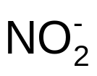
15.7
Predict the direction of the following reaction in aqueous solution:
HNO₂(aq) + CN⁻(aq) HCN(aq) + (aq)

Slide 35
15.7
Strategy
The problem is to determine whether, at equilibrium, the reaction will be shifted to the right, favoring HCN and , or to the left, favoring HNO₂ and CN⁻. Which of the two is a stronger acid and hence a stronger proton donor: HNO₂ or HCN? Which of the two is a stronger base and hence a stronger proton acceptor: CN⁻ or ? Remember that the stronger the acid, the weaker its conjugate base.

Slide 36
15.7
Solution
In Table 15.2 we see that HNO₂ is a stronger acid than HCN. Thus, CN⁻ is a stronger base than . The net reaction will proceed from left to right as written because HNO₂ is a better proton donor than HCN (and CN⁻ is a better proton acceptor than ).

Slide 37
Weak Acids (HA) and Acid Ionization Constants
HA (aq) + H₂O (l) H₃O⁺ (aq) + A⁻ (aq)
HA (aq) H⁺ (aq) + A⁻ (aq)
[H⁺][A⁻]
K_{a} =
[HA]
K_{a} is the acid ionization constant
weak acid
strength
K_{a}

Slide 38
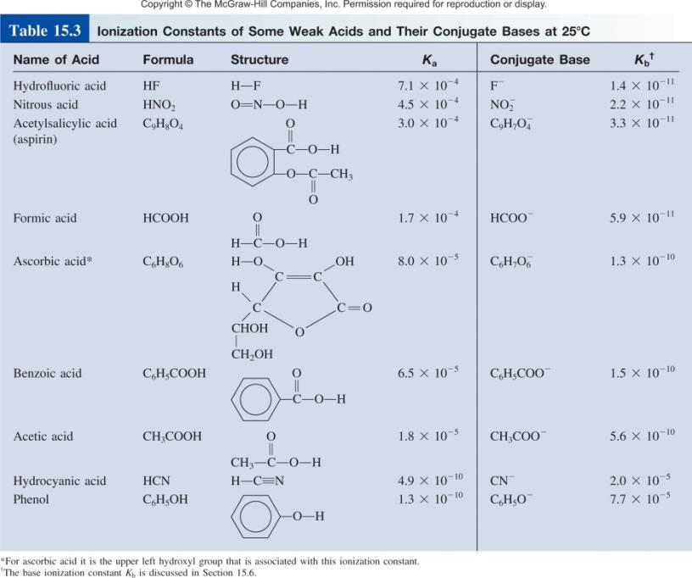

Slide 39
Solving weak acid ionization problems:
Identify the major species that can affect the pH.
  In most cases, you can ignore the autoionization of water.
  Ignore [OH⁻] because it is determined by [H⁺].
Use ICE to express the equilibrium concentrations in terms of single unknown x.
Write K_{a} in terms of equilibrium concentrations. Solve for x by the approximation method. If approximation is not valid, solve for x exactly.
Calculate concentrations of all species and/or pH of the solution.

Slide 40
15.8
Calculate the pH of a 0.036 M nitrous acid (HNO₂) solution:
HNO₂(aq) H⁺(aq) + (aq)

Slide 41
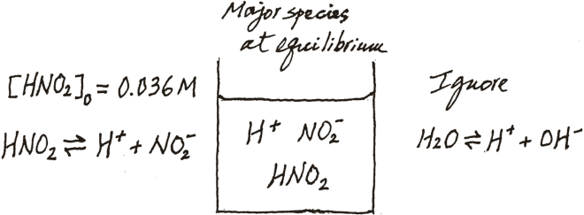
15.8
Strategy Recall that a weak acid only partially ionizes in water. We are given the initial concentration of a weak acid and asked to calculate the pH of the solution at equilibrium. It is helpful to make a sketch to keep track of the pertinent species.
As in Example 15.6, we ignore the ionization of H₂O so the major source of H⁺ ions is the acid. The concentration of OH⁻ ions is very small as we would expect from an acidic solution so it is present as a minor species.

Slide 42
15.8
Solution We follow the procedure already outlined.
Step 1: The species that can affect the pH of the solution are HNO₂, H⁺, and the conjugate base . We ignore water’s contribution to [H⁺].
Step 2: Letting x be the equilibrium concentration of H⁺ and ions in mol/L, we summarize:
 | HNO₂(aq) |  | H⁺(aq) + | (aq)
Initial (M): | 0.036 |  | 0.00 | 0.00
Change (M): | -x |  | +x | +x
Equilibrium (M): | 0.036 - x |  | x | x

Slide 43
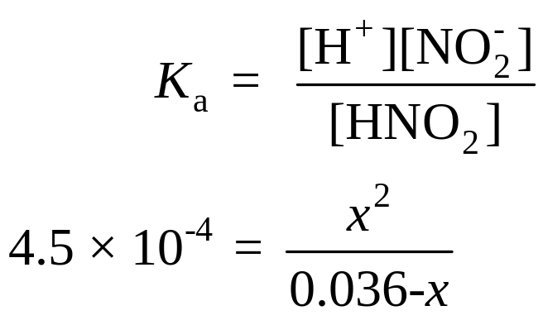
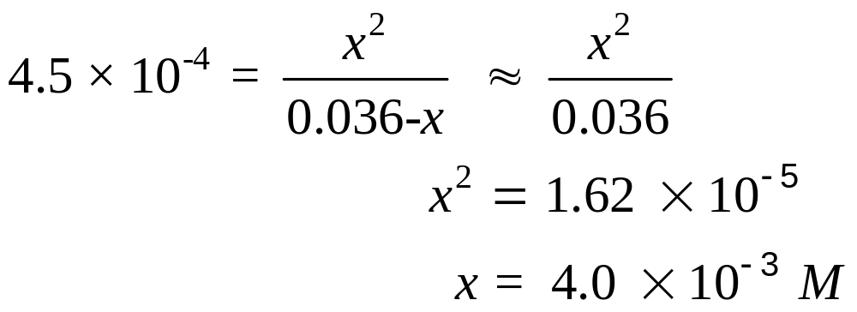
15.8
Step 3: From Table 15.3 we write
Applying the approximation 0.036 - x ≈ 0.036, we obtain

Slide 44
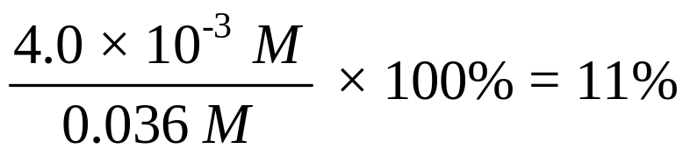
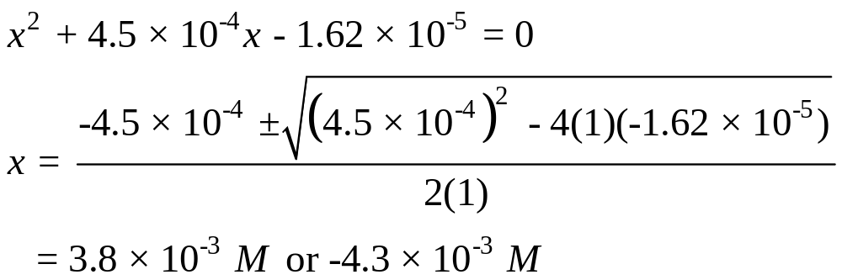
15.8
To test the approximation,
Because this is greater than 5%, our approximation is not valid and we must solve the quadratic equation, as follows:

Slide 45
15.8
The second solution is physically impossible, because the concentration of ions produced as a result of ionization cannot be negative. Therefore, the solution is given by the positive root, x = 3.8 x 10⁻³ M.
Step 4: At equilibrium
[H⁺] = 3.8 x 10⁻³ M
pH = -log (3.8 x 10⁻³ )
= 2.42
Check Note that the calculated pH indicates that the solution is acidic, which is what we would expect for a weak acid solution. Compare the calculated pH with that of a 0.036 M strong acid solution such as HCl to convince yourself of the difference between a strong acid and a weak acid.

Slide 46
15.9
The pH of a 0.10 M solution of formic acid (HCOOH) is 2.39. What is the K_{a} of the acid?

Slide 47
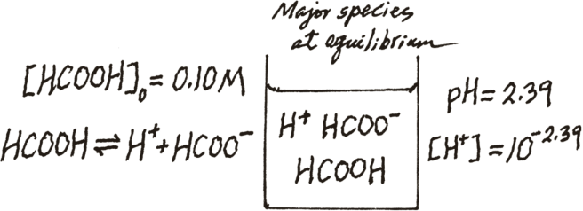
15.9
Strategy Formic acid is a weak acid. It only partially ionizes in water. Note that the concentration of formic acid refers to the initial concentration, before ionization has started. The pH of the solution, on the other hand, refers to the equilibrium state. To calculate K_{a}, then, we need to know the concentrations of all three species: [H⁺], [HCOO⁻], and [HCOOH] at equilibrium. As usual, we ignore the ionization of water. The following sketch summarizes the situation.

Slide 48
15.9
Solution We proceed as follows.
Step 1: The major species in solution are HCOOH, H⁺, and the conjugate base HCOO⁻.
Step 2: First we need to calculate the hydrogen ion concentration from the pH value
pH = -log [H⁺]
2.39 = -log [H⁺]
Taking the antilog of both sides, we get
[H⁺] = 10^{-2.39} = 4.1 x 10⁻³ M

Slide 49
15.9
Next we summarize the changes:
 | HCOOH(aq) |  | H⁺(aq) + | HCOO⁻(aq)
Initial (M): | 0.10 |  | 0.00 | 0.00
Change (M): | - 4.1 x 10⁻³ |  | +4.1 x 10⁻³ | + 4.1 x 10⁻³
Equilibrium (M): | (0.10 - 4.1 x 10⁻³) |  | 4.1 x 10⁻³ | 4.1 x 10⁻³
Note that because the pH and hence the H⁺ ion concentration is known, it follows that we also know the concentrations of HCOOH and HCOO⁻ at equilibrium.

Slide 50
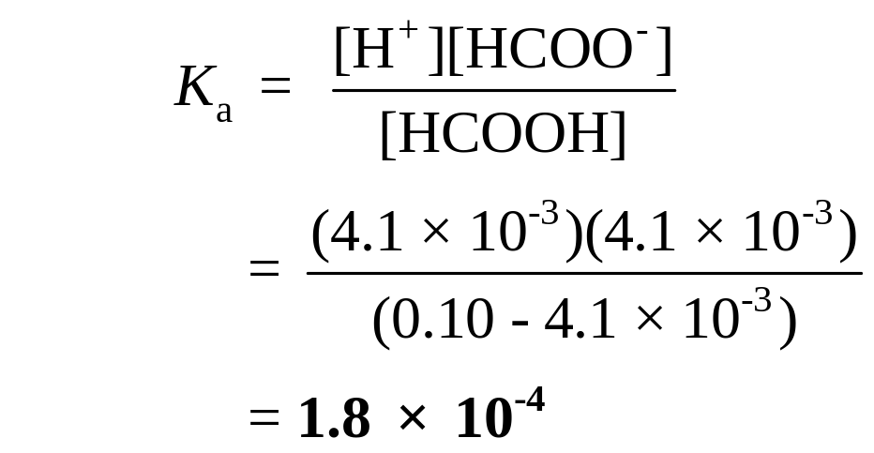
15.9
Step 3: The ionization constant of formic acid is given by
Check
The K_{a} value differs slightly from the one listed in Table 15.3 because of the rounding-off procedure we used in the calculation.

Slide 51
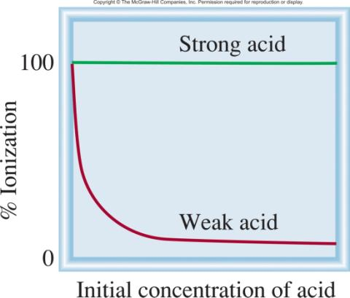
Ionized acid concentration at equilibrium
percent ionization =
x 100%
Initial concentration of acid
For a monoprotic acid HA,
[H⁺]
Percent ionization =
x 100%
[HA]₀ = initial concentration
[HA]₀

Slide 52
Weak Bases and Base Ionization Constants
NH₃ (aq) + H₂O (l) NH₄⁺ (aq) + OH⁻ (aq)
[NH₄⁺][OH⁻]
K_{b} =
[NH₃]
K_{b} is the base ionization constant
weak base
strength
K_{b}
Solve weak base problems like weak acids except solve for [OH-] instead of [H⁺].

Slide 53
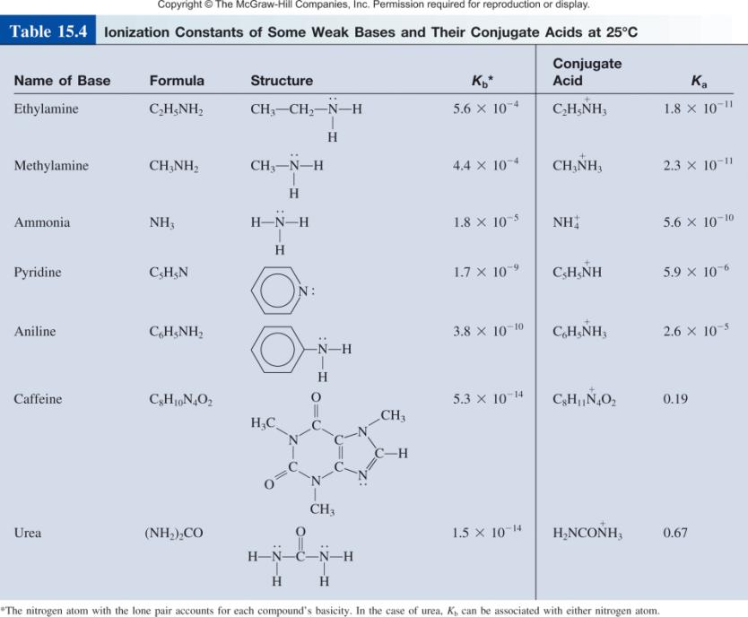

Slide 54
15.10
What is the pH of a 0.40 M ammonia solution?

Slide 55
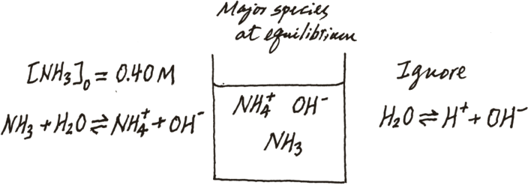
15.10
Strategy The procedure here is similar to the one used for a weak acid (see Example 15.8). From the ionization of ammonia, we see that the major species in solution at equilibrium are
NH₃, ,and OH⁻. The hydrogen ion concentration is very small as we would expect from a basic solution, so it is present as a minor species. As before, we ignore the ionization of water. We make a sketch to keep track of the pertinent species as follows:

Slide 56
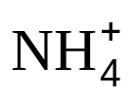
15.10
Solution We proceed according to the following steps.
Step 1: The major species in an ammonia solution are NH₃, , and OH⁻. We ignore the very small contribution to OH⁻ concentration by water.
Step 2: Letting x be the equilibrium concentration of and OH⁻ ions in mol/L, we summarize:
 | NH₃(aq) | + H₂O (l) |  | (aq) | + OH⁻(aq)
Initial (M): | 0.40 |  |  | 0.00 | 0.00
Change (M): | -x |  |  | +x | +x
Equilibrium (M): | 0.40 - x |  |  | x | x

Slide 57
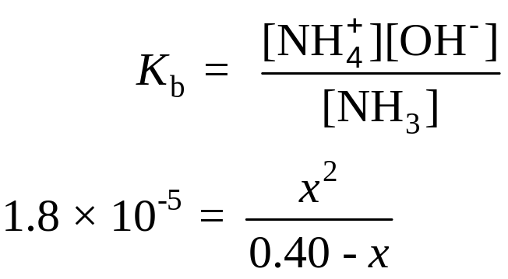
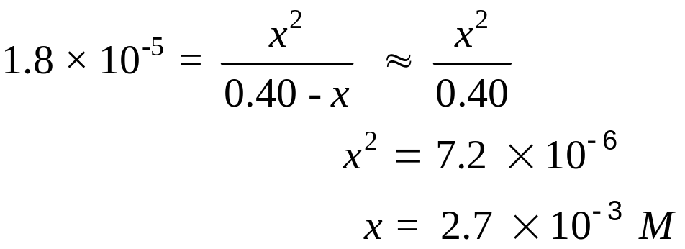
15.10
Step 3: Table 15.4 gives us K_{b}:
Applying the approximation 0.40 - x ≈ 0.40, we obtain

Slide 58
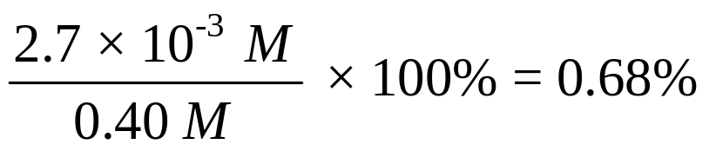
15.10
To test the approximation, we write
Therefore, the approximation is valid.
Step 4: At equilibrium, [OH⁻] = 2.7 x 10⁻³ M. Thus,
pOH = -log (2.7 x 10⁻³ )
= 2.57
pH = 14.00 - 2.57
= 11.43

Slide 59
15.10
Check
Note that the pH calculated is basic, which is what we would expect from a weak base solution. Compare the calculated pH with that of a 0.40 M strong base solution, such as KOH, to convince yourself of the difference between a strong base
and a weak base.

Slide 60
Ionization Constants of Conjugate Acid-Base Pairs
HA (aq) H⁺ (aq) + A⁻ (aq)
K_{a}
A⁻ (aq) + H₂O (l) OH⁻ (aq) + HA (aq)
K_{b}
H₂O (l) H⁺ (aq) + OH⁻ (aq)
K_{w}
K_{a}K_{b} = K_{w}
Weak Acid and Its Conjugate Base
K_{w}
K_{w}
K_{a} =
K_{b} =
K_{b}
K_{a}

Slide 61
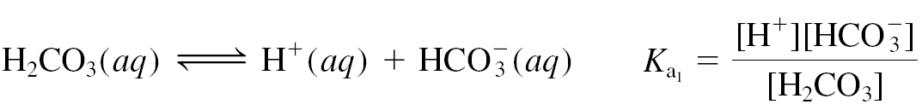
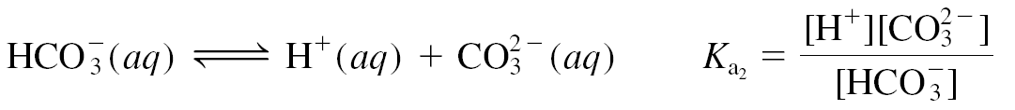
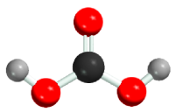
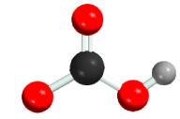
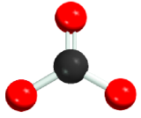
Diprotic and Triprotic Acids
May yield more than one hydrogen ion per molecule.
Ionize in a stepwise manner; that is, they lose one proton at
a time.
An ionization constant expression can be written for each
ionization stage.
Consequently, two or more equilibrium constant expressions
must often be used to calculate the concentrations of
species in the acid solution.

Slide 62
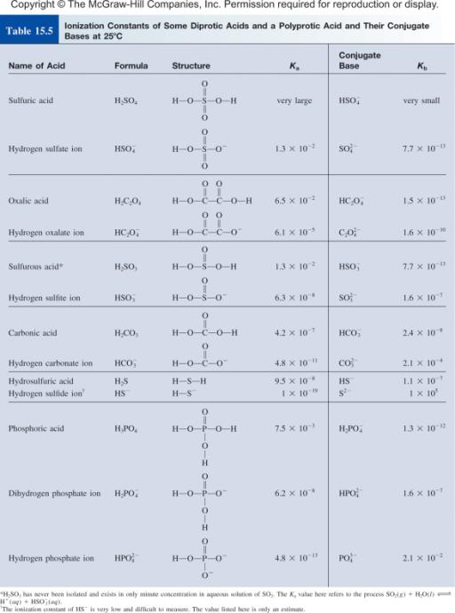

Slide 63
15.11
Oxalic acid (H₂C₂O₄) is a poisonous substance used chiefly as a bleaching and cleansing agent (for example, to remove bathtub rings). Calculate the concentrations of all the
species present at equilibrium in a 0.10 M solution.

Slide 64
15.11
Strategy
Determining the equilibrium concentrations of the species of a diprotic acid in aqueous solution is more involved than for a monoprotic acid. We follow the same procedure as that used for a monoprotic acid for each stage, as in Example 15.8. Note that the conjugate base from the first stage of ionization becomes the acid for the second stage ionization.

Slide 65
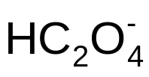
15.11
Solution We proceed according to the following steps.
Step 1: The major species in solution at this stage are the nonionized acid, H⁺ ions, and the conjugate base,
.
Step 2: Letting x be the equilibrium concentration of H⁺ and
ions in mol/L, we summarize:
 | H₂C₂O₄(aq) |  | H⁺(aq) + | (aq)
Initial (M): | 0.10 |  | 0.00 | 0.00
Change (M): | -x |  | +x | +x
Equilibrium (M): | 0.10 - x |  | x | x

Slide 66
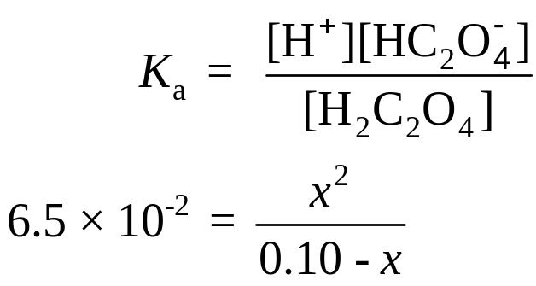

15.11
Step 3: Table 15.5 gives us
Applying the approximation 0.10 - x ≈ 0.10, we obtain

Slide 67
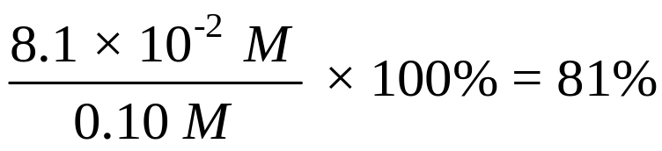
15.11
To test the approximation,
Clearly the approximation is not valid. Therefore, we must solve the quadratic equation
x² + 6.5 x 10⁻²x - 6.5 x 10⁻³ = 0
The result is x = 0.054 M.

Slide 68
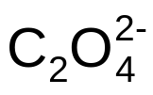
15.11
Step 4: When the equilibrium for the fi rst stage of ionization is reached, the concentrations are
[H⁺] = 0.054 M
[ ] = 0.054 M
[H₂C₂O₄] = (0.10 - 0.054) M = 0.046 M
Next we consider the second stage of ionization.
Step 1: At this stage, the major species are , which acts as the acid in the second stage of ionization, H⁺, and the conjugate base .

Slide 69
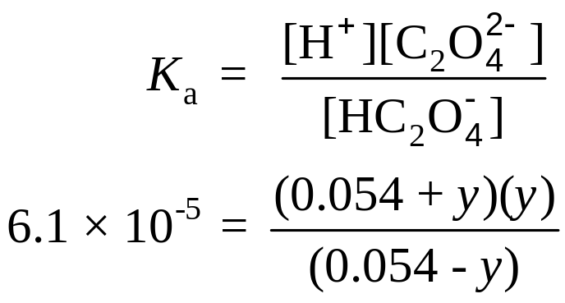
15.11
Step 2: Letting y be the equilibrium concentration of H⁺ and ions in mol/L, we summarize:
 | (aq) |  | H⁺(aq) + | (aq)
Initial (M): | 0.054 |  | 0.054 | 0.00
Change (M): | -y |  | +y | +y
Equilibrium (M): | 0.054 - y |  | 0.054 + y | y
Step 3: Table 15.5 gives us

Slide 70
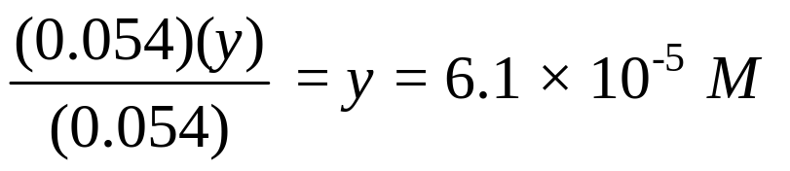
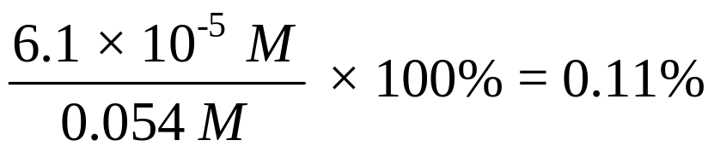
15.11
Applying the approximation 0.054 + y ≈ 0.054 and 0.054 - y ≈ 0.054, we obtain
and we test the approximation,
The approximation is valid.

Slide 71
15.11
Step 4: At equilibrium,
[H₂C₂O₄] = 0.046 M
[ ] = (0.054 - 6.1 x 10⁻⁵) M = 0.054 M
[H⁺] = (0.054 + 6.1 x 10⁻⁵) M = 0.054 M
[ ] = 6.1 x 10⁻⁵ M
[OH⁻] = 1.0 x 10⁻¹⁴/0.054 = 1.9 x 10⁻¹³ M

Slide 72
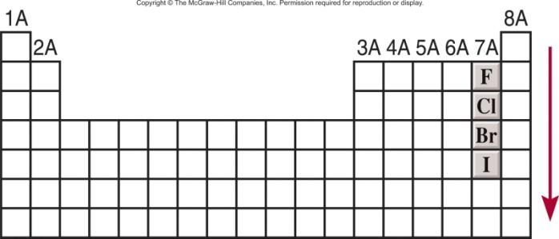
Molecular Structure and Acid Strength
H X
H⁺ + X⁻
The stronger the bond
The weaker the acid
HF << HCl < HBr < HI
acidity
increases

Slide 73
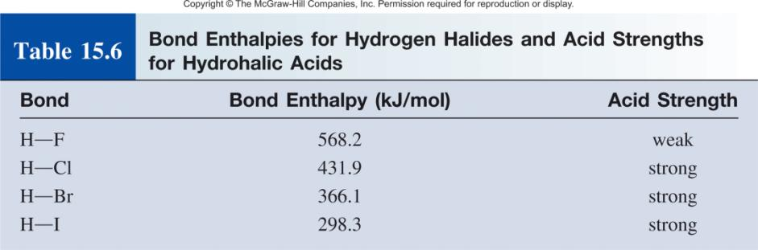

Slide 74
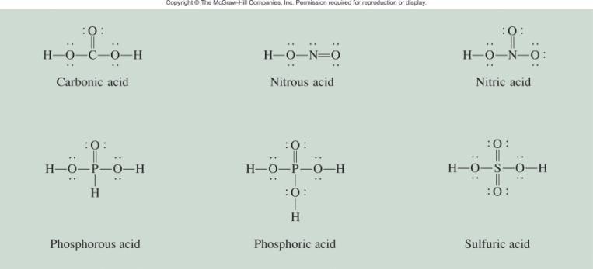
Molecular Structure and Oxoacid Strength
δ⁻
δ⁺
Z
O
H
Z
O⁻
+ H⁺
The O-H bond will be more polar and easier to break if:
Z is very electronegative or
Z is in a high oxidation state

Slide 75
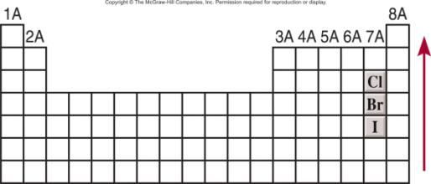
Molecular Structure and Oxoacid Strength
1. Oxoacids having different central atoms (Z) that are from the same group and that have the same oxidation number.
Acid strength increases with increasing electronegativity of Z
•
•
•
•
•
•
•
•
O
O
•
•
•
•
•
•
•
•
•
•
•
•
•
•
H O Cl O
H O Br O
•
•
•
•
•
•
•
•
•
•
•
•
•
•
Cl is more electronegative than Br
HClO₃ > HBrO₃
acidity
increases

Slide 76
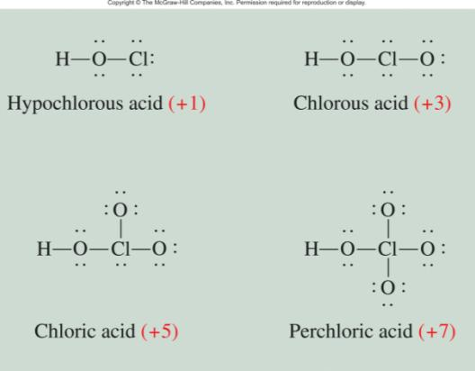
Molecular Structure and Acid Strength
2. Oxoacids having the same central atom (Z) but different numbers of attached groups.
Acid strength increases as the oxidation number of Z increases.
HClO₄ > HClO₃ > HClO₂ > HClO

Slide 77
15.12
Predict the relative strengths of the oxoacids in each of the following groups:
HClO, HBrO, and HIO
(b) HNO₃ and HNO₂

Slide 78
15.12
Strategy
Examine the molecular structure. In (a) the two acids have similar structure but differ only in the central atom (Cl, Br, and I). Which central atom is the most electronegative? In (b) the acids have the same central atom (N) but differ in the
number of O atoms. What is the oxidation number of N in each of these two acids?

Slide 79
15.12
Solution
These acids all have the same structure, and the halogens all have the same oxidation number (+1). Because the electronegativity decreases from Cl to I,the Cl atom attracts the electron pair it shares with the O atom to the greatest extent. Consequently, the O−H bond is the most polar in HClO and least polar in HIO. Thus, the acid strength decreases as follows:
HClO > HBrO > HIO

Slide 80
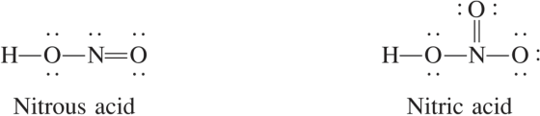
15.12
(b) The structures of HNO₃ and HNO₂ are shown in Figure 15.5. Because the oxidation number of N is +5 in HNO₃ and +3 in HNO₂, HNO₃ is a stronger acid than HNO₂.

Slide 81
Acid-Base Properties of Salts
Neutral Solutions:
Salts containing an alkali metal or alkaline earth metal ion (except Be²⁺) and the conjugate base of a strong acid (e.g. Cl⁻, Br⁻, and NO₃⁻).
H₂O
NaCl (s) Na⁺ (aq) + Cl⁻ (aq)
Basic Solutions:
Salts derived from a strong base and a weak acid.
H₂O
CH₃COONa (s) Na⁺ (aq) + CH₃COO⁻ (aq)
CH₃COO⁻ (aq) + H₂O (l) CH₃COOH (aq) + OH⁻ (aq)

Slide 82
15.13
Calculate the pH of a 0.15 M solution of sodium acetate (CH₃COONa). What is the percent hydrolysis?

Slide 83
15.13
Strategy
What is a salt? In solution, CH₃COONa dissociates completely into Na⁺ and CH₃COO⁻ ions. The Na⁺ ion, as we saw earlier, does not react with water and has no effect on the pH of the solution. The CH₃COO⁻ ion is the conjugate base of the weak acid CH₃COOH. Therefore, we expect that it will react to a certain extent with water to produce CH₃COOH and OH⁻, and the solution will be basic.

Slide 84
15.13
Solution
Step 1: Because we started with a 0.15 M sodium acetate solution, the concentrations of the ions are also equal to 0.15 M after dissociation:
 | CH₃COONa(aq) |  | Na⁺(aq) + | CH₃COO⁻(aq)
Initial (M): | 0.15 |  | 0 | 0
Change (M): | -0.15 |  | +0.15 | +0.15
Final (M): | 0 |  | 0.15 | 0.15
Of these ions, only the acetate ion will react with water
CH₃COO⁻(aq) + H₂O(l) CH₃COOH(aq) + OH⁻(aq)

Slide 85
15.13
At equilibrium, the major species in solution are CH₃COOH, CH₃COO⁻, and OH⁻. The concentration of the H⁺ ion is very small as we would expect for a basic solution, so it is treated as a minor species. We ignore the ionization of water.
Step 2: Let x be the equilibrium concentration of CH₃COOH and OH⁻ ions in mol/L, we summarize:
 | CH₃COO⁻ (aq) | + H₂O (l) |  | CH₃COOH(aq) | + OH⁻(aq)
Initial (M): | 0.15 |  |  | 0.00 | 0.00
Change (M): | -x |  |  | +x | +x
Equilibrium (M): | 0.15 - x |  |  | x | x

Slide 86
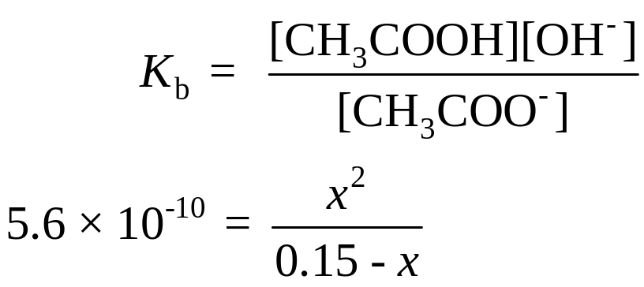
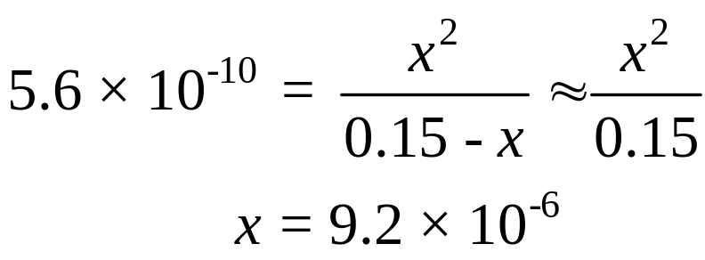
15.13
Step 3: From the preceding discussion and Table 15.3 we write the equilibrium constant of hydrolysis, or the base ionization constant, as
Because K_{b} is very small and the initial concentration of the base is large, we can apply the approximation 0.15 - x ≈ 0.15:

Slide 87

15.13
Step 4: At equilibrium:
[OH⁻] = 9.2 x 10⁻⁶ M
pOH = -log (9.2 x 10⁻⁶ )
= 5.04
pH = 14.00 - 5.04
= 8.96
Thus the solution is basic, as we would expect. The percent
hydrolysis is given by

Slide 88
15.13
Check
The result shows that only a very small amount of the anion undergoes hydrolysis. Note that the calculation of percent hydrolysis takes the same form as the test for the approximation, which is valid in this case.

Slide 89
Acid-Base Properties of Salts
Acid Solutions:
Salts derived from a strong acid and a weak base.
H₂O
NH₄Cl (s) NH₄⁺ (aq) + Cl⁻ (aq)
NH₄⁺ (aq) NH₃ (aq) + H⁺ (aq)
Salts with small, highly charged metal cations (e.g. Al³⁺, Cr³⁺, and Be²⁺) and the conjugate base of a strong acid.
3+
2+
Al(H₂O)₆ (aq) Al(OH)(H₂O)₅ (aq) + H⁺ (aq)

Slide 90

Acid Hydrolysis of Al³⁺

Slide 91
Acid-Base Properties of Salts
Solutions in which both the cation and the anion hydrolyze:
K_{b} for the anion > K_{a} for the cation, solution will be basic
K_{b} for the anion < K_{a} for the cation, solution will be acidic
K_{b} for the anion ≈ K_{a} for the cation, solution will be neutral

Slide 92


Slide 93
15.14
Predict whether the following solutions will be acidic, basic, or nearly neutral:
NH₄I
(b) NaNO₂
(c) FeCl₃
(d) NH₄F

Slide 94
15.14
Strategy
In deciding whether a salt will undergo hydrolysis, ask yourself the following questions: Is the cation a highly charged metal ion or an ammonium ion? Is the anion the conjugate base of a weak acid? If yes to either question, then hydrolysis will occur. In cases where both the cation and the anion react with water, the pH of the solution will depend on the relative magnitudes of K_{a} for the cation and K_{b} for the anion (see Table 15.7).

Slide 95

15.14
Solution
We first break up the salt into its cation and anion components and then examine the possible reaction of each ion with water.
The cation is , which will hydrolyze to produce NH₃ and H⁺. The I⁻ anion is the conjugate base of the strong acid HI. Therefore, I⁻ will not hydrolyze and the solution is acidic.
(b) The Na⁺ cation does not hydrolyze. The is the conjugate base of the weak acid HNO₂ and will hydrolyze to give HNO₂ and OH⁻. The solution will be basic.

Slide 96
15.14
(c) Fe³⁺ is a small metal ion with a high charge and hydrolyzes to produce H⁺ ions. The Cl⁻ does not hydrolyze. Consequently, the solution will be acidic.
(d) Both the and F⁻ ions will hydrolyze. From Tables 15.3 and 15.4 we see that the K_{a} of (5.6 x 10⁻¹⁰) is greater than the K_{b} for F⁻ (1.4 x 10⁻¹¹). Therefore, the solution will be acidic.

Slide 97

Oxides of the Representative Elements
In Their Highest Oxidation States
Na₂O (s) + H₂O (l) 2NaOH (aq)
CO₂ (g) + H₂O (l) H₂CO₃ (aq)
N₂O₅ (g) + H₂O (l) 2HNO₃ (aq)

Slide 98
Definition of An Acid
Arrhenius acid is a substance that produces H⁺ (H₃O⁺) in water
A Brønsted acid is a proton donor
A Lewis acid is a substance that can accept a pair of electrons
A Lewis base is a substance that can donate a pair of electrons
•
•
•
+ OH⁻
•
H⁺
•
H O H
•
•
•
•
•
acid
base
H
H
+
H⁺
+
•
H
N H
N H
•
H
H
acid
base

Slide 99
Lewis Acids and Bases
F
H
F
H
F B
+
•
F B
N H
N H
•
F
H
F
H
acid
base
No protons donated or accepted!

Slide 100


Chemistry In Action: Antacids and the Stomach pH Balance
NaHCO₃ (aq) + HCl (aq)
NaCl (aq) + H₂O (l) + CO₂ (g)
Mg(OH)₂ (s) + 2HCl (aq)
MgCl₂ (aq) + 2H₂O (l)

Slide 101

15.15
Identify the Lewis acid and Lewis base in each of the following reactions:
C₂H₅OC₂H₅ + AlCl₃ (C₂H₅)₂OAlCl₃
(b) Hg²⁺(aq) + 4CN⁻(aq) (aq)

Slide 102
15.15
Strategy
In Lewis acid-base reactions, the acid is usually a cation or an electron-deficient molecule, whereas the base is an anion or a molecule containing an atom with lone pairs.
Draw the molecular structure for C₂H₅OC₂H₅. What is the hybridization state of Al in AlCl₃?
(b) Which ion is likely to be an electron acceptor? An electron donor?

Slide 103

15.15
Solution
(a) The Al is sp²-hybridized in AlCl₃ with an empty 2p_{z} orbital. It is electron deficient, sharing only six electrons. Therefore, the Al atom has a tendency to gain two electrons to complete its octet. This property makes AlCl₃ a Lewis acid. On the other hand, the lone pairs on the oxygen atom in C₂H₅OC₂H₅ make the compound a Lewis base:

Slide 104
15.15
(b) Here the Hg²⁺ ion accepts four pairs of electrons from the CN⁻ ions. Therefore, Hg²⁺ is the Lewis acid and CN⁻ is the Lewis base.

