Slide 1

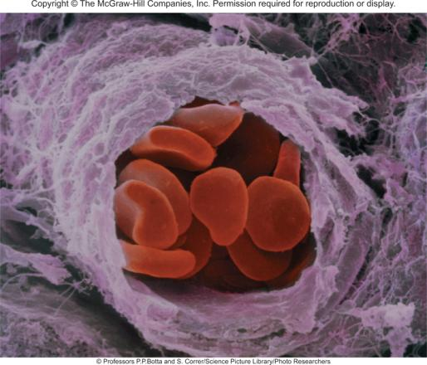

Acid-Base Equilibria and
Solubility Equilibria
Chapter 16
Copyright © The McGraw-Hill Companies, Inc. Permission required for reproduction or display.

Slide 2
The common ion effect is the shift in equilibrium caused by the addition of a compound having an ion in common with the dissolved substance.
The presence of a common ion suppresses the ionization of a weak acid or a weak base.
Consider mixture of CH₃COONa (strong electrolyte) and CH₃COOH (weak acid).
CH₃COONa (s) Na⁺ (aq) + CH₃COO⁻ (aq)
common ion
CH₃COOH (aq) H⁺ (aq) + CH₃COO⁻ (aq)

Slide 3
Consider mixture of salt NaA and weak acid HA.
NaA (s) Na⁺ (aq) + A⁻ (aq)
[H⁺][A⁻]
K_{a} =
HA (aq) H⁺ (aq) + A⁻ (aq)
[HA]
K_{a} [HA]
[H⁺] =
[A⁻]
Henderson-Hasselbalch equation
[HA]
-log [H⁺] = -log K_{a} - log
[A⁻]
[conjugate base]
pH = pK_{a} + log
[A⁻]
[acid]
-log [H⁺] = -log K_{a} + log
[HA]
[A⁻]
pH = pK_{a} + log
pK_{a} = -log K_{a}
[HA]

Slide 4
16.1
Calculate the pH of a 0.20 M CH₃COOH solution.
(b) What is the pH of a solution containing both 0.20 M CH₃COOH and 0.30 M CH₃COONa? The K_{a} of CH₃COOH is 1.8 x 10⁻⁵.

Slide 5
16.1
Strategy
We calculate [H⁺] and hence the pH of the solution by following the procedure in Example 15.8.
(b) CH₃COOH is a weak acid (CH₃COOH CH₃COO⁻ + H⁺), and CH₃COONa is a soluble salt that is completely dissociated in solution (CH₃COONa → Na⁺ + CH₃COO⁻). The common ion here is the acetate ion, CH₃COO⁻. At equilibrium, the major species in solution are CH₃COOH, CH₃COO⁻, Na⁺, H⁺, and H₂O. The Na⁺ ion has no acid or base properties and we ignore the ionization of water. Because K_{a} is an equilibrium constant, its value is the same whether we have just the acid or a mixture of the acid and its salt in solution. Therefore, we can calculate [H⁺] at equilibrium and hence pH if we know both [CH₃COOH] and [CH₃COO⁻] at equilibrium.

Slide 6
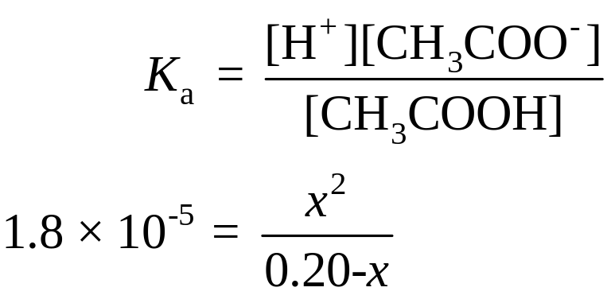
16.1
Solution
(a) In this case, the changes are
 | CH₃COOH(aq) |  | H⁺(aq) + | CH₃COO⁻(aq)
Initial (M): | 0.20 |  | 0 | 0
Change (M): | -x |  | +x | +x
Equilibrium (M): | 0.20-x |  | x | x

Slide 7
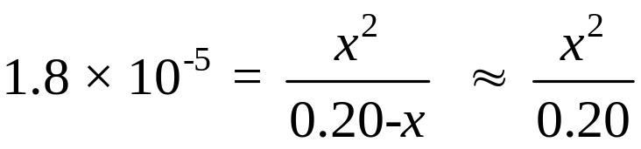
16.1
Assuming 0.20 - x ≈ 0.20, we obtain
or
x = [H⁺] = 1.9 x 10⁻³ M
Thus,
pH= -log (1.9 x 10⁻³ ) = 2.72

Slide 8
16.1
Sodium acetate is a strong electrolyte, so it dissociates completely in solution:
CH₃COONa(aq) → Na⁺(aq) + CH₃COO⁻(aq)
0.30 M 0.30 M
The initial concentrations, changes, and final concentrations of the species involved in the equilibrium are
 | CH₃COOH(aq) |  | H⁺(aq) + | CH₃COO⁻(aq)
Initial (M): | 0.20 |  | 0 | 0.30
Change (M): | -x |  | +x | +x
Equilibrium (M): | 0.20-x |  | x | 0.30+x

Slide 9
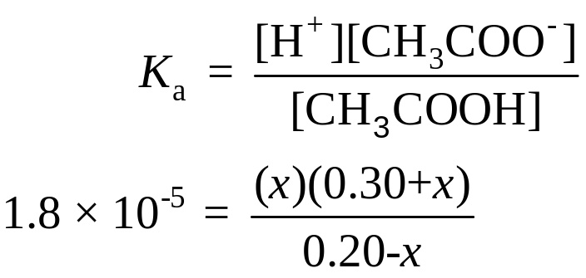
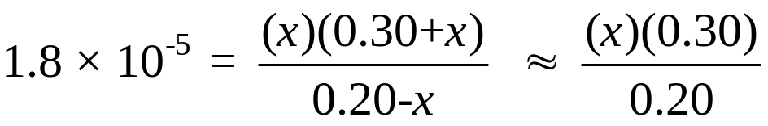
16.1
From Equation (16.1),
Assuming that 0.30 + x ≈ 0.30 and 0.20 - x ≈ 0.20, we obtain
or
x = [H⁺] = 1.2 x 10⁻⁵ M
Thus,
pH = -log [H⁺]
= -log (1.2 x 10⁻⁵ ) = 4.92

Slide 10
16.1
Check
Comparing the results in (a) and (b), we see that when the common ion (CH₃COO⁻) is present, according to Le Châtelier’s principle, the equilibrium shifts from right to left. This action decreases the extent of ionization of the weak acid.
Consequently, fewer H⁺ ions are produced in (b) and the pH of the solution is higher than that in (a). As always, you should check the validity of the assumptions.

Slide 11
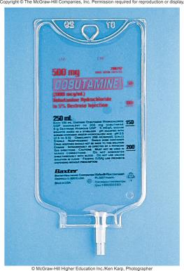
A buffer solution is a solution of:
A weak acid or a weak base and
The salt of the weak acid or weak base
Both must be present!
A buffer solution has the ability to resist changes in pH upon the addition of small amounts of either acid or base.
Consider an equal molar mixture of CH₃COOH and CH₃COONa
Add strong acid
H⁺ (aq) + CH₃COO⁻ (aq) CH₃COOH (aq)
Add strong base
OH⁻ (aq) + CH₃COOH (aq) CH₃COO⁻ (aq) + H₂O (l)

Slide 12
16.2
Which of the following solutions can be classified as buffer systems?
(a) KH₂PO₄/H₃PO₄
(b) NaClO₄/HClO₄
(c) C₅H₅N/C₅H₅NHCl (C₅H₅N is pyridine; its K_{b} is given in Table 15.4)
Explain your answer.

Slide 13
16.2
Strategy
What constitutes a buffer system? Which of the preceding solutions contains a weak acid and its salt (containing the weak conjugate base)? Which of the preceding solutions contains a weak base and its salt (containing the weak conjugate acid)? Why is the conjugate base of a strong acid not able to neutralize an added acid?

Slide 14
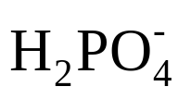
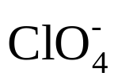
16.2
Solution The criteria for a buffer system is that we must have a weak acid and its salt (containing the weak conjugate base) or a weak base and its salt (containing the weak conjugate acid).
(a) H₃PO₄ is a weak acid, and its conjugate base, ,is a weak base (see Table 15.5). Therefore, this is a buffer system.
(b) Because HClO₄ is a strong acid, its conjugate base, , is an extremely weak base. This means that the ion will not combine with a H⁺ ion in solution to form HClO₄. Thus, the system cannot act as a buffer system.
(c) As Table 15.4 shows, C₅H₅N is a weak base and its conjugate acid, C₅H₅N⁺H (the cation of the salt C₅H₅NHCl), is a weak acid. Therefore, this is a buffer system.

Slide 15
16.3
(a) Calculate the pH of a buffer system containing 1.0 M CH₃COOH and 1.0 M CH₃COONa.
(b) What is the pH of the buffer system after the addition of 0.10 mole of gaseous HCl to 1.0 L of the solution? Assume that the volume of the solution does not change when the HCl is added.

Slide 16
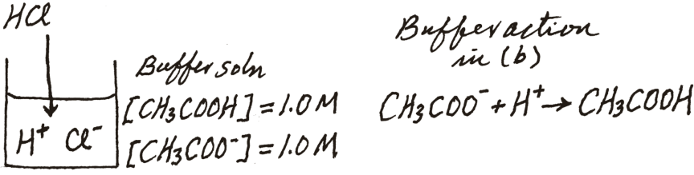
16.3
Strategy
The pH of the buffer system before the addition of HCl can be calculated with the procedure described in Example 16.1, because it is similar to the common ion problem. The K_{a} of CH₃COOH is 1.8 x 10⁻⁵ (see Table 15.3).
(b) It is helpful to make a sketch of the changes that occur in this case.

Slide 17
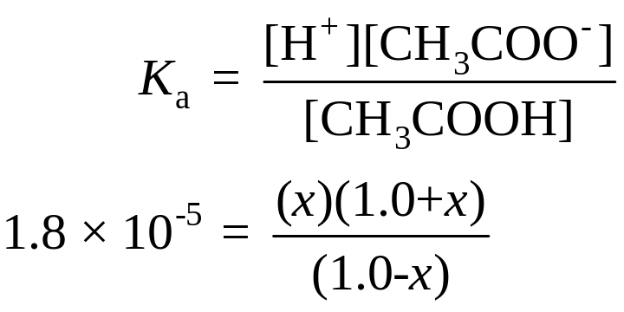
16.3
Solution (a) We summarize the concentrations of the species at equilibrium as follows:
 | CH₃COOH(aq) |  | H⁺(aq) + | CH₃COO⁻(aq)
Initial (M): | 1.0 |  | 0 | 1.0
Change (M): | -x |  | +x | +x
Equilibrium (M): | 1.0-x |  | x | 1.0+x

Slide 18
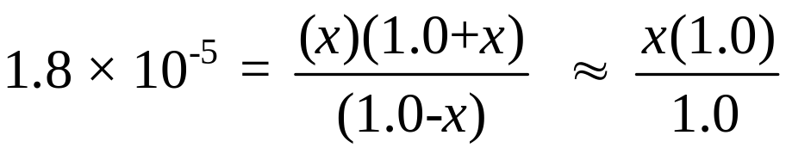
16.3
Assuming 1.0 + x ≈ 1.0 and 1.0 - x ≈ 1.0, we obtain
or
x = [H⁺] = 1.8 x 10⁻⁵ M
Thus,
pH = -log (1.8 x 10⁻⁵ ) = 4.74

Slide 19
16.3
(b) When HCl is added to the solution, the initial changes are
The Cl⁻ ion is a spectator ion in solution because it is the conjugate base of a strong acid. The H⁺ ions provided by the strong acid HCl react completely with the conjugate base of the buffer, which is CH₃COO⁻. At this point it is more convenient to work with moles rather than molarity. The reason is that in some cases the volume of the solution may change when a substance is added. A change in volume will change the molarity, but not the number of moles.
 | HCl(aq) | → | H⁺(aq) + | Cl⁻(aq)
Initial (mol): | 0.10 |  | 0 | 0
Change (mol): | -0.10 |  | +0.10 | +0.10
Final (mol): | 0 |  | 0.10 | 0.10

Slide 20
16.3
The neutralization reaction is summarized next:
Finally, to calculate the pH of the buffer after neutralization of the acid, we convert back to molarity by dividing moles by 1.0 L of solution.
 | CH₃COO⁻(aq) | + H⁺(aq) | → | CH₃COOH(aq)
Initial (mol): | 1.0 | 0.10 |  | 1.0
Change (mol): | -0.10 | -0.10 |  | +0.10
Final (mol): | 0.90 | 0 |  | 1.1

Slide 21
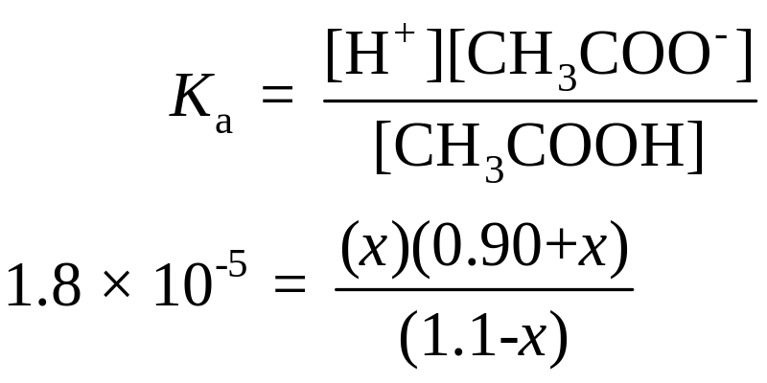
16.3
 | CH₃COOH(aq) |  | H⁺(aq) + | CH₃COO⁻(aq)
Initial (M): | 1.1 |  | 0 | 0.90
Change (M): | -x |  | +x | +x
Equilibrium (M): | 1.1-x |  | x | 0.90+x

Slide 22
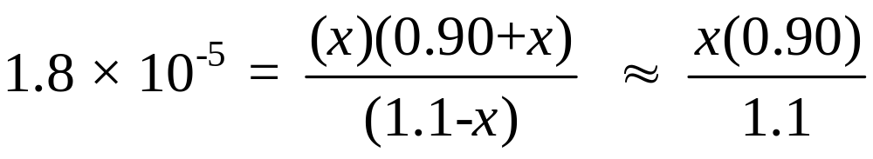
16.3
Assuming 0.90 + x ≈ 0.90 and 1.1 - x ≈ 1.1, we obtain
or
x = [H⁺] = 2.2 x 10⁻⁵ M
Thus,
pH = -log (2.2 x 10⁻⁵ ) = 4.66
Check The pH decreases by only a small amount upon the addition of HCl. This is consistent with the action of a buffer solution.

Slide 23
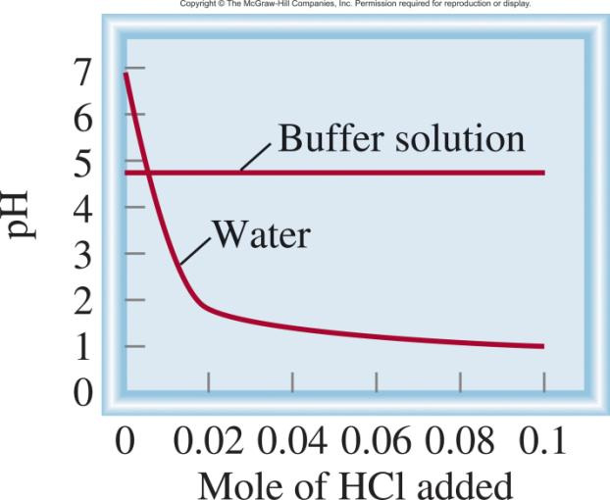
HCl H⁺ + Cl⁻
HCl + CH₃COO⁻ CH₃COOH + Cl⁻

Slide 24
16.4
Describe how you would prepare a “phosphate buffer” with a pH of about 7.40.

Slide 25
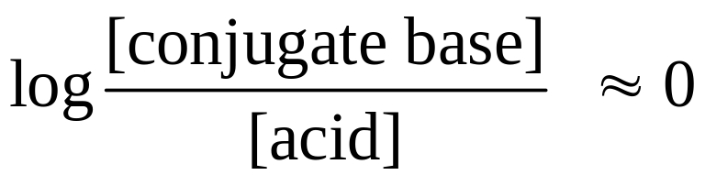
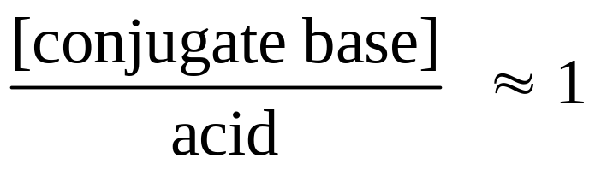
16.4
Strategy
For a buffer to function effectively, the concentrations of the acid component must be roughly equal to the conjugate base component. According to Equation (16.4), when the desired pH is close to the pK_{a} of the acid, that is, when
pH ≈ pK_{a},
or

Slide 26
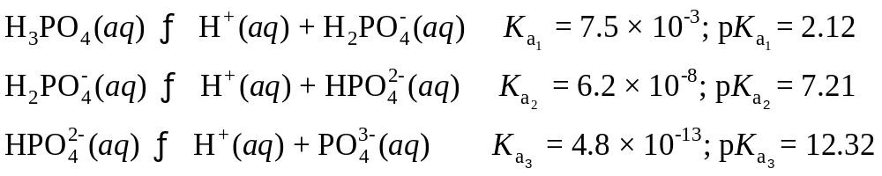
16.4
Solution
Because phosphoric acid is a triprotic acid, we write the three stages of ionization as follows. The K_{a} values are obtained from Table 15.5 and the pK_{a} values are found by applying Equation (16.3).

Slide 27
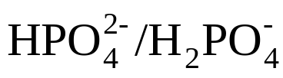
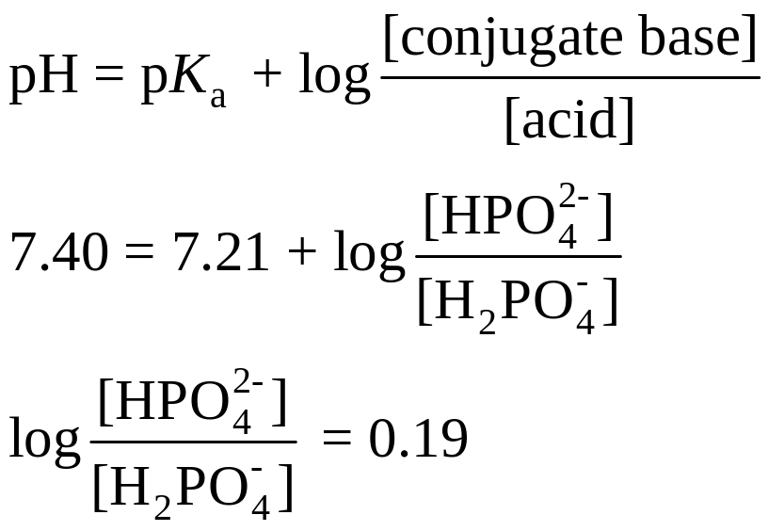
16.4
The most suitable of the three buffer systems is , because the pK_{a} of the acid is closest to the desired pH. From the Henderson-Hasselbalch equation we write

Slide 28
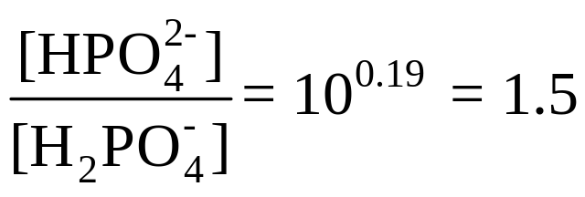
16.4
Taking the antilog, we obtain
Thus, one way to prepare a phosphate buffer with a pH of 7.40 is to dissolve disodium hydrogen phosphate (Na₂HPO₄) and sodium dihydrogen phosphate (NaH₂PO₄) in a mole ratio of 1.5:1.0 in water. For example, we could dissolve 1.5 moles of Na₂HPO₄ and 1.0 mole of NaH₂PO₄ in enough water to make up a 1-L solution.

Slide 29
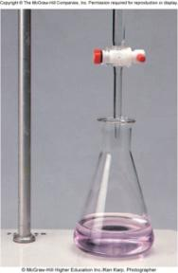
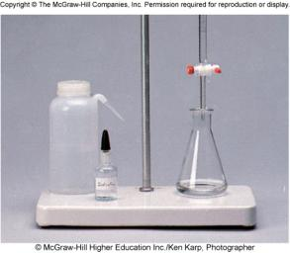
Titrations (Review)
In a titration, a solution of accurately known concentration is gradually added to another solution of unknown concentration until the chemical reaction between the two solutions is complete.
Equivalence point – the point at which the reaction is complete
Indicator – substance that changes color at (or near) the
equivalence point
Slowly add base
to unknown acid
UNTIL
the indicator
changes color
(pink)

Slide 30
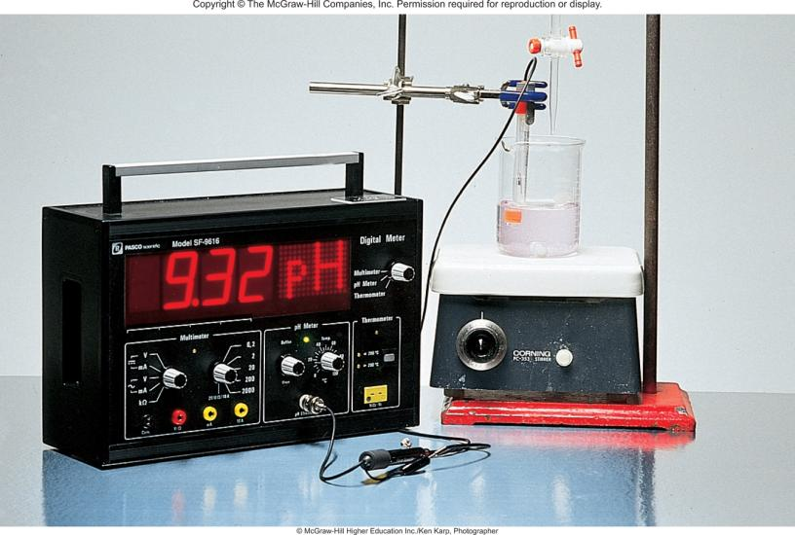
Alternative Method of Equivalence Point Detection
monitor pH

Slide 31
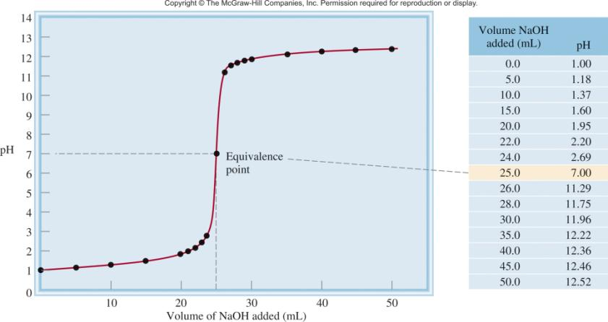
Strong Acid-Strong Base Titrations
NaOH (aq) + HCl (aq) H₂O (l) + NaCl (aq)
OH⁻ (aq) + H⁺ (aq) H₂O (l)

Slide 32
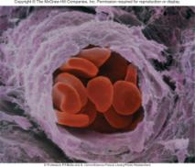
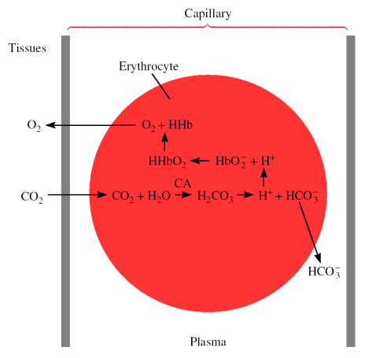
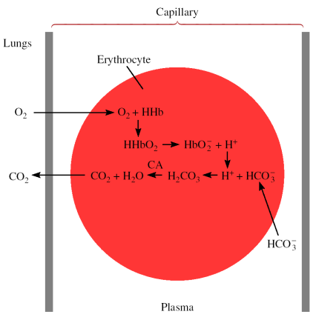
Chemistry In Action: Maintaining the pH of Blood
Red blood cells in a capillary

Slide 33
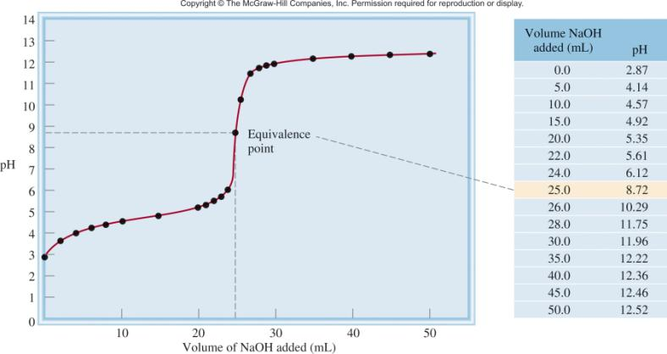
Weak Acid-Strong Base Titrations
CH₃COOH (aq) + NaOH (aq) CH₃COONa (aq) + H₂O (l)
CH₃COOH (aq) + OH⁻ (aq) CH₃COO⁻ (aq) + H₂O (l)
At equivalence point (pH > 7):
CH₃COO⁻ (aq) + H₂O (l) OH⁻ (aq) + CH₃COOH (aq)

Slide 34
16.5
Calculate the pH in the titration of 25.0 mL of 0.100 M acetic acid by sodium hydroxide after the addition to the acid solution of
10.0 mL of 0.100 M NaOH
(b) 25.0 mL of 0.100 M NaOH
(c) 35.0 mL of 0.100 M NaOH

Slide 35

16.5
Strategy
The reaction between CH₃COOH and NaOH is
CH₃COOH(aq) + NaOH(aq) CH₃COONa(aq) + H₂O(l)
We see that 1 mol CH₃COOH 1 mol NaOH. Therefore, at every stage of the titration we can calculate the number of moles of base reacting with the acid, and the pH of the
solution is determined by the excess acid or base left over. At the equivalence point, however, the neutralization is complete and the pH of the solution will depend on the extent of the hydrolysis of the salt formed, which is CH₃COONa.

Slide 36
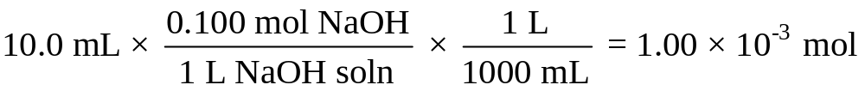
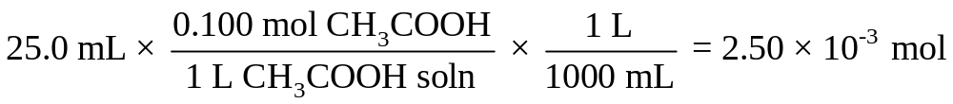
16.5
Solution
(a) The number of moles of NaOH in 10.0 mL is
The number of moles of CH₃COOH originally present in 25.0 mL of solution is
We work with moles at this point because when two solutions are mixed, the solution volume increases. As the volume increases, molarity will change but the number of moles will remain the same.

Slide 37
16.5
The changes in number of moles are summarized next:
 | CH₃COOH (aq) | + NaOH (aq) | → | CH₃COONa(aq) | + H₂O(l)
Initial (mol): | 2.50 x 10⁻³ | 1.00 x 10⁻³ |  | 0
Change (mol): | -1.00 x 10⁻³ | -1.00 x 10⁻³ |  | +1.00 x 10⁻³
Final (mol): | 1.50 x 10⁻³ | 0 |  | 1.00 x 10⁻³
At this stage we have a buffer system made up of CH₃COOH and CH₃COO⁻ (from the salt, CH₃COONa).

Slide 38
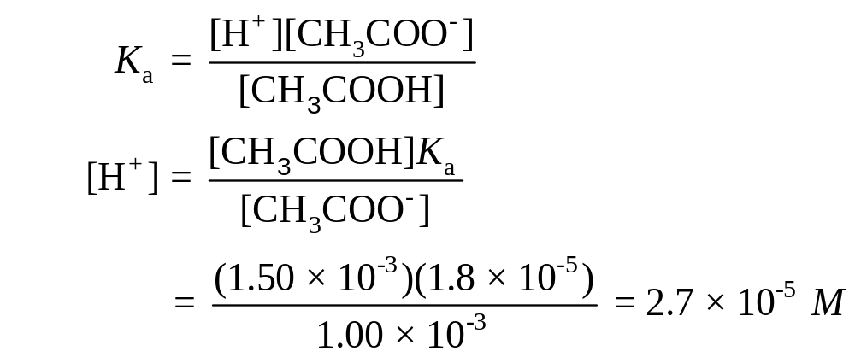
16.5
To calculate the pH of the solution, we write
Therefore,
pH = -log (2.7 x 10⁻⁵) = 4.57

Slide 39

16.5
(b) These quantities (that is, 25.0 mL of 0.100 M NaOH reacting with 25.0 mL of 0.100 M CH₃COOH) correspond to the equivalence point. The number of moles of NaOH in 25.0 mL of the solution is
The changes in number of moles are summarized next:
 | CH₃COOH (aq) | + NaOH (aq) | → | CH₃COONa(aq) | + H₂O(l)
Initial (mol): | 2.50 x 10⁻³ | 2.50 x 10⁻³ |  | 0
Change (mol): | -2.50 x 10⁻³ | -2.50 x 10⁻³ |  | +2.50 x 10⁻³
Final (mol): | 0 | 0 |  | 2.50 x 10⁻³

Slide 40
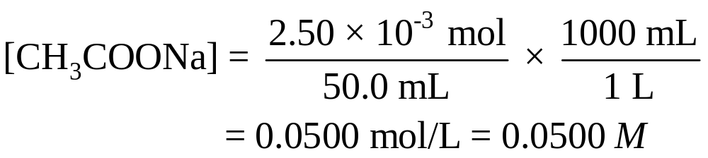
16.5
At the equivalence point, the concentrations of both the acid and the base are zero. The total volume is (25.0 + 25.0) mL or 50.0 mL, so the concentration of the salt is
The next step is to calculate the pH of the solution that results from the hydrolysis of the CH₃COO⁻ ions.

Slide 41
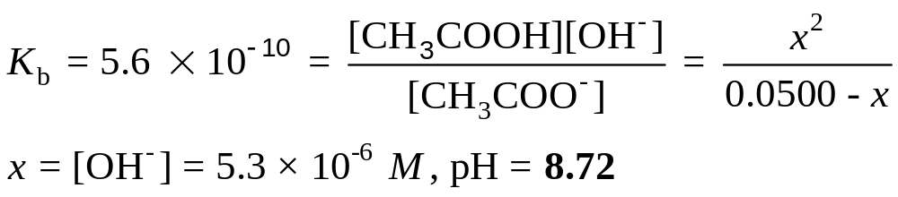
16.5
Following the procedure described in Example 15.13 and looking up the base ionization constant (K_{b}) for CH₃COO⁻ in Table 15.3, we write

Slide 42

16.5
(c) After the addition of 35.0 mL of NaOH, the solution is well past the equivalence point. The number of moles of NaOH originally present is
The changes in number of moles are summarized next:
 | CH₃COOH (aq) | + NaOH (aq) | → | CH₃COONa(aq) | + H₂O(l)
Initial (mol): | 2.50 x 10⁻³ | 3.50 x 10⁻³ |  | 0
Change (mol): | -2.50 x 10⁻³ | -2.50 x 10⁻³ |  | +2.50 x 10⁻³
Final (mol): | 0 | 1.00 x 10⁻³ |  | 2.50 x 10⁻³

Slide 43
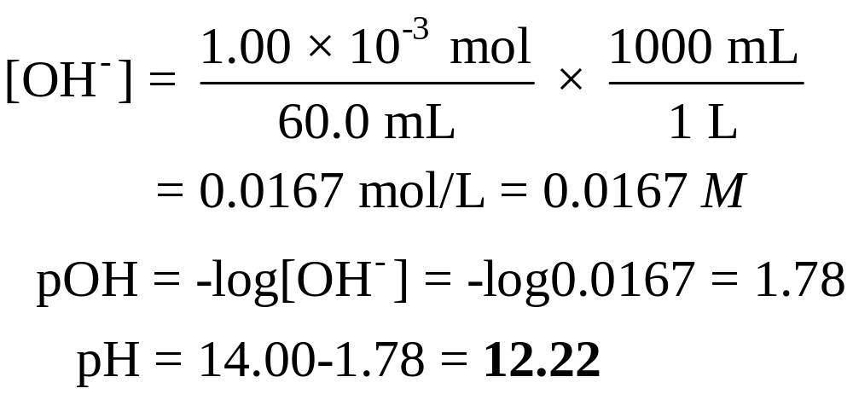
16.5
At this stage we have two species in solution that are responsible for making the solution basic: OH⁻ and CH₃COO⁻ (from CH₃COONa). However, because OH⁻ is a much stronger base than CH₃COO⁻, we can safely neglect the hydrolysis of the CH₃COO⁻ ions and calculate the pH of the solution using only the concentration of the OH⁻ ions. The total volume of the combined solutions is (25.0 + 35.0) mL or
60.0 mL, so we calculate OH⁻ concentration as follows:

Slide 44
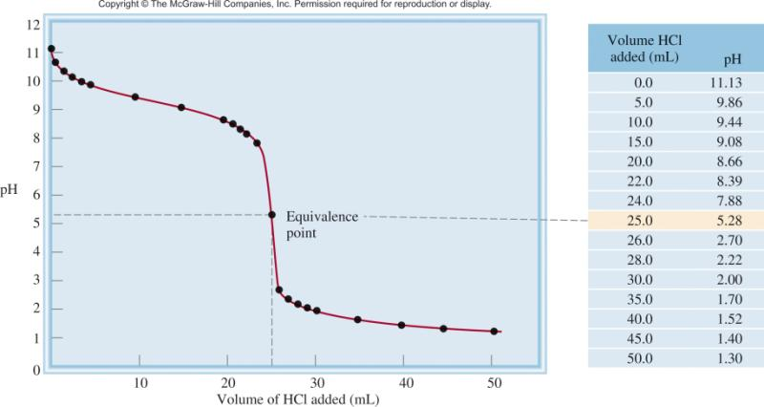
Strong Acid-Weak Base Titrations
HCl (aq) + NH₃ (aq) NH₄Cl (aq)
H⁺ (aq) + NH₃ (aq) NH₄⁺ (aq)
At equivalence point (pH < 7):
NH₄⁺ (aq) + H₂O (l) NH₃ (aq) + H⁺ (aq)

Slide 45
16.6
Calculate the pH at the equivalence point when 25.0 mL of 0.100 M NH₃ is titrated by a 0.100 M HCl solution.

Slide 46
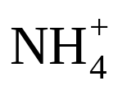
16.6
Strategy
The reaction between NH₃ and HCl is
NH₃(aq) + HCl(aq) NH₄Cl(aq)
We see that 1 mol NH₃ 1 mol HCl. At the equivalence point, the major species in solution are the salt NH₄Cl (dissociated into and Cl⁻ ions) and H₂O. First, we determine the concentration of NH₄Cl formed. Then we calculate the pH as a result of the ion hydrolysis. The Cl⁻ ion, being the conjugate base of a strong acid HCl, does not react with water. As usual, we ignore the ionization of water.

Slide 47
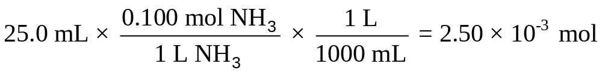
16.6
Solution The number of moles of NH₃ in 25.0 mL of 0.100 M
solution is
At the equivalence point the number of moles of HCl added equals the number of moles of NH₃. The changes in number of moles are summarized below:
 | NH₃(aq) + | HCl(aq) | → | NH₄Cl(aq)
Initial (mol): | 2.50 x 10⁻³ | 2.50 x 10⁻³ |  | 0
Change (mol): | -2.50 x 10⁻³ | -2.50 x 10⁻³ |  | + 2.50 x 10⁻³
Final (mol): | 0 | 0 |  | 2.50 x 10⁻³

Slide 48
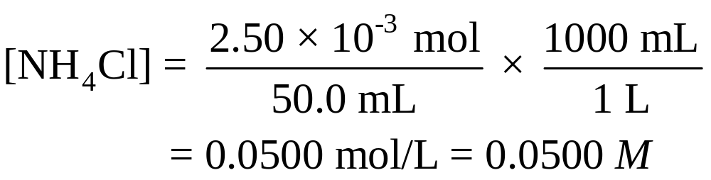
16.6
At the equivalence point, the concentrations of both the acid and the base are zero. The total volume is (25.0 + 25.0) mL, or 50.0 mL, so the concentration of the salt is
The pH of the solution at the equivalence point is determined by the hydrolysis of ions.

Slide 49
16.6
Step 1: We represent the hydrolysis of the cation , and let x be the equilibrium concentration of NH₃ and H⁺ ions in mol/L:
 | (aq) |  | NH₃(aq) + | H⁺(aq)
Initial (M): | 0.0500 |  | 0.000 | 0.000
Change (M): | -x |  | +x | +x
Equilibrium (M): | (0.0500-x) |  | x | x

Slide 50
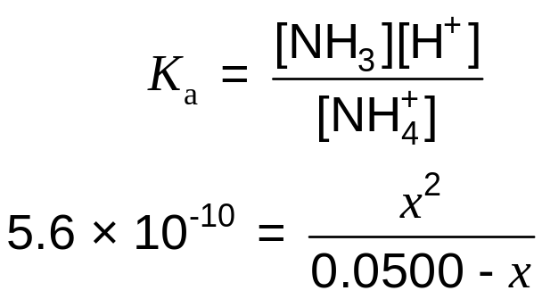
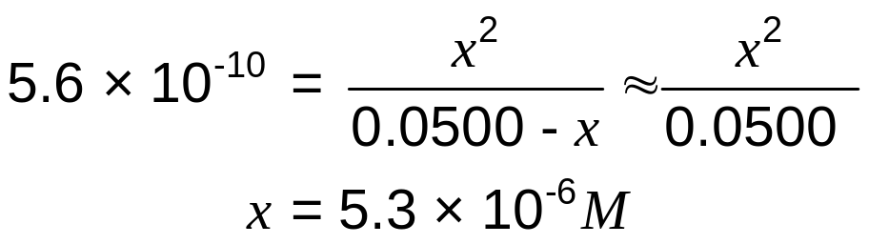
16.6
Step 2: From Table 15.4 we obtain the K_{a} for :
Applying the approximation 0.0500 - x ≈ 0.0500, we get
Thus, the pH is given by
pH = -log (5.3 x 10⁻⁶)
= 5.28

Slide 51
16.6
Check
Note that the pH of the solution is acidic. This is what we would expect from the hydrolysis of the ammonium ion.

Slide 52
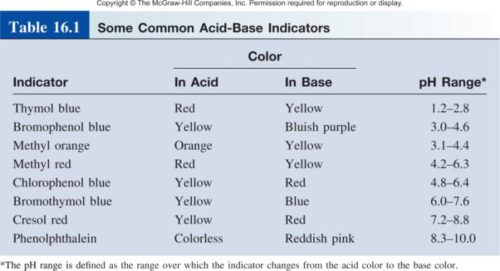
Acid-Base Indicators
HIn (aq) H⁺ (aq) + In⁻ (aq)
[HIn]
≥ 10
Color of acid (HIn) predominates
[In⁻]
[HIn]
≤ 10
Color of conjugate base (In⁻) predominates
[In⁻]

Slide 53
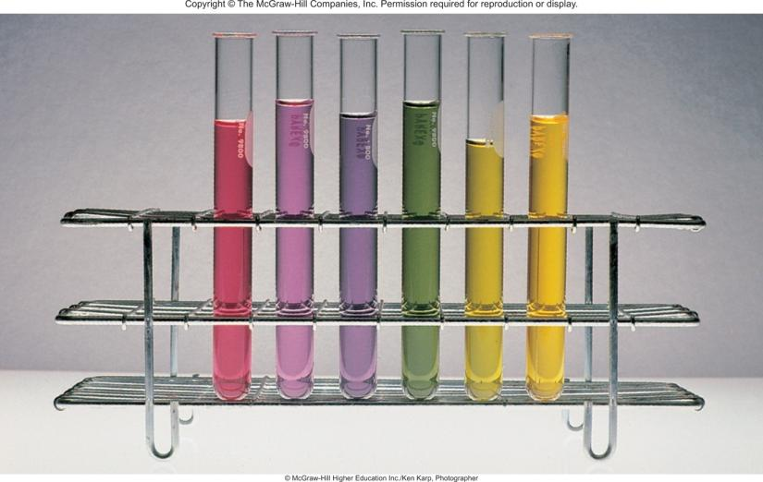
Solutions of Red Cabbage Extract
pH

Slide 54
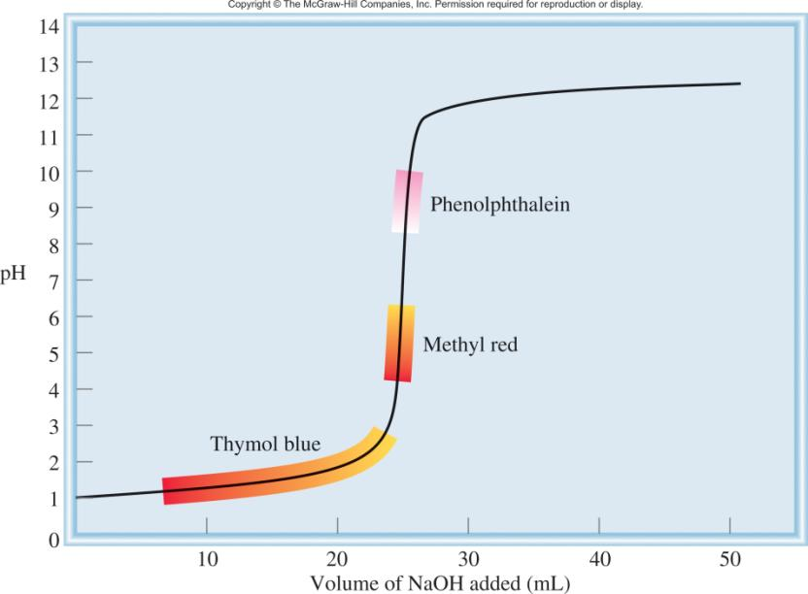
The titration curve of a strong acid with a strong base.

Slide 55
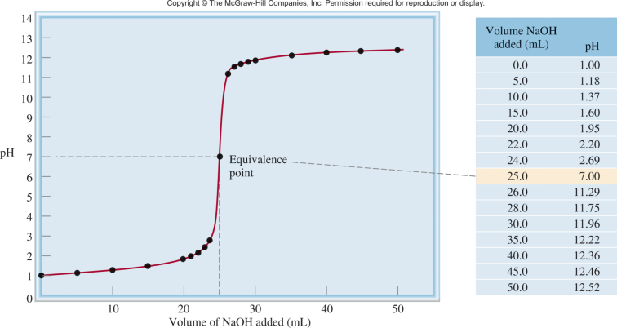
16.7
Which indicator or indicators listed in Table 16.1 would you use for the acid-base titrations shown in
(a) Figure 16.4?

Slide 56
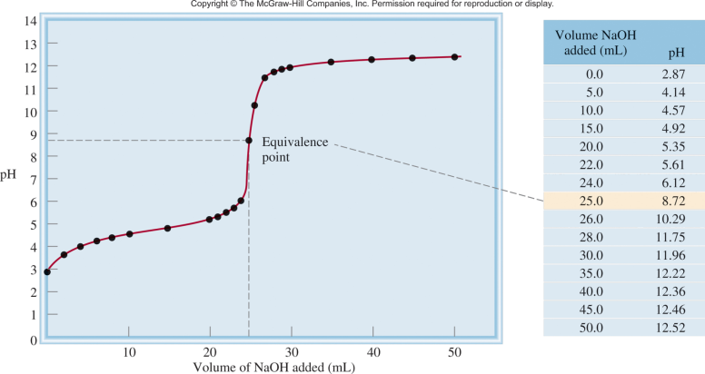
16.7
(b) Figure 16.5?

Slide 57
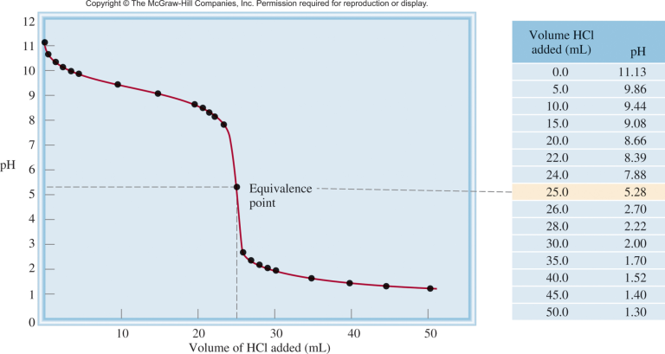
16.7
(c) Figure 16.6?

Slide 58
16.7
Strategy
The choice of an indicator for a particular titration is based on the fact that its pH range for color change must overlap the steep portion of the titration curve. Otherwise we cannot use the color change to locate the equivalence point.

Slide 59
16.7
Solution
(a) Near the equivalence point, the pH of the solution changes abruptly from 4 to 10. Therefore, all the indicators except thymol blue, bromophenol blue, and methyl orange are suitable for use in the titration.
(b) Here the steep portion covers the pH range between 7 and 10; therefore, the suitable indicators are cresol red and phenolphthalein.
(c) Here the steep portion of the pH curve covers the pH range between 3 and 7; therefore, the suitable indicators are bromophenol blue, methyl orange, methyl red, and chlorophenol blue.

Slide 60
Solubility Equilibria
AgCl (s) Ag⁺ (aq) + Cl⁻ (aq)
K_{sp} = [Ag⁺][Cl⁻]
K_{sp} is the solubility product constant
MgF₂ (s) Mg²⁺ (aq) + 2F⁻ (aq)
K_{sp} = [Mg²⁺][F⁻]²
Ag₂CO₃ (s) 2Ag⁺ (aq) + CO₃²⁻ (aq)
K_{sp} = [Ag⁺]²[CO₃²⁻]
Ca₃(PO₄)₂ (s) 3Ca²⁺ (aq) + 2PO₄³⁻ (aq)
K_{sp} = [Ca²⁺]³[PO₄³⁻]²
Dissolution of an ionic solid in aqueous solution:
Q < K_{sp}
Unsaturated solution
No precipitate
Q = K_{sp}
Saturated solution
Q > K_{sp}
Supersaturated solution
Precipitate will form

Slide 61
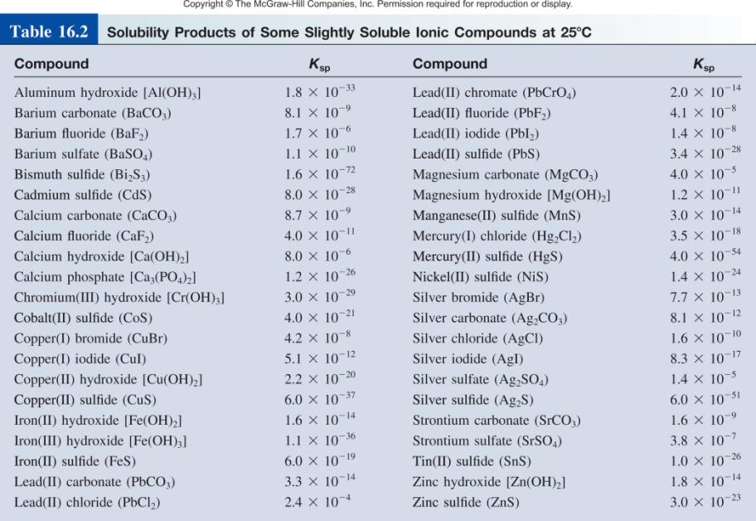

Slide 62
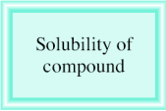
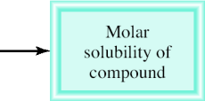
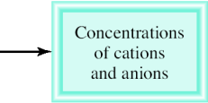





Molar solubility (mol/L) is the number of moles of solute dissolved in 1 L of a saturated solution.
Solubility (g/L) is the number of grams of solute dissolved in 1 L of a saturated solution.

Slide 63
16.8
The solubility of calcium sulfate (CaSO₄) is found to be
0.67 g/L. Calculate the value of K_{sp} for calcium sulfate.

Slide 64

16.8
Strategy
We are given the solubility of CaSO₄ and asked to calculate its K_{sp}. The sequence of conversion steps, according to Figure 16.9(a), is
solubility of molar solubility [Ca²⁺] and K_{sp} of
CaSO₄ in g/L of CaSO₄ [ ] CaSO₄

Slide 65
16.8
Solution Consider the dissociation of CaSO₄ in water. Let s be the molar solubility (in mol/L) of CaSO₄.
 | CaSO₄(s) |  | Ca²⁺(aq) + | (aq)
Initial (M): |  |  | 0 | 0
Change (M): | -s |  | +s | +s
Equilibrium (M): |  |  | s | s
The solubility product for CaSO₄ is
K_{sp} = [Ca²⁺][ ] = s²

Slide 66

16.8
First, we calculate the number of moles of CaSO₄ dissolved in
1 L of solution:
From the solubility equilibrium we see that for every mole of CaSO₄ that dissolves, 1 mole of Ca²⁺ and 1 mole of are produced. Thus, at equilibrium,
[Ca²⁺] = 4.9 x 10⁻³ M and [ ] = 4.9 x 10⁻³ M

Slide 67
16.8
Now we can calculate K_{sp}:
K_{sp} = [Ca²⁺] ][ ]
= (4.9 x 10⁻³ )(4.9 x 10⁻³ )
= 2.4 x 10⁻⁵

Slide 68

16.9
Using the data in Table 16.2, calculate the solubility of copper(II) hydroxide, Cu(OH)₂, in g/L.

Slide 69
16.9
Strategy
We are given the K_{sp} of Cu(OH)₂ and asked to calculate its solubility in g/L. The sequence of conversion steps, according to Figure 16.9(b), is
K_{sp} of [Cu²⁺] and molar solubilty solubility of
Cu(OH)₂ [OH⁻] of Cu(OH)₂ Cu(OH)₂ in g/L

Slide 70
16.9
Consider the dissociation of Cu(OH)₂ in water:
 | Cu(OH)₂(s) |  | Cu²⁺(aq) + | 2OH⁻(aq)
Initial (M): |  |  | 0 | 0
Change (M): | -s |  | +s | +2s
Equilibrium (M): |  |  | s | 2s
Note that the molar concentration of OH⁻ is twice that of Cu²⁺. The solubility product of Cu(OH)₂ is
K_{sp} = [Cu²⁺][OH⁻]²
= (s)(2s)² = 4s³

Slide 71


16.9
From the K_{sp} value in Table 16.2, we solve for the molar solubility of Cu(OH)₂ as follows:
Hence
Finally, from the molar mass of Cu(OH)₂ and its molar solubility, we calculate the solubility in g/L:

Slide 72


Slide 73
16.10
Exactly 200 mL of 0.0040 M BaCl₂ are mixed with exactly
600 mL of 0.0080 M K₂SO₄. Will a precipitate form?

Slide 74
16.10
Strategy
Under what condition will an ionic compound precipitate from solution? The ions in solution are Ba²⁺, Cl⁻, K⁺, and . According to the solubility rules listed in Table 4.2 (p. 125), the only precipitate that can form is BaSO₄. From the information given, we can calculate [Ba²⁺] and [ ] because we know the number of moles of the ions in the original solutions and the volume of the combined solution. Next, we calculate the ion product Q (Q = [Ba²⁺]₀[ ]₀) and compare the value of Q with K_{sp} of BaSO₄ to see if a precipitate will form, that is, if the solution is supersaturated.

Slide 75

16.10
It is helpful to make a sketch of the situation.

Slide 76


16.10
Solution
The number of moles of Ba²⁺ present in the original 200 mL of solution is
The total volume after combining the two solutions is
800 mL. The concentration of Ba²⁺ in the 800 mL volume is

Slide 77


16.10
The number of moles of in the original 600 mL solution is
The concentration of in the 800 mL of the combined solution is

Slide 78
16.10
Now we must compare Q and K_{sp}. From Table 16.2,
BaSO₄(s) Ba²⁺(aq) + (aq) K_{sp} = 1.1 x 10⁻¹⁰
As for Q,
Q = [Ba²⁺]₀[ ]₀ = (1.0 x 10⁻³)(6.0 x 10⁻³)
= 6.0 x 10⁻⁶
Therefore, Q > K_{sp}
The solution is supersaturated because the value of Q indicates that the concentrations of the ions are too large. Thus, some of the BaSO₄ will precipitate out of solution until
[Ba²⁺][ ] = 1.1 x 10⁻¹⁰

Slide 79
16.11
A solution contains 0.020 M Cl⁻ ions and 0.020 M Br⁻ ions. To separate the Cl⁻ ions from the Br⁻ ions, solid AgNO₃ is slowly added to the solution without changing the volume. What concentration of Ag⁺ ions (in mol/L) is needed to precipitate as much AgBr as possible without precipitating AgCl?

Slide 80

16.11
Strategy
In solution, AgNO₃ dissociates into Ag⁺ and ions. The Ag⁺ ions then combine with the Cl⁻ and Br⁻ ions to form AgCl and AgBr precipitates. Because AgBr is less soluble (it has a smaller K_{sp} than that of AgCl), it will precipitate first. Therefore, this is a fractional precipitation problem. Knowing the concentrations of Cl⁻ and Br⁻ ions, we can calculate [Ag⁺] from the K_{sp} values. Keep in mind that K_{sp} refers to a
saturated solution. To initiate precipitation, [Ag⁺] must exceed the concentration in the saturated solution in each case.

Slide 81

16.11
Solution The solubility equilibrium for AgBr is
Because [Br⁻] = 0.020 M, the concentration of Ag⁺ that must be exceeded to initiate the precipitation of AgBr is
Thus, [Ag⁺] > 3.9 x 10⁻¹¹ M is required to start the precipitation of AgBr.
AgBr(s) Ag⁺(aq) + Br⁻(aq) K_{sp} = [Ag⁺][Br⁻]

Slide 82

16.11
The solubility equilibrium for AgCl is
so that
Therefore, [Ag⁺] > 8.0 x 10⁻⁹ M is needed to initiate the precipitation of AgCl. To precipitate the Br⁻ ions as AgBr without precipitating the Cl⁻ ions as AgCl, then, [Ag⁺] must be greater than 3.9 x 10⁻¹¹ M and lower than 8.0 x 10⁻⁹ M.
AgCl(s) Ag⁺(aq) + Cl⁻(aq) K_{sp} = [Ag⁺][Cl⁻]

Slide 83
The Common Ion Effect and Solubility
The presence of a common ion decreases the solubility of the salt.

Slide 84
16.12
Calculate the solubility of silver chloride (in g/L) in a 6.5 x 10⁻³ M silver nitrate solution.

Slide 85
16.12
Strategy
This is a common-ion problem. The common ion here is Ag⁺, which is supplied by both AgCl and AgNO₃. Remember that the presence of the common ion will affect only the solubility of AgCl (in g/L), but not the K_{sp} value because it is an
equilibrium constant.

Slide 86
16.12
Solution
Step 1: The relevant species in solution are Ag⁺ ions (from both AgCl and AgNO₃) and Cl⁻ ions. The ions are spectator ions.
Step 2: Because AgNO₃ is a soluble strong electrolyte, it dissociates completely:
AgNO₃(s) Ag⁺(aq) + (aq)
6.5 x 10⁻³ M 6.5 x 10⁻³ M
H₂O

Slide 87
16.12
Let s be the molar solubility of AgCl in AgNO₃ solution. We summarize the changes in concentrations as follows:
 | AgCl(s) |  | Ag⁺(aq) + | Cl⁻(aq)
Initial (M): |  |  | 6.5 x 10⁻³ | 0.00
Change (M): | -s |  | +s | +s
Equilibrium (M): |  |  | (6.5 x 10⁻³ +s) | s
Step 3:
K_{sp} = [Ag⁺][Cl⁻]
1.6 x 10⁻¹⁰ = (6.5 x 10⁻³ + s)(s)

Slide 88
16.12
Because AgCl is quite insoluble and the presence of Ag⁺ ions from AgNO₃ further lowers the solubility of AgCl, s must be very small compared with 6.5 x 10⁻³. Therefore, applying the approximation 6.5 x 10⁻³ + s ≈ 6.5 x 10⁻³ , we obtain
1.6 x 10⁻¹⁰ = (6.5 x 10⁻³ )s
s = 2.5 x 10⁻⁸ M
Step 4: At equilibrium
[Ag⁺] = (6.5 x 10⁻³ + 2.5 x 10⁻⁸ ) M ≈ 6.5 x 10⁻³ M
[Cl⁺] = 2.5 x 10⁻⁸ M

Slide 89

16.12
and so our approximation was justified in step 3. Because all the Cl⁻ ions must come from AgCl, the amount of AgCl dissolved in AgNO₃ solution also is 2.5 x 10⁻⁸ M. Then, knowing the molar mass of AgCl (143.4 g), we can calculate the solubility of AgCl as follows:

Slide 90
16.12
Check
The solubility of AgCl in pure water is 1.9 x 10⁻³ g/L (see the Practice Exercise in Example 16.9). Therefore, the lower solubility (3.6 x 10⁻⁶ g/L) in the presence of AgNO₃ is reasonable. You should also be able to predict the lower
solubility using Le Châtelier’s principle. Adding Ag⁺ ions shifts the equilibrium to the left, thus decreasing the solubility of AgCl.

Slide 91
pH and Solubility
The presence of a common ion decreases the solubility.
Insoluble bases dissolve in acidic solutions
Insoluble acids dissolve in basic solutions
remove
add
Mg(OH)₂ (s) Mg²⁺ (aq) + 2OH⁻ (aq)
At pH less than 10.45
K_{sp} = [Mg²⁺][OH⁻]² = 1.2 x 10⁻¹¹
Lower [OH⁻]
K_{sp} = (s)(2s)² = 4s³
OH⁻ (aq) + H⁺ (aq) H₂O (l)
4s³ = 1.2 x 10⁻¹¹
Increase solubility of Mg(OH)₂
s = 1.4 x 10⁻⁴ M
At pH greater than 10.45
[OH⁻] = 2s = 2.8 x 10⁻⁴ M
Raise [OH⁻]
pOH = 3.55 pH = 10.45
Decrease solubility of Mg(OH)₂

Slide 92
16.13
Which of the following compounds will be more soluble in acidic solution than in water:
CuS
(b) AgCl
(c) PbSO₄

Slide 93
16.13
Strategy
In each case, write the dissociation reaction of the salt into its cation and anion. The cation will not interact with the H⁺ ion because they both bear positive charges. The anion will act as a proton acceptor only if it is the conjugate base of a
weak acid. How would the removal of the anion affect the solubility of the salt?

Slide 94
16.13
Solution
(a) The solubility equilibrium for CuS is
CuS(s) Cu²⁺(aq) + S²⁻(aq)
The sulfide ion is the conjugate base of the weak acid HS⁻. Therefore, the S²⁻ ion reacts with the H⁺ ion as follows:
S²⁻(aq) + H⁺(aq) HS⁻(aq)
This reaction removes the S²⁻ ions from solution. According to Le Châtelier’s principle, the equilibrium will shift to the right to replace some of the S²⁻ ions that were removed, thereby increasing the solubility of CuS.

Slide 95
16.13
(b) The solubility equilibrium is
AgCl(s) Ag⁺(aq) + Cl⁻(aq)
Because Cl⁻ is the conjugate base of a strong acid (HCl), the solubility of AgCl is not affected by an acid solution.

Slide 96


16.13
(c) The solubility equilibrium for PbSO₄ is
PbSO₄(s) Pb²⁺(aq) + (aq)
The sulfate ion is a weak base because it is the conjugate base of the weak acid . Therefore, the ion reacts with the H⁺ ion as follows:
(aq) + H⁺(aq) (aq)
This reaction removes the ions from solution. According to Le Châtelier’s principle, the equilibrium will shift to the right to replace some of the ions that were removed, thereby increasing the solubility of PbSO₄.

Slide 97
16.14
Calculate the concentration of aqueous ammonia necessary to initiate the precipitation of iron(II) hydroxide from a 0.0030 M solution of FeCl₂.

Slide 98
16.14
Strategy
For iron(II) hydroxide to precipitate from solution, the product [Fe²⁺][OH⁻]² must be greater than its K_{sp}. First, we calculate [OH⁻] from the known [Fe²⁺] and the K_{sp} value listed in Table 16.2. This is the concentration of OH⁻ in a saturated solution of Fe(OH)₂. Next, we calculate the concentration of NH₃ that will supply this concentration of OH⁻ ions. Finally, any NH₃ concentration greater than the calculated value will initiate the precipitation of Fe(OH)₂ because the solution will become supersaturated.

Slide 99

16.14
Solution
Ammonia reacts with water to produce OH⁻ ions, which then react with Fe²⁺ to form Fe(OH)₂. The equilibria of interest are
First we find the OH⁻ concentration above which Fe(OH)₂ begins to precipitate. We write
K_{sp} = [Fe²⁺][OH⁻]² = 1.6 x 10⁻¹⁴

Slide 100

16.14
Because FeCl₂ is a strong electrolyte, [Fe²⁻] = 0.0030 M and
Next, we calculate the concentration of NH₃ that will supply
2.3 x 10⁻⁶ M OH⁻ ions. Let x be the initial concentration of NH₃ in mol/L.

Slide 101

16.14
We summarize the changes in concentrations resulting from the ionization of NH₃ as follows.
 | NH₃ (aq) | + H₂O (l) |  | (aq) | + OH⁻(aq)
Initial (M): | x |  |  | 0.00 | 0.00
Change (M): | -2.3 x 10⁻⁶ |  |  | +2.3 x 10⁻⁶ | +2.3 x 10⁻⁶
Equilibrium (M): | ( x -2.3 x 10⁻⁶) |  |  | 2.3 x 10⁻⁶ | 2.3 x 10⁻⁶
Substituting the equilibrium concentrations in the expression for the ionization constant (see Table 15.4),

Slide 102

16.14
Solving for x, we obtain
x = 2.6 x 10⁻⁶ M
Therefore, the concentration of NH₃ must be slightly greater than 2.6 x 10⁻⁶ M to initiate the precipitation of Fe(OH)₂.

Slide 103


Complex Ion Equilibria and Solubility
A complex ion is an ion containing a central metal cation bonded to one or more molecules or ions.
2-
Co²⁺ (aq) + 4Cl⁻ (aq) CoCl₄ (aq)
The formation constant or stability constant (K_{f}) is the equilibrium constant for the complex ion formation.
2-
[CoCl₄ ]
K_{f} =
2+
[Co²⁺][Cl⁻]⁴
Co(H₂O)₆
2-
CoCl₄
stability of complex
K_{f}
HCl

Slide 104


Slide 105
16.15
A 0.20-mole quantity of CuSO₄ is added to a liter of 1.20 M NH₃ solution. What is the concentration of Cu²⁺ ions at equilibrium?

Slide 106

16.15
Strategy The addition of CuSO₄ to the NH₃ solution results in complex ion formation
Cu²⁺(aq) + 4NH₃(aq) (aq)
From Table 16.4 we see that the formation constant (K_{f}) for this reaction is very large; therefore, the reaction lies mostly to the right. At equilibrium, the concentration of Cu²⁺ will be very small. As a good approximation, we can assume that essentially all the dissolved Cu²⁺ ions end up as ions. How many moles of NH₃ will react with 0.20 mole of Cu²⁺? How many moles of will be produced? A very small amount of Cu²⁺ will be present at equilibrium. Set up the K_{f} expression for the preceding equilibrium to solve for [Cu²⁺ ].

Slide 107

16.15
Solution The amount of NH₃ consumed in forming the complex ion is 4 x 0.20 mol, or 0.80 mol. (Note that 0.20 mol Cu²⁺ is initially present in solution and four NH₃ molecules are needed to form a complex ion with one Cu²⁺ ion.) The concentration
of NH₃ at equilibrium is therefore (1.20 - 0.80) mol/L soln or 0.40 M, and that of is 0.20 mol/L soln or 0.20 M, the same as the initial concentration of Cu²⁺. [There is a 1:1 mole ratio between Cu²⁺ and .] Because does dissociate to a slight extent, we call the concentration of Cu²⁺ at equilibrium x and write

Slide 108
16.15
Solving for x and keeping in mind that the volume of the solution is 1 L, we obtain
x = [Cu²⁺] = 1.6 x 10⁻¹³ M
Check
The small value of [Cu²⁺] at equilibrium, compared with 0.20 M, certainly justifies our approximation.

Slide 109
16.16
Calculate the molar solubility of AgCl in a 1.0 M NH₃ solution.

Slide 110

16.16
Strategy
AgCl is only slightly soluble in water
AgCl(s) Ag⁺(aq) + Cl⁻(aq)
The Ag⁺ ions form a complex ion with NH₃ (see Table 16.4)
Ag⁺(aq) + 2NH₃(aq)
Combining these two equilibria will give the overall equilibrium for the process.

Slide 111

16.16
Solution
Step 1: Initially, the species in solution are Ag⁺ and Cl⁻ ions and NH₃. The reaction between Ag⁺ and NH₃ produces the complex ion .
Step 2: The equilibrium reactions are
AgCl(s) Ag⁺(aq) + Cl⁻(aq) K_{sp} = [Ag⁺][Cl⁻] = 1.6 x 10⁻¹⁰
Ag⁺(aq) + 2NH₃(aq) (aq)
Overall: AgCl(s) + 2NH₃(aq) (aq) + Cl⁻(aq)

Slide 112

16.16
The equilibrium constant K for the overall reaction is the product of the equilibrium constants of the individual reactions (see Section 14.2):

Slide 113
16.16
Let s be the molar solubility of AgCl (mol/L). We summarize the changes in concentrations that result from formation of the complex ion as follows:
 | AgCl(s) | + 2NH₃(aq) |  | (aq) | + Cl-(aq)
Initial (M): |  | 1.0 |  | 0.0 | 0.0
Change (M): | -s | -2s |  | +s | +s
Equilibrium (M): |  | (1.0 – 2s) |  | s | s
The formation constant for is quite large, so most of the silver ions exist in the complexed form. In the absence of ammonia we have, at equilibrium, [Ag⁺] = [Cl⁻]. As a result of complex ion formation, however, we can write[ ] = [Cl⁻].

Slide 114


16.16
Step 3:
Taking the square root of both sides, we obtain
Step 4: At equilibrium, 0.045 mole of AgCl dissolves in 1 L of 1.0 M NH₃ solution.

Slide 115

16.16
Check
The molar solubility of AgCl in pure water is 1.3 x 10⁻⁵ M. Thus, the formation of the complex ion enhances the solubility of AgCl (Figure 16.12).

Slide 116


Chemistry In Action: How an Eggshell is Formed
Ca²⁺ (aq) + CO₃²⁻ (aq) CaCO₃ (s)
carbonic
CO₂ (g) + H₂O (l) H₂CO₃ (aq)
anhydrase
H₂CO₃ (aq) H⁺ (aq) + HCO₃⁻ (aq)
HCO₃⁻ (aq) H⁺ (aq) + CO₃²⁻ (aq)
electron micrograph

Slide 117




Effect of Complexation on Solubility
AgNO₃ + NaCl
Add NH₃
Ag(NH₃)₂⁺
AgCl

Slide 118


Slide 119









Qualitative Analysis of Cations

Slide 120




Flame Test for Cations
lithium
sodium
potassium
copper

