Slide 1

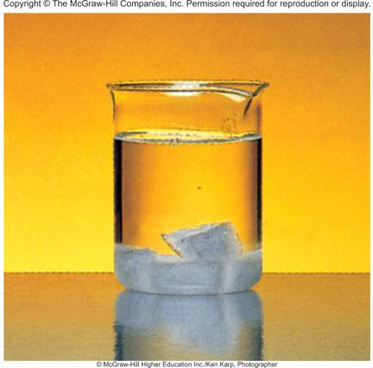
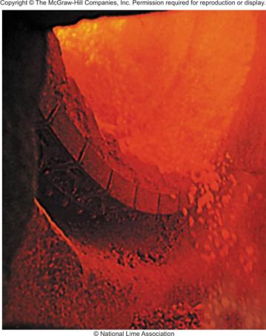
Entropy, Free Energy, and Equilibrium
Chapter 17
Copyright © The McGraw-Hill Companies, Inc. Permission required for reproduction or display.

Slide 2
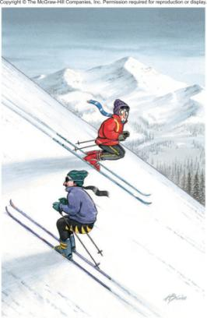
Spontaneous Physical and Chemical Processes
A waterfall runs downhill
A lump of sugar dissolves in a cup of coffee
At 1 atm, water freezes below 0 ºC and ice melts above 0 ºC
Heat flows from a hotter object to a colder object
A gas expands in an evacuated bulb
Iron exposed to oxygen and
water forms rust
spontaneous
nonspontaneous

Slide 3
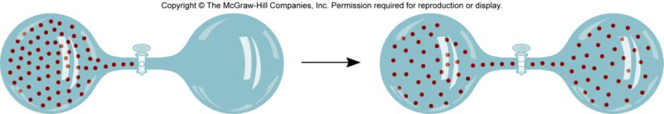

spontaneous
nonspontaneous

Slide 4
Does a decrease in enthalpy mean a reaction proceeds spontaneously?
Spontaneous reactions
CH₄ (g) + 2O₂ (g) CO₂ (g) + 2H₂O (l) ΔH⁰ = -890.4 kJ/mol
H⁺ (aq) + OH⁻ (aq) H₂O (l) ΔH⁰ = -56.2 kJ/mol
H₂O (s) H₂O (l) ΔH⁰ = 6.01 kJ/mol
H₂O
NH₄NO₃ (s) NH₄⁺(aq) + NO₃⁻ (aq) ΔH⁰ = 25 kJ/mol

Slide 5
Entropy (S) is a measure of the randomness or disorder of a system.
order
S
disorder
S
ΔS = S_{f} - S_{i}
If the change from initial to final results in an increase in randomness
S_{f} > S_{i}
ΔS > 0
For any substance, the solid state is more ordered than the liquid state and the liquid state is more ordered than gas state.
S_{solid} < S_{liquid} << S_{gas}
H₂O (s) H₂O (l)
ΔS > 0

Slide 6
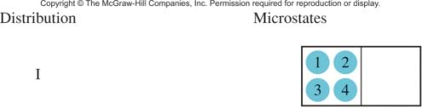
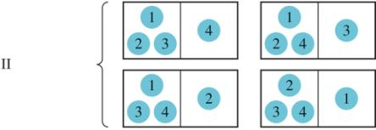
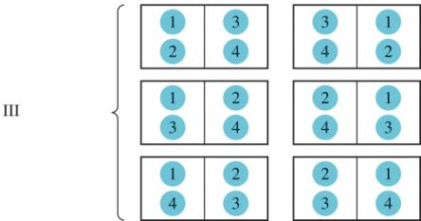
Entropy
W = number of microstates
S = k ln W
ΔS = S_{f} - S_{i}
W_{f}
ΔS = k ln
W_{i}
W_{f} > W_{i} then ΔS > 0
W_{f} < W_{i} then ΔS < 0

Slide 7
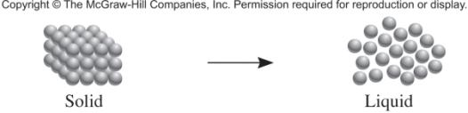
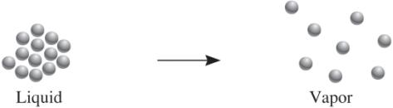
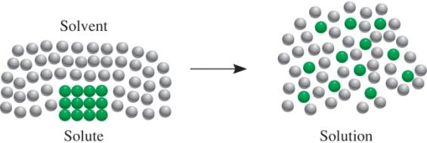
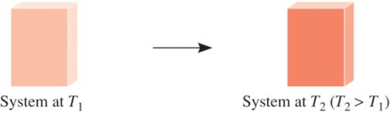
Processes that lead to an increase in entropy (ΔS > 0)

Slide 8
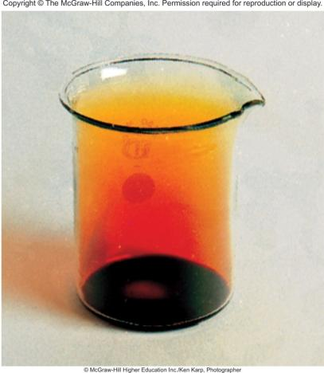
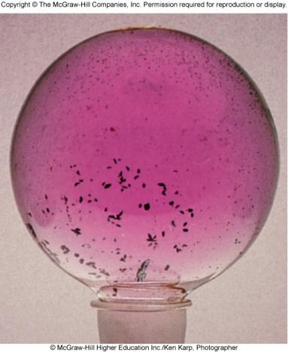
Example: Br₂(l) Br₂(g)
Example: I₂(s) I₂(g)
ΔS > 0
ΔS > 0

Slide 9
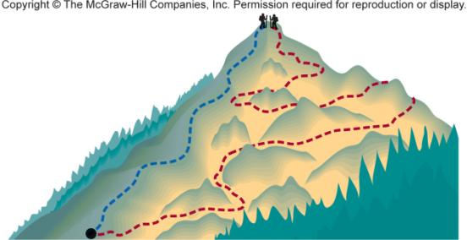
Entropy
State functions are properties that are determined by the state of the system, regardless of how that condition was achieved.
Examples:
energy, enthalpy, pressure, volume, temperature
, entropy
Review
Potential energy of hiker 1 and hiker 2 is the same even though they took different paths.

Slide 10
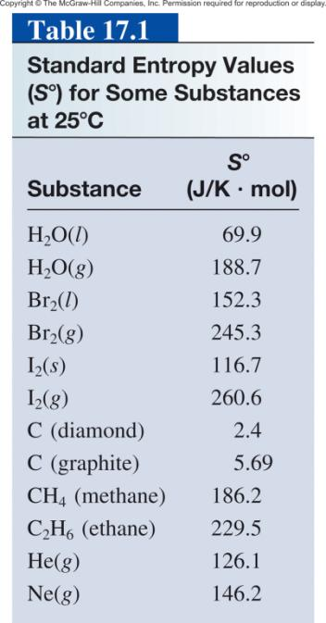

Slide 11
17.1
Predict whether the entropy change is greater or less than zero for each of the following processes:
(a) freezing ethanol
(b) evaporating a beaker of liquid bromine at room
temperature
(c) dissolving glucose in water
(d) cooling nitrogen gas from 80°C to 20°C

Slide 12
17.1
Strategy
To determine the entropy change in each case, we examine whether the number of microstates of the system increases or decreases. The sign of ΔS will be positive if there is an increase in the number of microstates and negative if the number of microstates decreases.
Solution
Upon freezing, the ethanol molecules are held rigid in position. This phase transition reduces the number of microstates and therefore the entropy decreases; that is,
ΔS < 0.

Slide 13
17.1
(b) Evaporating bromine increases the number of microstates because the Br₂ molecules can occupy many more positions in nearly empty space. Therefore, ΔS > 0.
(c) Glucose is a nonelectrolyte. The solution process leads to a greater dispersal of matter due to the mixing of glucose and water molecules so we expect ΔS > 0.
(d) The cooling process decreases various molecular motions. This leads to a decrease in microstates and so ΔS < 0.

Slide 14
First Law of Thermodynamics
Energy can be converted from one form to another but energy cannot be created or destroyed.
Second Law of Thermodynamics
The entropy of the universe increases in a spontaneous process and remains unchanged in an equilibrium process.
Spontaneous process:
ΔS_{univ} = ΔS_{sys} + ΔS_{surr} > 0
Equilibrium process:
ΔS_{univ} = ΔS_{sys} + ΔS_{surr} = 0

Slide 15
Entropy Changes in the System (ΔS_{sys})
The standard entropy of reaction (ΔS⁰ ) is the entropy change for a reaction carried out at 1 atm and 25⁰C.
rxn
aA + bB cC + dD
ΔS⁰
-
[
aS⁰(A)
+
bS⁰(B)
=
[
cS⁰(C)
+
dS⁰(D)
]
]
rxn
ΔS⁰
=
Σ
nS⁰(products)
-
Σ
mS⁰(reactants)
rxn

Slide 16
17.2
From the standard entropy values in Appendix 3, calculate the standard entropy changes for the following reactions at 25°C.
CaCO₃(s) CaO(s) + CO₂(g)
(b) N₂(g) + 3H₂(g) 2NH₃(g)
(c) H₂(g) + Cl₂(g) 2HCl(g)

Slide 17
17.2
Strategy
To calculate the standard entropy of a reaction, we look up the standard entropies of reactants and products in Appendix 3 and apply Equation (17.7). As in the calculation of enthalpy of reaction [see Equation (6.18)], the stoichiometric coefficients have no units, so ΔS°_{rxn} is expressed in units of J/K·mol.

Slide 18
17.2
Solution
(a) ΔS°_{rxn} = [S°(CaO) + S°(CO₂)] - [S°(CaCO₃)]
= [(39.8 J/K·mol) + (213.6 J/K·mol)] - (92.9 /K·mol)
= 160.5 J/K·mol
Thus, when 1 mole of CaCO₃ decomposes to form 1 mole of CaO and 1 mole of gaseous CO₂, there is an increase in entropy equal to 160.5 J/K·mol.

Slide 19
17.2
(b) ΔS°_{rxn} = [2S°(NH₃)] - [S°(N₂) + 3S°(H₂)]
= (2)(193 J/K·mol) - [(192 J/K·mol) + (3)(131 J/K·mol)]
= -199 J/K·mol
This result shows that when 1 mole of gaseous nitrogen reacts with 3 moles of gaseous hydrogen to form 2 moles of gaseous ammonia, there is a decrease in entropy equal to -199 J/K·mol.

Slide 20
17.2
(c) ΔS°_{rxn} = [2S°(HCl)] - [S°(H₂) + S°(Cl₂)]
= (2)(187 J/K·mol) - [(131 J/K·mol) + (223 J/K·mol)]
= 20 J/K·mol
Thus, the formation of 2 moles of gaseous HCl from 1 mole of gaseous H₂ and 1 mole of gaseous Cl₂ results in a small increase in entropy equal to 20 J/K·mol.
Comment The ΔS°_{rxn} values all apply to the system.

Slide 21
Entropy Changes in the System (ΔS_{sys})
When gases are produced (or consumed)
If a reaction produces more gas molecules than it consumes, ΔS⁰ > 0.
If the total number of gas molecules diminishes, ΔS⁰ < 0.
If there is no net change in the total number of gas molecules, then ΔS⁰ may be positive or negative BUT ΔS⁰ will be a small number.

Slide 22
17.3
Predict whether the entropy change of the system in each of the following reactions is positive or negative.
2H₂(g) + O₂(g) 2H₂O(l)
(b) NH₄Cl(s) NH₃(g) + HCl(g)
(c) H₂(g) + Br₂(g) 2HBr(g)

Slide 23
17.3
Strategy
We are asked to predict, not calculate, the sign of entropy change in the reactions. The factors that lead to an increase in entropy are: (1) a transition from a condensed phase to the vapor phase and (2) a reaction that produces more product molecules than reactant molecules in the same phase. It is also important to compare the relative complexity of the product and reactant molecules. In general, the more complex the molecular structure, the greater the entropy of the compound.

Slide 24
17.3
Solution
Two reactant molecules combine to form one product molecule. Even though H₂O is a more complex molecule than either H₂ and O₂, the fact that there is a net decrease of one molecule and gases are converted to liquid ensures that the number of microstates will be diminished and hence ΔS° is negative.
(b) A solid is converted to two gaseous products. Therefore,
ΔS° is positive.

Slide 25
17.3
(c) The same number of molecules is involved in the reactants as in the product. Furthermore, all molecules are diatomic and therefore of similar complexity. As a result, we cannot predict the sign of ΔS°, but we know that the change must be quite small in magnitude.

Slide 26
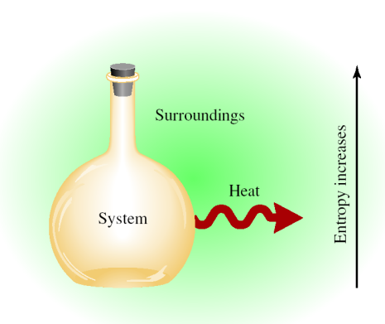
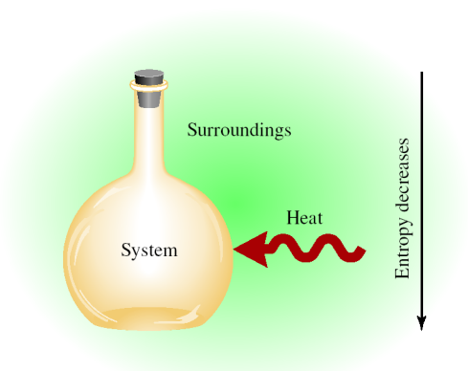
Entropy Changes in the Surroundings (ΔS_{surr})
Exothermic Process
ΔS_{surr} > 0
Endothermic Process
ΔS_{surr} < 0

Slide 27
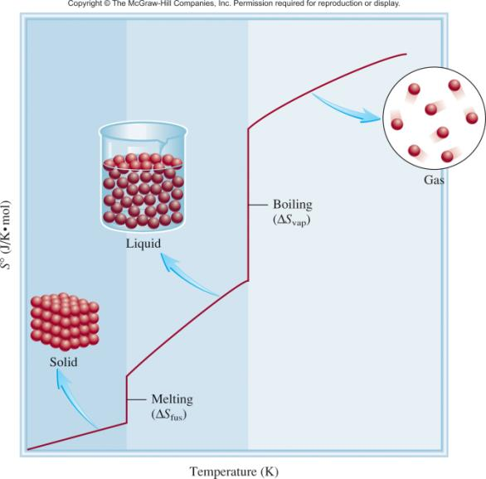
Third Law of Thermodynamics
The entropy of a perfect crystalline substance is zero at the absolute zero of temperature.
S = k ln W
W = 1
S = 0

Slide 28
Gibbs Free Energy
Spontaneous process:
ΔS_{univ} = ΔS_{sys} + ΔS_{surr} > 0
Equilibrium process:
ΔS_{univ} = ΔS_{sys} + ΔS_{surr} = 0
For a constant temperature and constant pressure process:
Gibbs free energy (G)
ΔG = ΔH_{sys} -TΔS_{sys}
ΔG < 0 The reaction is spontaneous in the forward direction.
ΔG > 0 The reaction is nonspontaneous as written. The
reaction is spontaneous in the reverse direction.
ΔG = 0 The reaction is at equilibrium.

Slide 29
The standard free-energy of reaction (ΔG⁰ ) is the free-energy change for a reaction when it occurs under standard-state conditions.
rxn
aA + bB cC + dD
ΔG⁰
cΔG⁰ (C)
dΔG⁰ (D)
-
aΔG⁰ (A)
bΔG⁰ (B)
=
[
+
]
[
+
]
rxn
f
f
f
f
ΔG⁰
=
Σ
nΔG⁰ (products)
-
Σ
mΔG⁰ (reactants)
rxn
f
f
Standard free energy of formation (ΔG⁰) is the free-energy change that occurs when 1 mole of the compound is formed from its elements in their standard states.
f
ΔG⁰ of any element in its stable form is zero.
f

Slide 30
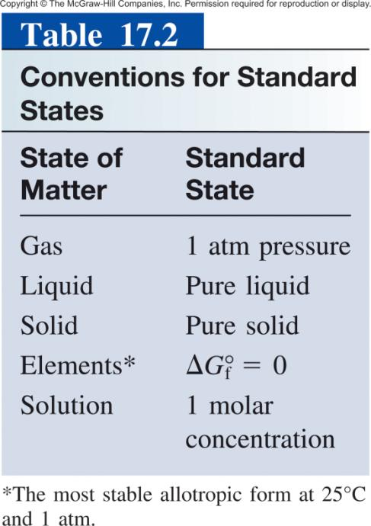

Slide 31
17.4
Calculate the standard free-energy changes for the following reactions at 25°C.
CH₄(g) + 2O₂(g) CO₂(g) + 2H₂O(l)
(b) 2MgO(s) 2Mg(s) + O₂(g)

Slide 32
17.4
Strategy
To calculate the standard free-energy change of a reaction, we look up the standard free energies of formation of reactants and products in Appendix 3 and apply Equation (17.12). Note that all the stoichiometric coefficients have no units so ΔG°_{rxn} is expressed in units of kJ/mol, and ΔG°_{f} for O₂ is zero because it is the stable allotropic element at 1 atm and 25°C.

Slide 33
17.4
Solution
According to Equation (17.12), we write
ΔG°_{rxn} = [ΔG°_{f} (CO₂) + 2ΔG°_{f} (H₂O)] - [ΔG°_{f} (CH₄) + 2ΔG°_{f} (O₂)]
We insert the appropriate values from Appendix 3:
ΔG°_{rxn} =[(-394.4 kJ/mol) + (2)(-237.2 kJ/mol)] -
[(-50.8 kJ/mol) + (2) (0 kJ/mol)]
= -818.0 kJ/mol

Slide 34
17.4
(b) The equation is
ΔG°_{rxn} = [2ΔG°_{f} (Mg) + ΔG°_{f} (O₂)] - [2ΔG°_{f} (MgO)]
From data in Appendix 3 we write
ΔG°_{rxn} = [(2)(0 kJ/mol) + (0 kJ/mol)] - [(2)(-569.6 kJ/mol)]
= 1139 kJ/mol

Slide 35
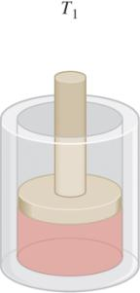
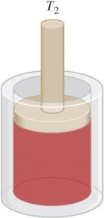
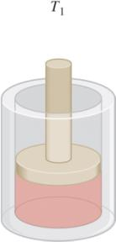
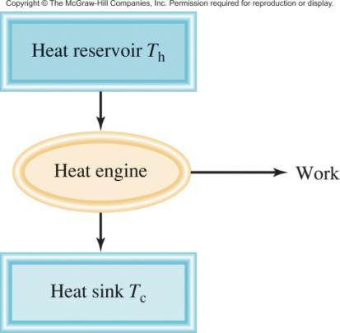
Chemistry In Action: The Efficiency of Heat Engines
T_{h} - T_{c}
Efficiency =
X 100%
T_{h}

Slide 36
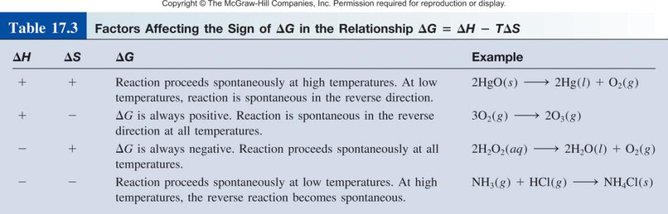
ΔG = ΔH - TΔS

Slide 37
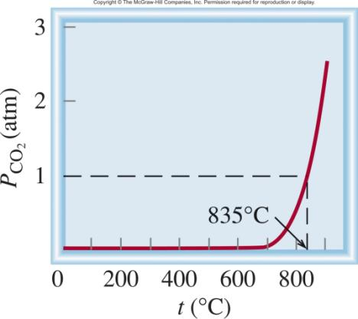
Temperature and Spontaneity of Chemical Reactions
CaCO₃ (s) CaO (s) + CO₂ (g)
Equilibrium Pressure of CO₂
ΔH⁰ = 177.8 kJ/mol
ΔS⁰ = 160.5 J/K·mol
ΔG⁰ = ΔH⁰ – TΔS⁰
At 25 ºC, ΔG⁰ = 130.0 kJ/mol
ΔG⁰ = 0 at 835 ºC

Slide 38
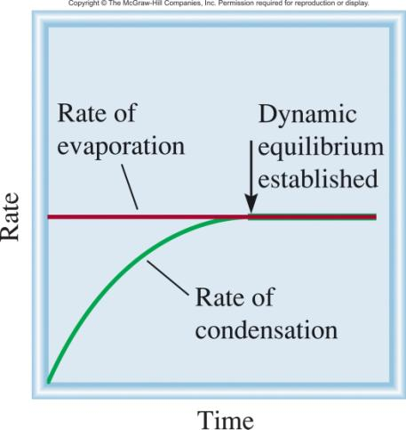
Gibbs Free Energy and Phase Transitions
ΔG⁰ = 0
= ΔH⁰ – TΔS⁰
H₂O (l) H₂O (g)
ΔH
40.79 kJ/mol
ΔS =
=
T
373 K
= 1.09 x 10⁻¹ kJ/K·mol
= 109 J/K·mol

Slide 39
17.5
The molar heats of fusion and vaporization of benzene are
10.9 kJ/mol and 31.0 kJ/mol, respectively. Calculate the entropy changes for the solid → liquid and liquid → vapor transitions for benzene. At 1 atm pressure, benzene melts at 5.5°C and boils at 80.1°C.

Slide 40
17.5
Strategy
At the melting point, liquid and solid benzene are at equilibrium, so ΔG = 0. From Equation (17.10) we have ΔG = 0 =
ΔH - T ΔS or ΔS = ΔH/T. To calculate the entropy change for the solid benzene → liquid benzene transition, we write
ΔS_{fus} = ΔH_{fus}/T_{f}. Here ΔH_{fus} is positive for an endothermic process, so ΔS_{fus} is also positive, as expected for a solid to liquid transition. The same procedure applies to the liquid
benzene → vapor benzene transition. What temperature unit should be used?

Slide 41
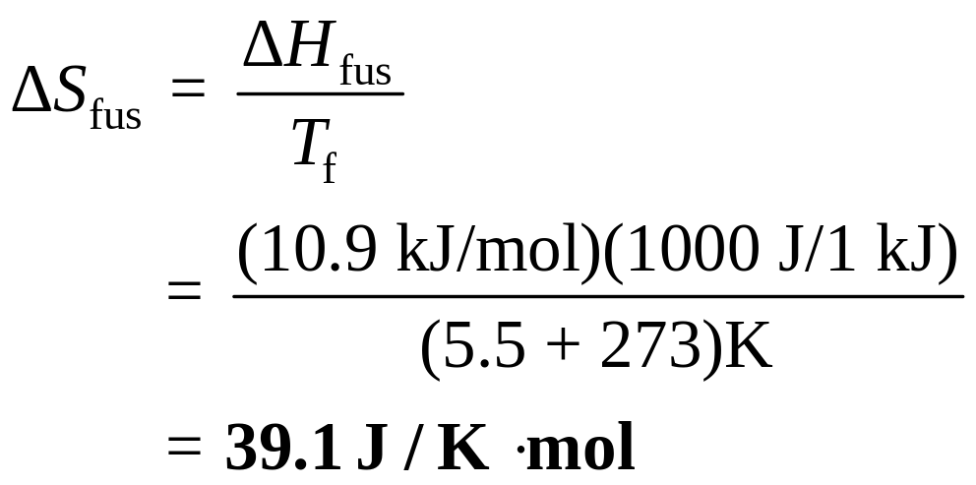
17.5
Solution
The entropy change for melting 1 mole of benzene at 5.5°C is

Slide 42
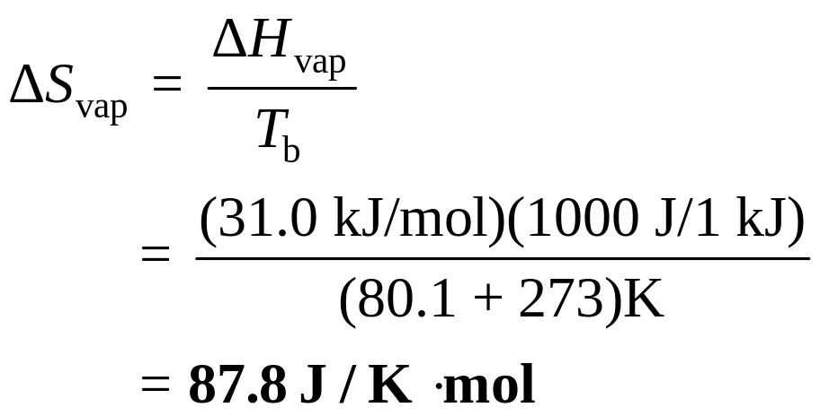
17.5
Similarly, the entropy change for boiling 1 mole of benzene at 80.1°C is
Check Because vaporization creates more microstates than the melting process, ΔS_{vap} > ΔS_{fus}.

Slide 43
Gibbs Free Energy and Chemical Equilibrium
ΔG = ΔG⁰ + RT lnQ
R is the gas constant (8.314 J/K•mol)
T is the absolute temperature (K)
Q is the reaction quotient
At Equilibrium
ΔG = 0
Q = K
0 = ΔG⁰ + RT lnK
ΔG⁰ = − RT lnK

Slide 44
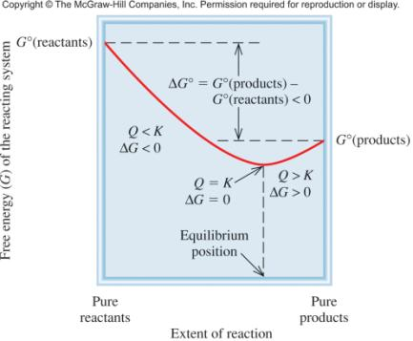
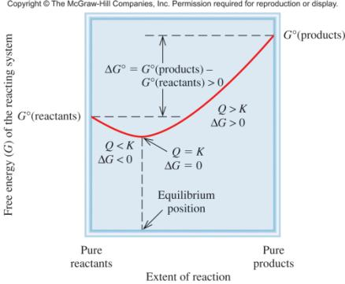
Free Energy Versus Extent of Reaction
ΔG⁰ < 0
ΔG⁰ > 0

Slide 45
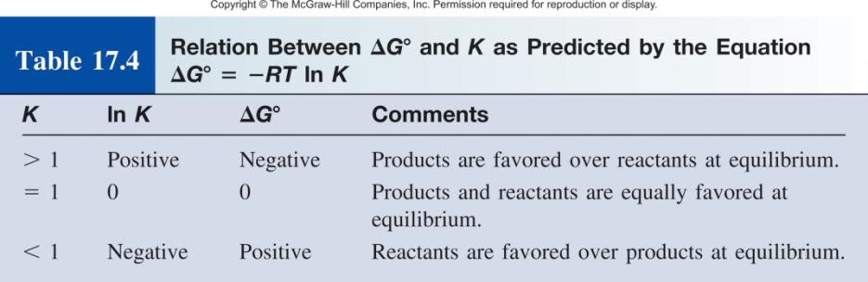
ΔG⁰ = − RT lnK

Slide 46
17.6
Using data listed in Appendix 3, calculate the equilibrium constant (K_{P}) for the following reaction at 25°C:
2H₂O(l) 2H₂(g) + O₂(g)

Slide 47
17.6
Strategy
According to Equation (17.14), the equilibrium constant for the reaction is related to the standard free-energy change; that is, ΔG° = -RT ln K. Therefore, we first need to calculate ΔG° by following the procedure in Example 17.4. Then we can
calculate K_{P}. What temperature unit should be used?

Slide 48
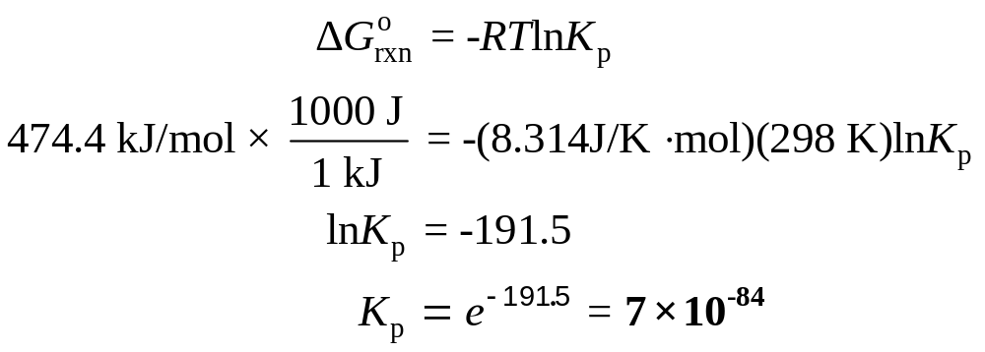
17.6
Solution According to Equation (17.12),
ΔG°_{rxn} = [2ΔG°_{f}(H₂) + ΔG°_{f}(O₂)] - [2ΔG°_{f}(H₂O)]
= [(2)(0 kJ/mol) + (0 kJ/mol)] - [(2)(-237.2 kJ/mol)]
= 474.4 kJ/mol
Using Equation (17.14)

Slide 49
17.6
Comment
This extremely small equilibrium constant is consistent with the fact that water does not spontaneously decompose into hydrogen and oxygen gases at 25°C. Thus, a large positive ΔG° favors reactants over products at equilibrium.

Slide 50
17.7
In Chapter 16 we discussed the solubility product of slightly soluble substances. Using the solubility product of silver chloride at 25°C (1.6 x 10⁻¹⁰), calculate ΔG° for the process
AgCl(s) Ag⁺(aq) + Cl⁻(aq)

Slide 51
17.7
Strategy
According to Equation (17.14), the equilibrium constant for the reaction is related to standard free-energy change; that is,
ΔG° = -RT ln K. Because this is a heterogeneous equilibrium, the solubility product (K_{sp}) is the equilibrium constant. We calculate the standard free-energy change from the K_{sp} value of AgCl. What temperature unit should be used?

Slide 52
17.7
Solution The solubility equilibrium for AgCl is
AgCl(s) Ag⁺(aq) + Cl⁻(aq)
K_{sp} = [Ag⁺][Cl⁻] = 1.6 x 10⁻¹⁰
Using Equation (17.14) we obtain
ΔG° = -(8.314 J/K·mol) (298 K) ln (1.6 x 10⁻¹⁰)
= 5.6 x 10⁴ J/mol
= 56 kJ/mol
Check The large, positive ΔG° indicates that AgCl is slightly soluble and that the equilibrium lies mostly to the left.

Slide 53
17.8
The equilibrium constant (K_{P}) for the reaction
N₂O₄(g) 2NO₂(g)
is 0.113 at 298 K, which corresponds to a standard free-energy change of 5.40 kJ/mol. In a certain experiment, the initial pressures are P_{NO2} = 0.122 atm and P_{N2O4} = 0.453 atm.
Calculate ΔG for the reaction at these pressures and predict the direction of the net reaction toward equilibrium.

Slide 54
17.8
Strategy
From the information given we see that neither the reactant nor the product is at its standard state of 1 atm. To determine the direction of the net reaction, we need to calculate the free-energy change under nonstandard-state conditions (ΔG) using Equation (17.13) and the given ΔG° value. Note that the partial pressures are expressed as dimensionless quantities in the reaction quotient Q_{P} because they are divided by the
standard-state value of 1 atm (see Table 17.2).

Slide 55
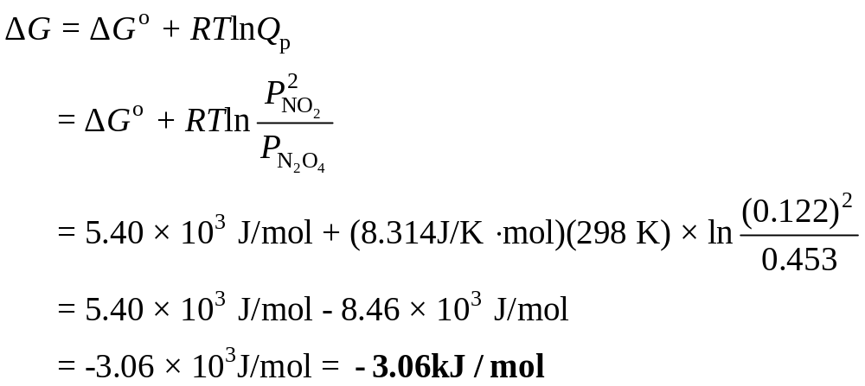
17.8
Solution Equation (17.13) can be written as
Because ΔG < 0, the net reaction proceeds from left to right to reach equilibrium.

Slide 56
17.8
Check
Note that although ΔG° > 0, the reaction can be made to favor product formation initially by having a small concentration (pressure) of the product compared to that of the reactant. Confirm the prediction by showing that Q_{P} < K_{P}.

Slide 57
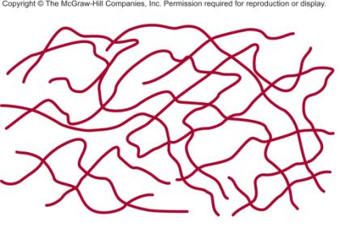

Chemistry In Action: The Thermodynamics of a Rubber Band
TΔS = ΔH - ΔG
High Entropy
Low Entropy

Slide 58
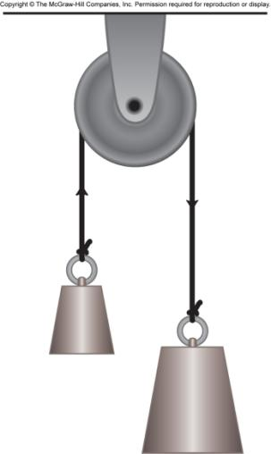
Mechanical Analog of Coupled Reactions
Make the smaller weight move upward (a nonspontaneous process) by coupling it with the falling of a larger weight.

Slide 59
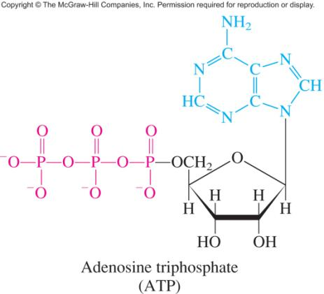
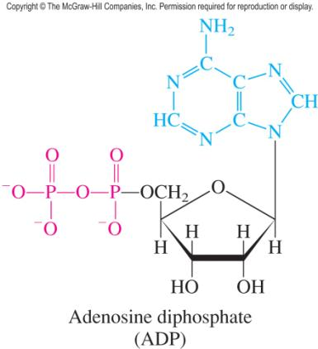
The Structure of ATP and ADP in Ionized Forms

Slide 60
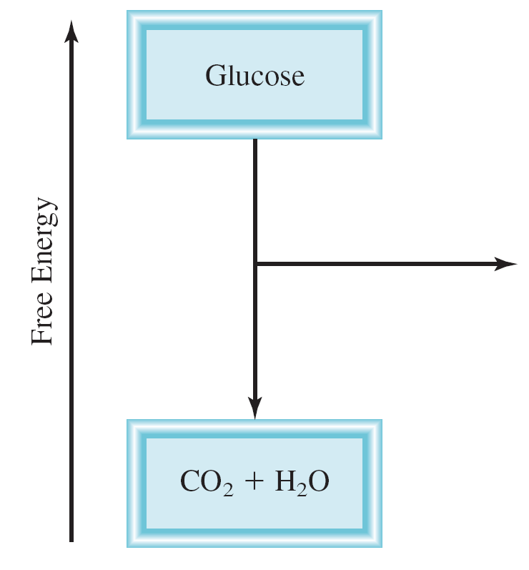
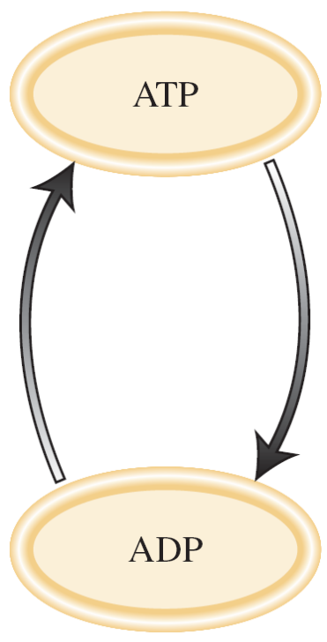
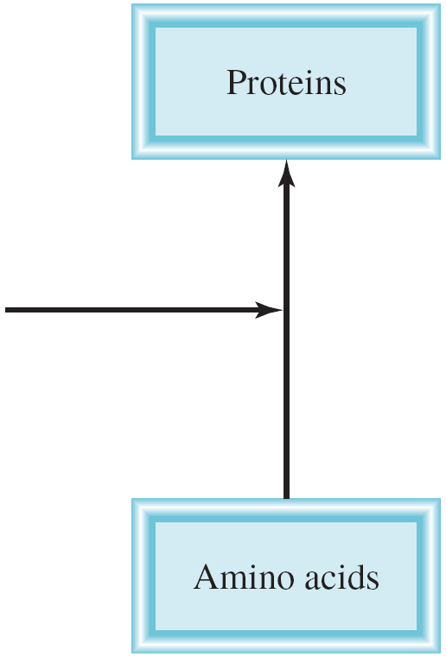
Coupled Reactions
Example:
Alanine + Glycine Alanylglycine
ΔG⁰ = +29 kJ
K < 1
ATP + H₂O + Alanine + Glycine ADP + H₃PO₄ + Alanylglycine
ΔG⁰ = -2 kJ
K > 1

