Slide 1
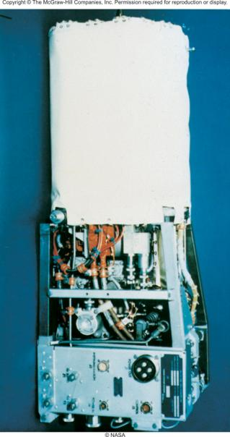
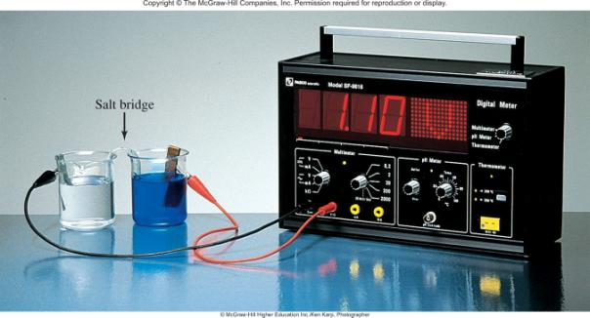

Electrochemistry
Chapter 18
Copyright © The McGraw-Hill Companies, Inc. Permission required for reproduction or display.

Slide 2
Electrochemical processes are oxidation-reduction reactions in which:
the energy released by a spontaneous reaction is converted to electricity or
electrical energy is used to cause a nonspontaneous reaction to occur
0
0
2+
2-
2Mg (s) + O₂ (g) 2MgO (s)
2Mg 2Mg²⁺ + 4e⁻
Oxidation half-reaction (lose e⁻)
O₂ + 4e⁻ 2O²⁻
Reduction half-reaction (gain e⁻)

Slide 3
Oxidation number
The charge the atom would have in a molecule (or an
ionic compound) if electrons were completely transferred.
Free elements (uncombined state) have an oxidation number of zero.
Na, Be, K, Pb, H₂, O₂, P₄ = 0
In monatomic ions, the oxidation number is equal to the charge on the ion.
Li⁺, Li = +1; Fe³⁺, Fe = +3; O²⁻, O = -2
The oxidation number of oxygen is usually –2. In H₂O₂ and O₂²⁻ it is –1.

Slide 4
The oxidation number of hydrogen is +1 except when it is bonded to metals in binary compounds. In these cases, its oxidation number is –1.
Group IA metals are +1, IIA metals are +2 and fluorine is always –1.
6. The sum of the oxidation numbers of all the atoms in a molecule or ion is equal to the charge on the molecule or ion.

Slide 5
Balancing Redox Equations
The oxidation of Fe²⁺ to Fe³⁺ by Cr₂O₇²⁻ in acid solution?
Write the unbalanced equation for the reaction in ionic form.
Fe²⁺ + Cr₂O₇²⁻ Fe³⁺ + Cr³⁺
Separate the equation into two half-reactions.
+2
+3
Oxidation:
Fe²⁺ Fe³⁺
+6
+3
Reduction:
Cr₂O₇²⁻ Cr³⁺
Balance the atoms other than O and H in each half-reaction.
Cr₂O₇²⁻ 2Cr³⁺

Slide 6
Balancing Redox Equations
For reactions in acid, add H₂O to balance O atoms and H⁺ to balance H atoms.
Cr₂O₇²⁻ 2Cr³⁺ + 7H₂O
14H⁺ + Cr₂O₇²⁻ 2Cr³⁺ + 7H₂O
Add electrons to one side of each half-reaction to balance the charges on the half-reaction.
Fe²⁺ Fe³⁺ + 1e⁻
6e⁻ + 14H⁺ + Cr₂O₇²⁻ 2Cr³⁺ + 7H₂O
If necessary, equalize the number of electrons in the two half-reactions by multiplying the half-reactions by appropriate coefficients.
6Fe²⁺ 6Fe³⁺ + 6e⁻
6e⁻ + 14H⁺ + Cr₂O₇²⁻ 2Cr³⁺ + 7H₂O

Slide 7
Balancing Redox Equations
Add the two half-reactions together and balance the final equation by inspection. The number of electrons on both sides must cancel.
Oxidation:
6Fe²⁺ 6Fe³⁺ + 6e⁻
Reduction:
6e⁻ + 14H⁺ + Cr₂O₇²⁻ 2Cr³⁺ + 7H₂O
14H⁺ + Cr₂O₇²⁻ + 6Fe²⁺ 6Fe³⁺ + 2Cr³⁺ + 7H₂O
Verify that the number of atoms and the charges are balanced.
14x1 – 2 + 6 x 2 = 24 = 6 x 3 + 2 x 3
For reactions in basic solutions, add OH⁻ to both sides of the equation for every H⁺ that appears in the final equation.

Slide 8
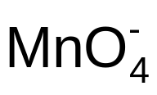
18.1
Write a balanced ionic equation to represent the oxidation of iodide ion (I⁻) by permanganate ion ( ) in basic solution to yield molecular iodine (I₂) and manganese(IV) oxide (MnO₂).

Slide 9
18.1
Strategy
We follow the preceding procedure for balancing redox equations. Note that the reaction takes place in a basic medium.
Solution
Step 1: The unbalanced equation is
+ I⁻ MnO₂ + I₂

Slide 10
18.1
Step 2: The two half-reactions are
Oxidation: I⁻ I₂
Reduction: MnO₂
-1
0
+7
+4
Step 3: We balance each half-reaction for number and type of atoms and charges. Oxidation half-reaction: We first balance the I atoms:
2I⁻ I₂

Slide 11
18.1
To balance charges, we add two electrons to the right-hand side of the equation:
2I⁻ I₂ + 2e⁻
Reduction half-reaction: To balance the O atoms, we add two H₂O molecules on the right:
MnO₂ + 2H₂O
To balance the H atoms, we add four H⁺ ions on the left:
+ 4H⁺ MnO₂ + 2H₂O

Slide 12
18.1
There are three net positive charges on the left, so we add three electrons to the same side to balance the charges:
+ 4H⁺ + 3e⁻ MnO₂ + 2H₂O
Step 4: We now add the oxidation and reduction half reactions to give the overall reaction. In order to equalize the number of electrons, we need to multiply the oxidation half-reaction by 3 and the reduction half-reaction by 2 as follows:
3(2I⁻ I₂ + 2e⁻)
2( + 4H⁺ + 3e⁻ MnO₂ + 2H₂O)
________________________________________
6I⁻ + + 8H⁺ + 6e⁻ 3I₂ + 2MnO₂ + 4H₂O + 6e⁻

Slide 13
18.1
The electrons on both sides cancel, and we are left with the balanced net ionic equation:
6I⁻ + 2 + 8H⁺ 3I₂ + 2MnO₂ + 4H₂O
This is the balanced equation in an acidic medium. However, because the reaction is carried out in a basic medium, for every H⁺ ion we need to add equal number of OH⁻ ions to both sides of the equation:
6I⁻ + 2 + 8H⁺ + 8OH⁻ 3I₂ + 2MnO₂ + 4H₂O + 8OH⁻

Slide 14
18.1
Finally, combining the H⁺ and OH⁻ ions to form water, we obtain
6I⁻ + 2 + 4H₂O 3I₂ + 2MnO₂ + 8OH⁻
Step 5: A final check shows that the equation is balanced in terms of both atoms and charges.

Slide 15
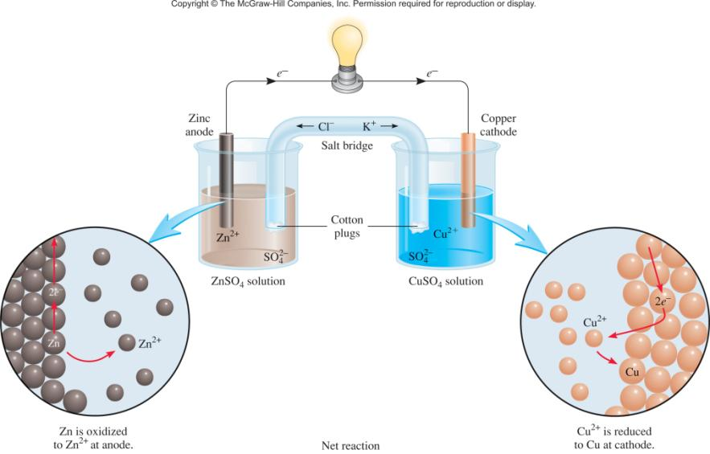



Galvanic Cells
anode
oxidation
cathode
reduction
spontaneous
redox reaction

Slide 16

Galvanic Cells
The difference in electrical potential between the anode and cathode is called:
cell voltage
electromotive force (emf)
cell potential
Zn (s) + Cu²⁺ (aq) Cu (s) + Zn²⁺ (aq)
[Cu²⁺] = 1 M and [Zn²⁺] = 1 M
Cell Diagram
phase boundary
Zn (s) | Zn²⁺ (1 M) || Cu²⁺ (1 M) | Cu (s)
anode
salt bridge
cathode

Slide 17
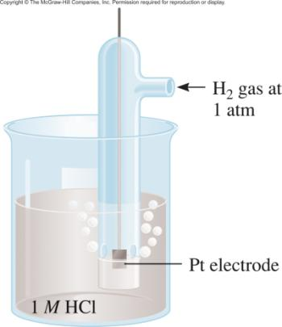
Standard Reduction Potentials
Standard reduction potential (E⁰) is the voltage associated with a reduction reaction at an electrode when all solutes are 1 M and all gases are at 1 atm.
Reduction Reaction
2e⁻ + 2H⁺ (1 M) H₂ (1 atm)
E⁰ = 0 V
Standard hydrogen electrode (SHE)

Slide 18
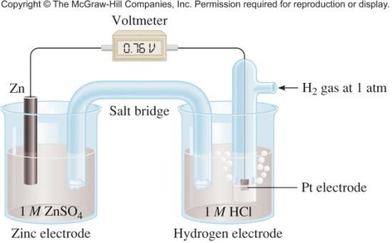
Standard Reduction Potentials
Zn (s) | Zn²⁺ (1 M) || H⁺ (1 M) | H₂ (1 atm) | Pt (s)
Anode (oxidation):
Zn (s) Zn²⁺ (1 M) + 2e⁻
Cathode (reduction):
2e⁻ + 2H⁺ (1 M) H₂ (1 atm)
Zn (s) + 2H⁺ (1 M) Zn²⁺ (1 M) + H₂ (1 atm)

Slide 19
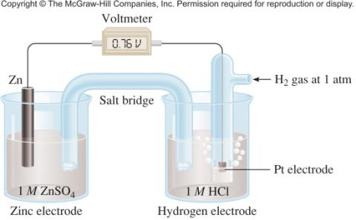
Standard Reduction Potentials
E⁰ = 0.76 V
cell
Standard emf (E⁰ )
cell
E⁰ = E_{cathode} - E_{anode}
0
0
cell
Zn (s) | Zn²⁺ (1 M) || H⁺ (1 M) | H₂ (1 atm) | Pt (s)
E⁰ = E_{H /H} - E_{Zn /Zn}
0
0
cell
+
2
2+
0.76 V = 0 - E_{Zn /Zn}
0
2+
E_{Zn /Zn} = -0.76 V
0
2+
Zn²⁺ (1 M) + 2e⁻ Zn E⁰ = -0.76 V

Slide 20
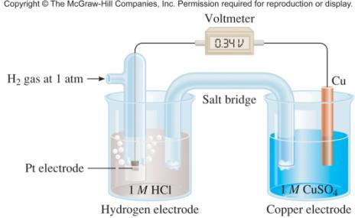
Standard Reduction Potentials
E⁰ = 0.34 V
cell
E⁰ = E_{cathode} - E_{anode}
0
0
cell
E_{cell} = E_{Cu /Cu} – E_{H /H}
0
0
2+
0
+
2
0.34 = E_{Cu /Cu} - 0
0
2+
0
E_{Cu /Cu} = 0.34 V
2+
Pt (s) | H₂ (1 atm) | H⁺ (1 M) || Cu²⁺ (1 M) | Cu (s)
Anode (oxidation):
H₂ (1 atm) 2H⁺ (1 M) + 2e⁻
Cathode (reduction):
2e⁻ + Cu²⁺ (1 M) Cu (s)
H₂ (1 atm) + Cu²⁺ (1 M) Cu (s) + 2H⁺ (1 M)

Slide 21
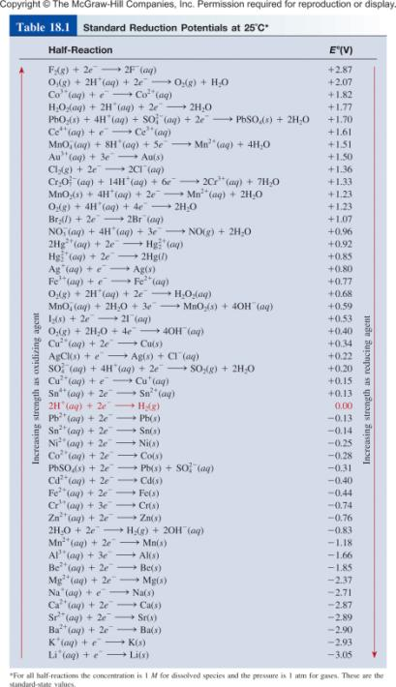
E⁰ is for the reaction as written
The more positive E⁰ the greater the tendency for the substance to be reduced
The half-cell reactions are reversible
The sign of E⁰ changes when the reaction is reversed
Changing the stoichiometric coefficients of a half-cell reaction does not change the value of E⁰

Slide 22
18.2
Predict what will happen if molecular bromine (Br₂) is added to a solution containing NaCl and NaI at 25°C. Assume all species are in their standard states.

Slide 23
18.2
Strategy To predict what redox reaction(s) will take place, we need to compare the standard reduction potentials of Cl₂, Br₂, and I₂ and apply the diagonal rule.
Solution From Table 18.1, we write the standard reduction potentials as follows:
Cl₂(1 atm) + 2e⁻ 2Cl⁻(1 M) E° = 1.36 V
Br₂(l) + 2e⁻ 2Br⁻(1 M) E° = 1.07 V
I₂(s) + 2e⁻ 2I⁻(1 M) E° = 0.53 V

Slide 24
18.2
Applying the diagonal rule we see that Br₂ will oxidize I⁻ but will not oxidize Cl⁻. Therefore, the only redox reaction that will occur appreciably under standard-state conditions is
Oxidation: 2I⁻(1 M) I₂(s) + 2e⁻
Reduction: Br₂(l) + 2e⁻ 2Br⁻(1 M)
______________________________________________
Overall: 2I⁻(1 M) + Br₂(l) I₂(s) + 2Br⁻(1 M)
Check We can confirm our conclusion by calculating E°_{cell}. Try it. Note that the Na⁺ ions are inert and do not enter into the redox reaction.

Slide 25
18.3
A galvanic cell consists of a Mg electrode in a 1.0 M Mg(NO₃)₂ solution and a Ag electrode in a 1.0 M AgNO₃ solution. Calculate the standard emf of this cell at 25°C.

Slide 26
18.3
Strategy At first it may not be clear how to assign the electrodes in the galvanic cell. From Table 18.1 we write the standard reduction potentials of Ag and Mg and apply the diagonal rule to determine which is the anode and which is the cathode.
Solution The standard reduction potentials are
Ag⁺(1.0 M) + e⁻ Ag(s) E° = 0.80 V
Mg²⁺(1.0 M) + 2e⁻ Mg(s) E° = -2.37 V

Slide 27
18.3
Applying the diagonal rule, we see that Ag⁺ will oxidize Mg:
Anode (oxidation): Mg(s) Mg²⁺(1.0 M) + 2e⁻
Cathode (reduction): 2Ag⁺(1.0 M) + 2e⁻ 2Ag(s)
_________________________________________________
Overall: Mg(s) + 2Ag⁺(1.0 M) Mg²⁺(1.0 M) + 2Ag(s)

Slide 28
18.3
Note that in order to balance the overall equation we multiplied the reduction of Ag⁺ by 2. We can do so because, as an intensive property, E° is not affected by this procedure. We find the emf of the cell by using Equation (18.1) and Table 18.1:
E°_{cell} = E°_{cathode} - E°_{anode}
= E°_{Ag+/Ag} - E°_{Mg2+/Mg}
= 0.80 V - (-2.37 V)
= 3.17 V
Check The positive value of E° shows that the forward reaction is favored.

Slide 29
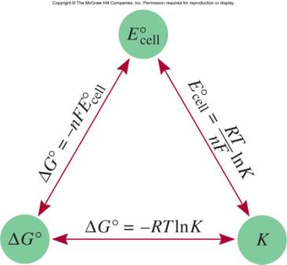
Spontaneity of Redox Reactions
ΔG = -nFE_{cell}
n = number of moles of electrons in reaction
J
ΔG⁰ = -nFE_{cell}
0
F = 96,500
= 96,500 C/mol
V • mol
ΔG⁰ = -RT ln K
0
= -nFE_{cell}
RT
(8.314 J/K•mol)(298 K)
0
=
ln K
=
ln K
E_{cell}
nF
n (96,500 J/V•mol)
0.0257 V
0
ln K
E_{cell}
=
n
0.0592 V
0
log K
E_{cell}
=
n

Slide 30
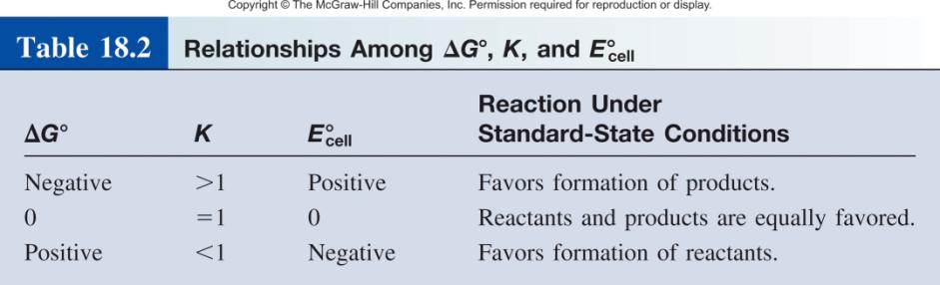
Spontaneity of Redox Reactions
ΔG⁰ = -RT ln K
0
= -nFE_{cell}

Slide 31
18.4
Calculate the equilibrium constant for the following reaction at 25°C:
Sn(s) + 2Cu²⁺(aq) Sn²⁺(aq) + 2Cu⁺(aq)

Slide 32
18.4
Strategy
The relationship between the equilibrium constant K and the standard emf is given by Equation (18.5):
E°_{cell} = (0.0257 V/n)ln K
Thus, if we can determine the standard emf, we can calculate the equilibrium constant. We can determine the E°_{cell} of a hypothetical galvanic cell made up of two couples (Sn²⁺/Sn and Cu²⁺/Cu⁺) from the standard reduction potentials in Table 18.1.

Slide 33
18.4
Solution
The half-cell reactions are
Anode (oxidation): Sn(s) Sn²⁺(aq) + 2e⁻
Cathode (reduction): 2Cu²⁺(aq) + 2e⁻ 2Cu⁺(aq)
E°_{cell} = E°_{cathode} - E°_{anode}
= E°_{Cu2+/Cu+} - E°_{Sn2+/Sn}
= 0.15 V - (-0.14 V)
= 0.29 V

Slide 34
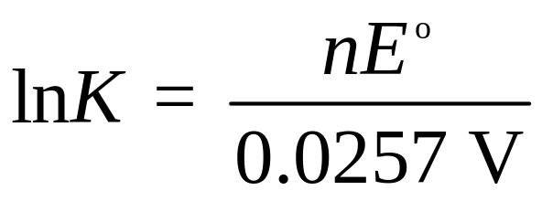
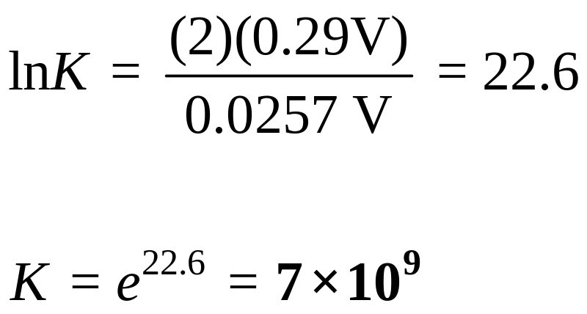
18.4
Equation (18.5) can be written
In the overall reaction we find n = 2. Therefore,

Slide 35
18.5
Calculate the standard free-energy change for the following reaction at 25°C:
2Au(s) + 3Ca²⁺(1.0 M) 2Au³⁺(1.0 M) + 3Ca(s)

Slide 36
18.5
Strategy
The relationship between the standard free energy change and the standard emf of the cell is given by Equation (18.3):
ΔG° = -nFE°_{cell}. Thus, if we can determine E°_{cell}, we can calculate ΔG°. We can determine the E°_{cell} of a hypothetical
galvanic cell made up of two couples (Au³⁺/Au and Ca²⁺/Ca) from the standard reduction potentials in Table 18.1.

Slide 37
18.5
Solution
The half-cell reactions are
Anode (oxidation): 2Au(s) 2Au³⁺(1.0 M) + 6e⁻
Cathode (reduction): 3Ca²⁺(1.0 M) + 6e⁻ 3Ca(s)
E°_{cell} = E°_{cathode} - E°_{anode}
= E°_{Ca2+/Ca} - E°_{Au3+/Au}
= -2.87 V - 1.50 V
= -4.37 V

Slide 38
18.5
Now we use Equation (18.3):
ΔG° = -nFE°
The overall reaction shows that n = 6, so
G° = -(6) (96,500 J/V · mol) (-4.37 V)
= 2.53 x 10⁶ J/mol
= 2.53 x 10³ kJ/mol
Check The large positive value of ΔG° tells us that the reaction favors the reactants at equilibrium. The result is consistent with the fact that E° for the galvanic cell is negative.

Slide 39
The Effect of Concentration on Cell Emf
ΔG = ΔG⁰ + RT ln Q
ΔG = -nFE
ΔG⁰ = -nFE
0
-nFE = -nFE⁰ + RT ln Q
Nernst equation
RT
E = E⁰ -
ln Q
nF
At 298 K
0.0257 V
0.0592 V
E =
0
ln Q
0
log Q
E
E =
-
E
-
n
n

Slide 40
18.6
Predict whether the following reaction would proceed spontaneously as written at 298 K:
Co(s) + Fe²⁺(aq) Co²⁺(aq) + Fe(s)
given that [Co²⁺] = 0.15 M and [Fe²⁺] = 0.68 M.

Slide 41
18.6
Strategy
Because the reaction is not run under standard-state conditions (concentrations are not 1 M), we need Nernst’s equation [Equation (18.8)] to calculate the emf (E) of a hypothetical galvanic cell and determine the spontaneity of the reaction. The standard emf (E°) can be calculated using the standard reduction potentials in Table 18.1. Remember that solids do not appear in the reaction quotient (Q) term in the Nernst equation. Note that 2 moles of electrons are transferred per mole of reaction, that is, n = 2.

Slide 42
18.6
Solution
The half-cell reactions are
Anode (oxidation): Co(s) Co²⁺(aq) + 2e⁻
Cathode (reduction): Fe²⁺(aq) + 2e⁻ Fe(s)
E°_{cell} = E°_{cathode} - E°_{anode}
= E°_{Fe2+/Fe} - E°_{Co2+/Co}
= -0.44 V – (-0.28 V)
= -0.16 V

Slide 43
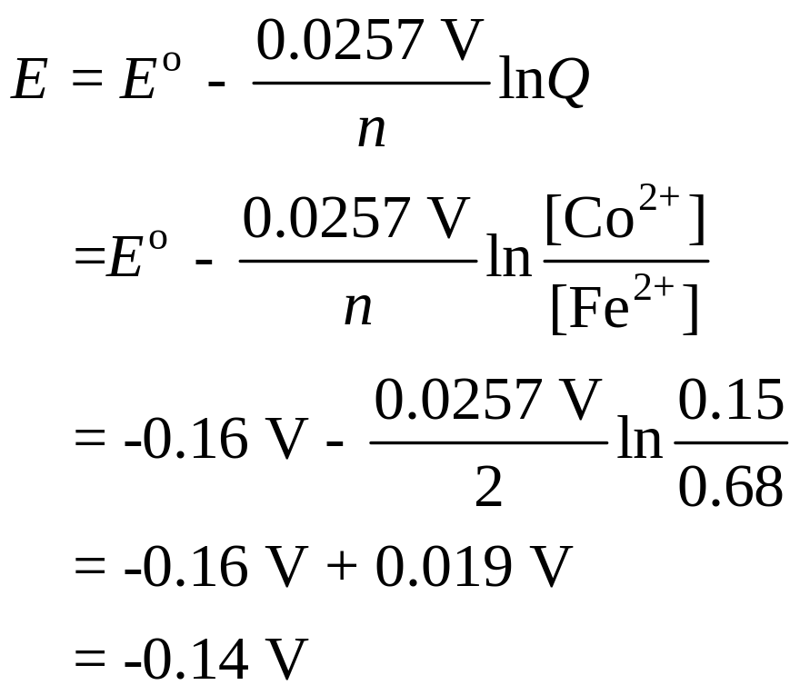
18.6
From Equation (18.8) we write
Because E is negative, the reaction is not spontaneous in the direction written.

Slide 44
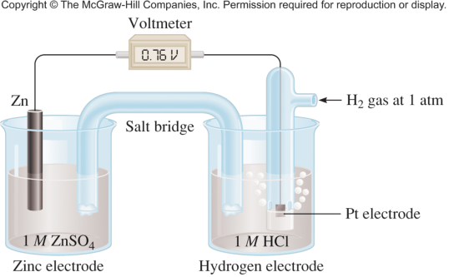
18.7
Consider the galvanic cell shown in Figure 18.4(a). In a certain experiment, the emf (E) of the cell is found to be 0.54 V at 25°C. Suppose that [Zn²⁺] = 1.0 M and P_{H2} = 1.0 atm. Calculate the molar concentration of H⁺.

Slide 45
18.7
Strategy
The equation that relates standard emf and nonstandard emf is the Nernst equation. The overall cell reaction is
Zn(s) + 2H⁺(? M) Zn²⁺(1.0 M) + H₂(1.0 atm)
Given the emf of the cell (E), we apply the Nernst equation to solve for [H⁺]. Note that 2 moles of electrons are transferred per mole of reaction; that is, n = 2.

Slide 46
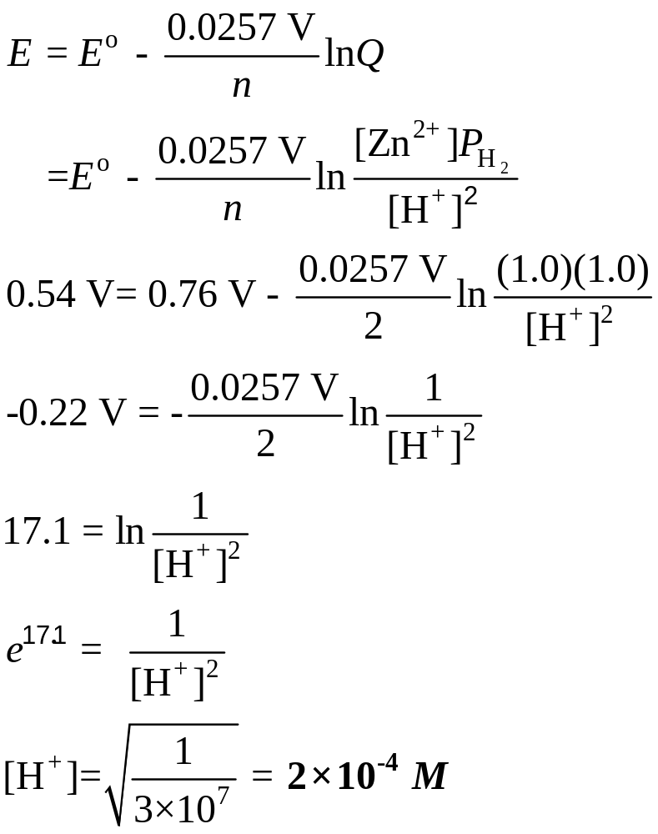
18.7
Solution As we saw earlier, the standard emf (E°) for the cell is 0.76 V. From Equation (18.8) we write

Slide 47
18.7
Check
The fact that the nonstandard-state emf (E) is given in the problem means that not all the reacting species are in their standard-state concentrations. Thus, because both Zn²⁺ ions and H₂ gas are in their standard states, [H⁺] is not 1 M.

Slide 48

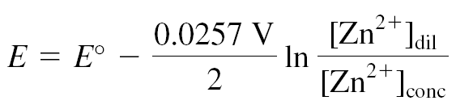
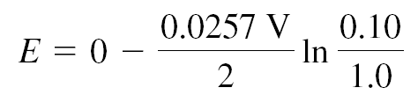

Concentration Cells
Galvanic cell from two half-cells composed of the same material but differing in ion concentrations.

Slide 49
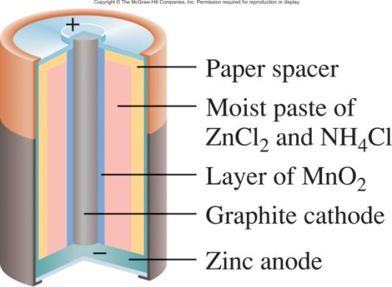
Batteries
Dry cell
Leclanché cell
Anode:
Zn (s) Zn²⁺ (aq) + 2e⁻
Cathode:
+
2NH₄ (aq) + 2MnO₂ (s) + 2e⁻ Mn₂O₃ (s) + 2NH₃ (aq) + H₂O (l)
Zn (s) + 2NH₄⁺ (aq) + 2MnO₂ (s) Zn²⁺ (aq) + 2NH₃ (aq) + H₂O (l) + Mn₂O₃(s)

Slide 50
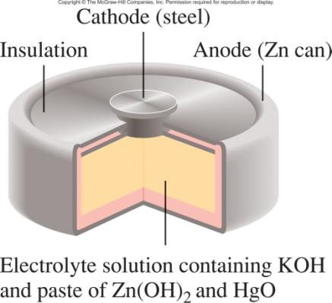
Batteries
Mercury Battery
Anode:
Zn(Hg) + 2OH⁻ (aq) ZnO (s) + H₂O (l) + 2e⁻
Cathode:
HgO (s) + H₂O (l) + 2e⁻ Hg (l) + 2OH⁻ (aq)
Zn(Hg) + HgO (s) ZnO (s) + Hg (l)

Slide 51
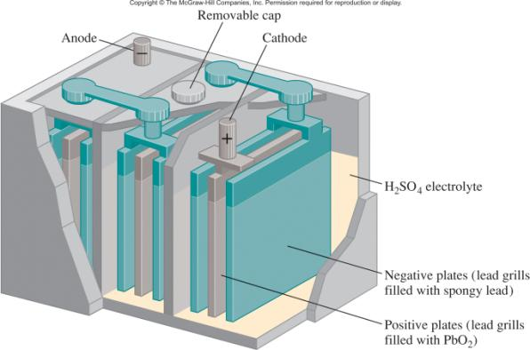
Batteries
Lead storage
battery
Anode:
Pb (s) + SO²⁻ (aq) PbSO₄ (s) + 2e⁻
4
Cathode:
PbO₂ (s) + 4H⁺ (aq) + SO²⁻ (aq) + 2e⁻ PbSO₄ (s) + 2H₂O (l)
4
Pb (s) + PbO₂ (s) + 4H⁺ (aq) + 2SO²⁻ (aq) 2PbSO₄ (s) + 2H₂O (l)
4

Slide 52
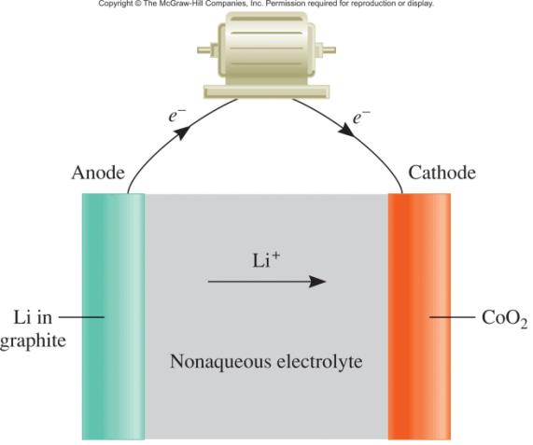


Batteries
Solid State Lithium Battery

Slide 53
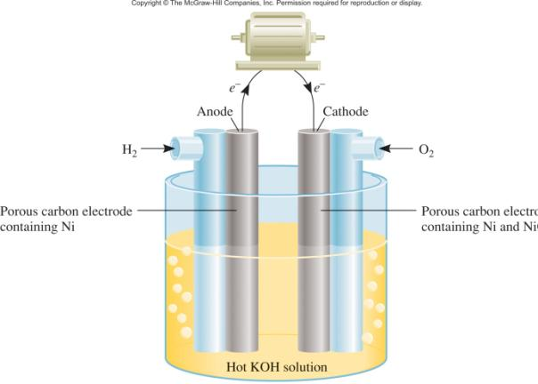
Batteries
A fuel cell is an electrochemical cell that requires a continuous supply of reactants to keep functioning
Anode:
2H₂ (g) + 4OH⁻ (aq) 4H₂O (l) + 4e⁻
Cathode:
O₂ (g) + 2H₂O (l) + 4e⁻ 4OH⁻ (aq)
2H₂ (g) + O₂ (g) 2H₂O (l)

Slide 54
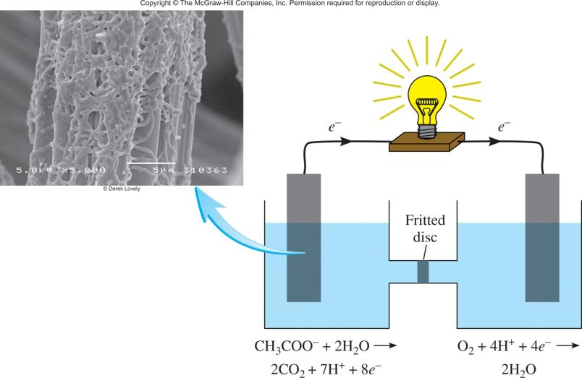
Chemistry In Action: Bacteria Power
CH₃COO⁻ + 2O₂ + H⁺ 2CO₂ + 2H₂O

Slide 55
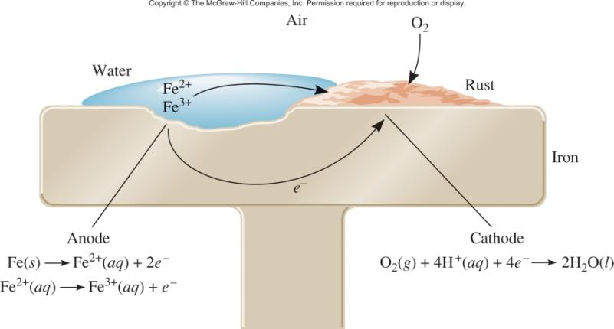
Corrosion
Corrosion is the term usually applied to the deterioration of metals by an electrochemical process.

Slide 56
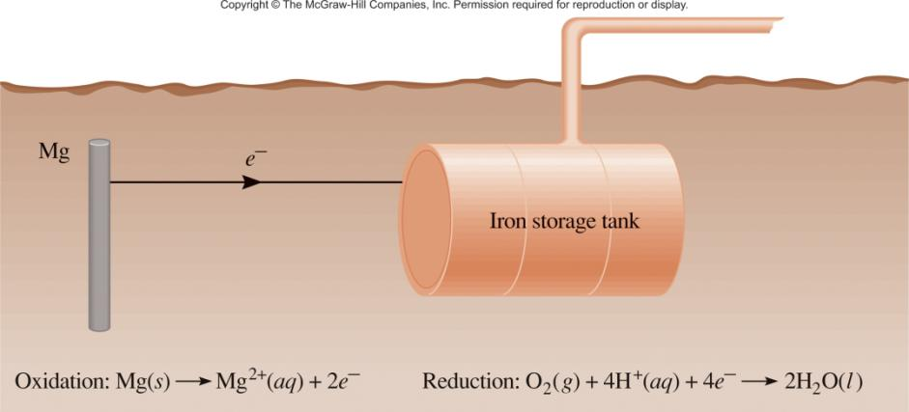
Cathodic Protection of an Iron Storage Tank

Slide 57
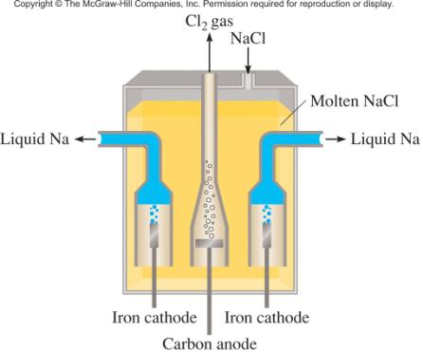
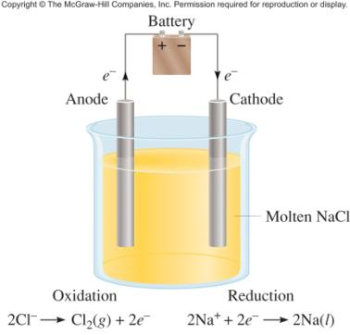



Electrolysis is the process in which electrical energy is used to cause a nonspontaneous chemical reaction to occur.
Electrolysis of molten NaCl

Slide 58
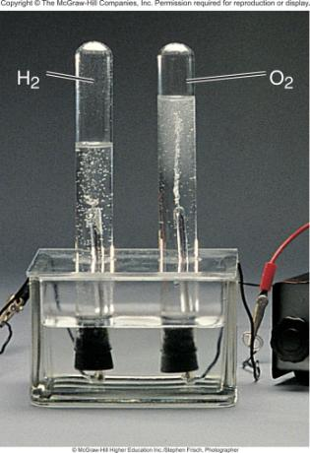
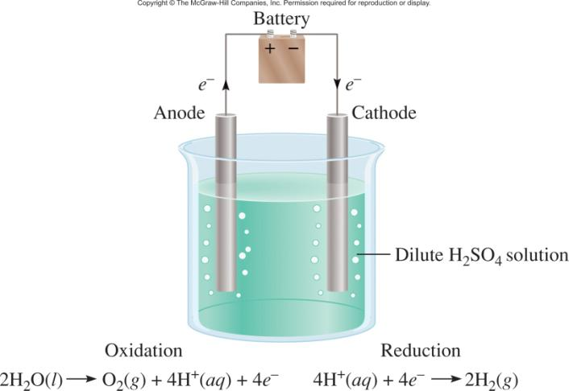
Electrolysis of Water

Slide 59
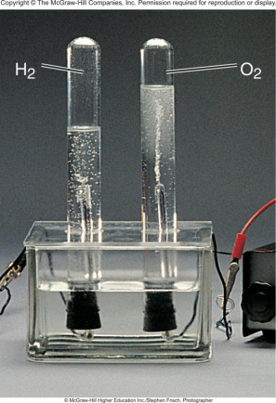
18.8
An aqueous Na₂SO₄ solution is electrolyzed, using the apparatus shown in Figure 18.18. If the products formed at the anode and cathode are oxygen gas and hydrogen gas,
respectively, describe the electrolysis in terms of the reactions at the electrodes.

Slide 60
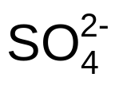
18.8
Strategy
Before we look at the electrode reactions, we should consider the following facts: (1) Because Na₂SO₄ does not hydrolyze, the pH of the solution is close to 7. (2) The Na⁺ ions are not reduced at the cathode and the ions are not oxidized at the anode. These conclusions are drawn from the electrolysis of water in the presence of sulfuric acid and in aqueous sodium chloride solution, as discussed earlier. Therefore, both the oxidation and reduction reactions involve only water molecules.

Slide 61
18.8
Solution
The electrode reactions are
Anode: 2H₂O(l) O₂(g) + 4H⁺(aq) + 4e⁻
Cathode: 2H₂O(l) + 2e⁻ H₂(g) + 2OH⁻(aq)
The overall reaction, obtained by doubling the cathode reaction coefficients and adding the result to the anode reaction, is
6H₂O(l) 2H₂(g) + O₂(g) + 4H⁺(aq) + 4OH⁻(aq)

Slide 62
18.8
If the H⁺ and OH⁻ ions are allowed to mix, then
4H⁺(aq) + 4OH⁻(aq) 4H₂O(l)
and the overall reaction becomes
2H₂O(l) 2H₂(g) + O₂(g)

Slide 63
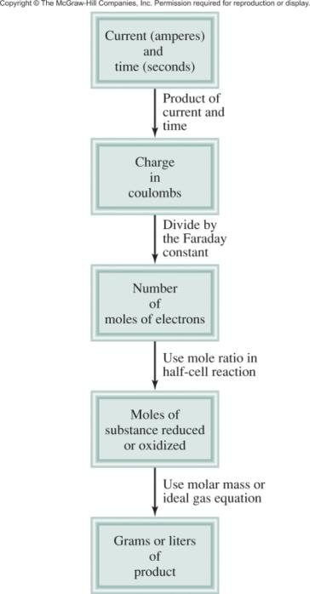
Electrolysis and Mass Changes
charge (C) = current (A) x time (s)
1 mol e⁻ = 96,500 C

Slide 64
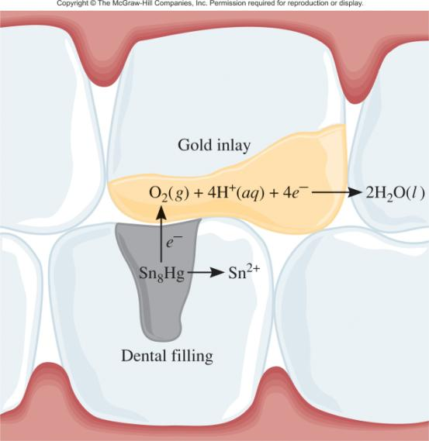
Chemistry In Action: Dental Filling Discomfort
2+
Hg₂ /Ag₂Hg₃ 0.85 V
2+
Sn /Ag₃Sn -0.05 V
2+
Sn /Ag₃Sn -0.05 V

Slide 65
18.9
A current of 1.26 A is passed through an electrolytic cell containing a dilute sulfuric acid solution for 7.44 h. Write the half-cell reactions and calculate the volume of gases generated at STP.

Slide 66

18.9
Strategy
Earlier we saw that the half-cell reactions for the process are
Anode (oxidation): 2H₂O(l) O₂(g) + 4H⁺(aq) + 4e⁻
Cathode (reduction): 4[H⁺(aq) + e⁻ H₂(g)]
__________________________________________________
Overall: 2H₂O(l) 2H₂(g) + O₂(g)

Slide 67
18.9
According to Figure 18.20, we carry out the following conversion steps to calculate the quantity of O₂ in moles:
current x time → coulombs → moles of e⁻ → moles of O₂
Then, using the ideal gas equation we can calculate the volume of O₂ in liters at STP. A similar procedure can be used for H₂.

Slide 68
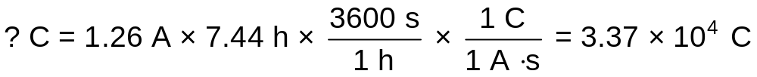
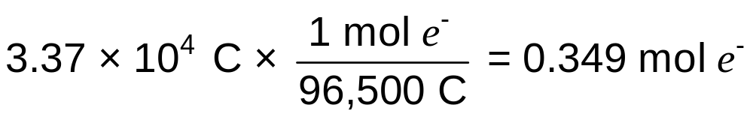
18.9
Solution
First we calculate the number of coulombs of electricity that pass through the cell:
Next, we convert number of coulombs to number of moles of electrons

Slide 69
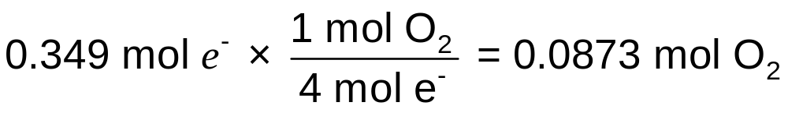
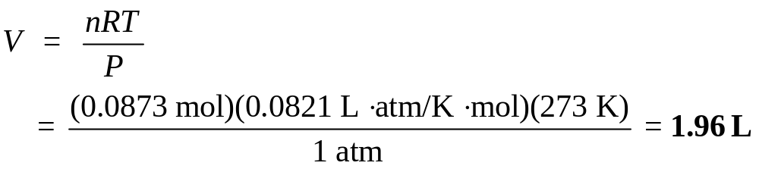
18.9
From the oxidation half-reaction we see that 1 mol O₂ =
4 mol e⁻. Therefore, the number of moles of O₂ generated is
The volume of 0.0873 mol O₂ at STP is given by

Slide 70
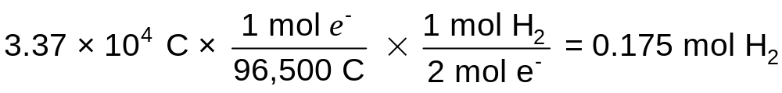
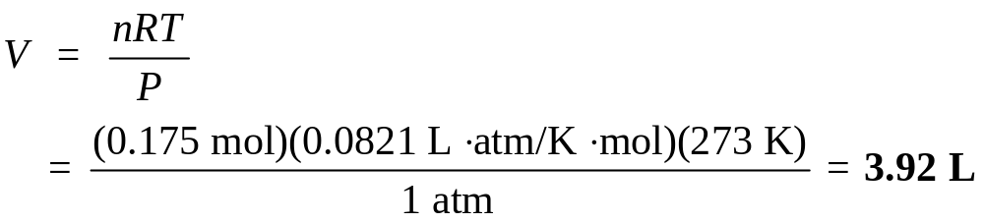
18.9
The procedure for hydrogen is similar. To simplify, we combine the first two steps to calculate the number of moles of H₂ generated:
The volume of 0.175 mol H₂ at STP is given by

Slide 71
18.9
Check
Note that the volume of H₂ is twice that of O₂ (see Figure 18.18), which is what we would expect based on Avogadro’s law (at the same temperature and pressure, volume is directly proportional to the number of moles of gases).

