Slide 1
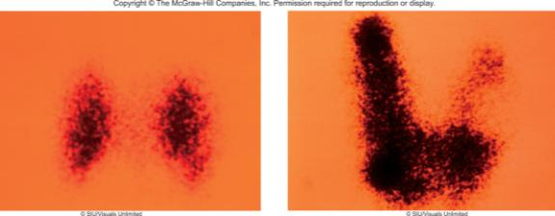

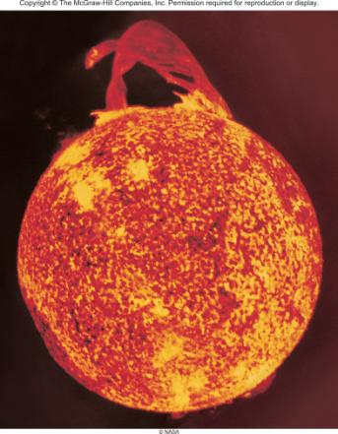
Nuclear Chemistry
Chapter 19
Copyright © The McGraw-Hill Companies, Inc. Permission required for reproduction or display.

Slide 2
Review
Atomic number (Z) = number of protons in nucleus
Mass number (A) = number of protons + number of neutrons
= atomic number (Z) + number of neutrons
Mass Number
A
X
Z
Element Symbol
Atomic Number
proton
neutron
electron
positron
α particle
¹p
or
¹H
¹n
⁰e
or
⁰β
⁰e
or
⁰β
⁴He
or
⁴α
1
1
0
-1
-1
+1
+1
2
2
A
1
1
0
0
4
Z
1
0
-1
+1
2

Slide 3
Balancing Nuclear Equations
Conserve mass number (A).
The sum of protons plus neutrons in the products must equal the sum of protons plus neutrons in the reactants.
235
U
+
¹n
138
Cs
+
96
Rb
+ 2
¹n
92
0
55
37
0
235 + 1 = 138 + 96 + 2x1
Conserve atomic number (Z) or nuclear charge.
The sum of nuclear charges in the products must equal the sum of nuclear charges in the reactants.
235
U
+
¹n
138
Cs
+
96
Rb
+ 2
¹n
92
0
55
37
0
92 + 0 = 55 + 37 + 2x0

Slide 4
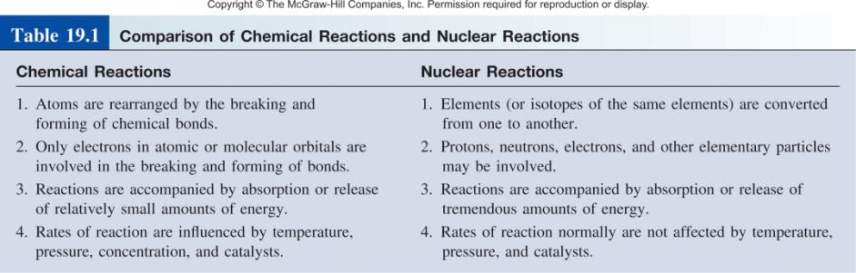

Slide 5
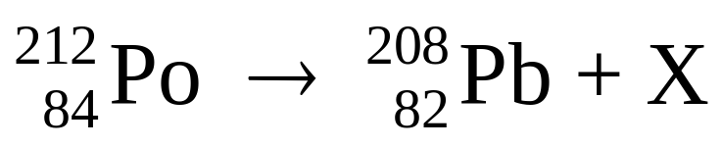
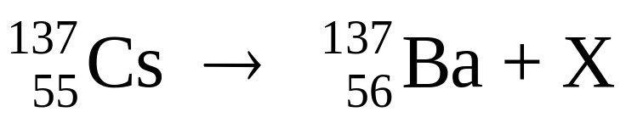
19.1
Balance the following nuclear equations (that is, identify the product X):
(a)
(b)

Slide 6
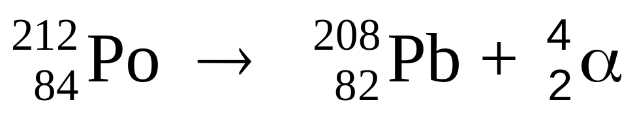
19.1
Strategy
In balancing nuclear equations, note that the sum of atomic numbers and that of mass numbers must match on both sides of the equation.
Solution
(a) The mass number and atomic number are 212 and 84, respectively, on the left-hand side and 208 and 82, respectively, on the right-hand side. Thus, X must have a mass number of 4 and an atomic number of 2, which means that it is an α particle. The balanced equation is

Slide 7
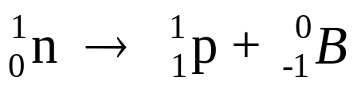
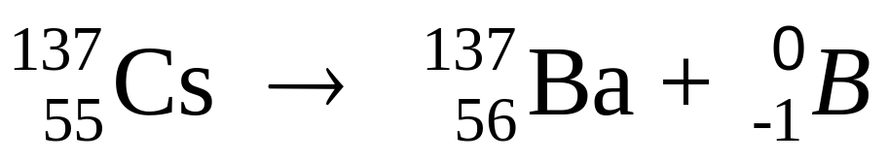
19.1
(b) In this case, the mass number is the same on both sides of the equation, but the atomic number of the product is 1 more than that of the reactant. Thus, X must have a mass number of 0 and an atomic number of -1, which means that it is a β particle. The only way this change can come about is to have a neutron in the Cs nucleus transformed into a proton and an electron; that is, (note that this process does not alter the mass number). Thus, the balanced equation is

Slide 8
19.1
Check
Note that the equation in (a) and (b) are balanced for nuclear particles but not for electrical charges. To balance the charges, we would need to add two electrons on the right-hand side of (a) and express barium as a cation (Ba⁺) in (b).

Slide 9
Nuclear Stability
Certain numbers of neutrons and protons are extra stable
  n or p = 2, 8, 20, 50, 82 and 126
  Like extra stable numbers of electrons in noble gases (e⁻ = 2, 10, 18, 36, 54 and 86)
Nuclei with even numbers of both protons and neutrons are more stable than those with odd numbers of neutrons and protons
All isotopes of the elements with atomic numbers higher than 83 are radioactive
All isotopes of Tc and Pm are radioactive

Slide 10
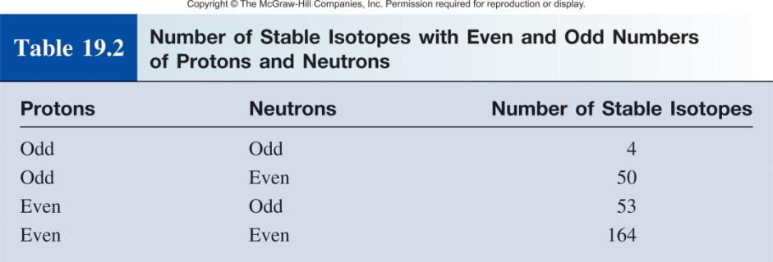

Slide 11
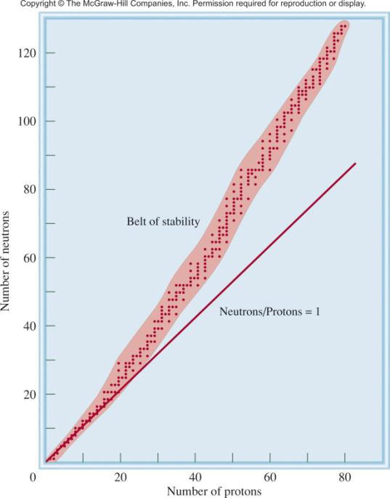
n/p too large
beta decay
X
Y
n/p too small
positron decay or electron capture

Slide 12
Nuclear Stability and Radioactive Decay
Beta decay
¹⁴C ¹⁴N + ⁰β
Decrease # of neutrons by 1
6
7
-1
⁴⁰K ⁴⁰Ca + ⁰β
Increase # of protons by 1
19
20
-1
¹n ¹p + ⁰β
0
1
-1
Positron decay
¹¹C ¹¹B + ⁰β
Increase # of neutrons by 1
6
5
+1
³⁸K ³⁸Ar + ⁰β
Decrease # of protons by 1
19
18
+1
¹p ¹n + ⁰β
1
0
+1

Slide 13
Nuclear Stability and Radioactive Decay
Electron capture decay
³⁷Ar + ⁰e ³⁷Cl
Increase number of neutrons by 1
18
-1
17
⁵⁵Fe + ⁰e ⁵⁵Mn
Decrease number of protons by 1
26
-1
25
¹p + ⁰e ¹n
1
-1
0
Alpha decay
Decrease number of neutrons by 2
²¹²Po ⁴He + ²⁰⁸Pb
84
2
82
Decrease number of protons by 2
Spontaneous fission
²⁵²Cf 2¹²⁵In + 2¹n
98
49
0

Slide 14
Nuclear binding energy is the energy required to break up a nucleus into its component protons and neutrons.
Nuclear binding energy + ¹⁹F 9¹p + 10¹n
9
1
0
ΔE = (Δm)c²
9 x (p mass) + 10 x (n mass) = 19.15708 amu
Δm= 18.9984 amu – 19.15708 amu
Δm = -0.1587 amu
ΔE = -0.1587 amu x (3.00 x 10⁸ m/s)²
= -1.43 x 10¹⁶ amu m²/s²
Using conversion factors:
1 kg = 6.022 x 10²⁶ amu
1 J = kg m²/s²
ΔE = -2.37 x 10⁻¹¹J

Slide 15
ΔE = (-2.37 x 10⁻¹¹J) x (6.022 x 10²³/mol)
ΔE = -1.43 x 10¹³J/mol
ΔE = -1.43 x 10¹⁰kJ/mol
Nuclear binding energy = 1.43 x 10¹⁰kJ/mol
binding energy
binding energy per nucleon =
number of nucleons
2.37 x 10⁻¹¹ J
=
19 nucleons
= 1.25 x 10⁻¹² J/nucleon

Slide 16
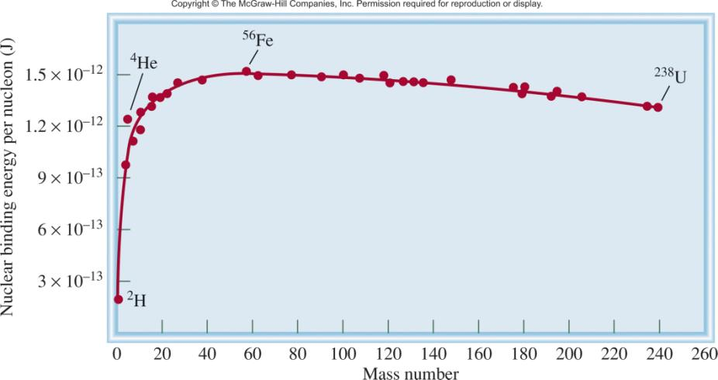
Nuclear binding energy per nucleon vs mass number
nuclear binding energy
nucleon
nuclear stability

Slide 17
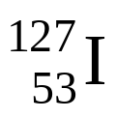
19.2
The atomic mass of is 126.9004 amu. Calculate the nuclear binding energy of this nucleus and the corresponding nuclear binding energy per nucleon.

Slide 18

19.2
Strategy
To calculate the nuclear binding energy, we first determine the
difference between the mass of the nucleus and the mass of all the protons and neutrons, which gives us the mass defect. Next, we apply Equation (19.2) [ΔE = (Δm)c²].
Solution
There are 53 protons and 74 neutrons in the iodine nucleus.
The mass of 53 atom is
53 x 1.007825 amu = 53.41473 amu
and the mass of 74 neutrons is
74 x 1.008665 amu = 74.64121 amu

Slide 19
19.2
Therefore, the predicted mass for is 53.41473 + 74.64121 = 128.05594 amu, and the mass defect is
Δm = 126.9004 amu - 128.05594 amu
= -1.1555 amu
The energy released is
ΔE = (Δm)c²
= (-1.1555 amu) (3.00 x 10⁸ m/s)²
= -1.04 x 10¹⁷ amu · m²/s²

Slide 20
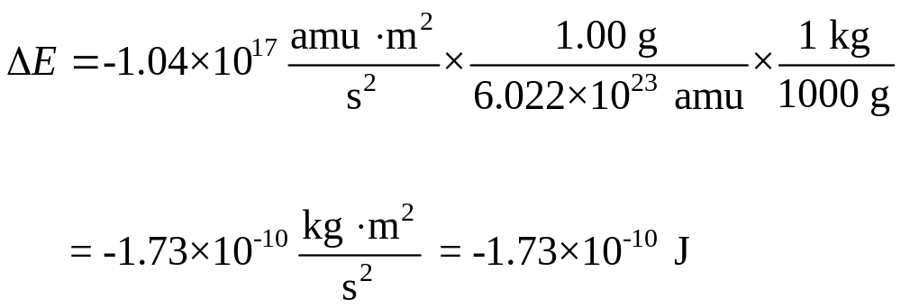
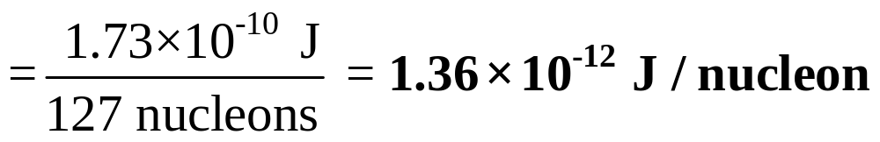
19.2
Let’s convert to a more familiar energy unit of joules. Recall that 1 J = 1 kg · m²/s². Therefore, we need to convert amu to kg:
Thus, the nuclear binding energy is 1.73 x 10⁻¹⁰ J . The nuclear binding energy per nucleon is obtained as follows:

Slide 21
Kinetics of Radioactive Decay
N daughter
rate = λN
N_{t}
ln
=
−λt
N₀
N = the number of atoms at time t
N₀ = the number of atoms at time t = 0
λ is the decay constant
0.693
t_{½}
=
λ

Slide 22
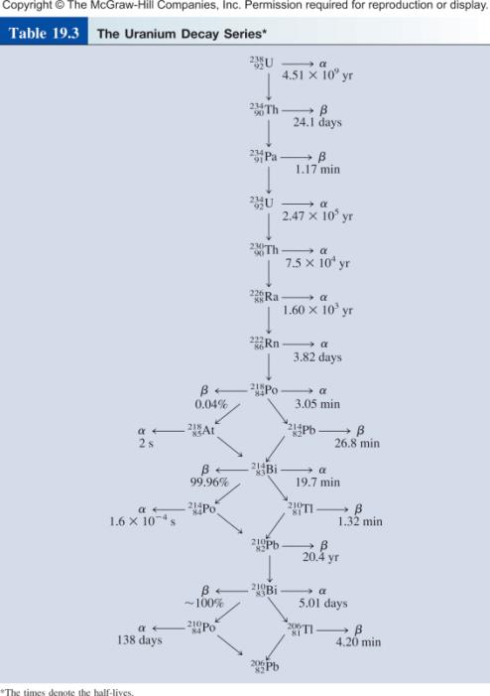

Slide 23
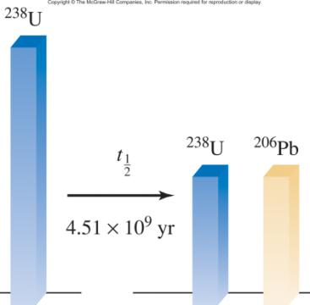
Radiocarbon Dating
¹⁴N + ¹n ¹⁴C + ¹H
7
0
6
1
¹⁴C ¹⁴N + ⁰β + ν
t_{½} = 5730 years
6
7
-1
Uranium-238 Dating
²³⁸U ²⁰⁶Pb + 8 ⁴α + 6 ⁰β
t_{½} = 4.51 x 10⁹ years
92
82
2
-1

Slide 24
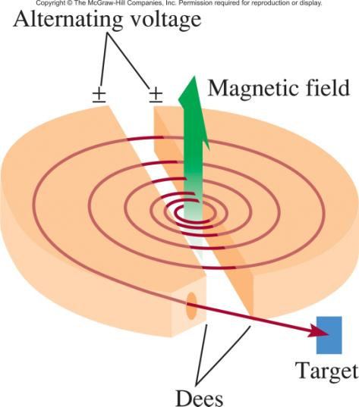
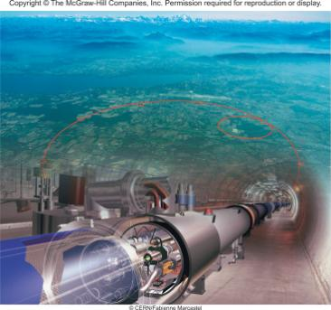
Nuclear Transmutation
¹⁴N + ⁴α ¹⁷O + ¹p
7
2
8
1
²⁷Al + ⁴α ³⁰P + ¹n
13
2
15
0
¹⁴N + ¹p ¹¹C + ⁴α
7
1
6
2

Slide 25


19.3
Write the balanced equation for the nuclear reaction
where d represents the deuterium nucleus (that is, ).

Slide 26
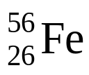
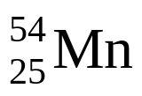
19.3
Strategy
To write the balanced nuclear equation, remember that the first isotope is the reactant and the second isotope
is the product. The first symbol in parentheses (d) is the bombarding particle and the second symbol in parentheses (α) is the particle emitted as a result of nuclear transmutation.

Slide 27
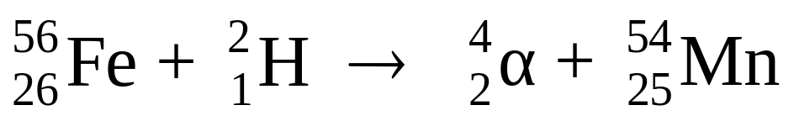
19.3
Solution
The abbreviation tells us that when iron-56 is bombarded with a deuterium nucleus, it produces the manganese-54 nucleus plus an α particle. Thus, the equation for this reaction is
Check
Make sure that the sum of mass numbers and the sum of atomic numbers are the same on both sides of the equation.

Slide 28
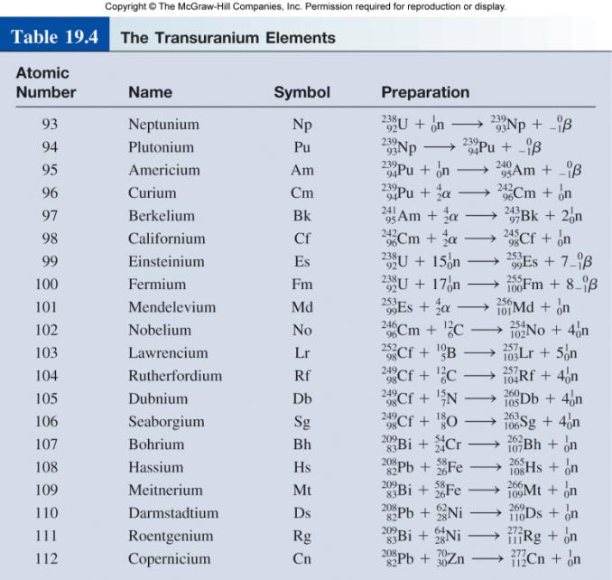
Nuclear Transmutation

Slide 29
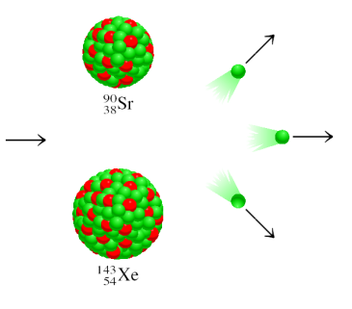
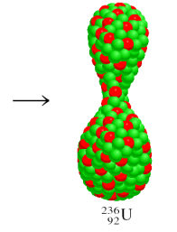
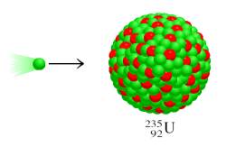
Nuclear Fission
²³⁵U + ¹n ⁹⁰Sr + ¹⁴³Xe + 3¹n + Energy
92
0
38
54
0
Energy = [mass ²³⁵U + mass n – (mass ⁹⁰Sr + mass ¹⁴³Xe + 3 x mass n )] x c²
Energy = 3.3 x 10⁻¹¹J per ²³⁵U
= 2.0 x 10¹³ J per mole ²³⁵U
Combustion of 1 ton of coal = 5 x 10⁷ J

Slide 30
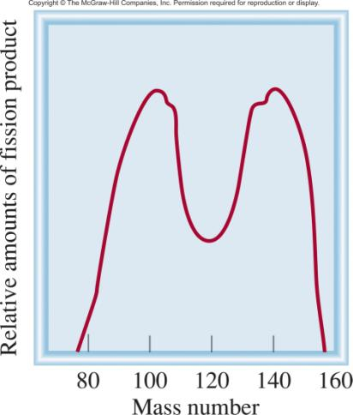
Nuclear Fission
Representative fission reaction
²³⁵U + ¹n ⁹⁰Sr + ¹⁴³Xe + 3¹n + Energy
92
0
38
54
0

Slide 31
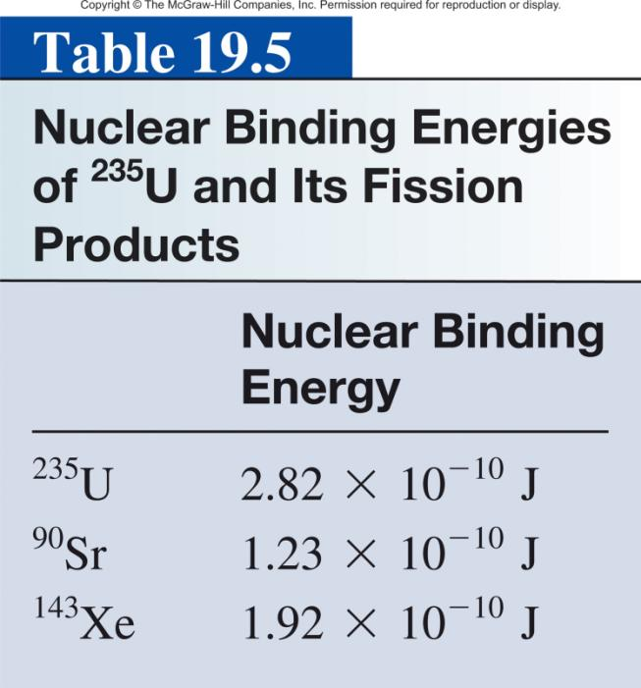

Slide 32
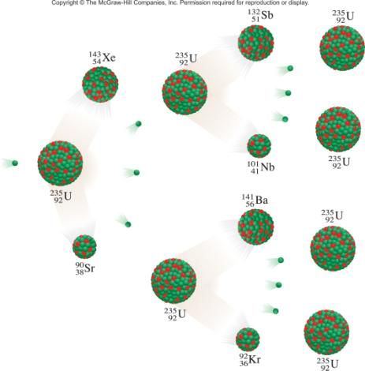
Nuclear Fission
Nuclear chain reaction is a self-sustaining sequence of nuclear fission reactions.
The minimum mass of fissionable material required to generate a self-sustaining nuclear chain reaction is the critical mass.

Slide 33
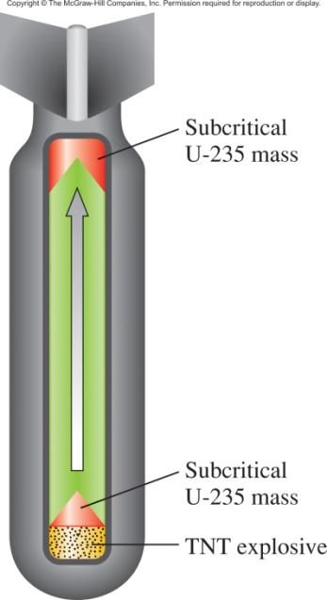
Schematic of an Atomic Bomb

Slide 34
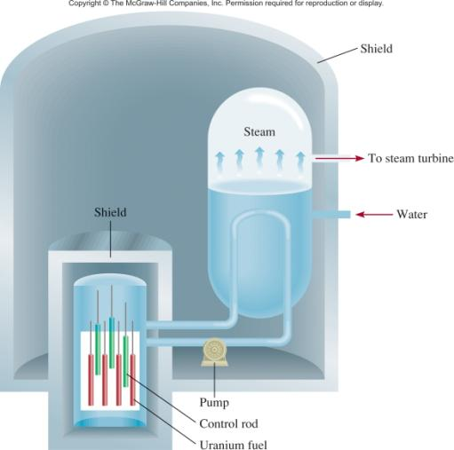
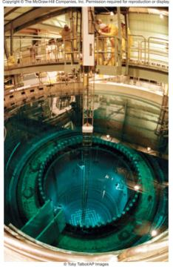
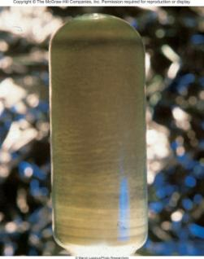
Schematic Diagram of a Nuclear Reactor
refueling
U₃O₈

Slide 35
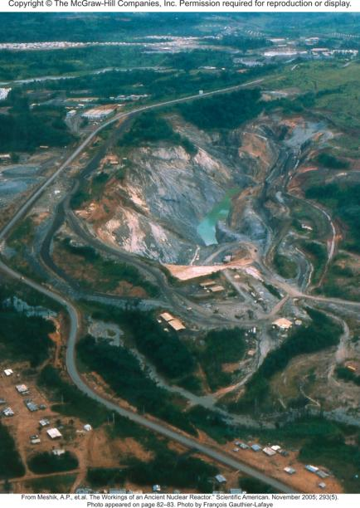
Chemistry In Action: Nature’s Own Fission Reactor
Natural Uranium
0.7202 % U-235 99.2798% U-238
Measured at Oklo
0.7171 % U-235

Slide 36
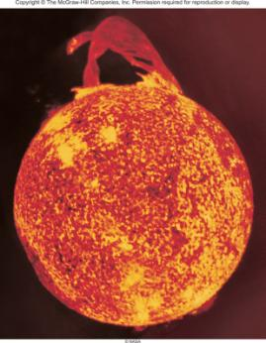
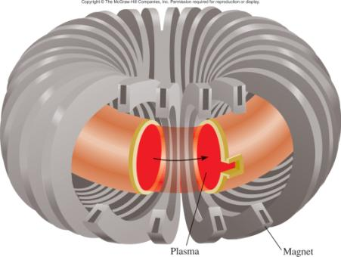
Nuclear Fusion
Fusion Reaction
Energy Released
²H + ²H ³H + ¹H
4.9 x 10⁻¹³ J
1
1
1
1
²H + ³H ⁴He + ¹n
2.8 x 10⁻¹² J
1
1
2
0
⁶Li + ²H 2 ⁴He
3.6 x 10⁻¹² J
3
1
2
solar fusion
Tokamak magnetic plasma confinement

Slide 37
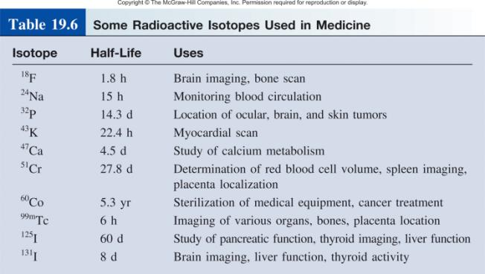
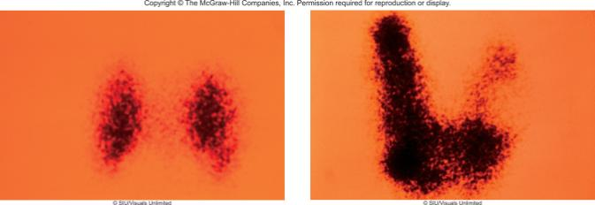
normal
enlarged
Thyroid images with ¹²⁵I-labeled compound

Slide 38
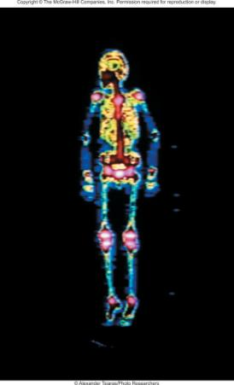
Radioisotopes in Medicine
Research production of ⁹⁹Mo
Bone Scan with ^{99m}Tc
⁹⁸Mo + ¹n ⁹⁹Mo
42
0
42
Commercial production of ⁹⁹Mo
²³⁵U + ¹n ⁹⁹Mo + other fission products
92
0
42
⁹⁹Mo ^{99m}Tc + ⁰β
t_{½} = 66 hours
42
43
-1
^{99m}Tc ⁹⁹Tc + γ-ray
t_{½} = 6 hours
43
43

Slide 39
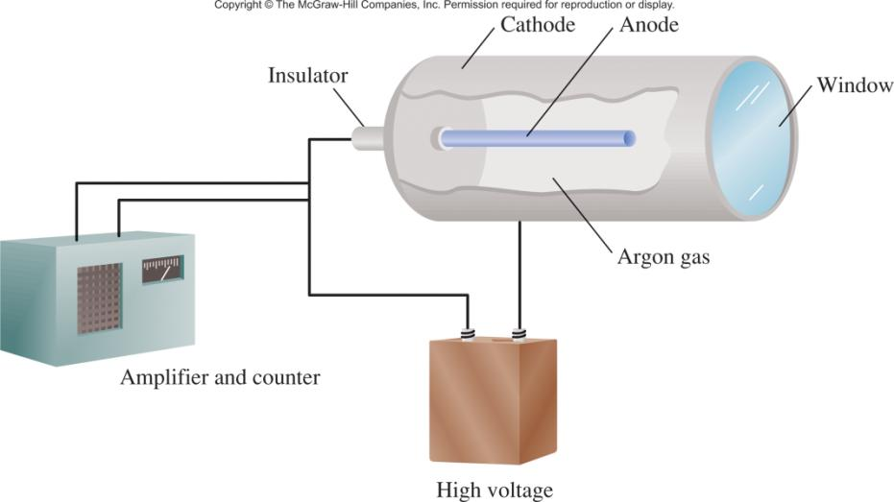
Geiger-Müller Counter

Slide 40
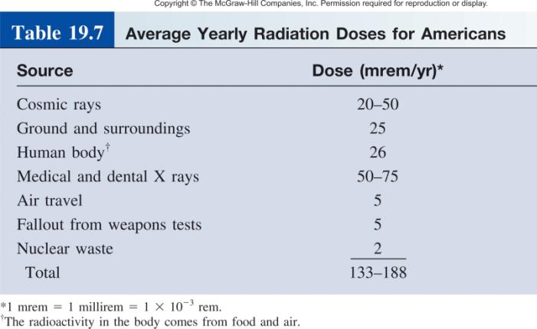
Biological Effects of Radiation
Radiation absorbed dose (rad)
1 rad = 1 x 10⁻⁵ J/g of material
Roentgen equivalent for man (rem)
1 rem = 1 rad x Q
Quality Factor
γ-ray = 1
β = 1
α = 20

Slide 41
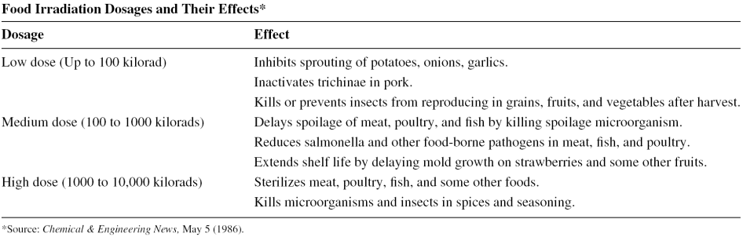
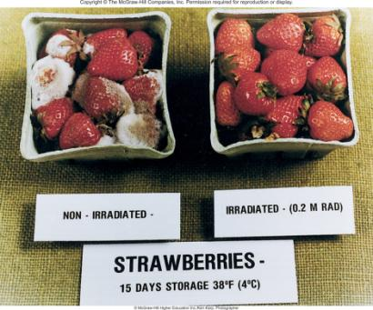
Chemistry In Action: Food Irradiation

