Slide 1

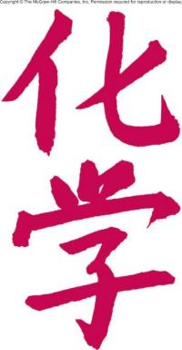
Chemistry:
The Study of Change
Chapter 1
Copyright © The McGraw-Hill Companies, Inc. Permission required for reproduction or display.

Slide 2
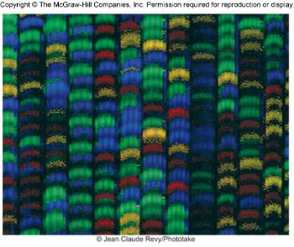
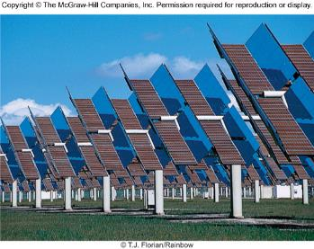
Chemistry: A Science for the 21st Century
Health and Medicine
  Sanitation systems
  Surgery with anesthesia
  Vaccines and antibiotics
  Gene therapy
Energy and the Environment
  Fossil fuels
  Solar energy
  Nuclear energy

Slide 3
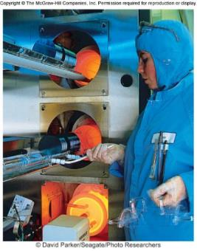
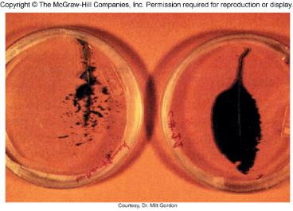
Chemistry: A Science for the 21st Century
Materials and Technology
  Polymers, ceramics, liquid crystals
  Room-temperature superconductors?
  Molecular computing?
Food and Agriculture
  Genetically modified crops
  “Natural” pesticides
  Specialized fertilizers

Slide 4
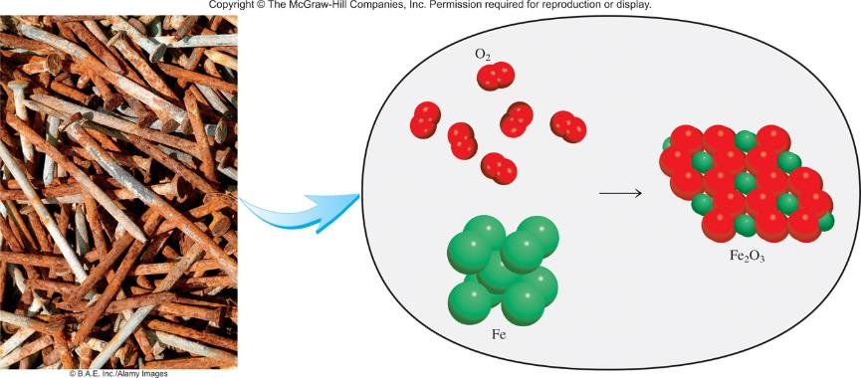
The Study of Chemistry
Macroscopic
Microscopic

Slide 5
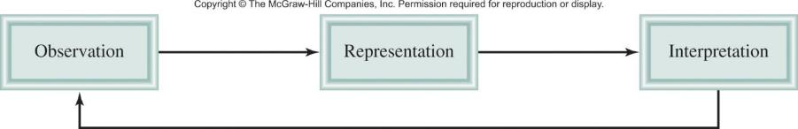
The scientific method is a systematic approach to research.
A hypothesis is a tentative explanation for a set of observations.
tested modified

Slide 6
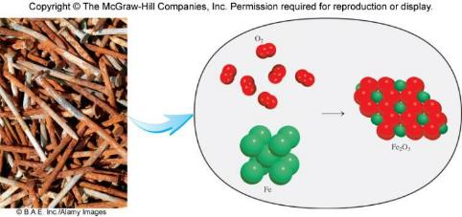
A law is a concise statement of a relationship between phenomena that is always the same under the same conditions.
Force = mass x acceleration
A theory is a unifying principle that explains a body of facts and/or those laws that are based on them.
Atomic Theory

Slide 7
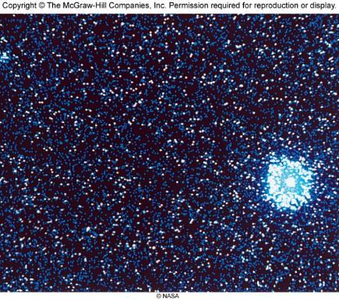
Chemistry In Action:
Primordial Helium and the Big Bang Theory
In 1940 George Gamow hypothesized that the universe began with a gigantic explosion or big bang.
Experimental Support
expanding universe
cosmic background radiation
primordial helium

Slide 8
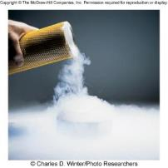
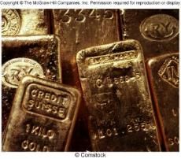
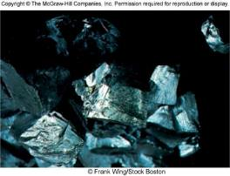
Chemistry is the study of matter and the
changes it undergoes.
Matter is anything that occupies space and has mass.
A substance is a form of matter that has a definite composition and distinct properties.
liquid nitrogen
gold ingots
silicon crystals

Slide 9
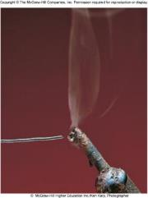
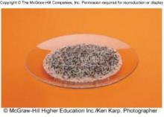
A mixture is a combination of two or more substances in which the substances retain their distinct identities.
Homogenous mixture – composition of the mixture is the same throughout
soft drink, milk, solder
Heterogeneous mixture – composition is not uniform throughout
cement,
iron filings in sand

Slide 10
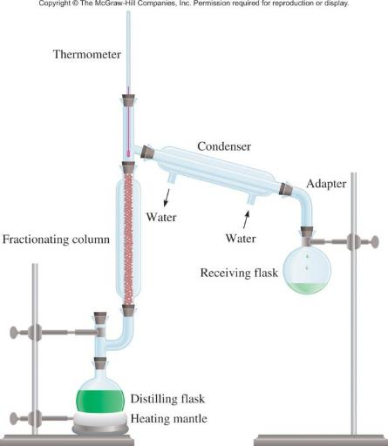
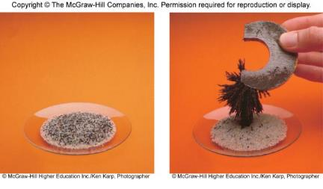
Physical means can be used to separate a mixture into its pure components.
magnet
distillation

Slide 11
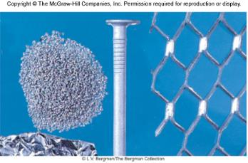
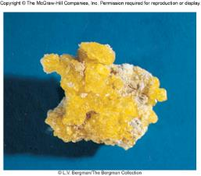
An element is a substance that cannot be separated into simpler substances by chemical means.
    114 elements have been identified
    82 elements occur naturally on Earth
      gold, aluminum, lead, oxygen, carbon, sulfur
    32 elements have been created by scientists
      technetium, americium, seaborgium

Slide 12
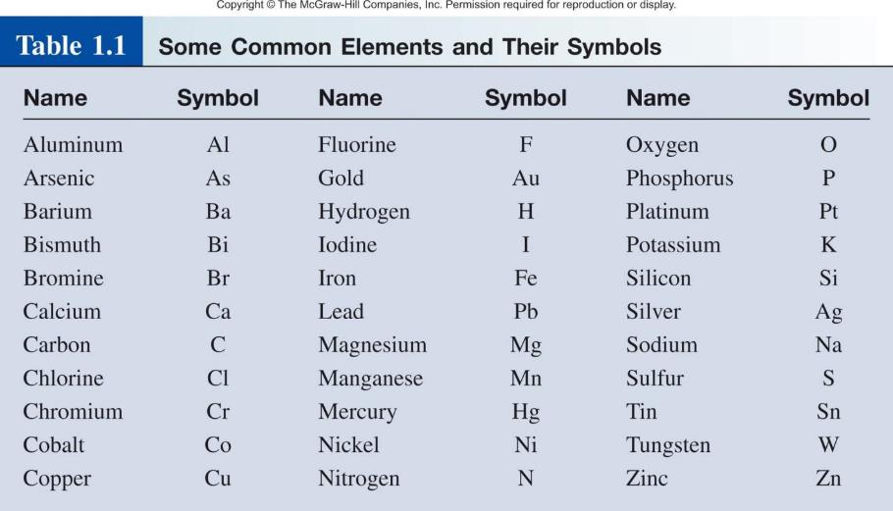

Slide 13
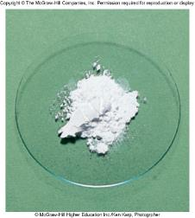
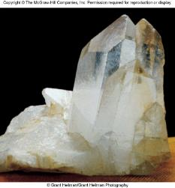
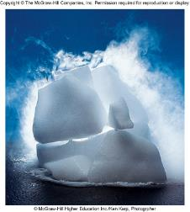
A compound is a substance composed of atoms of two or more elements chemically united in fixed proportions.
Compounds can only be separated into their pure components (elements) by chemical means.
lithium fluoride
quartz
dry ice – carbon dioxide

Slide 14
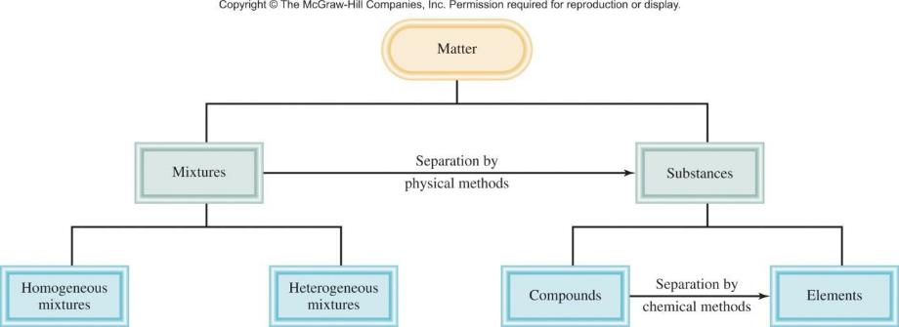
Classifications of Matter

Slide 15
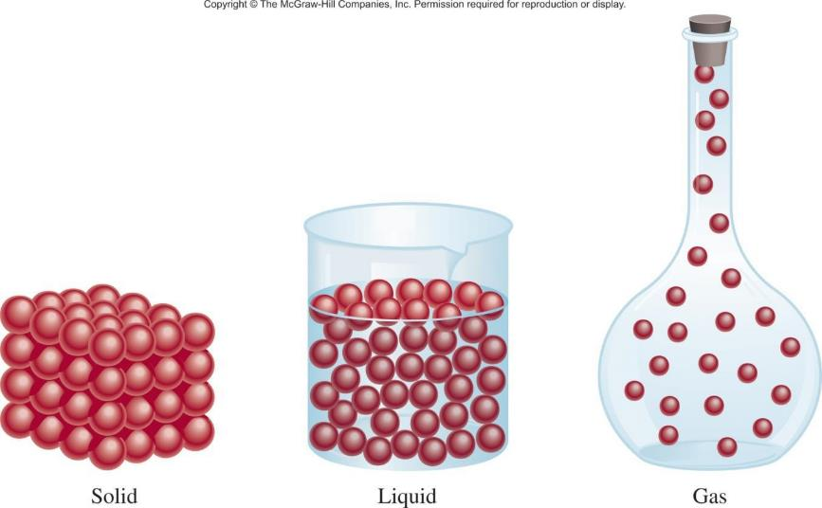
A Comparison: The Three States of Matter

Slide 16
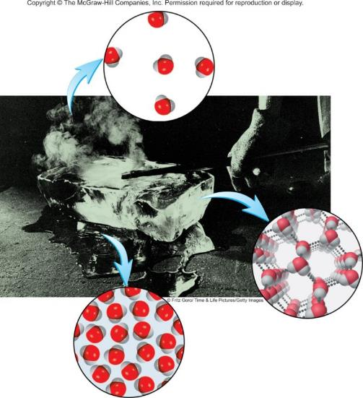
The Three States of Matter: Effect of a Hot Poker on a Block of Ice
gas
liquid
solid

Slide 17
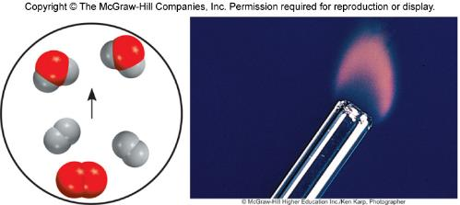
Types of Changes
A physical change does not alter the composition or identity of a substance.
sugar dissolving
in water
ice melting
A chemical change alters the composition or identity of the substance(s) involved.
hydrogen burns in air to form water

Slide 18
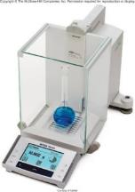
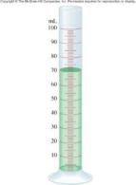
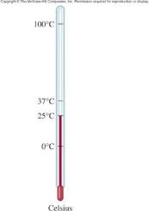
Extensive and Intensive Properties
An extensive property of a material depends upon how much matter is being considered.
mass
length
volume
An intensive property of a material does not depend upon how much matter is being considered.
density
temperature
color

Slide 19
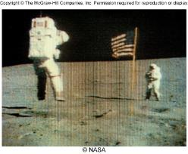
Matter - anything that occupies space and has mass
mass – measure of the quantity of matter
  SI unit of mass is the kilogram (kg)
  1 kg = 1000 g = 1 x 10³ g
weight – force that gravity exerts on an object
weight = c x mass
A 1 kg bar will weigh
on earth, c = 1.0
1 kg on earth
on moon, c ~ 0.1
0.1 kg on moon

Slide 20
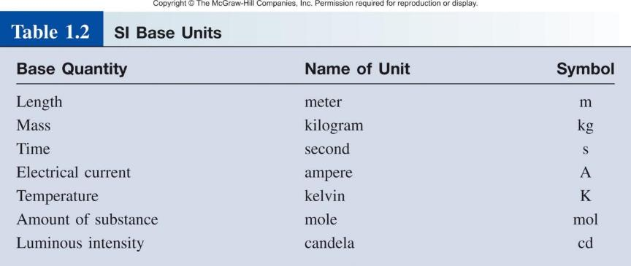
International System of Units (SI)

Slide 21
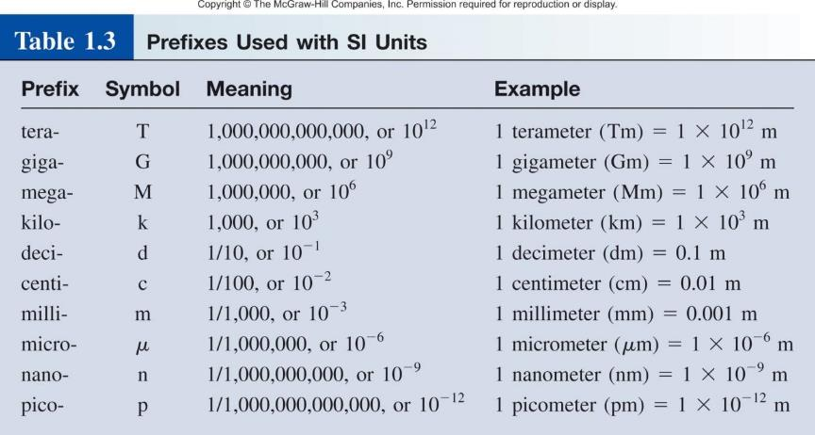

Slide 22
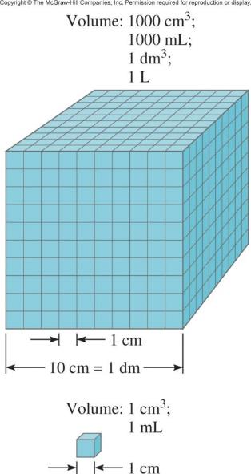
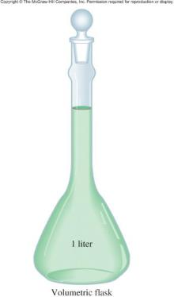
Volume – SI derived unit for volume is cubic meter (m³)
1 cm³ = (1 x 10⁻² m)³ = 1 x 10⁻⁶ m³
1 dm³ = (1 x 10⁻¹ m)³ = 1 x 10⁻³ m³
1 L = 1000 mL = 1000 cm³ = 1 dm³
1 mL = 1 cm³

Slide 23
Density – SI derived unit for density is kg/m³
1 g/cm³ = 1 g/mL = 1000 kg/m³
mass
density =
volume
m
d =
V

Slide 24
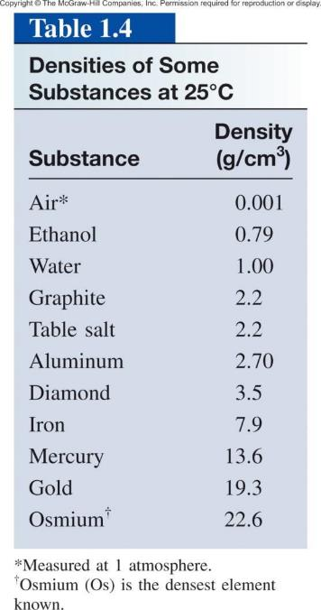

Slide 25
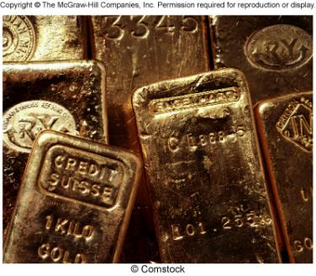
1.1
Gold is a precious metal that is chemically unreactive.
It is used mainly in jewelry, dentistry, and electronic devices.
A piece of gold ingot with a mass of 301 g has a volume of
15.6 cm³. Calculate the density of gold.
gold ingots

Slide 26
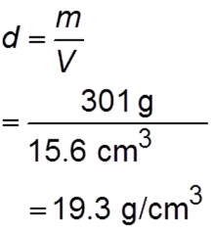
1.1
Solution We are given the mass and volume and asked to calculate the density. Therefore, from Equation (1.1), we write

Slide 27
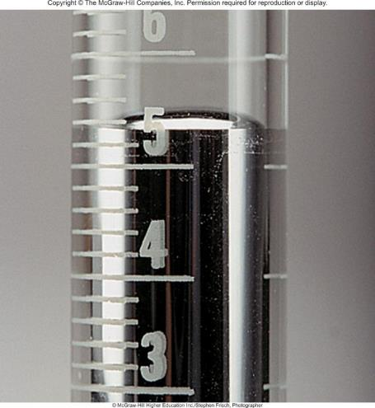
1.2
The density of mercury, the only metal that is a liquid at room temperature, is 13.6 g/mL. Calculate the mass of 5.50 mL of the liquid.

Slide 28
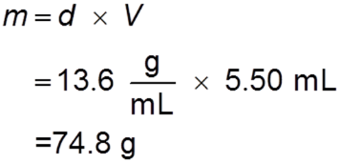
1.2
Solution We are given the density and volume of a liquid and asked to calculate the mass of the liquid.
We rearrange Equation (1.1) to give

Slide 29

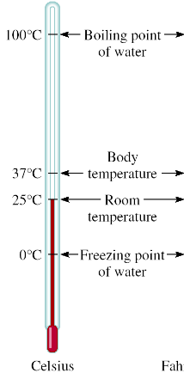
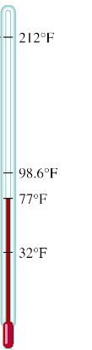

A Comparison of Temperature Scales
K = ⁰C + 273.15
273.15 K = 0 ⁰C
373.15 K = 100 ⁰C
9
⁰F = x ⁰C + 32
5
32 ⁰F = 0 ⁰C
212 ⁰F = 100 ⁰C

Slide 30
1.3
Solder is an alloy made of tin and lead that is used in electronic circuits. A certain solder has a melting point of 224°C. What is its melting point in degrees Fahrenheit?
Helium has the lowest boiling point of all the elements at 2452°F. Convert this temperature to degrees Celsius.
Mercury, the only metal that exists as a liquid at room temperature, melts at 238.9°C. Convert its melting point to kelvins.

Slide 31



1.3
Solution These three parts require that we carry out temperature conversions, so we need Equations (1.2), (1.3), and (1.4). Keep in mind that the lowest temperature on the Kelvin scale is zero (0 K); therefore, it can never be negative.
This conversion is carried out by writing
Here we have
The melting point of mercury in kelvins is given by

Slide 32
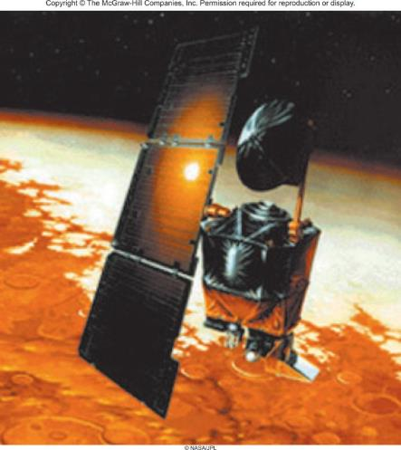
Chemistry In Action
On 9/23/99, $125,000,000 Mars Climate Orbiter entered Mars’ atmosphere 100 km (62 miles) lower than planned and was destroyed by heat.
1 lb = 1 N
1 lb = 4.45 N
“This is going to be the cautionary tale that will be embedded into introduction to the metric system in elementary school, high school, and college science courses till the end of time.”

Slide 33
Scientific Notation
The number of atoms in 12 g of carbon:
602,200,000,000,000,000,000,000
6.022 x 10²³
The mass of a single carbon atom in grams:
0.0000000000000000000000199
1.99 x 10⁻²³
N x 10^{n}
N is a number
between 1 and 10
n is a positive or
negative integer

Slide 34
Scientific Notation
568.762
0.00000772
move decimal left
move decimal right
n > 0
n < 0
568.762 = 5.68762 x 10²
0.00000772 = 7.72 x 10⁻⁶
Addition or Subtraction
Write each quantity with the same exponent n
Combine N₁ and N₂
The exponent, n, remains the same
4.31 x 10⁴ + 3.9 x 10³ =
4.31 x 10⁴ + 0.39 x 10⁴ =
4.70 x 10⁴

Slide 35
Scientific Notation
Multiplication
(4.0 x 10⁻⁵) x (7.0 x 10³) =
(4.0 x 7.0) x (10⁻⁵⁺³) =
28 x 10⁻² =
2.8 x 10⁻¹
Multiply N₁ and N₂
Add exponents n₁ and n₂
Division
8.5 x 10⁴ ÷ 5.0 x 10⁹ =
(8.5 ÷ 5.0) x 10⁴⁻⁹ =
1.7 x 10⁻⁵
Divide N₁ and N₂
Subtract exponents n₁ and n₂

Slide 36
Significant Figures
Any digit that is not zero is significant
  1.234 kg 4 significant figures
Zeros between nonzero digits are significant
  606 m 3 significant figures
Zeros to the left of the first nonzero digit are not significant
  0.08 L 1 significant figure
If a number is greater than 1, then all zeros to the right of the decimal point are significant
  2.0 mg 2 significant figures
If a number is less than 1, then only the zeros that are at the end and in the middle of the number are significant
  0.00420 g 3 significant figures

Slide 37
1.4
Determine the number of significant figures in the following measurements:
478 cm
6.01 g
0.825 m
0.043 kg
1.310 × 10²² atoms
7000 mL

Slide 38
1.4
Solution
(a) 478 cm -- Three, because each digit is a nonzero digit.
(b) 6.01 g -- Three, because zeros between nonzero digits are significant.
(c) 0.825 m -- Three, because zeros to the left of the first nonzero digit do not count as significant figures.
(d) 0.043 kg -- Two. Same reason as in (c).
(e) 1.310 × 10²² atoms -- Four, because the number is greater than one so all the zeros written to the right of the decimal point count as significant figures.

Slide 39
1.4
7000 mL -- This is an ambiguous case. The number of significant figures may be four (7.000 × 10³), three (7.00 × 10³), two (7.0 × 10³), or one (7 × 10³).
This example illustrates why scientific notation must be used to show the proper number of significant figures.

Slide 40
Significant Figures
Addition or Subtraction
The answer cannot have more digits to the right of the decimal
point than any of the original numbers.
89.332
+
1.1
one significant figure after decimal point
90.432
round off to 90.4
3.70
two significant figures after decimal point
-2.9133
0.7867
round off to 0.79

Slide 41
Significant Figures
Multiplication or Division
The number of significant figures in the result is set by the original number that has the smallest number of significant figures.
4.51 x 3.6666 = 16.536366
= 16.5
3 sig figs
round to
3 sig figs
6.8 ÷ 112.04 = 0.0606926
= 0.061
2 sig figs
round to
2 sig figs

Slide 42
Significant Figures
Exact Numbers
Numbers from definitions or numbers of objects are considered
to have an infinite number of significant figures.
The average of three measured lengths: 6.64, 6.68 and 6.70?
6.64 + 6.68 + 6.70
= 6.67333 = 6.67
= 7
3
Because 3 is an exact number

Slide 43
1.5
Carry out the following arithmetic operations to the correct number of significant figures:
11,254.1 g + 0.1983 g
66.59 L − 3.113 L
8.16 m × 5.1355
(d) 0.0154 kg ÷ 88.3 mL
(e) 2.64 × 10³ cm + 3.27 × 10² cm

Slide 44
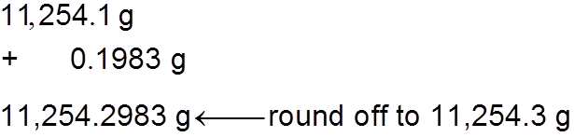
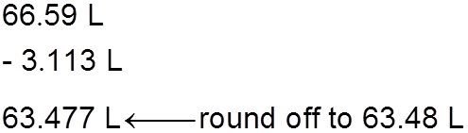
1.5
Solution In addition and subtraction, the number of decimal places in the answer is determined by the number having the lowest number of decimal places. In multiplication and division, the significant number of the answer is determined by the number having the smallest number of significant figures.
(a)
(b)

Slide 45
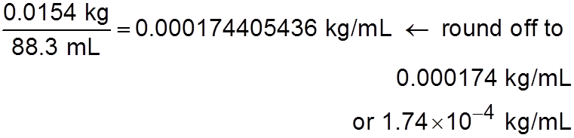
1.5
(c)
(d)
(e) First we change 3.27 × 10² cm to 0.327 × 10³ cm and then carry out the addition (2.64 cm + 0.327 cm) × 10³. Following the procedure in (a), we find the answer is 2.97 × 10³ cm.

Slide 46
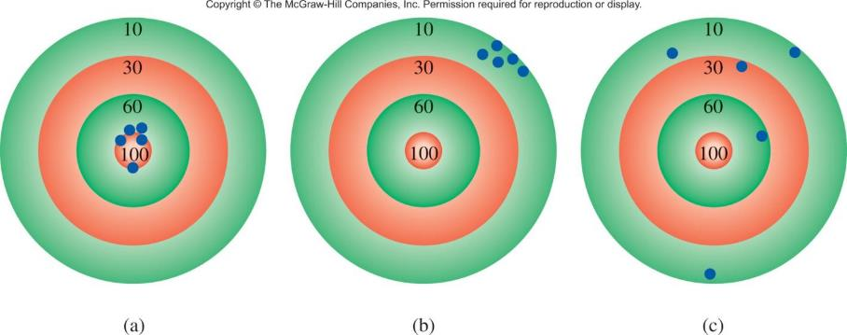
Accuracy – how close a measurement is to the true value
Precision – how close a set of measurements are to each other
accurate
&
precise
precise
but
not accurate
not accurate
&
not precise

Slide 47
Dimensional Analysis Method of Solving Problems
Determine which unit conversion factor(s) are needed
Carry units through calculation
If all units cancel except for the desired unit(s), then the problem was solved correctly.
given quantity x conversion factor = desired quantity
desired unit
given unit x
= desired unit
given unit

Slide 48
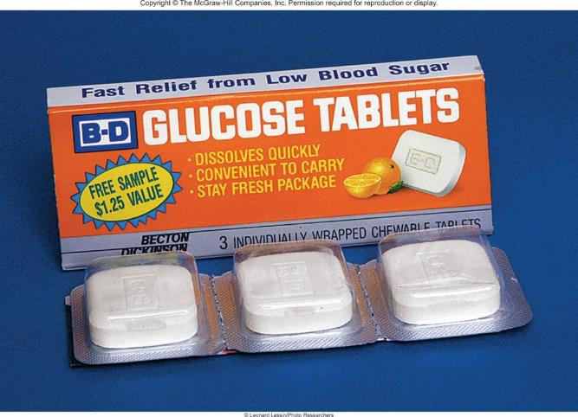
1.6
A person’s average daily intake of glucose (a form of sugar) is 0.0833 pound (lb). What is this mass in milligrams (mg)?
(1 lb = 453.6 g.)

Slide 49
1.6
Strategy The problem can be stated as
? mg = 0.0833 lb
The relationship between pounds and grams is given in the problem. This relationship will enable conversion from pounds to grams.
A metric conversion is then needed to convert grams to milligrams (1 mg = 1 × 10⁻³ g).
Arrange the appropriate conversion factors so that pounds and grams cancel and the unit milligrams is obtained in your answer.

Slide 50

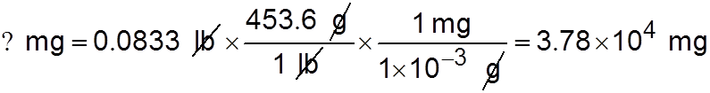
1.6
Solution The sequence of conversions is
Using the following conversion factors
we obtain the answer in one step:

Slide 51
1.6
Check As an estimate, we note that 1 lb is roughly 500 g and that 1 g = 1000 mg. Therefore, 1 lb is roughly 5 × 10⁵ mg.
Rounding off 0.0833 lb to 0.1 lb, we get 5 × 10⁴ mg, which is close to the preceding quantity.

Slide 52
1.7
An average adult has 5.2 L of blood. What is the volume of blood in m³?

Slide 53
1.7
Strategy
The problem can be stated as
? m³ = 5.2 L
How many conversion factors are needed for this problem?
Recall that 1 L = 1000 cm³ and 1 cm = 1 × 10⁻² m.

Slide 54

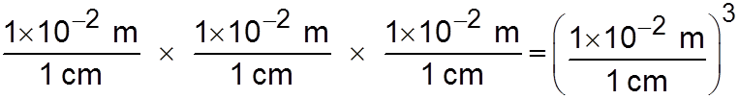
1.7
Solution We need two conversion factors here: one to convert liters to cm³ and one to convert centimeters to meters:
Because the second conversion factor deals with length (cm and m) and we want volume here, it must therefore be cubed to give
This means that 1 cm³ = 1 × 10⁻⁶ m³.

Slide 55
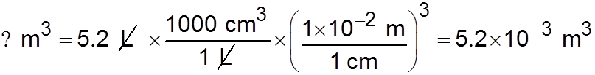
1.7
Now we can write
Check From the preceding conversion factors you can show that 1 L = 1 × 10⁻³ m³. Therefore, 5 L of blood would be equal to 5 × 10⁻³ m³, which is close to the answer.

Slide 56

1.8
Liquid nitrogen is obtained from liquefied air and is used to prepare frozen goods and in low-temperature research.
The density of the liquid at its boiling point (−196°C or 77 K) is 0.808 g/cm³. Convert the density to units of kg/m³.
liquid nitrogen

Slide 57

1.8
Strategy The problem can be stated as
? kg/m³ = 0.808 g/cm³
Two separate conversions are required for this problem:
Recall that 1 kg = 1000 g and 1 cm = 1 × 10⁻² m.

Slide 58


1.8
Solution In Example 1.7 we saw that 1 cm³ = 1 ×10⁻⁶ m³. The conversion factors are
Finally
Check Because 1 m³ = 1 × 10⁶ cm³, we would expect much more mass in 1 m³ than in 1 cm³. Therefore, the answer is reasonable.

Slide 59
1.9
A modern pencil “lead” is actually composed primarily of graphite, a form of carbon.
Estimate the mass of the graphite core in a standard No. 2 pencil before it is sharpened.

Slide 60

1.9
Strategy Assume that the pencil lead can be approximated as a cylinder.
Measurement of a typical unsharpened pencil gives a length of about 18 cm (subtracting the length of the eraser head) and a diameter of roughly 2 mm for the lead.
The volume of a cylinder V is given by
where r is the radius and l is the length.
Assuming that the lead is pure graphite, you can calculate the mass of the lead from the volume using the density of graphite given in Table 1.4.

Slide 61


1.9
Solution
Converting the diameter of the lead to units of cm gives
which, along with the length of the lead, gives

Slide 62

1.9
Rearranging Equation (1.1) gives
Check Rounding off the values used to calculate the volume of the lead gives 3 × (0.1 cm)² × 20 cm = 0.6 cm³.
Multiplying that volume by roughly 2 g/cm³ gives around 1 g, which agrees with the value just calculated.

