Slide 1
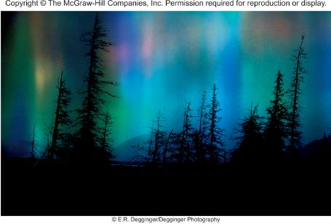

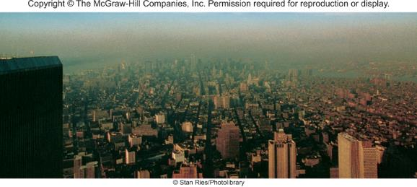
Chemistry in the Atmosphere
Chapter 20
Copyright © The McGraw-Hill Companies, Inc. Permission required for reproduction or display.

Slide 2
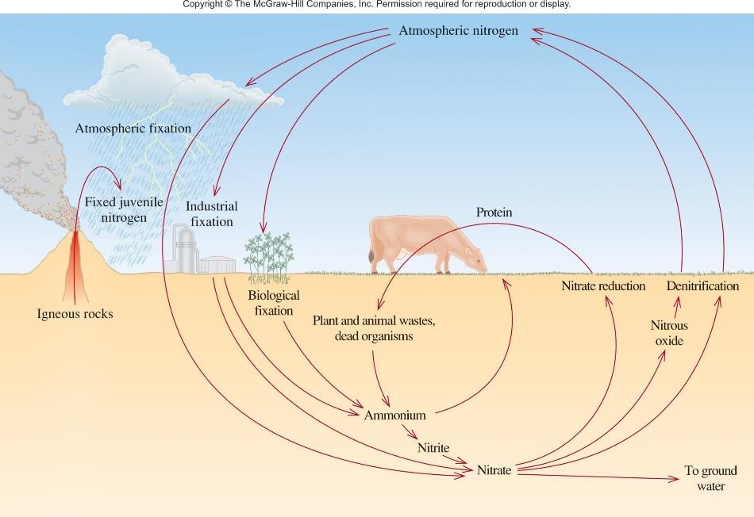
The Nitrogen Cycle

Slide 3
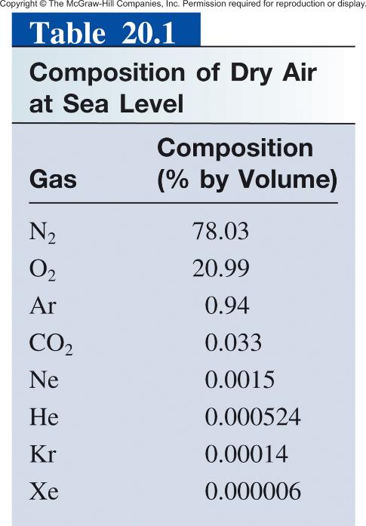

Slide 4
Atmospheric Nitrogen Fixation
electrical
N₂ (g) + O₂ (g) 2NO (g)
energy
2NO (g) + O₂ (g) 2NO₂ (g)
2NO₂ (g) + H₂O (l) HNO₂ (aq) + HNO₃ (aq)
Industrial Nitrogen Fixation
catalyst
N₂ (g) + 3H₂ (g) 2NH₃ (g)
NH₃ + 2O₂ HNO₃ + H₂O
NH₃ + HNO₃ NH₄NO₃
CH₄ + 2H₂O 4H₂ + CO₂

Slide 5
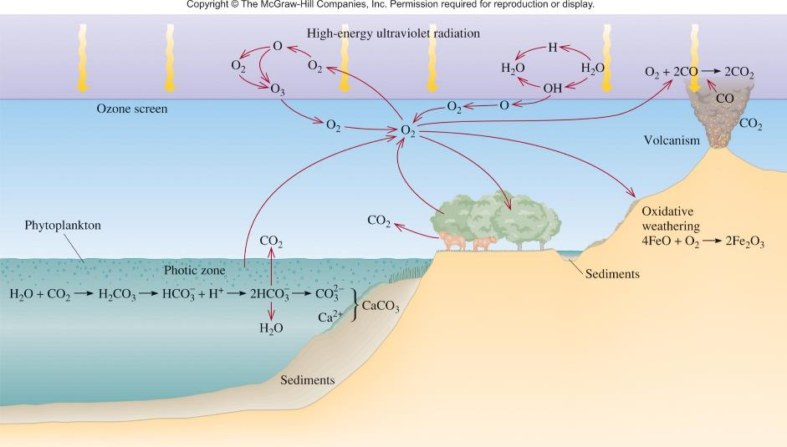
The Oxygen Cycle

Slide 6
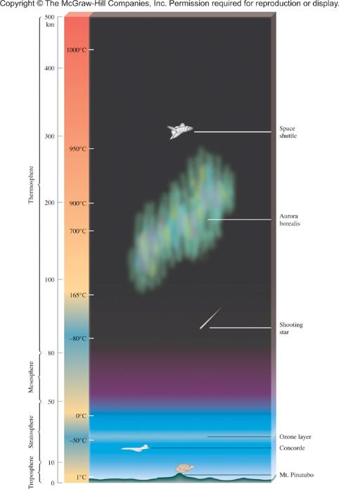
hν + N₂ 2N
hν + N N⁺ + e⁻
hν + O₂ O₂⁺ + e⁻

Slide 7

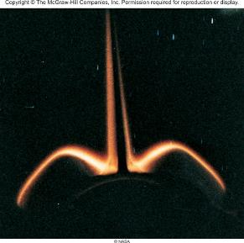
Chemical Reactions in the Thermosphere
e⁻
+ O O* + e⁻
Solar Radiation
+ N₂ N₂* + p⁺ + e⁻
p⁺
+
O* O + hν
green and red
+
+
blue and violet
N₂* N₂ + hν
O + NO NO₂*
NO₂* NO₂ + hν
orange
Glowing tail section of space shuttle

Slide 8
20.1
The bond enthalpy of O₂ is 498.7 kJ/mol. Calculate the maximum wavelength (nm) of a photon that can cause the dissociation of an O₂ molecule.

Slide 9
20.1
Strategy
We want to calculate the wavelength of a photon that will break an O=O bond. Therefore, we need the amount of energy in one bond. The bond enthalpy of O₂ is given in units of kJ/mol. The units needed for the energy of one bond are J/molecule. Once we know the energy in one bond, we can calculate the minimum frequency and maximum wavelength needed to dissociate one O₂ molecule. The conversion steps are
kJ/mol J/molecule frequency of photon
wavelength of photon

Slide 10
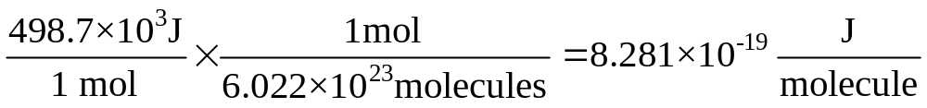
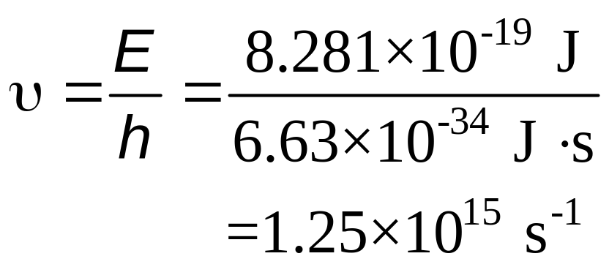
20.1
Solution
First we calculate the energy required to break one O=O bond:
The energy of the photon is given by E = hν [Equation (7.2)]. Therefore,

Slide 11
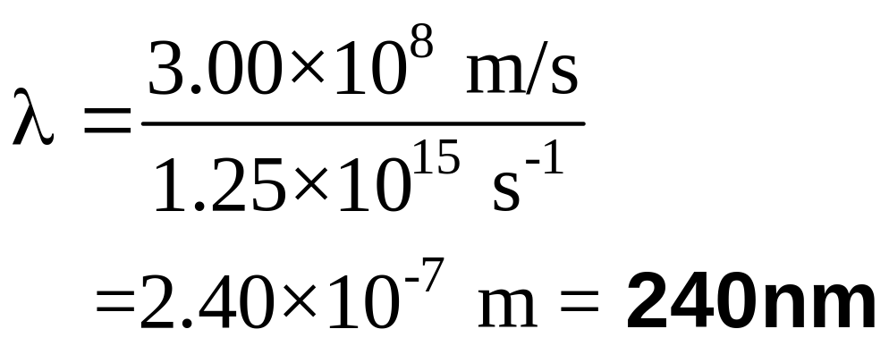
20.1
Finally, we calculate the wavelength of the photon, given by λ = c/v [see Equation (7.1)], as follows:
Comment In principle, any photon with a wavelength of 240 nm or shorter can dissociate an O₂ molecule.

Slide 12
Depletion of Ozone in the Stratosphere
O₃ production
UV
O₂ O + O
< 240 nm
O + O₂ + M O₃ + M
dynamic equilibrium
O₃ destruction
UV
constant concentration of O₃ in stratosphere
O₃ O + O₂
O + O₃ 2O₂

Slide 13
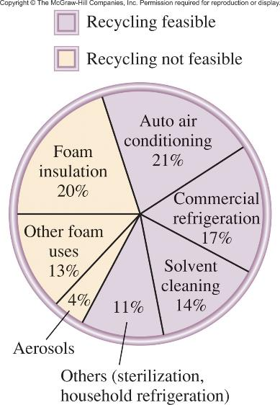
Depletion of Ozone in the Stratosphere
O₃ destruction
UV
CFCl₃ CFCl₂ + Cl
UV
CF₂Cl₂ CF₂Cl + Cl
Cl + O₃ ClO + O₂
+
ClO + O Cl + O₂
O₃ + O 2O₂
Cl catalyzes the reaction

Slide 14
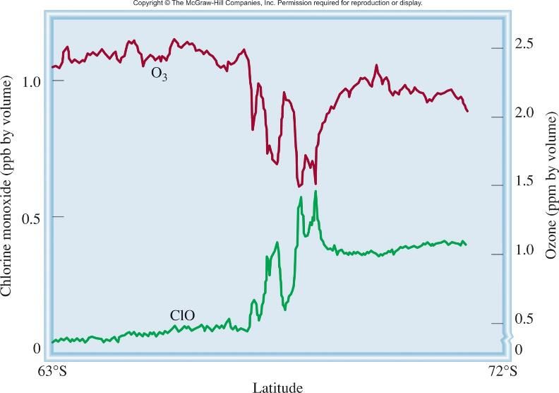
Concentrations of Chlorine Monoxide and
Ozone Versus Latitude

Slide 15
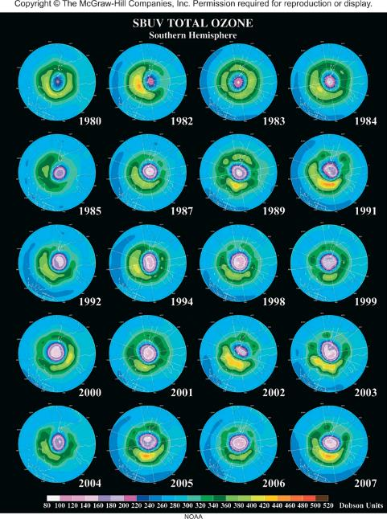
Ozone Depletion (in purple) Over the South Pole

Slide 16
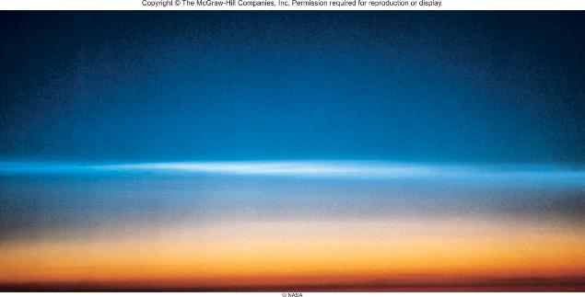
Polar stratospheric clouds provide a surface for the reaction:
HCl + ClONO₂ Cl₂ + HNO₃
Spring sunlight
Cl₂ + hν 2Cl
Cl + O₃ ClO + O₂
+
ClO + O Cl + O₂
O₃ + O 2O₂

Slide 17
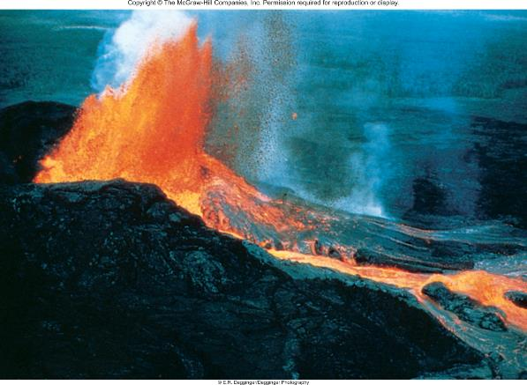
2H₂S (g) + 3O₂ (g) 2SO₂ (g) + 2H₂O (g)
SO₂ (g) + OH (g) HOSO₂ (g)
HOSO₂ (g) + O₂ (g) HO₂ (g) + SO₃ (g)
SO₃ (g) + H₂O (g) H₂SO₄ (g)
H₂SO₄ aerosols have a local cooling effect on the atmosphere.

Slide 18
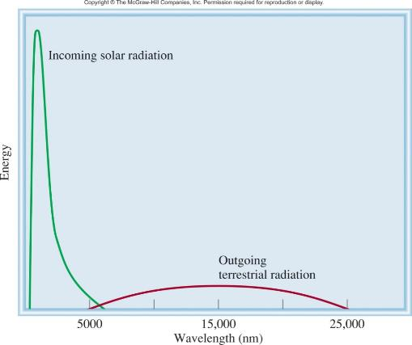


The trapping of heat near Earth’s surface by gases in the atmosphere is the greenhouse effect.
H₂O + hν H₂O*
CO₂ + hν CO₂*

Slide 19
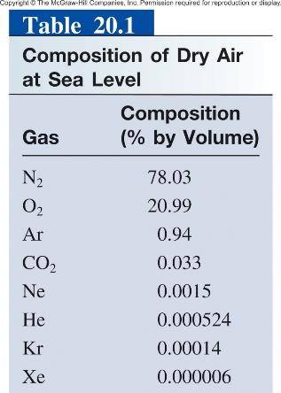
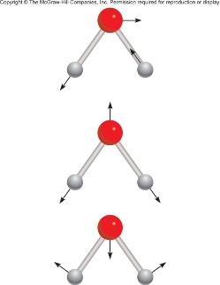
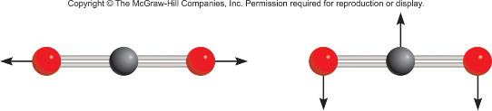
Why don’t N₂ and O₂ contribute to the greenhouse effect ?
N₂ and O₂ cannot absorb IR radiation.
H₂O and CO₂ can absorb IR radiation.
3 vibration modes of H₂O
2 of the vibration modes of CO₂

Slide 20
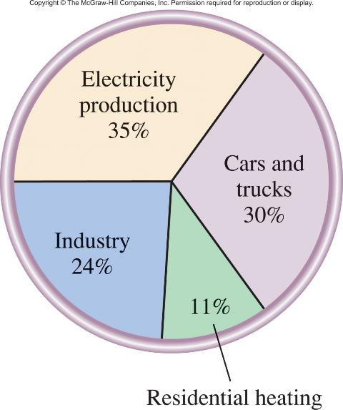
Sources of CO₂

Slide 21
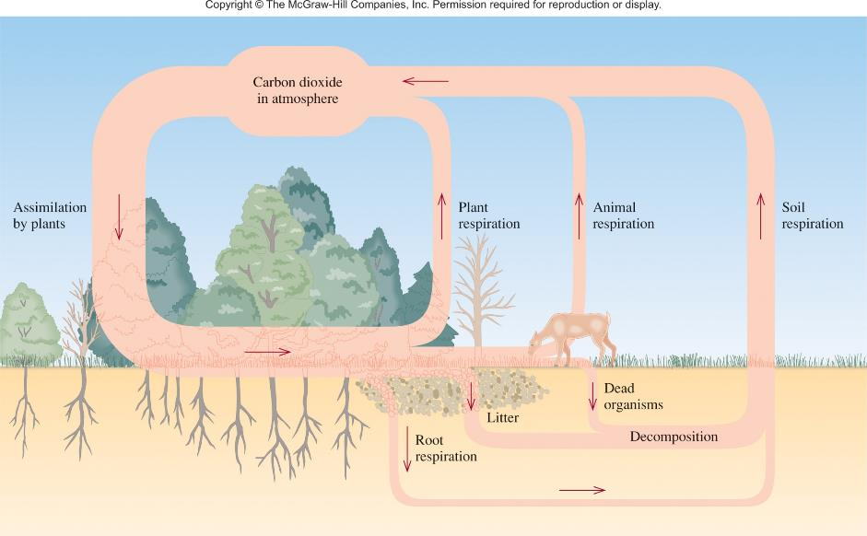
The Carbon Cycle

Slide 22
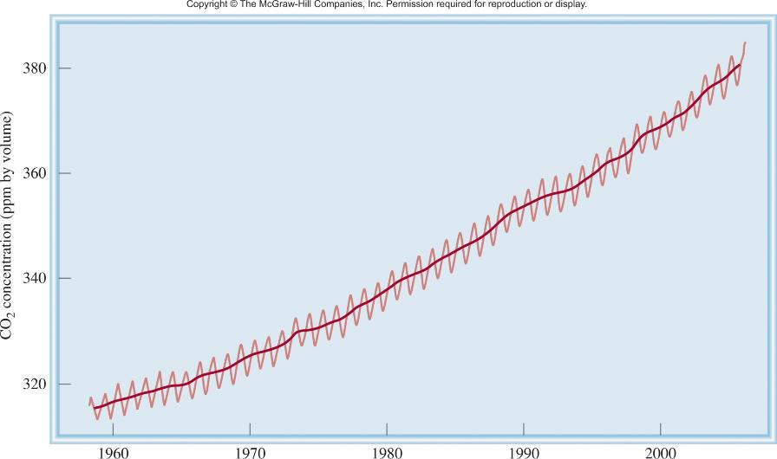
Yearly Variation of Carbon Dioxide Concentration at Mauna Loa, Hawaii.

Slide 23
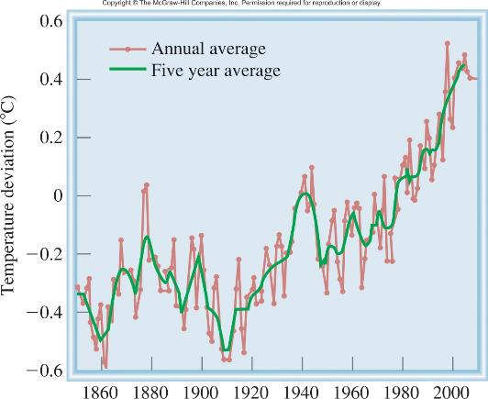
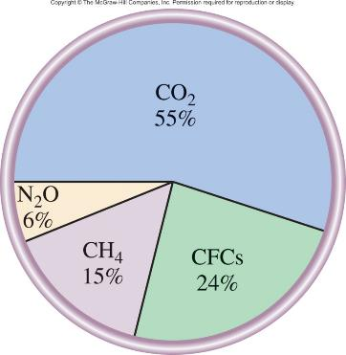
The Change in Global Temperature from 1850 to Present.
Contribution to Global Warming by Various
Greenhouse Gases

Slide 24
20.2
Which of the following gases qualify as a greenhouse gas: CO, NO, NO₂, Cl₂, H₂, Ne?

Slide 25
20.2
Strategy
To behave as a greenhouse gas, either the molecule must possess a dipole moment or some of its vibrational motions must generate a temporary dipole moment. These conditions immediately rule out homonuclear diatomic molecules and atomic species.
Solution
Only CO, NO, and NO₂, which are all polar molecules, qualify as greenhouse gases. Both Cl₂ and H₂ are homonuclear diatomic molecules, and Ne is atomic. These three species are all IR-inactive.

Slide 26
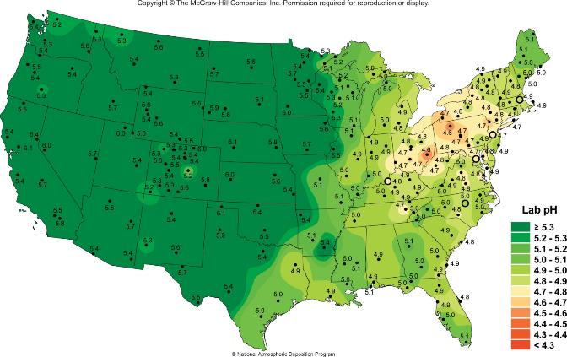
Acid Rain
SO₂ (g) + OH (g) HOSO₂ (g)
HOSO₂ (g) + O₂ (g) HO₂ (g) + SO₃ (g)
SO₃ (g) + H₂O (g) H₂SO₄ (g)
Mean precipitation pH in 2009

Slide 27
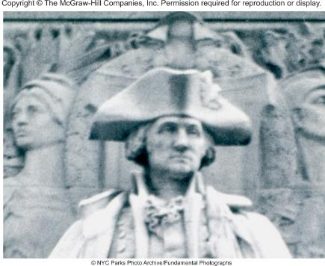
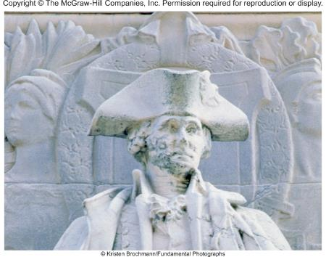
CaCO₃ (s) + H₂SO₄ (aq) CaSO₄ (s) + H₂O (l) + CO₂ (g)
2CaCO₃ (s) + 2SO₂ (g) + O₂ (g) 2CaSO₄ (s) + CO₂ (g)
The Effect of Acid Rain on the Marble Statue of George
Washington (New York, City). Photos Taken in 1944 and 1994

Slide 28
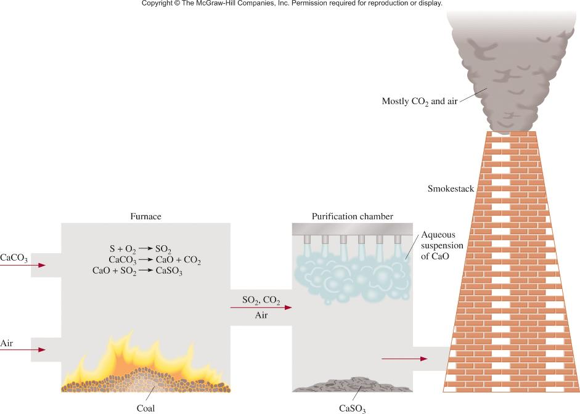
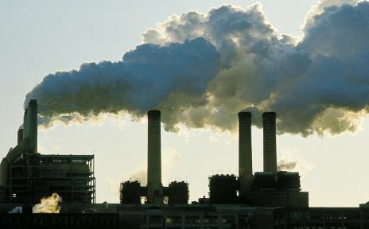

Slide 29
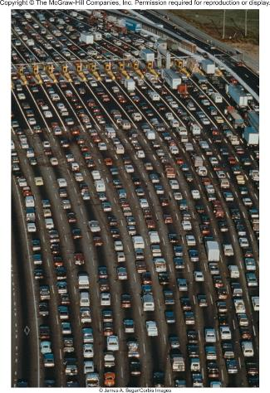
Photochemical smog is formed by the reactions of automobile exhaust in the presence of sunlight.
Primary pollutants: NO, CO and unburned hydrocarbons
Secondary pollutants: NO₂ and O₃
N₂ (g) + O₂ (g) 2NO (g)
2NO (g) + O₂ (g) 2NO₂ (g)
NO₂ (g) + hν NO (g) + O (g)
O (g) + O₂ (g) + M O₃ (g) + M

Slide 30
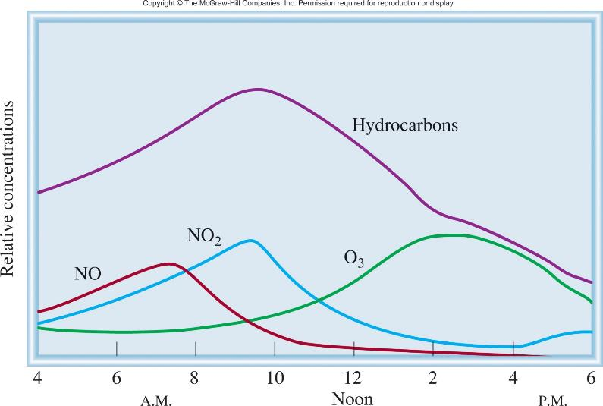
Typical Variations with Time in Concentration of Air Pollutants on a Smoggy Day.

Slide 31
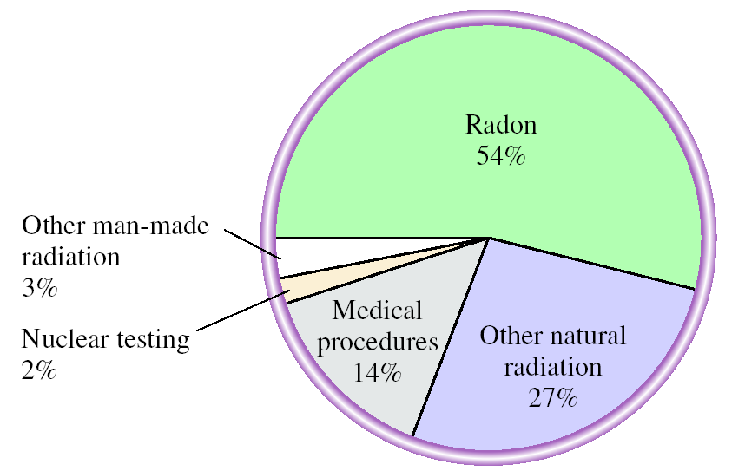
238
4.51 x 10⁹ yr
234
24.1 days
234
1.17 min
234
2.47 x 10⁵ yr
92
U
90
Th
91
Pa
92
U
230
7.5 x 10⁴ yr
226
1.6 x 10³ yr
222
3.82 d
218
Po
90
Th
88
Ra
86
Rn
84

Slide 32
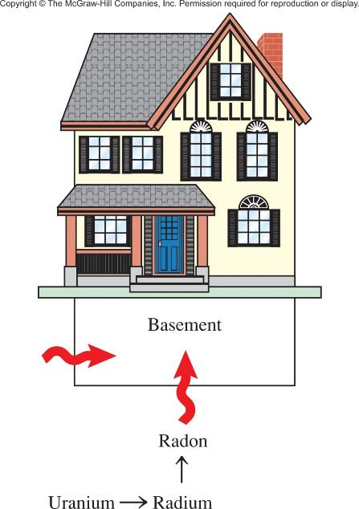
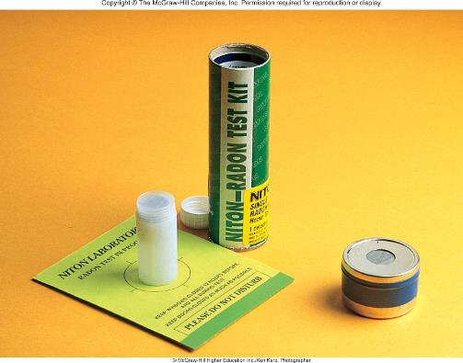
Home Radon Detectors

Slide 33
20.3
The half-life of Rn-222 is 3.8 days. Starting with 1.0 g of
Rn-222, how much will be left after 10 half-lives? Recall that radioactive decays obey first-order kinetics.

Slide 34
20.3
Strategy
All radioactive decays obey first-order kinetics. Therefore, its half-life is independent of the initial concentration.

Slide 35
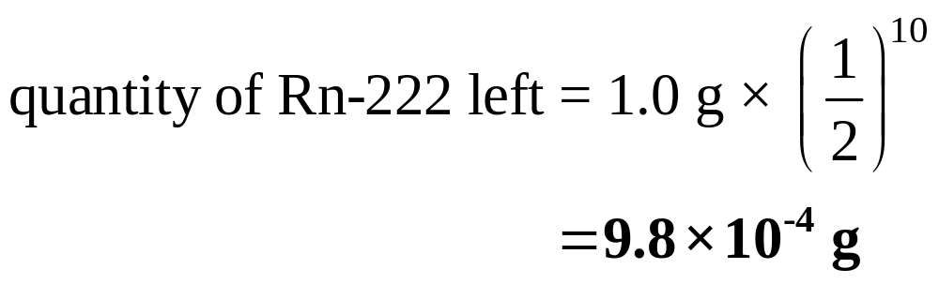
20.3
Solution
After one half-life, the amount of Rn left is 0.5 x 1.0 g, or 0.5 g. After two half-lives, only 0.25 g of Rn remains. Generalizing the fraction of the isotope left after n half lives as (1/2)^{n}, where n = 10, we write
An alternative solution is to calculate the first-order rate constant from the half-life. Next, use Equation (13.3) to calculate the concentration of radon after 10 half-lives. Try it.

