Slide 1
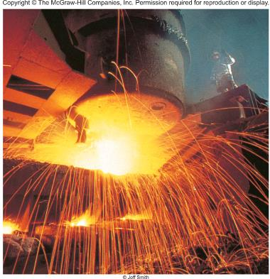

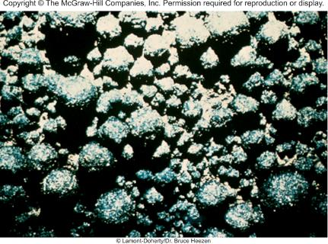
Metallurgy and the Chemistry of Metals
Chapter 21
Copyright © The McGraw-Hill Companies, Inc. Permission required for reproduction or display.

Slide 2
A mineral is a naturally occurring substance with a range of chemical compositions.
An ore is a mineral deposit concentrated enough to allow economical recovery of a desired metal.
Metallurgy is the science and technology of separating metals from their ores and of compounding alloys.
An alloy is a solid solution either of two or more metals, or of a metal or metals with one or more nonmetals.
Recovery of a metal from its ore:
Preparation of the ore
Production of the metal
Purification of the metal

Slide 3
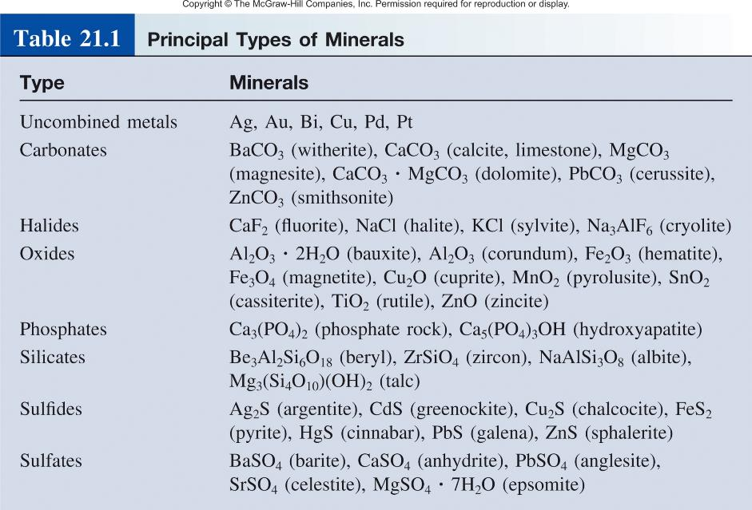

Slide 4
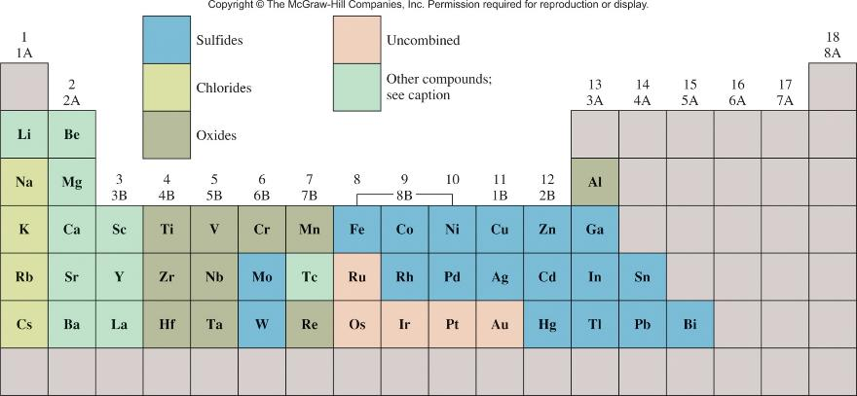
Metals and Their Best-Known Minerals

Slide 5
Production of Metals
Roasting
CaCO₃ (s) CaO (s) + CO₂ (g)
2PbS (s) + 3O₂ (g) 2PbO (s) + 2SO₂ (g)
Chemical Reduction
TiCl₄ (g) + 2Mg (l) Ti (s) + 2MgCl₂ (l)
Cr₂O₃ (s) + 2Al (s) 2Cr (l) + Al₂O₃ (s)
WO₃ (s) + 3H₂ (g) W (s) + 3H₂O (g)
Electrolytic Reduction
2MO (l) 2M (at cathode) + O₂ (at anode)
2MCl (l) 2M (at cathode) + Cl₂ (at anode)

Slide 6
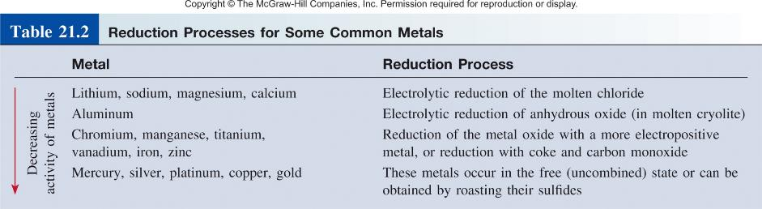

Mn nodules on the ocean floor

Slide 7
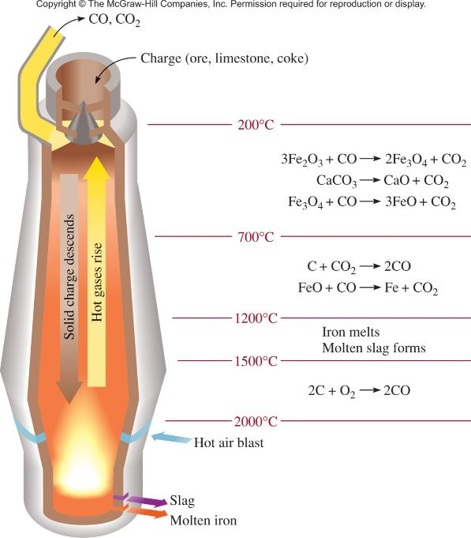

Blast Furnace for Producing Iron
(reduction process)

Slide 8

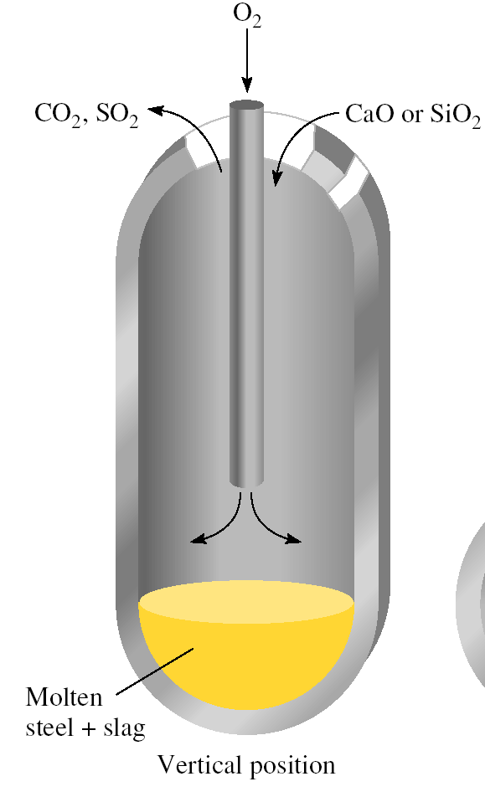
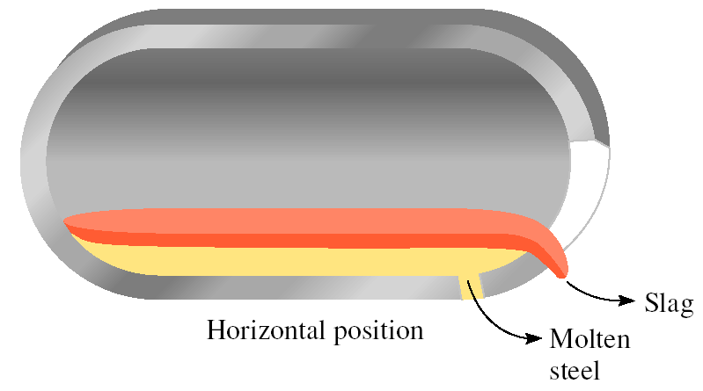

Steel Manufacturing via the Oxygen Process
(oxidation process)

Slide 9
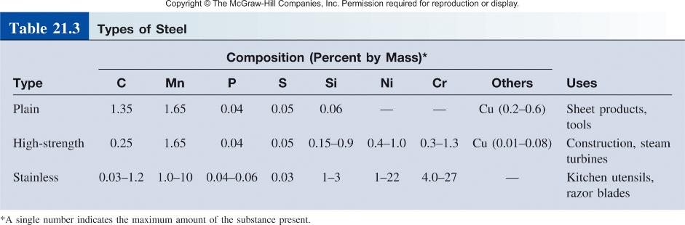

Slide 10
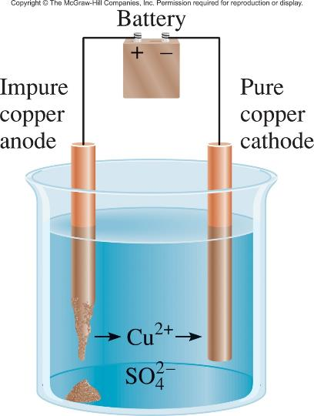
Purification of Metals
Distillation
70 ºC
Ni (s) + 4CO (g) Ni(CO)₄ (g)
200 ºC
Ni(CO)₄(g) Ni (s) + 4CO (g)
Electrolysis
Cu (s) (impure) Cu²⁺ (aq) + 2e⁻
Cu²⁺ (aq) + 2e⁻ Cu (s) (pure)
Zone refining

Slide 11
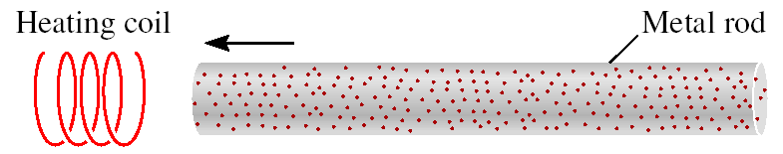
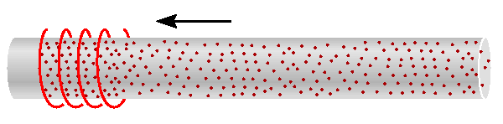
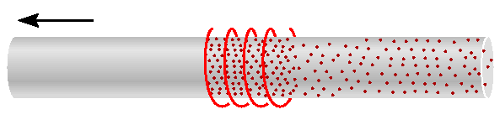
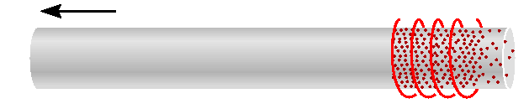
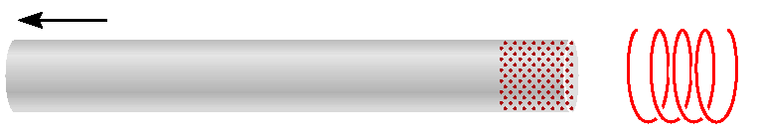
Zone Refining of Metals

Slide 12
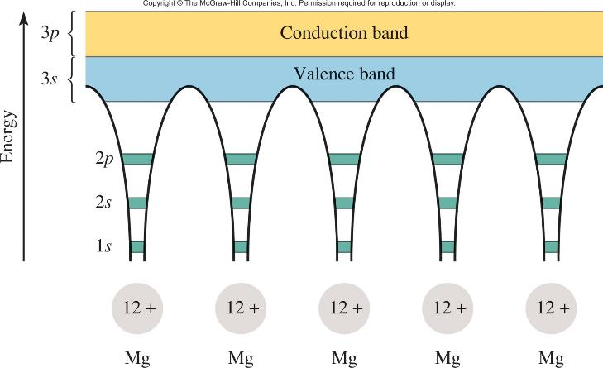
In band theory of conductivity, delocalized electrons move freely through “bands” formed by overlapping molecular orbitals.
Mg 1s²2s²2p⁶3s² or [Ne]3s²
e⁻

Slide 13
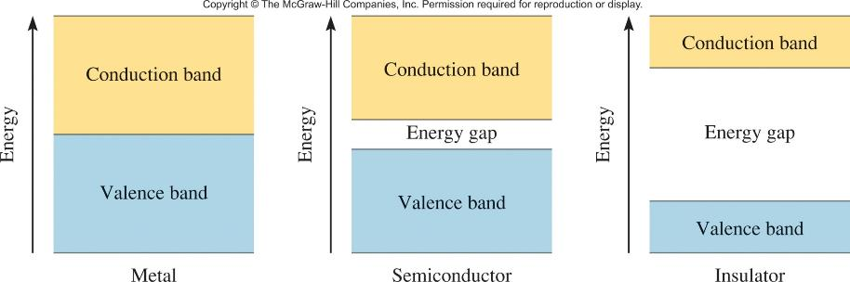
Energy Gaps Between Valence and Conduction Bands in
Metals, Semiconductors and Insulators
e⁻
e⁻

Slide 14
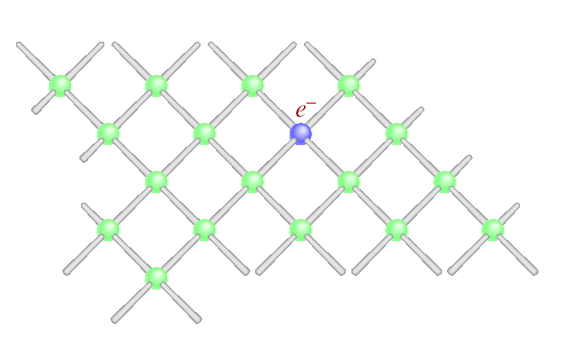
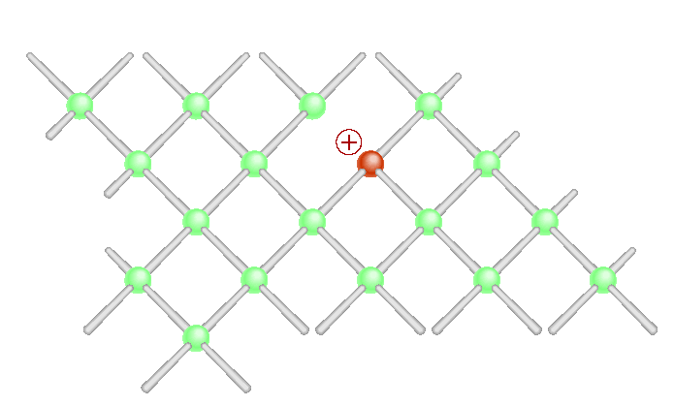
Semiconductors
Si
[Ne]3s²3p²
n-type semiconductor
p-type semiconductor
donor impurities
acceptor impurities
P
B
[Ne]3s²3p³
[Ne]3s²3p¹

Slide 15
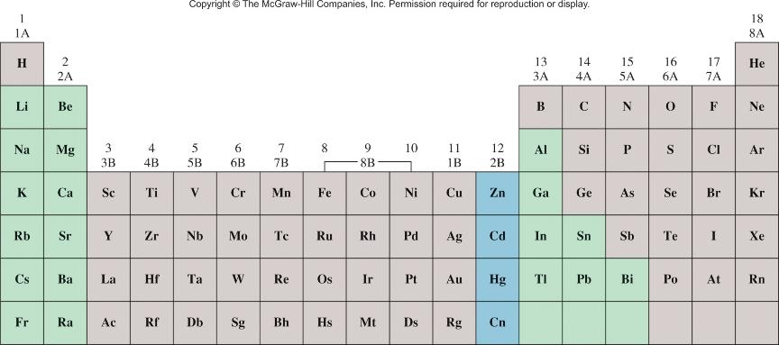
Increasing Metallic Character
Increasing Metallic Character

Slide 16
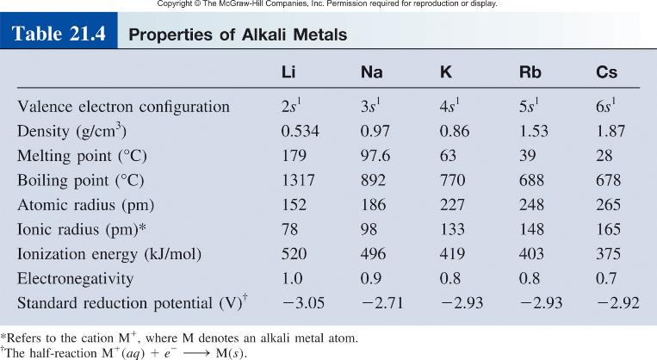
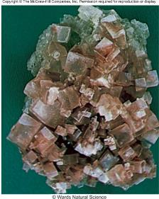
Halite: NaCl

Slide 17
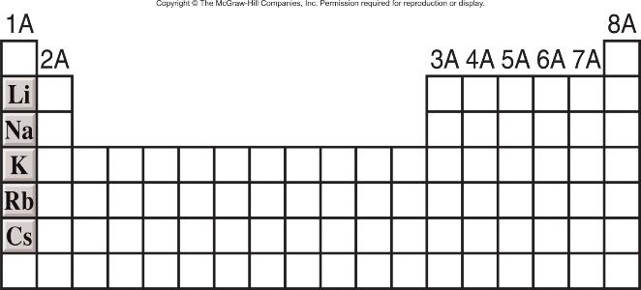
Alkali Metals (ns¹, n ≥ 2)
M M⁺¹ + 1e⁻
2M_{(s)} + 2H₂O_{(l)} 2MOH_{(aq)} + H_{2(g)}
2M_{(s)} + ½ O_{2(g)} M₂O_{(s)}
Increasing reactivity

Slide 18
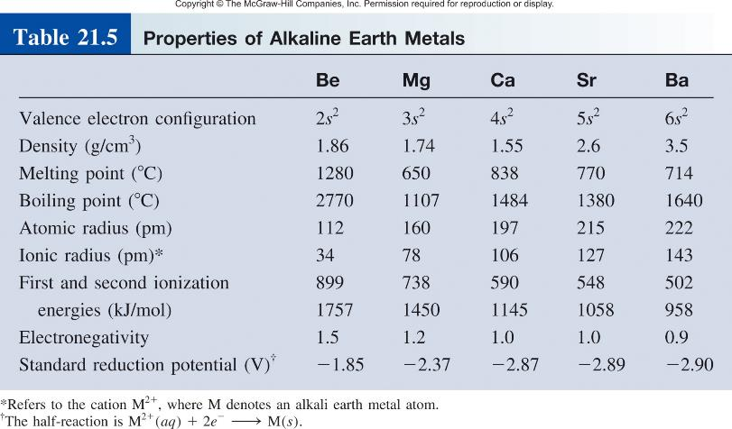
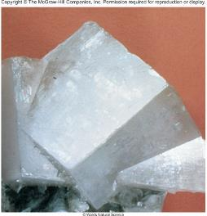
Dolomite: MgCO₃ · CaCO₃

Slide 19
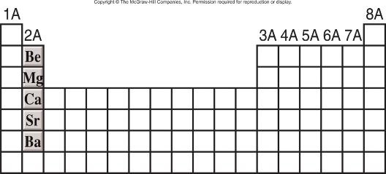
Alkaline Earth Metals (ns², n ≥ 2)
M M⁺² + 2e⁻
Be_{(s)} + 2H₂O_{(l)} No Reaction
Mg_{(s)} + H₂O_{(g)} MgO _{(s)} + H_{2(g)}
M_{(s)} + 2H₂O_{(l)} M(OH)_{2(aq)} + H_{2(g)} M = Ca, Sr, or Ba
Increasing reactivity

Slide 20
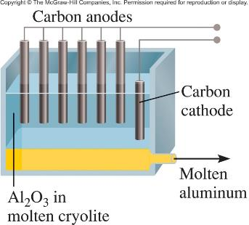
Aluminum
Impure Al₂O₃ (s) + 2OH⁻ (aq) 2AlO₂⁻ (aq) + H₂O (l)
AlO₂⁻ (s) + H₃O⁺ (aq) Al(OH)₃ (s)
Δ
2Al(OH)₃ (s) Al₂O₃ (s) + 3H₂O (g)
Anode:
3[2O²⁻ O₂ (g) + 4e⁻]
Cathode:
4[Al³⁺ + 3e⁻ Al (l)]
2Al₂O₃ 4Al (l) + 3O₂ (g)

Slide 21
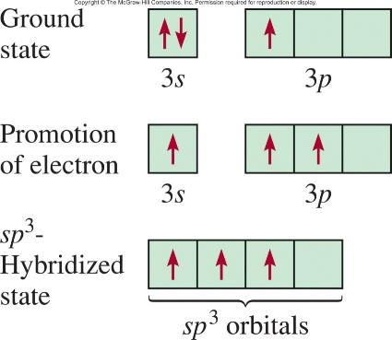
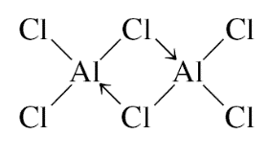
AlCl₃ Dimer
Amphoterism

Slide 22
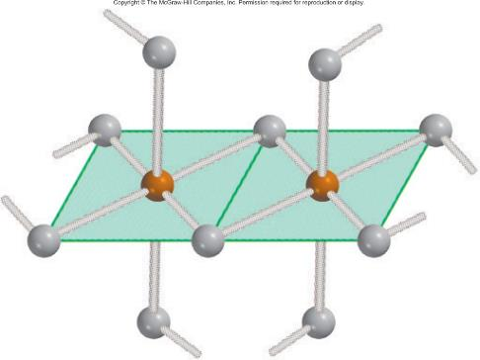



Aluminum hydride: a polymer
Double salts

Slide 23
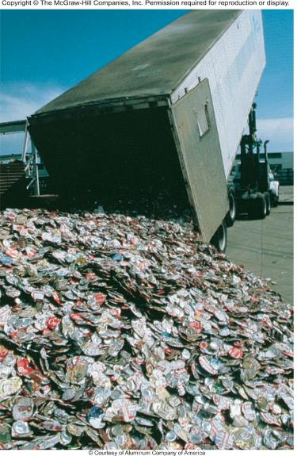
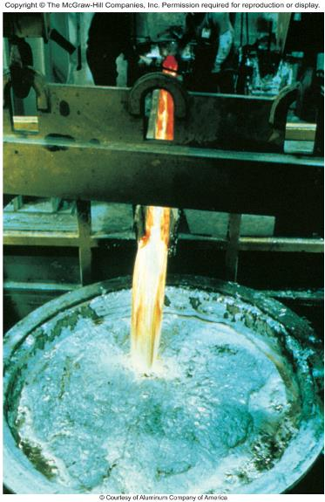
Chemistry In Action: Recycling Aluminum
Collecting
Purifying

