Slide 1

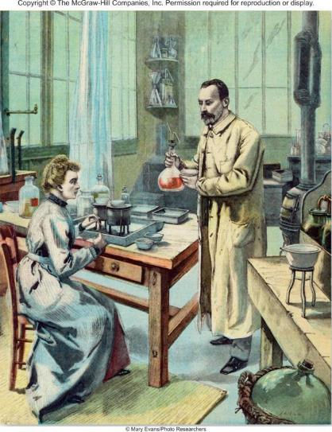
Atoms, Molecules, and Ions
Chapter 2
Copyright © The McGraw-Hill Companies, Inc. Permission required for reproduction or display.

Slide 2
Dalton’s Atomic Theory (1808)
1. Elements are composed of extremely small particles called atoms.
2. All atoms of a given element are identical, having the same size, mass and chemical properties. The atoms of one element are different from the atoms of all other elements.
3. Compounds are composed of atoms of more than one element. In any compound, the ratio of the numbers of atoms of any two of the elements present is either an integer or a simple fraction.
4. A chemical reaction involves only the separation, combination, or rearrangement of atoms; it does not result in their creation or destruction.

Slide 3
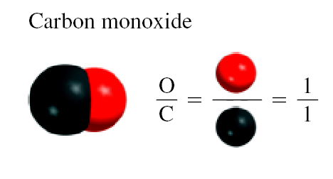
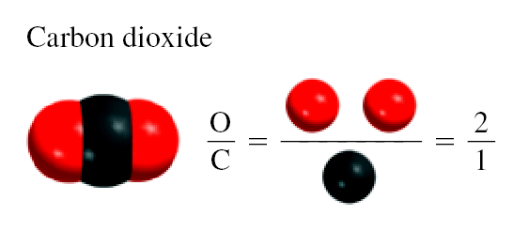
Dalton’s Atomic Theory
Law of Multiple Proportions

Slide 4
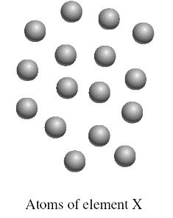
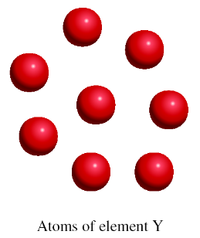
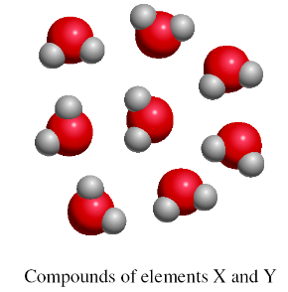
16 X
+
8 Y
8 X₂Y
Law of Conservation of Mass

Slide 5
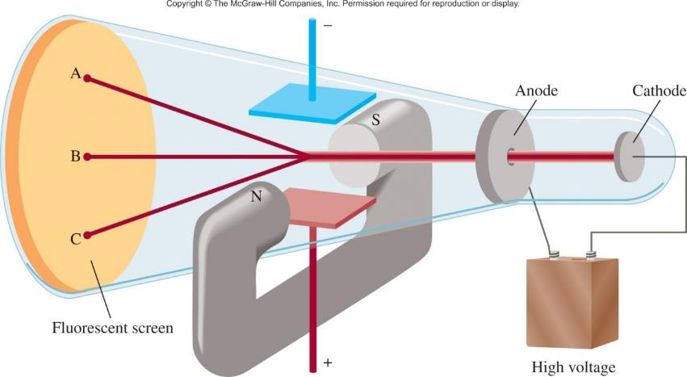
Cathode Ray Tube
J.J. Thomson, measured mass/charge of e⁻
(1906 Nobel Prize in Physics)

Slide 6
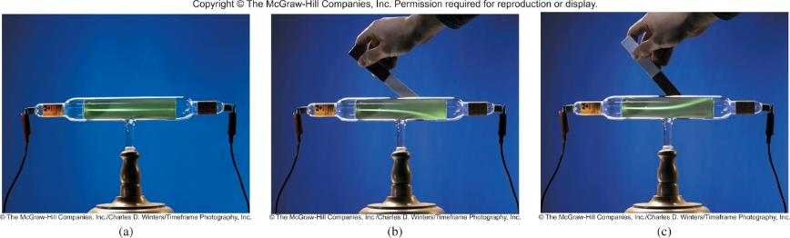
Cathode Ray Tube

Slide 7
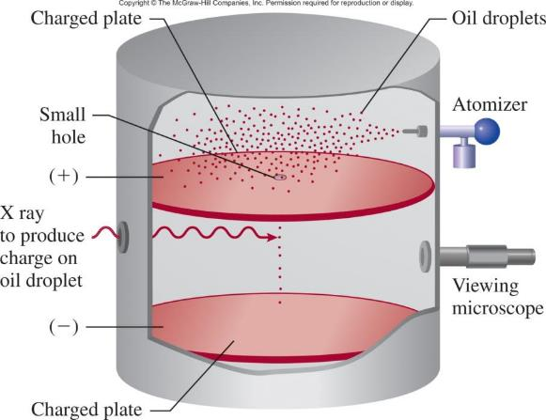
Millikan’s Experiment
Measured mass of e⁻
(1923 Nobel Prize in Physics)
e⁻ charge = -1.60 x 10⁻¹⁹ C
Thomson’s charge/mass of e⁻ = -1.76 x 10⁸ C/g
e⁻ mass = 9.10 x 10⁻²⁸ g

Slide 8
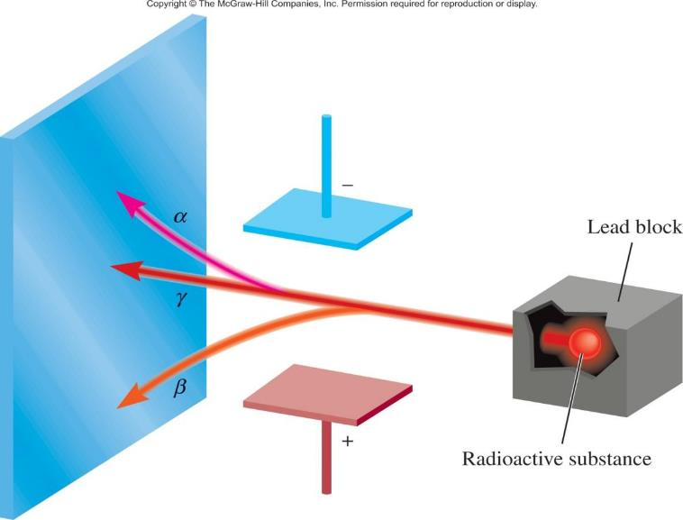
Types of Radioactivity
(uranium compound)

Slide 9
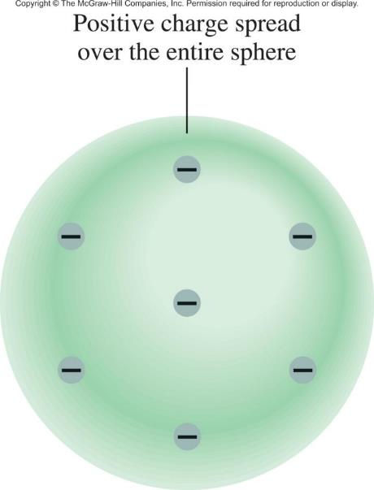
Thomson’s Model

Slide 10
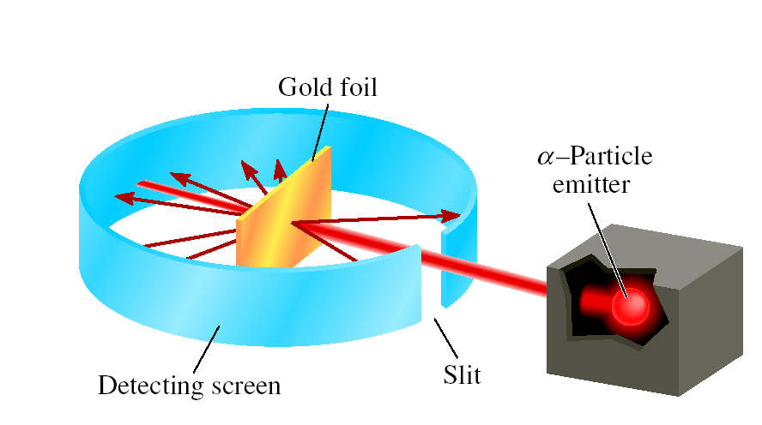
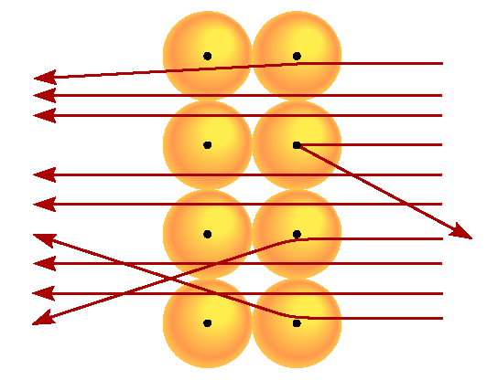
Rutherford’s Experiment
(1908 Nobel Prize in Chemistry)
particle velocity ~ 1.4 x 10⁷ m/s
(~5% speed of light)
atoms positive charge is concentrated in the nucleus
proton (p) has opposite (+) charge of electron (-)
mass of p is 1840 x mass of e⁻ (1.67 x 10⁻²⁴ g)

Slide 11
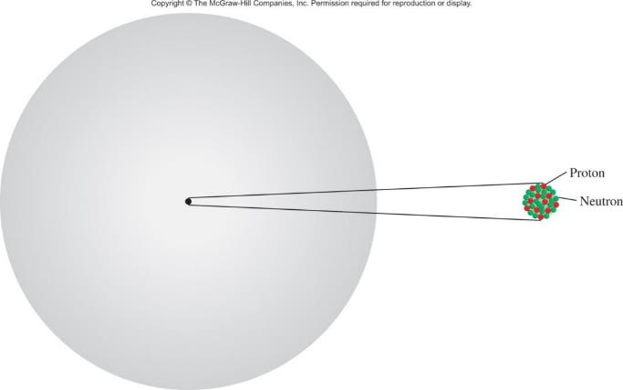

Rutherford’s Model of
the Atom
atomic radius ~ 100 pm = 1 x 10⁻¹⁰ m
nuclear radius ~ 5 x 10⁻³ pm = 5 x 10⁻¹⁵ m
“If the atom is the Houston Astrodome, then the nucleus is a marble on the 50-yard line.”

Slide 12
Chadwick’s Experiment (1932)
(1935 Noble Prize in Physics)
H atoms: 1 p; He atoms: 2 p
mass He/mass H should = 2
measured mass He/mass H = 4
α + ⁹Be
¹n + ¹²C + energy
neutron (n) is neutral (charge = 0)
n mass ~ p mass = 1.67 x 10⁻²⁴ g

Slide 13
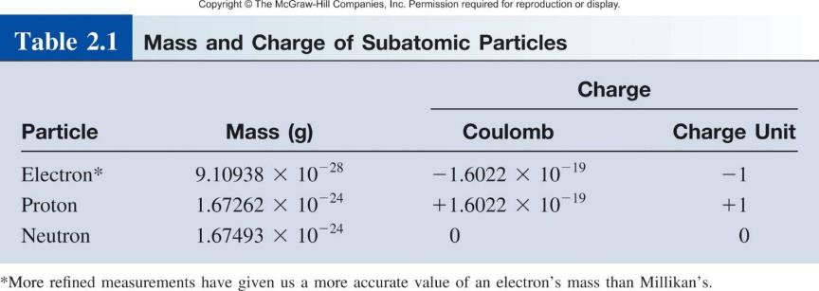
mass p ≈ mass n ≈ 1840 x mass e⁻

Slide 14
Atomic Number, Mass Number, and Isotopes
Atomic number (Z) = number of protons in nucleus
Mass number (A) = number of protons + number of neutrons
= atomic number (Z) + number of neutrons
Isotopes are atoms of the same element (X) with different numbers of neutrons in their nuclei
Mass Number
A
X
Element Symbol
Atomic Number
Z
1
2
3
H
H (D)
H (T)
1
1
1
235
U
238
U
92
92

Slide 15
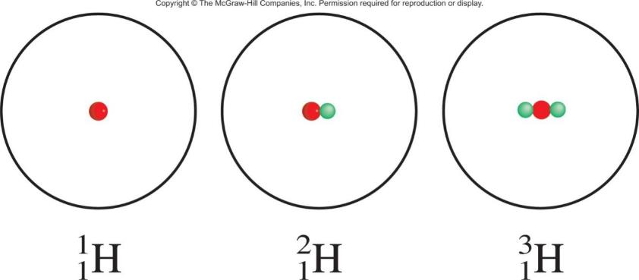
The Isotopes of Hydrogen

Slide 16



2.1
Give the number of protons, neutrons, and electrons in each of the following species:
(c)
(d) carbon-14

Slide 17
2.1
Strategy Recall that the superscript denotes the mass number (A) and the subscript denotes the atomic number (Z).
Mass number is always greater than atomic number. (The only exception is H, where the mass number is equal to the atomic number.)
In a case where no subscript is shown, as in parts (c) and (d), the atomic number can be deduced from the element symbol or name.
To determine the number of electrons, remember that because atoms are electrically neutral, the number of electrons is equal to the number of protons.

Slide 18

2.1
Solution
The atomic number is 11, so there are 11 protons. The mass number is 20, so the number of neutrons is 20 − 11 = 9. The number of electrons is the same as the number of protons; that is, 11.
(b) The atomic number is the same as that in (a), or 11. The mass number is 22, so the number of neutrons is 22 − 11 = 11. The number of electrons is 11. Note that the species in (a) and (b) are chemically similar isotopes of sodium.

Slide 19

2.1
The atomic number of O (oxygen) is 8, so there are 8 protons. The mass number is 17, so there are 17 − 8 = 9 neutrons. There are 8 electrons.
(d) Carbon-14 can also be represented as ¹⁴C. The atomic number of carbon is 6, so there are 14 − 6 = 8 neutrons. The number of electrons is 6.

Slide 20
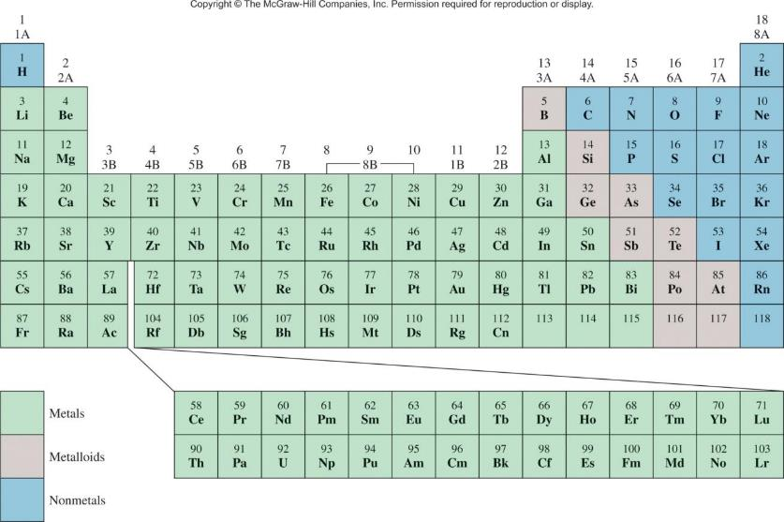
The Modern Periodic Table
Halogen
Alkali Metal
Noble Gas
Alkali Earth Metal
Group
Period

Slide 21
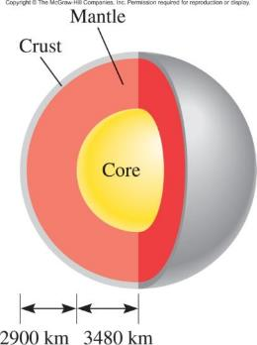
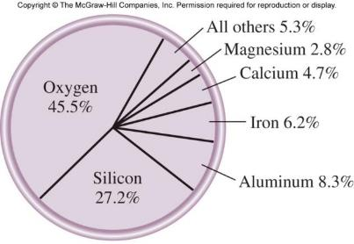
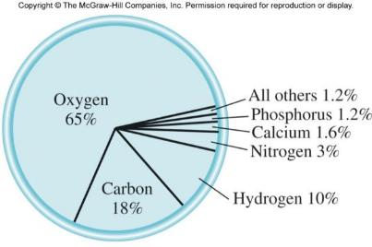
Chemistry In Action
Natural abundance of elements in Earth’s crust:
Natural abundance of elements in human body:

Slide 22
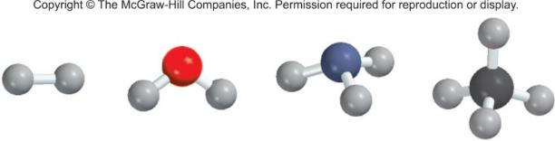
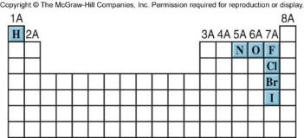
A molecule is an aggregate of two or more atoms in a definite arrangement held together by chemical forces.
H₂
H₂O
NH₃
CH₄
A diatomic molecule contains only two atoms:
H₂, N₂, O₂, Br₂, HCl, CO
diatomic elements
A polyatomic molecule contains more than two atoms:
O₃, H₂O, NH₃, CH₄

Slide 23
An ion is an atom, or group of atoms, that has a net positive or negative charge.
cation – ion with a positive charge
If a neutral atom loses one or more electrons
it becomes a cation.
Na
11 protons
11 electrons
11 protons
10 electrons
Na⁺
anion – ion with a negative charge
If a neutral atom gains one or more electrons
it becomes an anion.
Cl
17 protons
17 electrons
17 protons
18 electrons
Cl⁻

Slide 24
A monatomic ion contains only one atom:
Na⁺, Cl⁻, Ca²⁺, O²⁻, Al³⁺, N³⁻
A polyatomic ion contains more than one atom:
OH⁻, CN⁻, NH₄⁺, NO₃⁻

Slide 25
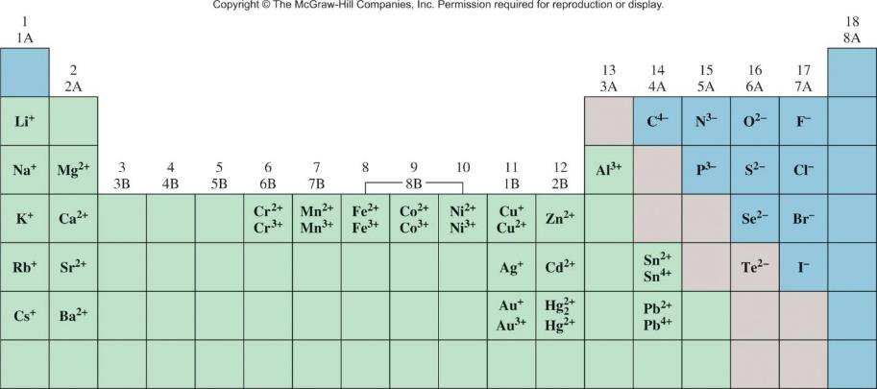
Common Ions Shown on the Periodic Table

Slide 26

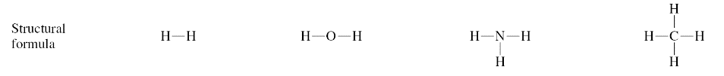
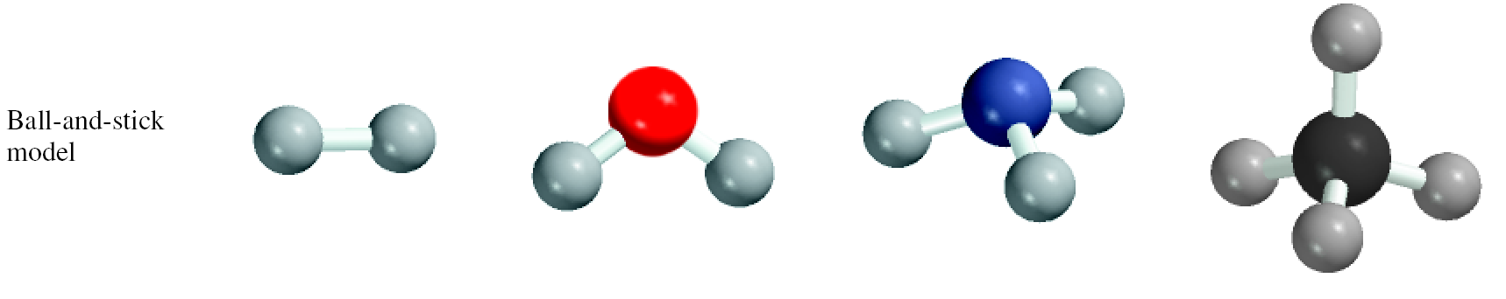
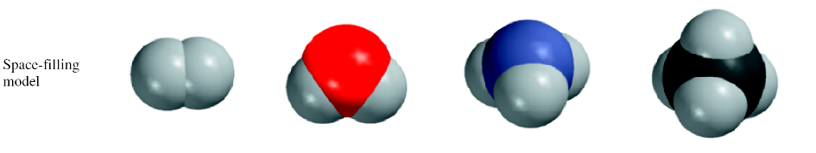
Formulas and Models

Slide 27
A molecular formula shows the exact number of atoms of each element in the smallest unit of a substance.
An empirical formula shows the simplest
whole-number ratio of the atoms in a substance.
molecular
empirical
H₂O
H₂O
C₆H₁₂O₆
CH₂O
O₃
O
N₂H₄
NH₂

Slide 28
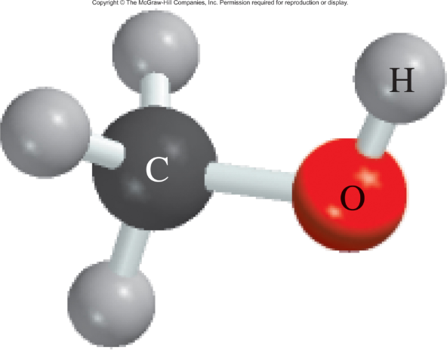
2.2
Write the molecular formula of methanol, an organic solvent and antifreeze, from its ball-and-stick model, shown below.

Slide 29
2.2
Solution
Refer to the labels (also see back endpapers).
There are four H atoms, one C atom, and one O atom. Therefore, the molecular formula is CH₄O.
However, the standard way of writing the molecular formula for methanol is CH₃OH because it shows how the atoms are joined in the molecule.

Slide 30
2.3
Write the empirical formulas for the following molecules:
acetylene (C₂H₂), which is used in welding torches
glucose (C₆H₁₂O₆), a substance known as blood sugar
nitrous oxide (N₂O), a gas that is used as an anesthetic gas (“laughing gas”) and as an aerosol propellant for whipped creams.

Slide 31
2.3
Strategy
Recall that to write the empirical formula, the subscripts in the molecular formula must be converted to the smallest possible whole numbers.

Slide 32
2.3
Solution
There are two carbon atoms and two hydrogen atoms in acetylene. Dividing the subscripts by 2, we obtain the empirical formula CH.
In glucose there are 6 carbon atoms, 12 hydrogen atoms, and 6 oxygen atoms. Dividing the subscripts by 6, we obtain the empirical formula CH₂O. Note that if we had divided the subscripts by 3, we would have obtained the formula C₂H₄O₂. Although the ratio of carbon to hydrogen to oxygen atoms in C₂H₄O₂ is the same as that in C₆H₁₂O₆ (1:2:1), C₂H₄O₂ is not the simplest formula because its subscripts are not in the smallest whole-number ratio.

Slide 33
2.3
(c) Because the subscripts in N₂O are already the smallest possible whole numbers, the empirical formula for nitrous oxide is the same as its molecular formula.

Slide 34
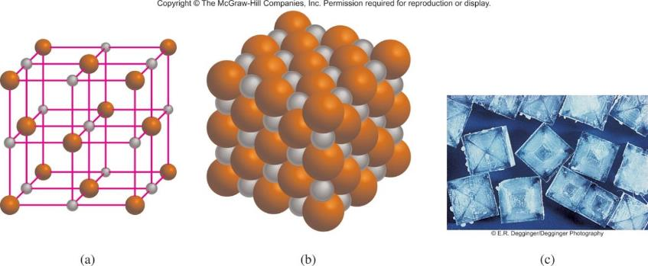
Ionic compounds consist of a combination of cations and anions.
The formula is usually the same as the empirical formula.
The sum of the charges on the cation(s) and anion(s) in each formula unit must equal zero.
The ionic compound NaCl

Slide 35
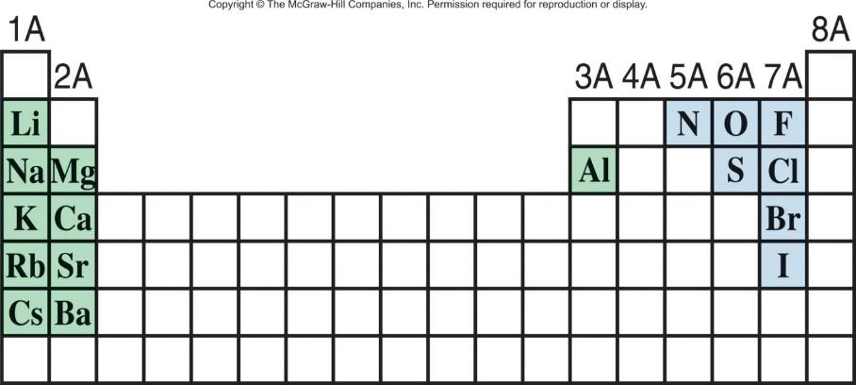
The most reactive metals (green) and the most reactive nonmetals (blue) combine to form ionic compounds.

Slide 36
Formulas of Ionic Compounds
2 x +3 = +6
3 x -2 = -6
Al₂O₃
Al³⁺
O²⁻
1 x +2 = +2
2 x -1 = -2
CaBr₂
Ca²⁺
Br⁻
2 x +1 = +2
1 x -2 = -2
Na₂CO₃
Na⁺
CO₃²⁻

Slide 37
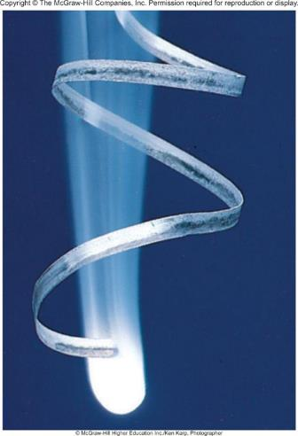
2.4
Write the formula of magnesium nitride, containing the Mg²⁺ and N³⁻ ions.
When magnesium burns in air, it forms both magnesium oxide and magnesium nitride.

Slide 38
2.4
Strategy Our guide for writing formulas for ionic compounds is electrical neutrality; that is, the total charge on the cation(s) must be equal to the total charge on the anion(s).
Because the charges on the Mg²⁺ and N³⁻ ions are not equal, we know the formula cannot be MgN.
Instead, we write the formula as Mg_{x}N_{y}, where x and y are subscripts to be determined.

Slide 39
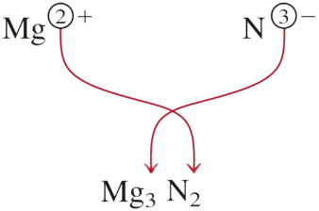
2.4
Solution To satisfy electrical neutrality, the following relationship must hold:
(+2)x + (−3)y = 0
Solving, we obtain x/y = 3/2. Setting x = 3 and y = 2, we write
Check The subscripts are reduced to the smallest whole- number ratio of the atoms because the chemical formula of an ionic compound is usually its empirical formula.

Slide 40
Chemical Nomenclature
Ionic Compounds
  Often a metal + nonmetal
  Anion (nonmetal), add “-ide” to element name
BaCl₂
barium chloride
K₂O
potassium oxide
Mg(OH)₂
magnesium hydroxide
KNO₃
potassium nitrate

Slide 41
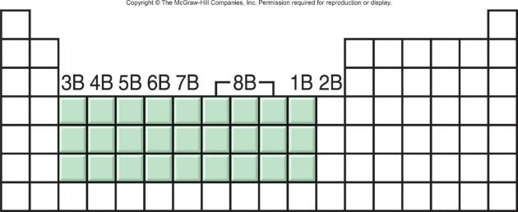
Transition metal ionic compounds
  indicate charge on metal with Roman numerals
FeCl₂
2 Cl⁻ -2 so Fe is +2
iron(II) chloride
FeCl₃
3 Cl⁻ -3 so Fe is +3
iron(III) chloride
Cr₂S₃
3 S⁻² -6 so Cr is +3 (6/2)
chromium(III) sulfide

Slide 42
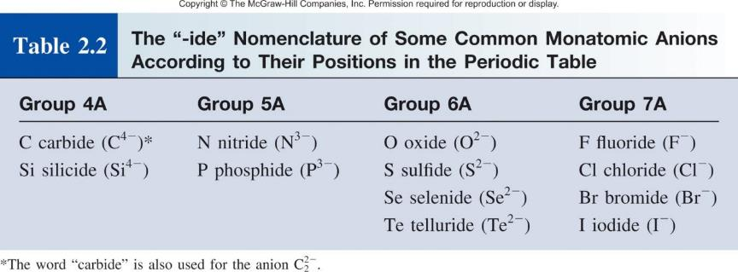

Slide 43
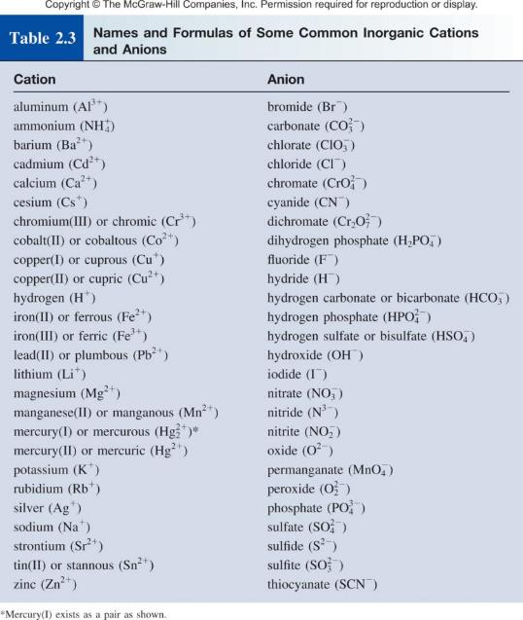

Slide 44
2.5
Name the following compounds:
Cu(NO₃)₂
KH₂PO₄
NH₄ClO₃

Slide 45
2.5
Strategy Note that the compounds in (a) and (b) contain both metal and nonmetal atoms, so we expect them to be ionic compounds.
There are no metal atoms in (c) but there is an ammonium group, which bears a positive charge. So NH₄ClO₃ is also an ionic compound.
Our reference for the names of cations and anions is Table 2.3.
Keep in mind that if a metal atom can form cations of different charges (see Figure 2.11), we need to use the Stock system.

Slide 46




2.5
Solution
The nitrate ion ( ) bears one negative charge, so the copper ion must have two positive charges. Because copper forms both Cu⁺ and Cu²⁺ ions, we need to use the Stock system and call the compound copper(II) nitrate.
The cation is K⁺ and the anion is (dihydrogen phosphate). Because potassium only forms one type of ion (K⁺), there is no need to use potassium(I) in the name. The compound is potassium dihydrogen phosphate.
(c) The cation is (ammonium ion) and the anion is . The compound is ammonium chlorate.

Slide 47
2.6
Write chemical formulas for the following compounds:
mercury(I) nitrite
cesium sulfide
calcium phosphate

Slide 48
2.6
Strategy
We refer to Table 2.3 for the formulas of cations and anions.
Recall that the Roman numerals in the Stock system provide useful information about the charges of the cation.

Slide 49


2.6
Solution
The Roman numeral shows that the mercury ion bears a +1 charge. According to Table 2.3, however, the mercury(I) ion is diatomic (that is, ) and the nitrite ion is . Therefore, the formula is Hg₂(NO₂)₂.
Each sulfide ion bears two negative charges, and each cesium ion bears one positive charge (cesium is in Group 1A, as is sodium). Therefore, the formula is Cs₂S.

Slide 50

2.6
(c) Each calcium ion (Ca²⁺) bears two positive charges, and each phosphate ion ( ) bears three negative charges.
To make the sum of the charges equal zero, we must adjust the numbers of cations and anions:
3(+2) + 2(−3) = 0
Thus, the formula is Ca₃(PO₄)₂.

Slide 51
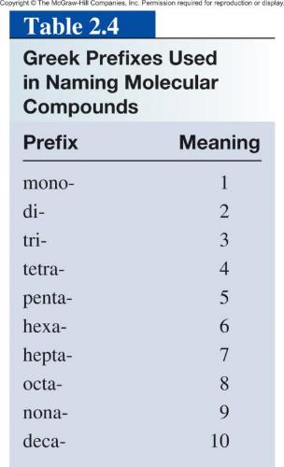
Molecular compounds
  Nonmetals or nonmetals + metalloids
  Common names
    H₂O, NH₃, CH₄
  Element furthest to the left in a period and closest to the bottom of a group on periodic table is placed first in formula
  If more than one compound can be formed from the same elements, use prefixes to indicate number of each kind of atom
  Last element name ends in -ide

Slide 52
Molecular Compounds
HI
hydrogen iodide
NF₃
nitrogen trifluoride
SO₂
sulfur dioxide
N₂Cl₄
dinitrogen tetrachloride
NO₂
nitrogen dioxide
N₂O
dinitrogen monoxide

Slide 53
2.7
Name the following molecular compounds:
SiCl₄
P₄O₁₀

Slide 54
2.7
Strategy
We refer to Table 2.4 for prefixes.
In (a) there is only one Si atom so we do not use the prefix “mono.”
Solution
Because there are four chlorine atoms present, the compound is silicon tetrachloride.
There are four phosphorus atoms and ten oxygen atoms present, so the compound is tetraphosphorus decoxide. Note that the “a” is omitted in “deca.”

Slide 55
2.8
Write chemical formulas for the following molecular compounds:
carbon disulfide
(b) disilicon hexabromide

Slide 56
2.8
Strategy
Here we need to convert prefixes to numbers of atoms (see Table 2.4).
Because there is no prefix for carbon in (a), it means that there is only one carbon atom present.
Solution
Because there are two sulfur atoms and one carbon atom present, the formula is CS₂.
(b) There are two silicon atoms and six bromine atoms present, so the formula is Si₂Br₆.

Slide 57
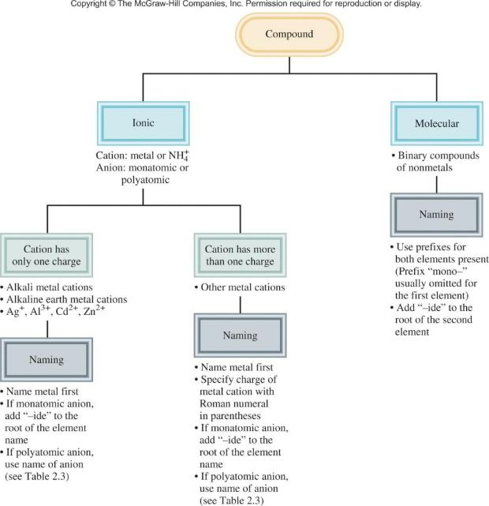

Slide 58
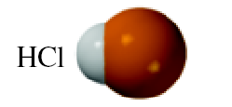
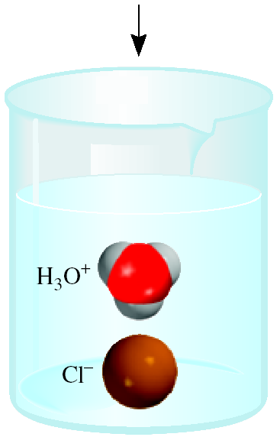
An acid can be defined as a substance that yields
hydrogen ions (H⁺) when dissolved in water.
For example: HCl gas and HCl in water
  Pure substance, hydrogen chloride
  Dissolved in water (H₃O⁺ and Cl⁻),
  hydrochloric acid

Slide 59
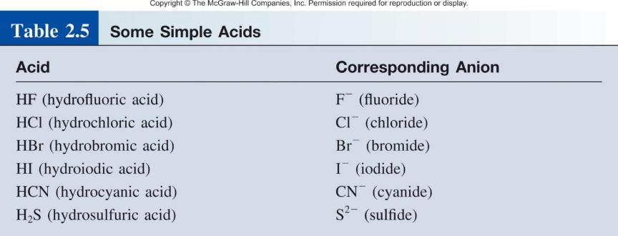

Slide 60
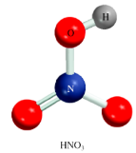
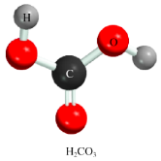
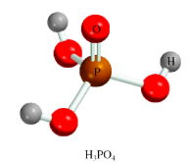
An oxoacid is an acid that contains hydrogen, oxygen, and another element.
HNO₃
nitric acid
H₂CO₃
carbonic acid
H₃PO₄
phosphoric acid

Slide 61
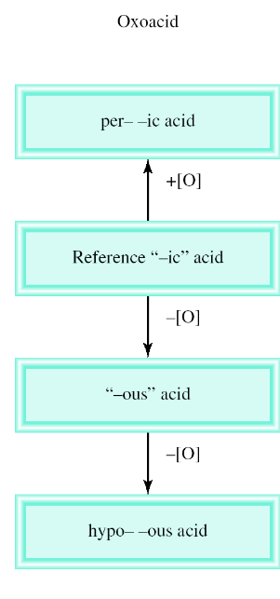
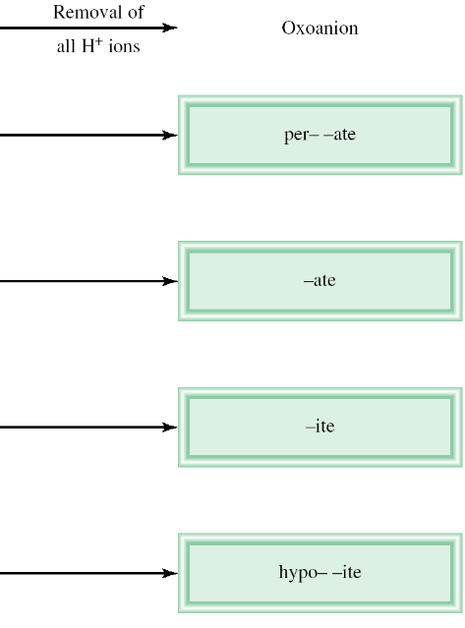
Naming Oxoacids and Oxoanions

Slide 62
The rules for naming oxoanions, anions of
oxoacids, are as follows:
1. When all the H ions are removed from the “-ic” acid, the anion’s name ends with “-ate.”
2. When all the H ions are removed from the “-ous” acid, the anion’s name ends with “-ite.”
3. The names of anions in which one or more but not all the hydrogen ions have been removed must indicate the number of H ions present.
For example:
  H₂PO₄⁻ dihydrogen phosphate
  HPO₄ ²⁻ hydrogen phosphate
  PO₄³⁻ phosphate

Slide 63
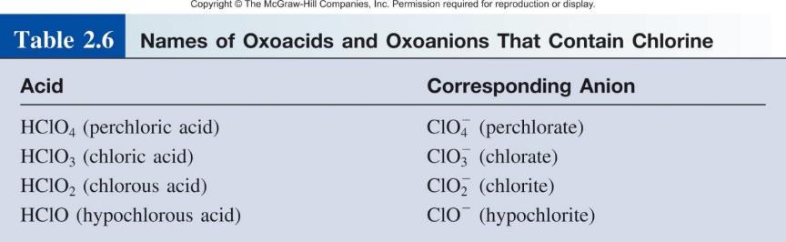

Slide 64

2.9
Name the following oxoacid and oxoanion:
H₃PO₃

Slide 65
2.9
Strategy To name the acid in (a), we first identify the reference acid, whose name ends with “ic,” as shown in Figure 2.15.
In (b), we need to convert the anion to its parent acid shown in Table 2.6.
Solution
We start with our reference acid, phosphoric acid (H₃PO₄). Because H₃PO₃ has one fewer O atom, it is called phosphorous acid.
The parent acid is HIO₄. Because the acid has one more O atom than our reference iodic acid (HIO₃), it is called periodic acid. Therefore, the anion derived from HIO₄ is called periodate.

Slide 66
A base can be defined as a substance that yields
hydroxide ions (OH⁻) when dissolved in water.
NaOH
sodium hydroxide
KOH
potassium hydroxide
Ba(OH)₂
barium hydroxide

Slide 67
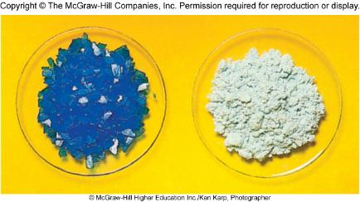
Hydrates are compounds that have a specific number of water molecules attached to them.
BaCl₂•2H₂O
barium chloride dihydrate
LiCl•H₂O
lithium chloride monohydrate
MgSO₄•7H₂O
magnesium sulfate heptahydrate
Sr(NO₃)₂ •4H₂O
strontium nitrate tetrahydrate
CuSO₄•5H₂O
CuSO₄

Slide 68
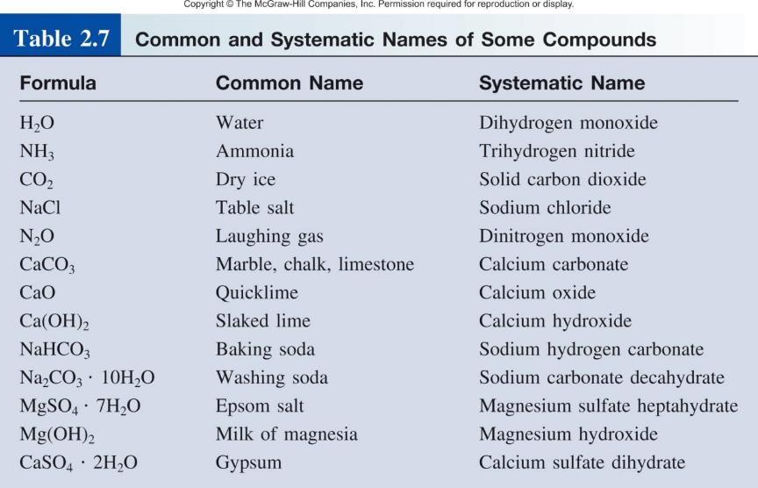

Slide 69
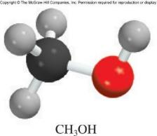
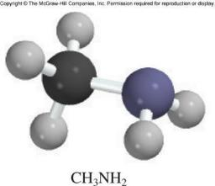
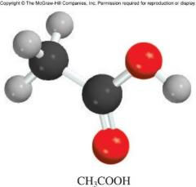
Organic chemistry is the branch of chemistry that deals with carbon compounds.
Functional Groups:
H
H
H
O
H
C
OH
H
C
NH₂
H
C
C
OH
H
H
H
methanol
methylamine
acetic acid

Slide 70


