Slide 1

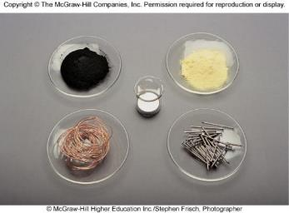
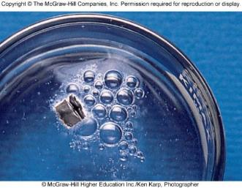
Mass Relationships in Chemical Reactions
Chapter 3
Copyright © The McGraw-Hill Companies, Inc. Permission required for reproduction or display.

Slide 2
Micro World
atoms & molecules
Macro World
grams
Atomic mass is the mass of an atom in atomic mass units (amu)
By definition:
1 atom ¹²C “weighs” 12 amu
On this scale
¹H = 1.008 amu
¹⁶O = 16.00 amu

Slide 3
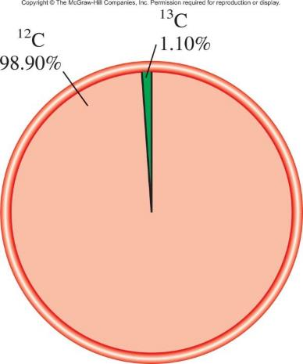
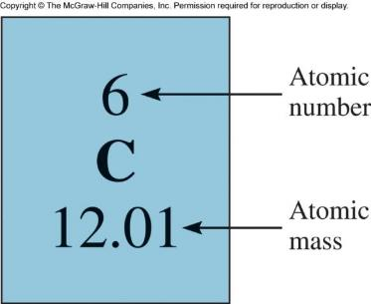
The average atomic mass is the weighted
average of all of the naturally occurring
isotopes of the element.

Slide 4
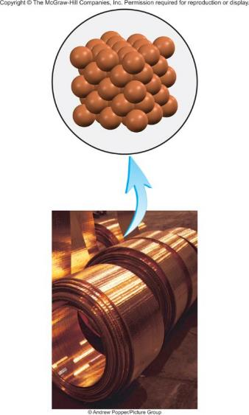


3.1
Copper, a metal known since ancient times, is used in electrical cables and pennies, among other things.
The atomic masses of its two stable isotopes, (69.09 percent) and (30.91 percent), are 62.93 amu and 64.9278 amu, respectively.
Calculate the average atomic mass of copper. The relative abundances are given in parentheses.

Slide 5
3.1
Strategy
Each isotope contributes to the average atomic mass based on its relative abundance.
Multiplying the mass of an isotope by its fractional abundance (not percent) will give the contribution to the average atomic mass of that particular isotope.

Slide 6
3.1
Solution
First the percents are converted to fractions:
69.09 percent to 69.09/100 or 0.6909
30.91 percent to 30.91/100 or 0.3091.
We find the contribution to the average atomic mass for each isotope, then add the contributions together to obtain the average atomic mass.
(0.6909) (62.93 amu) + (0.3091) (64.9278 amu) = 63.55 amu

Slide 7


3.1
Check
The average atomic mass should be between the two isotopic masses; therefore, the answer is reasonable.
Note that because there are more than isotopes, the average atomic mass is closer to 62.93 amu than to 64.9278 amu.

Slide 8
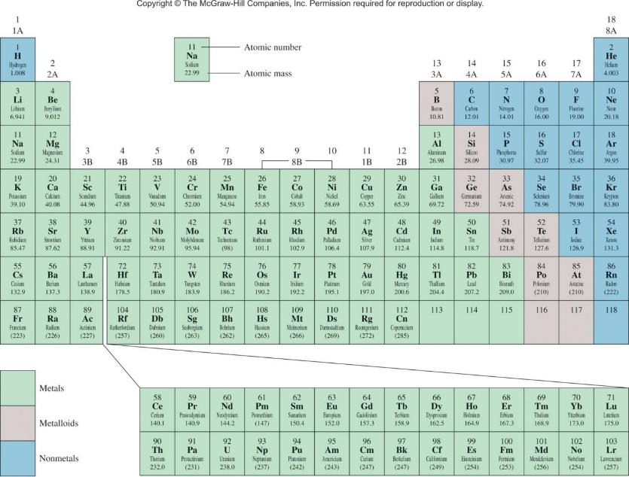
Average atomic mass (63.55)

Slide 9


The Mole (mol): A unit to count numbers of particles
Dozen = 12
Pair = 2
The mole (mol) is the amount of a substance that
contains as many elementary entities as there
are atoms in exactly 12.00 grams of ¹²C
1 mol = N_{A} = 6.0221415 x 10²³
Avogadro’s number (N_{A})

Slide 10
eggs
shoes
Molar mass is the mass of 1 mole of in grams
marbles
atoms
1 mole ¹²C atoms = 6.022 x 10²³ atoms = 12.00 g
1 ¹²C atom = 12.00 amu
1 mole ¹²C atoms = 12.00 g ¹²C
1 mole lithium atoms = 6.941 g of Li
For any element
atomic mass (amu) = molar mass (grams)

Slide 11
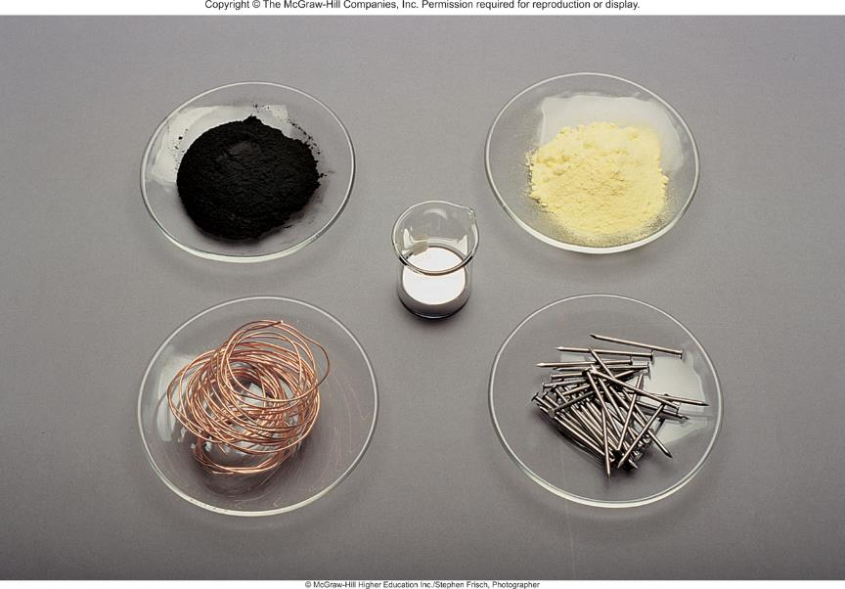
One Mole of:
C
S
Hg
Cu
Fe

Slide 12
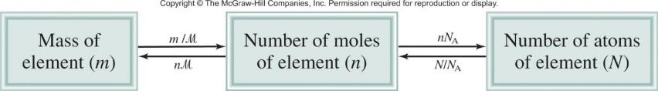
1 ¹²C atom
12.00 g
1.66 x 10⁻²⁴ g
x
=
12.00 amu
6.022 x 10²³ ¹²C atoms
1 amu
1 amu = 1.66 x 10⁻²⁴ g or 1 g = 6.022 x 10²³ amu
M = molar mass in g/mol
N_{A} = Avogadro’s number

Slide 13
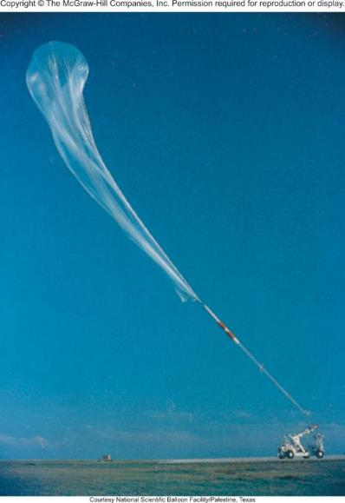
3.2
Helium (He) is a valuable gas used in industry, low-temperature research, deep-sea diving tanks, and balloons.
How many moles of He atoms are in 6.46 g of He?
A scientific research helium balloon.

Slide 14
3.2
Strategy
We are given grams of helium and asked to solve for moles of helium.
What conversion factor do we need to convert between grams and moles?
Arrange the appropriate conversion factor so that grams cancel and the unit moles is obtained for your answer.

Slide 15

3.2
Solution
The conversion factor needed to convert between grams and moles is the molar mass. In the periodic table (see inside front cover) we see that the molar mass of He is 4.003 g. This can be expressed as
1 mol He = 4.003 g He
From this equality, we can write two conversion factors
The conversion factor on the left is the correct one.

Slide 16

3.2
Grams will cancel, leaving the unit mol for the answer, that is,
Thus, there are 1.61 moles of He atoms in 6.46 g of He.
Check
Because the given mass (6.46 g) is larger than the molar mass of He, we expect to have more than 1 mole of He.

Slide 17
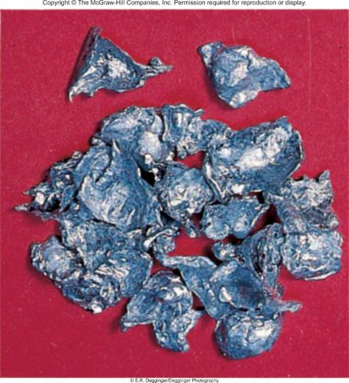
3.3
Zinc (Zn) is a silvery metal that is used in making brass (with copper) and in plating iron to prevent corrosion.
How many grams of Zn are in 0.356 mole of Zn?
Zinc

Slide 18
3.3
Strategy
We are trying to solve for grams of zinc.
What conversion factor do we need to convert between moles and grams?
Arrange the appropriate conversion factor so that moles cancel and the unit grams are obtained for your answer.

Slide 19

3.3
Solution
The conversion factor needed to convert between moles and grams is the molar mass. In the periodic table (see inside front cover) we see the molar mass of Zn is 65.39 g. This can be expressed as
1 mol Zn = 65.39 g Zn
From this equality, we can write two conversion factors
The conversion factor on the right is the correct one.

Slide 20

3.3
Moles will cancel, leaving unit of grams for the answer. The number of grams of Zn is
Thus, there are 23.3 g of Zn in 0.356 mole of Zn.
Check Does a mass of 23.3 g for 0.356 mole of Zn seem reasonable? What is the mass of 1 mole of Zn?

Slide 21
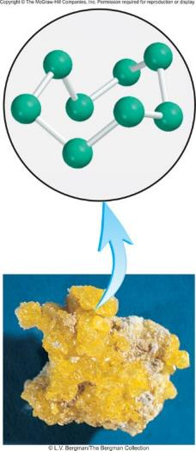
3.4
Sulfur (S) is a nonmetallic element that is present in coal.
When coal is burned, sulfur is converted to sulfur dioxide and eventually to sulfuric acid that gives rise to the acid rain phenomenon.
How many atoms are in 16.3 g of S?
Elemental sulfur (S₈) consists of eight S atoms joined in a ring.

Slide 22
3.4
Strategy
The question asks for atoms of sulfur.
We cannot convert directly from grams to atoms of sulfur.
What unit do we need to convert grams of sulfur to in order
to convert to atoms?
What does Avogadro’s number represent?

Slide 23

3.4
Solution
We need two conversions: first from grams to moles and then from moles to number of particles (atoms). The first step is similar to Example 3.2. Because
1 mol S = 32.07 g S
the conversion factor is
Avogadro’s number is the key to the second step. We have
1 mol = 6.022 × 10²³ particles (atoms)

Slide 24

3.4
and the conversion factors are
The conversion factor on the left is the one we need because it has number of S atoms in the numerator.
We can solve the problem by first calculating the number of moles contained in 16.3 g of S, and then calculating the number of S atoms from the number of moles of S:

Slide 25

3.4
We can combine these conversions in one step as follows:
Thus, there are 3.06 × 10²³ atoms of S in 16.3 g of S.
Check
Should 16.3 g of S contain fewer than Avogadro’s number of atoms?
What mass of S would contain Avogadro’s number of atoms?

Slide 26
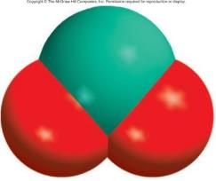
Molecular mass (or molecular weight) is the sum of
the atomic masses (in amu) in a molecule.
1S
32.07 amu
2O
+ 2 x 16.00 amu
SO₂
64.07 amu
SO₂
For any molecule
molecular mass (amu) = molar mass (grams)
1 molecule SO₂ = 64.07 amu
1 mole SO₂ = 64.07 g SO₂

Slide 27
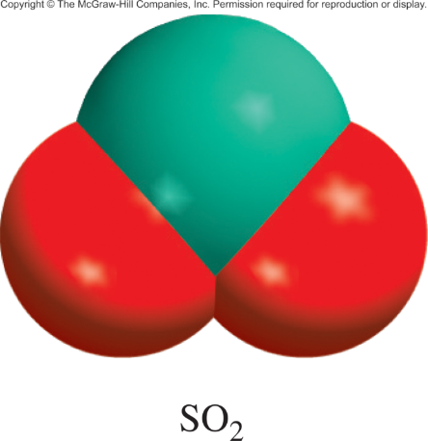
3.5
Calculate the molecular masses (in amu) of the following compounds:
sulfur dioxide (SO₂), a gas that is responsible for acid rain
caffeine (C₈H₁₀N₄O₂), a stimulant present in tea, coffee, and cola beverages

Slide 28
3.5
Strategy How do atomic masses of different elements combine to give the molecular mass of a compound?
Solution To calculate molecular mass, we need to sum all the atomic masses in the molecule. For each element, we multiply the atomic mass of the element by the number of atoms of that element in the molecule. We find atomic masses in the periodic table (inside front cover).
There are two O atoms and one S atom in SO₂, so that
molecular mass of SO₂ = 32.07 amu + 2(16.00 amu)
= 64.07 amu

Slide 29
3.5
(b) There are eight C atoms, ten H atoms, four N atoms, and two O atoms in caffeine, so the molecular mass of C₈H₁₀N₄O₂ is given by
8(12.01 amu) + 10(1.008 amu) + 4(14.01 amu) + 2(16.00 amu)
= 194.20 amu

Slide 30
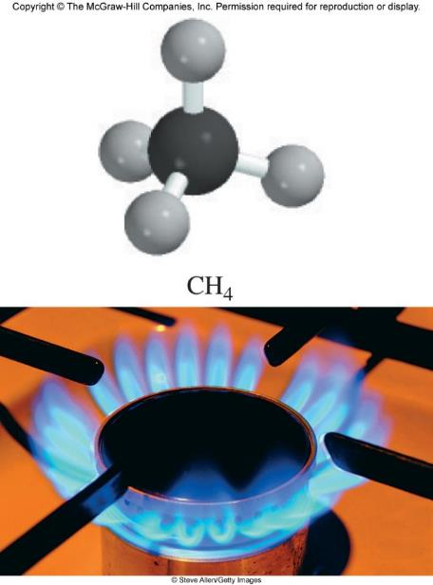
3.6
Methane (CH₄) is the principal component of natural gas.
How many moles of CH₄ are present in 6.07 g of CH₄?

Slide 31
3.6
Strategy
We are given grams of CH₄ and asked to solve for moles of CH₄.
What conversion factor do we need to convert between grams and moles?
Arrange the appropriate conversion factor so that grams cancel and the unit moles are obtained for your answer.

Slide 32

3.6
Solution
The conversion factor needed to convert between grams and moles is the molar mass. First we need to calculate the molar mass of CH₄, following the procedure in Example 3.5:
molar mass of CH₄ = 12.01 g + 4(1.008 g)
= 16.04 g
Because
1 mol CH₄ = 16.04 g CH₄
the conversion factor we need should have grams in the denominator so that the unit g will cancel, leaving the unit mol in the numerator:

Slide 33

3.6
We now write
Thus, there is 0.378 mole of CH₄ in 6.07 g of CH₄.
Check
Should 6.07 g of CH₄ equal less than 1 mole of CH₄?
What is the mass of 1 mole of CH₄?

Slide 34
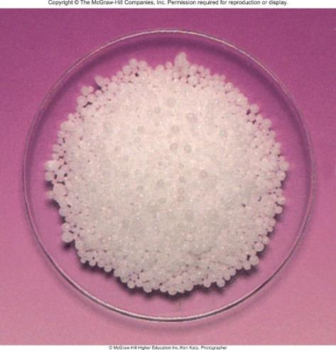
3.7
How many hydrogen atoms are present in 25.6 g of urea [(NH₂)₂CO], which is used as a fertilizer, in animal feed, and in the manufacture of polymers?
The molar mass of urea is 60.06 g.
urea

Slide 35
3.7
Strategy
We are asked to solve for atoms of hydrogen in 25.6 g of urea. We cannot convert directly from grams of urea to atoms of hydrogen.
How should molar mass and Avogadro’s number be used in this calculation?
How many moles of H are in 1 mole of urea?

Slide 36
3.7
Solution
To calculate the number of H atoms, we first must convert grams of urea to moles of urea using the molar mass of urea. This part is similar to Example 3.2.
The molecular formula of urea shows there are four moles of H atoms in one mole of urea molecule, so the mole ratio is 4:1.
Finally, knowing the number of moles of H atoms, we can calculate the number of H atoms using Avogadro’s number. We need two conversion factors: molar mass and Avogadro’s number.

Slide 37

3.7
We can combine these conversions
into one step:
= 1.03 × 10²⁴ H atoms
Check Does the answer look reasonable?
How many atoms of H would 60.06 g of urea contain?

Slide 38
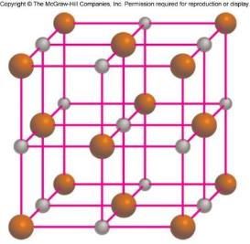
Formula mass is the sum of the atomic masses
(in amu) in a formula unit of an ionic compound.
1Na
22.99 amu
NaCl
1Cl
+ 35.45 amu
NaCl
58.44 amu
For any ionic compound
formula mass (amu) = molar mass (grams)
1 formula unit NaCl = 58.44 amu
1 mole NaCl = 58.44 g NaCl

Slide 39
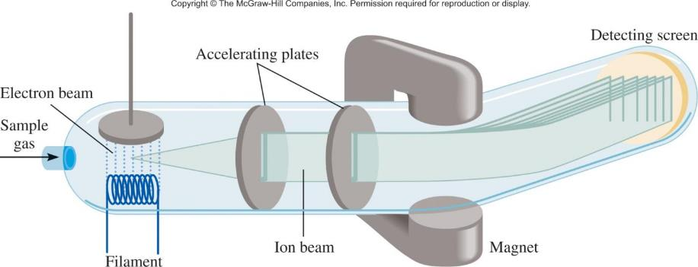
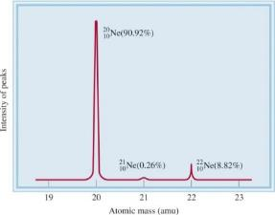
Mass Spectrometer
Light
Heavy
Light
Heavy
Mass Spectrum of Ne

Slide 40
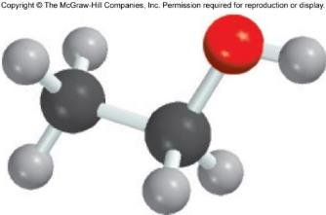
Percent composition of an element in a compound =
n x molar mass of element
x 100%
molar mass of compound
n is the number of moles of the element in 1 mole of the compound
2 x (12.01 g)
%C =
x 100% = 52.14%
46.07 g
6 x (1.008 g)
%H =
x 100% = 13.13%
46.07 g
1 x (16.00 g)
%O =
x 100% = 34.73%
46.07 g
C₂H₆O
52.14% + 13.13% + 34.73% = 100.0%

Slide 41
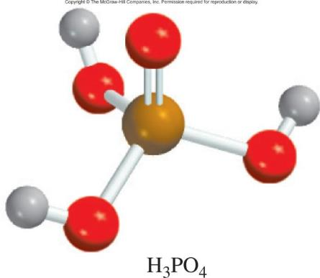
3.8
Phosphoric acid (H₃PO₄) is a colorless, syrupy liquid used in detergents, fertilizers, toothpastes, and in carbonated beverages for a “tangy” flavor.
Calculate the percent
composition by mass of H, P, and O in this compound.

Slide 42
3.8
Strategy
Recall the procedure for calculating a percentage.
Assume that we have 1 mole of H₃PO₄.
The percent by mass of each element (H, P, and O) is given by the combined molar mass of the atoms of the element in 1 mole of H₃PO₄ divided by the molar mass of H₃PO₄, then multiplied by 100 percent.

Slide 43
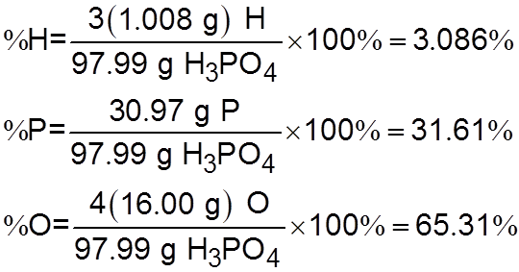
3.8
Solution The molar mass of H₃PO₄ is 97.99 g. The percent by mass of each of the elements in H₃PO₄ is calculated as follows:
Check Do the percentages add to 100 percent? The sum of the percentages is (3.086% + 31.61% + 65.31%) = 100.01%. The small discrepancy from 100 percent is due to the way we rounded off.

Slide 44
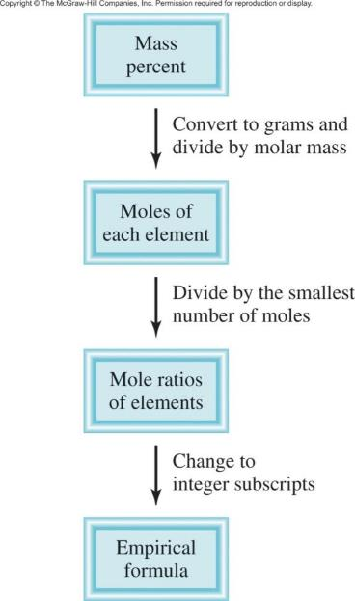
Percent Composition and Empirical Formulas

Slide 45
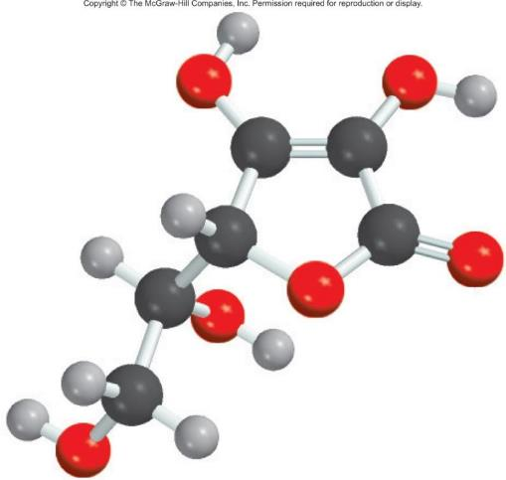
3.9
Ascorbic acid (vitamin C) cures scurvy.
It is composed of 40.92 percent carbon (C), 4.58 percent hydrogen (H), and 54.50 percent oxygen (O) by mass.
Determine its empirical formula.

Slide 46
3.9
Strategy
In a chemical formula, the subscripts represent the ratio of the number of moles of each element that combine to form one mole of the compound.
How can we convert from mass percent to moles?
If we assume an exactly 100-g sample of the compound, do we know the mass of each element in the compound?
How do we then convert from grams to moles?

Slide 47
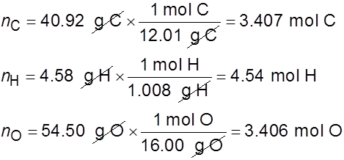
3.9
Solution If we have 100 g of ascorbic acid, then each percentage can be converted directly to grams. In this sample, there will be 40.92 g of C, 4.58 g of H, and 54.50 g of O. Because the subscripts in the formula represent a mole ratio, we need to convert the grams of each element to moles. The conversion factor needed is the molar mass of each element. Let n represent the number of moles of each element so that

Slide 48

3.9
Thus, we arrive at the formula C_{3.407}H_{4.54}O_{3.406}, which gives the identity and the mole ratios of atoms present. However, chemical formulas are written with whole numbers. Try to convert to whole numbers by dividing all the subscripts by the smallest subscript (3.406):
where the sign means “approximately equal to.”
This gives CH_{1.33}O as the formula for ascorbic acid. Next, we need to convert 1.33, the subscript for H, into an integer.

Slide 49
3.9
This can be done by a trial-and-error procedure:
1.33 × 1 = 1.33
1.33 × 2 = 2.66
1.33 × 3 = 3.99 < 4
Because 1.33 × 3 gives us an integer (4), we multiply all the subscripts by 3 and obtain C₃H₄O₃ as the empirical formula for ascorbic acid.
Check
Are the subscripts in C₃H₄O₃ reduced to the smallest whole numbers?

Slide 50
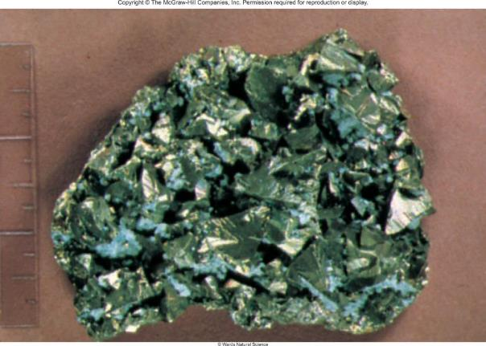
3.10
Chalcopyrite (CuFeS₂) is a principal mineral of copper.
Calculate the number of kilograms of Cu in 3.71 × 10³ kg of chalcopyrite.
Chalcopyrite.

Slide 51
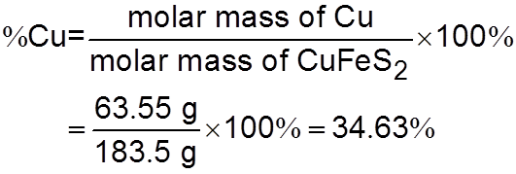
3.10
Strategy Chalcopyrite is composed of Cu, Fe, and S. The mass due to Cu is based on its percentage by mass in the compound.
How do we calculate mass percent of an element?
Solution The molar masses of Cu and CuFeS₂ are 63.55 g and 183.5 g, respectively. The mass percent of Cu is therefore

Slide 52
3.10
To calculate the mass of Cu in a 3.71 × 10³ kg sample of CuFeS₂, we need to convert the percentage to a fraction (that is, convert 34.63 percent to 34.63/100, or 0.3463) and write
mass of Cu in CuFeS₂ = 0.3463 × (3.71 × 10³ kg)
= 1.28 × 10³ kg
Check
As a ball-park estimate, note that the mass percent of Cu is roughly 33 percent, so that a third of the mass should be Cu;
that is, × 3.71 × 10³ kg 1.24 × 10³ kg.
This quantity is quite close to the answer.

Slide 53
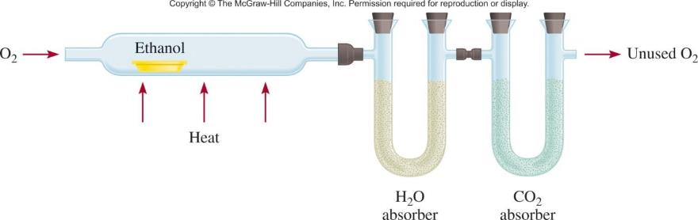
Combust 11.5 g ethanol
Collect 22.0 g CO₂ and 13.5 g H₂O
g CO₂
mol CO₂
mol C
g C
6.0 g C = 0.5 mol C
g H₂O
mol H₂O
mol H
g H
1.5 g H = 1.5 mol H
g of O = g of sample – (g of C + g of H)
4.0 g O = 0.25 mol O
Empirical formula C_{0.5}H_{1.5}O_{0.25}
Divide by smallest subscript (0.25)
Empirical formula C₂H₆O

Slide 54
3.11
A sample of a compound contains 30.46 percent nitrogen and 69.54 percent oxygen by mass, as determined by a mass spectrometer.
In a separate experiment, the molar mass of the compound is found to be between 90 g and 95 g.
Determine the molecular formula and the accurate molar mass of the compound.

Slide 55
3.11
Strategy
To determine the molecular formula, we first need to determine the empirical formula. Comparing the empirical molar mass to the experimentally determined molar mass will reveal the relationship between the empirical formula and molecular formula.
Solution
We start by assuming that there are 100 g of the compound. Then each percentage can be converted directly to grams; that is, 30.46 g of N and 69.54 g of O.

Slide 56
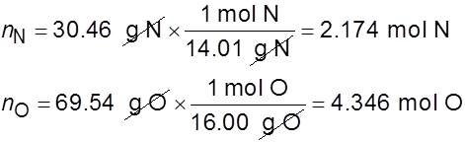
3.11
Let n represent the number of moles of each element so that
Thus, we arrive at the formula N_{2.174}O_{4.346}, which gives the identity and the ratios of atoms present. However, chemical formulas are written with whole numbers.
Try to convert to whole numbers by dividing the subscripts by the smaller subscript (2.174). After rounding off, we obtain NO₂ as the empirical formula.

Slide 57
3.11
The molecular formula might be the same as the empirical formula or some integral multiple of it (for example, two, three, four, or more times the empirical formula).
Comparing the ratio of the molar mass to the molar mass of the empirical formula will show the integral relationship between the empirical and molecular formulas.
The molar mass of the empirical formula NO₂ is
empirical molar mass = 14.01 g + 2(16.00 g) = 46.01 g

Slide 58

3.11
Next, we determine the ratio between the molar mass and the empirical molar mass
The molar mass is twice the empirical molar mass. This means that there are two NO₂ units in each molecule of the compound, and the molecular formula is (NO₂)₂ or N₂O₄. The actual molar mass of the compound is two times the empirical molar mass,
that is, 2(46.01 g) or 92.02 g, which is between 90 g and 95 g.

Slide 59
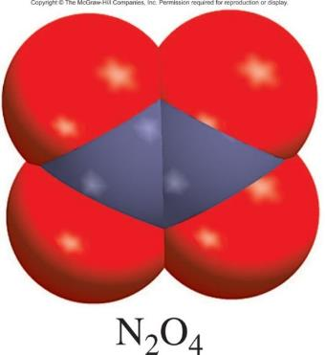
3.11
Check Note that in determining the molecular formula from the empirical formula, we need only know the approximate molar mass of the compound. The reason is that the true molar mass is an integral multiple (1×, 2×, 3×, . . .) of the empirical molar mass. Therefore, the ratio (molar mass/empirical molar mass) will always be close to an integer.

Slide 60
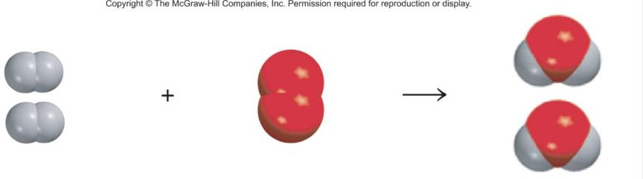
A process in which one or more substances is changed into one or more new substances is a chemical reaction.
A chemical equation uses chemical symbols to show what happens during a chemical reaction:
reactants
products
3 ways of representing the reaction of H₂ with O₂ to form H₂O

Slide 61
How to “Read” Chemical Equations
2 Mg + O₂ 2 MgO
2 atoms Mg + 1 molecule O₂ makes 2 formula units MgO
2 moles Mg + 1 mole O₂ makes 2 moles MgO
48.6 grams Mg + 32.0 grams O₂ makes 80.6 g MgO
NOT
2 grams Mg + 1 gram O₂ makes 2 g MgO

Slide 62
Balancing Chemical Equations
Write the correct formula(s) for the reactants on the left side and the correct formula(s) for the product(s) on the right side of the equation.
Ethane reacts with oxygen to form carbon dioxide and water
C₂H₆ + O₂
CO₂ + H₂O
Change the numbers in front of the formulas (coefficients) to make the number of atoms of each element the same on both sides of the equation. Do not change the subscripts.
2C₂H₆
NOT
C₄H₁₂

Slide 63
Balancing Chemical Equations
Start by balancing those elements that appear in only one reactant and one product.
C₂H₆ + O₂
CO₂ + H₂O
start with C or H but not O
2 carbon
on left
1 carbon
on right
multiply CO₂ by 2
C₂H₆ + O₂
2CO₂ + H₂O
6 hydrogen
on left
2 hydrogen
on right
multiply H₂O by 3
C₂H₆ + O₂
2CO₂ + 3H₂O

Slide 64
Balancing Chemical Equations
Balance those elements that appear in two or more reactants or products.
7
C₂H₆ + O₂
2CO₂ + 3H₂O
multiply O₂ by
2
2 oxygen
on left
4 oxygen
(2x2)
+ 3 oxygen
(3x1)
= 7 oxygen
on right
7
remove fraction
multiply both sides by 2
C₂H₆ + O₂
2CO₂ + 3H₂O
2
2C₂H₆ + 7O₂
4CO₂ + 6H₂O

Slide 65
Balancing Chemical Equations
Check to make sure that you have the same number of each type of atom on both sides of the equation.
2C₂H₆ + 7O₂
4CO₂ + 6H₂O
4 C (2 x 2)
4 C
12 H (2 x 6)
12 H (6 x 2)
14 O (7 x 2)
14 O (4 x 2 + 6)
Reactants
Products
4 C
4 C
12 H
12 H
14 O
14 O

Slide 66
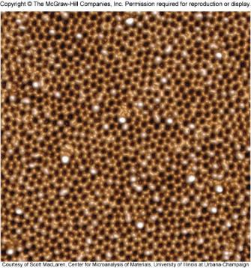
3.12
When aluminum metal is exposed to air, a protective layer of aluminum oxide (Al₂O₃) forms on its surface. This layer prevents further reaction between aluminum and oxygen, and it is the reason that aluminum beverage cans do not corrode. [In the case of iron, the rust, or iron(III) oxide, that forms is too porous to protect the iron metal underneath, so rusting continues.]
Write a balanced equation for the formation of Al₂O₃.
An atomic scale image of aluminum oxide.

Slide 67

3.12
Strategy Remember that the formula of an element or compound cannot be changed when balancing a chemical equation. The equation is balanced by placing the appropriate coefficients in front of the formulas. Follow the procedure described on p. 92.
Solution The unbalanced equation is
In a balanced equation, the number and types of atoms on each side of the equation must be the same. We see that there is one Al atom on the reactants side and there are two Al atoms on the product side.

Slide 68


3.12
We can balance the Al atoms by placing a coefficient of 2 in front of Al on the reactants side.
There are two O atoms on the reactants side, and three O atoms on the product side of the equation. We can balance the
O atoms by placing a coefficient of in front of O₂ on the reactants side.
This is a balanced equation. However, equations are normally balanced with the smallest set of whole-number coefficients.

Slide 69


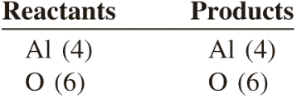
3.12
Multiplying both sides of the equation by 2 gives whole-number
coefficients.
or
Check For an equation to be balanced, the number and types of atoms on each side of the equation must be the same. The final tally is
The equation is balanced. Also, the coefficients are reduced to the simplest set of whole numbers.

Slide 70
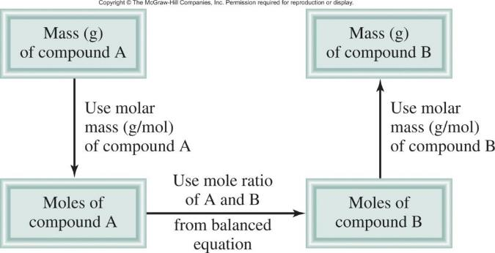
Amounts of Reactants and Products
Write balanced chemical equation
Convert quantities of known substances into moles
Use coefficients in balanced equation to calculate the number of moles of the sought quantity
Convert moles of sought quantity into desired units

Slide 71
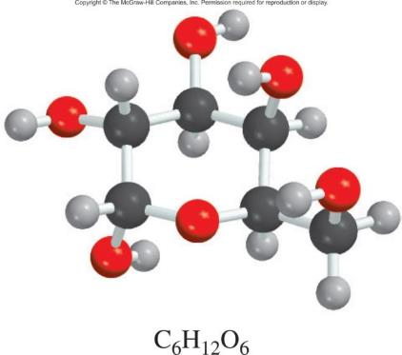

3.13
The food we eat is degraded, or broken down, in our bodies to provide energy for growth and function. A general overall equation for this very complex process represents the degradation of glucose (C₆H₁₂O₆) to carbon dioxide (CO₂) and water (H₂O):
If 856 g of C₆H₁₂O₆ is consumed by a person over a certain period, what is the mass of CO₂ produced?

Slide 72
3.13
Strategy
Looking at the balanced equation, how do we compare the amounts of C₆H₁₂O₆ and CO₂?
We can compare them based on the mole ratio from the balanced equation. Starting with grams of C₆H₁₂O₆, how do we convert to moles of C₆H₁₂O₆?
Once moles of CO₂ are determined using the mole ratio from the balanced equation, how do we convert to grams of CO₂?

Slide 73


3.13
Solution We follow the preceding steps and Figure 3.8.
Step 1: The balanced equation is given in the problem.
Step 2: To convert grams of C₆H₁₂O₆ to moles of C₆H₁₂O₆, we
write
Step 3: From the mole ratio, we see that
1 mol C₆H₁₂O₆ 6 mol CO₂.
Therefore, the number of moles of CO₂ formed is

Slide 74


3.13
Step 4: Finally, the number of grams of CO₂ formed is given by
After some practice, we can combine the conversion steps
into one equation:

Slide 75
3.13
Check Does the answer seem reasonable?
Should the mass of CO₂ produced be larger than the mass of C₆H₁₂O₆ reacted, even though the molar mass of CO₂ is considerably less than the molar mass of C₆H₁₂O₆?
What is the mole ratio between CO₂ and C₆H₁₂O₆?

Slide 76
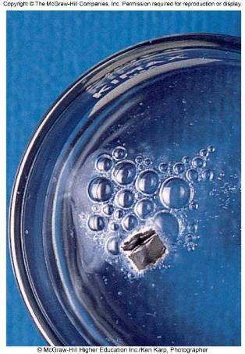
3.14
All alkali metals react with water to produce hydrogen gas and the corresponding alkali metal hydroxide.
A typical reaction is that between lithium and water:
How many grams of Li are needed to produce 9.89 g of H₂?
Lithium reacting with water to produce hydrogen gas.

Slide 77
3.14
Strategy The question asks for number of grams of reactant (Li) to form a specific amount of product (H₂). Therefore, we need to reverse the steps shown in Figure 3.8. From the equation we see that 2 mol Li 1 mol H₂.

Slide 78

3.14
Solution The conversion steps are
Combining these steps into one equation, we write
Check There are roughly 5 moles of H₂ in 9.89 g H₂, so we need 10 moles of Li. From the approximate molar mass of Li (7 g), does the answer seem reasonable?

Slide 79
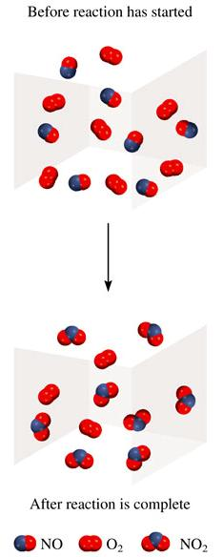
Limiting Reagent:
Reactant used up first in the reaction.
2NO + O₂ 2NO₂
NO is the limiting reagent
O₂ is the excess reagent

Slide 80
3.15
Urea [(NH₂)₂CO] is prepared by reacting ammonia with carbon dioxide:
In one process, 637.2 g of NH₃ are treated with 1142 g of CO₂.
(a) Which of the two reactants is the limiting reagent?
(b) Calculate the mass of (NH₂)₂CO formed.
(c) How much excess reagent (in grams) is left at the end of the reaction?

Slide 81
3.15
Strategy The reactant that produces fewer moles of product is the limiting reagent because it limits the amount of product that can be formed.
How do we convert from the amount of reactant to amount of product?
Perform this calculation for each reactant, then compare the moles of product, (NH₂)₂CO, formed by the given amounts of NH₃ and CO₂ to determine which reactant is the limiting reagent.

Slide 82
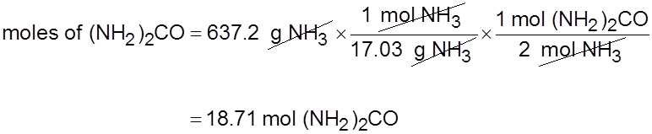
3.15
Solution We carry out two separate calculations. First, starting with 637.2 g of NH₃, we calculate the number of moles of (NH₂)₂CO that could be produced if all the NH₃ reacted according to the following conversions:
Combining these conversions in one step, we write

Slide 83
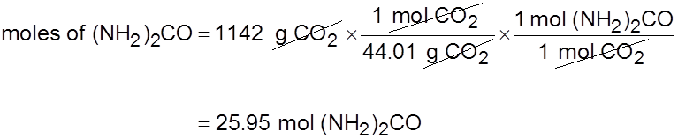
3.15
Second, for 1142 g of CO₂, the conversions are
The number of moles of (NH₂)₂CO that could be produced if all the CO₂ reacted is
It follows, therefore, that NH₃ must be the limiting reagent because it produces a smaller amount of (NH₂)₂CO.

Slide 84
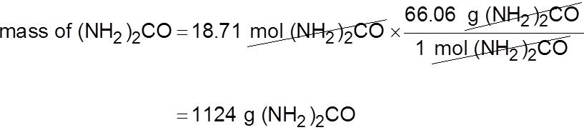
3.15
(b) Strategy We determined the moles of (NH₂)₂CO produced in part (a), using NH₃ as the limiting reagent. How do we convert from moles to grams?
Solution The molar mass of (NH₂)₂CO is 60.06 g. We use this as a conversion factor to convert from moles of (NH₂)₂CO to grams of (NH₂)₂CO:
Check Does your answer seem reasonable? 18.71 moles of product are formed. What is the mass of 1 mole of (NH₂)₂CO?

Slide 85
3.15
(c) Strategy Working backward, we can determine the amount of CO₂ that reacted to produce 18.71 moles of (NH₂)₂CO. The amount of CO₂ left over is the difference between the initial amount and the amount reacted.
Solution Starting with 18.71 moles of (NH₂)₂CO, we can determine the mass of CO₂ that reacted using the mole ratio from the balanced equation and the molar mass of CO₂. The conversion steps are

Slide 86
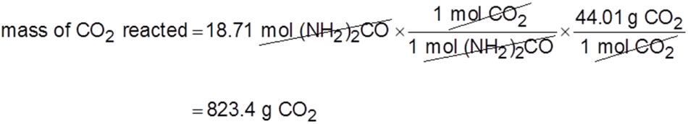
3.15
Combining these conversions in one step, we write
The amount of CO₂ remaining (in excess) is the difference between the initial amount (1142 g) and the amount reacted (823.4 g):
mass of CO₂ remaining = 1142 g − 823.4 g = 319 g

Slide 87
3.16
The reaction between alcohols and halogen compounds to form ethers is important in organic chemistry, as illustrated here for the reaction between methanol (CH₃OH) and methyl bromide (CH₃Br) to form dimethylether (CH₃OCH₃), which is a useful precursor to other organic compounds and an aerosol propellant.
This reaction is carried out in a dry (water-free) organic solvent, and the butyl lithium (LiC₄H₉) serves to remove a hydrogen ion from CH₃OH. Butyl lithium will also react with any residual water in the solvent, so the reaction is typically carried out with 2.5 molar equivalents of that reagent. How many grams of CH₃Br and LiC₄H₉ will be needed to carry out the preceding reaction with 10.0 g of CH₃OH?

Slide 88
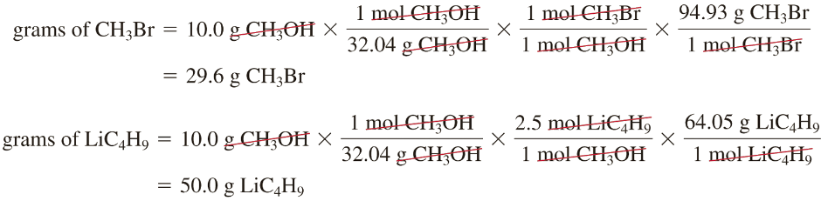
3.16
Solution We start with the knowledge that CH₃OH and CH₃Br are present in stoichiometric amounts and that LiC₄H₉ is the excess reagent. To calculate the quantities of CH₃Br and LiC₄H₉ needed, we proceed as shown in Example 3.14.

Slide 89
Reaction Yield
Theoretical Yield is the amount of product that would
result if all the limiting reagent reacted.
Actual Yield is the amount of product actually obtained
from a reaction.
Actual Yield
% Yield =
x 100%
Theoretical Yield

Slide 90
3.17
Titanium is a strong, lightweight, corrosion-resistant metal that is used in rockets, aircraft, jet engines, and bicycle frames. It is prepared by the reaction of titanium(IV) chloride with molten magnesium between 950°C and 1150°C:
In a certain industrial operation 3.54 × 10⁷ g of TiCl₄ are reacted with 1.13 × 10⁷ g of Mg.
Calculate the theoretical yield of Ti in grams.
Calculate the percent yield if 7.91 × 10⁶ g of Ti are actually obtained.

Slide 91
3.17
Strategy
Because there are two reactants, this is likely to be a limiting reagent problem. The reactant that produces fewer moles of product is the limiting reagent.
How do we convert from amount of reactant to amount of product?
Perform this calculation for each reactant, then compare the moles of product, Ti, formed.

Slide 92
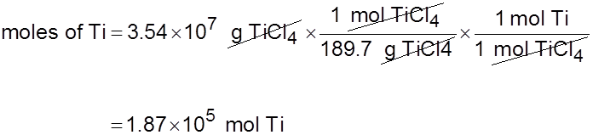
3.17
Solution
Carry out two separate calculations to see which of the two reactants is the limiting reagent. First, starting with 3.54 × 10⁷ g of TiCl₄, calculate the number of moles of Ti that could be produced if all the TiCl₄ reacted. The conversions are
so that

Slide 93
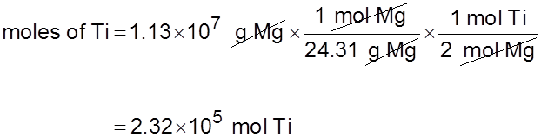
3.17
Next, we calculate the number of moles of Ti formed from 1.13 × 10⁷ g of Mg. The conversion steps are
And we write
Therefore, TiCl₄ is the limiting reagent because it produces a smaller amount of Ti.

Slide 94

3.17
The mass of Ti formed is
(b) Strategy The mass of Ti determined in part (a) is the theoretical yield. The amount given in part (b) is the actual yield of the reaction.

Slide 95
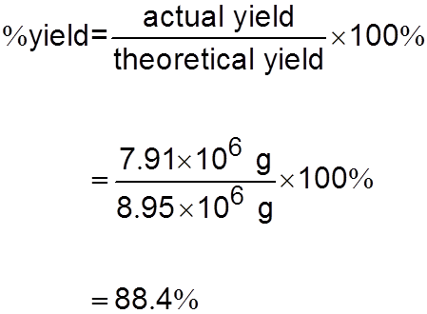
3.17
Solution The percent yield is given by
Check Should the percent yield be less than 100 percent?

Slide 96
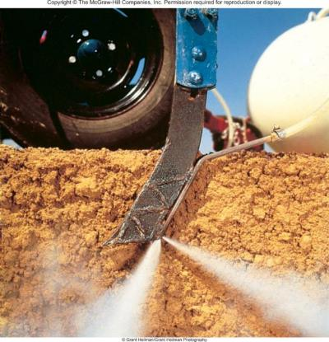
Chemistry In Action: Chemical Fertilizers
Plants need: N, P, K, Ca, S, & Mg
3H₂ (g) + N₂ (g) 2NH₃ (g)
NH₃ (aq) + HNO₃ (aq) NH₄NO₃ (aq)
fluorapatite
2Ca₅(PO₄)₃F (s) + 7H₂SO₄ (aq)
3Ca(H₂PO₄)₂ (aq) + 7CaSO₄ (aq) + 2HF (g)

