Slide 1
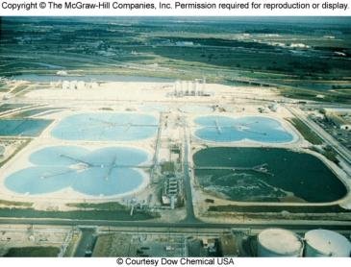

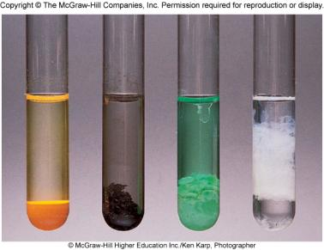
Reactions in Aqueous Solutions
Chapter 4
Copyright © The McGraw-Hill Companies, Inc. Permission required for reproduction or display.

Slide 2
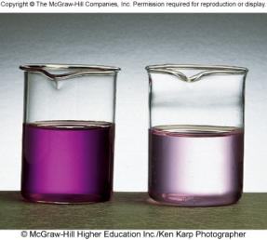
A solution is a homogenous mixture of 2 or more substances.
The solute is (are) the substance(s) present in the smaller amount(s).
The solvent is the substance present in the larger amount.
Solution
Solvent
Solute
Soft drink (l)
H₂O
Sugar, CO₂
Air (g)
N₂
O₂, Ar, CH₄
Soft solder (s)
Pb
Sn
aqueous solutions of KMnO₄

Slide 3
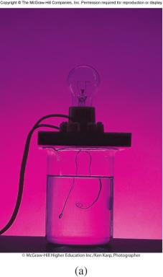
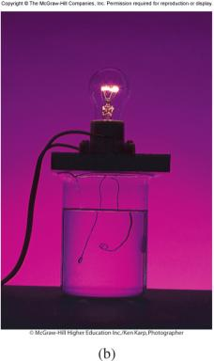
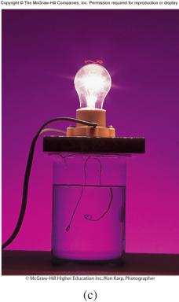
An electrolyte is a substance that, when dissolved in water, results in a solution that can conduct electricity.
A nonelectrolyte is a substance that, when dissolved, results in a solution that does not conduct electricity.
nonelectrolyte
weak electrolyte
strong electrolyte

Slide 4
Conduct electricity in solution?
Cations (+) and Anions (-)
Strong Electrolyte – 100% dissociation
H₂O
NaCl (s) Na⁺ (aq) + Cl⁻ (aq)
Weak Electrolyte – not completely dissociated
CH₃COOH CH₃COO⁻ (aq) + H⁺ (aq)

Slide 5
Ionization of acetic acid
CH₃COOH CH₃COO⁻ (aq) + H⁺ (aq)
A reversible reaction. The reaction can occur in both directions.
Acetic acid is a weak electrolyte because its ionization in water is incomplete.

Slide 6
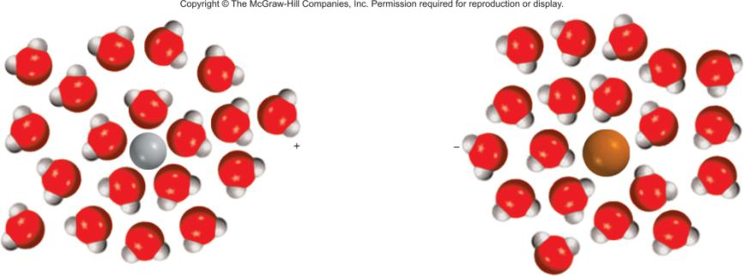
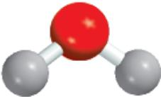
Hydration is the process in which an ion is surrounded by water molecules arranged in a specific manner.
δ⁻
δ⁺
H₂O

Slide 7
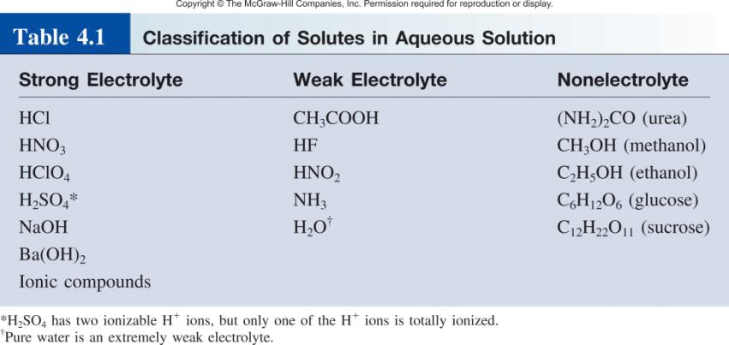
Nonelectrolyte does not conduct electricity?
No cations (+) and anions (-) in solution
H₂O
C₆H₁₂O₆ (s) C₆H₁₂O₆ (aq)

Slide 8
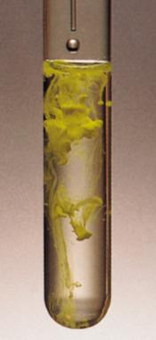
Precipitation Reactions
Precipitate – insoluble solid that separates from solution
precipitate
Pb(NO₃)₂ (aq) + 2NaI (aq) PbI₂ (s) + 2NaNO₃ (aq)
molecular equation
Pb²⁺ + 2NO₃⁻ + 2Na⁺ + 2I⁻ PbI₂ (s) + 2Na⁺ + 2NO₃⁻
ionic equation
Pb²⁺ + 2I⁻ PbI₂ (s)
PbI₂
net ionic equation
Na⁺ and NO₃⁻ are spectator ions

Slide 9
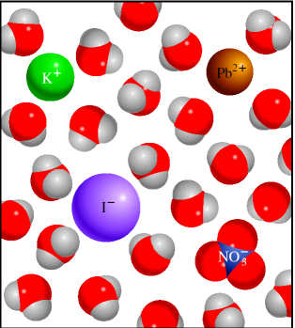
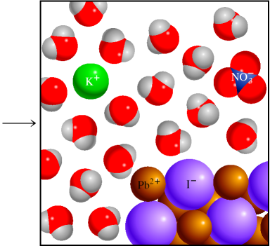
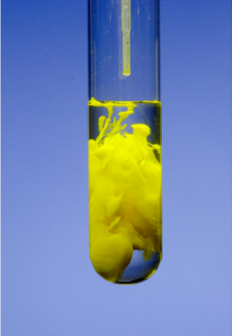
Precipitation of Lead Iodide
Pb²⁺ + 2I⁻ PbI₂ (s)
PbI₂

Slide 10
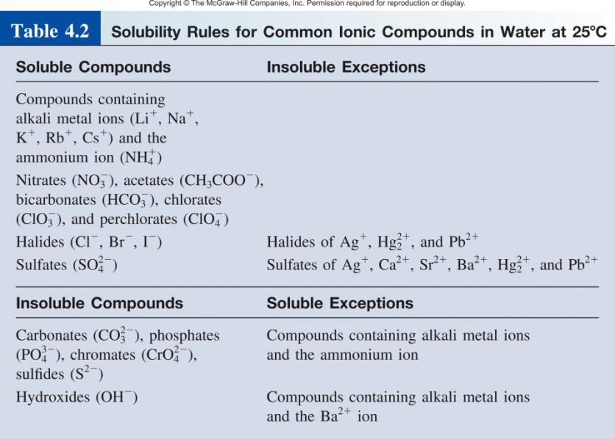
Solubility is the maximum amount of solute that will dissolve in a given quantity of solvent at a specific temperature.

Slide 11
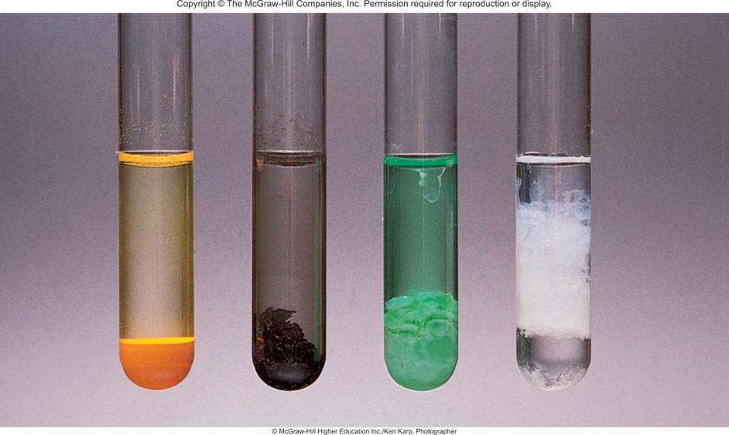
Examples of Insoluble Compounds
CdS
PbS
Ni(OH)₂
Al(OH)₃

Slide 12
4.1
Classify the following ionic compounds as soluble or insoluble:
silver sulfate (Ag₂SO₄)
calcium carbonate (CaCO₃)
sodium phosphate (Na₃PO₄).

Slide 13
4.1
Strategy Although it is not necessary to memorize the solubilities of compounds, you should keep in mind the following useful rules: all ionic compounds containing alkali metal cations; the ammonium ion; and the nitrate, bicarbonate, and chlorate ions are soluble. For other compounds, we need to refer to Table 4.2.
Solution
According to Table 4.2, Ag₂SO₄ is insoluble.
(b) This is a carbonate and Ca is a Group 2A metal. Therefore, CaCO₃ is insoluble.
(c) Sodium is an alkali metal (Group 1A) so Na₃PO₄ is soluble.

Slide 14
Writing Net Ionic Equations
Write the balanced molecular equation.
Write the ionic equation showing the strong electrolytes completely dissociated into cations and anions.
Cancel the spectator ions on both sides of the ionic equation.
Check that charges and number of atoms are balanced in the net ionic equation.

Slide 15
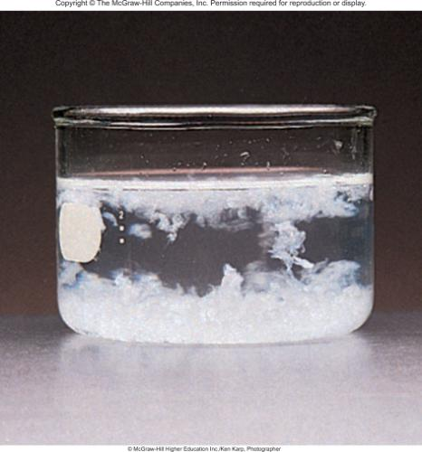
4.2
Predict what happens when a potassium phosphate (K₃PO₄) solution is mixed with a calcium nitrate [Ca(NO₃)₂] solution. Write a net ionic equation for the reaction.

Slide 16

4.2
Strategy
From the given information, it is useful to first write the unbalanced equation
What happens when ionic compounds dissolve in water?
What ions are formed from the dissociation of K₃PO₄ and Ca(NO₃)₂?
What happens when the cations encounter the anions in solution?

Slide 17



4.2
Solution In solution, K₃PO₄ dissociates into K⁺ and ions and Ca(NO₃)₂ dissociates into Ca²⁺ and ions.
According to Table 4.2, calcium ions (Ca²⁺) and phosphate ions ( ) will form an insoluble compound, calcium phosphate [Ca₃(PO₄)₂], while the other product, KNO₃, is soluble and remains in solution.
Therefore, this is a precipitation reaction. We follow the stepwise procedure just outlined.
Step 1: The balanced molecular equation for this reaction is

Slide 18
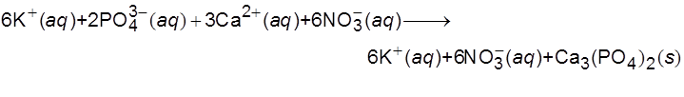


4.2
Step 2: To write the ionic equation, the soluble compounds are shown as dissociated ions:
Step 3: Canceling the spectator ions (K⁺ and ) on each side of the equation, we obtain the net ionic equation:
Step 4: Note that because we balanced the molecular equation first, the net ionic equation is balanced as to the number of atoms on each side and the number of positive (+6) and negative (−6) charges on the left- hand side is the same.

Slide 19

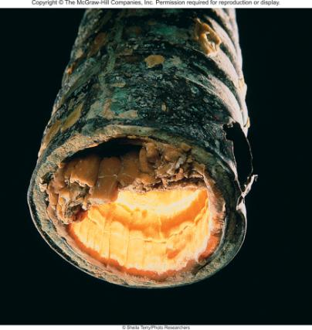
Chemistry In Action:
An Undesirable Precipitation Reaction
-
Ca²⁺ (aq) + 2HCO₃ (aq) CaCO₃ (s) + CO₂ (aq) + H₂O (l)
CO₂ (aq) CO₂ (g)

Slide 20
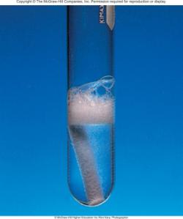
Properties of Acids
Have a sour taste. Vinegar owes its taste to acetic acid. Citrus
fruits contain citric acid.
Cause color changes in plant dyes.
React with certain metals to produce hydrogen gas.
2HCl (aq) + Mg (s) MgCl₂ (aq) + H₂ (g)
React with carbonates and bicarbonates
to produce carbon dioxide gas.
2HCl (aq) + CaCO₃ (s) CaCl₂ (aq) + CO₂ (g) + H₂O (l)
Aqueous acid solutions conduct electricity.

Slide 21
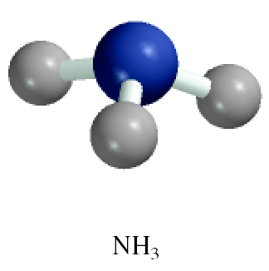
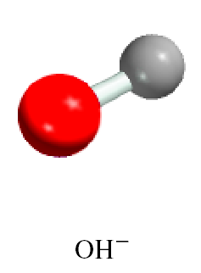
Properties of Bases
Have a bitter taste.
Feel slippery. Many soaps contain bases.
Cause color changes in plant dyes.
Aqueous base solutions conduct electricity.
Examples:

Slide 22
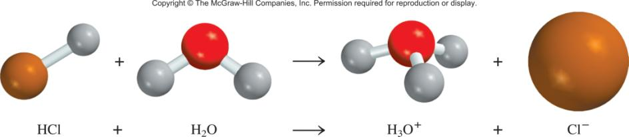
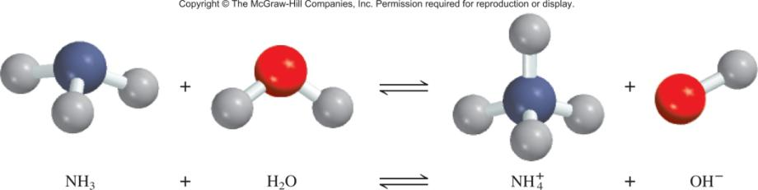
Arrhenius acid is a substance that produces H⁺ (H₃O⁺) in water.
Arrhenius base is a substance that produces OH⁻ in water.

Slide 23
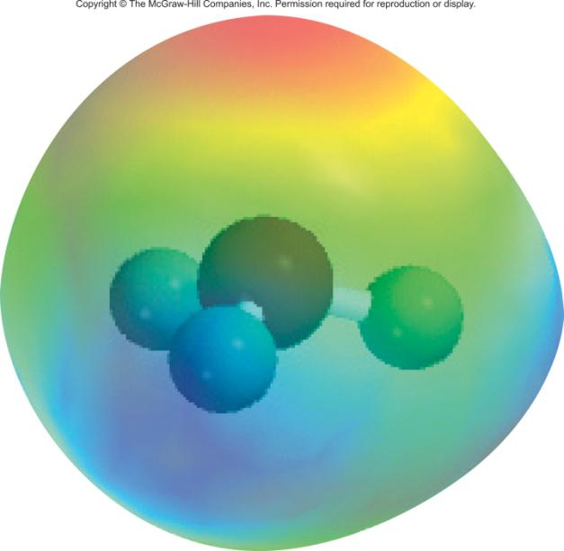
Hydronium ion, hydrated proton, H₃O⁺

Slide 24
A Brønsted acid is a proton donor
A Brønsted base is a proton acceptor
base
acid
acid
base
A Brønsted acid must contain at least one ionizable proton!

Slide 25
Monoprotic acids
HCl H⁺ + Cl⁻
Strong electrolyte, strong acid
HNO₃ H⁺ + NO₃⁻
Strong electrolyte, strong acid
CH₃COOH H⁺ + CH₃COO⁻
Weak electrolyte, weak acid
Diprotic acids
H₂SO₄ H⁺ + HSO₄⁻
Strong electrolyte, strong acid
HSO₄⁻ H⁺ + SO₄²⁻
Weak electrolyte, weak acid
Triprotic acids
H₃PO₄ H⁺ + H₂PO₄⁻
Weak electrolyte, weak acid
H₂PO₄⁻ H⁺ + HPO₄²⁻
Weak electrolyte, weak acid
HPO₄²⁻ H⁺ + PO₄³⁻
Weak electrolyte, weak acid

Slide 26
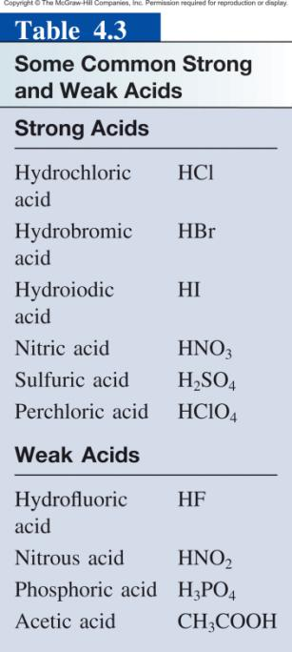

Slide 27


4.3
Classify each of the following species in aqueous solution as a Brønsted acid or base:
HBr

Slide 28
4.3
Strategy
What are the characteristics of a Brønsted acid?
Does it contain at least an H atom?
With the exception of ammonia, most Brønsted bases that you will encounter at this stage are anions.

Slide 29



4.3
Solution
We know that HCl is an acid. Because Br and Cl are both halogens (Group 7A), we expect HBr, like HCl, to ionize in water as follows:
Therefore HBr is a Brønsted acid.
(b) In solution the nitrite ion can accept a proton from water to form nitrous acid:
This property makes a Brønsted base.

Slide 30
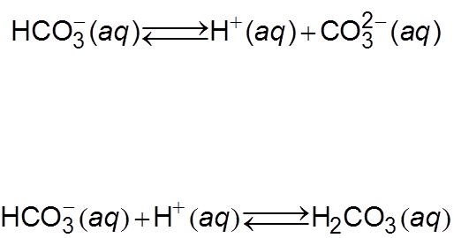

4.3
(c) The bicarbonate ion is a Brønsted acid because it ionizes in solution as follows:
It is also a Brønsted base because it can accept a proton to form carbonic acid:
Comment The species is said to be amphoteric because it possesses both acidic and basic properties. The double arrows show that this is a reversible reaction.

Slide 31
Neutralization Reaction
acid + base salt + water
HCl (aq) + NaOH (aq) NaCl (aq) + H₂O
H⁺ + Cl⁻ + Na⁺ + OH⁻ Na⁺ + Cl⁻ + H₂O
H⁺ + OH⁻ H₂O

Slide 32
Neutralization Reaction Involving a Weak Electrolyte
weak acid + base salt + water
HCN (aq) + NaOH (aq) NaCN (aq) + H₂O
HCN + Na⁺ + OH⁻ Na⁺ + CN⁻ + H₂O
HCN + OH⁻ CN⁻ + H₂O

Slide 33

4.4
Write molecular, ionic, and net ionic equations for each of the following acid-base reactions:
hydrobromic acid(aq) + barium hydroxide(aq)
(b) sulfuric acid(aq) + potassium hydroxide(aq)

Slide 34
4.4
Strategy
The first step is to identify the acids and bases as strong or weak.
We see that HBr is a strong acid and H₂SO₄ is a strong acid for the first step ionization and a weak acid for the second step ionization.
Both Ba(OH)₂ and KOH are strong bases.

Slide 35



4.4
Solution
Molecular equation:
2HBr(aq) + Ba(OH)₂(aq) BaBr₂(aq) + 2H₂O(l)
Ionic equation:
2H⁺(aq) + 2Br⁻(aq) + Ba²⁺(aq) + 2OH⁻(aq)
Ba²⁺(aq) + 2Br⁻(aq) + 2H₂O(l)
Net ionic equation:
2H⁺(aq) + 2OH⁻(aq) 2H₂O(l)
or
H⁺(aq) + OH⁻(aq) H₂O(l)
Both Ba²⁺ and Br⁻ are spectator ions.

Slide 36



4.4
(b) Molecular equation:
H₂SO₄(aq) + 2KOH(aq) K₂SO₄(aq) + 2H₂O(l)
Ionic equation:
Net ionic equation:
Note that because is a weak acid and does not ionize appreciably in water, the only spectator ion is K⁺.

Slide 37
Neutralization Reaction Producing a Gas
acid + base salt + water + CO₂
2HCl (aq) + Na₂CO₃ (aq) 2NaCl (aq) + H₂O +CO₂
2H⁺ + 2Cl⁻ + 2Na⁺ + CO₃²⁻ 2Na⁺ + 2Cl⁻ + H₂O + CO₂
2H⁺ + CO₃²⁻ H₂O + CO₂

Slide 38
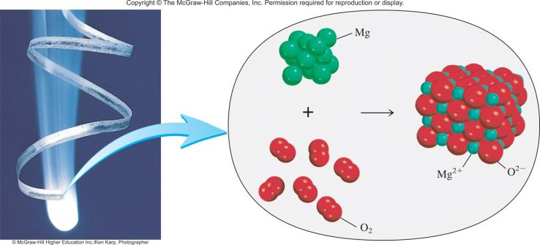
Oxidation-Reduction Reactions
(electron transfer reactions)
2Mg 2Mg²⁺ + 4e⁻
Oxidation half-reaction (lose e⁻)
O₂ + 4e⁻ 2O²⁻
Reduction half-reaction (gain e⁻)
2Mg + O₂ + 4e⁻ 2Mg²⁺ + 2O²⁻ + 4e⁻
2Mg + O₂ 2MgO

Slide 39
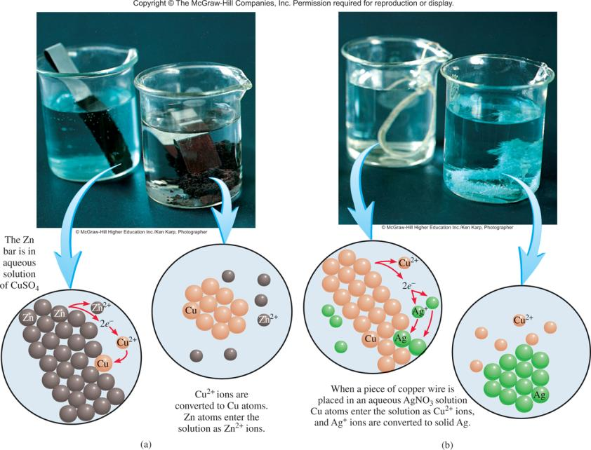

Slide 40
Zn(s) + CuSO₄(aq) ZnSO₄(aq) + Cu(s)
Zn Zn²⁺ + 2e⁻
Zn is oxidized
Zn is the reducing agent
Cu²⁺ + 2e⁻ Cu
Cu²⁺ is reduced
Cu²⁺ is the oxidizing agent

Slide 41
Oxidation number
The charge the atom would have in a molecule (or an
ionic compound) if electrons were completely transferred.
Free elements (uncombined state) have an oxidation number of zero.
Na, Be, K, Pb, H₂, O₂, P₄ = 0
In monatomic ions, the oxidation number is equal to the charge on the ion.
Li⁺, Li = +1; Fe³⁺, Fe = +3; O²⁻, O = -2
The oxidation number of oxygen is usually –2. In H₂O₂ and O₂²⁻ it is –1.
4.4

Slide 42
The oxidation number of hydrogen is +1 except when it is bonded to metals in binary compounds. In these cases, its oxidation number is –1.
Group IA metals are +1, IIA metals are +2 and fluorine is always –1.
6. The sum of the oxidation numbers of all the atoms in a molecule or ion is equal to the charge on the molecule or ion.
Oxidation numbers do not have to be integers. The oxidation number of oxygen in the superoxide ion,
O₂⁻, is –½.

Slide 43

4.5
Assign oxidation numbers to all the elements in the following compounds and ion:
Li₂O
HNO₃

Slide 44
4.5
Strategy
In general, we follow the rules just listed for assigning oxidation numbers.
Remember that all alkali metals have an oxidation number of +1, and in most cases hydrogen has an oxidation number of +1 and oxygen has an oxidation number of −2 in their compounds.

Slide 45


4.5
Solution
By rule 2 we see that lithium has an oxidation number of +1 (Li⁺) and oxygen’s oxidation number is −2 (O²⁻).
This is the formula for nitric acid, which yields a H⁺ ion and a N ion in solution. From rule 4 we see that H has an oxidation number of +1. Thus the other group (the nitrate ion) must have a net oxidation number of −1. Oxygen has an oxidation number of −2, and if we use x to represent the oxidation number of nitrogen, then the nitrate ion can be written as
so that
x + 3(−2) = −1
x = +5

Slide 46

4.5
(c) From rule 6 we see that the sum of the oxidation numbers in the dichromate ion must be − 2. We know that the oxidation number of O is − 2, so all that remains is to determine the oxidation number of Cr, which we call y. The dichromate ion can be written as
so that
2(y) + 7(−2) = −2
y = +6
Check In each case, does the sum of the oxidation numbers of all the atoms equal the net charge on the species?

Slide 47
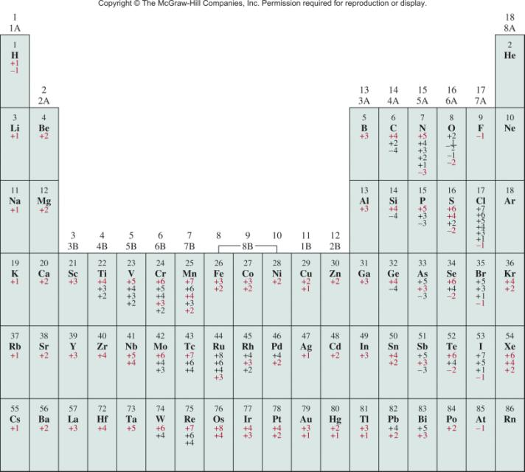
The Oxidation Numbers of Elements in their Compounds

Slide 48
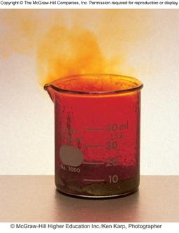
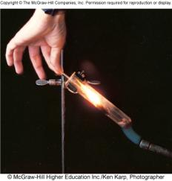
Types of Oxidation-Reduction Reactions
Combination Reaction
A + B C
0
0
+3
-1
2Al + 3Br₂ 2AlBr₃
Decomposition Reaction
C A + B
+1
+5
-2
+1
-1
0
2KClO₃ 2KCl + 3O₂

Slide 49
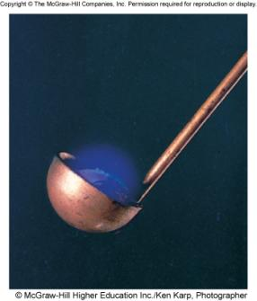
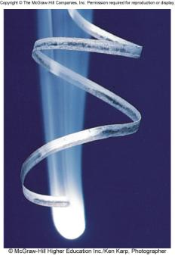
Types of Oxidation-Reduction Reactions
Combustion Reaction
A + O₂ B
0
0
+4
-2
S + O₂ SO₂
0
0
+2
-2
2Mg + O₂ 2MgO

Slide 50
Types of Oxidation-Reduction Reactions
Displacement Reaction
A + BC AC + B
0
+1
+2
0
Sr + 2H₂O Sr(OH)₂ + H₂
Hydrogen Displacement
+4
0
0
+2
TiCl₄ + 2Mg Ti + 2MgCl₂
Metal Displacement
0
-1
-1
0
Cl₂ + 2KBr 2KCl + Br₂
Halogen Displacement

Slide 51
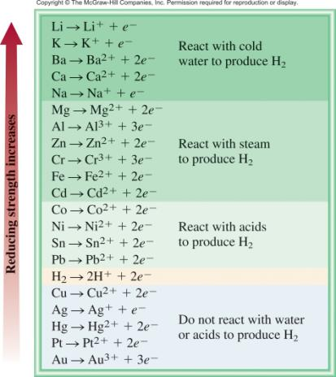
The Activity Series for Metals
Hydrogen Displacement Reaction
M + BC MC + B
M is metal
BC is acid or H₂O
B is H₂
Ca + 2H₂O Ca(OH)₂ + H₂
Pb + 2H₂O Pb(OH)₂ + H₂

Slide 52
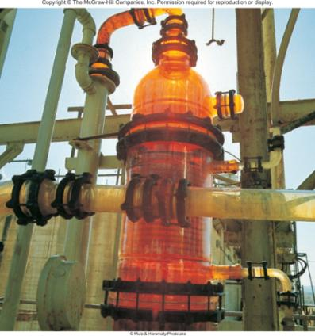
The Activity Series for Halogens
F₂ > Cl₂ > Br₂ > I₂
Halogen Displacement Reaction
0
-1
-1
0
Cl₂ + 2KBr 2KCl + Br₂
I₂ + 2KBr 2KI + Br₂

Slide 53
Types of Oxidation-Reduction Reactions
Disproportionation Reaction
The same element is simultaneously oxidized and reduced.
Example:
reduced
0
+1
-1
Cl₂ + 2OH⁻ ClO⁻ + Cl⁻ + H₂O
oxidized

Slide 54


4.6
Classify the following redox reactions and indicate changes in the oxidation numbers of the elements:
(a)
(b)
(c)
(d)

Slide 55
4.6
Strategy Review the definitions of combination reactions, decomposition reactions, displacement reactions, and disproportionation reactions.
Solution
This is a decomposition reaction because one reactant is converted to two different products. The oxidation number of N changes from +1 to 0, while that of O changes from −2 to 0.
This is a combination reaction (two reactants form a single product). The oxidation number of Li changes from 0 to +1 while that of N changes from 0 to −3.

Slide 56
4.6
(c) This is a metal displacement reaction. The Ni metal replaces (reduces) the Pb²⁺ ion. The oxidation number of Ni increases from 0 to +2 while that of Pb decreases from +2 to 0.
(d) The oxidation number of N is +4 in NO₂ and it is +3 in HNO₂ and +5 in HNO₃. Because the oxidation number of the same element both increases and decreases, this is a disproportionation reaction.

Slide 57
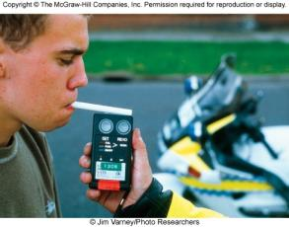
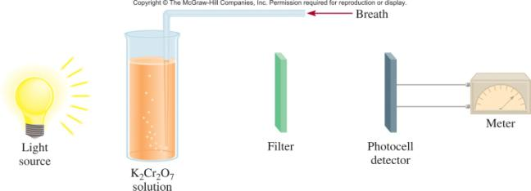
Chemistry in Action: Breath Analyzer
+6
3CH₃CH₂OH + 2K₂Cr₂O₇ + 8H₂SO₄
+3
3CH₃COOH + 2Cr₂(SO₄)₃ + 2K₂SO₄ + 11H₂O

Slide 58
Solution Stoichiometry
The concentration of a solution is the amount of solute present in a given quantity of solvent or solution.
moles of solute
M = molarity =
liters of solution

Slide 59
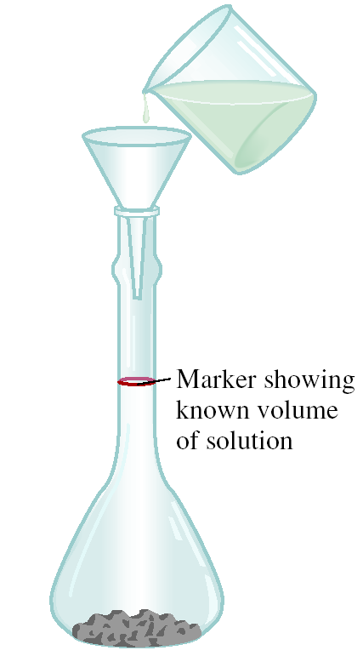

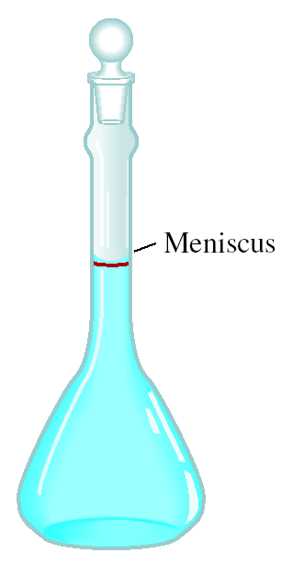
Preparing a Solution of Known Concentration

Slide 60
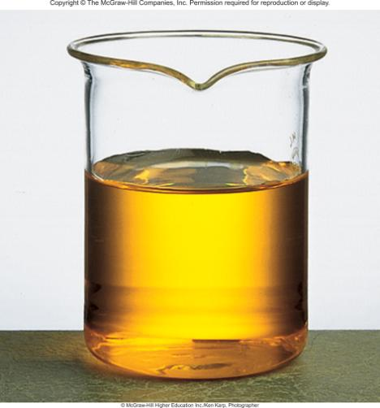
4.7
How many grams of potassium dichromate (K₂Cr₂O₇) are required to prepare a 250-mL solution whose concentration is 2.16 M?
A K₂Cr₂O₇ solution.

Slide 61
4.7
Strategy
How many moles of K₂Cr₂O₇ does a 1-L (or 1000 mL) 2.16 M K₂Cr₂O₇ solution contain?
A 250-mL solution?
How would you convert moles to grams?

Slide 62
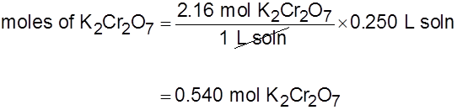
4.7
Solution The first step is to determine the number of moles of K₂Cr₂O₇ in 250 mL or 0.250 L of a 2.16 M solution. Rearranging Equation (4.1) gives
moles of solute = molarity × L soln
Thus,

Slide 63
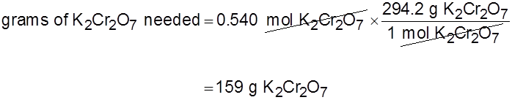
4.7
The molar mass of K₂Cr₂O₇ is 294.2 g, so we write
Check As a ball-park estimate, the mass should be given by [molarity (mol/L) × volume (L) × molar mass (g/mol)] or [2 mol/L × 0.25 L × 300 g/mol] = 150 g. So the answer is reasonable.

Slide 64
4.8
In a biochemical assay, a chemist needs to add 3.81 g of glucose to a reaction mixture. Calculate the volume in milliliters of a 2.53 M glucose solution she should use for the addition.

Slide 65

4.8
Strategy
We must first determine the number of moles contained in 3.81 g of glucose and then use Equation (4.2) to calculate the volume.
Solution
From the molar mass of glucose, we write

Slide 66
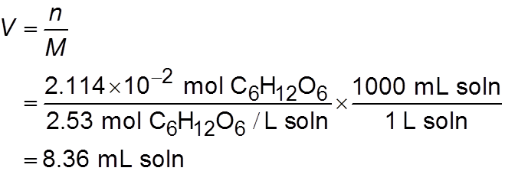
4.8
Next, we calculate the volume of the solution that contains 2.114 × 10⁻² mole of the solute. Rearranging Equation (4.2) gives
Check One liter of the solution contains 2.53 moles of C₆H₁₂O₆. Therefore, the number of moles in 8.36 mL or 8.36 × 10⁻³ L is (2.53 mol × 8.36 × 10⁻³) or 2.12 × 10⁻² mol. The small difference is due to the different ways of rounding off.

Slide 67
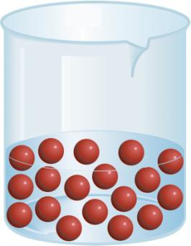
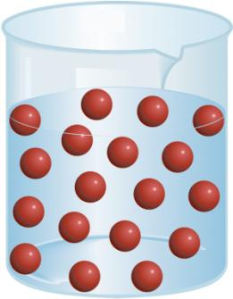
Dilution is the procedure for preparing a less concentrated solution from a more concentrated solution.
Dilution
Add Solvent
Moles of solute
before dilution (i)
=
Moles of solute
after dilution (f)
M_{i}V_{i}
=
M_{f}V_{f}

Slide 68
4.9
Describe how you would prepare 5.00 × 10² mL of a
1.75 M H₂SO₄ solution, starting with an 8.61 M stock
solution of H₂SO₄.

Slide 69
4.9
Strategy
Because the concentration of the final solution is less than that of the original one, this is a dilution process.
Keep in mind that in dilution, the concentration of the solution decreases but the number of moles of the solute remains the same.

Slide 70
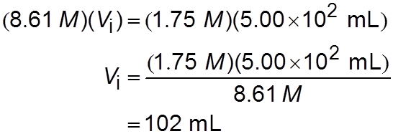
4.9
Solution We prepare for the calculation by tabulating our data:
M_{i} = 8.61 M M_{f} = 1.75 M
V_{i} = ? V_{f} = 5.00 × 10² mL
Substituting in Equation (4.3),

Slide 71
4.9
Thus, we must dilute 102 mL of the 8.61 M H₂SO₄ solution with sufficient water to give a final volume of 5.00 × 10² mL in a 500-mL volumetric flask to obtain the desired concentration.
Check The initial volume is less than the final volume, so the answer is reasonable.

Slide 72
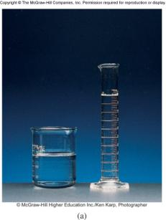
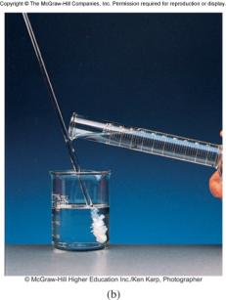
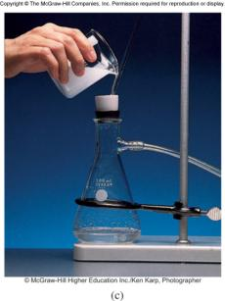
Gravimetric Analysis
Dissolve unknown substance in water
React unknown with known substance to form a precipitate
Filter and dry precipitate
Weigh precipitate
Use chemical formula and mass of precipitate to determine amount of unknown ion

Slide 73
4.10
A 0.5662-g sample of an ionic compound containing chloride ions and an unknown metal is dissolved in water and treated with an excess of AgNO₃. If 1.0882 g of AgCl precipitate forms, what is the percent by mass of Cl in the original compound?

Slide 74

4.10
Strategy
We are asked to calculate the percent by mass of Cl in the unknown sample, which is
The only source of Cl⁻ ions is the original compound. These chloride ions eventually end up in the AgCl precipitate.
Can we calculate the mass of the Cl⁻ ions if we know the percent by mass of Cl in AgCl?

Slide 75
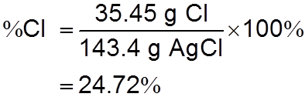

4.10
Solution The molar masses of Cl and AgCl are 35.45 g and 143.4 g, respectively. Therefore, the percent by mass of Cl in AgCl is given by
Next, we calculate the mass of Cl in 1.0882 g of AgCl. To do so we convert 24.72 percent to 0.2472 and write

Slide 76

4.10
Because the original compound also contained this amount of Cl⁻ ions, the percent by mass of Cl in the compound is
Check AgCl is about 25 percent chloride by mass, so the roughly 1 g of AgCl precipitate that formed corresponds to about 0.25 g of chloride, which is a little less than half of the mass of the original sample. Therefore, the calculated percent chloride of 47.51 percent is reasonable.

Slide 77


Titrations
In a titration, a solution of accurately known concentration is added gradually added to another solution of unknown concentration until the chemical reaction between the two solutions is complete.
Equivalence point – the point at which the reaction is complete
Indicator – substance that changes color at (or near) the
equivalence point
Slowly add base
to unknown acid
UNTIL
the indicator
changes color

Slide 78


Titrations can be used in the analysis of
Acid-base reactions
Redox reactions
H₂SO₄ + 2NaOH 2H₂O + Na₂SO₄
5Fe²⁺ + MnO₄⁻ + 8H⁺ Mn²⁺ + 5Fe³⁺ + 4H₂O

Slide 79
4.11
In a titration experiment, a student finds that 23.48 mL of a NaOH solution are needed to neutralize 0.5468 g of KHP. What is the concentration (in molarity) of the NaOH solution?

Slide 80

4.11
Strategy We want to determine the molarity of the NaOH solution. What is the definition of molarity?
The volume of NaOH solution is given in the problem. Therefore, we need to find the number of moles of NaOH to solve for molarity. From the preceding equation for the reaction between KHP and NaOH shown in the text we see that 1 mole of KHP neutralizes 1 mole of NaOH. How many moles of KHP are contained in 0.5468 g of KHP?
need to find
want to calculate
given

Slide 81


4.11
Solution First we calculate the number of moles of KHP consumed in the titration:
Because 1 mol KHP 1 mol NaOH, there must be 2.678 × 10⁻³ mole of NaOH in 23.48 mL of NaOH solution. Finally, we calculate the number of moles of NaOH in 1 L of the solution or the molarity as follows:

Slide 82
4.12
How many milliliters (mL) of a 0.610 M NaOH solution are needed to neutralize 20.0 mL of a 0.245 M H₂SO₄ solution?

Slide 83

4.12
Strategy We want to calculate the volume of the NaOH solution. From the definition of molarity [see Equation (4.1)], we write
From the equation for the neutralization reaction just shown, we see that 1 mole of H₂SO₄ neutralizes 2 moles of NaOH.
How many moles of H₂SO₄ are contained in 20.0 mL of a 0.245 M H₂SO₄ solution?
How many moles of NaOH would this quantity of H₂SO₄ neutralize?
need to find
want to calculate
given

Slide 84


4.12
Solution
First we calculate the number of moles of H₂SO₄ in a 20.0 mL solution:
From the stoichiometry we see that 1 mol H₂SO₄ 2 mol NaOH. Therefore, the number of moles of NaOH reacted must be 2 × 4.90 × 10⁻³ mole, or 9.80 × 10⁻³ mole.

Slide 85


4.12
From the definition of molarity [see Equation (4.1)], we have
or

Slide 86

4.13
A 16.42-mL volume of 0.1327 M KMnO₄ solution is needed to oxidize 25.00 mL of a FeSO₄ solution in an acidic medium. What is the concentration of the FeSO₄ solution in molarity? The net ionic equation is

Slide 87


4.13
Strategy We want to calculate the molarity of the FeSO₄ solution. From the definition of molarity
The volume of the FeSO₄ solution is given in the problem. Therefore, we need to find the number of moles of FeSO₄ to solve for the molarity.
From the net ionic equation, what is the stoichiometric equivalence between Fe²⁺ and ?
How many moles of KMnO₄ are contained in 16.42 mL of 0.1327 M KMnO₄ solution?
need to find
want to calculate
given

Slide 88


4.13
Solution The number of moles of KMnO₄ in 16.42 mL of the solution is
From the net ionic equation we see that 5 mol Fe²⁺ 1 mol Therefore, the number of moles of FeSO₄ oxidized is

Slide 89

4.13
The concentration of the FeSO₄ solution in moles of FeSO₄ per liter of solution is

Slide 90

Chemistry in Action: Metals from the Sea
CaCO₃ (s) CaO (s) + CO₂ (g)
-
CaO (s) + H₂O (l) Ca²⁺ (aq) + 2OH (aq)
-
Mg²⁺ (aq) + 2OH (aq) Mg(OH)₂ (s)
Mg(OH)₂ (s) + 2HCl (aq) MgCl₂ (aq) + 2H₂O (l)
Mg²⁺ + 2e⁻ Mg
2Cl⁻ Cl₂ + 2e⁻
MgCl₂ (aq) Mg (l) + Cl₂ (g)

