Slide 1
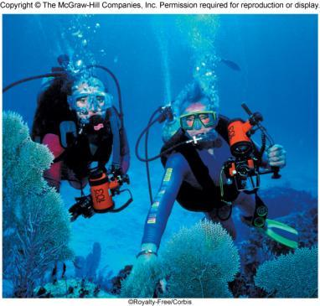


Gases
Chapter 5
Copyright © The McGraw-Hill Companies, Inc. Permission required for reproduction or display.

Slide 2
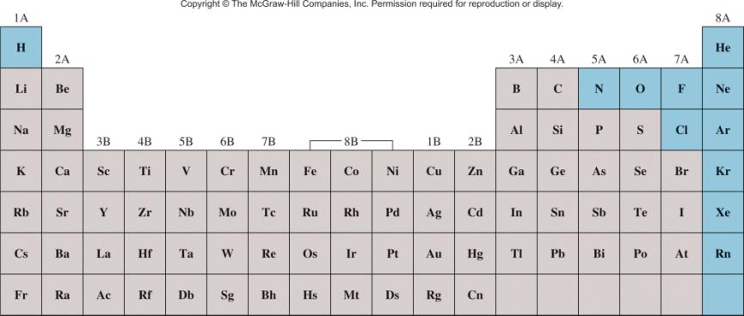
Elements that exist as gases at 25⁰C and 1 atmosphere

Slide 3
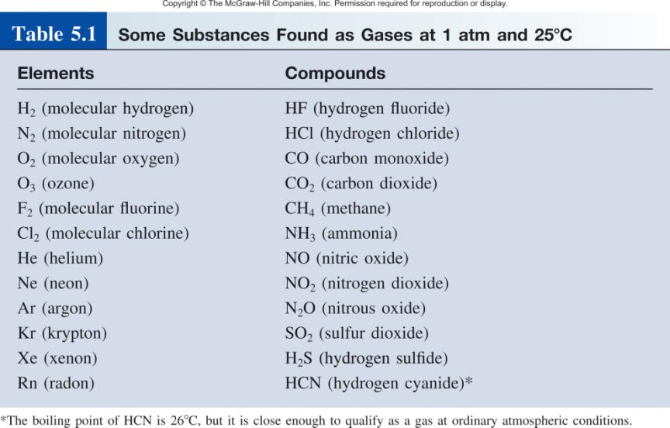

Slide 4
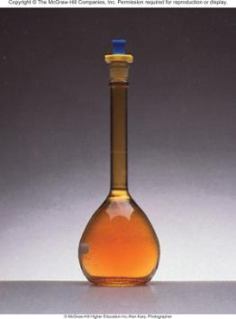
Physical Characteristics of Gases
Gases assume the volume and shape of their containers.
Gases are the most compressible state of matter.
Gases will mix evenly and completely when confined to the same container.
Gases have much lower densities than liquids and solids.
NO₂ gas

Slide 5
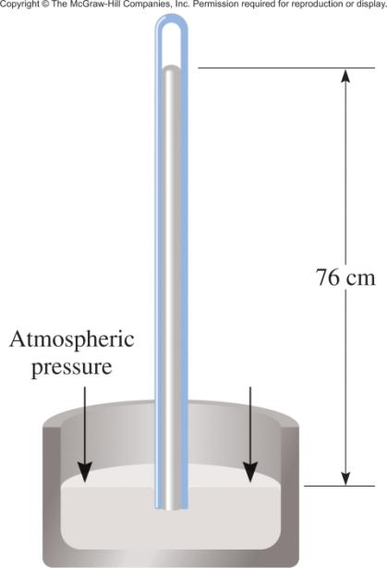
Force
Pressure =
Area
(force = mass x acceleration)
Units of Pressure
1 pascal (Pa) = 1 N/m²
1 atm = 760 mmHg = 760 torr
1 atm = 101,325 Pa

Slide 6
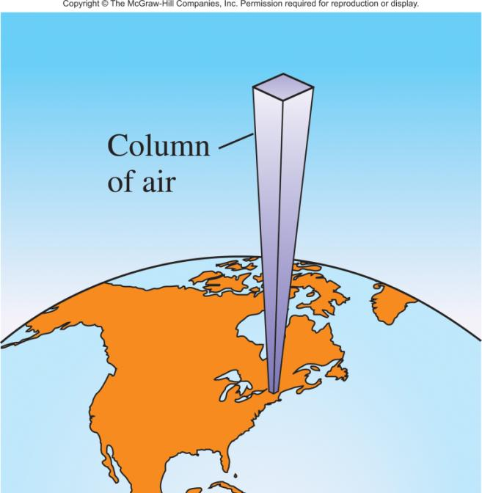
10 miles
0.2 atm
4 miles
0.5 atm
Sea level
1 atm

Slide 7
5.1
The pressure outside a jet plane flying at high altitude falls considerably below standard atmospheric pressure. Therefore, the air inside the cabin must be pressurized to protect the passengers.
What is the pressure in atmospheres in the cabin if the barometer reading is 688 mmHg?

Slide 8

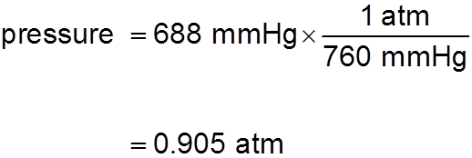
5.1
Strategy Because 1 atm = 760 mmHg, the following conversion factor is needed to obtain the pressure in atmospheres:
Solution The pressure in the cabin is given by

Slide 9
5.2
The atmospheric pressure in San Francisco on a certain day was 732 mmHg.
What was the pressure in kPa?

Slide 10

5.2
Strategy
Here we are asked to convert mmHg to kPa.
Because
1 atm = 1.01325 × 10⁵ Pa = 760 mmHg
the conversion factor we need is

Slide 11
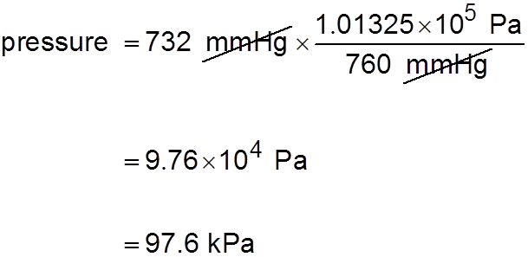
5.2
Solution The pressure in kPa is

Slide 12
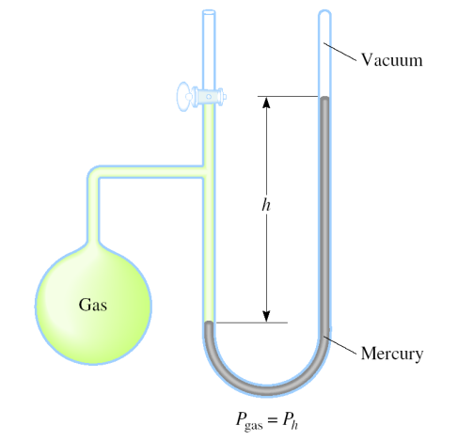
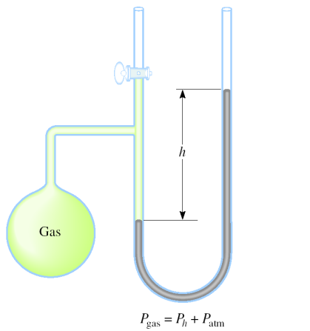
Manometers Used to Measure Gas Pressures
closed-tube
open-tube

Slide 13
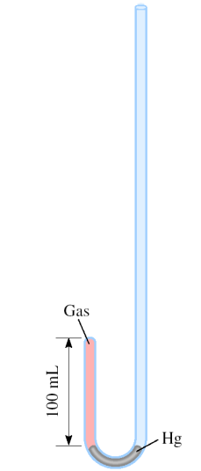
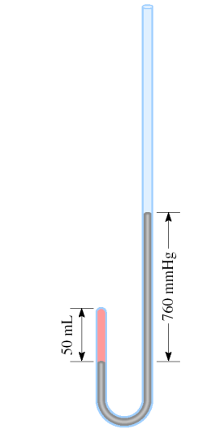
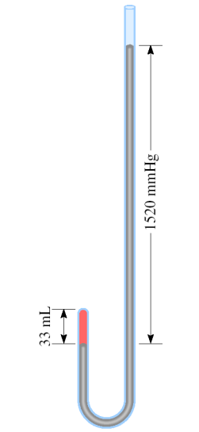
Apparatus for Studying the Relationship Between
Pressure and Volume of a Gas
As P (h) increases
V decreases

Slide 14
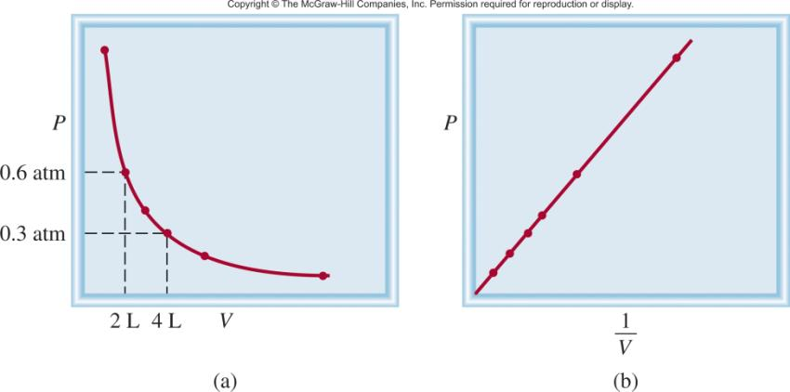
Boyle’s Law
P α 1/V
Constant temperature
Constant amount of gas
P x V = constant
P₁ x V₁ = P₂ x V₂

Slide 15
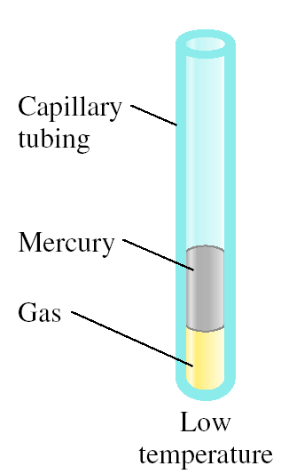
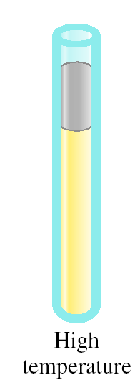
Variation in Gas Volume with Temperature at Constant Pressure
As T increases
V increases

Slide 16
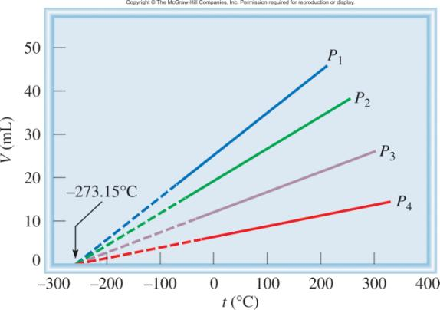
Variation of Gas Volume with Temperature
at Constant Pressure
Charles’s & Gay-Lussac’s Law
V α T
Temperature must be
in Kelvin
V = constant x T
V₁/T₁ = V₂ /T₂
T (K) = t (⁰C) + 273.15

Slide 17
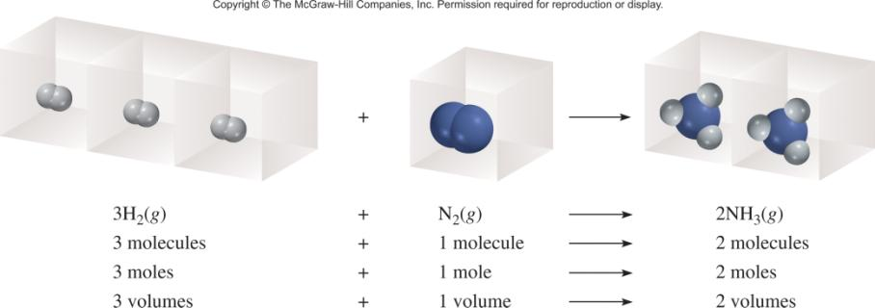
Avogadro’s Law
V α number of moles (n)
Constant temperature
Constant pressure
V = constant x n
V₁ / n₁ = V₂ / n₂

Slide 18
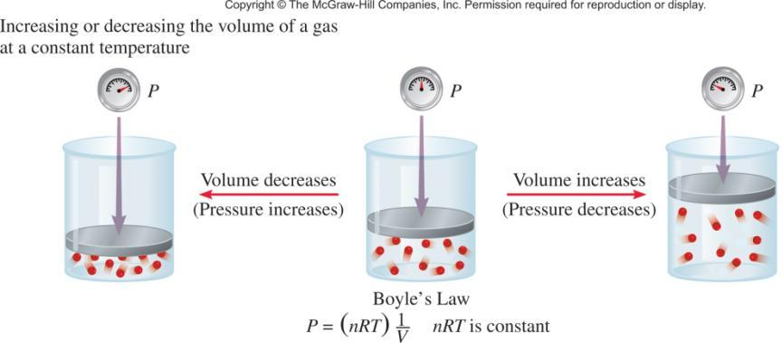
Summary of Gas Laws
Boyle’s Law

Slide 19
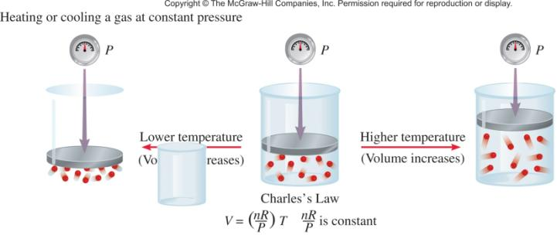
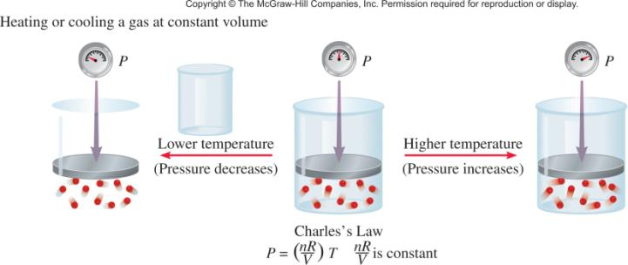
Charles’s Law

Slide 20
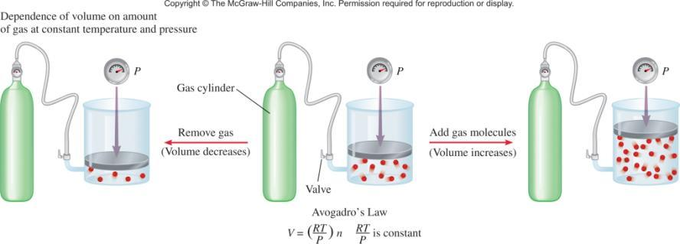
Avogadro’s Law

Slide 21
Ideal Gas Equation
1
Boyle’s law: P α (at constant n and T)
V
Charles’s law: V α T (at constant n and P)
Avogadro’s law: V α n (at constant P and T)
nT
V α
P
nT
nT
V = constant x = R
R is the gas constant
P
P
PV = nRT

Slide 22
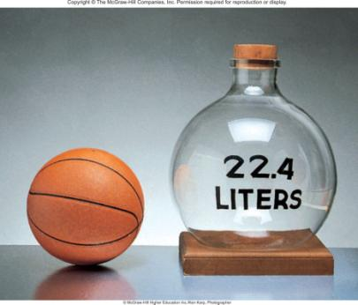
The conditions 0 ⁰C and 1 atm are called standard temperature and pressure (STP).
Experiments show that at STP, 1 mole of an ideal gas occupies 22.414 L.
PV = nRT
PV
(1 atm)(22.414L)
R =
=
nT
(1 mol)(273.15 K)
R = 0.082057 L • atm / (mol • K)

Slide 23
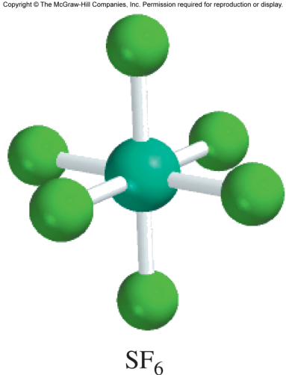
5.3
Sulfur hexafluoride (SF₆) is a colorless and odorless gas.
Due to its lack of chemical reactivity, it is used as an insulator in electronic equipment.
Calculate the pressure (in atm) exerted by 1.82 moles of the gas in a steel vessel of volume 5.43 L at 69.5°C.

Slide 24
5.3
Strategy
The problem gives the amount of the gas and its volume and temperature.
Is the gas undergoing a change in any of its properties?
What equation should we use to solve for the pressure?
What temperature unit should we use?

Slide 25
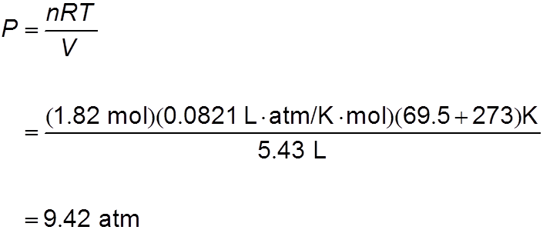
5.3
Solution Because no changes in gas properties occur, we can use the ideal gas equation to calculate the pressure.
Rearranging Equation (5.8), we write

Slide 26
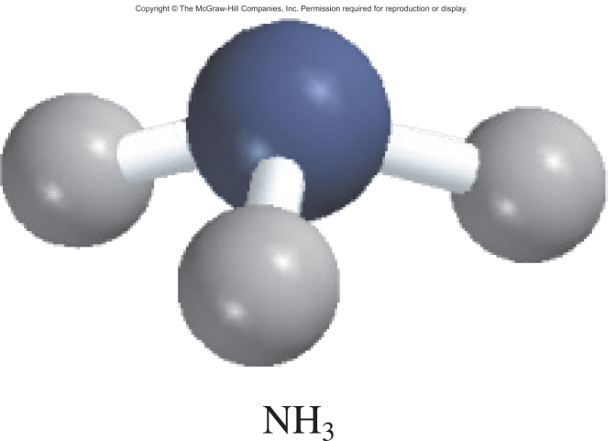
5.4
Calculate the volume (in L) occupied by 7.40 g of NH₃ at STP.

Slide 27
5.4
Strategy
What is the volume of one mole of an ideal gas at STP?
How many moles are there in 7.40 g of NH₃?
Solution
Recognizing that 1 mole of an ideal gas occupies 22.41 L at STP and using the molar mass of NH₃ (17.03 g), we write the sequence of conversions as

Slide 28
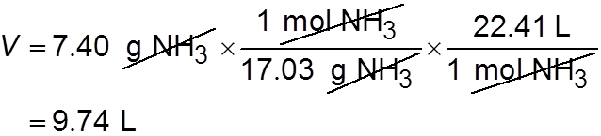
5.4
So the volume of NH₃ is given by
It is often true in chemistry, particularly in gas-law calculations, that a problem can be solved in more than one way. Here the problem can also be solved by first converting 7.40 g of NH₃ to number of moles of NH₃, and then applying the ideal gas
equation (V = nRT/P). Try it.
Check Because 7.40 g of NH₃ is smaller than its molar mass, its volume at STP should be smaller than 22.41 L. Therefore, the answer is reasonable.

Slide 29
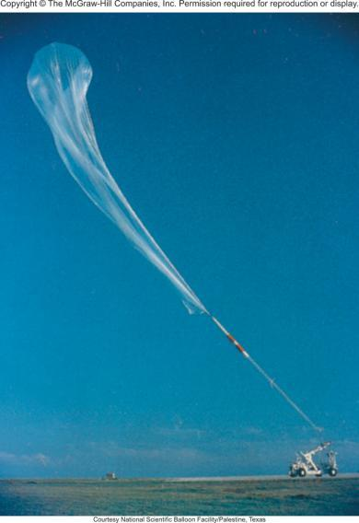
5.5
An inflated helium balloon with a volume of 0.55 L at sea level (1.0 atm) is allowed to rise to a height of 6.5 km, where the pressure is about 0.40 atm.
Assuming that the temperature remains constant, what is the final volume of the balloon?
A scientific research helium balloon.

Slide 30


5.5
Strategy The amount of gas inside the balloon and its temperature remain constant, but both the pressure and the volume change. What gas law do you need?
Solution We start with Equation (5.9)
Because n₁ = n₂ and T₁ = T₂,
which is Boyle’s law [see Equation (5.2)].

Slide 31
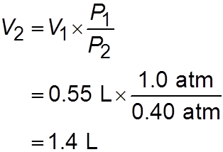
5.5
The given information is tabulated:
Initial Conditions Final Conditions
P₁ = 1.0 atm P₂ = 0.40 atm
V₁ = 0.55 L V₂ = ?
Therefore,
Check When pressure applied on the balloon is reduced (at constant temperature), the helium gas expands and the balloon’s volume increases. The final volume is greater than the initial volume, so the answer is reasonable.

Slide 32
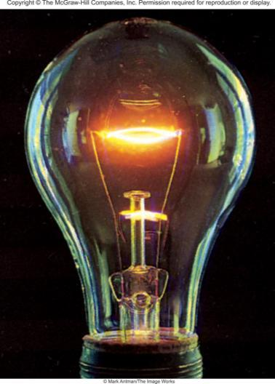
5.6
Argon is an inert gas used in lightbulbs to retard the vaporization of the tungsten filament.
A certain lightbulb containing argon at 1.20 atm and 18°C is heated to 85°C at constant volume.
Calculate its final pressure (in atm).
Electric lightbulbs are usually filled with argon.

Slide 33

5.6
Strategy The temperature and pressure of argon change but the amount and volume of gas remain the same.
What equation would you use to solve for the final pressure?
What temperature unit should you use?
Solution Because n₁ = n₂ and V₁ = V₂, Equation (5.9) becomes
which is Charles’s law [see Equation (5.6)].

Slide 34
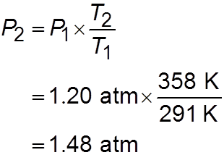
5.6
Next we write
Initial Conditions Final Conditions
P₁ = 1.20 atm P₂ = ?
T₁ = (18 + 273) K = 291 K T₂ = (85 + 273) K = 358 K
The final pressure is given by
Check At constant volume, the pressure of a given amount of gas is directly proportional to its absolute temperature. Therefore the increase in pressure is reasonable.

Slide 35
5.7
A small bubble rises from the bottom of a lake, where the temperature and pressure are 8°C and 6.4 atm, to the water’s surface, where the temperature is 25°C and the pressure
is 1.0 atm.
Calculate the final volume (in mL) of the bubble if its initial volume was 2.1 mL.

Slide 36
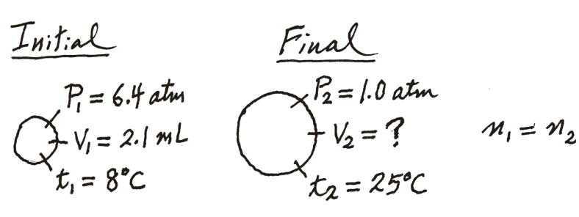
5.7
Strategy In solving this kind of problem, where a lot of information is given, it is sometimes helpful to make a sketch of the situation, as shown here:
What temperature unit should be used in the calculation?

Slide 37

5.7
Solution According to Equation (5.9)
We assume that the amount of air in the bubble remains constant, that is, n₁ = n₂ so that
which is Equation (5.10).

Slide 38
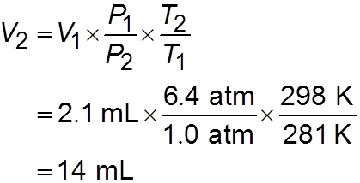
5.7
The given information is summarized:
Initial Conditions Final Conditions
P₁ = 6.4 atm P₂ = 1.0 atm
V₁ = 2.1 mL V₂ = ?
T₁ = (8 + 273) K = 281 K T₂ = (25 + 273) K = 298 K
Rearranging Equation (5.10) gives

Slide 39
5.7
Check We see that the final volume involves multiplying the initial volume by a ratio of pressures (P₁/P₂) and a ratio of temperatures (T₂/T₁).
Recall that volume is inversely proportional to pressure, and volume is directly proportional to temperature.
Because the pressure decreases and temperature increases as the bubble rises, we expect the bubble’s volume to increase.
In fact, here the change in pressure plays a greater role in the volume change.

Slide 40
Density (d) Calculations
PM
m is the mass of the gas in g
m
d =
=
V
RT
M is the molar mass of the gas
Molar Mass (M ) of a Gaseous Substance
dRT
M =
d is the density of the gas in g/L
P

Slide 41
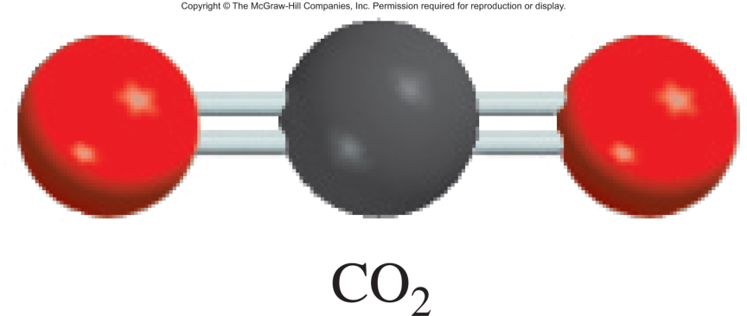
5.8
Calculate the density of carbon dioxide (CO₂) in grams per liter (g/L) at 0.990 atm and 55°C.

Slide 42
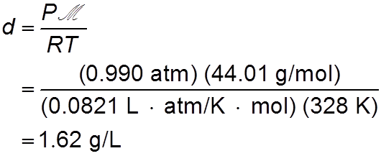
5.8
Strategy We need Equation (5.11) to calculate gas density.
Is sufficient information provided in the problem?
What temperature unit should be used?
Solution To use Equation (5.11), we convert temperature to kelvins (T = 273 + 55 = 328 K) and use 44.01 g for the molar mass of CO₂:

Slide 43

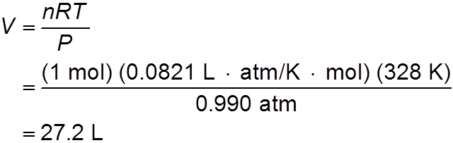
5.8
Alternatively, we can solve for the density by writing
Assuming that we have 1 mole of CO₂, the mass is 44.01 g. The volume of the gas can be obtained from the ideal gas equation

Slide 44

5.8
Therefore, the density of CO₂ is given by
Comment ln units of grams per milliliter, the gas density is 1.62 × 10⁻³ g/mL, which is a very small number. In comparison, the density of water is 1.0 g/mL and that of gold is 19.3 g/cm³.

Slide 45
5.9
A chemist has synthesized a greenish-yellow gaseous compound of chlorine and oxygen and finds that its density is 7.71 g/L at 36°C and 2.88 atm.
Calculate the molar mass of the compound and determine its molecular formula.

Slide 46
5.9
Strategy
Because Equations (5.11) and (5.12) are rearrangements of each other, we can calculate the molar mass of a gas if we know its density, temperature, and pressure.
The molecular formula of the compound must be consistent with its molar mass. What temperature unit should we use?

Slide 47
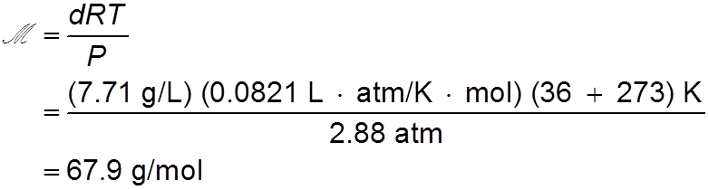

5.9
Solution From Equation (5.12)
Alternatively, we can solve for the molar mass by writing
From the given density we know there are 7.71 g of the gas in 1 L.

Slide 48
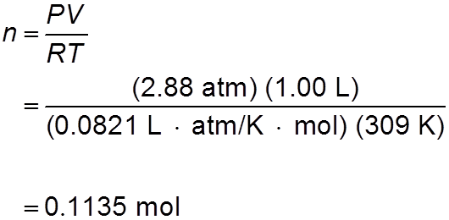

5.9
The number of moles of the gas in this volume can be obtained from the ideal gas equation
Therefore, the molar mass is given by

Slide 49
5.9
We can determine the molecular formula of the compound by trial and error, using only the knowledge of the molar masses of chlorine (35.45 g) and oxygen (16.00 g).
We know that a compound containing one Cl atom and one O atom would have a molar mass of 51.45 g, which is too low, while the molar mass of a compound made up of two Cl atoms and one O atom is 86.90 g, which is too high.
Thus, the compound must contain one Cl atom and two O atoms and have the formula ClO₂, which has a molar mass of 67.45 g.

Slide 50
5.10
Chemical analysis of a gaseous compound showed that it contained 33.0 percent silicon (Si) and 67.0 percent fluorine (F) by mass.
At 35°C, 0.210 L of the compound exerted a pressure of 1.70 atm.
If the mass of 0.210 L of the compound was 2.38 g, calculate the molecular formula of the compound.

Slide 51
5.10
Strategy This problem can be divided into two parts.
First, it asks for the empirical formula of the compound from the percent by mass of Si and F.
Second, the information provided enables us to calculate the molar mass of the compound and hence determine its molecular formula.
What is the relationship between empirical molar mass and molar mass calculated from the molecular formula?

Slide 52
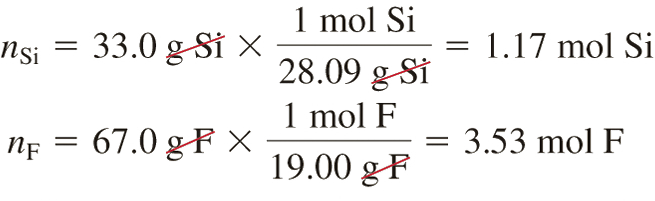
5.10
Solution We follow the procedure in Example 3.9 (p. 86) to calculate the empirical formula by assuming that we have 100 g of the compound, so the percentages are converted to grams.
The number of moles of Si and F are given by
Therefore, the empirical formula is Si_{1.17}F_{3.53}, or, dividing by the smaller subscript (1.17), we obtain SiF₃.

Slide 53
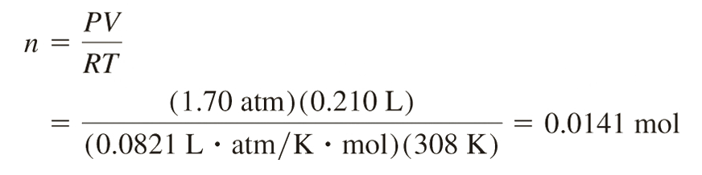

5.10
To calculate the molar mass of the compound, we need first to calculate the number of moles contained in 2.38 g of the compound. From the ideal gas equation
Because there are 2.38 g in 0.0141 mole of the compound, the mass in 1 mole, or the molar mass, is given by

Slide 54
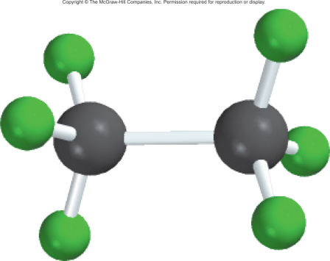
5.10
The molar mass of the empirical formula SiF₃ is 85.09 g.
Recall that the ratio (molar mass/empirical molar mass) is always an integer (169/85.09 ≈ 2).
Therefore, the molecular formula of the compound must be (SiF₃)₂ or Si₂F₆ .

Slide 55
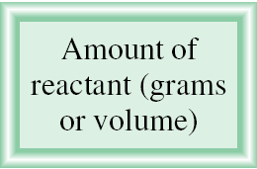
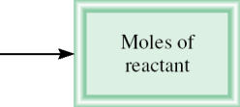
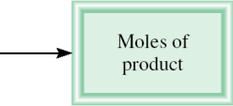
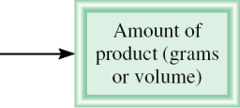
Gas Stoichiometry

Slide 56
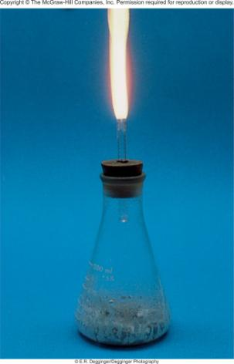
5.11
Calculate the volume of O₂ (in liters) required for the complete combustion of 7.64 L of acetylene (C₂H₂) measured at the same temperature and pressure.
The reaction of calcium carbide (CaC₂) with water produces acetylene (C₂H₂), a flammable gas.

Slide 57
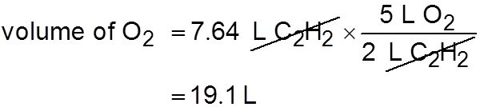
5.11
Strategy Note that the temperature and pressure of O₂ and C₂H₂ are the same. Which gas law do we need to relate the volume of the gases to the moles of gases?
Solution According to Avogadro’s law, at the same temperature and pressure, the number of moles of gases are directly related to their volumes. From the equation, we
have 5 mol O₂ 2 mol C₂H₂; therefore, we can also write 5 L O₂ 2 L C₂H₂. The volume of O₂ that will react with 7.64 L C₂H₂ is given by

Slide 58
5.12
Sodium azide (NaN₃) is used in some automobile air bags. The impact of a collision triggers the decomposition of NaN₃ as follows:
The nitrogen gas produced quickly inflates the bag between the driver and the windshield and dashboard.
Calculate the volume of N₂ generated at 80°C and 823 mmHg by the decomposition of 60.0 g of NaN₃.
An air bag can protect the driver in an automobile collision.

Slide 59
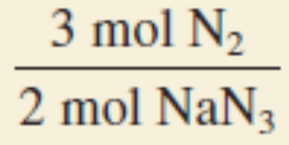
5.12
Strategy From the balanced equation we see that 2 mol NaN₃ 3 mol N₂ so the conversion factor between NaN₃ and N₂ is
Because the mass of NaN₃ is given, we can calculate the number of moles of NaN₃ and hence the number of moles of N₂ produced.
Finally, we can calculate the volume of N₂ using the ideal gas equation.

Slide 60
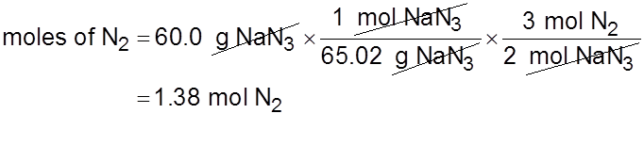

5.12
Solution First we calculate number of moles of N₂ produced by 60.0 g NaN₃ using the following sequence of conversions
so that
The volume of 1.38 moles of N₂ can be obtained by using the ideal gas equation:

Slide 61
5.13
Aqueous lithium hydroxide solution is used to purify air in spacecrafts and submarines because it absorbs carbon dioxide, which is an end product of metabolism, according to the equation
The pressure of carbon dioxide inside the cabin of a submarine having a volume of 2.4 × 10⁵ L is 7.9 × 10⁻³ atm at 312 K. A solution of lithium hydroxide (LiOH) of negligible volume is introduced into the cabin. Eventually the pressure of CO₂ falls to 1.2 × 10⁻⁴ atm. How many grams of lithium carbonate are formed by this process?

Slide 62
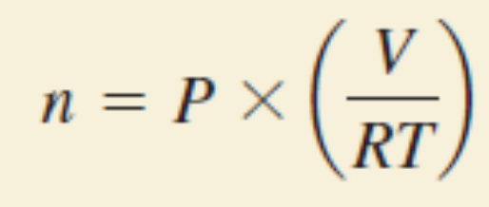

5.13
Strategy How do we calculate the number of moles of CO₂ reacted from the drop in CO₂ pressure?
From the ideal gas equation we write
At constant T and V, the change in pressure of CO₂, ΔP, corresponds to the change in the number of moles of CO₂, Δn. Thus,
What is the conversion factor between CO₂ and Li₂CO₃?

Slide 63

5.13
Solution The drop in CO₂ pressure is
(7.9 × 10⁻³ atm) − (1.2 × 10⁻⁴ atm) or 7.8 × 10⁻³ atm
Therefore, the number of moles of CO₂ reacted is given by
From the chemical equation we see that
1 mol CO₂ 1 mol Li₂CO₃
so the amount of Li₂CO₃ formed is also 73 moles.

Slide 64

5.13
Then, with the molar mass of Li₂CO₃ (73.89 g), we calculate its mass:

Slide 65



Dalton’s Law of Partial Pressures
V and T are constant
P₁
P₂
P_{total} = P₁ + P₂

Slide 66

Consider a case in which two gases, A and B, are in a container of volume V.
n_{A}RT
P_{A} =
n_{A} is the number of moles of A
V
n_{B}RT
P_{B} =
n_{B} is the number of moles of B
V
n_{A}
n_{B}
P_{T} = P_{A} + P_{B}
X_{A} =
X_{B} =
n_{A} + n_{B}
n_{A} + n_{B}
P_{A} = X_{A} P_{T}
P_{B} = X_{B} P_{T}
P_{i} = X_{i} P_{T}
n_{i}
mole fraction (X_{i} ) =
n_{T}

Slide 67
5.14
A mixture of gases contains 4.46 moles of neon (Ne), 0.74 mole of argon (Ar), and 2.15 moles of xenon (Xe).
Calculate the partial pressures of the gases if the total pressure is 2.00 atm at a certain temperature.

Slide 68

5.14
Strategy What is the relationship between the partial pressure of a gas and the total gas pressure?
How do we calculate the mole fraction of a gas?
Solution According to Equation (5.14), the partial pressure of Ne (P_{Ne}) is equal to the product of its mole fraction (X_{Ne}) and the total pressure (P_{T})

Slide 69


5.14
Using Equation (5.13), we calculate the mole fraction of Ne as follows:
Therefore,

Slide 70


5.14
Similarly,
and
Check Make sure that the sum of the partial pressures is equal to the given total pressure; that is,
(1.21 + 0.20 + 0.586) atm = 2.00 atm.

Slide 71

Collecting a Gas over Water
2KClO₃ (s) 2KCl (s) + 3O₂ (g)
P_{T} = P_{O} + P_{H O}
2
2

Slide 72


Vapor of Water and Temperature

Slide 73
5.15
Oxygen gas generated by the decomposition of potassium chlorate is collected as shown in Figure 5.15.
The volume of oxygen collected at 24°C and atmospheric pressure of 762 mmHg is 128 mL.
Calculate the mass (in grams) of oxygen gas obtained.
The pressure of the water vapor at 24°C is 22.4 mmHg.

Slide 74

5.15
Strategy To solve for the mass of O₂ generated, we must first calculate the partial pressure of O₂ in the mixture.
What gas law do we need?
How do we convert pressure of O₂ gas to mass of O₂ in grams?
Solution From Dalton’s law of partial pressures we know that

Slide 75


5.15
Therefore,
From the ideal gas equation we write
where m and are the mass of O₂ collected and the molar mass of O₂, respectively.

Slide 76

5.15
Rearranging the equation we obtain
Check The density of the oxygen gas is (0.164 g/0.128 L), or 1.28 g/L, which is a reasonable value for gases under atmospheric conditions (see Example 5.8).

Slide 77

Chemistry in Action:
Scuba Diving and the Gas Laws
Depth (ft) | Pressure (atm)
0 | 1
33 | 2
66 | 3
P
V

Slide 78
Kinetic Molecular Theory of Gases
A gas is composed of molecules that are separated from each other by distances far greater than their own dimensions. The molecules can be considered to be points; that is, they possess mass but have negligible volume.
Gas molecules are in constant motion in random directions, and they frequently collide with one another. Collisions among molecules are perfectly elastic.
Gas molecules exert neither attractive nor repulsive forces on one another.
The average kinetic energy of the molecules is proportional to the temperature of the gas in kelvins. Any two gases at the same temperature will have the same average kinetic energy
KE = ½ mu²

Slide 79
Kinetic theory of gases and …
Compressibility of Gases
Boyle’s Law
    P α collision rate with wall
    Collision rate α number density
    Number density α 1/V
    P α 1/V
Charles’s Law
    P α collision rate with wall
    Collision rate α average kinetic energy of gas molecules
    Average kinetic energy α T
    P α T

Slide 80
Kinetic theory of gases and …
Avogadro’s Law
    P α collision rate with wall
    Collision rate α number density
    Number density α n
    P α n
Dalton’s Law of Partial Pressures
    Molecules do not attract or repel one another
    P exerted by one type of molecule is unaffected by the presence of another gas
    P_{total} = ΣP_{i}

Slide 81

Apparatus for Studying Molecular Speed Distribution

Slide 82


The distribution of speeds
of three different gases
at the same temperature
The distribution of speeds
for nitrogen gas molecules
at three different temperatures
√
3RT
u_{rms} =
M

Slide 83
5.16
Calculate the root-mean-square speeds of helium atoms and nitrogen molecules in m/s at 25°C.

Slide 84
5.16
Strategy To calculate the root-mean-square speed we need Equation (5.16).
What units should we use for R and so that u_{rms} will be expressed in m/s?
Solution
To calculate u_{rms}, the units of R should be 8.314 J/K · mol and, because 1 J = 1 kg m²/s², the molar mass must be in kg/mol.
The molar mass of He is 4.003 g/mol, or 4.003 × 10⁻³ kg/mol.

Slide 85


5.16
From Equation (5.16),
Using the conversion factor 1 J = 1 kg m²/s² we get

Slide 86


5.16
The procedure is the same for N₂, the molar mass of which is 28.02 g/mol, or 2.802 × 10⁻² kg/mol so that we write
Check
Because He is a lighter gas, we expect it to move faster, on average, than N₂. A quick way to check the answers is to note that the ratio of the two u_{rms} values (1.36 × 10³/515 ≈ 2.6) should be equal to the square root of the ratios of the molar masses of N₂ to He, that is, .

Slide 87

Chemistry in Action: Super Cold Atoms
Maxwell velocity distribution of Rb atoms at about 1.7 x 10⁻⁷ K
Bose-Einstein condensate (BEC)

Slide 88


Gas diffusion is the gradual mixing of molecules of one gas with molecules of another by virtue of their kinetic properties.
r₁
√
M₂
=
r₂
M₁
molecular path
NH₄Cl
NH₃
17 g/mol
HCl
36 g/mol

Slide 89

Gas effusion is the process by which gas under pressure escapes from one compartment of a container to another by passing through a small opening.
r₁
t₂
√
M₂
=
=
r₂
t₁
M₁

Slide 90

5.17
A flammable gas made up only of carbon and hydrogen is found to effuse through a porous barrier in 1.50 min.
Under the same conditions of temperature and pressure, it takes an equal volume of bromine vapor 4.73 min to effuse through the same barrier.
Calculate the molar mass of the unknown gas, and suggest what this gas might be.
Gas effusion. Gas molecules move from a high-pressure
region (left) to a low-pressure
one through a pinhole.

Slide 91

5.17
Strategy The rate of diffusion is the number of molecules passing through a porous barrier in a given time.
The longer the time it takes, the slower is the rate.
Therefore, the rate is inversely proportional to the time required for diffusion.
Equation (5.17) can now be written as r₁/r₂ = t₂/t₁ = , where t₁ and t₂ are the times for effusion for gases 1 and 2, respectively.

Slide 92


5.17
Solution From the molar mass of Br₂, we write
Where is the molar mass of the unknown gas. Solving for we obtain
Because the molar mass of carbon is 12.01 g and that of hydrogen is 1.008 g, the gas is methane (CH₄).

Slide 93

Deviations from Ideal Behavior
1 mole of ideal gas
Repulsive Forces
PV = nRT
PV
n =
= 1.0
RT
Attractive Forces

Slide 94

Effect of intermolecular forces on the pressure exerted by a gas.

Slide 95

Van der Waals equation
nonideal gas
(
an²
)
P + (V – nb) = nRT
V²
}
}
corrected
pressure
corrected
volume

Slide 96
5.18
Given that 3.50 moles of NH₃ occupy 5.20 L at 47°C, calculate the pressure of the gas (in atm) using
the ideal gas equation and
the van der Waals equation.

Slide 97
5.18
Strategy
To calculate the pressure of NH₃ using the ideal gas equation, we proceed as in Example 5.3.
What corrections are made to the pressure and volume terms in the van der Waals equation?

Slide 98

5.18
Solution
We have the following data:
V = 5.20 L
T = (47 + 273) K = 320 K
n = 3.50 mol
R = 0.0821 L · atm/K · mol
Substituting these values in the ideal gas equation, we write

Slide 99

5.18
(b) We need Equation (5.18). It is convenient to first calculate the correction terms in Equation (5.18) separately. From Table 5.4, we have
a = 4.17 atm · L²/mol²
b = 0.0371 L/mol
so that the correction terms for pressure and volume are

Slide 100

5.18
Finally, substituting these values in the van der Waals equation, we have
Check Based on your understanding of nonideal gas behavior, is it reasonable that the pressure calculated using the van der Waals equation should be smaller than that using the ideal gas equation? Why?

