Slide 1
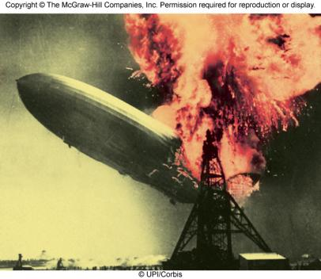

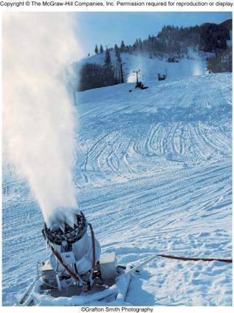
Thermochemistry
Chapter 6
Copyright © The McGraw-Hill Companies, Inc. Permission required for reproduction or display.

Slide 2
Energy is the capacity to do work.
Radiant energy comes from the sun and is earth’s primary energy source
Thermal energy is the energy associated with the random motion of atoms and molecules
Chemical energy is the energy stored within the bonds of chemical substances
Nuclear energy is the energy stored within the collection of neutrons and protons in the atom
Potential energy is the energy available by virtue of an object’s position

Slide 3
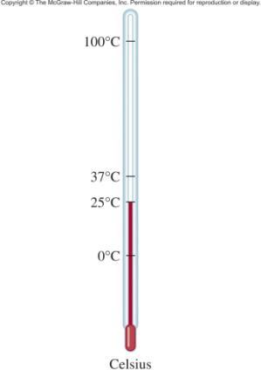
Energy Changes in Chemical Reactions
Heat is the transfer of thermal energy between two bodies that are at different temperatures.
Temperature is a measure of the thermal energy.
Temperature = Thermal Energy

Slide 4
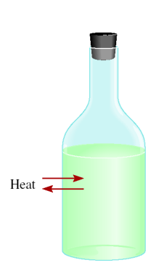
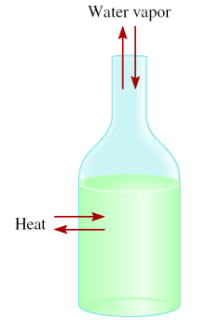

Thermochemistry is the study of heat change in chemical reactions.
The system is the specific part of the universe that is of interest in the study.
open
closed
isolated
Exchange:
mass & energy
energy
nothing

Slide 5
Exothermic process is any process that gives off heat – transfers thermal energy from the system to the surroundings.
2H₂ (g) + O₂ (g) 2H₂O (l) + energy
H₂O (g) H₂O (l) + energy
Endothermic process is any process in which heat has to be supplied to the system from the surroundings.
energy + 2HgO (s) 2Hg (l) + O₂ (g)
energy + H₂O (s) H₂O (l)

Slide 6
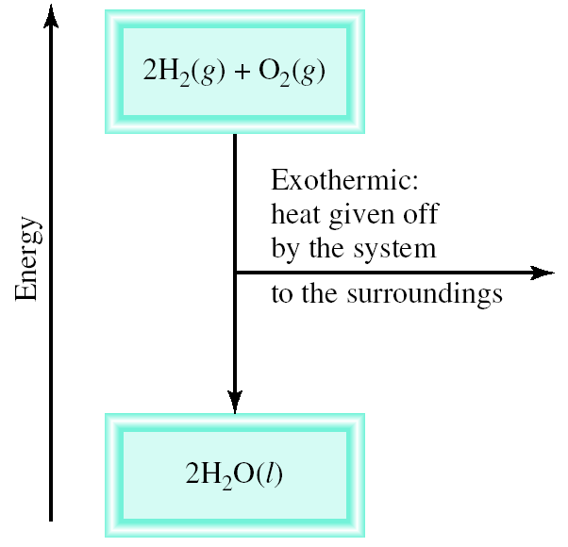
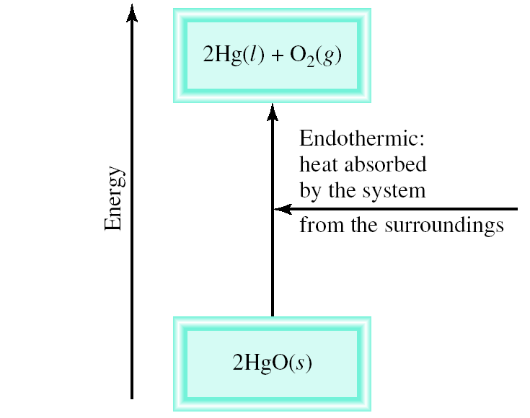
Schematic of Exothermic and Endothermic Processes

Slide 7
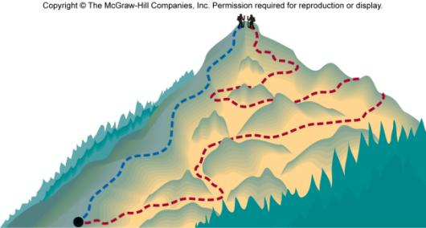
Thermodynamics is the scientific study of the interconversion of heat and other kinds of energy.
State functions are properties that are determined by the state of the system, regardless of how that condition was achieved.
energy
, pressure, volume, temperature
ΔU = U_{final} - U_{initial}
ΔP = P_{final} - P_{initial}
ΔV = V_{final} - V_{initial}
ΔT = T_{final} - T_{initial}
Potential energy of hiker 1 and hiker 2 is the same even though they took different paths.

Slide 8
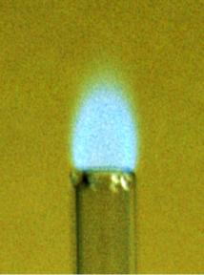
First law of thermodynamics – energy can be converted from one form to another, but cannot be created or destroyed.
ΔU_{system} + ΔU_{surroundings} = 0
or
ΔU_{system} = -ΔU_{surroundings}
C₃H₈ + 5O₂ 3CO₂ + 4H₂O
Exothermic chemical reaction!
Chemical energy lost by combustion = Energy gained by the surroundings
system
surroundings

Slide 9
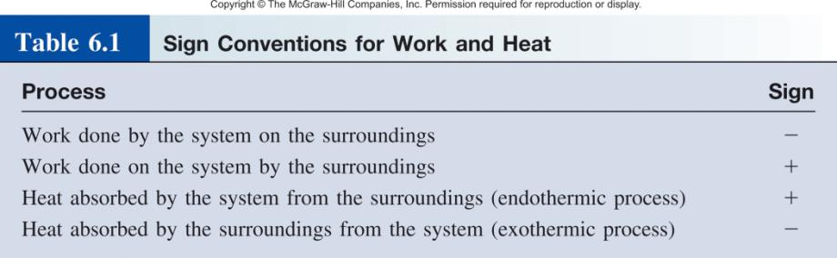
Another form of the first law for ΔU_{system}
ΔU = q + w
ΔU is the change in internal energy of a system
q is the heat exchange between the system and the surroundings
w is the work done on (or by) the system
w = -PΔV when a gas expands against a constant external pressure

Slide 10
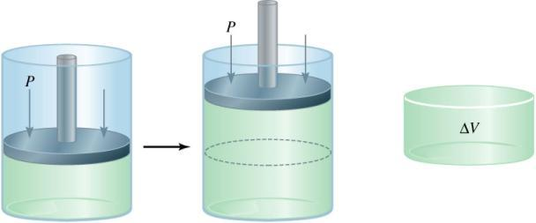
Work Done By the System On the Surroundings
w = F x d
w = -P ΔV
ΔV > 0
-PΔV < 0
F
P x V = x d³ = F x d = w
d²
w < 0
Work is not a state function.
Δw = w_{final} - w_{initial}
initial
final

Slide 11
6.1
A certain gas expands in volume from 2.0 L to 6.0 L at constant temperature.
Calculate the work done by the gas if it expands
against a vacuum
against a constant pressure of 1.2 atm

Slide 12
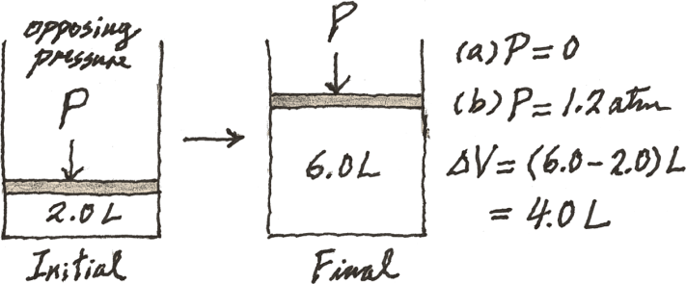
6.1
Strategy A simple sketch of the situation is helpful here:
The work done in gas expansion is equal to the product of the external, opposing pressure and the change in volume.
What is the conversion factor between L · atm and J?

Slide 13
6.1
Solution
(a) Because the external pressure is zero, no work is done in the expansion.
w = −PΔV
= −(0)(6.0 − 2.0) L
= 0
(b) The external, opposing pressure is 1.2 atm, so
w = −PΔV
= −(1.2 atm) (6.0 − 2.0) L
= −4.8 L · atm

Slide 14
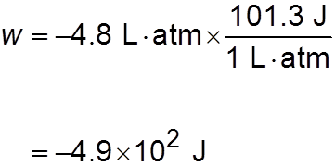
6.1
To convert the answer to joules, we write
Check Because this is gas expansion (work is done by the system on the surroundings), the work done has a negative sign.

Slide 15
6.2
The work done when a gas is compressed in a cylinder like that shown in Figure 6.5 is 462 J.
During this process, there is a heat transfer of 128 J from the gas to the surroundings.
Calculate the energy change for this process.

Slide 16
6.2
Strategy
Compression is work done on the gas, so what is the sign for w?
Heat is released by the gas to the surroundings.
Is this an endothermic or exothermic process?
What is the sign for q?

Slide 17
6.2
Solution To calculate the energy change of the gas, we need Equation (6.1). Work of compression is positive and because heat is released by the gas, q is negative. Therefore, we have
ΔU = q + w
= −128 J + 462 J
= 334 J
As a result, the energy of the gas increases by 334 J.

Slide 18

Chemistry in Action: Making Snow
ΔU = q + w
q = 0
w < 0, ΔU < 0
ΔU = CΔT
ΔT < 0, SNOW!

Slide 19
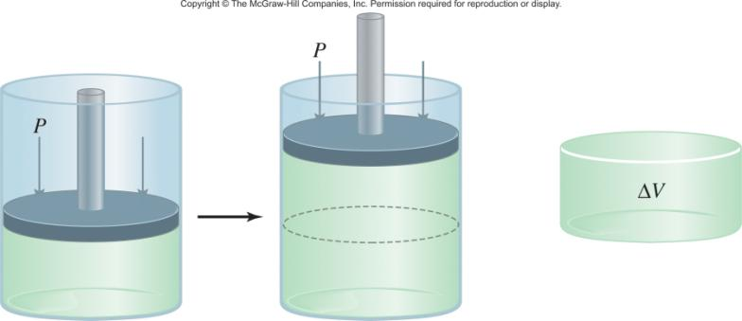
Enthalpy and the First Law of Thermodynamics
ΔU = q + w
At constant pressure:
q = ΔH and w = -PΔV
ΔU = ΔH - PΔV
ΔH = ΔU + PΔV

Slide 20
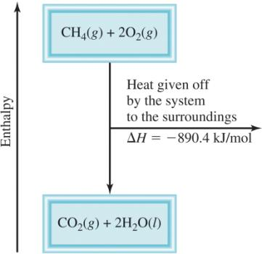
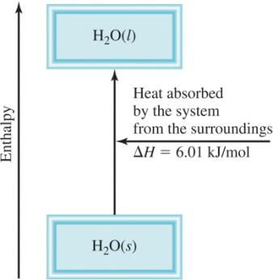
Enthalpy (H) is used to quantify the heat flow into or out of a system in a process that occurs at constant pressure.
ΔH = H (products) – H (reactants)
ΔH = heat given off or absorbed during a reaction at constant pressure
H_{products} < H_{reactants}
H_{products} > H_{reactants}
ΔH < 0
ΔH > 0

Slide 21

Thermochemical Equations
Is ΔH negative or positive?
System absorbs heat
Endothermic
ΔH > 0
6.01 kJ are absorbed for every 1 mole of ice that melts at 0⁰C and 1 atm.
H₂O (s) H₂O (l)
ΔH = 6.01 kJ/mol

Slide 22
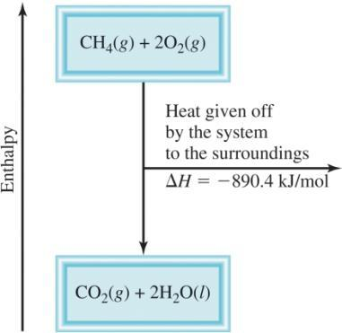
Thermochemical Equations
Is ΔH negative or positive?
System gives off heat
Exothermic
ΔH < 0
890.4 kJ are released for every 1 mole of methane that is combusted at 25⁰C and 1 atm.
CH₄ (g) + 2O₂ (g) CO₂ (g) + 2H₂O (l)
ΔH = -890.4 kJ/mol

Slide 23
Thermochemical Equations
The stoichiometric coefficients always refer to the number of moles of a substance
H₂O (s) H₂O (l)
ΔH = 6.01 kJ/mol
If you reverse a reaction, the sign of ΔH changes
H₂O (l) H₂O (s)
ΔH = -6.01 kJ/mol
If you multiply both sides of the equation by a factor n, then ΔH must change by the same factor n.
2H₂O (s) 2H₂O (l)
ΔH = 2 x 6.01 = 12.0 kJ

Slide 24
Thermochemical Equations
The physical states of all reactants and products must be specified in thermochemical equations.
H₂O (s) H₂O (l)
ΔH = 6.01 kJ/mol
H₂O (l) H₂O (g)
ΔH = 44.0 kJ/mol

Slide 25
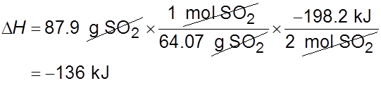
6.3
Solution We need to first calculate the number of moles of SO₂ in 87.9 g of the compound and then find the number of kilojoules produced from the exothermic reaction. The sequence of conversions is as follows:
Therefore, the enthalpy change for this reaction is given by
and the heat released to the surroundings is 136 kJ.

Slide 26
6.3
Check
Because 87.9 g is less than twice the molar mass of SO₂ (2 × 64.07 g) as shown in the preceding thermochemical equation, we expect the heat released to be smaller than 198.2 kJ.

Slide 27
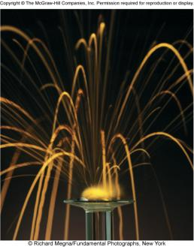
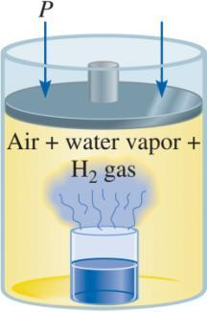
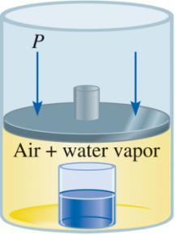
A Comparison of ΔH and ΔU
2Na(s) + 2H₂O(l) 2NaOH(aq) + H₂(g) ΔH = -367.5 kJ/mol
ΔU = ΔH - PΔV
At 25 ºC, 1 mole H₂ = 24.5 L at 1 atm
PΔV = 1 atm x 24.5 L = 2.5 kJ
ΔU = -367.5 kJ/mol – 2.5 kJ/mol = -370.0 kJ/mol

Slide 28
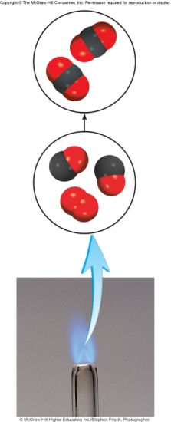
6.4
Calculate the change in internal energy when 2 moles of CO are converted to 2 moles of CO₂ at 1 atm and 25°C:
Carbon monoxide burns in air to form carbon dioxide.

Slide 29
6.4
Strategy
We are given the enthalpy change, ΔH, for the reaction and are asked to calculate the change in internal energy, ΔU.
Therefore, we need Equation (6.10).
What is the change in the number of moles of gases?
Δ H is given in kilojoules, so what units should we use for R?

Slide 30

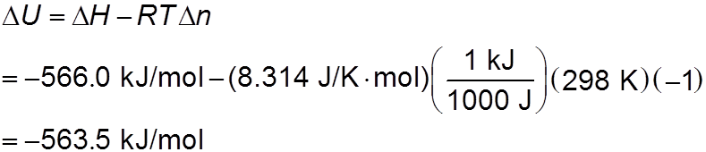
6.4
Solution From the chemical equation we see that 3 moles of gases are converted to 2 moles of gases so that
Using 8.314 J/K · mol for R and T = 298 K in Equation (6.10), we write

Slide 31
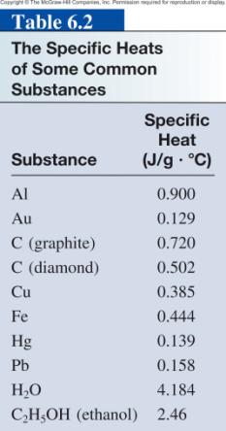
The specific heat(s) of a substance is the amount of heat (q) required to raise the temperature of one gram of the substance by one degree Celsius.
The heat capacity (C) of a substance is the amount of heat (q) required to raise the temperature of a given quantity (m) of the substance by one degree Celsius.
C = m x s
Heat (q) absorbed or released:
q = m x s x Δt
q = C x Δt
Δt = t_{final} - t_{initial}

Slide 32
6.5
A 466-g sample of water is heated from 8.50°C to 74.60°C.
Calculate the amount of heat absorbed (in kilojoules) by the water.

Slide 33
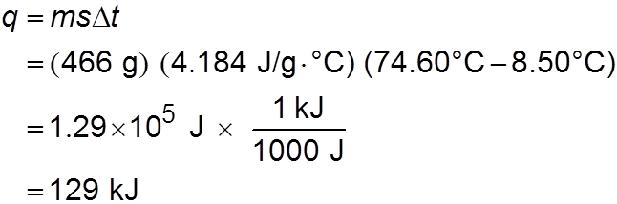
6.5
Strategy We know the quantity of water and the specific heat of water. With this information and the temperature rise, we can calculate the amount of heat absorbed (q).
Solution Using Equation (6.12), we write
Check The units g and °C cancel, and we are left with the desired unit kJ. Because heat is absorbed by the water from the surroundings, it has a positive sign.

Slide 34
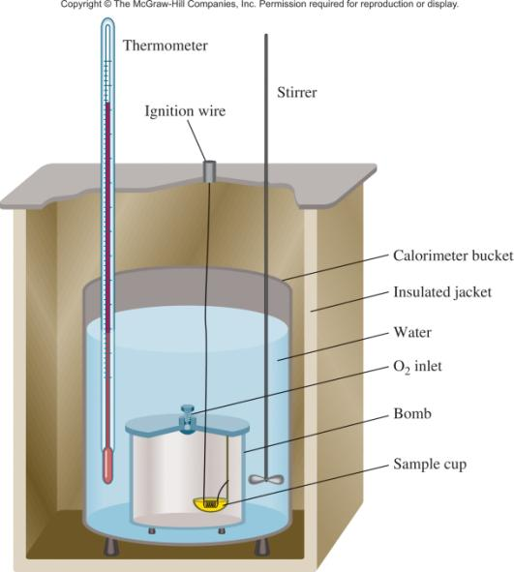
Constant-Volume Calorimetry
q_{sys} = q_{water} + q_{bomb} + q_{rxn}
q_{sys} = 0
q_{rxn} = - (q_{water} + q_{bomb})
q_{water} = m x s x Δt
q_{bomb} = C_{bomb} x Δt
Reaction at Constant V
ΔH = q_{rxn}
ΔH ~ q_{rxn}
No heat enters or leaves!

Slide 35
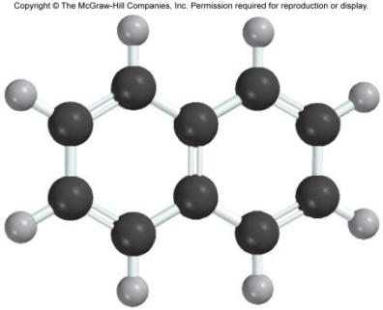
6.6
A quantity of 1.435 g of naphthalene (C₁₀H₈), a pungent-smelling substance used in moth repellents, was burned in a constant-volume bomb calorimeter.
Consequently, the temperature of the water rose from 20.28°C to 25.95°C.
If the heat capacity of the bomb plus water was 10.17 kJ/°C, calculate the heat of combustion of naphthalene on a molar basis; that is, find the molar heat of combustion.

Slide 36
6.6
Strategy
Knowing the heat capacity and the temperature rise, how do we calculate the heat absorbed by the calorimeter?
What is the heat generated by the combustion of 1.435 g of naphthalene?
What is the conversion factor between grams and moles of
naphthalene?

Slide 37
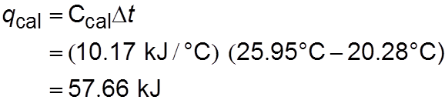

6.6
Solution The heat absorbed by the bomb and water is equal to the product of the heat capacity and the temperature change.
From Equation (6.16), assuming no heat is lost to the surroundings, we write
Because q_{sys} = q_{cal} + q_{rxn} = 0, q_{cal} = −q_{rxn}. The heat change of the reaction is − 57.66 kJ. This is the heat released by the combustion of 1.435 g of C₁₀H₈; therefore, we can write the conversion factor as

Slide 38
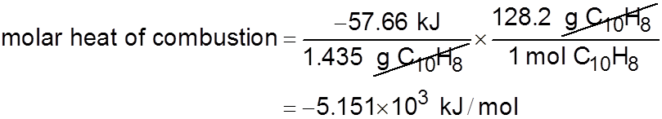
6.6
The molar mass of naphthalene is 128.2 g, so the heat of combustion of 1 mole of naphthalene is
Check Knowing that the combustion reaction is exothermic and that the molar mass of naphthalene is much greater than 1.4 g, is the answer reasonable? Under the reaction conditions, can the heat change (257.66 kJ) be equated to the enthalpy change of the reaction?

Slide 39
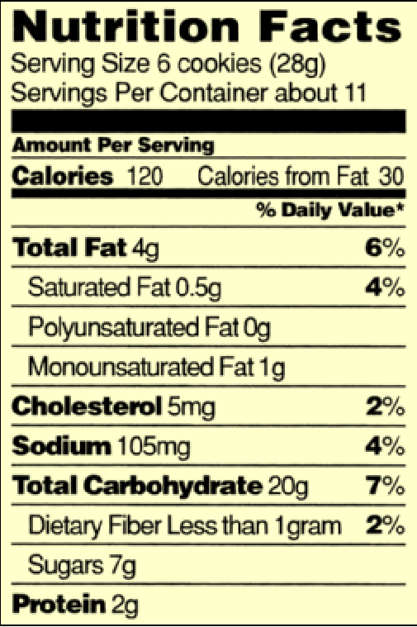
Chemistry in Action:
Fuel Values of Foods and Other Substances
C₆H₁₂O₆ (s) + 6O₂ (g) 6CO₂ (g) + 6H₂O (l) ΔH = -2801 kJ/mol
1 cal = 4.184 J
1 Cal = 1000 cal = 4184 J
Substance | ΔH_{combustion} (kJ/g)
Apple | -2
Beef | -8
Beer | -1.5
Gasoline | -34

Slide 40
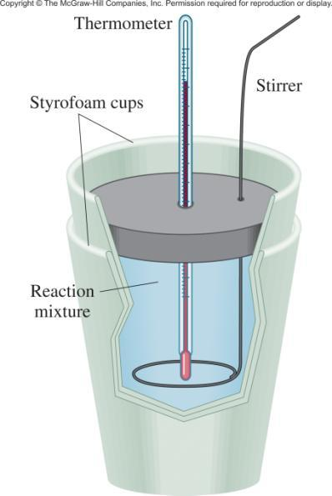
Constant-Pressure Calorimetry
q_{sys} = q_{water} + q_{cal} + q_{rxn}
q_{sys} = 0
q_{rxn} = - (q_{water} + q_{cal})
q_{water} = m x s x Δt
q_{cal} = C_{cal} x Δt
Reaction at Constant P
ΔH = q_{rxn}
No heat enters or leaves!

Slide 41

6.7
A lead (Pb) pellet having a mass of 26.47 g at 89.98°C was placed in a constant-pressure calorimeter of negligible heat capacity containing 100.0 mL of water.
The water temperature rose from 22.50°C to 23.17°C.
What is the specific heat of the lead pellet?

Slide 42
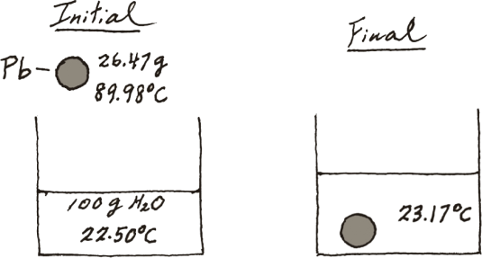
6.7
Strategy A sketch of the initial and final situation is as follows:
We know the masses of water and the lead pellet as well as the initial and final temperatures. Assuming no heat is lost to the surroundings, we can equate the heat lost by the lead pellet to the heat gained by the water. Knowing the specific heat of water, we can then calculate the specific heat of lead.

Slide 43
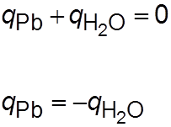

6.7
Solution Treating the calorimeter as an isolated system (no heat lost to the surroundings), we write
or
The heat gained by the water is given by
where m and s are the mass and specific heat and
Δt = t_{final} − t_{initial}

Slide 44

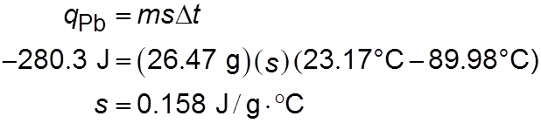
6.7
Therefore,
Because the heat lost by the lead pellet is equal to the heat gained by the water, q_{Pb} = −280.3 J. Solving for the specific heat of Pb, we write

Slide 45
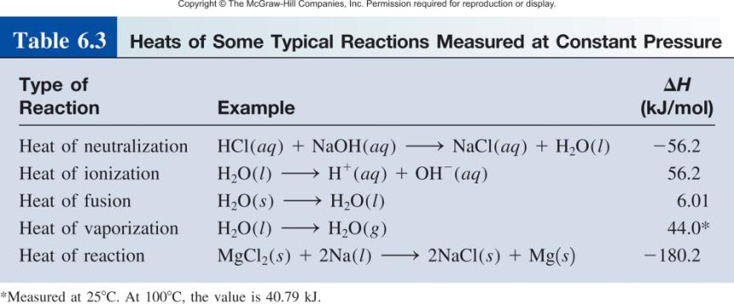

Slide 46
6.8
A quantity of 1.00 × 10² mL of 0.500 M HCl was mixed with 1.00 × 10² mL of 0.500 M NaOH in a constant-pressure calorimeter of negligible heat capacity. The initial temperature of the HCl and NaOH solutions was the same, 22.50°C, and the final temperature of the mixed solution was 25.86°C. Calculate the heat change for the neutralization reaction on a molar basis:
Assume that the densities and specific heats of the solutions are the same as for water (1.00 g/mL and 4.184 J/g · °C, respectively).

Slide 47
6.8
Strategy
Because the temperature rose, the neutralization reaction is exothermic.
How do we calculate the heat absorbed by the combined solution?
What is the heat of the reaction?
What is the conversion factor for expressing the heat of reaction on a molar basis?

Slide 48
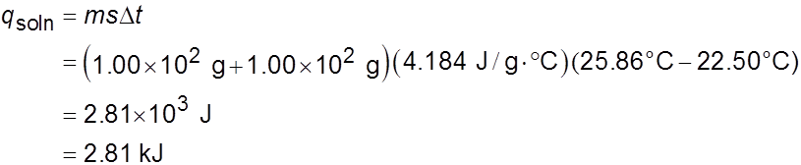
6.8
Solution Assuming no heat is lost to the surroundings,
q_{sys} = q_{soln} + q_{rxn} = 0, so q_{rxn} = −q_{soln}, where q_{soln} is the heat
absorbed by the combined solution. Because the density of the solution is 1.00 g/mL, the mass of a 100-mL solution is 100 g.
Thus,
Because q_{rxn} = −q_{soln}, q_{rxn} = −2.81 kJ.

Slide 49


6.8
From the molarities given, the number of moles of both HCl and NaOH in 1.00 × 10² mL solution is
Therefore, the heat of neutralization when 1.00 mole of HCl reacts with 1.00 mole of NaOH is
Check Is the sign consistent with the nature of the reaction? Under the reaction condition, can the heat change be equated to the enthalpy change?

Slide 50
Because there is no way to measure the absolute value of the enthalpy of a substance, must I measure the enthalpy change for every reaction of interest?
Establish an arbitrary scale with the standard enthalpy of formation (ΔH⁰) as a reference point for all enthalpy expressions.
f
Standard enthalpy of formation (ΔH⁰) is the heat change that results when one mole of a compound is formed from its elements at a pressure of 1 atm.
f
The standard enthalpy of formation of any element in its most stable form is zero.
ΔH⁰ (C, graphite) = 0
ΔH⁰ (O₂) = 0
f
f
ΔH⁰ (C, diamond) = 1.90 kJ/mol
ΔH⁰ (O₃) = 142 kJ/mol
f
f

Slide 51
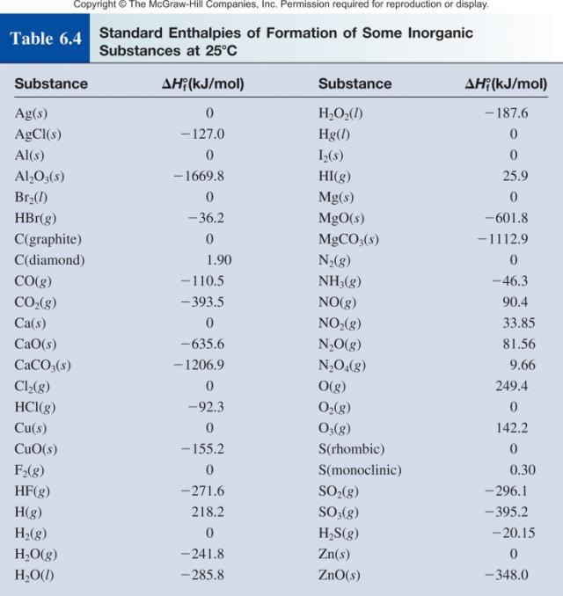

Slide 52
The standard enthalpy of reaction (ΔH⁰ ) is the enthalpy of a reaction carried out at 1 atm.
rxn
aA + bB cC + dD
ΔH⁰
cΔH⁰ (C)
dΔH⁰ (D)
-
aΔH⁰ (A)
bΔH⁰ (B)
=
[
+
]
[
+
]
rxn
f
f
f
f
ΔH⁰
=
Σ
nΔH⁰ (products)
-
Σ
mΔH⁰ (reactants)
rxn
f
f
Hess’s Law: When reactants are converted to products, the change in enthalpy is the same whether the reaction takes place in one step or in a series of steps.
(Enthalpy is a state function. It doesn’t matter how you get there, only where you start and end.)

Slide 53
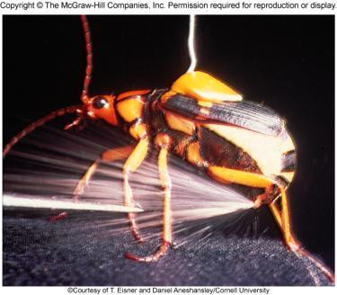
Chemistry in Action: Bombardier Beetle Defense
C₆H₄(OH)₂ (aq) + H₂O₂ (aq) C₆H₄O₂ (aq) + 2H₂O (l) ΔH⁰ = ?
C₆H₄(OH)₂ (aq) C₆H₄O₂ (aq) + H₂ (g) ΔH⁰ = 177 kJ/mol
H₂O₂ (aq) H₂O (l) + ½O₂ (g) ΔH⁰ = -94.6 kJ/mol
H₂ (g) + ½ O₂ (g) H₂O (l) ΔH⁰ = -286 kJ/mol
ΔH⁰ = 177 - 94.6 – 286 = -204 kJ/mol
Exothermic!

Slide 54
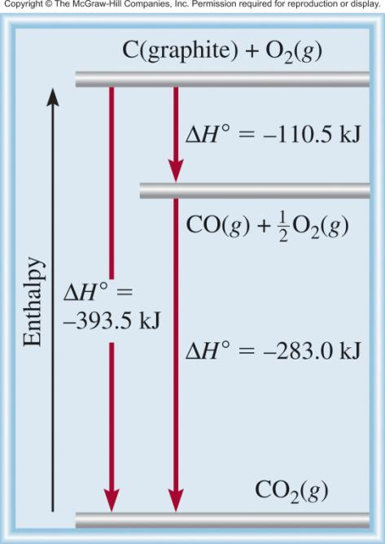
C (graphite) + 1/2O₂ (g) CO (g)
CO (g) + 1/2O₂ (g) CO₂ (g)
C (graphite) + O₂ (g) CO₂ (g)

Slide 55

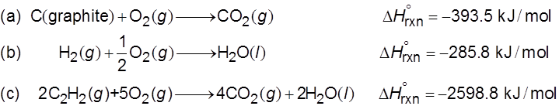
6.9
Calculate the standard enthalpy of formation of acetylene (C₂H₂) from its elements:
The equations for each step and the corresponding enthalpy changes are

Slide 56
6.9
Strategy Our goal here is to calculate the enthalpy change for the formation of C₂H₂ from its elements C and H₂. The reaction does not occur directly, however, so we must use an indirect route using the information given by Equations (a), (b), and (c).
Solution Looking at the synthesis of C₂H₂, we need 2 moles of graphite as reactant. So we multiply Equation (a) by 2 to get
Next, we need 1 mole of H₂ as a reactant and this is provided by Equation (b). Last, we need 1 mole of C₂H₂ as a product.

Slide 57

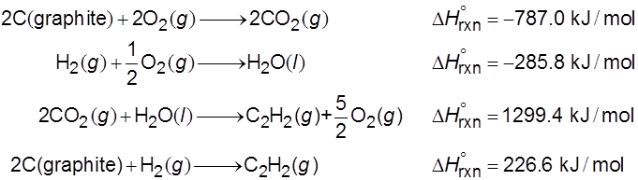
6.9
Equation (c) has 2 moles of C₂H₂ as a reactant so we need to reverse the equation and divide it by 2:
Adding Equations (d), (b), and (e) together, we get

Slide 58

6.9
Therefore,
This value means that when 1 mole of C₂H₂ is synthesized from 2 moles of C(graphite) and 1 mole of H₂, 226.6 kJ of heat are absorbed by the reacting system from the surroundings. Thus, this is an endothermic process.

Slide 59
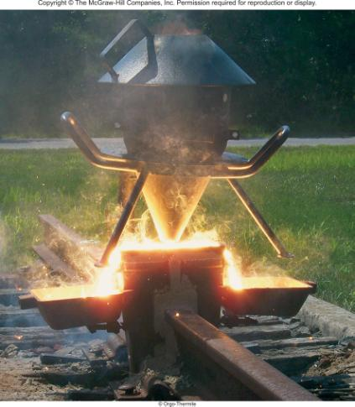

6.10
The thermite reaction involves aluminum and iron(III) oxide
This reaction is highly exothermic and the liquid iron formed is used to weld metals.
Calculate the heat released in kilojoules per gram of Al reacted with Fe₂O₃. The for Fe(l) is 12.40 kJ/mol.
The molten iron formed in a thermite reaction is run down into a mold between the ends of two railroad rails. On cooling, the rails are welded together.

Slide 60
6.10
Strategy
The enthalpy of a reaction is the difference between the sum of the enthalpies of the products and the sum of the enthalpies of the reactants.
The enthalpy of each species (reactant or product) is given by its stoichiometric coefficient times the standard enthalpy of formation of the species.

Slide 61

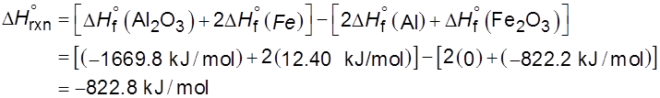

6.10
Solution Using the given value for Fe(l) and other
values in Appendix 3 and Equation (6.18), we write
This is the amount of heat released for two moles of Al reacted. We use the following ratio
to convert to kJ/g Al.

Slide 62

6.10
The molar mass of Al is 26.98 g, so
Check Is the negative sign consistent with the exothermic nature of the reaction? As a quick check, we see that 2 moles of Al weigh about 54 g and give off about 823 kJ of heat when reacted with Fe₂O₃. Therefore, the heat given off per gram of Al reacted is approximately −830 kJ/54 g or −15.4 kJ/g.

Slide 63
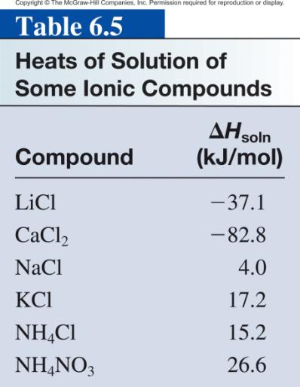
The enthalpy of solution (ΔH_{soln}) is the heat generated or absorbed when a certain amount of solute dissolves in a certain amount of solvent.
ΔH_{soln} = H_{soln} - H_{components}

Slide 64
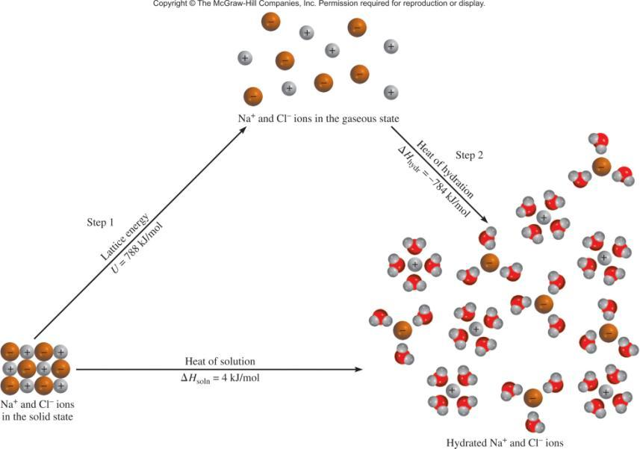
The Solution Process for NaCl
ΔH_{soln} = Step 1 + Step 2 = 788 – 784 = 4 kJ/mol

