Slide 1

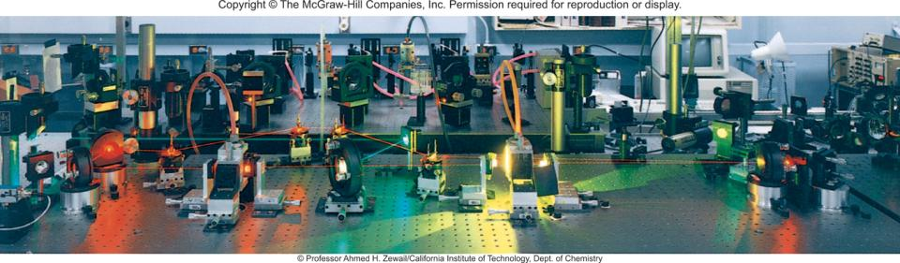
Quantum Theory and the Electronic Structure of Atoms
Chapter 7
Copyright © The McGraw-Hill Companies, Inc. Permission required for reproduction or display.

Slide 2
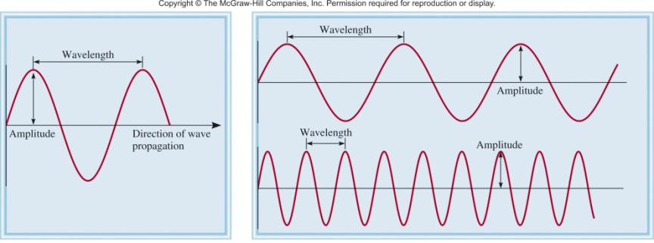
Properties of Waves
Wavelength (λ) is the distance between identical points on successive waves.
Amplitude is the vertical distance from the midline of a wave to the peak or trough.
Frequency (ν) is the number of waves that pass through a particular point in 1 second (Hz = 1 cycle/s).
The speed (u) of the wave = λ x ν

Slide 3
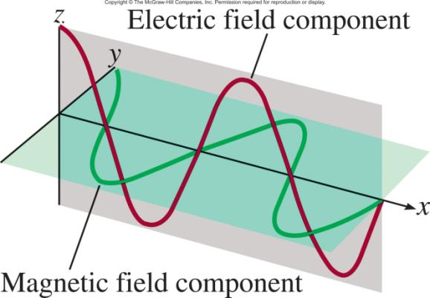
Maxwell (1873), proposed that visible light consists of electromagnetic waves.
Electromagnetic radiation is the emission and transmission of energy in the form of electromagnetic waves.
Speed of light (c) in vacuum = 3.00 x 10⁸ m/s
All electromagnetic radiation
λ x ν = c

Slide 4
7.1
The wavelength of the green light from a traffic signal is centered at 522 nm. What is the frequency of this radiation?

Slide 5

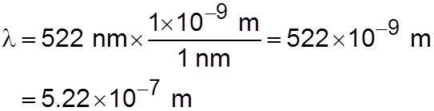
7.1
Strategy We are given the wavelength of an electromagnetic wave and asked to calculate its frequency.
Rearranging Equation (7.1) and replacing u with c (the speed of light) gives
Solution Because the speed of light is given in meters per second, it is convenient to first convert wavelength to meters. Recall that 1 nm = 1 × 10−⁹ m (see Table 1.3). We
write

Slide 6
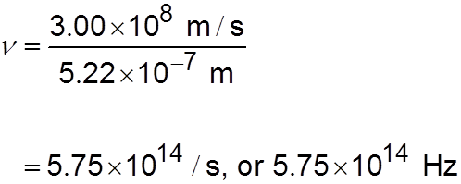
7.1
Substituting in the wavelength and the speed of light (3.00 × 10⁸ m/s), the frequency is
Check The answer shows that 5.75 × 10¹⁴ waves pass a fixed point every second. This very high frequency is in accordance with the very high speed of light.

Slide 7
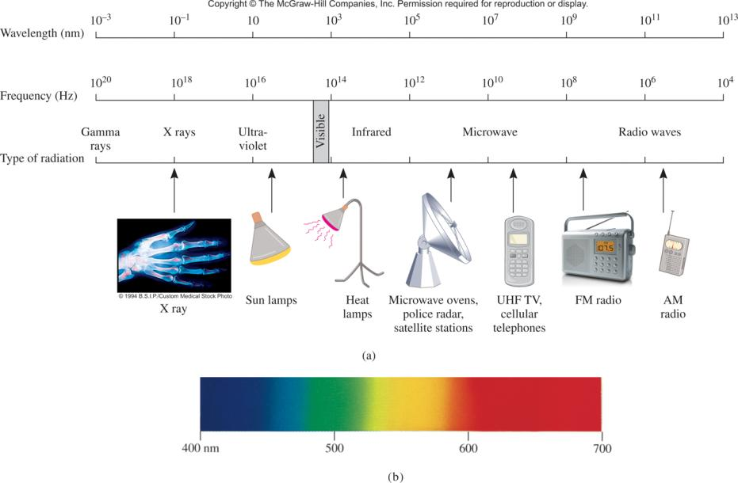

Slide 8
Mystery #1, “Heated Solids Problem”
Solved by Planck in 1900
When solids are heated, they emit electromagnetic radiation over a wide range of wavelengths.
Radiant energy emitted by an object at a certain temperature depends on its wavelength.
Energy (light) is emitted or absorbed in discrete units (quantum).
E = h x ν
Planck’s constant (h)
h = 6.63 x 10⁻³⁴ J•s

Slide 9
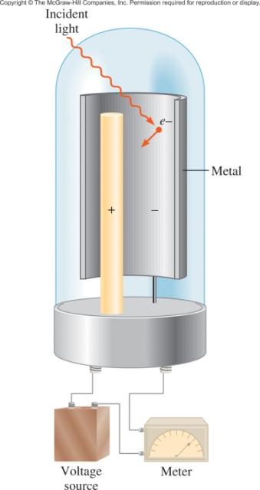
Mystery #2, “Photoelectric Effect”
Solved by Einstein in 1905
hν
Light has both:
wave nature
particle nature
KE e⁻
Photon is a “particle” of light
hν = KE + W
KE = hν - W
where W is the work function and
depends how strongly electrons
are held in the metal

Slide 10
7.2
Calculate the energy (in joules) of
(a) a photon with a wavelength of 5.00 × 10⁴ nm (infrared region)
(b) a photon with a wavelength of 5.00 × 10⁻² nm (X ray region)

Slide 11
7.2
Strategy
In both (a) and (b) we are given the wavelength of a photon and asked to calculate its energy.
We need to use Equation (7.3) to calculate the energy.
Planck’s constant is given in the text and also on the back inside cover.

Slide 12
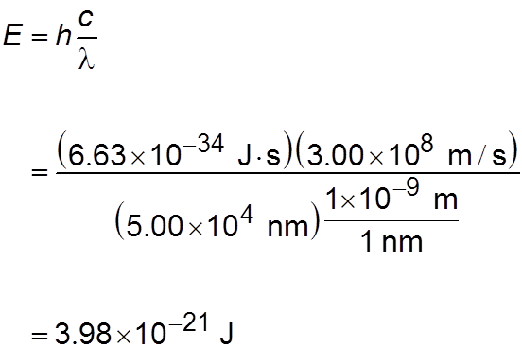
7.2
Solution
From Equation (7.3),
This is the energy of a single photon with a 5.00 × 10⁴ nm wavelength.

Slide 13
7.2
(b) Following the same procedure as in (a), we can show that the energy of the photon that has a wavelength of 5.00 × 10⁻² nm is 3.98 × 10⁻¹⁵ J .
Check Because the energy of a photon increases with decreasing wavelength, we see that an “X-ray” photon is 1 × 10⁶, or a million times more energetic than an “infrared” photon.

Slide 14
7.3
The work function of cesium metal is 3.42 × 10⁻¹⁹ J.
Calculate the minimum frequency of light required to release electrons from the metal.
Calculate the kinetic energy of the ejected electron if light of frequency 1.00 × 10¹⁵ s⁻¹ is used for irradiating the metal.

Slide 15
7.3
Strategy
The relationship between the work function of an element and the frequency of light is given by Equation (7.4).
The minimum frequency of light needed to dislodge an electron is the point where the kinetic energy of the ejected electron is zero.
(b) Knowing both the work function and the frequency of light, we can solve for the kinetic energy of the ejected electron.

Slide 16
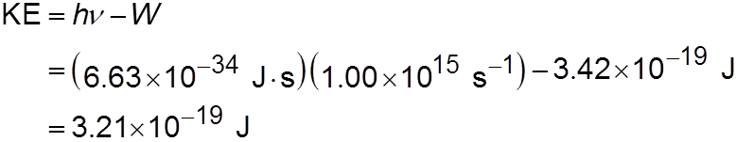
7.3
Solution
Setting KE = 0 in Equation (7.4), we write
hν = W
Thus,
Check The kinetic energy of the ejected electron (3.21×10⁻¹⁹ J) is smaller than the energy of the photon (6.63×10⁻¹⁹ J). Therefore, the answer is reasonable.

Slide 17
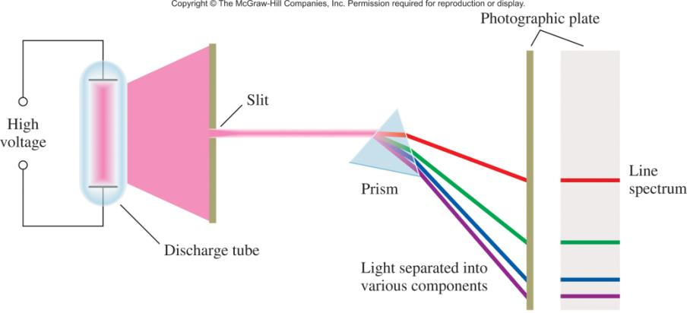
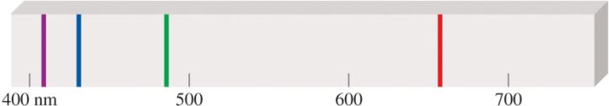
Line Emission Spectrum of Hydrogen Atoms

Slide 18
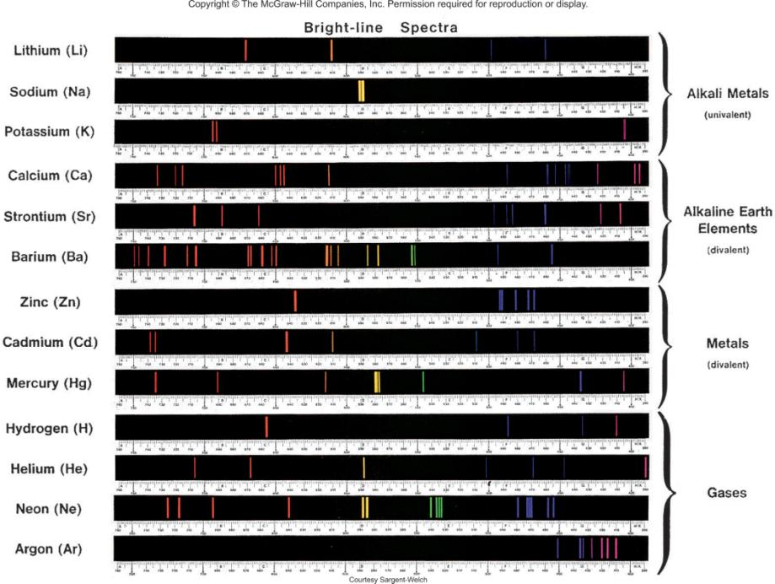

Slide 19
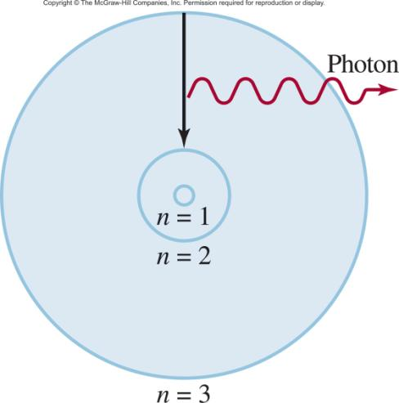
Bohr’s Model of
the Atom (1913)
e⁻ can only have specific (quantized) energy values
light is emitted as e⁻ moves from one energy level to a lower energy level
1
E_{n} = -R_{H}
( )
n²
n (principal quantum number) = 1,2,3,…
R_{H} (Rydberg constant) = 2.18 x 10⁻¹⁸J

Slide 20
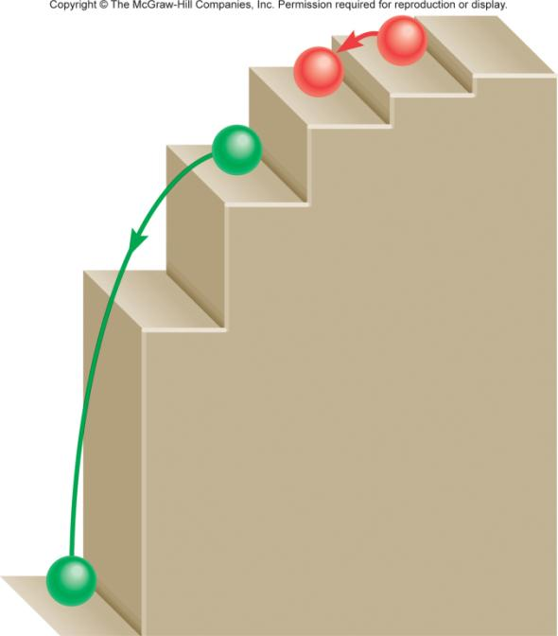
E = hν
E = hν

Slide 21
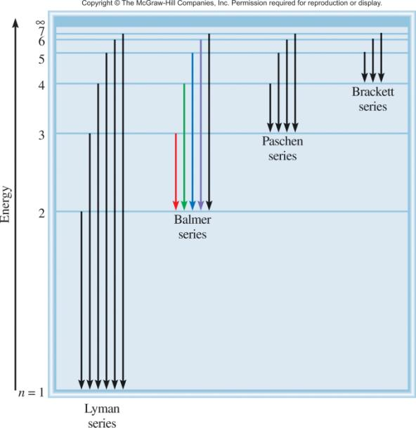
E_{photon} = ΔE = E_{f} - E_{i}
n_{i} = 3
n_{i} = 3
1
E_{f} = -R_{H}
( )
n²
f
n_{i} = 2
1
E_{i} = -R_{H}
( )
n_{f} = 2
n²
i
1
1
ΔE = R_{H}
( )
n²
n²
i
f
n_{f} = 1
n_{f} = 1

Slide 22
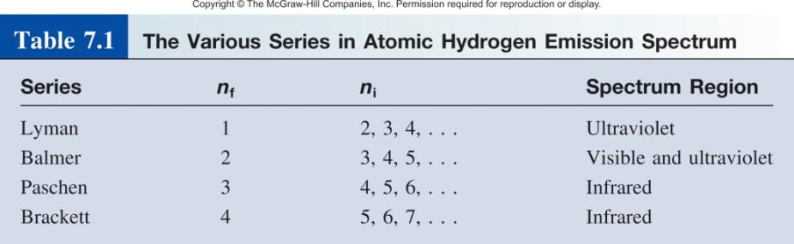

Slide 23
7.4
What is the wavelength of a photon (in nanometers) emitted during a transition from the n_{i} = 5 state to the n_{f} = 2 state in the hydrogen atom?

Slide 24
7.4
Strategy
We are given the initial and final states in the emission process.
We can calculate the energy of the emitted photon using Equation (7.6).
Then from Equations (7.2) and (7.1) we can solve for the wavelength of the photon.
The value of Rydberg’s constant is given in the text.

Slide 25
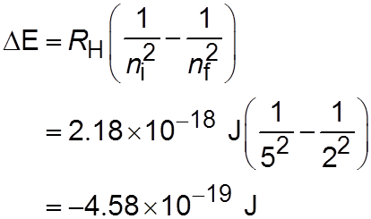
7.4
Solution From Equation (7.6) we write
The negative sign indicates that this is energy associated with an emission process. To calculate the wavelength, we will omit the minus sign for ΔE because the wavelength of the photon must be positive.

Slide 26
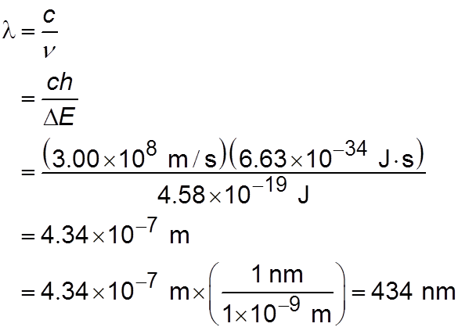
7.4
Because ΔE = hν or ν = ΔE/h, we can calculate the wavelength of the photon by writing

Slide 27
7.4
Check
The wavelength is in the visible region of the electromagnetic region (see Figure 7.4).
This is consistent with the fact that because n_{f} = 2, this transition gives rise to a spectral line in the Balmer series (see Figure 7.6).

Slide 28
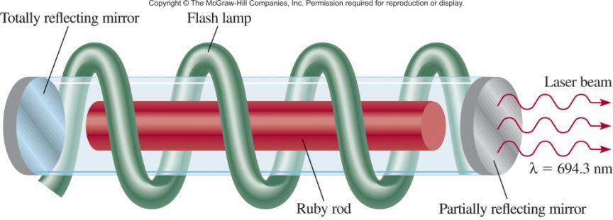
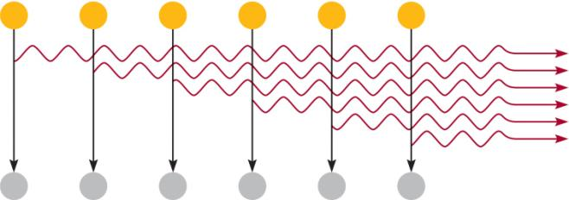
Chemistry in Action: Laser – The Splendid Light
Laser light is (1) intense, (2) monoenergetic, and (3) coherent

Slide 29
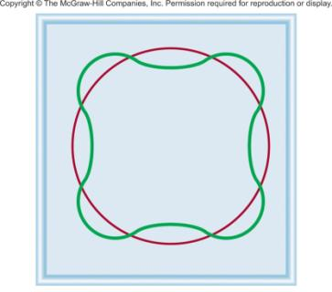
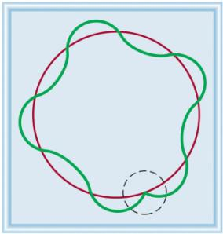
Why is e⁻ energy quantized?
De Broglie (1924) reasoned that e⁻ is both particle and wave.
h
2πr = nλ λ =
mu
u = velocity of e-
m = mass of e-

Slide 30
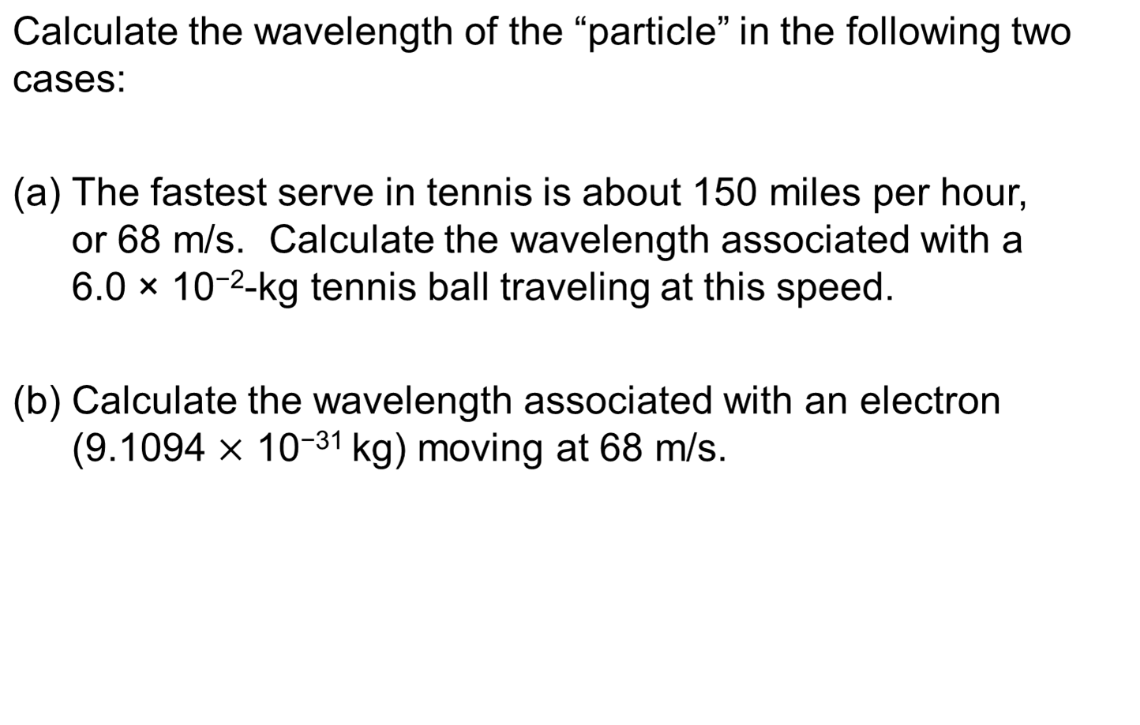
7.5

Slide 31
7.5
Strategy
We are given the mass and the speed of the particle in (a) and (b) and asked to calculate the wavelength so we need Equation (7.8).
Note that because the units of Planck’s constants are J · s, m and u must be in kg and m/s (1 J = 1 kg m²/s²), respectively.

Slide 32
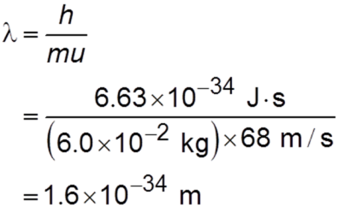
7.5
Solution
Using Equation (7.8) we write
Comment This is an exceedingly small wavelength considering that the size of an atom itself is on the order of 1 × 10⁻¹⁰ m. For this reason, the wave properties of a tennis ball cannot be detected by any existing measuring device.

Slide 33
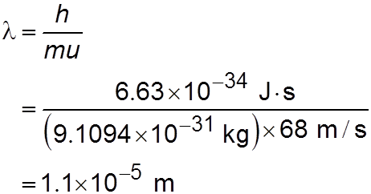
7.5
(b) In this case,
Comment This wavelength (1.1 × 10⁻⁵ m or 1.1 × 10⁴ nm) is in the infrared region. This calculation shows that only electrons (and other submicroscopic particles) have measurable wavelengths.

Slide 34
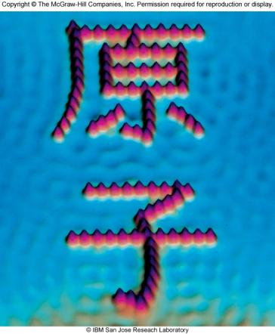
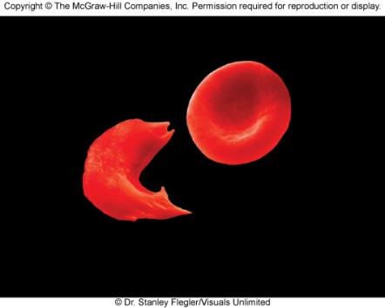
Chemistry in Action: Electron Microscopy
λ_{e} = 0.004 nm
STM image of iron atoms
on copper surface
Electron micrograph of a normal red blood cell and a sickled red
blood cell from the same person

Slide 35
7.6
An electron is moving at a speed of 8.0 × 10⁶ m/s. If the uncertainty in measuring the speed is 1.0 percent of the speed, calculate the uncertainty in the electron’s position. The mass of the electron is 9.1094 × 10⁻³¹ kg.
A baseball of mass 0.15 kg thrown at 100 mph has a momentum of 6.7 kg · m/s. If the uncertainty in measuring this momentum is 1.0 × 10⁻⁷ of the momentum, calculate the uncertainty in the baseball’s position.

Slide 36
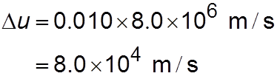
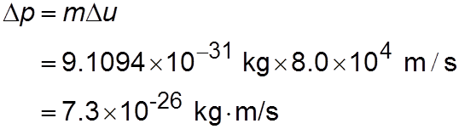
7.6
Strategy To calculate the minimum uncertainty in both (a) and (b), we use an equal sign in Equation (7.9).
Solution
The uncertainty in the electron’s speed u is
Momentum (p) is p = mu, so that

Slide 37
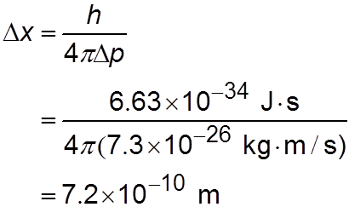
7.6
From Equation (7.9), the uncertainty in the electron’s position is
This uncertainty corresponds to about 4 atomic diameters.

Slide 38
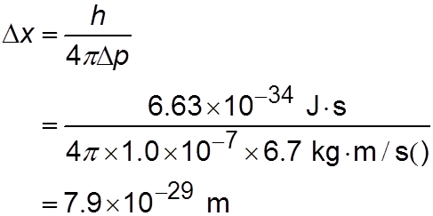
7.6
(b) The uncertainty in the position of the baseball is
This is such a small number as to be of no consequence, that is, there is practically no uncertainty in determining the position of the baseball in the macroscopic world.

Slide 39
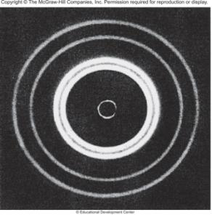
Schrodinger Wave Equation
In 1926 Schrodinger wrote an equation that described both the particle and wave nature of the e⁻
Wave function (ψ) describes:
  . energy of e⁻ with a given ψ
  . probability of finding e⁻ in a volume of space
Schrodinger’s equation can only be
solved exactly for the hydrogen atom.
Must approximate its solution for
multi-electron systems.

Slide 40
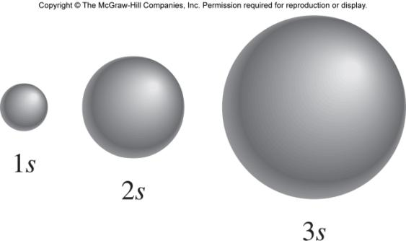
Schrodinger Wave Equation
ψ is a function of four numbers called
quantum numbers (n, l, m_{l}, m_{s})
principal quantum number n
n = 1, 2, 3, 4, ….
distance of e⁻ from the nucleus
n=1
n=2
n=3

Slide 41
Schrodinger Wave Equation
quantum numbers: (n, l, m_{l}, m_{s})
angular momentum quantum number l
for a given value of n, l = 0, 1, 2, 3, … n-1
l = 0 s orbital
l = 1 p orbital
l = 2 d orbital
l = 3 f orbital
n = 1, l = 0
n = 2, l = 0 or 1
n = 3, l = 0, 1, or 2
Shape of the “volume” of space that the e⁻ occupies

Slide 42
Schrodinger Wave Equation
quantum numbers: (n, l, m_{l}, m_{s})
magnetic quantum number m_{l}
for a given value of l
m_{l} = -l, …., 0, …. +l
if l = 1 (p orbital), m_{l} = -1, 0, or 1
if l = 2 (d orbital), m_{l} = -2, -1, 0, 1, or 2
orientation of the orbital in space

Slide 43
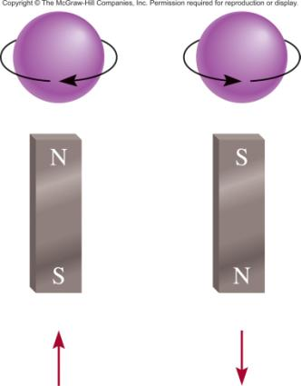
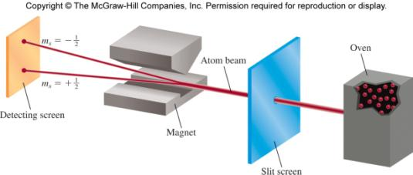
Schrodinger Wave Equation
(n, l, m_{l}, m_{s})
spin quantum number m_{s}
m_{s} = +½ or -½
m_{s} = +½
m_{s} = -½

Slide 44
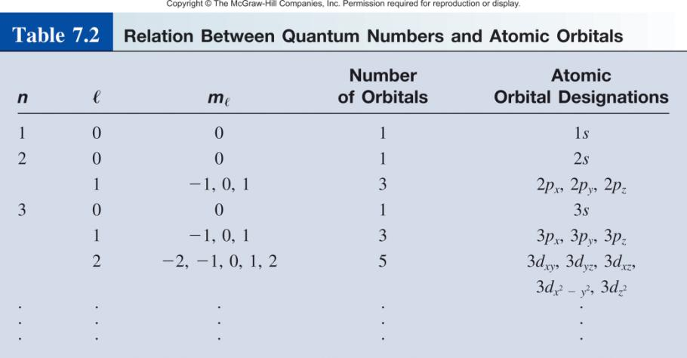

Slide 45

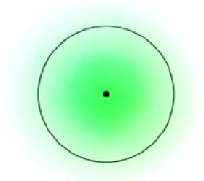
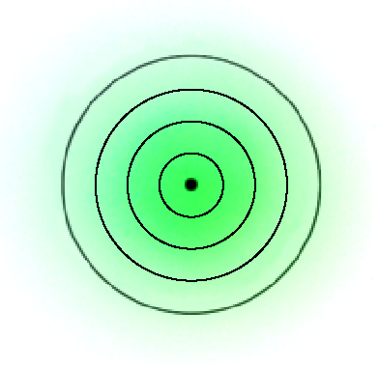
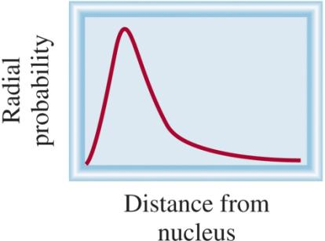
Where 90% of the
e⁻ density is found
for the 1s orbital

Slide 46
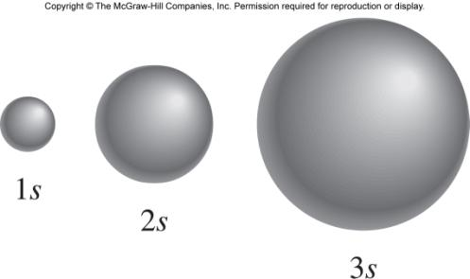
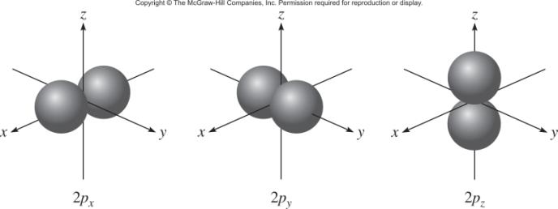
l = 0 (s orbitals)
l = 1 (p orbitals)

Slide 47
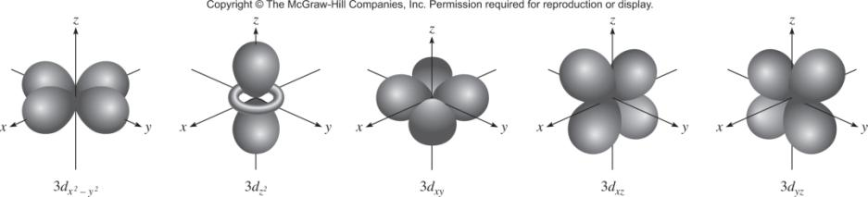
l = 2 (d orbitals)

Slide 48
7.7
List the values of n, ℓ, and m_{ℓ} for orbitals in the 4d subshell.

Slide 49
7.7
Strategy What are the relationships among n, ℓ, and m_{ℓ}?
What do “4” and “d” represent in 4d?
Solution As we saw earlier, the number given in the designation of the subshell is the principal quantum number, so in this case n = 4. The letter designates the type of orbital. Because we are dealing with d orbitals, ℓ = 2. The values of m_{ℓ} can vary from −ℓ to ℓ. Therefore, m_{ℓ} can be −2, −1, 0, 1, or 2.
Check The values of n and ℓ are fixed for 4d, but m_{ℓ} can have any one of the five values, which correspond to the five d orbitals.

Slide 50
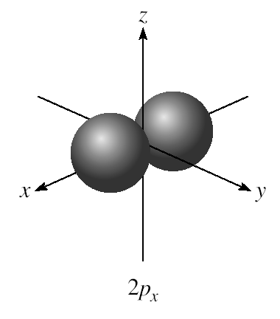
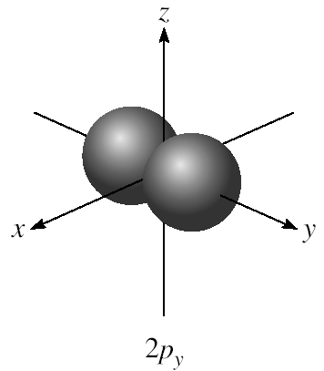
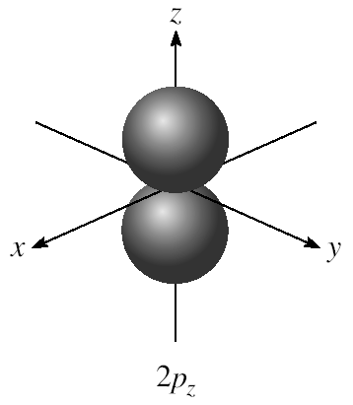
m_{l} = -1, 0, or 1
3 orientations is space

Slide 51
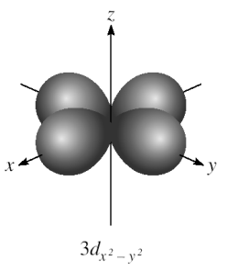
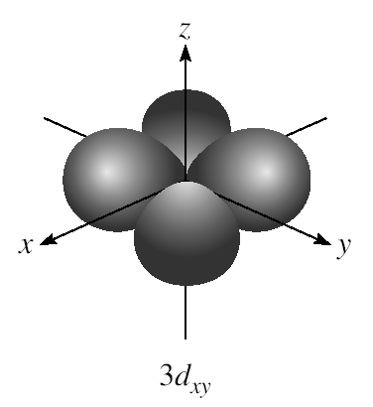
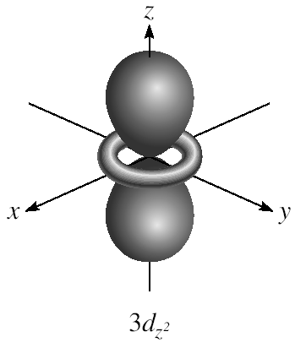
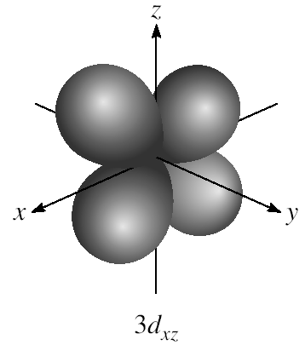
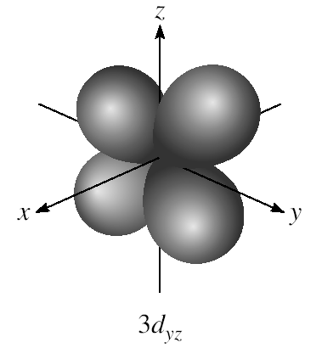
m_{l} = -2, -1, 0, 1, or 2
5 orientations is space

Slide 52
7.8
What is the total number of orbitals associated with the principal quantum number n = 3?

Slide 53
7.8
Strategy To calculate the total number of orbitals for a given n value, we need to first write the possible values of ℓ. We then determine how many m_{ℓ} values are associated with each value of ℓ. The total number of orbitals is equal to the sum of all the m_{ℓ} values.
Solution For n = 3, the possible values of ℓ are 0, 1, and 2. Thus, there is one 3s orbital (n = 3, ℓ = 0, and m_{ℓ} = 0); there are three 3p orbitals (n = 3, ℓ = 1, and m_{ℓ} = −1, 0, 1); there are five 3d orbitals (n = 3, ℓ = 2, and m_{ℓ} = −2, −1, 0, 1, 2). The total number of orbitals is 1 + 3 + 5 = 9.
Check The total number of orbitals for a given value of n is n². So here we have 3² = 9. Can you prove the validity of this relationship?

Slide 54

Schrodinger Wave Equation
quantum numbers: (n, l, m_{l}, m_{s})
Existence (and energy) of electron in atom is described
by its unique wave function ψ.
Pauli exclusion principle - no two electrons in an atom
can have the same four quantum numbers.
Each seat is uniquely identified (E, R12, S8).
Each seat can hold only one individual at a time.

Slide 55
Schrodinger Wave Equation
quantum numbers: (n, l, m_{l}, m_{s})
Shell – electrons with the same value of n
Subshell – electrons with the same values of n and l
Orbital – electrons with the same values of n, l, and m_{l}

Slide 56

Energy of orbitals in a single electron atom
Energy only depends on principal quantum number n
n=3
n=2
1
E_{n} = -R_{H}
( )
n²
n=1

Slide 57

Energy of orbitals in a multi-electron atom
Energy depends on n and l
n=3 l = 2
n=3 l = 1
n=3 l = 0
n=2 l = 1
n=2 l = 0
n=1 l = 0

Slide 58

“Fill up” electrons in lowest energy orbitals (Aufbau principle)

Slide 59

The most stable arrangement of electrons in subshells is the one with the greatest number of parallel spins (Hund’s rule).

Slide 60

Order of orbitals (filling) in multi-electron atom
1s < 2s < 2p < 3s < 3p < 4s < 3d < 4p < 5s < 4d < 5p < 6s

Slide 61
7.9
Write the four quantum numbers for an electron in a 3p orbital.

Slide 62
7.9
Strategy
What do the “3” and “p” designate in 3p?
How many orbitals (values of m_{ℓ}) are there in a 3p subshell?
What are the possible values of electron spin quantum number?
Solution To start with, we know that the principal quantum number n is 3 and the angular momentum quantum number ℓ must be 1 (because we are dealing with a p orbital). For ℓ = 1, there are three values of m_{ℓ} given by −1, 0, and 1. Because the electron spin quantum number m_{s} can be either +½ or −½, we conclude that there are six possible ways to designate the electron using the (n, ℓ , m_{ℓ}, m_{s}) notation.

Slide 63

7.9
These are:
Check In these six designations we see that the values of n and ℓ are constant, but the values of m_{ℓ} and m_{s} can vary.

Slide 64
Electron configuration is how the electrons are distributed among the various atomic orbitals in an atom.
number of electrons
in the orbital or subshell
1s¹
principal quantum
number n
angular momentum
quantum number l
Orbital diagram
H
1s¹

Slide 65


Paramagnetic
Diamagnetic
unpaired electrons
all electrons paired
2p
2p

Slide 66
7.10
What is the maximum number of electrons that can be present in the principal level for which n = 3?

Slide 67

7.10
Strategy We are given the principal quantum number (n) so we can determine all the possible values of the angular momentum quantum number (ℓ). The preceding rule shows that the number of orbitals for each value of ℓ is (2 ℓ + 1). Thus, we can determine the total number of orbitals. How many electrons can each orbital accommodate?
Solution When n = 3, ℓ = 0, 1, and 2. The number of orbitals for each value of ℓ is given by

Slide 68
7.10
The total number of orbitals is nine. Because each orbital can accommodate two electrons, the maximum number of electrons that can reside in the orbitals is 2 × 9, or 18.
Check If we use the formula (n²) in Example 7.8, we find that the total number of orbitals is 3² and the total number of electrons is 2(3²) or 18. In general, the number of
electrons in a given principal energy level n is 2n².

Slide 69
7.11
An oxygen atom has a total of eight electrons. Write the four quantum numbers for each of the eight electrons in the ground state.

Slide 70
7.11
Strategy
We start with n = 1 and proceed to fill orbitals in the order shown in Figure 7.24.
For each value of n we determine the possible values of ℓ.
For each value of ℓ, we assign the possible values of m_{ℓ}.
We can place electrons in the orbitals according to the Pauli exclusion principle and Hund’s rule.

Slide 71

7.11
Solution
We start with n = 1, so ℓ = 0, a subshell corresponding to the 1s orbital. This orbital can accommodate a total of two electrons. Next, n = 2, and / may be either 0 or 1. The ℓ = 0 subshell contains one 2s orbital, which can accommodate two electrons. The remaining four electrons are placed in the ℓ = 1 subshell, which contains three 2p orbitals. The orbital diagram is

Slide 72

7.11
The results are summarized in the following table:
Of course, the placement of the eighth electron in the orbital labeled m_{ℓ} = 1 is completely arbitrary. It would be equally correct to assign it to m_{ℓ} = 0 or m_{ℓ} = −1.

Slide 73


Slide 74

Outermost subshell being filled with electrons

Slide 75

7.12
Write the ground-state electron configurations for
sulfur (S)
palladium (Pd), which is diamagnetic.

Slide 76
7.12
Strategy How many electrons are in the S (Z = 16) atom? We start with n = 1 and proceed to fill orbitals in the order shown in Figure 7.24. For each value of ℓ, we assign the possible values of m_{ℓ}. We can place electrons in the orbitals according to the Pauli exclusion principle and Hund’s rule and then write the electron configuration. The task is simplified if we use the noble-gas core preceding S for the inner electrons.
Solution Sulfur has 16 electrons. The noble gas core in this case is [Ne]. (Ne is the noble gas in the period preceding sulfur.) [Ne] represents 1s²2s²2p⁶. This leaves us 6 electrons to fill the 3s subshell and partially fill the 3p subshell. Thus, the electron configuration of S is 1s²2s²2p⁶3s²3p⁴ or [Ne]3s²3p⁴ .

Slide 77
7.12
(b) Strategy We use the same approach as that in (a). What does it mean to say that Pd is a diamagnetic element?
Solution Palladium has 46 electrons. The noble-gas core in this case is [Kr]. (Kr is the noble gas in the period preceding palladium.) [Kr] represents
1s²2s²2p⁶3s²3p⁶4s²3d¹⁰4p⁶
The remaining 10 electrons are distributed among the 4d and 5s orbitals. The three choices are (1) 4d¹⁰, (2) 4d⁹5s¹, and (3) 4d⁸5s².

Slide 78
7.12
Because palladium is diamagnetic, all the electrons are paired and its electron configuration must be
1s²2s²2p⁶3s²3p⁶4s²3d¹⁰4p⁶4d¹⁰
or simply [Kr]4d¹⁰ . The configurations in (2) and (3) both represent paramagnetic elements.
Check To confirm the answer, write the orbital diagrams for (1), (2), and (3).

