Slide 1

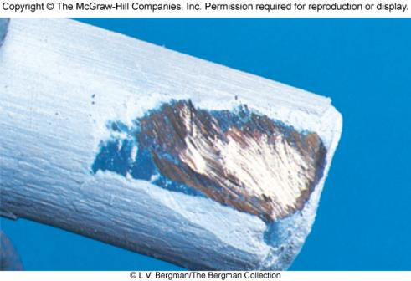
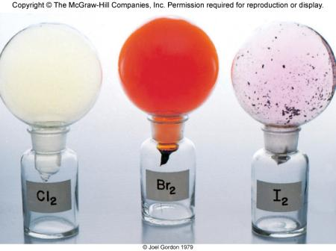
Periodic Relationships Among the Elements
Chapter 8
Copyright © The McGraw-Hill Companies, Inc. Permission required for reproduction or display.

Slide 2
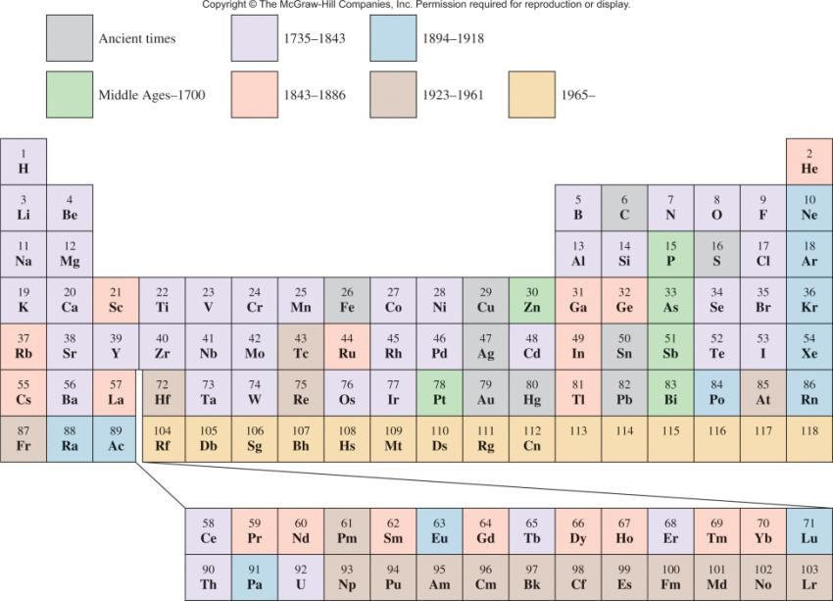
When the Elements Were Discovered

Slide 3
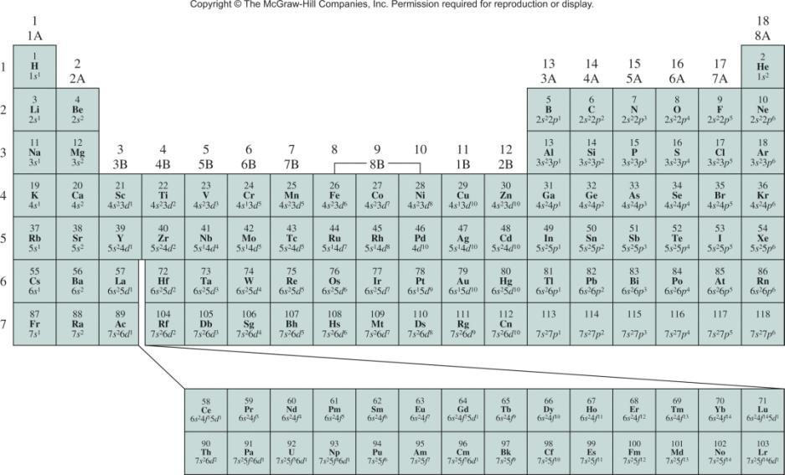
Ground State Electron Configurations of the Elements
ns¹
ns²np⁶
ns²np¹
ns²np²
ns²np³
ns²np⁴
ns²np⁵
ns²
d¹
d⁵
d¹⁰
4f
5f

Slide 4
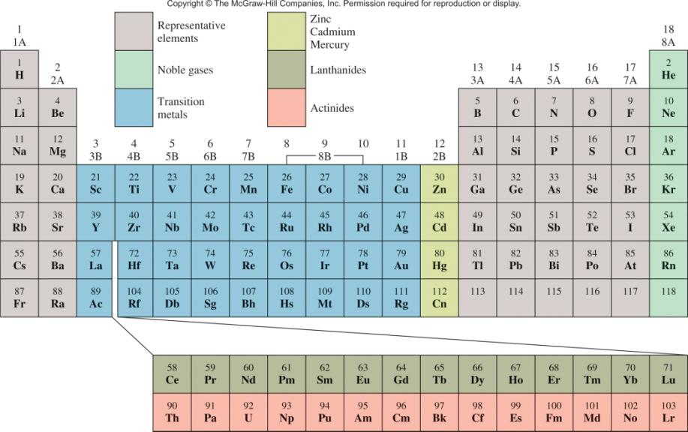
Classification of the Elements

Slide 5
8.1
An atom of a certain element has 15 electrons. Without consulting a periodic table, answer the following questions:
What is the ground-state electron configuration of the element?
(b) How should the element be classified?
(c) Is the element diamagnetic or paramagnetic?

Slide 6
8.1
Strategy
(a) We refer to the building-up principle discussed in Section 7.9 and start writing the electron configuration with principal quantum number n = 1 and continuing upward until all the electrons are accounted for.
(b) What are the electron configuration characteristics of representative elements? transition elements? noble gases?
(c) Examine the pairing scheme of the electrons in the outermost shell. What determines whether an element is diamagnetic or paramagnetic?

Slide 7
8.1
Solution
We know that for n = 1 we have a 1s orbital (2 electrons); for n = 2 we have a 2s orbital (2 electrons) and three 2p orbitals (6 electrons); for n = 3 we have a 3s orbital (2 electrons). The number of electrons left is 15 − 12 = 3 and these three electrons are placed in the 3p orbitals. The electron configuration is 1s²2s²2p⁶3s²3p³.
(b) Because the 3p subshell is not completely filled, this is a representative element. Based on the information given, we cannot say whether it is a metal, a nonmetal, or a metalloid.
(c) According to Hund’s rule, the three electrons in the 3p orbitals have parallel spins (three unpaired electrons). Therefore, the element is paramagnetic.

Slide 8
Electron Configurations of Cations and Anions
Of Representative Elements
Na [Ne]3s¹
Na⁺ [Ne]
Atoms lose electrons so that cation has a noble-gas outer electron configuration.
Ca [Ar]4s²
Ca²⁺ [Ar]
Al [Ne]3s²3p¹
Al³⁺ [Ne]
H 1s¹
H⁻ 1s² or [He]
Atoms gain electrons so that anion has a noble-gas outer electron configuration.
F 1s²2s²2p⁵
F⁻ 1s²2s²2p⁶ or [Ne]
O 1s²2s²2p⁴
O²⁻ 1s²2s²2p⁶ or [Ne]
N 1s²2s²2p³
N³⁻ 1s²2s²2p⁶ or [Ne]

Slide 9

Cations and Anions Of Representative Elements
+1
+2
+3
-3
-2
-1

Slide 10
Isoelectronic: have the same number of electrons, and hence the same ground-state electron configuration
Na⁺: [Ne]
Al³⁺: [Ne]
F⁻: 1s²2s²2p⁶ or [Ne]
O²⁻: 1s²2s²2p⁶ or [Ne]
N³⁻: 1s²2s²2p⁶ or [Ne]
Na⁺, Al³⁺, F⁻, O²⁻, and N³⁻ are all isoelectronic with Ne

Slide 11
Electron Configurations of Cations of Transition Metals
When a cation is formed from an atom of a transition metal, electrons are always removed first from the ns orbital and then from the (n – 1)d orbitals.
Fe: [Ar]4s²3d⁶
Mn: [Ar]4s²3d⁵
Fe²⁺: [Ar]4s⁰3d⁶ or [Ar]3d⁶
Mn²⁺: [Ar]4s⁰3d⁵ or [Ar]3d⁵
Fe³⁺: [Ar]4s⁰3d⁵ or [Ar]3d⁵

Slide 12
Effective nuclear charge (Z_{eff}) is the “positive charge” felt by an electron.
Z_{eff} = Z - σ
0 < σ < Z (σ = shielding constant)
Z_{eff} ≈ Z – number of inner or core electrons
Z
Core
Z_{eff}
Radius (pm)
Na
11
10
1
186
Mg
12
10
2
160
Al
13
10
3
143
Si
14
10
4
132

Slide 13
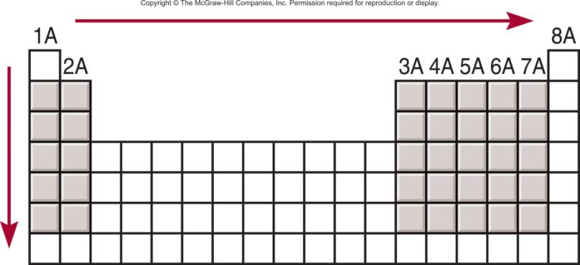
Effective Nuclear Charge (Z_{eff})
increasing Z_{eff}
increasing Z_{eff}

Slide 14
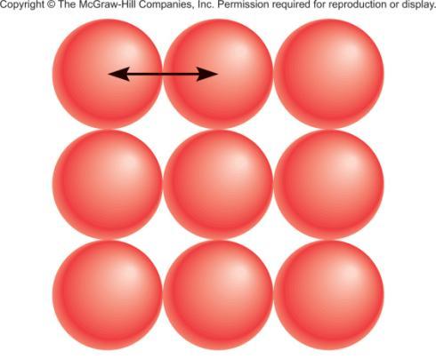
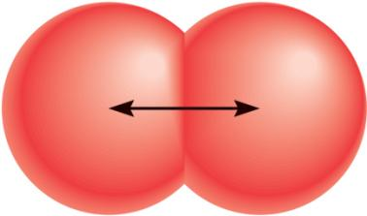
Atomic Radii
metallic radius
covalent radius

Slide 15
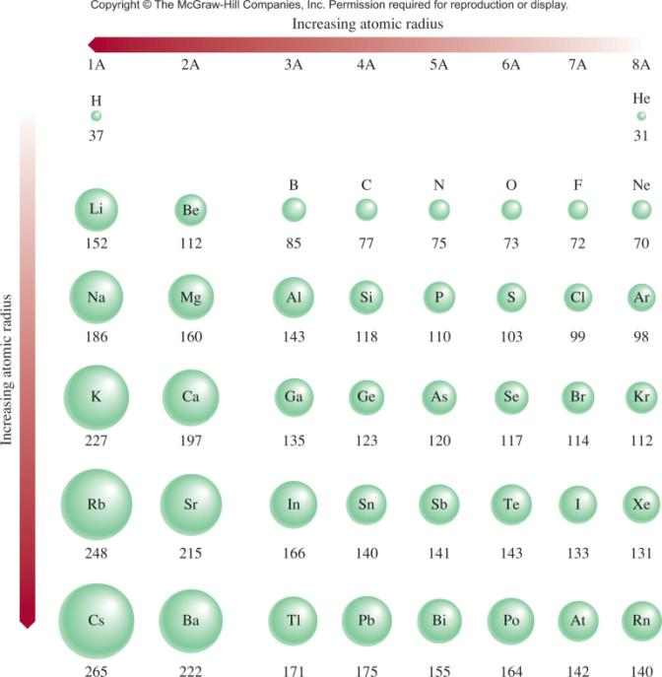

Slide 16
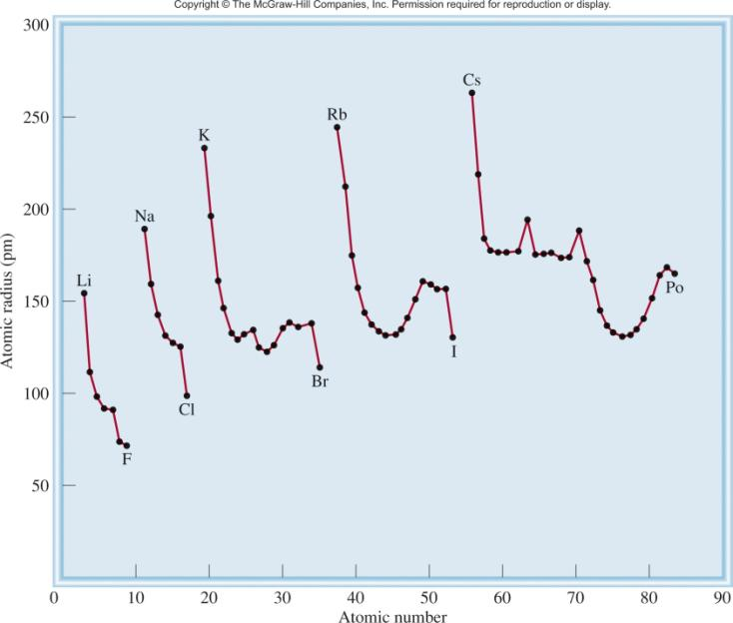
Trends in Atomic Radii

Slide 17
8.2
Referring to a periodic table, arrange the following atoms in order of increasing atomic radius: P, Si, N.

Slide 18
8.2
Strategy What are the trends in atomic radii in a periodic group and in a particular period? Which of the preceding elements are in the same group? in the same period?
Solution From Figure 8.1 we see that N and P are in the same group (Group 5A). Therefore, the radius of N is smaller than that of P (atomic radius increases as we go down a group).
Both Si and P are in the third period, and Si is to the left of P. Therefore, the radius of P is smaller than that of Si (atomic radius decreases as we move from left to right across a period).
Thus, the order of increasing radius is
N < P < Si

Slide 19
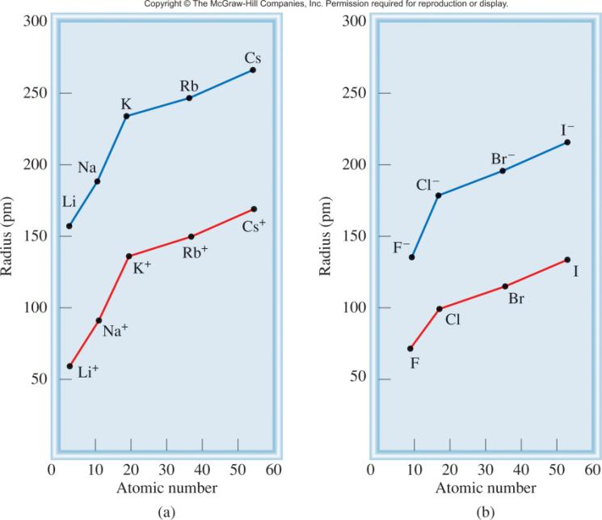
Comparison of Atomic Radii with Ionic Radii

Slide 20
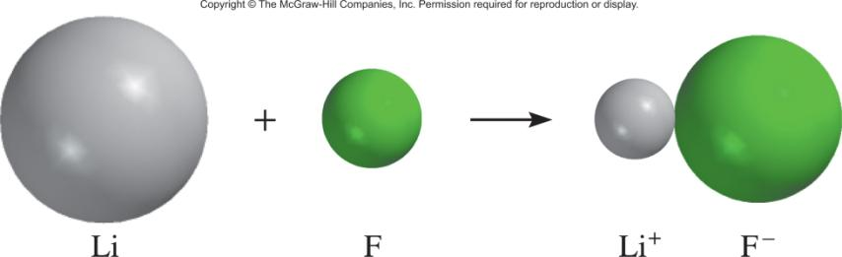
Cation is always smaller than atom from which it is formed.
Anion is always larger than atom from which it is formed.

Slide 21
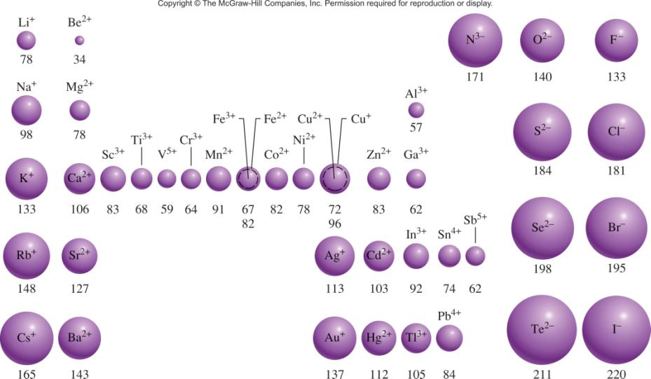
The Radii (in pm) of Ions of Familiar Elements

Slide 22
8.3
For each of the following pairs, indicate which one of the two species is larger:
N³⁻ or F2
Mg²⁺ or Ca²⁺
Fe²⁺ or Fe³⁺

Slide 23
8.3
Strategy In comparing ionic radii, it is useful to classify the ions into three categories:
isoelectronic ions
ions that carry the same charges and are generated from atoms of the same periodic group, and
ions that carry different charges but are generated from the same atom.
In case (1), ions carrying a greater negative charge are always larger; in case (2), ions from atoms having a greater atomic number are always larger; in case (3), ions having a smaller positive charge are always larger.

Slide 24
8.3
Solution
N³⁻ and F⁻ are isoelectronic anions, both containing 10 electrons. Because N³⁻ has only seven protons and F⁻ has nine, the smaller attraction exerted by the nucleus on the electrons results in a larger N³⁻ ion.
Both Mg and Ca belong to Group 2A (the alkaline earth metals). Thus, Ca²⁺ ion is larger than Mg²⁺ because Ca’s valence electrons are in a larger shell (n = 4) than are Mg’s (n = 3).
Both ions have the same nuclear charge, but Fe²⁺ has one more electron (24 electrons compared to 23 electrons for Fe³⁺) and hence greater electron-electron repulsion. The radius of Fe²⁺ is larger.

Slide 25
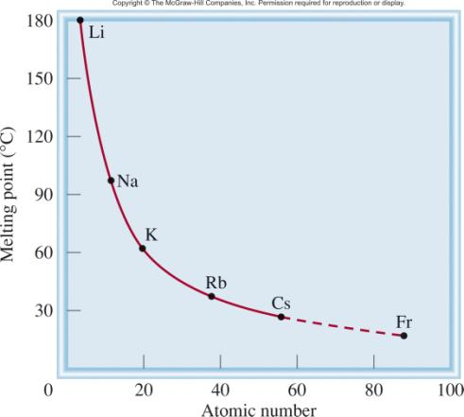
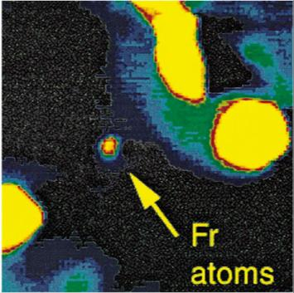
Chemistry in Action: The 3rd Liquid Element?
117 elements, 2 are liquids at 25⁰C – Br₂ and Hg
²²³Fr, t_{1/2} = 21 minutes
Liquid?

Slide 26
Ionization energy is the minimum energy (kJ/mol) required to remove an electron from a gaseous atom in its ground state.
I₁ + X _{(g)} X⁺_{(g)} + e⁻
I₁ first ionization energy
I₂ + X⁺_{(g)} X²⁺_{(g)} + e⁻
I₂ second ionization energy
I₃ + X²⁺_{(g)} X³⁺_{(g)} + e⁻
I₃ third ionization energy
I₁ < I₂ < I₃

Slide 27
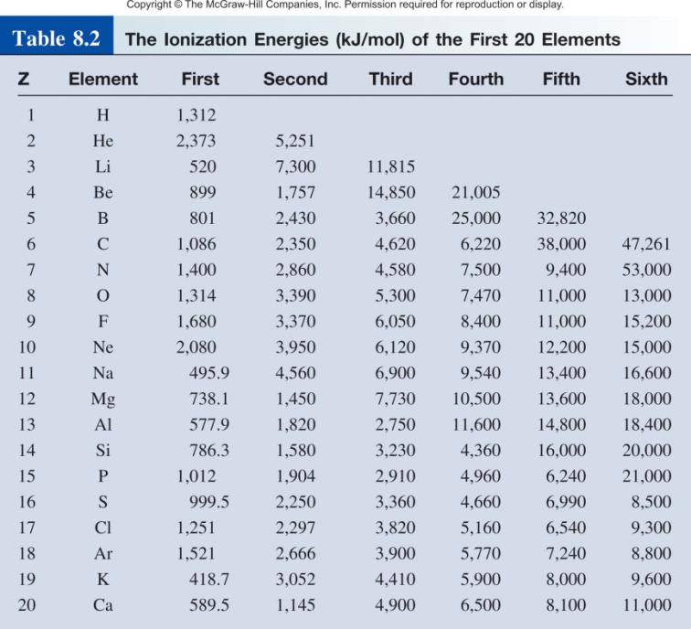

Slide 28
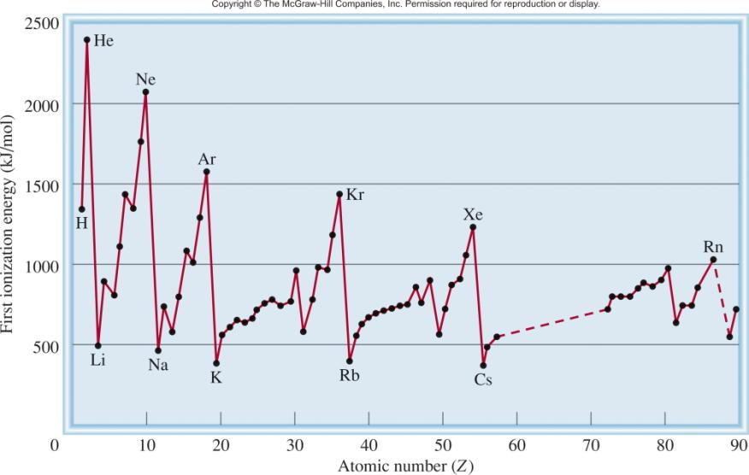
Variation of the First Ionization Energy with Atomic Number
Filled n=1 shell
Filled n=2 shell
Filled n=3 shell
Filled n=4 shell
Filled n=5 shell

Slide 29
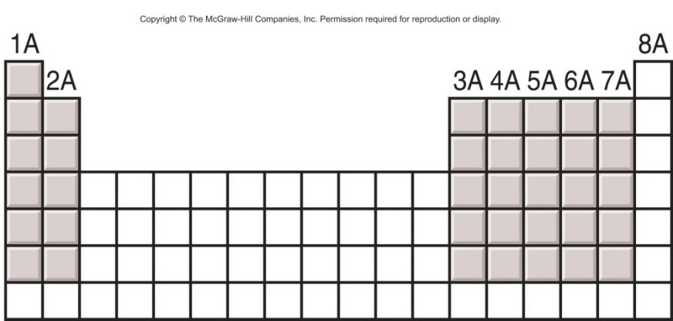
General Trends in First Ionization Energies
Increasing First Ionization Energy
Increasing First Ionization Energy

Slide 30
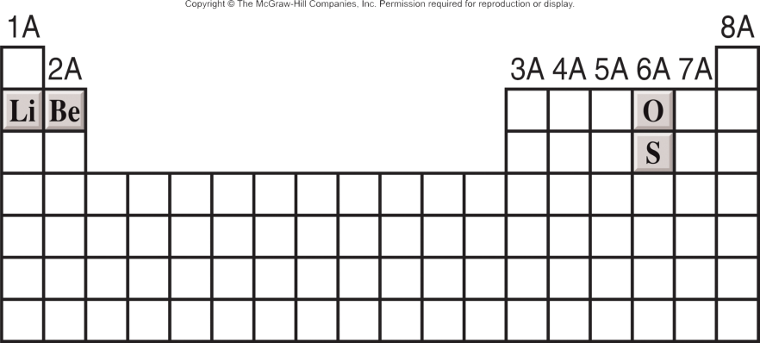
8.4
Which atom should have a smaller first ionization energy: oxygen or sulfur?
Which atom should have a higher second ionization energy: lithium or beryllium?

Slide 31
8.4
Strategy
First ionization energy decreases as we go down a group because the outermost electron is farther away from the nucleus and feels less attraction.
Removal of the outermost electron requires less energy if it is shielded by a filled inner shell.
Solution
(a) Oxygen and sulfur are members of Group 6A. They have the same valence electron configuration (ns²np⁴), but the 3p electron in sulfur is farther from the nucleus and experiences less nuclear attraction than the 2p electron in oxygen. Thus, we predict that sulfur should have a smaller first ionization energy.

Slide 32
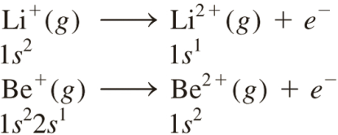
8.4
(b) The electron configurations of Li and Be are 1s²2s¹ and 1s²2s², respectively. The second ionization energy is the minimum energy required to remove an electron from a gaseous unipositive ion in its ground state. For the second ionization process, we write
Because 1s electrons shield 2s electrons much more effectively than they shield each other, we predict that it should be easier to remove a 2s electron from Be⁺ than to remove a 1s electron from Li⁺.

Slide 33
8.4
Check
Compare your result with the data shown in Table 8.2.
In (a), is your prediction consistent with the fact that the metallic character of the elements increases as we move down a periodic group?
In (b), does your prediction account for the fact that alkali metals form +1 ions while alkaline earth metals form +2 ions?

Slide 34
Electron affinity is the negative of the energy change that occurs when an electron is accepted by an atom in the gaseous state to form an anion.
X _{(g)} + e⁻ X⁻_{(g)}
F _{(g)} + e⁻ F⁻_{(g)}
ΔH = -328 kJ/mol
EA = +328 kJ/mol
O _{(g)} + e⁻ O⁻_{(g)}
ΔH = -141 kJ/mol
EA = +141 kJ/mol

Slide 35
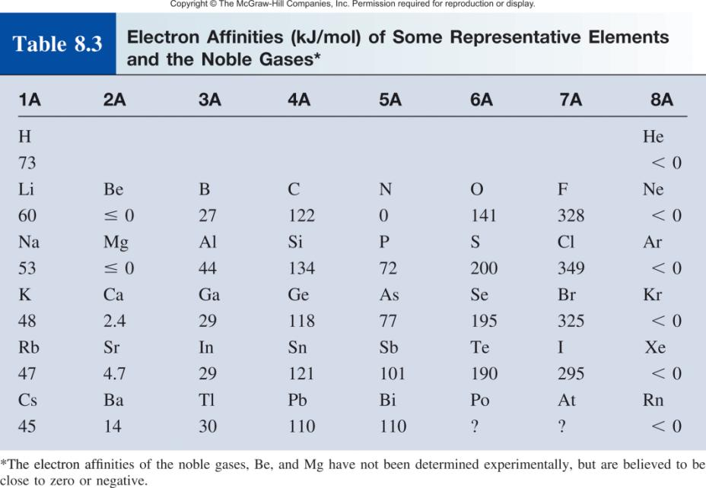

Slide 36
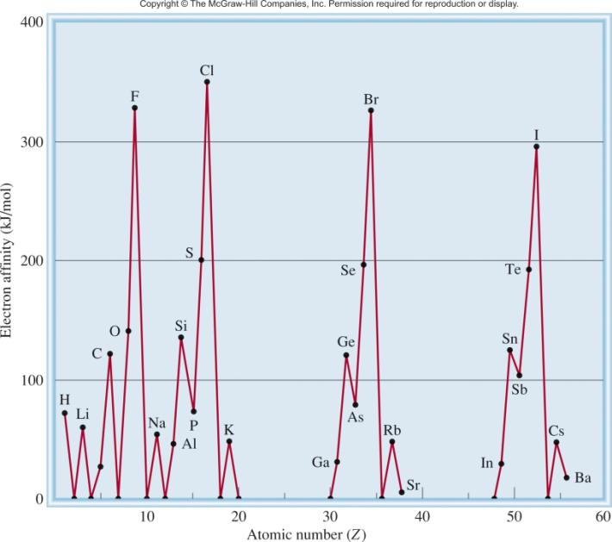
Variation of Electron Affinity With Atomic Number (H – Ba)

Slide 37
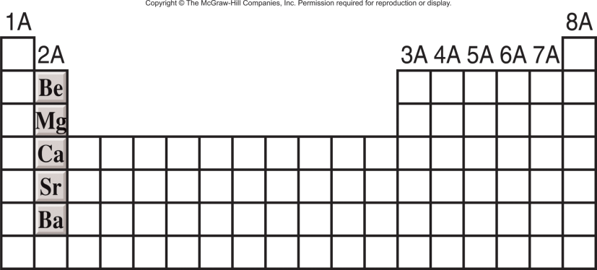
8.5
Why are the electron affinities of the alkaline earth metals, shown in Table 8.3, either negative or small positive values?

Slide 38

8.5
Strategy What are the electron configurations of alkaline earth metals? Would the added electron to such an atom be held strongly by the nucleus?
Solution The valence electron configuration of the alkaline earth metals is ns², where n is the highest principal quantum number. For the process
where M denotes a member of the Group 2A family, the extra electron must enter the np subshell, which is effectively shielded by the two ns electrons (the ns electrons are more penetrating than the np electrons) and the inner electrons. Consequently, alkaline earth metals have little tendency to pick up an extra electron.

Slide 39
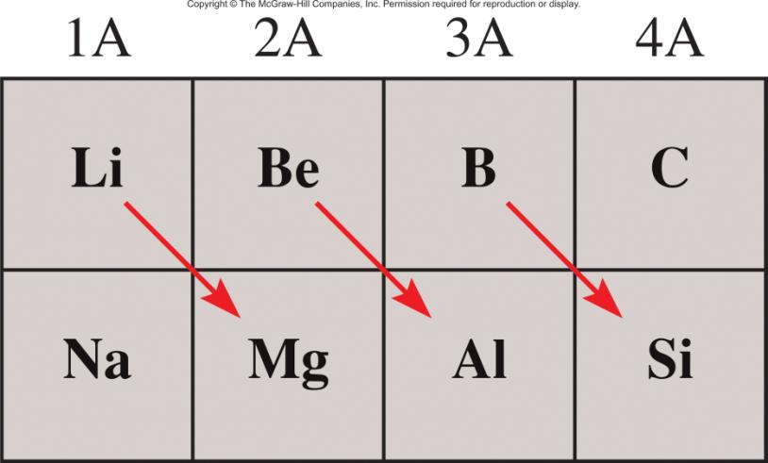
Diagonal Relationships on the Periodic Table

Slide 40
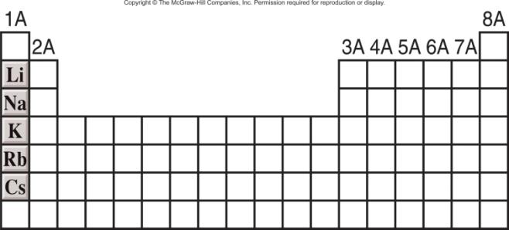
Group 1A Elements (ns¹, n ≥ 2)
M M⁺¹ + 1e⁻
2M_{(s)} + 2H₂O_{(l)} 2MOH_{(aq)} + H_{2(g)}
4M_{(s)} + O_{2(g)} 2M₂O_{(s)}
Increasing reactivity

Slide 41
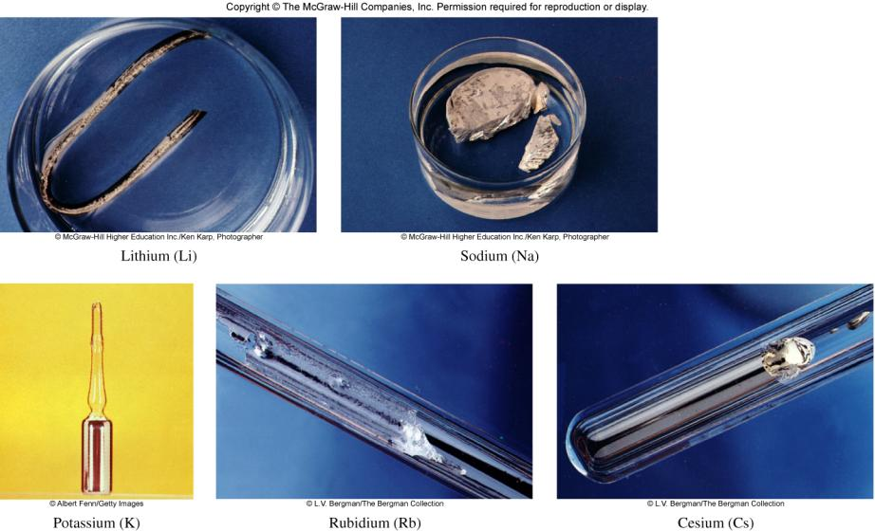
Group 1A Elements (ns¹, n ≥ 2)

Slide 42
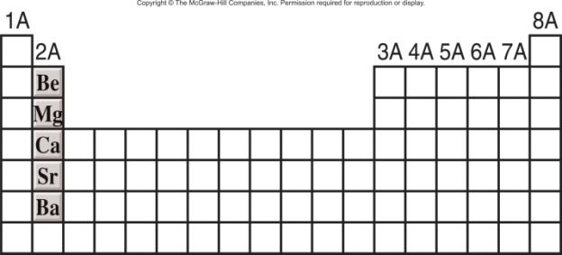
Group 2A Elements (ns², n ≥ 2)
M M⁺² + 2e⁻
Be_{(s)} + 2H₂O_{(l)} No Reaction
Mg_{(s)} + 2H₂O_{(g)} Mg(OH)_{2(aq)} + H_{2(g)}
M_{(s)} + 2H₂O_{(l)} M(OH)_{2(aq)} + H_{2(g)} M = Ca, Sr, or Ba
Increasing reactivity

Slide 43
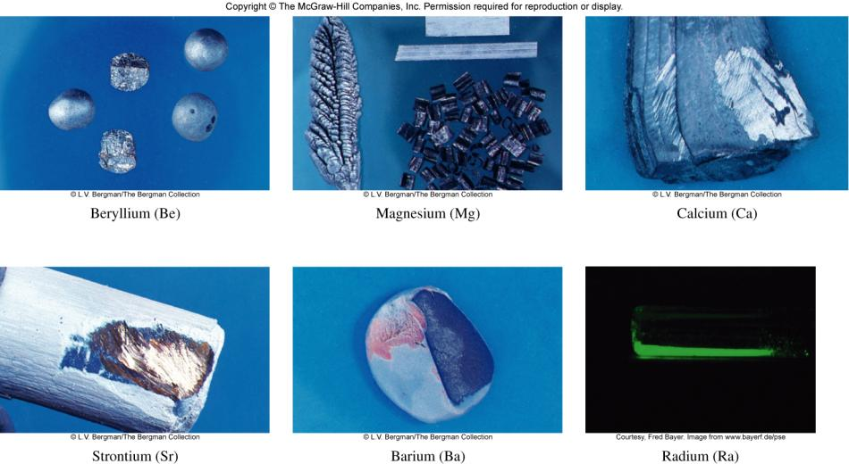
Group 2A Elements (ns², n ≥ 2)

Slide 44
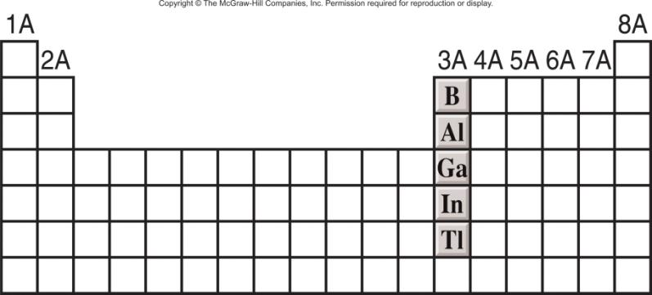
Group 3A Elements (ns²np¹, n ≥ 2)
4Al_{(s)} + 3O_{2(g)} 2Al₂O_{3(s)}
2Al_{(s)} + 6H⁺_{(aq)} 2Al³⁺_{(aq)} + 3H_{2(g)}

Slide 45
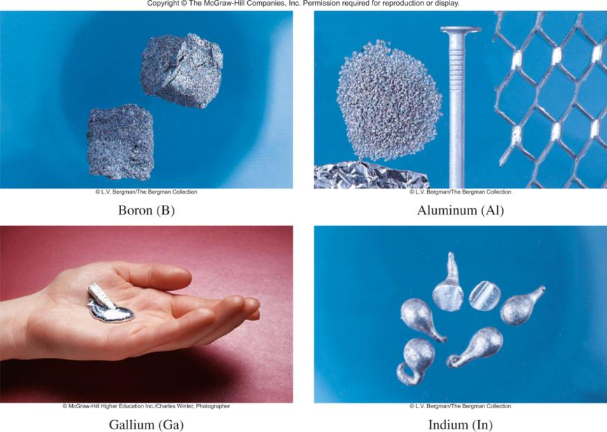
Group 3A Elements (ns²np¹, n ≥ 2)

Slide 46
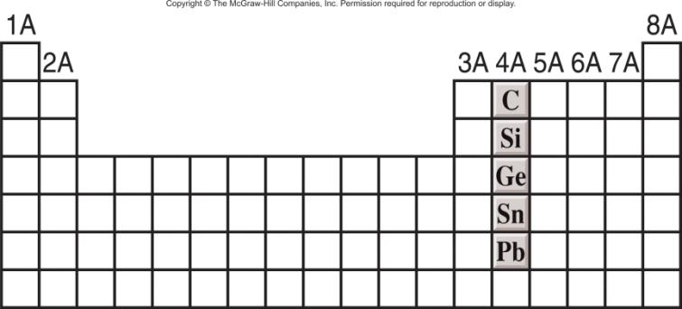
Group 4A Elements (ns²np², n ≥ 2)
Sn_{(s)} + 2H⁺_{(aq)} Sn²⁺_{(aq)} + H₂ _{(g)}
Pb_{(s)} + 2H⁺_{(aq)} Pb²⁺_{(aq)} + H₂ _{(g)}

Slide 47
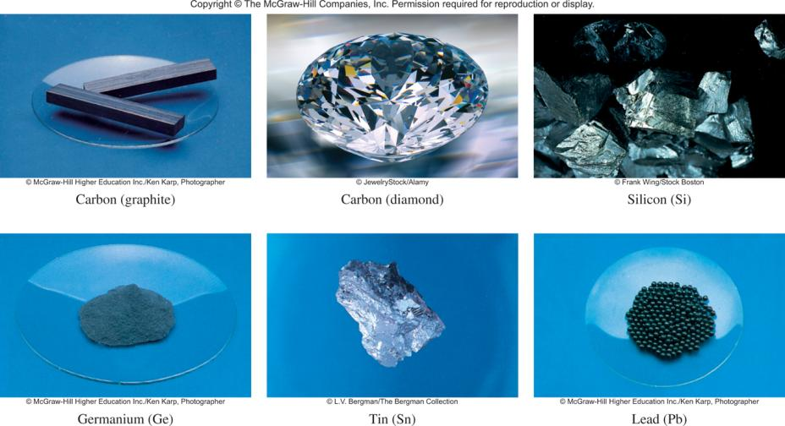
Group 4A Elements (ns²np², n ≥ 2)

Slide 48
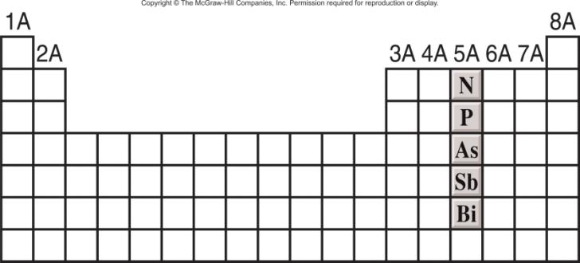
Group 5A Elements (ns²np³, n ≥ 2)
N₂O_{5(s)} + H₂O_{(l)} 2HNO_{3(aq)}
P₄O_{10(s)} + 6H₂O_{(l)} 4H₃PO_{4(aq)}

Slide 49
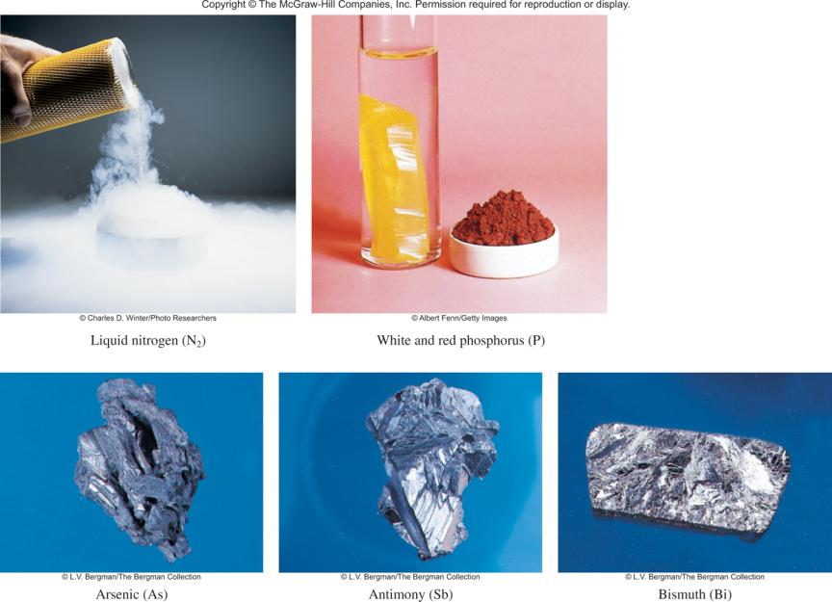
Group 5A Elements (ns²np³, n ≥ 2)

Slide 50
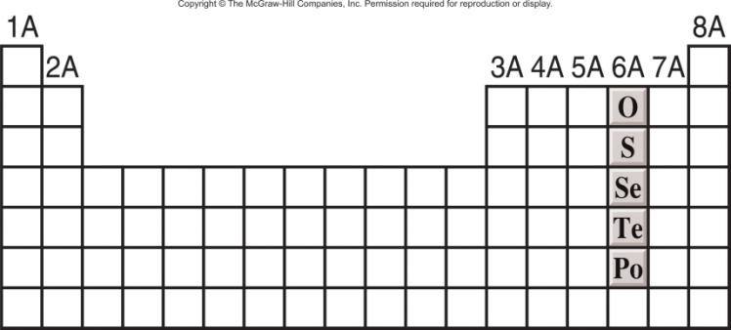
Group 6A Elements (ns²np⁴, n ≥ 2)
SO_{3(g)} + H₂O_{(l)} H₂SO_{4(aq)}

Slide 51
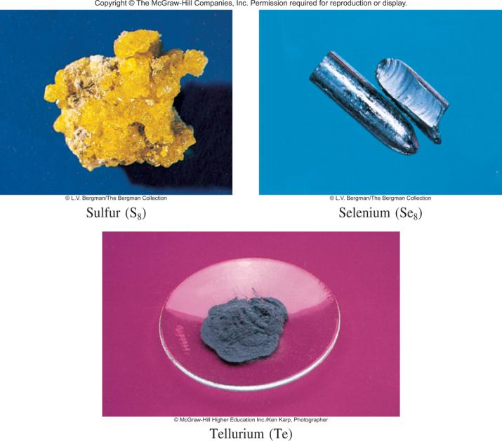
Group 6A Elements (ns²np⁴, n ≥ 2)

Slide 52
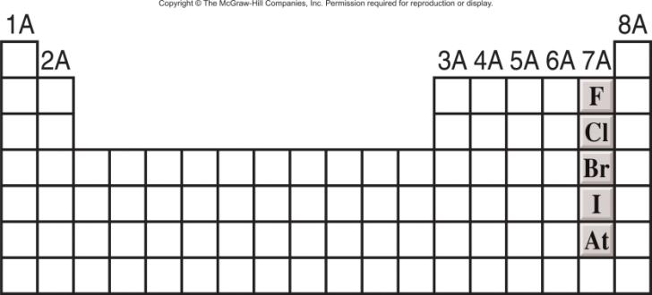
Group 7A Elements (ns²np⁵, n ≥ 2)
X + 1e⁻ X⁻¹
X_{2(g)} + H_{2(g)} 2HX_{(g)}
Increasing reactivity

Slide 53
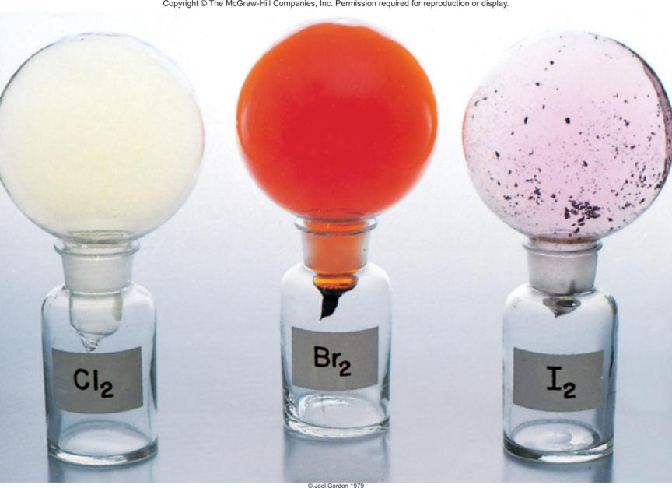
Group 7A Elements (ns²np⁵, n ≥ 2)

Slide 54
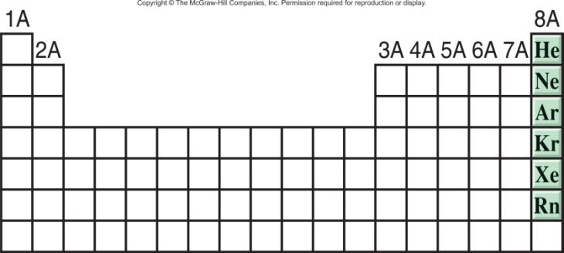
Group 8A Elements (ns²np⁶, n ≥ 2)
Completely filled ns and np subshells.
Highest ionization energy of all elements.
No tendency to accept extra electrons.

Slide 55
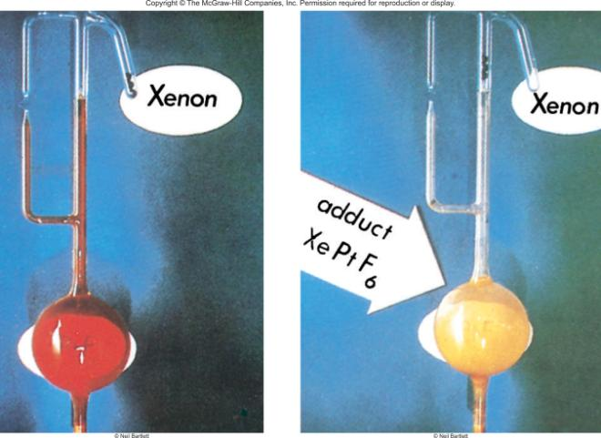
Compounds of the Noble Gases
A number of xenon compounds XeF₄, XeO₃, XeO₄, XeOF₄ exist.
A few krypton compounds (KrF₂, for example) have been prepared.

Slide 56
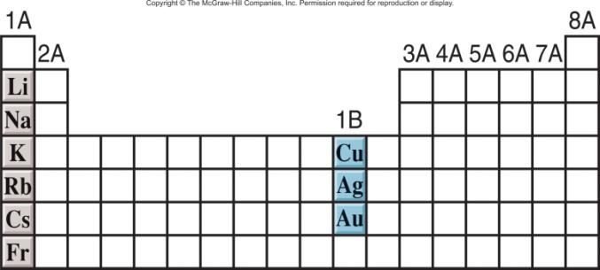
Comparison of Group 1A and 1B
The metals in these two groups have similar outer electron configurations, with one electron in the outermost s orbital.
Chemical properties are quite different due to difference in the ionization energy.
Lower I₁, more reactive

Slide 57
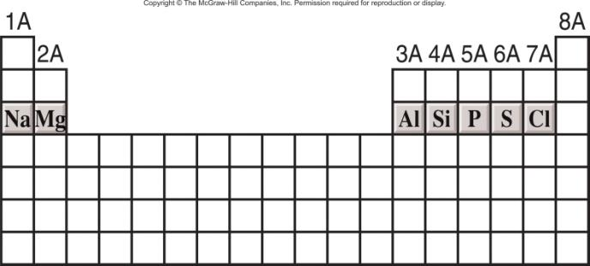
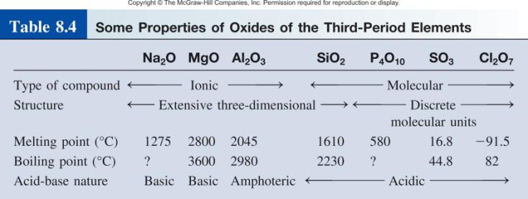
Properties of Oxides Across a Period
basic
acidic

Slide 58
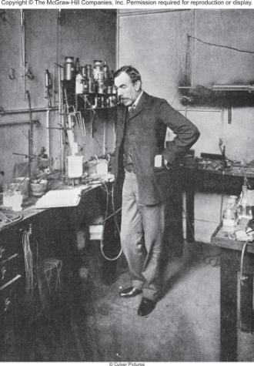
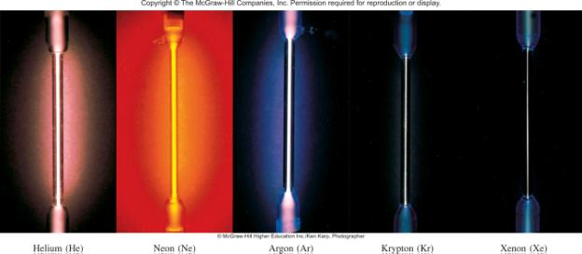
Chemistry in Action: Discovery of the Noble Gases
Sir William Ramsay

Slide 59
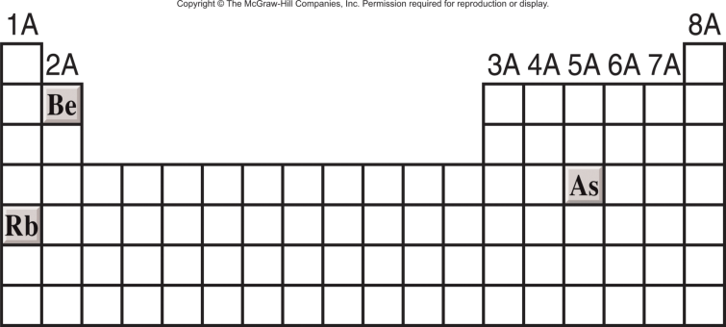
8.6
Classify the following oxides as acidic, basic, or amphoteric:
Rb₂O
BeO
As₂O₅

Slide 60
8.6
Strategy
What type of elements form acidic oxides? basic oxides? amphoteric oxides?
Solution
Because rubidium is an alkali metal, we would expect Rb₂O to be a basic oxide.

Slide 61
8.6
(b) Beryllium is an alkaline earth metal. However, because it is the first member of Group 2A, we expect that it may differ somewhat from the other members of the group. In the text we saw that Al₂O₃ is amphoteric. Because beryllium and aluminum exhibit a diagonal relationship, BeO may resemble Al₂O₃ in properties. It turns out that BeO is also an amphoteric oxide.
(b) Because arsenic is a nonmetal, we expect As₂O₅ to be an acidic oxide.

