Slide 1
積分
5-2 The Definite Integral

Slide 2
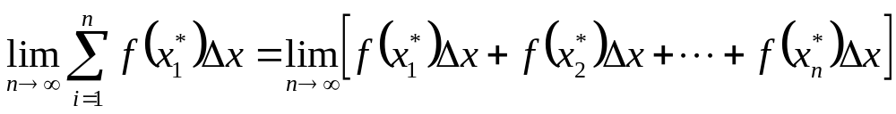


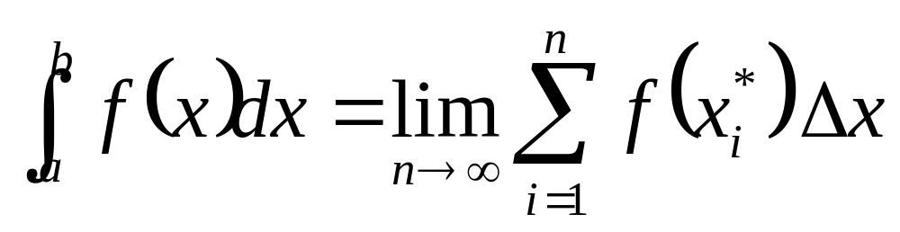
i
Definition of a Definite Integral
If f is a continuous function defined for , we divide the interval into n subintervals of equal width △x= (b-a ) / n. We let x₀(=a),x₁,x₂,…,x_{n}(=b) be the endpoints of these subintervals and we let x₁*, x₂*, … , x_{n}*, be any sample points in these subintervals, so x_{i}* lies in the ith subinterval [x_{i-1}, x_{i}].
Then the definite integral of f from a to b is :

Slide 3
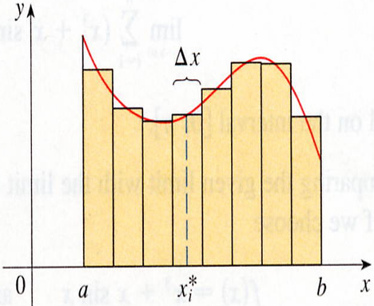
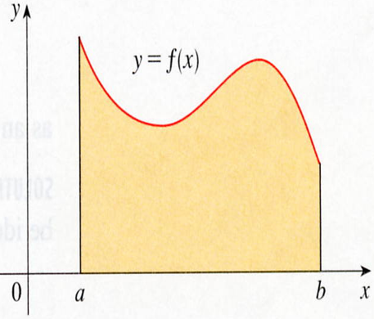

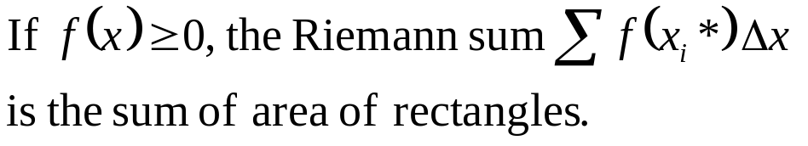
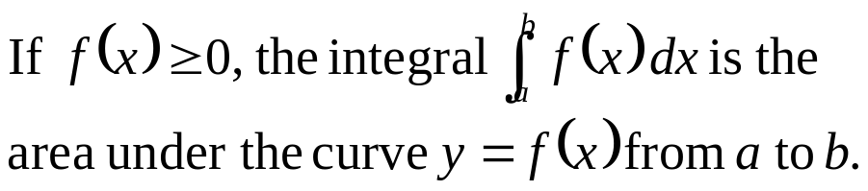
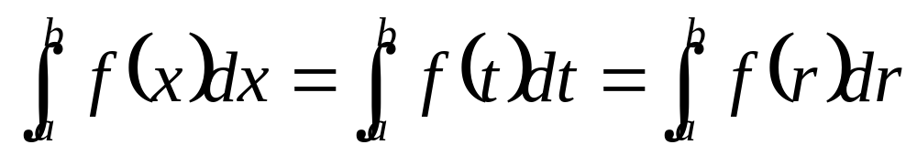
y
y
y=f (x)
b
0
a
b
x
0
a
x_{i}*
x
Leibniz

Slide 4
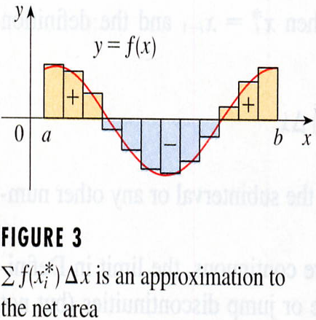
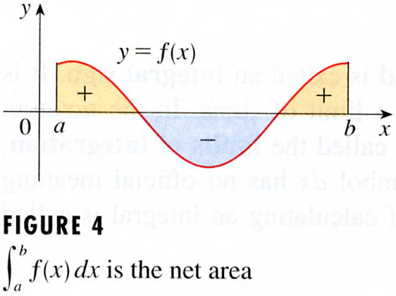
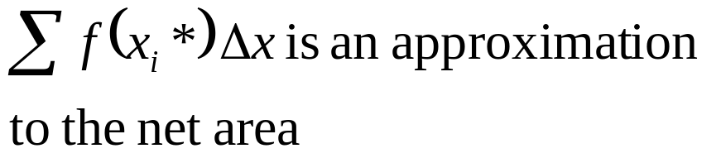
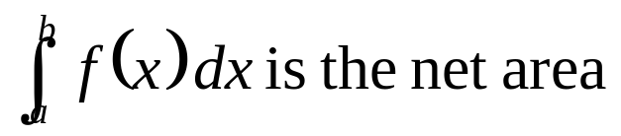
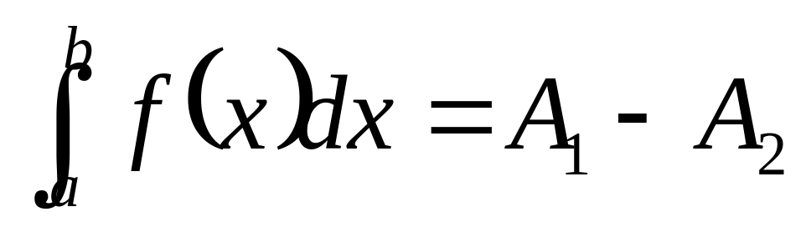
y
y
y=f (x)
y=f (x)
0
a
b
x
0
a
b
x
net area

Slide 5
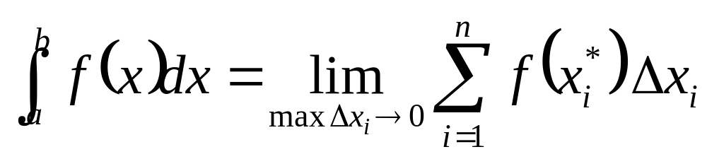

Slide 6
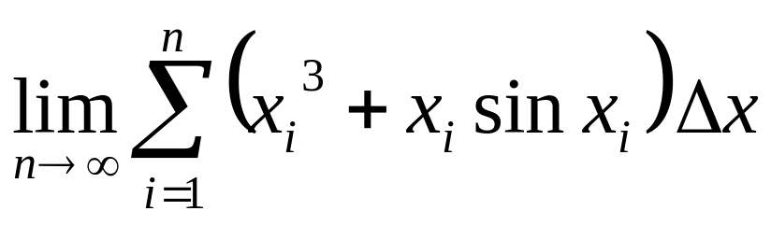
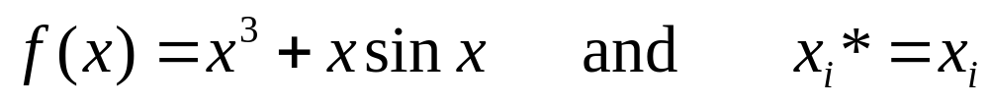
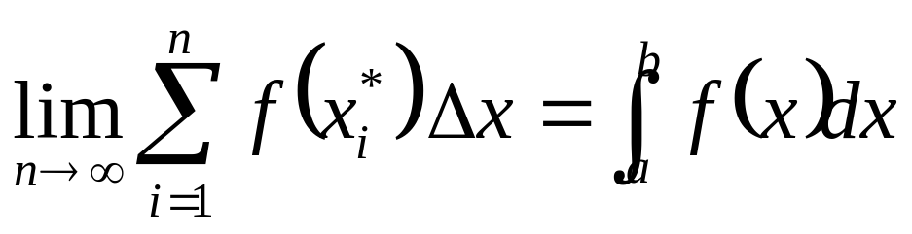
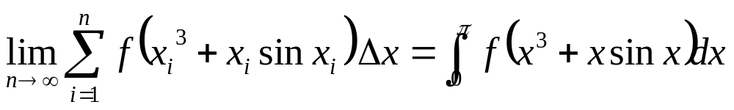
EXAMPLE 1 Express
as an integral on the interval [0,π]
SOLUTION
Comparing the given limit with the limit in Definition 2, we see that they will be identical if we choose

Slide 7
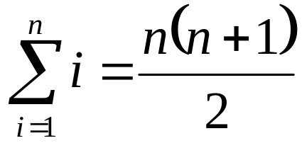
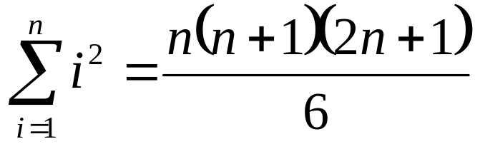
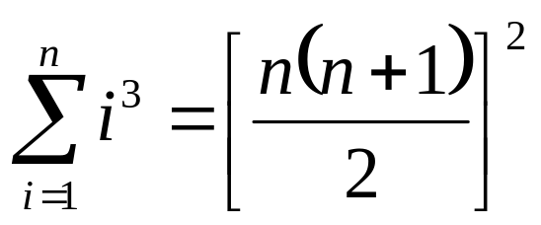
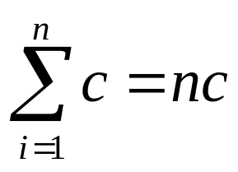
Evaluating Integrals
Proved in Appendix E.
4
5
6
7

Slide 8
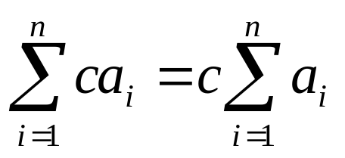
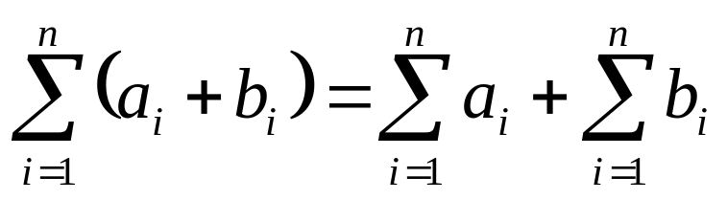
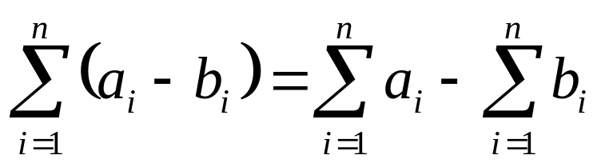
Evaluating Integrals
Proved in Appendix E.
8
9
10

Slide 9
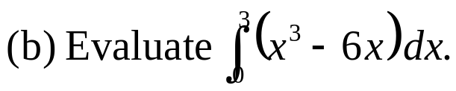
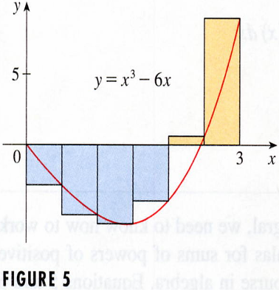
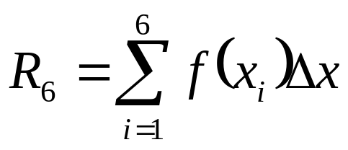
EXAMPLE 2
(a) Evaluate the Riemann sum for f(x)=x³-6x taking the sample
points to be right endpoints and a=0, b=3, and n=6.
solution
y
△x= 3- 0/6= 0.5
5
y=x³- 6x
x₁=0.5, x₂=1.0, x₃=1.5, x₄=2.0, x₅=2.5, x₆=3.0.
0
3
x
= f(0.5)△x+f(1.0)△x+f(1.5)△x+ f(2.0)△x+f(2.5)△x+f(3.0)△x
=-3.9375

Slide 10
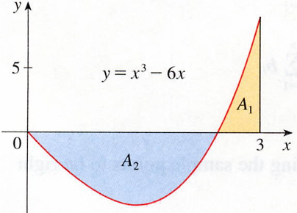
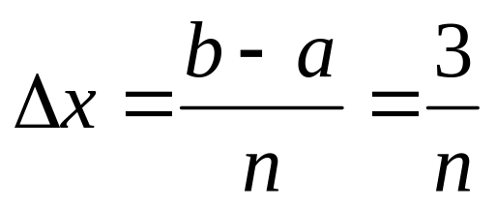
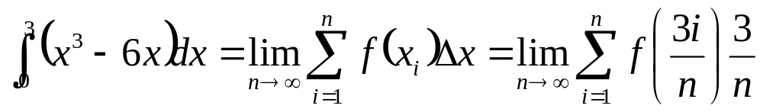
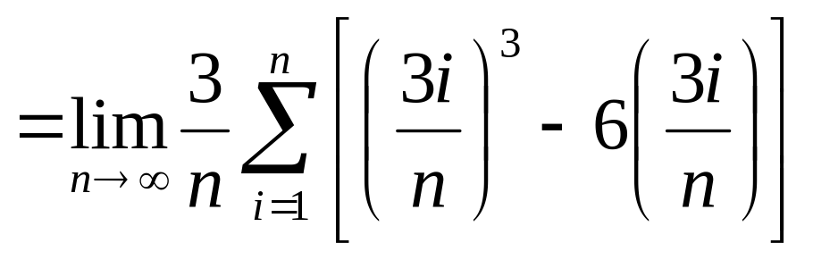
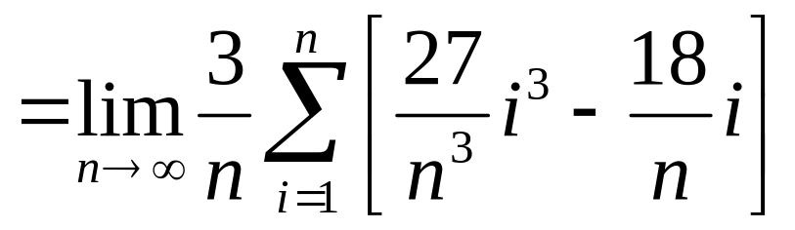
y
Figure 6
(b) With n subintervals we have
5
y=x³- 6x
A₁
0
3
x
x₀=0, x₁=3/n, x₂=6/n, x₃=9/n, and x_{i}=3i/n
A₂
right

Slide 11
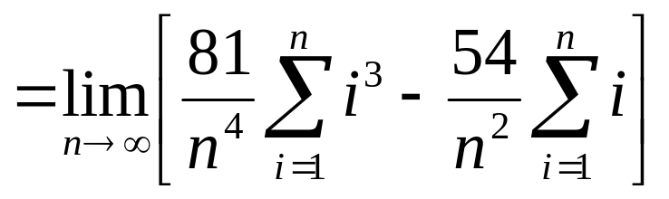
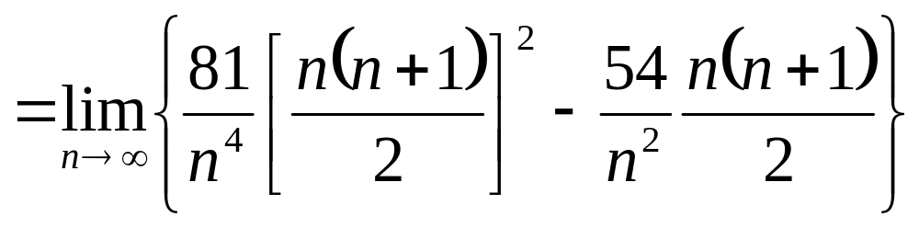
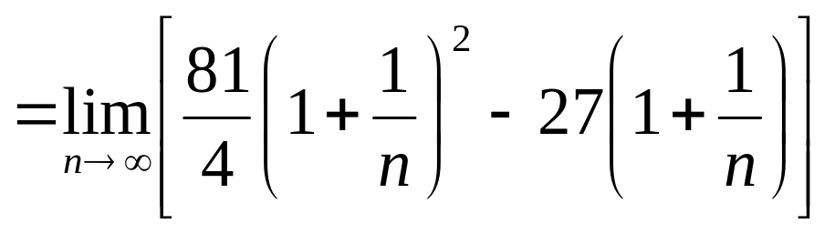
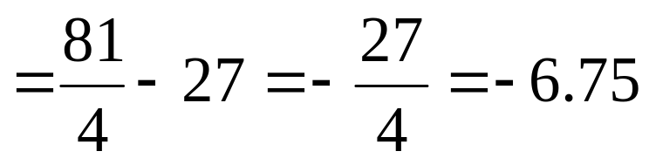
查表
-6.75不能解釋成真正的aera
但可以解釋成A1-A2差值aera

Slide 12
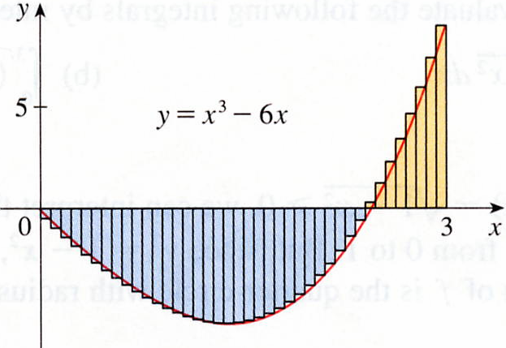


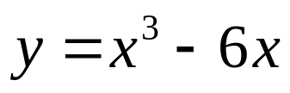



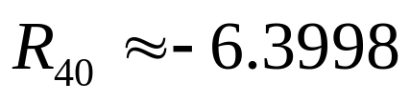
Riemann sum Rn
n | R_{n}
40 100 500 1000 5000 | -6.3998 -6.6130 -6.7229 -6.7365 -6.7473
n→∞ Rn= -6.75
A much simpler method will be given in section 5-3.

Slide 13
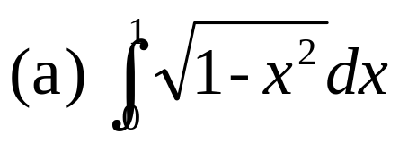
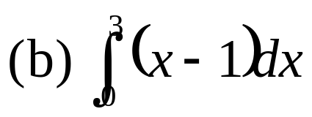
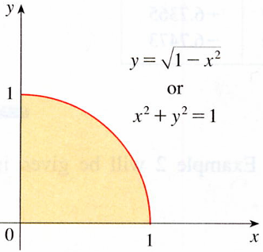
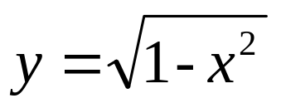
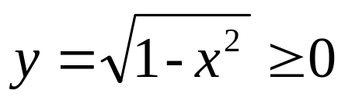
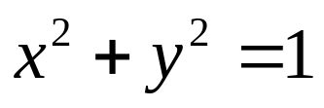
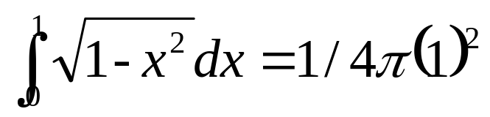
EXAMPLE 4
Evaluate the following integrals by interpreting each in terms of areas.
y
solution
1
or
y² = 1 - x²
x² + y² = 1
半徑為1的圓，佔1/4的範圍。
0
1
x
Figure 9
= π/4

Slide 14
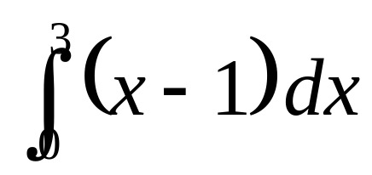

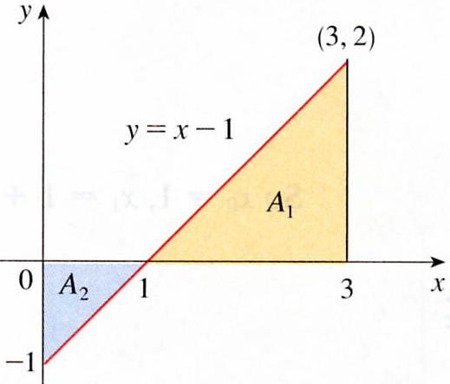
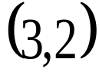
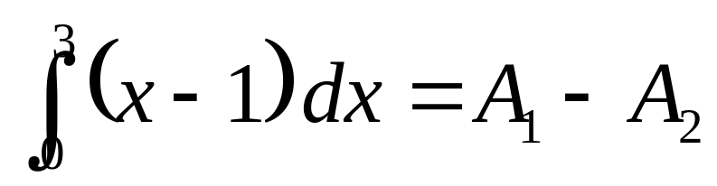









(b) The graph of y = x-1 is the line with slope 1 shown in Figure 10. We compute the integral as the difference of the areas of the two triangles:
solution

Slide 15




The Midpoint Rule

Slide 16











EXAMPLE 5
solution
y=1/x的圖形，a=1，b=2，△X=1/5

Slide 17



Properties of the Definite Integral

Slide 18










Properties of the Definite Integral
y= c, a≦x≦b

Slide 19











Properties of the Definite Integral

Slide 20


Properties of the Definite Integral

Slide 21





EXAMPLE 6
solution
Using Properties 2 and 3 of integrals,
(Ex2 in Section 5-1)

Slide 22






Properties of the Definite Integral

Slide 23





EXAMPLE 6
If it is known that
solution
By Property 5, we have
0 8 10
（移項）

Slide 24



Properties of the Definite Integral

Slide 25











Properties of the Definite Integral
證明
將m≦f(x)≦M積分，區間[a,b]

Slide 26












EXAMPLE 7
SOLUTION
M=1
y=1
e⁻¹=
f(1)=
m≦f(x)≦M
= f(0)
= 1
m=e⁻¹

Slide 27
5-2 Exercises
EX37，EX49

Slide 28






EXAMPLE 3
solution

Slide 29





(b) If we ask a computer algebra sysytem to evaluate the sum and simplify, we obtain
(l’Hospital’s rule)
A much simpler method will be given in section 5-3.

