Slide 1
5-3 The Fundamental
Theorem of Calculus

Slide 2
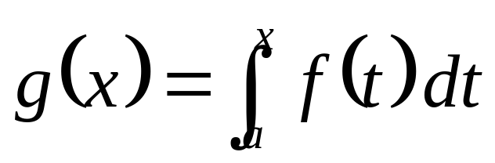
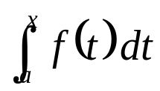
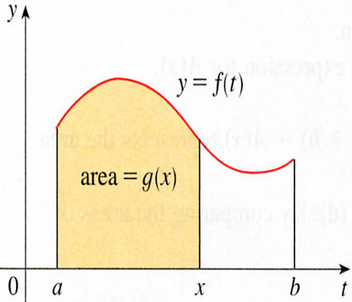








f is a continuous function on [a, b] and x varies between a and b.
If x is a fixed number, then the integral is a definite number.
If we let x vary, the number
also varies and defines a function of x denoted by g(x).

Slide 3

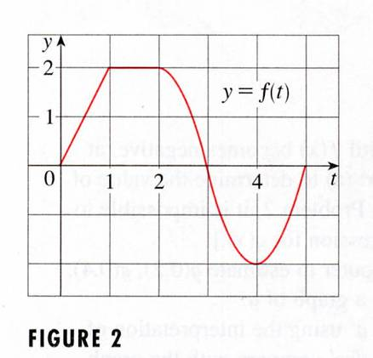
EXAMPLE 1

Slide 4

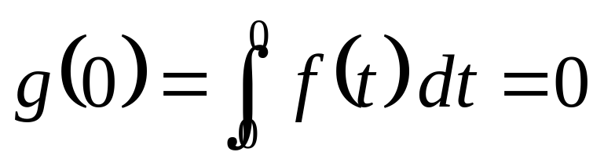
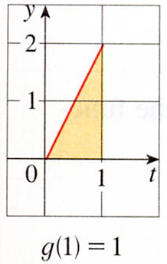


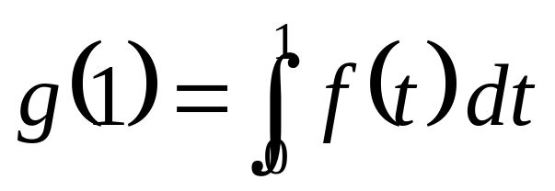




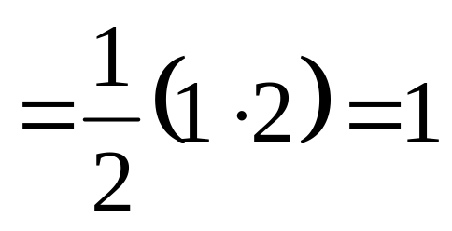
SOLUTION
First we notice that :
Figure 3
From Figure 3 we see that g(1) is the area of a triangle.

Slide 5
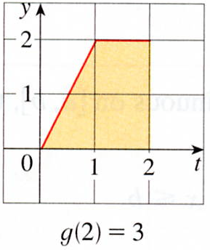
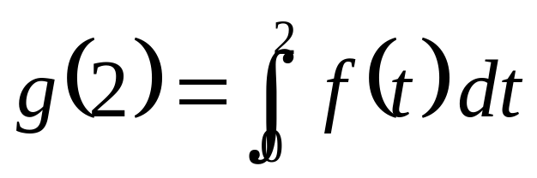
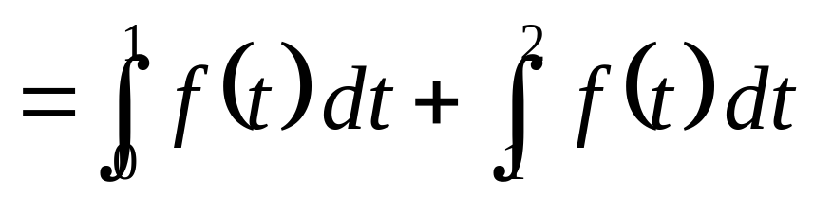

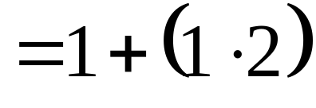

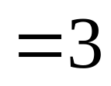
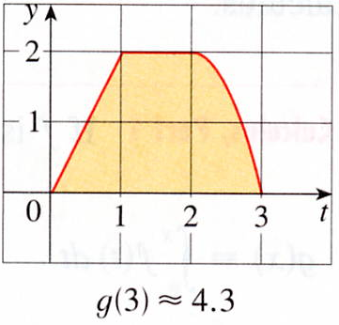
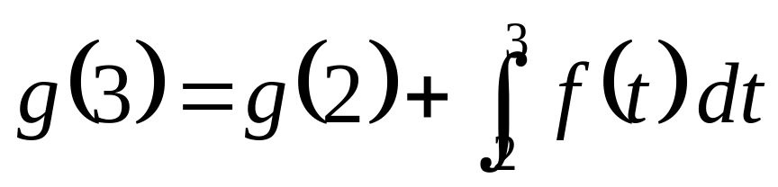
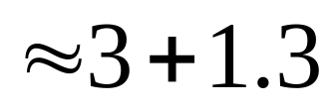

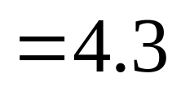


Slide 6
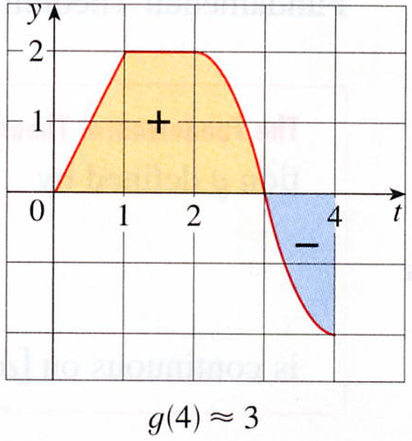
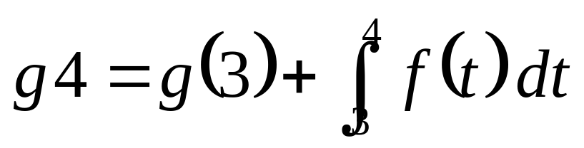

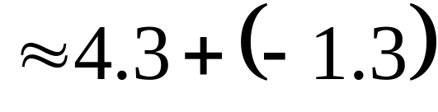
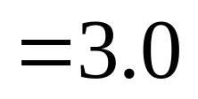

For t> 3, f(t) is negative and so we start subtracting areas"
３

Slide 7
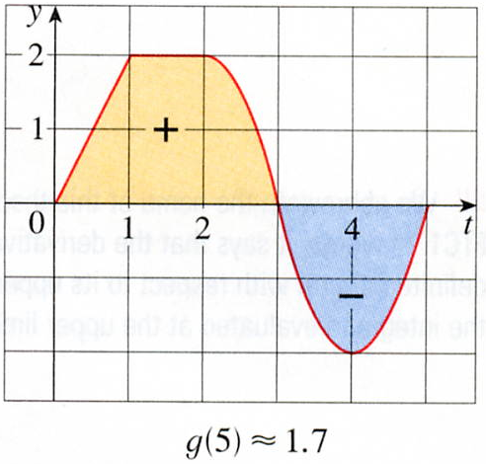
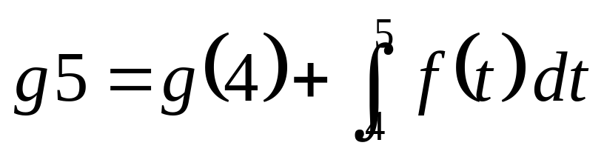
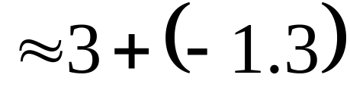
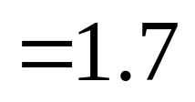

５
３

Slide 8
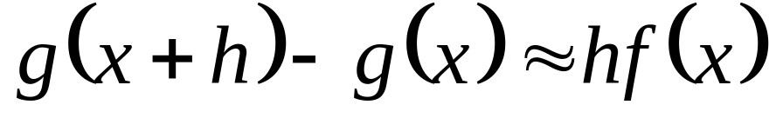
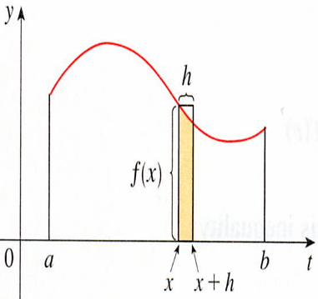
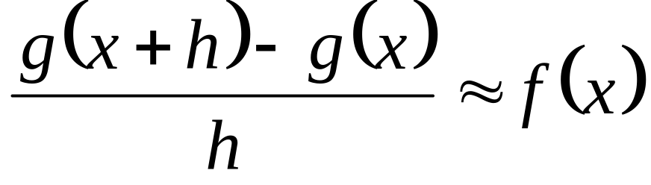

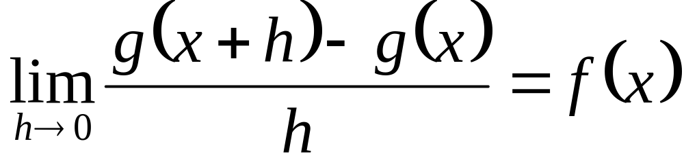
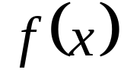

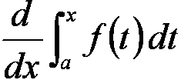





Area of [a, x+h]
Area of [a, x]
Rectangle area

Slide 9
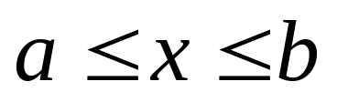
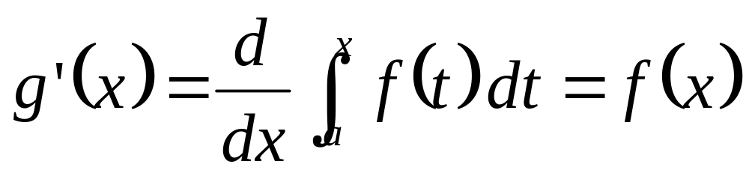
The Fundamental Theorem of Calculus Part 1
If f is continuous on [a, b], then the function g defined by
f is continuous on [a, b] and differentiable on (a, b), and

Slide 10
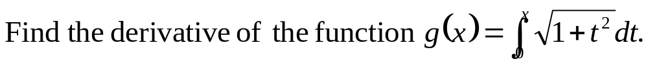

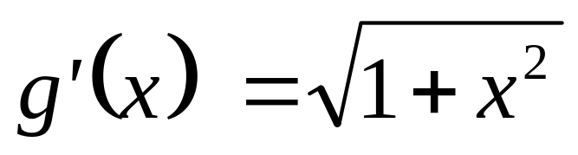
EXAMPLE 2
SOLUTION

Slide 11
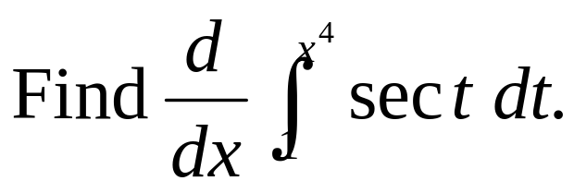
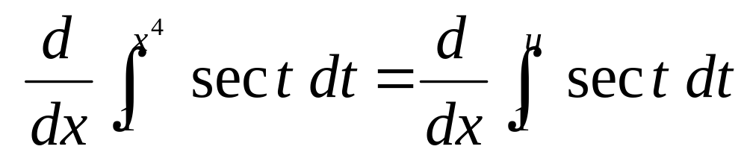
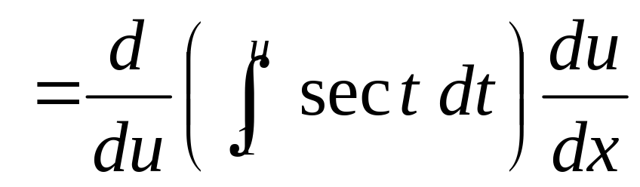
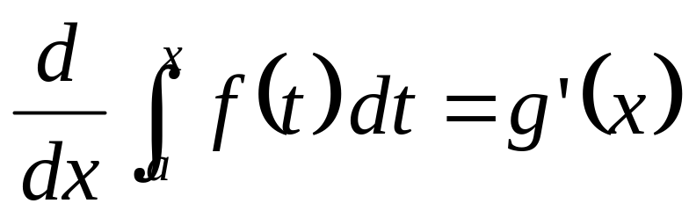

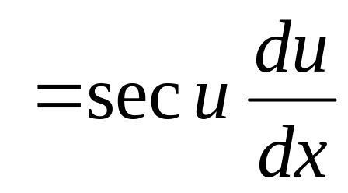
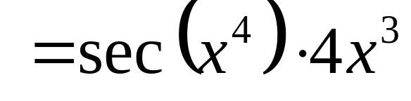
EXAMPLE 4
SOLUTION
Here we have to be careful to use the Chain Rule.
Let u =x⁴

Slide 12
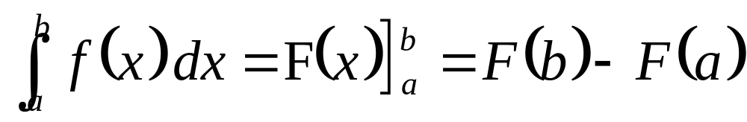
The Fundamental Theorem of Calculus Part 2
If f is continuous on [a, b], then
Where F(x) is any antiderivative of f(x), that is,
a function such that F‘(x) = f(x).

Slide 13
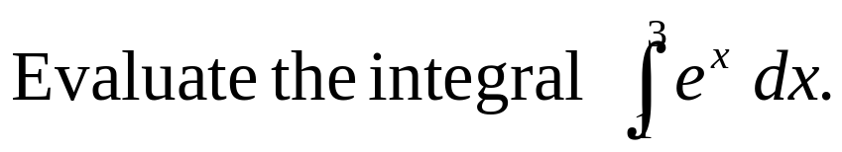
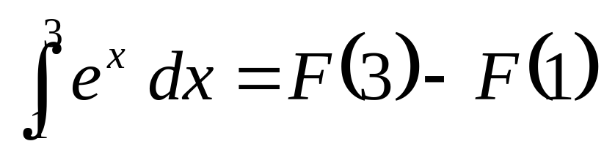
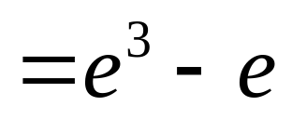
EXAMPLE 5
SOLUTION
anti

Slide 14
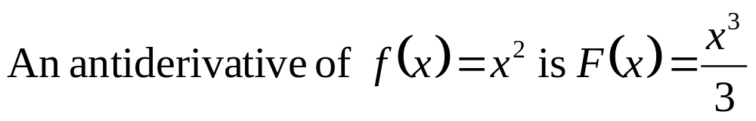
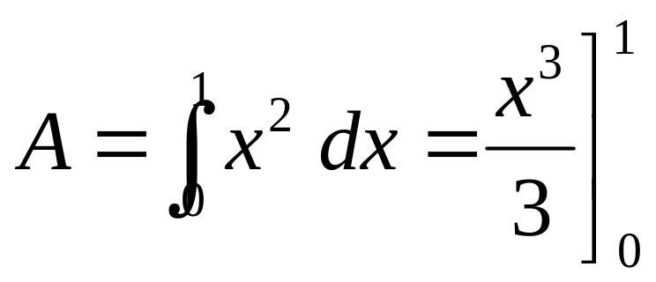
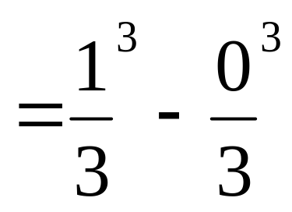
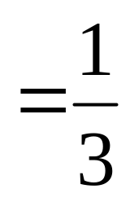
EXAMPLE 6
Find the area under the parabola y =x² from 0 to 1.
SOLUTION

Slide 15
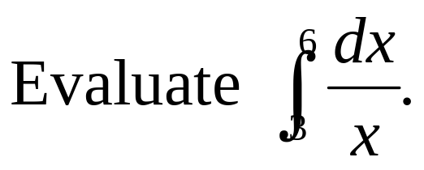



EXAMPLE 7
SOLUTION
An antiderivative of f(x) =1/x is : F(x) = ln | x |
Because 3≦ x ≦6, we can write F(x) = lnx.

Slide 16










EXAMPLE 8
SOLUTION
`
taking b = π/2

Slide 17








EXAMPLE 9
What is wrong with the following calculation ?
Comparison Properties of the Integral
for -1≦x≦3
≧0
But
Because x= 0, f(0)= 1/0 has infinite

Slide 18






Differentiation and Integration as Inverse Processes
The Fundamental Theorem of Calculus

Slide 19
5-3 Exercises
EX3，EX66，EX67

Slide 20







EXAMPLE 3
French physicist famous in optics.

