Slide 1
5-4 Indefinite Integrals and the
Net Change Theorem

Slide 2
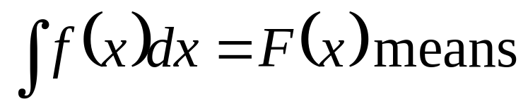
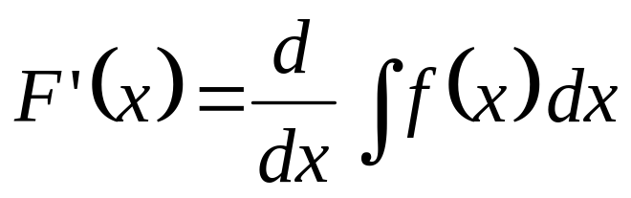
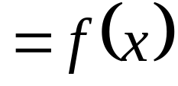
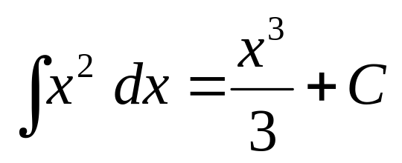
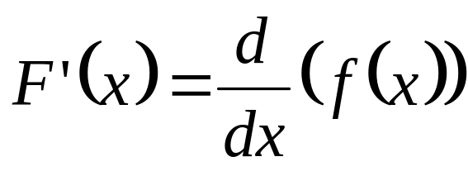
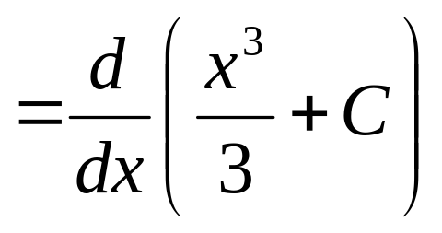
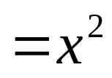
Indefinite Integrals
F(x)
f (x)
F(x)
Indefinite integral
Represent an entire family of functions.

Slide 3
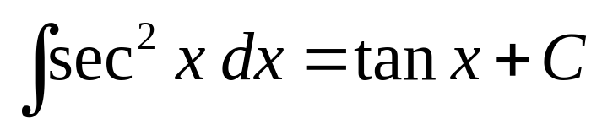
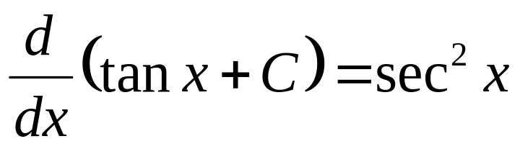

Slide 4

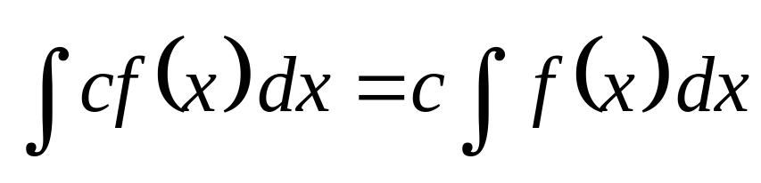
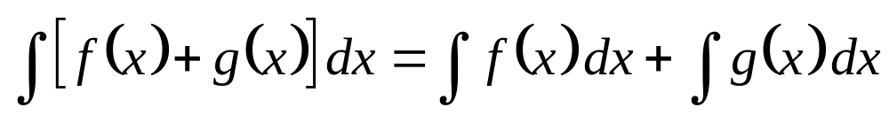
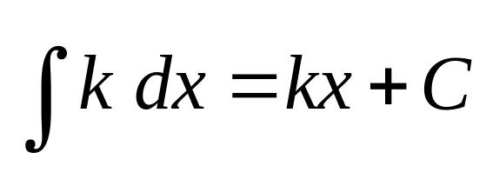
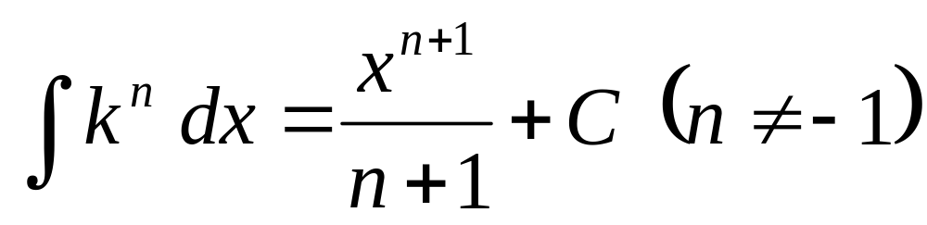
Table of Indefinite Integral
x

Slide 5
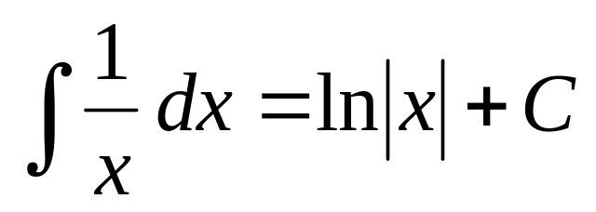
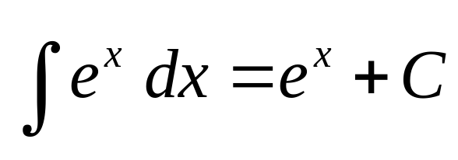
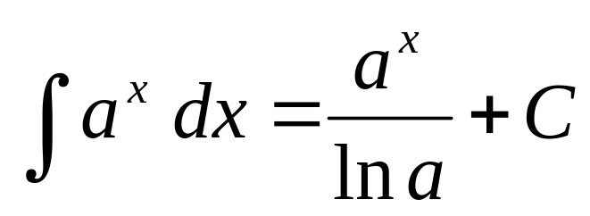
Table of Indefinite Integral
如何證明？

Slide 6
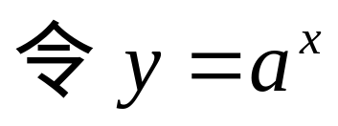
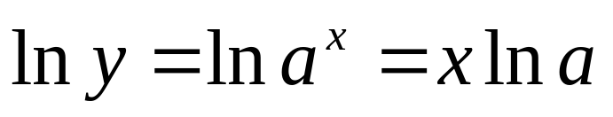
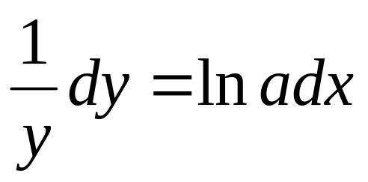
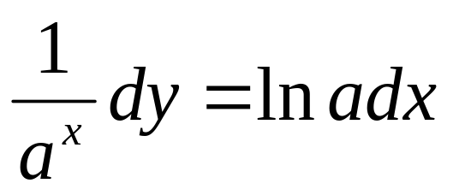
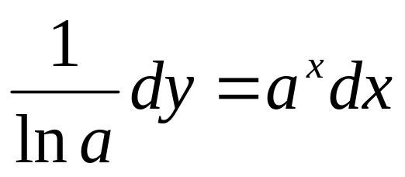
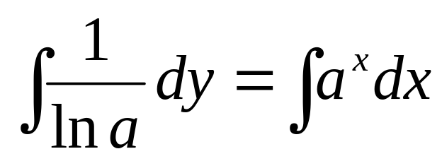
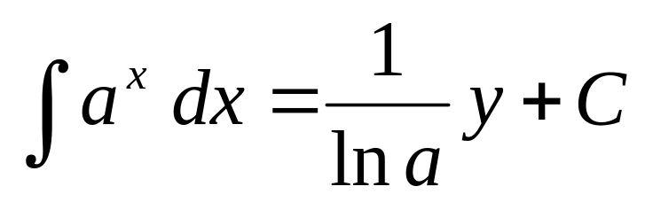
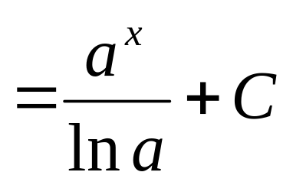
Table of Indefinite Integral
證明
兩邊微分
兩邊積分

Slide 7
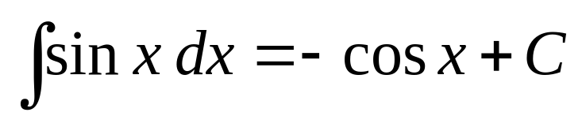
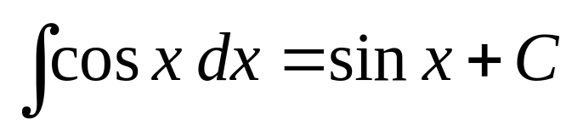
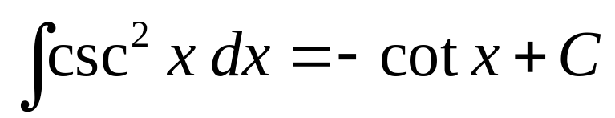
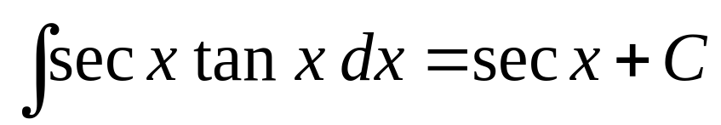
Table of Indefinite Integral

Slide 8
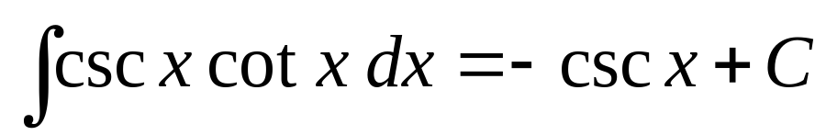
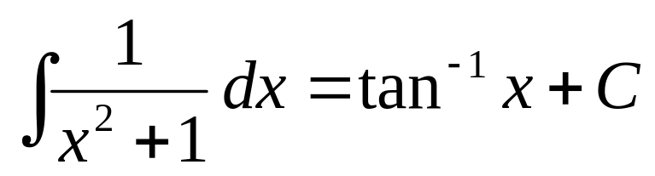
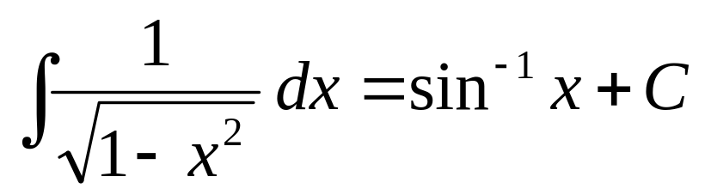
Table of Indefinite Integral

Slide 9
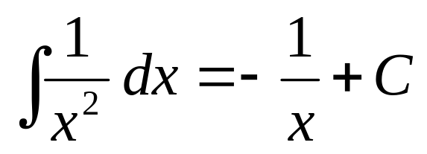
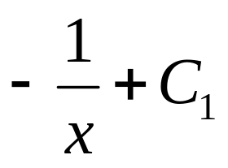

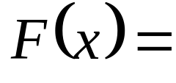
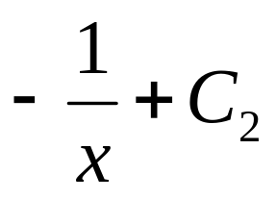

-∞
∞
0
It is valid on the interval (-∞,0) or (0,∞)
Antiderivative of the function f(x)= 1/x²,x= 0 is

Slide 10
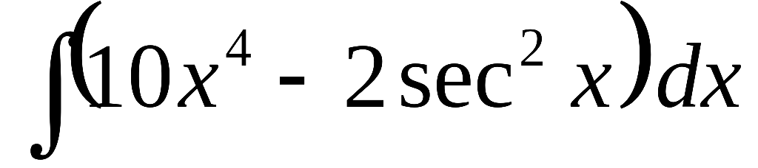
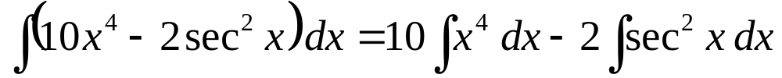
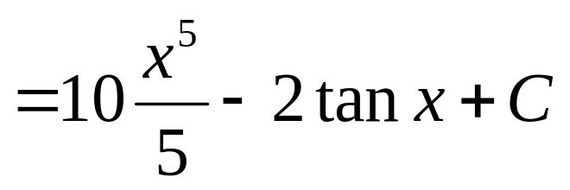

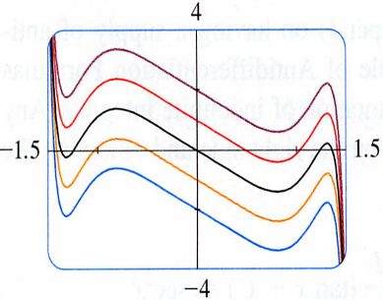
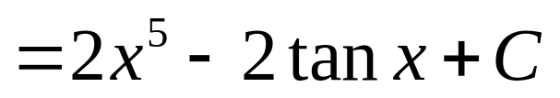
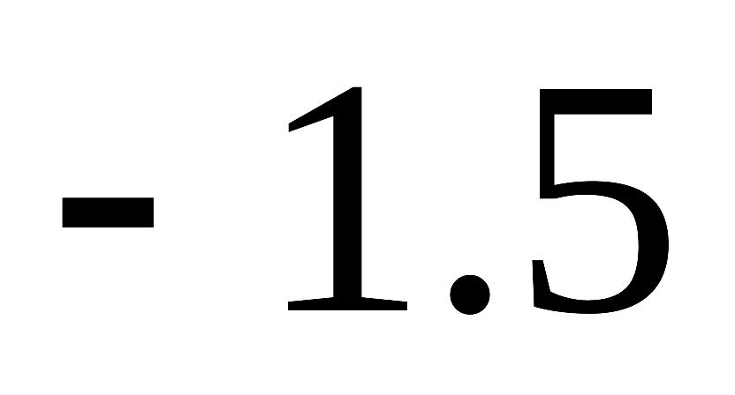
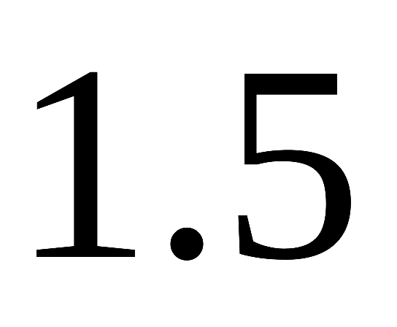
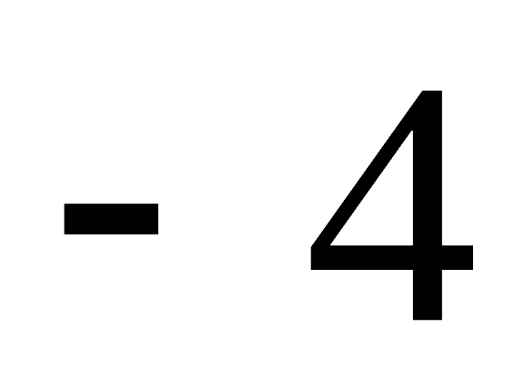
EXAMPLE 1
Find the general indefinite integral
SOLUTION
Using our convention and Table 1, we have
Shift up and down
You should check this answer by differentiating it.

Slide 11
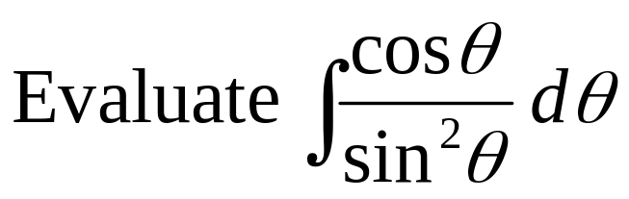
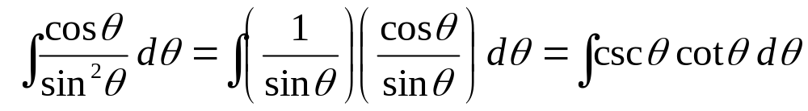



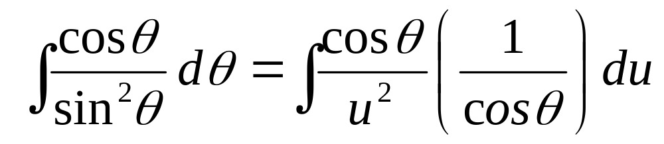
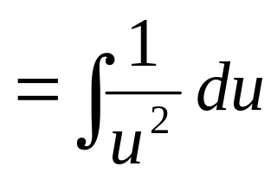
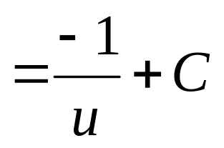
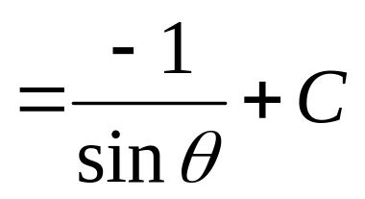
EXAMPLE 2
解法１
解法２
Let

Slide 12
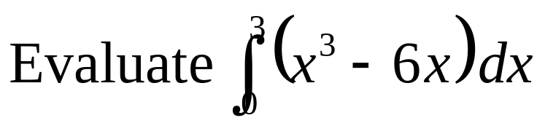





EXAMPLE 3
SOLUTION
Compare this calculation with EX2(b) in section 5-2

Slide 13





EX2(b) in section 5-2
y
Figure 6
(b) With n subintervals we have
5
y=x³- 6x
A₁
0
3
x
x₀=0, x₁=3/n, x₂=6/n, x₃=9/n, and x_{i}=3i/n
A₂
right

Slide 14





Slide 15








EXAMPLE 4
and interpret the result in terms of areas.
SOLUTION
公式
y
3
0
2
x

Slide 16






EXAMPLE 5
SOLUTION

Slide 17


Applications
The Net Change Theorem
The integral of a rate of change is the net change:
1
If V(t) is the volume of water in a reservoir at time t,
then its derivative V’(t) is the rate at which water flow into the reservoir at time t. So
is the change in the amount of water in the reservoir between time t₁ and t₂.

Slide 18

2
If [C] is the concentration of the product of a chemical reaction at time t,
then the rate of reaction is the derivative d[C]/dt, So
is the change in the concentration of C from t₁ to t₂.

Slide 19

3
If the mass of a rod measured from the left end to a point x is m(x),
then the linear density is ρ(x)= m’(x), So
is the mass of the segment of the rod that lies between x= a, and x= b.

Slide 20

4
If the rate of growth to a population is dn/dt, then
is the net change in population during the period t₁ to t₂.
The population increases when births happen and decreases when deaths occur.
The net change takes into account both births and deaths.

Slide 21

5
If an object moves along a straight line with position function s(t), then its velocity is v(t)= s’(t), so
位移
is the net change of position, or displacement, of the particle during the time period from t₁ to t₂.

Slide 22

6
If we want to calculate the distance traveled during the time interval, we have to consider the intervals when v(t)≧0 ；
１
(the particle moves to the right)
when v(t)≦0；
２
(the particle moves to the left).
In both cases the distance is computed by integrating ｜v(t)｜, the speed. Therefore
總移動距離

Slide 23













Figure 3 shows how both displacement and distance traveled can be interpreted in terms of areas under a velocity curve.
displacement
(位移)
distance
distance
(距離)
The acceleration of the object is a(t) = v’(t), so
is the change in velocity from time t₁ to t₂.

Slide 24





EXAMPLE 6
A particle moves along a line so that its velocity at time t is
(a) Find the displacement of the particle during the time period
(b) Find the displace traveled during this time period .
V(t)
(a) By Equation 2, the displacement is
A2
t
S(4) - S(1)
1
2
3
4
A0
A1
(-A0-A1+A2)
– (-A0)
A2 – A1

Slide 25





V(t)
A2
t
1
2
3
4
A0
A1
= A1 +A2

Slide 26










S(1)
(0→1)
S(2)
(1→2)
V(t)
S(3)
(2→3)
S(4)
(3→4)
A2
t
S(4)
1
2
3
4
S(3)
S(1)
S(2)
A0
A1
3秒
2秒
4秒
1秒
0秒

Slide 27


Figure 4 shows the power consumption in the city of San Francisco for a day in September (P is measured in megawatts; t is measured in hours starting at midnight). Estimate the energy used on that day.
P
800
600
Energy = Power x time
400
200
0
3
6
9
12
15
18
21
t

Slide 28






P
solution
Power is the rate of change of energy.
800
So, by the net change theorem;
600
400
200
We approximating the value of the integral using the Midpoint Rule with 12 subintervals and △t = 24/12=2;
0
3
6
9
12
15
18
21
t

Slide 29
5- 4 Exercises
EX39，EX44

