Slide 1
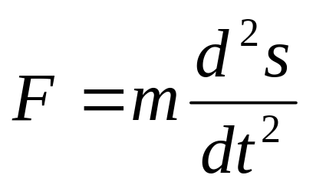
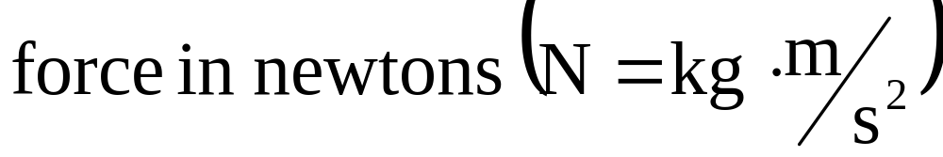
6.4 Work
1
(Newton’s Second Law of Motion)
2

Slide 2
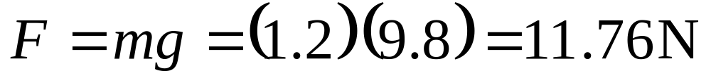
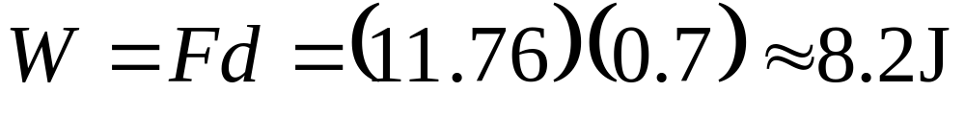
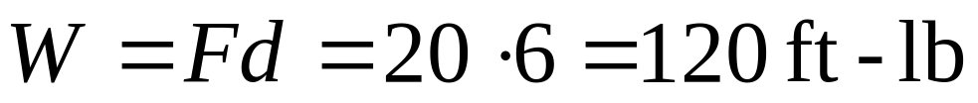
EXAMPLE 1
(A) How much work is done in lifting a 1.2 kg book off the floor to put it on a desk that is 0.7 m high? Use the fact that the acceleration due to gravity is g = 9.8 m/s².
(B) How much work is done in lifting a 20 lb weight 6 ft off the ground?
(a)
(b)

Slide 3
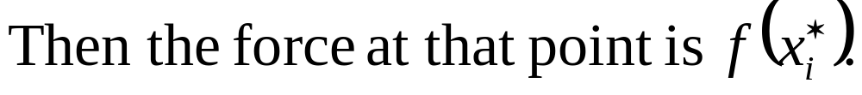
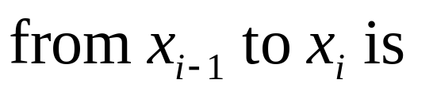
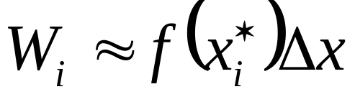


Let’s suppose that the object moves along the x – axis in the positive direction, from x = a to x = b, and at each point x between a and b a force f (x) acts on the object where f is a continuous function.
The
f(x)
a
b
x₀
x₁
x_{n}

Slide 4
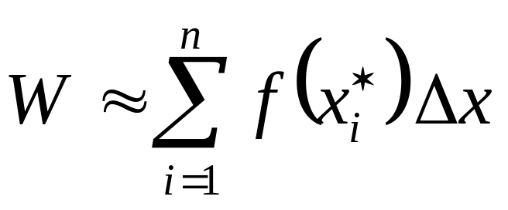
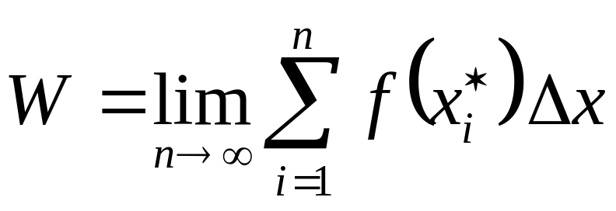
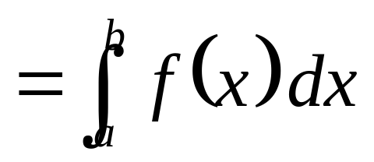
3
4
f(x)
a
b
x₀
x₁
x_{n}

Slide 5
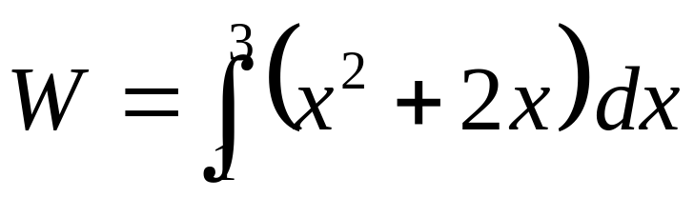
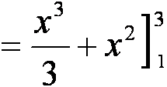
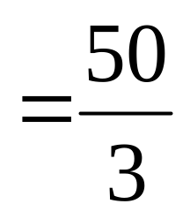
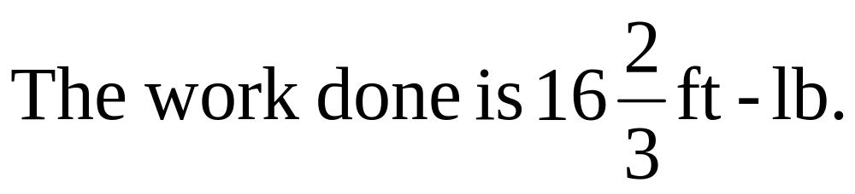
EXAMPLE 2
When a particle is located a distance x feet from the origin, a force of x² + 2 x pounds acts on it.
How much work is done in moving it from x = 1 to x = 3 ?
Solution

Slide 6
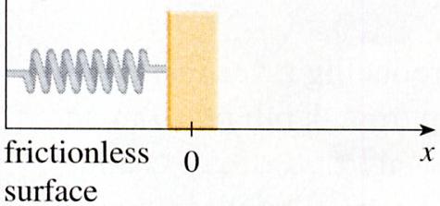
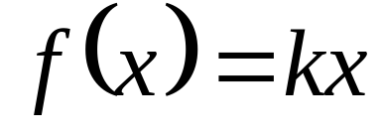

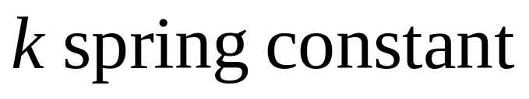
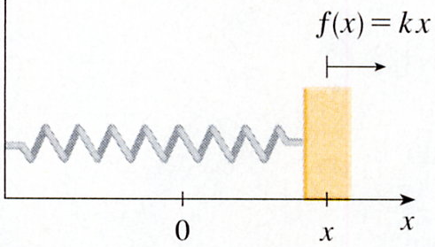
Hooke’s law

Slide 7
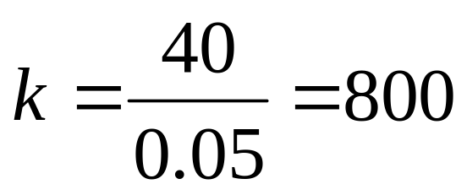
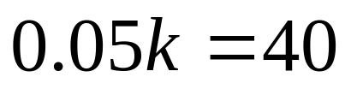
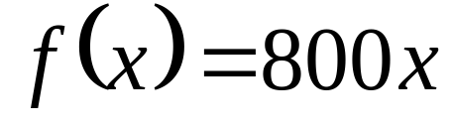
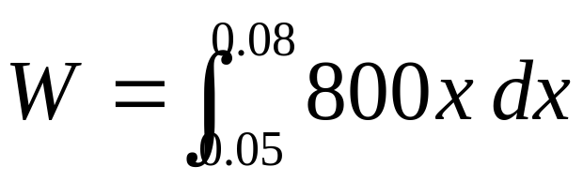
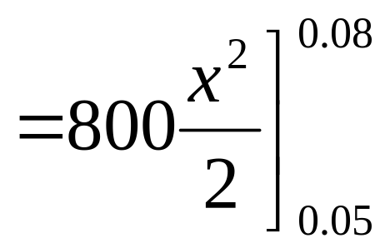
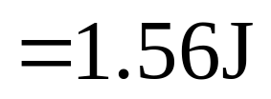
EXAMPLE 3
A force of 40 N is required to hold a spring that has been stretched from its natural length of 10 cm to a length of 15 cm.
How much work is done in stretching the spring from 15 cm to 18 cm?
Solution

Slide 8
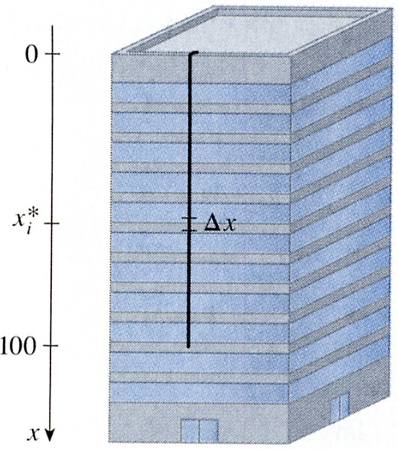
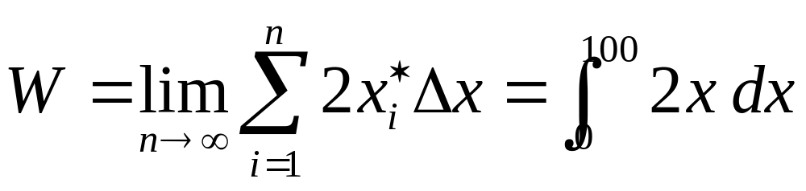

EXAMPLE 4
A 200 lb cables is 100 ft long and hangs vertically from the top of a tall building.
How much work is required to lift the cable to the top of the building?
Origin(top )
單位長度cable重量 = 200/100
= 2 lb/ft
第 i 等分
△x的重量= 2 △x
X_{i}*
distance
force
第 i 等分
△x
△x拉到樓頂所作的功=
(2△x) x_{i}*
= 10,000 ft-lb

Slide 9
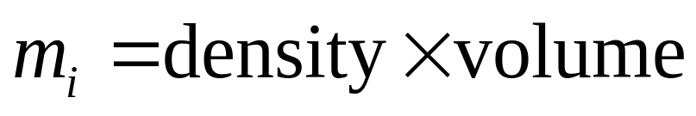
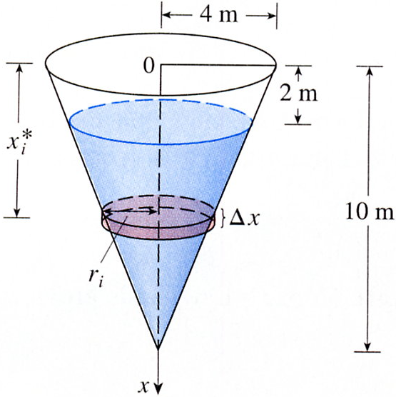
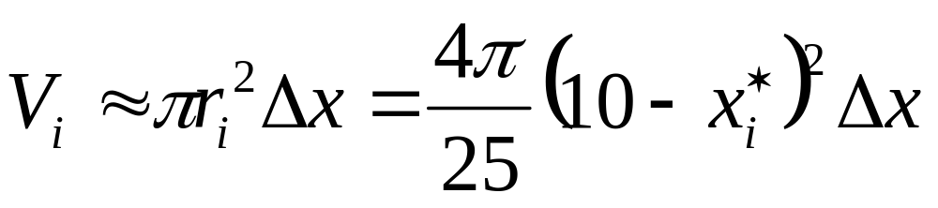
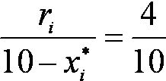

EXAMPLE 5
A tank has the shapes of an inverted circular cone with height 10 m and base radius 4 m. It is filled with water to a height of 8 m.
Find the work required to empty the tank by pumping all of the water to the top of the tank. (The density of water is 1000 kg/m³)
8
相似三角形
10-x*_{i}

Slide 10
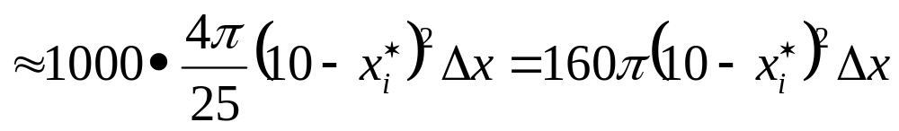
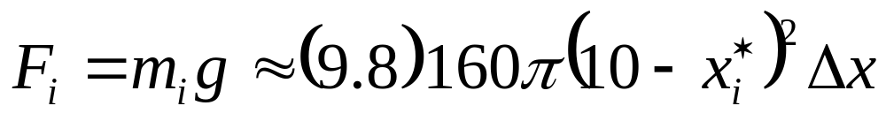
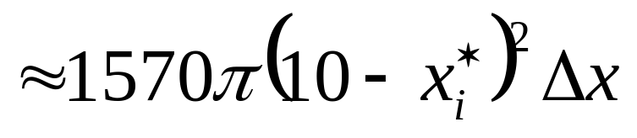
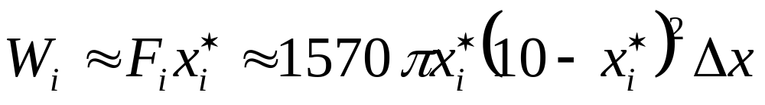
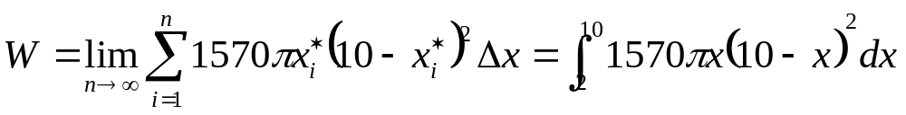
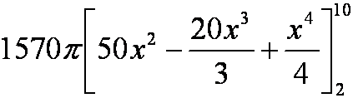


Slide 11
EX 13, EX21, EX24

Slide 12
