Slide 1
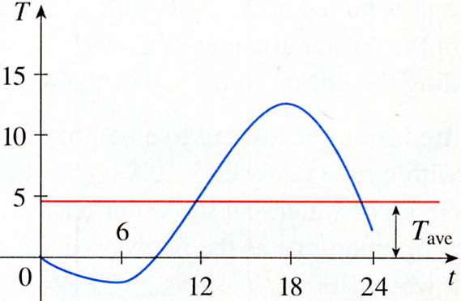

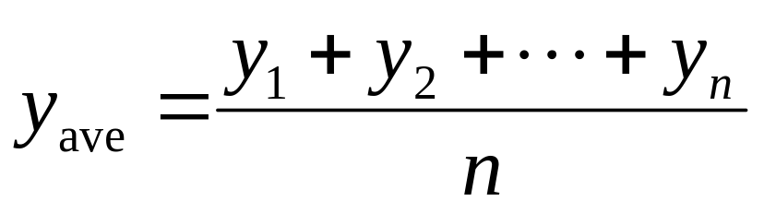
6.5 Average Value of a Function

Slide 2
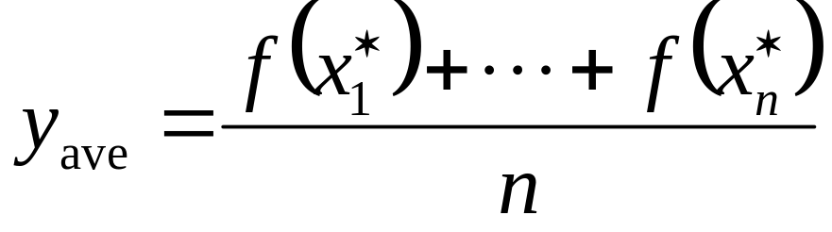
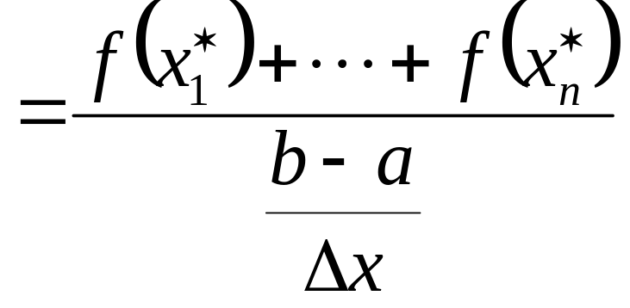
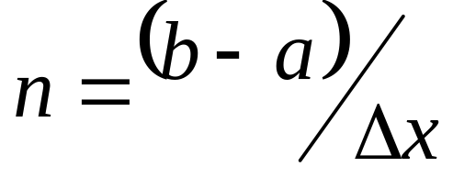
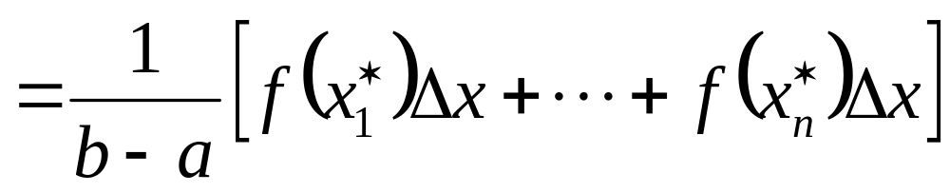
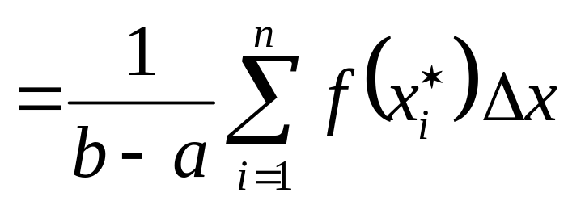

Slide 3
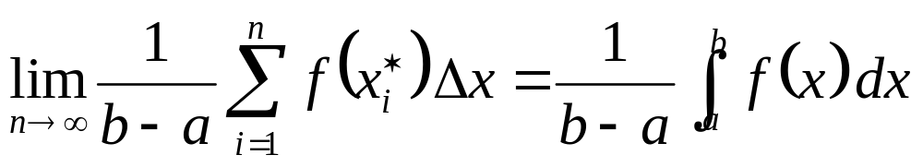
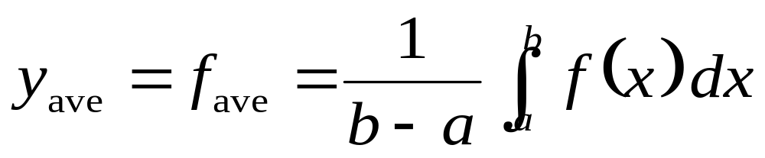
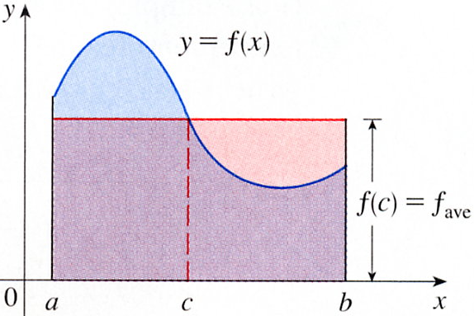

Slide 4
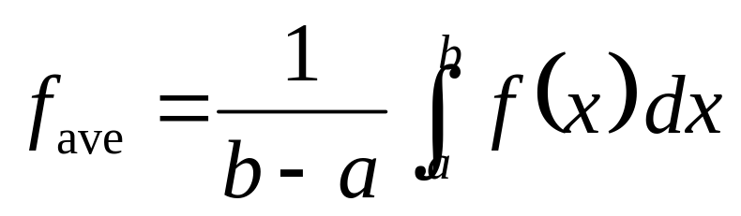
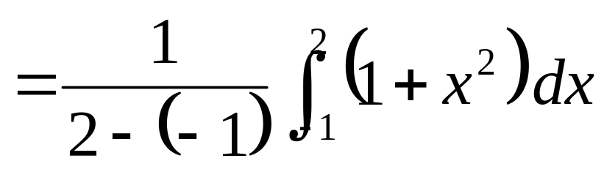
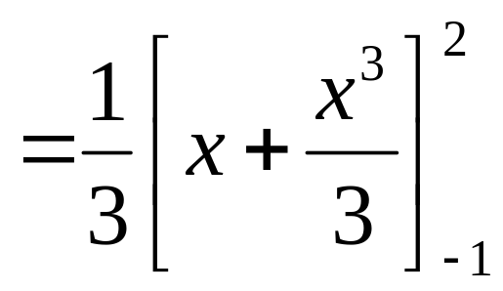

EXAMPLE 1
Find the average value of the function f (x) = 1 + x² on the interval [-1, 2].
Solution

Slide 5
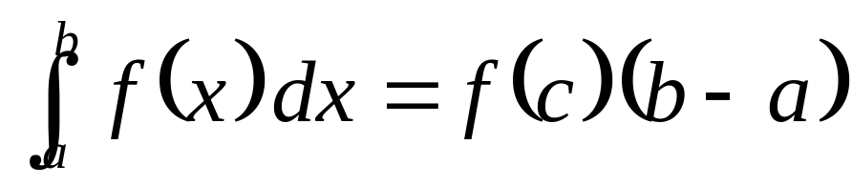

The Mean Value Theorem for lntegrals
If f is continuous on [a, b], then there exists a number c in [a, b] such that

Slide 6

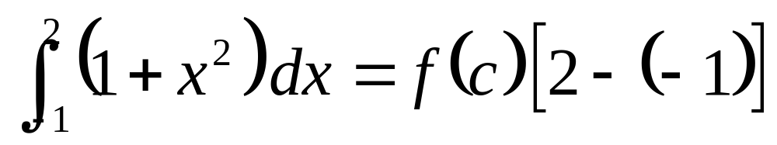
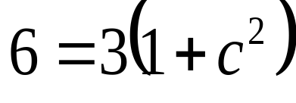
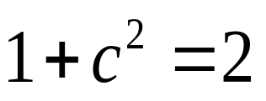
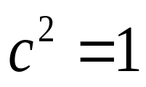
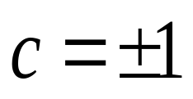


EXAMPLE 2
Since f(x) = 1 + x² is continuous on the interval [-1, 2], the Mean Value Theorem for Integrals says there is a number c in [-1, 2] such that

Slide 7
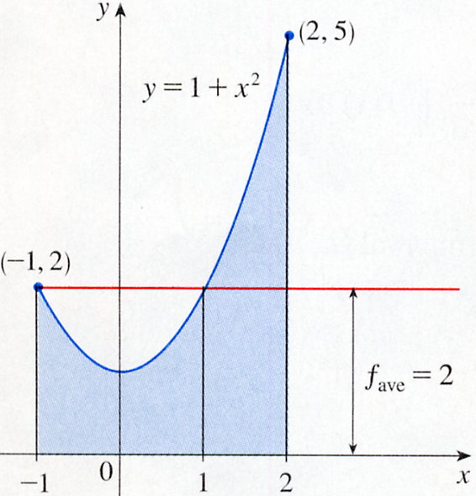


Thus, in this case there happen to be two numbers c = ± 1 in the interval [-1, 2] that work in the Mean Value Theorem for Integrals.

Slide 8
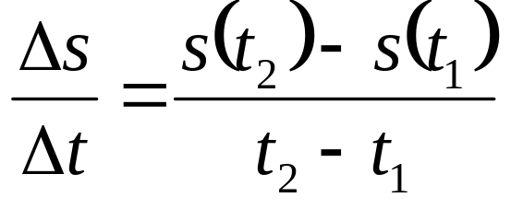
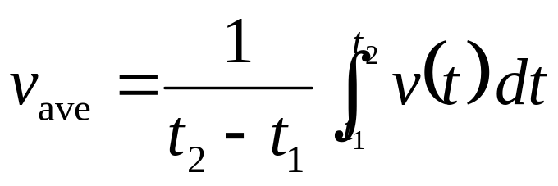
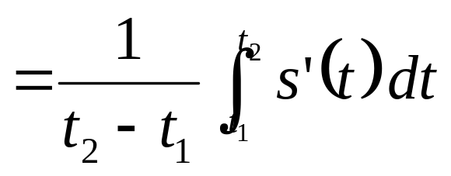
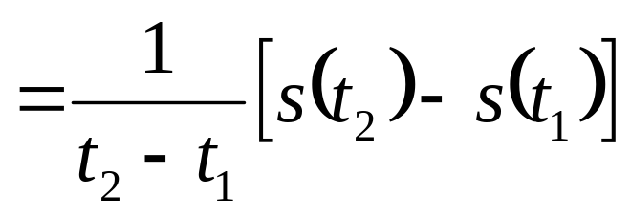
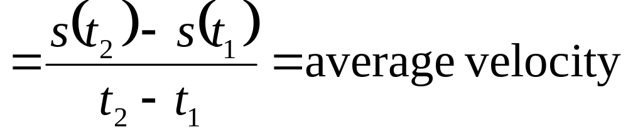
EXAMPLE 3
Show that the average velocity of a car over a time interval [t₁, t₂] is same as the average of its velocities during the trip.
If s(t) is the displacement of the car at time t, then the average velocity of the car over the interval is
証明

Slide 9
6-5 Exercises
EX7 , EX17

