Slide 1
7-8 Improper Integrals

Slide 2
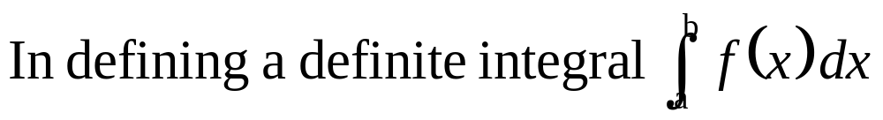

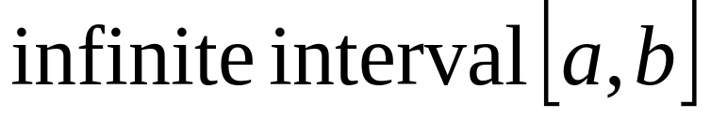
discontinuity.
In this section
Improper integral.

Slide 3
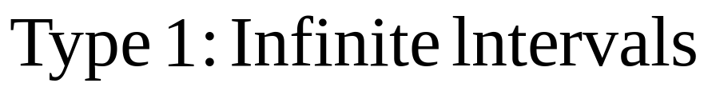
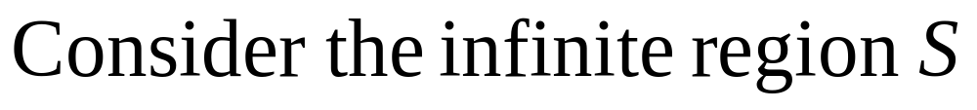
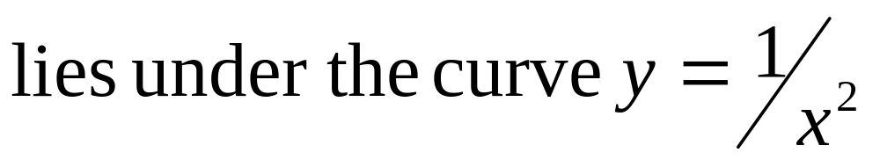
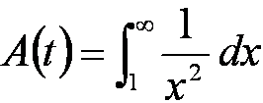
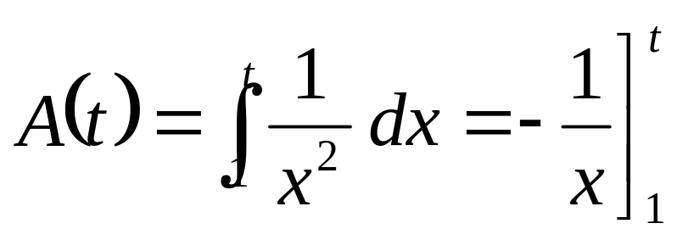
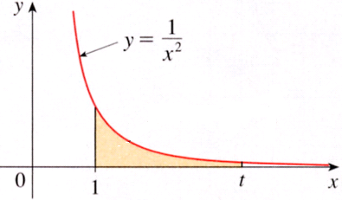
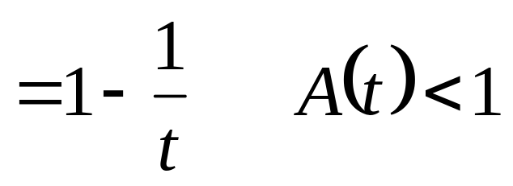
Type 1 : Infinite Intervals
Its area

Slide 4
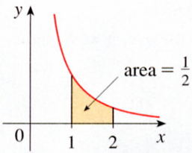
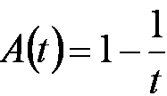
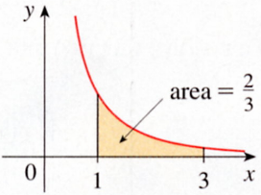
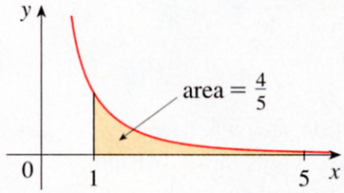
t = 2
t = 3
t = 5

Slide 5
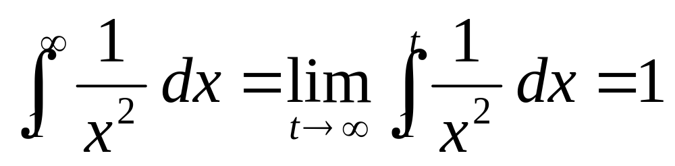
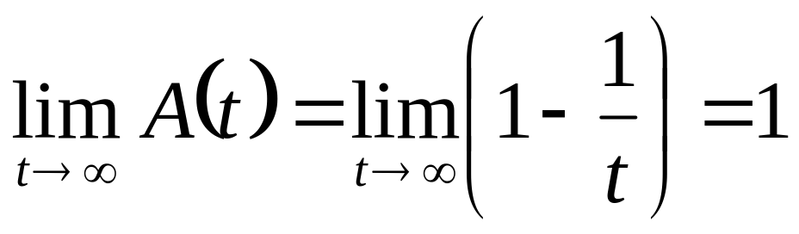
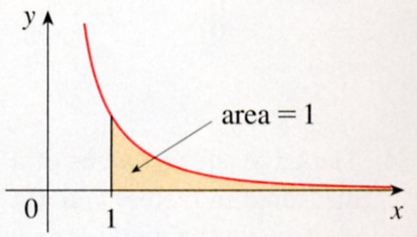
Its area
t = ∞

Slide 6
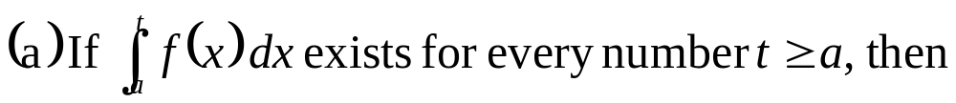
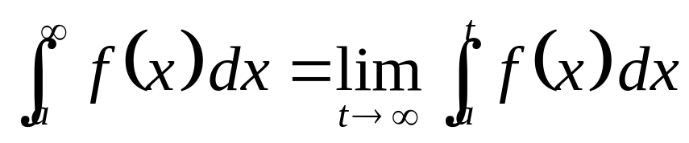
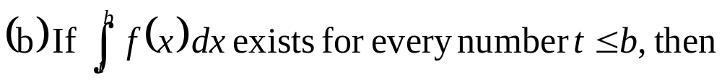

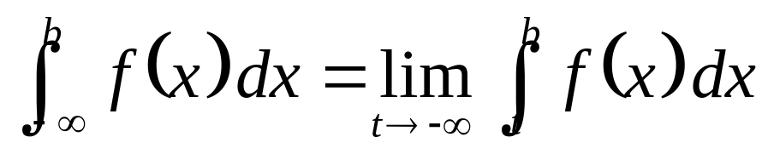
1
Definition of an lmproper lntegral of Type 1
Convergent（收斂），if (a) and (b), limit exists.
Divergent （發散），if (a) and (b), limit not exists.

Slide 7
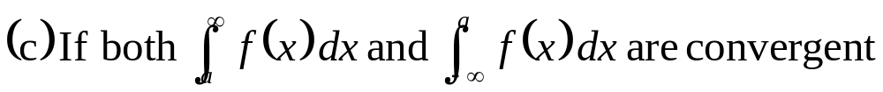
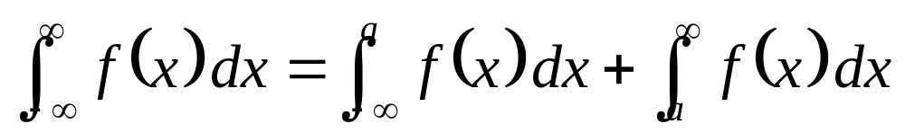


convergent.
a
- ∞
∞

Slide 8
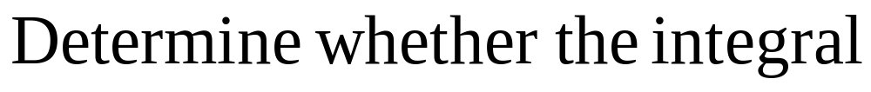
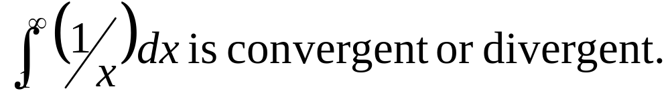
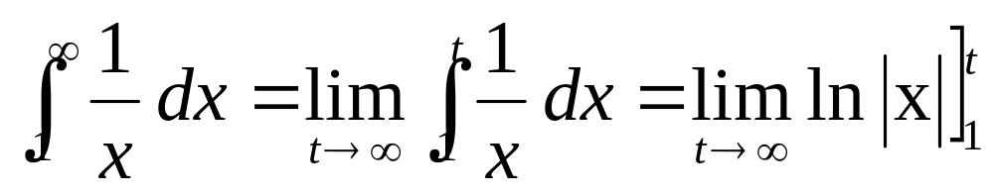
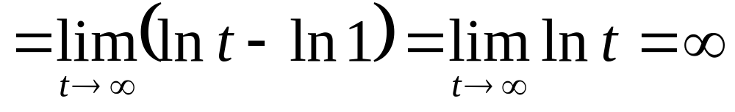
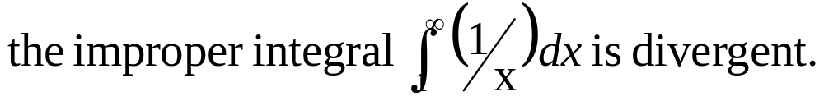
EXAMPLE 1
SOLUTION
0

Slide 9
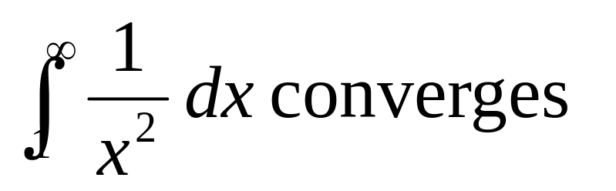
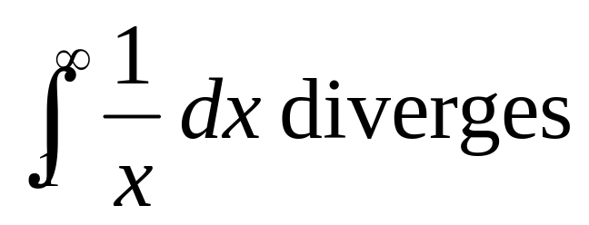
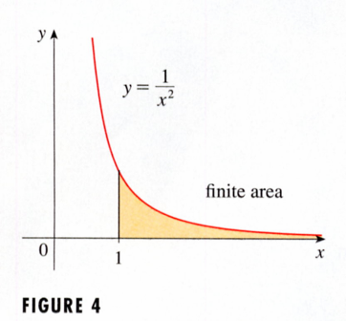
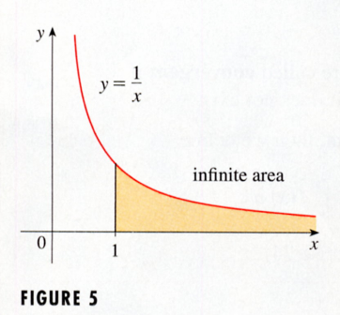
finite area
infinite area
Approaches 0 faster.
The values of 1/x don’t decrease fast enough for its integral to have a finite value.

Slide 10
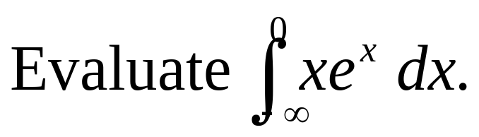
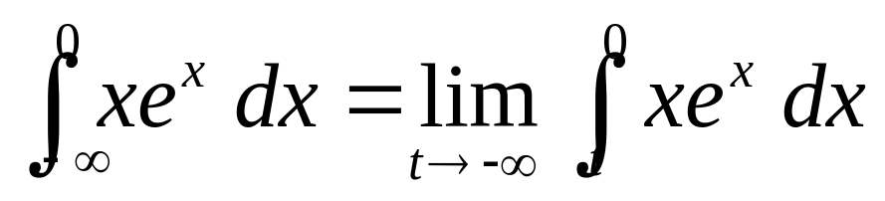
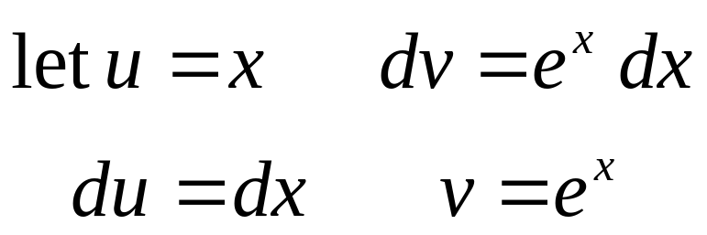
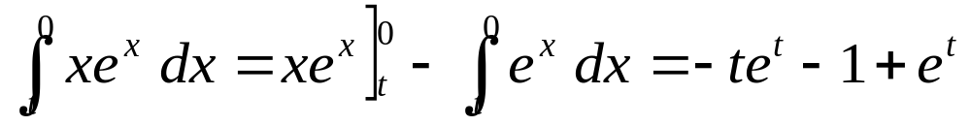
EXAMPLE 2
SOLUTION

Slide 11
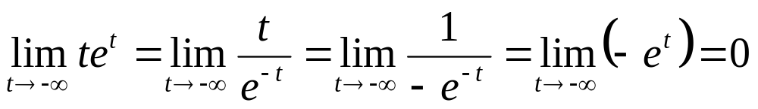
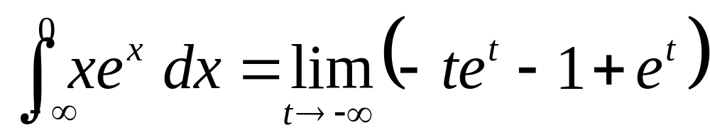
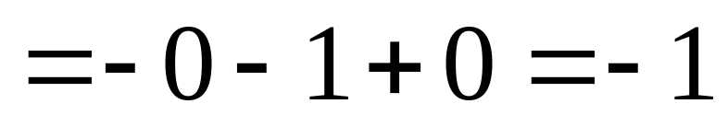

分子/分母微分
0
0
-1

Slide 12
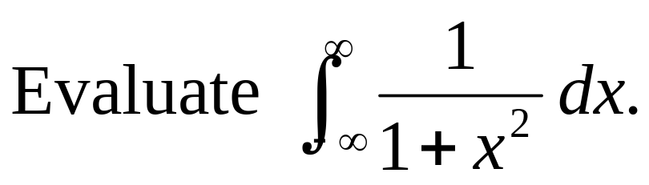
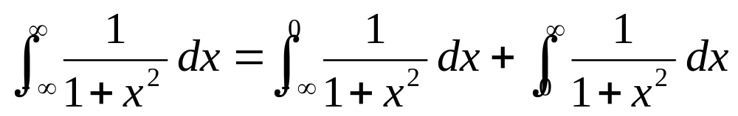
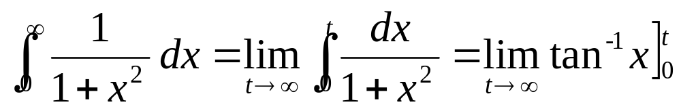
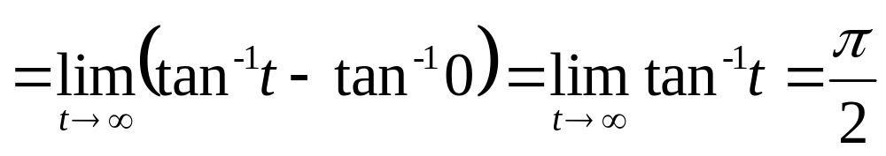
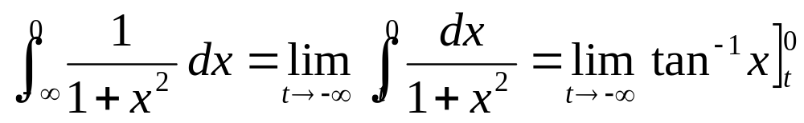
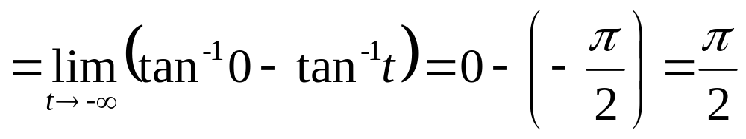
EXAMPLE 3
SOLUTION
0

Slide 13
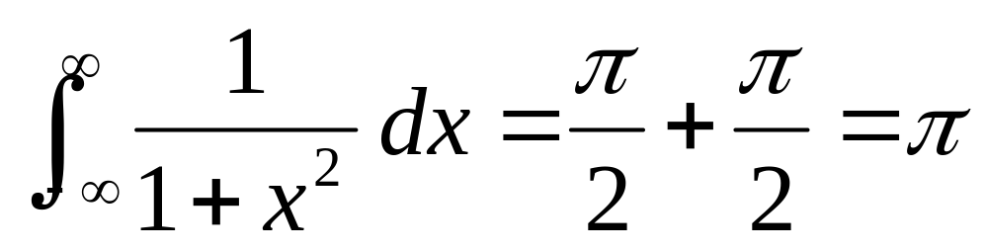
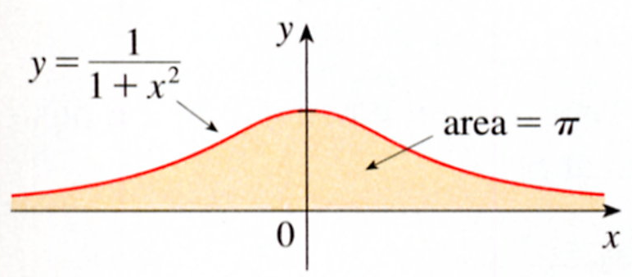
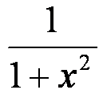
y =
area =
- ∞
∞

Slide 14
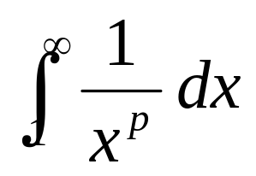
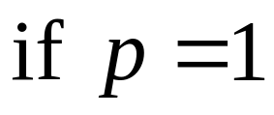
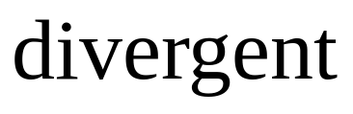






EXAMPLE 4
SOLUTION
0

Slide 15






2

Slide 16







Type 2: Discontinuous Integrands
漸近線

Slide 17





3
Definition of an lmproper lntegral of Type 2

Slide 18




a
c
b

Slide 19









EXAMPLE 5
SOLUTION
漸近線
0
Figure 10

Slide 20








EXAMPLE 6
SOLUTION
0

Slide 21








EXAMPLE 7
SOLUTION
x = 1 is a vertical asymptote.
（不連続点）
0

Slide 22








EXAMPLE 8
SOLUTION
x = 0 is a vertical asymptote.
（不連続点）
y
0
0
1
x
area= 1
y=lnx

Slide 23






分子/分母微分
y
0
1
x
area= 1
y=lnx

Slide 24






A Comparison Test for Improper Integrals
Comparison Theorem

Slide 25









EXAMPLE 9
SOLUTION
0
(收斂)

Slide 26




is convergent.
is convergent.
TABLE 1
1 2 3 4 5 6 | 0.7468241328 0.8820813908 0.8862073483 0.8862269118 0.8862269255 0.8862269255

Slide 27









EXAMPLE 10
SOLUTION
TABLE 2
2 5 10 100 1000 10000 | 0.8636306042 1.8276735512 2.5219648704 4.8245541204 7.1271392134 9.4297243064

Slide 28
7-8 Exercises
EX13 , EX21, EX27

