Slide 1
SPEECH SYNTHESIS
TEAM MEMBERS:
ABHIRAM. V 2010030180
ROKKAM VIVEK VARDHAN REDDY 2010030142
SIDHARTH RAO. K 2010030443
RAGHAVENDRA GOUD. A 2010030394
MENTOR:- Dr. ARPITA Gupta

Slide 2
TABLE OF CONTENTS
INTRODUCTION
PROBLEM STATEMENT
MOTIVATION
OBJECTIVES
LITERATURE SURVEY
DATASET
TECHNIQUES
CONCLUSION
REFERENCES

Slide 3
INTRODUCTION
The idea of Speech Synthesis comes under the domain of “SPEECH” in Artificial Intelligence.
Speech synthesis is the artificial production of human speech. A computer system used for this purpose is called a speech synthesizer, and can be implemented in software or hardware products. A text-to-speech (TTS) system converts normal language text into speech.

Slide 4
PROBLEM STATEMENT
The major aim of this project is to convert the given text into audio format, which will make it more comfortable for the users who work in various departments, as they can simply listen to the audio, instead of reading it, which might stress their eyes, and thus, can save time.
This will also play an important role in replacing the Braille System, making it more easy, simple and error free for the blind.

Slide 5
MOTIVATION
Increasing and growing popularity of interactive voice response (IVR) systems makes the use of text-to-speech (TTS) systems more appealing.
Growing demand from dialog systems, including robots and agents dialog systems use natural speech input and user expects the answer naturally sounding response.
To help the aphasiac, as they can express their thoughts through text-to-speech, where they can type what they want to say, and the output will be the speech in audio format.

Slide 6
OBJECTIVES
Not only to English, but other regional languages also can be converted from text-to-speech.
We can choose different voices and different accents because each language has its own way of delivering the speech.
We can also hear with different speed limits.

Slide 7
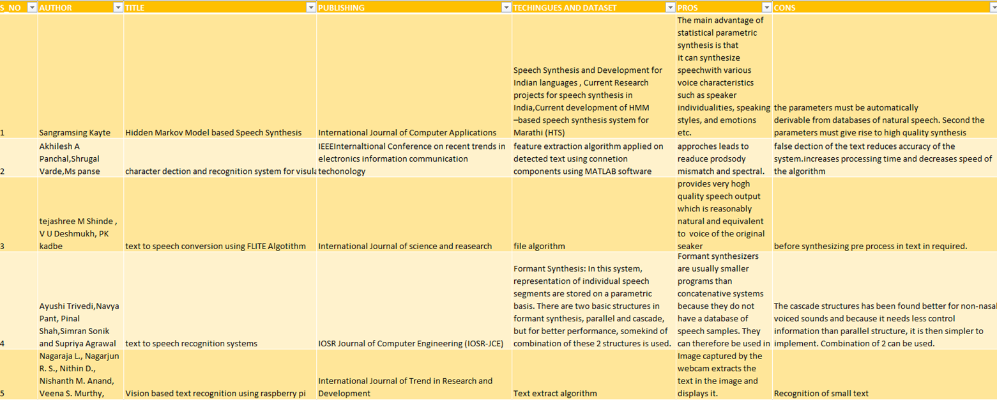
LITERATURE SURVEY

Slide 8
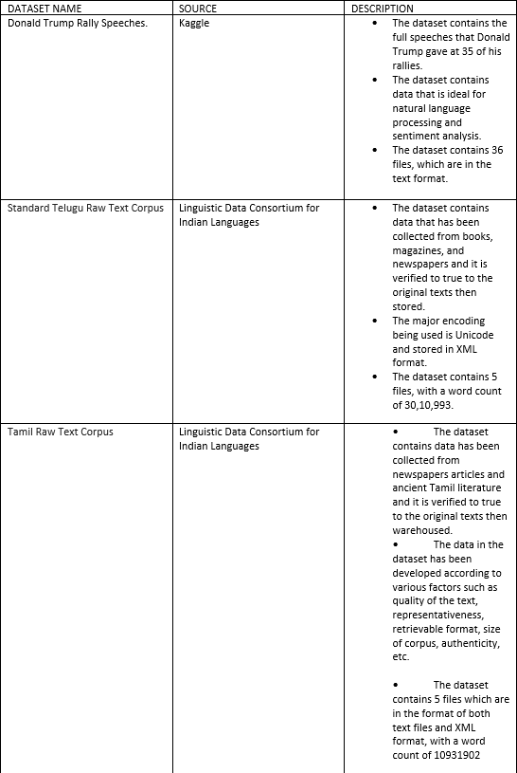
DATASET

Slide 9
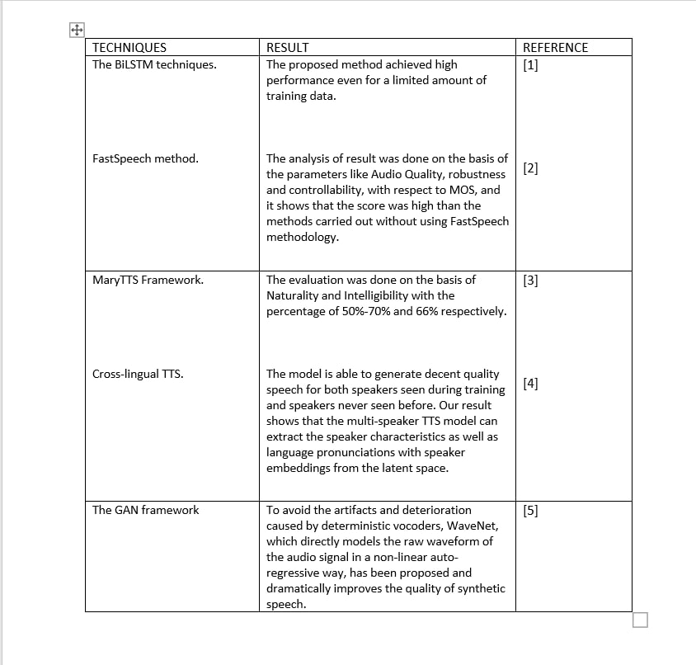
TECNIQUES

Slide 10
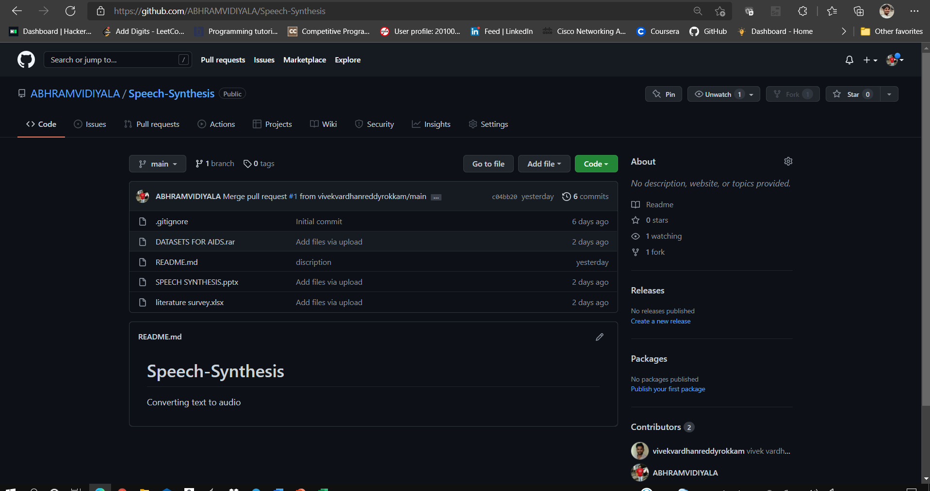
GITHUB SETUP

Slide 11
CONCLUSION
So far we have many models on text to speech synthesis. But with this model we can choose multiple voices for giving out the speech output, and better-quality speech will be generated. This system can be improved by considering the punctuation marks while converting text to speech.
This system of Text-To-Speech can be implemented for to different languages like English, Hindi, Punjabi etc. , depending upon the user’s requirement.

Slide 12
REFERENCES
https://www.kaggle.com/christianlillelund/donald-trumps-rallies
https://data.ldcil.org/a-gold-standard-telugu-raw-text-corpus
https://data.ldcil.org/a-gold-standard-tamil-raw-text-corpus
1. Futamata, Kosuke, Byeongseon Park, Ryuichi Yamamoto, and Kentaro Tachibana. "Phrase break prediction with bidirectional encoder representations in Japanese text-to-speech synthesis." arXiv preprint arXiv:2104.12395 (2021).
2. Ren, Yi, Yangjun Ruan, Xu Tan, Tao Qin, Sheng Zhao, Zhou Zhao, and Tie-Yan Liu. "Fastspeech: Fast, robust and controllable text to speech." arXiv preprint arXiv:1905.09263 (2019).
3. Nanayakkara, Lakshika, Chamila Liyanage, Pubudu Tharaka Viswakula, Thilini Nagungodage, Randil Pushpananda, and Ruvan Weerasinghe. "A Human Quality Text to Speech System for Sinhala." In SLTU, pp. 157-161. 2018.
4. Chen, Mengnan, Minchuan Chen, Shuang Liang, Jun Ma, Lei Chen, Shaojun Wang, and Jing Xiao. "Cross-Lingual, Multi-Speaker Text-To-Speech Synthesis Using Neural Speaker Embedding." In Interspeech, pp. 2105-2109. 2019.
5. Zhao, Yi, Shinji Takaki, Hieu-Thi Luong, Junichi Yamagishi, Daisuke Saito, and Nobuaki Minematsu. "Wasserstein gan and waveform loss-based acoustic model training for multi-speaker text-to-speech synthesis systems using a wavenet vocoder." IEEE access 6 (2018): 60478-60488.

Slide 13
THANKYOU

