Slide 1
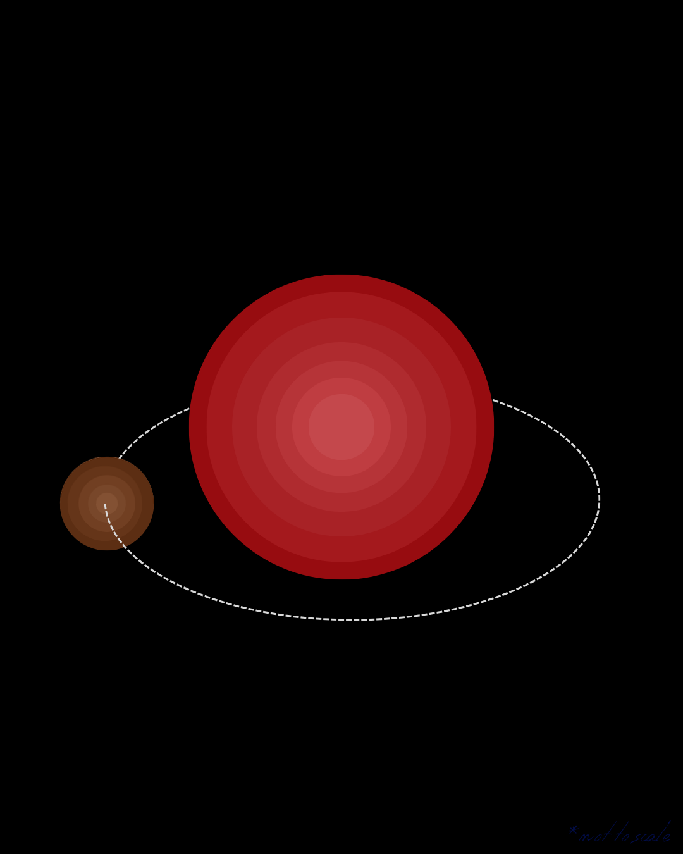

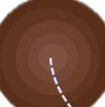



2P, or not 2P: that is the question…
A deep dive into periodicity
extraction methods
Katelyn Smith
ASTRON | University of Amsterdam
supervised by Joe Callingham & Rob Kavanagh

Slide 2



why are star-planet interactions special?
transits
radial velocities
pulsars
brightness
RV
Intensity
time
time
time

Slide 3

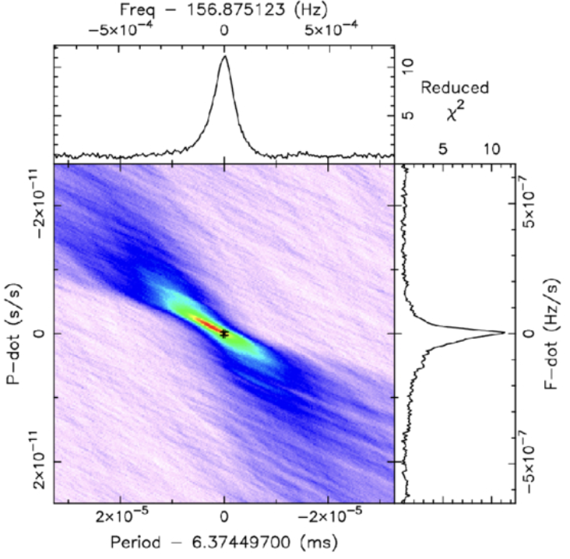
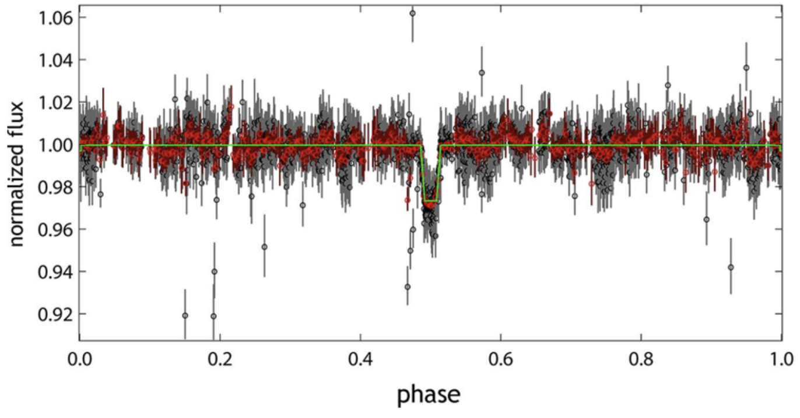
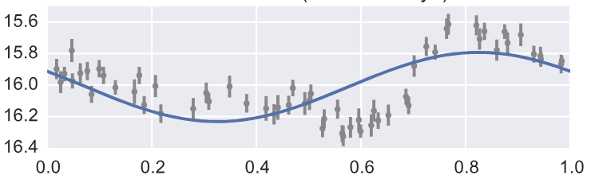
why are star-planet interactions special?
transits
radial velocities
pulsars
features: stellar period competes, sinusoidal signal
features: stellar period competes, narrow duty cycle, box-shape
features: very short duty cycle, phase-coherent, stable pulse profile, one period
typical approach: Box / Transit Least Squares
typical approach:
Lomb-Scargle
typical approach: Fast Folding Algorithm
brightness
RV
Intensity
magnitude
phase
time
time
time
MALIK+2020
VANDERPLAS & IVEZIĆ 2015
LI+2025

Slide 4


why are star-planet interactions special?
star-planet interactions
emission period could be the strongest evidence for a flare being planet-induced!
however…
several periods involved
rotational period
geometry dictates the dominant period
anisotropic beaming = short pulses
orbital period
$$α$$
$$Δα$$
unique beaming

Slide 5
why are star-planet interactions special?
star-planet interactions
emission period could be the strongest evidence for a flare being planet-induced!
however…
several periods involved
rotational period
geometry dictates the dominant period
anisotropic beaming = short pulses
emissions from north & south
orbital period
RHC
unique beaming
LHC

Slide 6
why are star-planet interactions special?
star-planet interactions
1
How does geometry impact the periodicity of emissions?
2
How do we best recover periods in these systems?

Slide 7
why are star-planet interactions special?
star-planet interactions
1
How does geometry impact the periodicity of emissions?
2
How do we best recover periods in these systems?

Slide 8
why are star-planet interactions special?
star-planet interactions
1
How does geometry impact the periodicity of emissions?
Check refs
2
How do we best recover periods in these systems?
Check out these works:
LOUIS+2026, VEDANTHAM+2026, BLOOT+2024, PINEDA & VILLADSEN 2023

Slide 9
getting set up

Slide 10
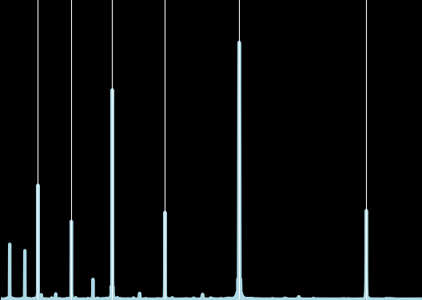
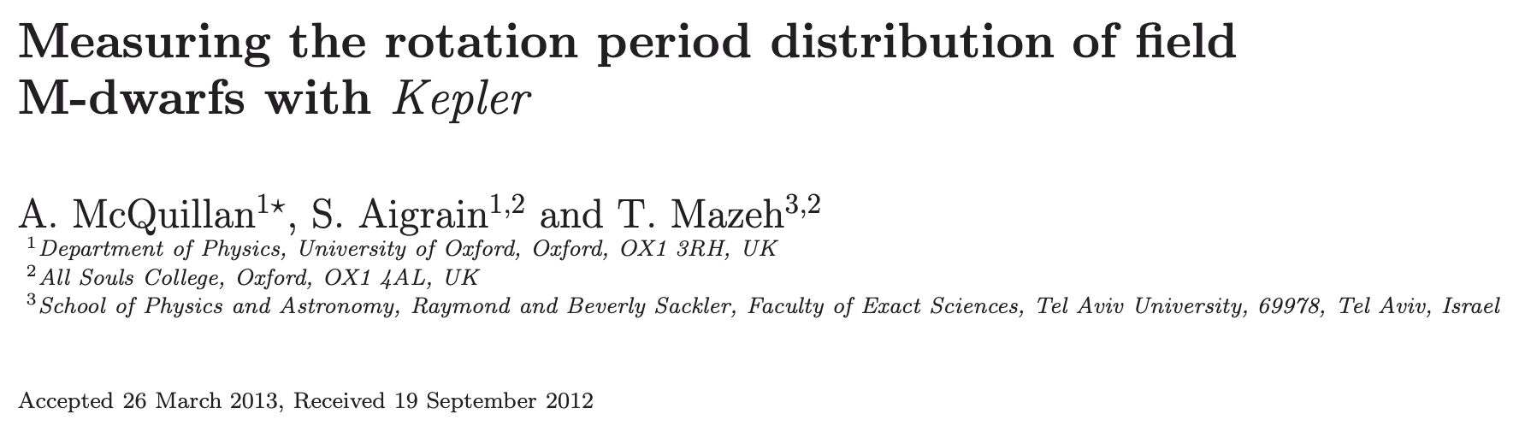






the challenges of period estimation
harmonics
period extraction algorithms can routinely assign the highest power to (sub)harmonics of the fundamental
adapted from KAVANAGH+2022
$$\frac{P_{p}}{6}$$
$$\frac{P_{p}}{5}$$
$$\frac{P_{p}}{4}$$
$$\frac{P_{p}}{3}$$
$$\frac{P_{p}}{2}$$
$$P_{p}$$
normalised periodogram power
1
period (days)
10

Slide 11
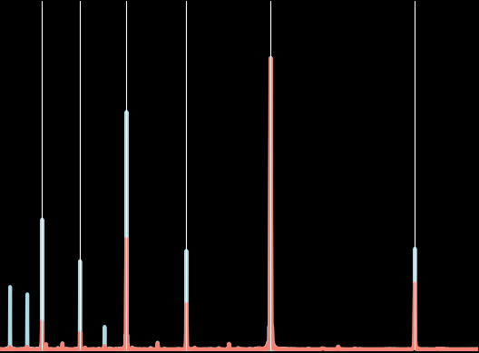







the challenges of period estimation
harmonics
period extraction algorithms can routinely assign the highest power to (sub)harmonics of the fundamental
Why does this happen?
adapted from KAVANAGH+2022
$$\frac{P_{p}}{6}$$
$$\frac{P_{p}}{5}$$
$$\frac{P_{p}}{4}$$
$$\frac{P_{p}}{3}$$
$$\frac{P_{p}}{2}$$
$$P_{p}$$
ill-chosen frequency grid
well-motivated grid
bad grid
normalised periodogram power
the most important decision you will make!
$$f_{min}, f_{max}, Δf$$
1
period (days)
10

Slide 12






the challenges of period estimation
harmonics
period extraction algorithms can routinely assign the highest power to (sub)harmonics of the fundamental
Why does this happen?
choosing $f_{max}$
ill-chosen frequency grid
Our data is sampled with some resolution $Δt$ – the range of frequencies you can tell apart is tied to your resolution.
The Nyquist frequency is:
$$f_{max}≤f_{Nyq}=\frac{1}{2\left\langle Δt\right\rangle }=2f_{s}$$
the most important decision you will make!
This is the largest value you can set $f_{max}$ to be!
$$f_{min}, f_{max}, Δf$$
$$\frac{4f_{s}}{3}$$

Slide 13


the challenges of period estimation
harmonics
period extraction algorithms can routinely assign the highest power to (sub)harmonics of the fundamental
Why does this happen?
choosing $f_{min}$
ill-chosen frequency grid
For a set of observations spanning some baseline T, a signal with frequency 1/T will complete one oscillation cycle.
$$f_{min}≥\frac{1}{T}$$
the most important decision you will make!
This is the largest period you can probe!
$$f_{min}, f_{max}, Δf$$
T

Slide 14



the challenges of period estimation
harmonics
period extraction algorithms can routinely assign the highest power to (sub)harmonics of the fundamental
Why does this happen?
grid spacing should be smaller than the widths of periodogram peaks!
ill-chosen frequency grid
periodogram peaks will have widths of $\sim 1/T$
$Δf=1/n_{0}T$
the most important decision you will make!
fine grid spacing
$$f_{min}, f_{max}, Δf$$
coarse grid spacing

Slide 15

the challenges of period estimation
harmonics
period extraction algorithms can routinely assign the highest power to (sub)harmonics of the fundamental
Fourier Transform
Why does this happen?
ill-chosen frequency grid
narrow signals spread power across higher harmonics
time
frequency
time
frequency
Inverse
Fourier Transform

Slide 16
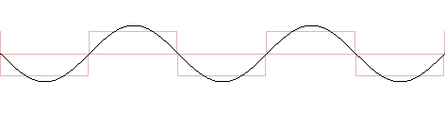
the challenges of period estimation
harmonics
period extraction algorithms can routinely assign the highest power to (sub)harmonics of the fundamental
Why does this happen?
ill-chosen frequency grid
reconstructing sharp or non-sinusoidal shapes requires higher-frequency sinusoids
narrow signals spread power across higher harmonics
non-sinusoidal signal
Wikimedia Commons (2008)

Slide 17
the challenges of period estimation
harmonics
period extraction algorithms can routinely assign the highest power to (sub)harmonics of the fundamental
Why does this happen?
ill-chosen frequency grid
time
narrow signals spread power across higher harmonics
non-sinusoidal signal
fold @ P/2
folding degeneracies
fold @ P/3
fold @ P/6
time

Slide 18


the challenges of period estimation
harmonics
period extraction algorithms can routinely assign the highest power to (sub)harmonics of the fundamental
how you sample your data can inject periods into your periodogram!
Why does this happen?
ill-chosen frequency grid
narrow signals spread power across higher harmonics
non-sinusoidal signal
observing gap once per day
folding degeneracies
window function
$$P$$
1 day
period

Slide 19
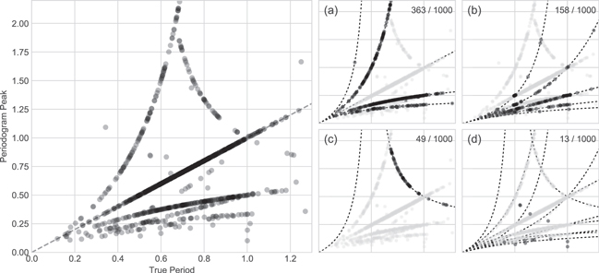
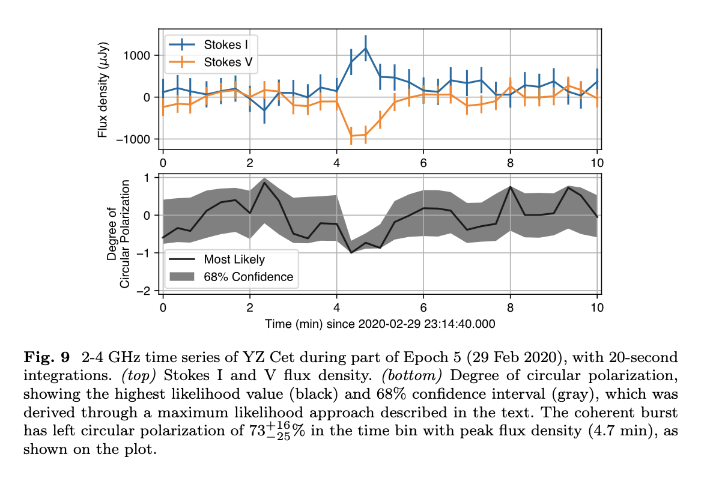

the challenges of period estimation
harmonics
period extraction algorithms can routinely assign the highest power to (sub)harmonics of the fundamental
VANDERPLAS (2018)
Why does this happen?
2.00
ill-chosen frequency grid
1.50
found period
narrow signals spread power across higher harmonics
1.00
LS failure modes
0.50
57% of the time we don’t recover true period!
how do we combat this?
non-sinusoidal signal
2.00
folding degeneracies
1.50
window function
found period
1.00
PINEDA & VILLADSEN (2023)
1000
0.50
flux density ($μ$Jy)
0
0.4
1.0
0.4
1.0
-1000
true period
true period
0
2
4
6
8
10
time (min)

Slide 20
oh wait, there’s another challenge…
choosing a method for period estimation

Slide 21

an abundance of methods…
Fourier-based
Phase folding
Lomb-Scargle
runs test
phase dispersion minimisation
$Z_{n}^{2}$ test*
autocorrelation
Kuiper’s test
* also phase folding!

Slide 22


an abundance of methods…
original signal
Fourier-based
Phase folding
Lomb-Scargle
runs test
phase dispersion minimisation
$Z_{n}^{2}$ test*
decomposed into frequency components
autocorrelation
Kuiper’s test
reconstruction
* also phase folding!

Slide 23

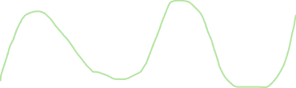
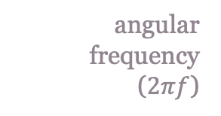
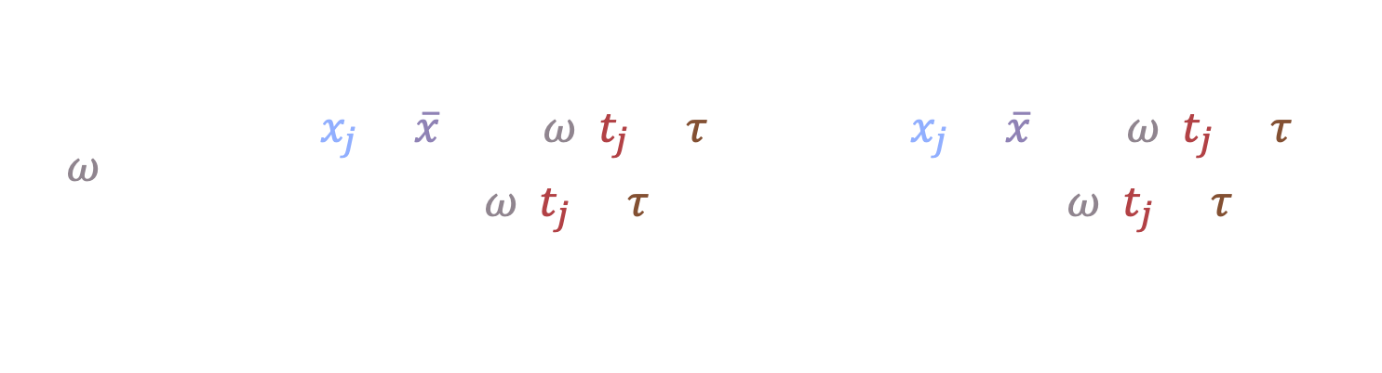

Fourier methods
1 of 3
Lomb-Scargle Algorithm
step 2.
calculate residuals of fits
Classic form from LOMB(1976) and SCARGLE(1982) is given as:
flux
flux
value at time j
mean of values at time j
time
time
step 1.
$$P(ω)=\frac{1}{2}\left\{\frac{{\left[\sum_{j}{\left(x_{j}−\overline{x}\right)\cos{ω\left(t_{j}−τ\right)}}\right]}^{2}}{\sum_{j}{\cos^{2}{ω\left(t_{j}−τ\right)}}}+\frac{{\left[\sum_{j}{\left(x_{j}−\overline{x}\right)\sin{ω\left(t_{j}−τ\right)}}\right]}^{2}}{\sum_{j}{\sin^{2}{ω\left(t_{j}−τ\right)}}}\right\}$$
step 4.
step 3.
fit sinusoids with different periods
calculate power at each period
construct periodogram
angular frequency
($2πf$)
time
time offset
best period
flux
power
time
period

Slide 24

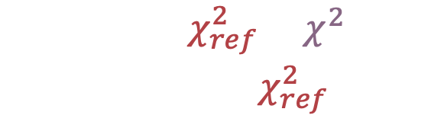

Fourier methods
1 of 3
Lomb-Scargle Algorithm
step 2.
calculate residuals of fits
flux
$$P_{LS}\left(f\right)=\frac{χ_{ref}^{2}−χ^{2}(f)}{χ_{ref}^{2}}$$
flux
$χ^{2}$ of test sinusoid
$χ^{2}$ of reference model
(straight line at mean)
time
time
step 1.
step 3.
step 4.
fit sinusoids with different periods
calculate power at each period
construct periodogram
assumptions: sinusoidal signal shape
example applications: stellar rotation (MCQUILLAN+2013), RVs (MAYOR & QUELOZ 1995)
best period
flux
power
time
period

Slide 25
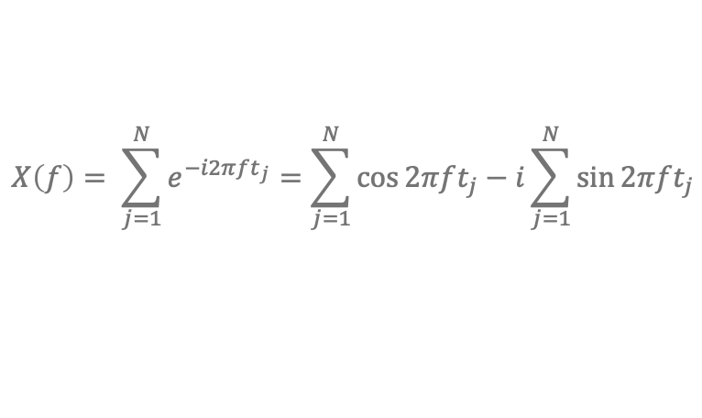
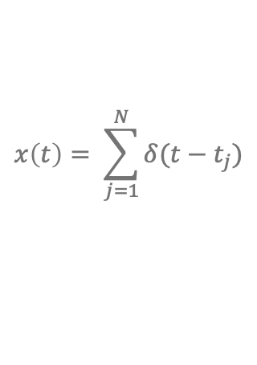

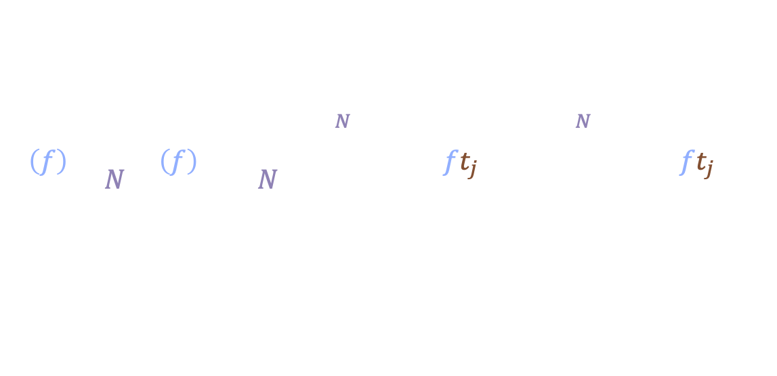
Fourier methods
2 of 3
$Z_{n}^{2}$ test
0.25
step 2.
The $Z_{n}^{2}$ test is a harmonic expansion of the Rayleigh test (LEAHY1983, BUCCHERI+1983)
The Rayleigh periodogram is mathematically identical to classical Fourier power spectrum of an event train:
map phases to angles and vectors on unit circle
flux
$$x\left(t\right)= \sum_{j=1}^{N}{δ(t−t_{j})}$$
0.00
0.50
step 3.
calculate resulting unit vector
Fourier Transform
time
$$X\left(f\right)= \sum_{j=1}^{N}{e^{−i2πft_{j}}}=\sum_{j=1}^{N}{\cos{2πft_{j}}}−i\sum_{j=1}^{N}{\sin{2πft_{j}}}$$
step 4.
0.75
add up power from n harmonics
step 5.
$$P\left(f\right)=\frac{1}{N}{\left|X\left(f\right)\right|}^{2}=\frac{1}{N}\left({\left(\sum_{j=1}^{N}{\cos{2πft_{j}}}\right)}^{2}+{\left(\sum_{j=1}^{N}{\sin{2πft_{j}}}\right)}^{2}\right)$$
trial frequency
step 1.
repeat for different p and build periodogram
phase fold event times on trial period
best period
# events
time of event j
power
0
phase
1
Rayleigh statistic
period

Slide 26

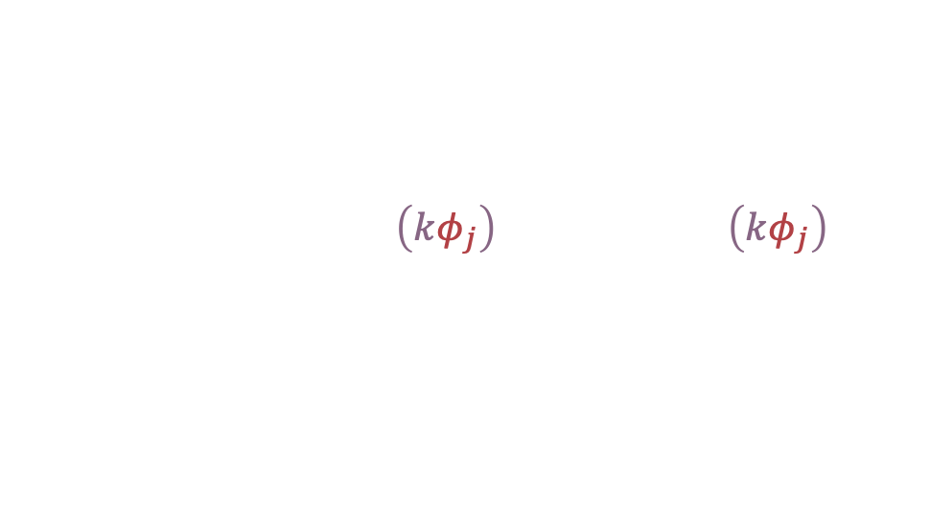
Fourier methods
2 of 3
$Z_{n}^{2}$ test
0.25
step 2.
map phases to angles and vectors on unit circle
flux
$$Z_{n}^{2}=\frac{2}{N} \sum_{k=1}^{n}{\left[{\left(\sum_{j=1}^{N}{\cos\left(kφ_{j}\right)}\right)}^{2}+{\left(\sum_{j=1}^{N}{\sin\left(kφ_{j}\right)}\right)}^{2}\right]}$$
harmonic
0.00
0.50
step 3.
calculate resulting unit vector
phase of event
($φ=t/P$ % 1)
time
step 4.
0.75
add up power from n harmonics
assumptions: independent events
step 5.
repeat for different p and build periodogram
example applications: pulsars (BUCCHERI+1983, KERR2011)
step 1.
phase fold event times on trial period
best period
power
0
phase
1
period

Slide 27
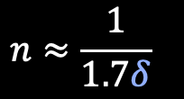

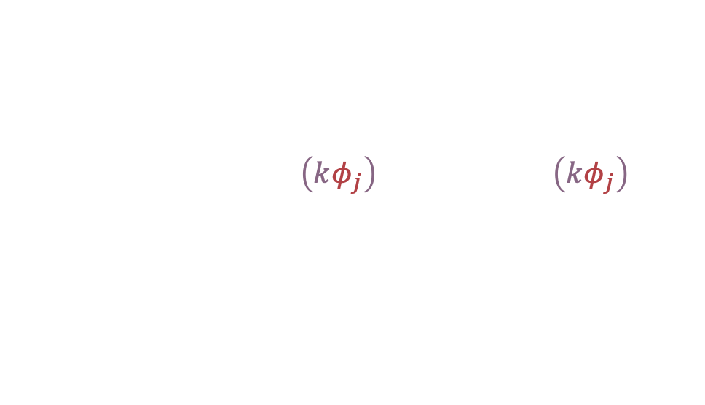
Fourier methods
2 of 3
$Z_{n}^{2}$ test
0.25
step 2.
map phases to angles and vectors on unit circle
flux
$$Z_{n}^{2}=\frac{2}{N} \sum_{k=1}^{n}{\left[{\left(\sum_{j=1}^{N}{\cos\left(kφ_{j}\right)}\right)}^{2}+{\left(\sum_{j=1}^{N}{\sin\left(kφ_{j}\right)}\right)}^{2}\right]}$$
harmonic
0.00
0.50
step 3.
calculate resulting unit vector
phase of event
($φ=t/P$ % 1)
time
step 4.
0.75
add up power from n harmonics
how to choose n: the best value is tied to your duty cycle (DE JAGER+1989)
step 5.
step 1.
$$n≈\frac{1}{1.7δ}$$
repeat for different p and build periodogram
phase fold event times on trial period
best period
power
0
phase
1
period

Slide 28





















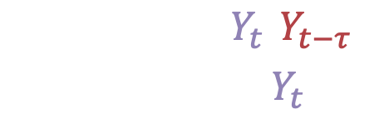









Fourier methods
3 of 3
Autocorrelation
step 2.
$$x=(2, 3, −1)$$
multiply point-by-point & add up
Linked to Fourier theory through the Wiener-Khinchin theorem (WIENER1930, KHINCHIN1934)
$$2$$
$$3$$
$$−1$$
flux
$$R\left(τ\right)=ℱ^{−1}\left[{\left|X\left(f\right)\right|}^{2}\right]$$
$$X$$
$$2$$
$$3$$
$$−1$$
F(t)*F($τ$)
0
$$−2$$
$$−3$$
$$1$$
“the FT of a signals ACF is its power spectral density”
$$6$$
$$9$$
$$−3$$
$$S(f)=ℱ\left[R(τ)\right]$$
$$+$$
$$4$$
$$6$$
$$−2$$
time
time
$$−2$$
$$3$$
$$14$$
$$3$$
$$−2$$
step 1.
For a stochastic process, the autocorrelation at lag $τ$ is:
shift copy by lag $τ$
step 3.
repeat for all lags and plot ACF against lag
original signal
lagged signal
$$ρ\left(τ\right)=\frac{Cov(Y_{t},Y_{t−τ})}{Var\left(Y_{t}\right)}$$
flux
power
best period
0
time
period

Slide 29
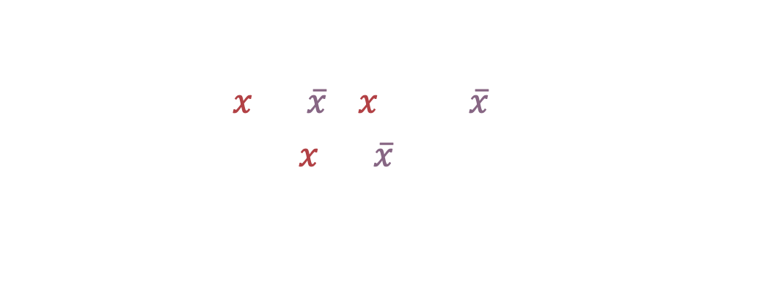
Fourier methods
3 of 3
Autocorrelation
step 2.
multiply point-by-point & add up
Phase folding
flux
F(t)*F($τ$)
runs test
value of point
mean
0
$$ρ\left(k\right)=\frac{\sum_{i=1}^{N−k}{(x_{i}−\overline{x})(x_{i+k}−\overline{x})}}{\sum_{i=1}^{N}{{\left(x_{i}−\overline{x}\right)}^{2}}}$$
phase dispersion minimisation
time
time
step 1.
shift copy by lag $τ$
assumptions: stationary signal
step 3.
Kuiper’s test
repeat for all lags and plot ACF against lag
example applications: stellar rotation (MCQUILLAN+2013,2014, AIGRAIN+2015), AGN (KRISHNAN+2021)
flux
power
best period
0
time
period

Slide 30

an abundance of methods… (continued)
Fourier-based
Phase folding
time
Lomb-Scargle
runs test
trial period 1
trial period 2
phase dispersion minimisation
$Z_{n}^{2}$ test*
time
time
autocorrelation
Kuiper’s test
stack
stack
time
time

Slide 31
Phase folding methods
1 of 3
Runs test
step 3.
Wald-Wolfowitz runs test (WALD & WOLFOWITZ 1940) asks:
sort + and – by phase
flux
R=3
-
-
-
-
-
-
-
-
-
-
-
-
-
-
+
+
+
+
+
+
+
“was this sequence of data points generated by a random process?”
0
phase
1
time
Tests the null hypothesis $H_{0}$ that all elements in the sequence are mutually independent.
step 1.
step 2.
step 4.
step 5.
phase fold on trial period
draw threshold at median
calculate # of runs & compare to chance
repeat for different periods
flux
power
+
-
best period
0
phase
1
period

Slide 32
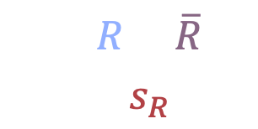
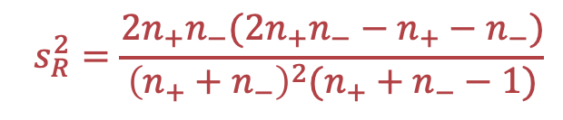
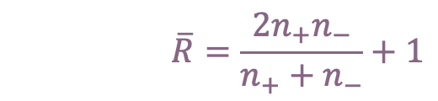
Phase folding methods
1 of 3
Runs test
step 3.
sort + and – by phase
flux
observed # runs
expected # runs
$$\overline{R}=\frac{2n_{+}n_{−}}{n_{+}+n_{−}}+1$$
R=3
$$Z=\frac{R−\overline{R}}{s_{R}}$$
-
-
-
-
-
-
-
-
-
-
-
-
-
-
+
+
+
+
+
+
+
$$s_{R}^{2}=\frac{2n_{+}n_{−}(2n_{+}n_{−}−n_{+}−n_{−})}{{\left(n_{+}+n_{−}\right)}^{2}(n_{+}+n_{−}−1)}$$
variance of # runs
0
phase
1
time
step 1.
step 2.
step 4.
step 5.
phase fold on trial period
draw threshold at median
calculate # of runs & compare to chance
repeat for different periods
assumptions: independent events, two-valued sequence
example applications: pulsars (REDMAN & RANKIN 2009)
flux
power
+
-
best period
0
phase
1
period

Slide 33

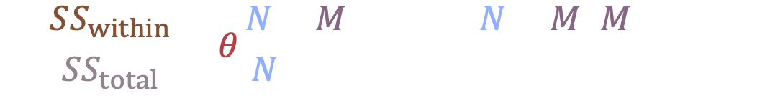
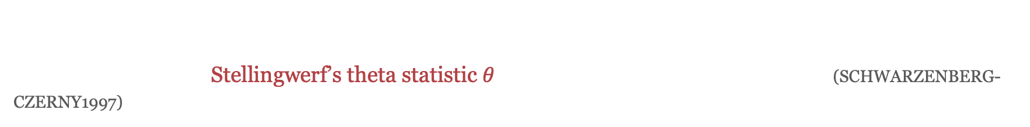
Phase folding methods
2 of 3
Phase dispersion minimisation
step 2.
This method is closely related to epoch folding, however we are looking to minimize the test statistic, $θ$
At each trial period, Stellingwerf’s theta statistic $θ$ is compared to a beta distribution (SCHWARZENBERG-CZERNY1997) – the null distribution assuming the data consists purely of uncorrelated, independent noise
bin phases
flux
flux
time
0
phase
1
step 1.
step 3.
step 4.
phase fold on trial period
# of bins
sum of squares within bin
calculate test statistic $θ_{PDM}$
repeat for different trial periods
$$\frac{SS_{within}}{SS_{total}}=θ\frac{N−M}{N−1}\sim Beta\left(\frac{N−M}{2},\frac{M−1}{2}\right)$$
total sum of squares
# of data points
1
flux
power
best period
0
phase
1
period

Slide 34
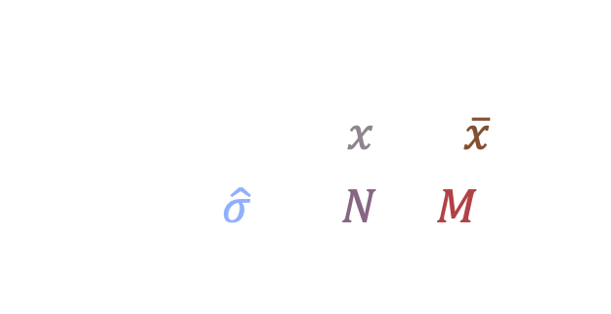
Phase folding methods
2 of 3
Phase dispersion minimisation
step 2.
value of point in bin
mean of bin
bin phases
flux
flux
$$θ_{PDM}=\frac{1}{\hat{σ}}\frac{\sum_{ij}{{\left(x_{ij}−{\overline{x}}_{j}\right)}^{2}} }{N−M}$$
total variance
# points
# bins
time
0
phase
1
step 1.
step 3.
step 4.
phase fold on trial period
calculate test statistic $θ_{PDM}$
repeat for different trial periods
assumptions: adequate bins, no sampling gaps
example applications: x-ray binaries (MARTI+2021), blazars (LU+2012)
1
flux
power
best period
0
phase
1
period

Slide 35


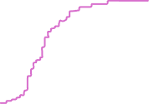

Phase folding methods
3 of 3
Kuiper’s test
$$D^{+}$$
step 2.
Assesses the discrepancy between a sample cumulative probability distribution and a background distribution.
Closely related to the Kolmogorov-Smirnov (K-S) test and Anderson-Darling test – however, it is equally sensitive in discriminating phase sets concentrated at any time in a periodic cycle.
build empirical CDF and compare to uniform
time
$$D^{−}$$
step 1.
0
phase
1
phase fold on trial period
step 3.
step 4.
calculate test statistic $V$
repeat for different trial periods
(for circular data)
Kuiper’s test > Anderson Darling test > K-S test
best period
power
0
phase
1
period

Slide 36


Phase folding methods
3 of 3
Kuiper’s test
$$D^{+}$$
step 2.
build empirical CDF and compare to uniform
$$V=D^{+}+D^{−}$$
$$=\max_{x}\left[F_{n}\left(x\right)−F(x)\right]+\max_{x}\left[F\left(x\right)−F_{n}(x)\right]$$
time
$$D^{−}$$
empirical CDF
theoretical CDF
step 1.
0
phase
1
phase fold on trial period
step 3.
step 4.
assumptions: continuous distribution, independent events
calculate test statistic $V$
repeat for different trial periods
example applications: x-rays (PALTANI2004), solar flares (JETSU+1997), Earth impacts (JETSU1997, JETSU & PELT 2000)
best period
power
0
phase
1
period

Slide 37
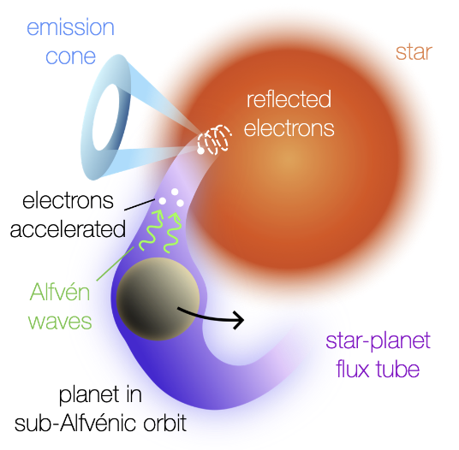
MASER: Magnetically interActing Stars and Exoplanets in the Radio
https://github.com/robkavanagh/maser
Check it out! ☺
e.g., stellar/planetary inclination, magnetic obliquity, orbital distance
CALLINGHAM+2024
1
system geometry
visibility
emission properties
0
e.g., cone thickness/opening angle, observing frequency
time (days)
MASER
assumes: dipolar field, circular orbit, strictly sub-alfvénic

Slide 38
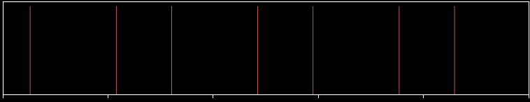


MASER example
aligned system
days
$$P_{∗}=0.8$$
$$P_{p}≈1.35$$
days
LOS
north
0
1
2
3
4
5
time (days)

Slide 39
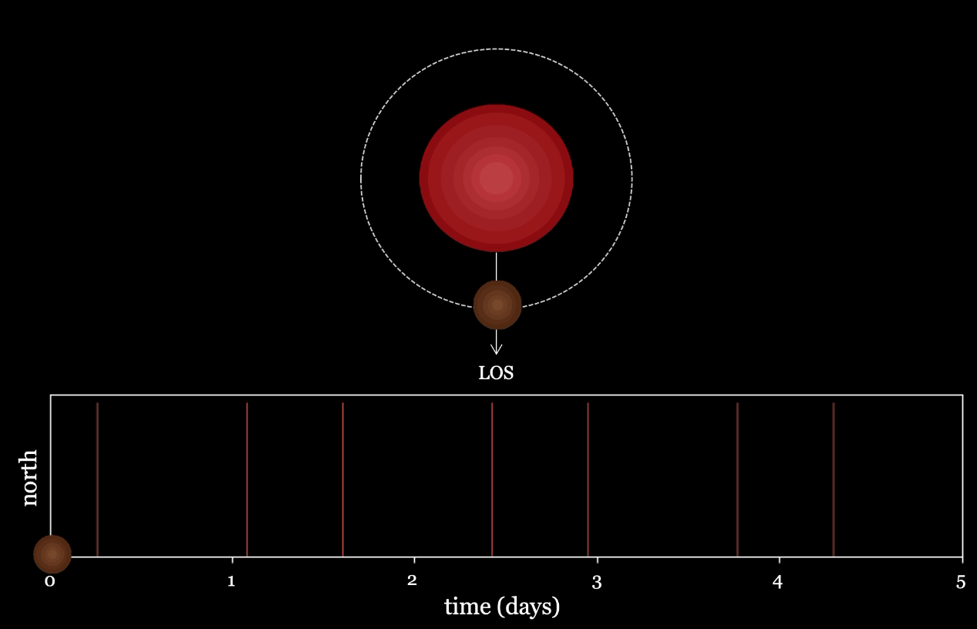


MASER example
aligned system
days
$$P_{∗}=0.8$$
$$P_{p}≈1.35$$
days

Slide 40
MASER example
aligned system
what do you think is the dominant period?
days
$$P_{∗}=0.8$$
$$P_{p}≈1.35$$
days
LOS
north
0
1
2
3
4
5
time (days)

Slide 41
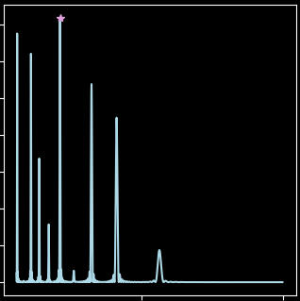
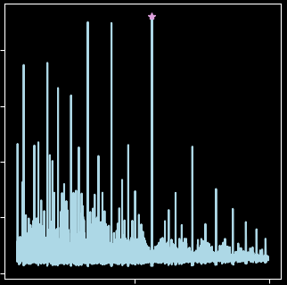
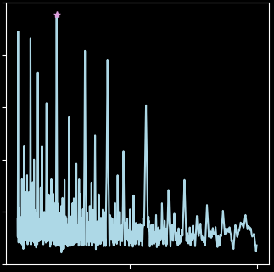
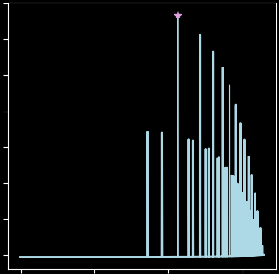
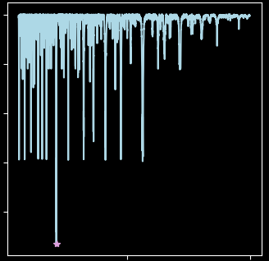
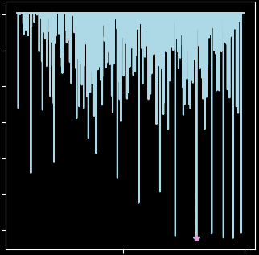







MASER example
aligned system
x10⁻²
1.0
700
1.4
$$\frac{P_{p}}{5}$$
$$P_{p}$$
Z test
$$\frac{P_{p}}{5}$$
Kuiper test
$$P_{p}$$
Lomb-Scargle
ACF
1.2
2000
600
0.8
1.0
500
1500
0.6
400
0.8
power
power
power
power
0.6
1000
300
0.4
0.4
200
0.2
500
0.2
100
0.0
0
0.0
0
1
10
1.00
0
1
10
period (days)
period (days)
0.99
-50
-100
0.98
power
power
-150
perfectly sampled, noiseless data
no need to worry about window function or FAP
0.97
-200
-250
0.96
$$\frac{P_{p}}{5}$$
PDM
-300
Runs test
$$3P_{p}$$
1
10
1
10
me most days:
period (days)
period (days)

Slide 42
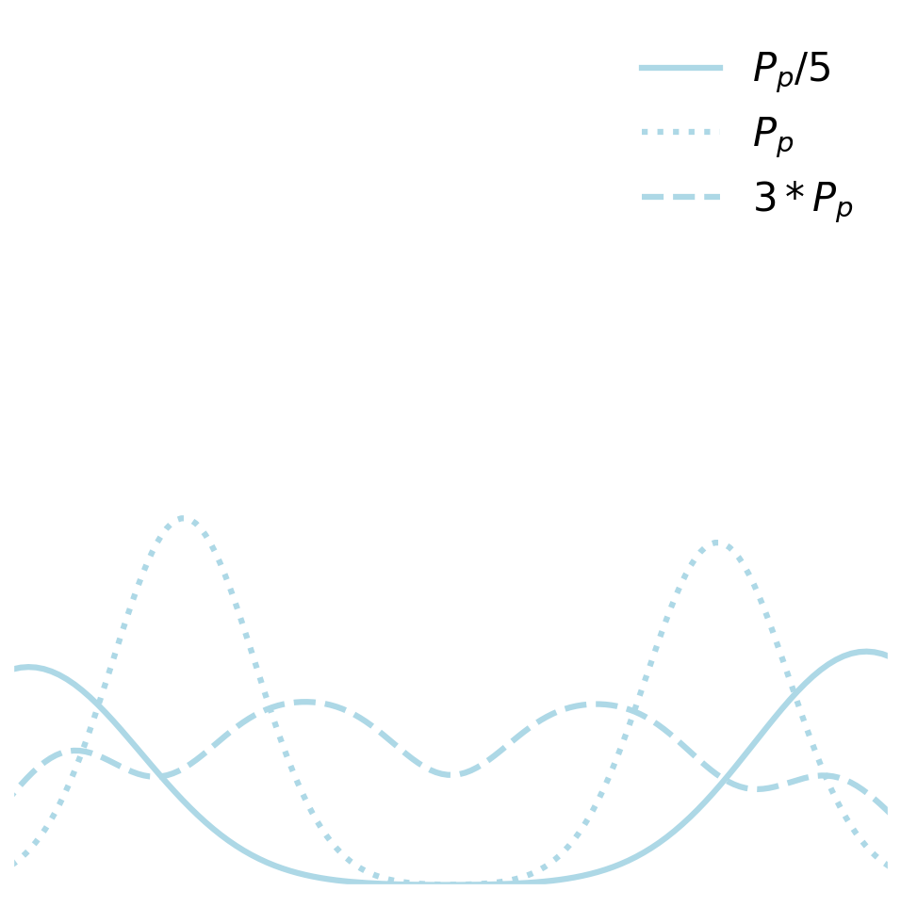



MASER example
aligned system
6
$$P_{p}/5$$
5
$$P_{p}$$
$${3P}_{p}$$
4
3
density
2
1
0.0
0.2
0.4
0.6
0.8
1.0
phase

Slide 43
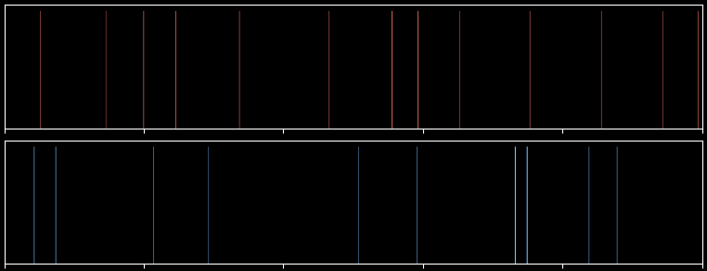
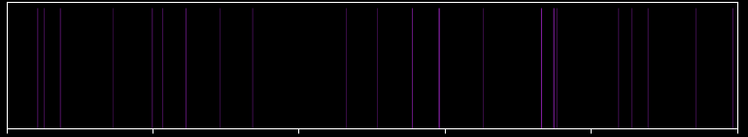

your turn ☺
misaligned system
your task: try implementing LS, $Z_{n}^{2}$, and Kuiper on this system!
north
days
$$P_{∗}=0.8$$
$$P_{p}≈1.35$$
days
south
combined
0
1
2
3
4
5
time (days)

Slide 44
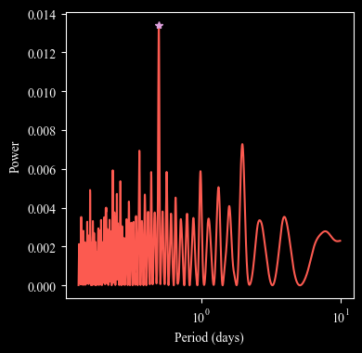
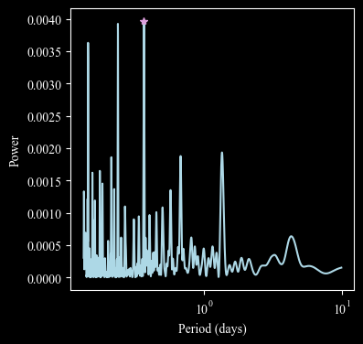
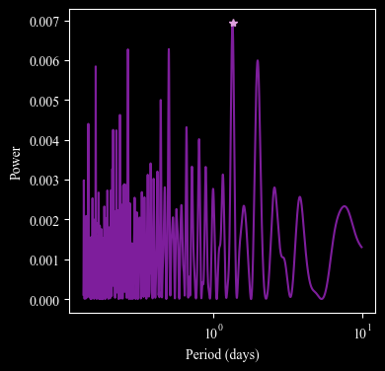
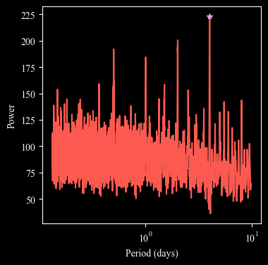
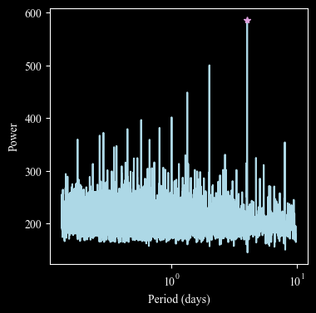
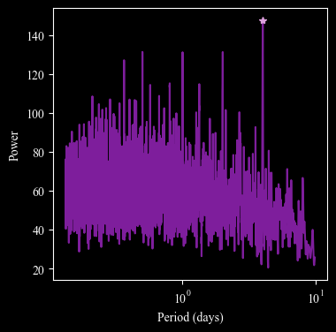
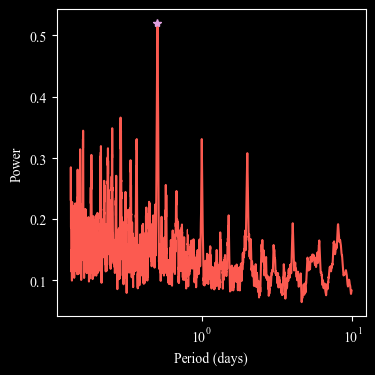
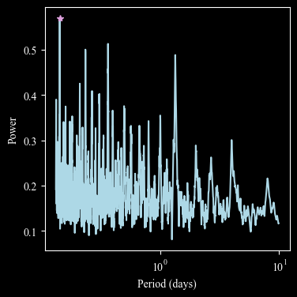


your turn ☺
1.4
x10⁻²
north
4.0
x10⁻³
south
7.0
x10⁻³
both
1.0
3.0
5.0
power
power
power
Lomb-Scargle
2.0
3.0
0.6
1.0
0.2
1.0
0.0
225
6
x10²
140
175
4
100
$Z_{n}^{2}$ test
power
power
power
125
60
75
2
20
0.5
0.5
0.3
Kuiper’s test
0.2
0.3
power
0.3
power
power
0.1
0.1
0.1
1
10
1
10
1
10
period (days)
period (days)
period (days)

Slide 45
your turn ☺
misaligned system
your tasks:
you today:
extract the six most dominant peaks for each method
consider why the results are different for north/south/combined
associate the peaks with the known periods in the system
(note: this causes me grief!)
(but in a fun way)
check the performance of the periods by phase folding

Slide 46

your turn ☺
misaligned system
why do north/south/combined differ?
spin-orbit diagram
duty cycle & pulse counts
1.0
N
S
Duty cycle and pulse counts in N are more than double that in the S
No emissions overlap between N and S, so the combined result further improves these stats.
0.8
0.6
orbital phase
0.4
0.2
0.0
0.2
0.4
0.6
0.8
rotational phase
1.0
N
S
0.8
0.6
orbital phase
0.4
0.2
0.0
0.2
0.4
0.6
0.8
rotational phase

Slide 47
your turn ☺
misaligned system
peak association / phase folding
Lomb-Scargle
unassigned peaks are all very close to known periods!
north
south
both
first : 0.50 d
synodic
first : 0.37 d
combined
first : 1.34 d
planet
second : 1.97 d
synodic
second : 0.24 d
second : 0.50 d
combined
third : 0.36 d
combined
third : 0.14 d
third : 0.27 d
star
fourth : 0.23 d
fourth : 1.34 d
planet
fourth : 1.98 d
synodic
fifth : 1.00 d
synodic
fifth : 0.67 d
planet
fifth : 0.16 d
sixth : 0.57 d
combined
sixth : 0.21 d
combined
sixth : 0.44 d
planet

Slide 48






your turn ☺
misaligned system
peak association / phase folding
Lomb-Scargle
8
1st peak
2nd peak
3rd peak
north
7
south
6
both
5
density
4
3
2
1
0
8
4th peak
5th peak
6th peak
7
6
5
4
density
3
2
1
0
0.2
0.4
0.6
0.8
0.2
0.4
0.6
0.8
0.2
0.4
0.6
0.8
phase
phase
phase

Slide 49

your turn ☺
misaligned system
peak association / phase folding
$Z_{n}^{2}$ test
unassigned peaks are all very close to known periods!
north
south
both
first : 4.01 d
planet / star
first : 4.02 d
first : 4.02 d
planet / star
second : 2.01 d
second : 2.01 d
second : 0.50 d
combined
third : 0.50 d
combined
third : 1.34 d
third : 2.01 d
fourth : 1.01 d
fourth : 1.01 d
synodic
fourth : 1.00 d
synodic
fifth : 0.50 d
fifth : 0.57 d
combined
fifth : 0.37 d
combined
sixth : 0.37 d
combined
sixth : 0.80 d
sixth : 0.80 d

Slide 50






your turn ☺
misaligned system
peak association / phase folding
$Z_{n}^{2}$ test
8
1st peak
2nd peak
3rd peak
north
7
south
6
both
5
density
4
3
2
1
0
8
4th peak
5th peak
6th peak
7
6
5
4
density
3
2
1
0
0.2
0.4
0.6
0.8
0.2
0.4
0.6
0.8
0.2
0.4
0.6
0.8
phase
phase
phase

Slide 51
your turn ☺
misaligned system
peak association / phase folding
Kuiper’s test
unassigned peaks are very close to known periods!
north
south
both
first : 0.50 d
combined
first : 0.14 d
first : 0.16 d
star
second : 0.29 d
combined
second : 0.37 d
combined
second : 0.21 d
combined
third : 0.25 d
combined
third : 0.24 d
third : 0.29 d
combined
fourth : 0.16 d
fourth : 1.34 d
planet
fourth : 0.27 d
planet / star / syn
fifth : 1.00 d
fifth : 0.21 d
combined
fifth : 1.34 d
sixth : 0.37 d
combined
sixth : 0.27 d
planet
sixth : 0.22 d
planet

Slide 52






your turn ☺
misaligned system
peak association / phase folding
Kuiper’s test
8
1st peak
2nd peak
3rd peak
north
7
south
6
both
5
density
4
3
2
1
0
8
4th peak
5th peak
6th peak
7
6
5
4
density
3
2
1
0
0.2
0.4
0.6
0.8
0.2
0.4
0.6
0.8
0.2
0.4
0.6
0.8
phase
phase
phase

Slide 53



your turn ☺
misaligned system
4.0
north
south
both
LS
3.5
Z
3.0
K
2.5
period (d)
2.0
1.5
1.0
0.5
0.0
1st
2nd
3rd
4th
5th
6th
1st
2nd
3rd
4th
5th
6th
1st
2nd
3rd
4th
5th
6th
periodogram peak
periodogram peak
periodogram peak

Slide 54
takeaways
there is no clear winner
Different methods pull out different harmonics
→ recommendation: use several methods and compare
The “best” period often isn’t the best
→ recommendation: visually inspect periods by phase folding
Peak association is challenging
→ recommendation: how much can our peak and a known period differ?
ACF, runs, and pdm are not recommended for SPI
Need to consider how evolving field impacts periods

Slide 55

windowing
4.0
3.0
2.0
where do you expect spurious peaks in your periodogram?
Your task: construct the window function and compare to LS periodogram
Flux
1.0
0.0
-1.0
-2.0
0
2
4
6
8
Time (days)

Slide 56

windowing
4.0
1.00
3.0
0.75
0.50
2.0
0.25
Normalised Power
Flux
0
1.0
-0.25
0.0
-0.50
-1.0
-0.75
-1.00
-2.0
0.0
0.5
1.0
1.5
2.0
2.5
3.0
Period (days)
0
2
4
6
8
Time (days)

Slide 57



shameless plug
influence of geometry on recovered period
how it started:
how it’s going:
90
planet
80
star
70
synodic
60
combined
other
50
magnetic obliquity (deg)
preliminary
40
30
20
10
0
10
20
30
40
50
60
70
80
90
talk to Elise about RVs!
stellar inclination (deg)

