Slide 1
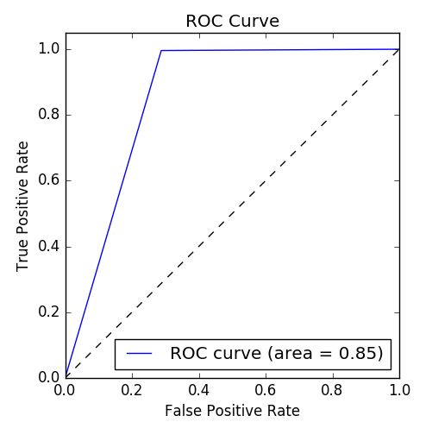
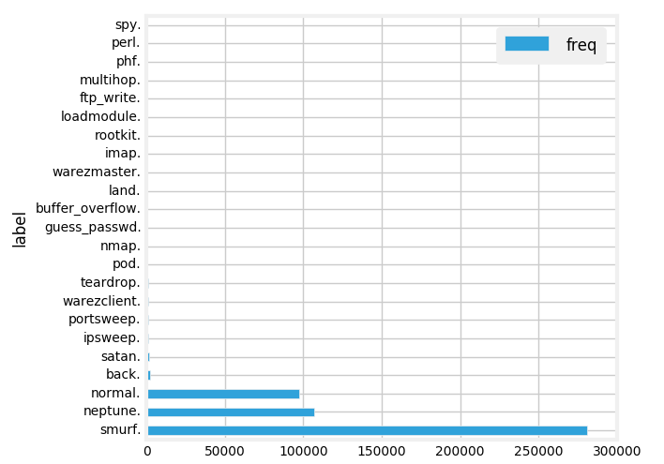
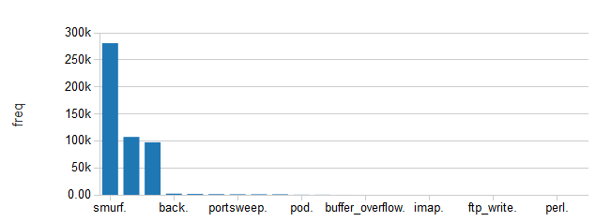
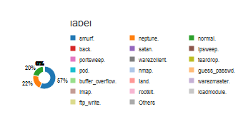
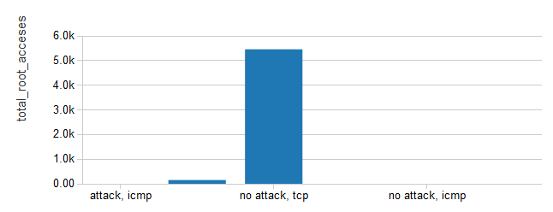
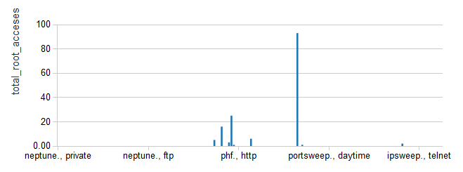
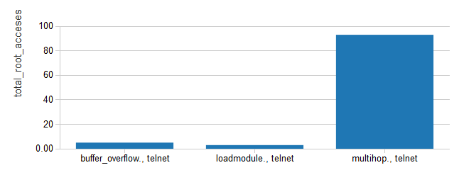
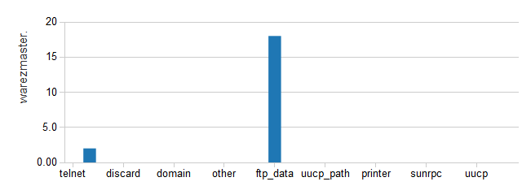
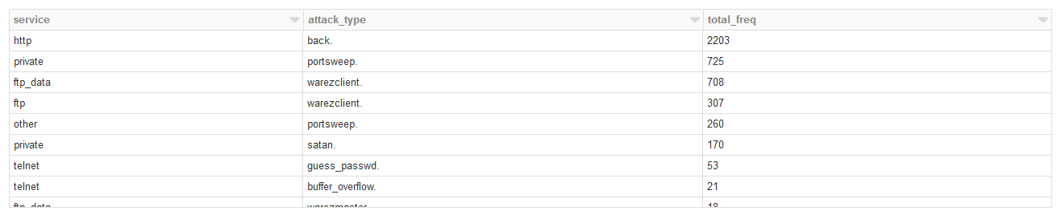
2018-2019 M.Sc. in Data Science and Analytics
Online Detection of User’s Anomalous Activities using Logs
Student: Kusumanjali Somisetty Supervisor: Dr. Pawel Pralat
Objective
Detecting traffic incoming from intrusion attempts is becoming more difficult, One of the main machine learning fields is data mining, where the inputs from the external world are datasets, which are categorized into two main categories, i.e, unsupervised and supervised techniques. Unsupervised data mining techniques require no addition to the input dataset, while supervised data mining techniques require some extra information to be added to the dataset by an expert. This knowledge, extracted from the sample dataset, also known as the training dataset, can be used in runtime.
Classification is one of the widely used data mining techniques, Thus, different Intrusion Detection Systems (IDS) are proposed based on classification techniques. Our Proposed Solution is to detect the Network Intrusion Detection, Using Random Forest Classification On Spark. The Main Purpose of Implementing the Solution on Spark is to have better Model Built on the Proven Distributed Processing System. Got the Accuracy of 98%.
Background
Results
Intrusion Detection Systems (IDSs) play a vital role in network security. Network Intrusion Detection Systems (NIDSs) detect attacks by observing various network activities, while Host-based Intrusion Detection Systems (HIDSs) detect intrusions in an individual host. There are two major intrusion detection techniques: misuse detection and anomaly detection. Misuse detection has low false positive rate, Anomaly detection has high false positive rate. Currently, many NIDSs such as Snort are rule-based systems, which employ misuse detection techniques.
Over the past several years, a growing number of research projects have applied data mining to intrusion detection with different algorithms. For instance, MADAM ID and ADAM employ association rules algorithm. We propose an approach to use random forests algorithm in intrusion detection. Random forests algorithm has been used extensively in different applications. For instance, it has been applied to prediction, probability estimation, and pattern analysis in multimedia information retrieval and bioinformatics. Unfortunately, to the best of our knowledge, random forests algorithm has not been applied in automatic intrusion detection.
One of the challenges in intrusion detection systems is feature selection. The process of feature construction from tcpdump format data involves a lot of computation. Thus, feature selection can help reducing the computational cost for feature construction. We use the feature selection algorithm of random forests, because the algorithm can give estimates of what features are important in the classification
Methodology
Apache Spark is a cluster computing platform designed to be fast. One of the main feature Spark offers for speed is the ability to run computations in memory, but the system is also more efficient than Map Reduce for complex applications running on disk. Spark is also designed to cover a wide range of workloads that previously required separate distributed systems. By supporting these workloads in the same engine, Spark makes it easy and inexpensive to combine different processing types, which is often necessary in production data.
In the experiments, four well-known machine learning algorithms are used, namely Naïve Bayes, Decision Tree, and Random Forest are used for performance evaluation. The classification measures are four elements: TP, TN, FP and FN. First, TP (true positive) is the number of correctly classified attacks. Second, TN (true negative) is the number of correctly classified normal records. Third, FP (false positive) is the number of misclassified attacks. Finally, FN (false negative) denotes the number of misclassified normal records.
Conclusions
In this paper, we employ random forests algorithm to improve detection performance. The experiments have shown that the approach can reduce the time to build patterns and increase the detection rate of the minority intrusions. From the experiments on various values of random features, we obtain the optimal value to improve the performance of random forests.
However, a poor detection rate in detecting U2R and R2L minority attacks are inevitable because of their large bias available in the dataset. The low false positive rate obtained in classifying attacks as well as normal instances makes our approach more interesting. Finally, it can be noted that no system is absolutely secure with a given set of best possible algorithms, while protecting our resources from network attacks. This makes the computer security is always an active and challenging area of research.
In our current approach, we only use random forests in misuse detection. Further study may be carried out to see whether the outlier detection provided by random forests can be implemented effectively in NIDSs. We also plan to investigate other data mining methods for anomaly detection.
Methods | Accuracy | Sensitivity | Specificity | Training Time | Prediction Time
Decision Tree | 95.82 | 92.52 | 97.10 | 4.80 | 0.13
Random Forest | 97.49 | 93.53 | 97.75 | 5.69 | 0.08
Logistic Regression | 74.19 | 92.16 | 67.82 | 2.25 | 0.18
Random Forest took the least time approximately 0.08 seconds and thus is the fastest detection scheme of all. Whereas Logistic Regression took highest time to predict with the maximum time of 0.20 seconds and thus become the slowest scheme of all the detection methods. Decision Tree ranks the second fastest scheme with approximately 0.13 seconds to predict.

