Slide 1
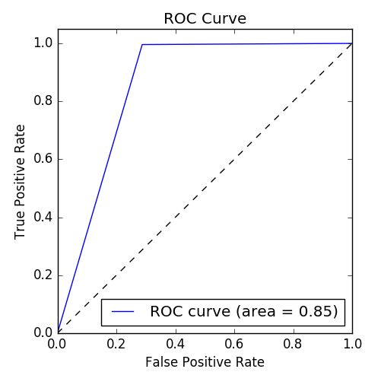
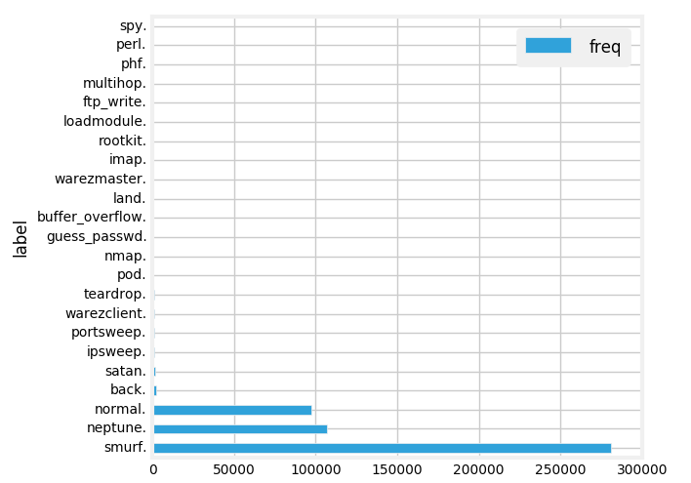
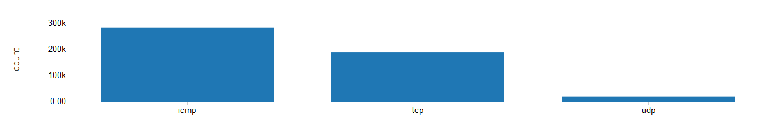
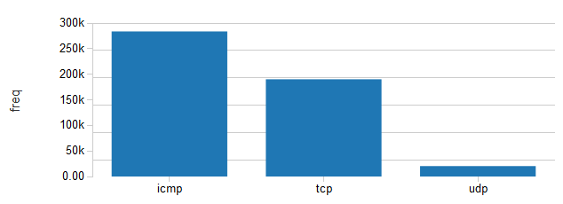
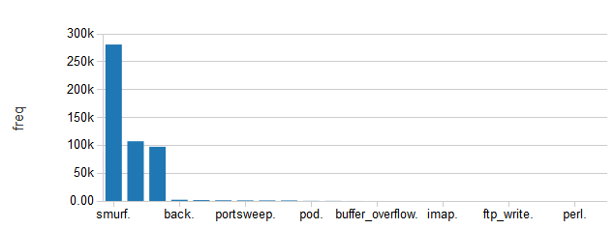
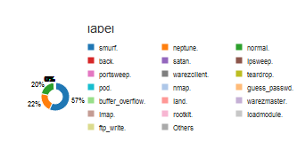
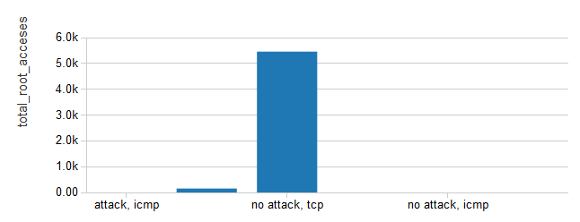
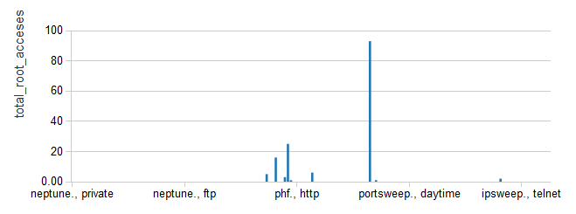
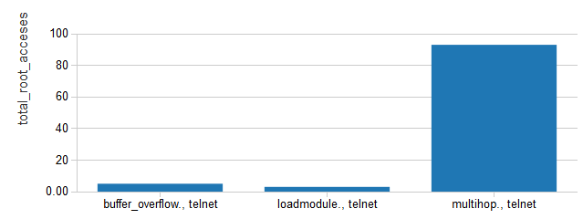
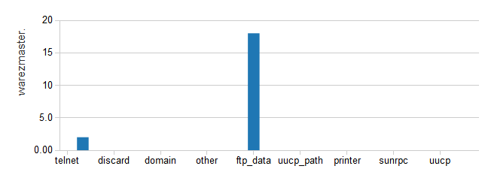
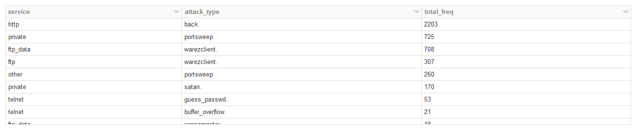
2018-2019 M.Sc. in Data Science and Analytics
Online Detection of User’s Anomalous Activities using Logs
Student: Kusumanjali Somisetty Supervisor: Dr. Pawel Pralat
Objective
Concerns about the security of networks are rising in the recent years, according to the rapid development of the techniques used to attack these networks. According to his development, detecting traffic incoming from intrusion attempts is becoming more difficult, as the techniques used in these attacks attempt to use network packets similar, in characteristics, to those incoming from normal traffic, which makes traditional networks protection techniques very weak toward such attacks. Thus, more complex techniques are being developed to protect these networks against complex attacks, such are the use of machine learning to distinguish packets of normal traffic from those from attacks. Machine learning is the field of study that aims to provide computers with the ability of gaining knowledge from the external world, without any human interaction. The knowledge extracted by a certain machine learning technique may be different from one set of inputs, from the external world, to another. Moreover, knowledge extracted from a single set of inputs may also be different from one machine learning technique to another, according to the different approaches used to extract such knowledge. One of the main machine learning fields is data mining, where the inputs from the external world are datasets, collected from the domain that knowledge extraction is required for. Data mining techniques, as well as other machine learning techniques, are categorized into two main categories, which are unsupervised and supervised techniques. Unsupervised data mining techniques require no addition to the input dataset, as the aim of these techniques is to extract relations among the objects in the dataset, while supervised data mining techniques require some extra information to be added to the dataset by an expert. Supervised data mining techniques extract the relations among the objects in the dataset, and the knowledge added by the expert. This knowledge, extracted from the sample dataset, which is known as the training dataset, can be used in runtime to apply the extracted knowledge on new objects to assist the operation of the system interacting with the domain
Classification is one of the widely used data mining techniques, where the information added to the dataset in the form of labels that classify each object in the dataset into one, or more, of the classes that exist in the domain. During the training phase of the classifier, the characteristics of objects in each class are extracted, so that, a model is built by the classifier base on these relations. These models are then used to predict classes for new data objects during the runtime in order to assist the decision making for the system controlling the domain. These decisions are based on the characteristics of the category that the data object is predicted to be in. Thus, different Intrusion Detection Systems (IDS) are proposed based on classification techniques, where data are collected from network traffic that includes normal and attack packets in order to train classifiers to be able to predict a class for each object to allow denying attack packets from accessing the network. Our Proposed Solution is to detect the Network Intrusion Detection Using Random Forest Classification On Spark. The Main Purpose of Implementing the Solution on Spark is to have better Model Built on the Proven Distributed Processing System. We have got the Accuracy of 98%.
Background
Results
With the tremendous growth of network-based services and sensitive information on networks, network security is getting more importance than ever. Although a wide range of security technologies such as information encryption, access control, and intrusion prevention can protect network-based systems, there are still many undetected intrusions. For example, firewalls cannot prevent internal attacks. Thus, Intrusion Detection Systems (IDSs) play a vital role in network security. Network Intrusion Detection Systems (NIDSs) detect attacks by observing various network activities, while Host-based Intrusion Detection Systems (HIDSs) detect. intrusions in an individual host. An IDS usually does not affect the normal network operations of the targets. There are two major intrusion detection techniques: misuse detection and anomaly detection. Misuse detection discovers attacks based on the patterns extracted from known intrusions. Anomaly detection identifies attacks based on the significant deviations from the established profiles of normal activities. Misuse detection has low false positive rate, but cannot detect novel attacks. Anomaly detection can detect unknown attacks, but has high false positive rate.
Currently, many NIDSs such as Snort are rule based systems, which employ misuse detection techniques and have limited extensibility for novel attacks. Their performances highly rely on the rules identified by the security experts. However, the amount of network traffic is huge, and it is very difficult to specify some intrusions using the rules. Therefore, the process of encoding rules is expensive and slow.
To overcome the limitations of the rule-based systems, a number of IDSs employ data mining techniques. Data mining is the analysis of (often large) observational data sets to find patterns or models that are both understandable and useful to the data owner . Data mining can efficiently extract patterns of intrusions for misuse detection, establish profiles of normal network activities for anomaly detection, and build classifiers to detect attacks, especially for the vast amount of audit data. Data mining-based systems are more flexible and deployable. The security experts only need to label the audit data to indicate intrusions instead of hand-coding rules for intrusions. Over the past several years, a growing number of research projects have applied data mining to intrusion detection with different algorithms . For instance, MADAM ID and ADAM employ association rules algorithm. We propose an approach to use random forests algorithm in intrusion detection. Random forests is an ensemble classification and regression approach, which is unsurpassable in accuracy among current data mining algorithms Random forests algorithm has been used extensively in different applications. For instance, it has been applied to prediction, probability estimation , and pattern analysis in multimedia information retrieval and bioinformatics. Unfortunately, to the best of our knowledge, random forests algorithm has not been applied in automatic intrusion detection.
Accuracy is critical to develop effective NIDSs, since high false positive rate or low detection rate will make NIDSs unusable. To improve detection performance, we also propose methods to address the issues of imbalanced intrusions and feature selection in mining process as discussed below. One of the challenges in intrusion detection systems is feature selection. Many algorithms are sensitive to the number of features. Hence, feature selection is essential for improving detection rate. Moreover, the raw data of network traffic is usually audited in tcpdump format, and the tcpdump format is not suitable for detection. IDSs must construct features from the raw data. The process of feature construction from tcpdump format data involves a lot of computation. Thus, feature selection can help reducing the computational cost for feature construction. However, in many current data mining-based IDSs, feature selection is based on domain knowledge or intuition. We use the feature selection algorithm of random forests, because the algorithm can give estimates of what features are important in the classification
Methodology
Apache Spark is a cluster computing platform designed to be fast .Spark extends the popular MapReduce model to efficiently support more types of computations, including interactive queries and stream processing. Speed is important in processing large datasets, as it means the difference between exploring data interactively and waiting minutes or hours. One of the main features Spark offers for speed is the ability to run computations in memory, but the system is also more efficient than MapReduce for complex applications running on disk. Spark is also designed to cover a wide range of workloads that previously required separate distributed systems, including batch applications, iterative algorithms, interactive queries, and streaming. By supporting these workloads in the same engine, Spark makes it easy and inexpensive to combine different processing types, which is often necessary in production data
The latest Big Data Processing Tool: Apache Spark and its MLlib library are used for experiment and result analysis. In the experiments, four well-known machine learning algorithms are used, namely Naïve Bayes, Decision Tree, and Random Forest are used for performance evaluation. The classification measures are four elements: TP, TN, FP and FN. First, TP (true positive) is the number of correctly classified attacks. Second, TN (true negative) is the number of correctly classified normal records. Third, FP (false positive) is the number of misclassified attacks. Finally, FN (false negative) denotes the number of misclassified normal records.
Methods | Accuracy | Sensitivity | Specificity | Training Time | Prediction Time
DecisionTree | 95.82 | 92.52 | 97.10 | 4.80 | 0.13
Random Forest | 97.49 | 93.53 | 97.75 | 5.69 | 0.08
Logistic Regression | 74.19 | 92.16 | 67.82 | 2.25 | 0.18
Conclusions
In this paper, we employ random forests algorithm in to improve detection performance. To increase the detection rate of the minority intrusions, we build the balanced dataset by over-sampling the minority classes and down-sampling the majority classes. Random forests can build patterns more efficiently over the balanced dataset, which is much smaller than the original one. The experiments have shown that the approach can reduce the time to build patterns dramatically and increase the detection rate of the minority intrusions. Instead of selecting features based on the domain knowledge, we select features automatically according to their variable importance calculated by random forests. By the feature selection algorithm, deciding upon the right set of features has become easy and automated. Although the approach reduces the dependency on the domain knowledge in feature selection, it increases the dependency on training sets. From the experiments on various values of random features, we obtain the optimal value to improve the performance of random forests.
The evaluation on the KDD’99 test set shows the performance provided by our approach is better than the best result of the KDD’99 contest (reduction of the overall error rate and the cost of misclassification). In our current approach, we only use random forests in misuse detection. Random forests algorithm also supports the outlier detection which can be used to detect novel attacks. Outliers are cases that have significant deviation from the main body of the data. Random forests algorithm uses proximity to detect outliers. Further study may be carried out to see whether the outlier detection provided by random forests can be implemented effectively in NIDSs. We also plan to investigate other data mining methods for anomaly detection.
However, a poor detection rate in detecting U2R and R2L minority attacks are inevitable because of their large bias available in the dataset. The low false positive rate obtained in classifying attacks as well as normal instances makes our approach more interesting. We also perform a cost sensitive classification and found the models achieve low misclassification cost. Finally, it can be noted that no system is absolutely secure with a given set of best possible algorithms, while protecting our resources from network attacks. This makes the computer security is always an active and challenging area of research.
Random Forest took the least time approximately 0.08 seconds and thus is the fastest detection scheme of all. Whereas Logistic Regression took highest time to predict with the maximum time of 0.20 seconds and thus become the slowest scheme of all the detection methods. Decision Tree ranks the second fastest scheme with approximately 0.13 seconds to predict.

