Slide 1


Interview Task:
Offshore Decommissioning
Presented by:
Karan Soni
Date : 22.11.2024
Place: Flensburg

Slide 2
Index
Steps involved for Offshore Decommissioning
Factors Affecting Decommissioning
Vessels
Steps involved in my approach to Decommissioning Offshore Wind Farm
Fuel Usage, CO2 Emissions, and Cost Analysis for Ships
Flow chart of the code
Results
References

Slide 3
1. Step involved on offshore Decommissioning
Decommissioning
Pre-Decommissioning
Decommissioning Operations
Post- Decommissioning
Reference: [1]

Slide 4
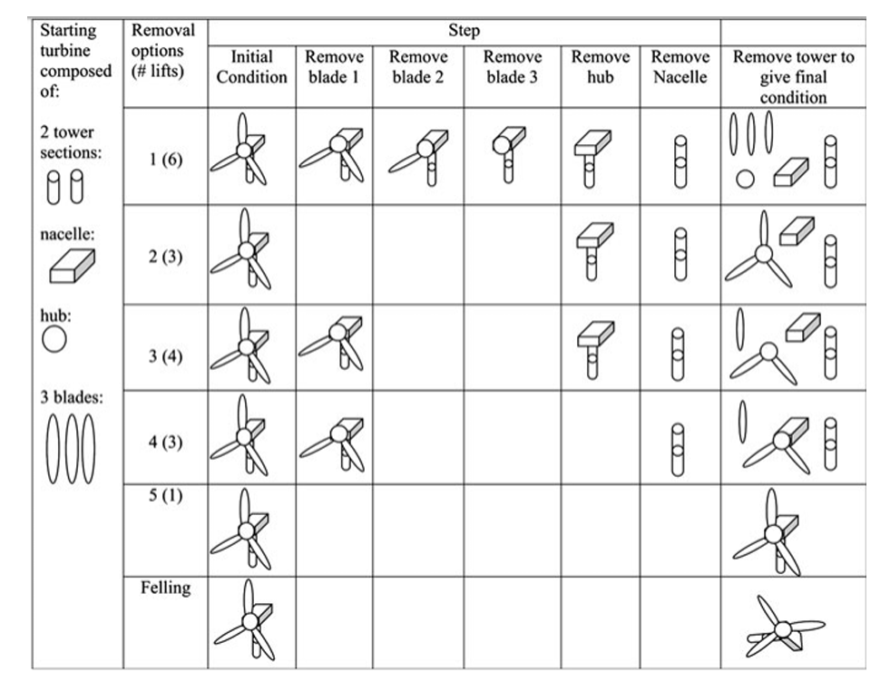
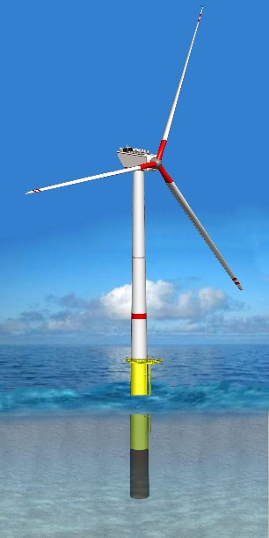
1. Steps involved in Offshore Decommissioning
Figure 1.1: Traditional offshore turbine decommissioning options [1]
Figure 1.2: Offshore Wind turbine with Monopile Foundation [1]

Slide 5
1. Step involved on offshore Decommissioning
Decommissioning Strategy
Advantages: Less cost, Less time consuming
Disadvantages: Environment risk such as trapping marine life. Maintenance and monitoring requirements
partial removal
Regulation
Pre-Decommissioning
Financial Resources
Advantages: Minimizing long term rick, cleaner site for development new wind Farm
Disadvantages: High cost, longer duration.
complete removal
Environmental Impact
Reference: [1]

Slide 6
1. Step involved on offshore Decommissioning
Wind Turbines
Lift
Foundations
Cut and Lift
Decommissioning Operation
Offshore Substations
Lift or Leave
Cables
Cut and Remove
Leave in situ
Onshore
Substation Remove
Cable leave in situ

Slide 7
1. Step involved on offshore Decommissioning
Reuse
Handling of Removed Elements
Recycle
Post - Decommissioning
Disposal
Surveys
Monitoring and Maintainers

Slide 8
2. Factors Affecting Decommissioning
Foundation type
Vessel Availability
Distance to port
Water depth
Weather conditions
Time
CO2 Emission
Costs

Slide 9
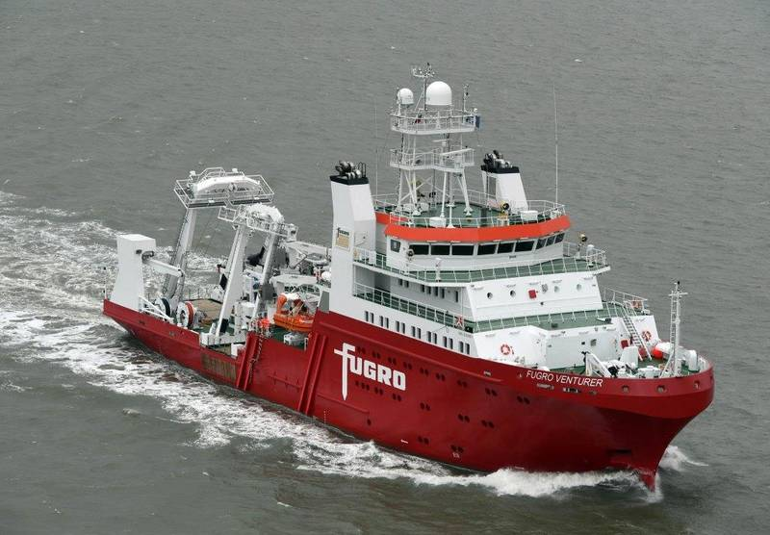
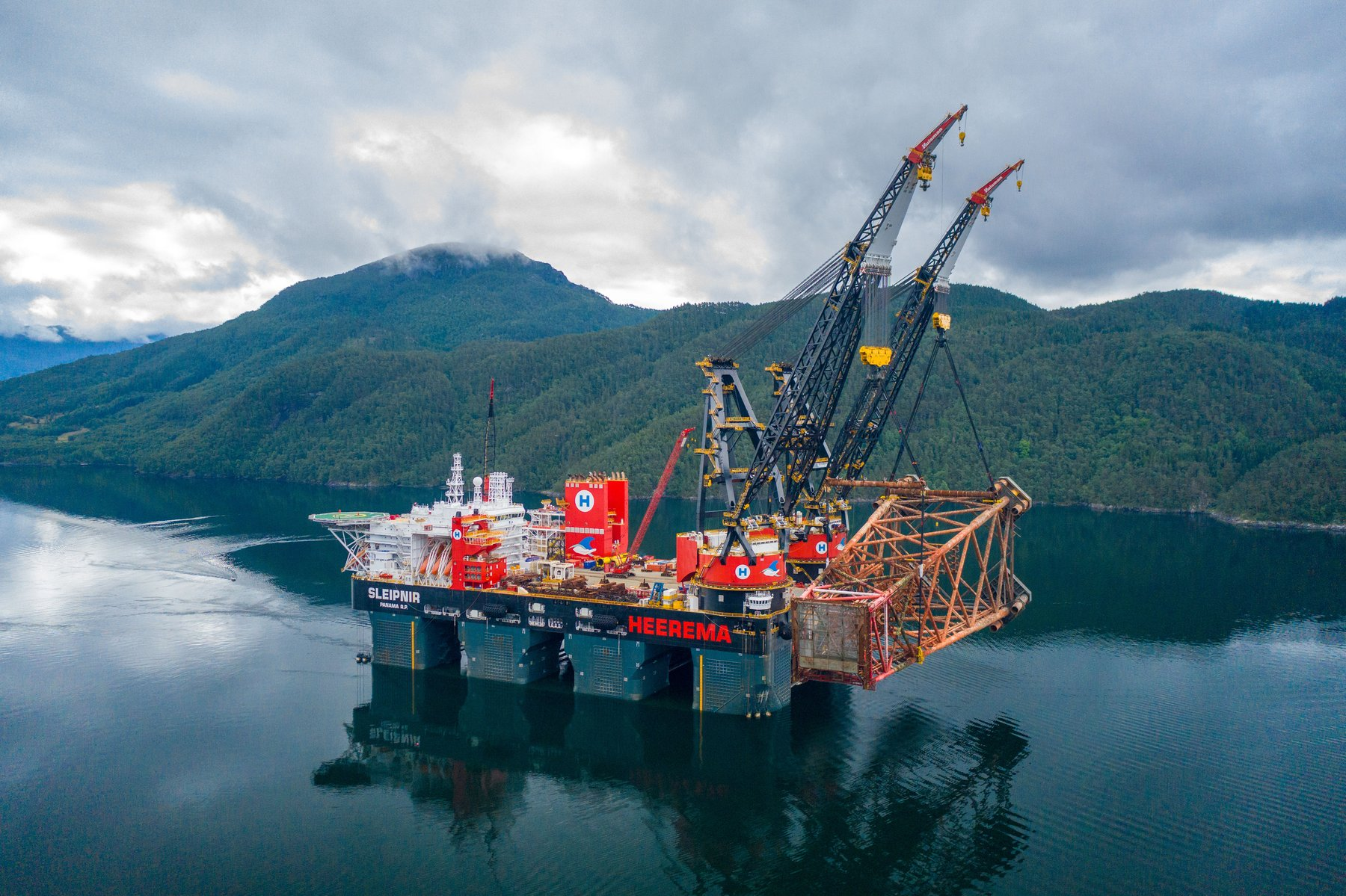
3. Vessels
Survey Vessel:
Fuel Type: HFO, Diesel, MGO, LNG, Methanol, Ammonia, Electricity
Size: Length: 80-100 m and Breadth: 15-18 m
Survey depth capacity: 2500 -3000 m [2] [3] [4] [5]
Figure 2.1: Survey Vessel [2]
2. SPIVs or Heavy Lift Vessel:
Fuel Type: HFO, Diesel, MGO, LNG, Methanol, Ammonia, Electricity
Size: Length: 220-382 meter and Breadth: 102-124 m
Lifting Capacity: 20000 -60000 tonnes [5] [6] [7]
Figure 2.2: Heavy Lift Vessel [6]

Slide 10
3. Vessels
3. Support Vessel:
Dive support Vessel Offer a place to launch, supply, recover, to assist underwater
Crew boats Transferring person, environmental studies, support of shallow waters or the enforcement of safety zones
Workboats Cutting processes
Multicats Light transport, underwater support and stability handling
Tugs Normally they come with a small crane for stability handling.
Cargo barges Used for the transportation of components [1]

Slide 11
4. My Approach to Decommissioning
Offshore Wind Farm
Pre-decommissioning
Decommissioning Strategy : Partial Remove Approach
Regulation, Financial resources: Right now, I assume, it is okay.
Environment Impact: Finding Co2 Emissions
Decommissioning Operation
Wind Turbine : 8 Wind Turbines (Assume 8MW one wind Turbine)
Turbine Type | Nacelle | Rotor blades | Tower
4 MW | 165 t | 20 t | 300 t
8 MW | 450 t | 35 t | 650 t
Table 4.1: Wind turbine components weight [1]

Slide 12
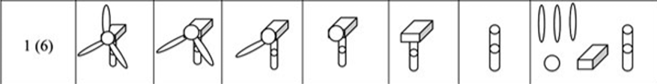
4. My Approach to Decommissioning
Offshore Wind Farm
Figure 4.1: Selected Decommissioning process for Wind Turbine [1]
5. Foundation : Cut (Monopile Foundation)
6. Offshore substation, Cables Assuming Constant
Post-Decommissioning
Ignore it

Slide 13
4. My Approach to Decommissioning
Offshore Wind Farm
Foundation type Monopile Foundation
availability Vessel Survey, SPIVs, Dive support, Crew boat, Work boat, Multicats, Cargo barges, Tugs
Distance to port 80km
Water depth 40 m
Weather conditions Normal
Time 4 [hours] + 15 days [assuming decommissioning per wind turbine] +
4.5 [hours]

Slide 14
4. My Approach to Decommissioning
Offshore Wind Farm
Vessel | Speed (km/h) / Travel Time = Dis./ speed | Port to Site | On Site | Site to Port
Survey | 18 -28 | 22 ( 3.63 hours) | - | 22
SPIVs | 18 - 28 | 22 | - | 18 (4.44 hours)
Dive support | 15 - 22 | 22 | - | 22
Crew boat | 28 - 37 | 28 (2.85 hours) | - | `28
Work boat | 15 - 23 | 22 | - | 22
Multicats | 15 - 22 | 22 | - | 22
Cargo | 18 - 27 | 22 | - | 18 (4.44 hours)
Table 4.2: Vessel, speed, travel time and case [6]

Slide 15
4. My Approach to Decommissioning
Offshore Wind Farm
Vessel | Fuel Consumptions ranges (litres/h) for Diesel | Port to Site | On Site | Site to Port | Total Fuel Consumptions for Diesel
Survey | 200 - 300 | 250 | 200 | 250
SPIVs | 200 - 300 | 250 | 200 | 300
Dive support | 300 - 500 | 400 | 300 | 400
Crew boat | 100 - 200 | 150 | 100 | `150
Work boat | 200 -400 | 300 | 200 | 300
Multicats/ Tugs | 300 -500 | 400 | 300 | 400
Cargo | 500 - 1000 | 700 | 500 | 1000
Table 4.3: Vessel, Fuel Consumptions and case [6]

Slide 16
4. My Approach to Decommissioning
Offshore Wind Farm
Case: Take to Wake
Fuel | Carbon Factor (gCo2/g Fuel) | Cost Energy [USD/kWh] | Energy Content (kWh/litres)
HFO | 3.114 | 0.043432836 | 9.6
Diesel | 3.206 | 0.06618267 | 10
MGO | 3.206 | 0.066 | 9.8
LNG | 2.750 | 0.0423 | 9
Methanol | 1.375 | 0.055175879 | 6
Ammonia | 0 | 0.123870968 | 4.5
Electricity | 0 | - | -
Table 4.4: Fuel types, carbon factor and cost [7]

Slide 17
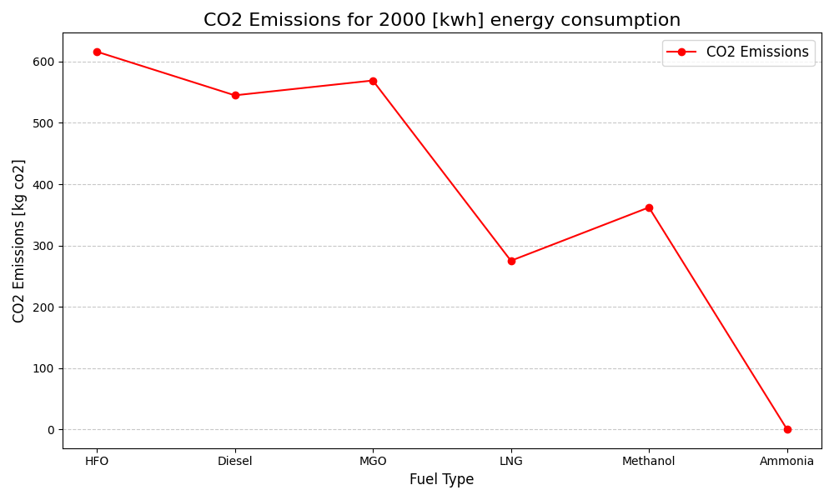
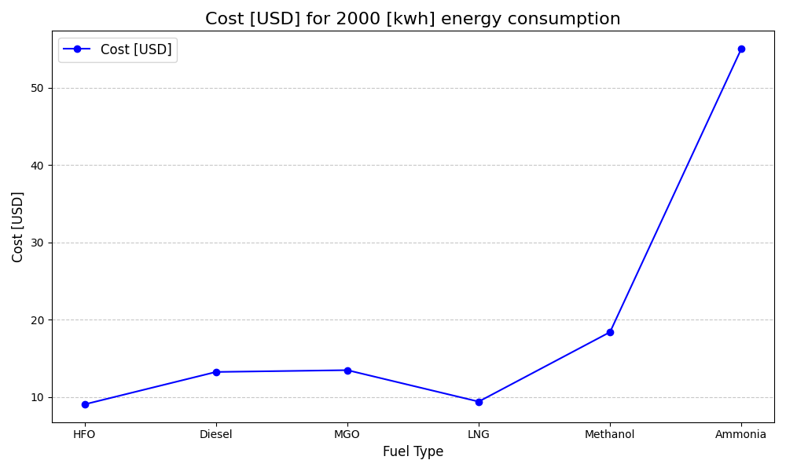
5. Fuel Usage, CO2 Emissions, and Cost Analysis for Ships
Figure 6.1: Energy Consumption Vs Co2 Emission [own drawing]
Figure 6.2: Energy Consumption Vs Cost [own drawing]

Slide 18
6. Flowchart of the code
Output.py
Analysis.py
Variable_Parameter.py
Case 1:
Consuming Fuel
Travelling time
Co2 Emission factor
Fuel density
Energy content
Energy Cost
Case 3:
Consuming Fuel
Travelling time
Case 2:
Consuming Fuel
Working time per day
Decommissioning wind turbine days
No of Wind turbine
Start
Start
Case 1:
Calculate Co2 emission
Calculate Co2 emission and
Cost for different Fuel
Case 3:
Calculate Co2 emission
+
Case 2:
Calculate Co2 emission
+
Plot 1
Fuel Vs Co2 emission
Total Co2 emission
+
Plot 2
Fuel Vs Cost
Plot
Stop
Stop
Code: https://github.com/KSoni1505/Fraunhofer_IWES_Interview_Task_Offshore-Decommissioning

Slide 19
6. Flowchart of the code
Fuel Usage, CO2 Emissions, and Cost Analysis for Ships :
${Co}_{2}$ Emission = Amount of fuel [litres] * Density [g /litres] * ${Co}_{2}$ Emission factor [g ${Co}_{2}$ /g Fuel]
Fuel Cost [USD]= Amount of fuel [litres] * Energy content [kwh/litres] * Energy costs[USD/kwh]
Case 1 and Case 3:
$${Co}_{2} Emission[kg{Co}_{2}]=\frac{Vessel Fuel consumption [\frac{liters}{hour}]\text{ ∗ }\text{Travelling} \text{times}\text{ [}\text{h}\text{] ∗ }\text{Density} [\frac{gram}{liters}]\text{ ∗ }{Co}_{2} Emission \text{Factor} [\frac{gCo2}{g fuel}] }{1000}$$
Case 2:
$${Co}_{2} Emission[kg{Co}_{2}]=\frac{Vessel Fuel consumption [\frac{liters}{hour}]\text{ ∗ }\text{working} \text{times}\text{ [}\text{hours}\text{] ∗ }\text{Decomissoning} \text{wind} \text{turbine} \text{days} [\frac{days}{wind turbine}]\text{ ∗}\text{Density} [\frac{gram}{liters}]\text{∗ }\text{No} \text{of} \text{Wind} \text{turbine}\text{ ∗}{Co}_{2} Emission \text{Factor} [\frac{gCo2}{g fuel}]}{1000}$$

Slide 20
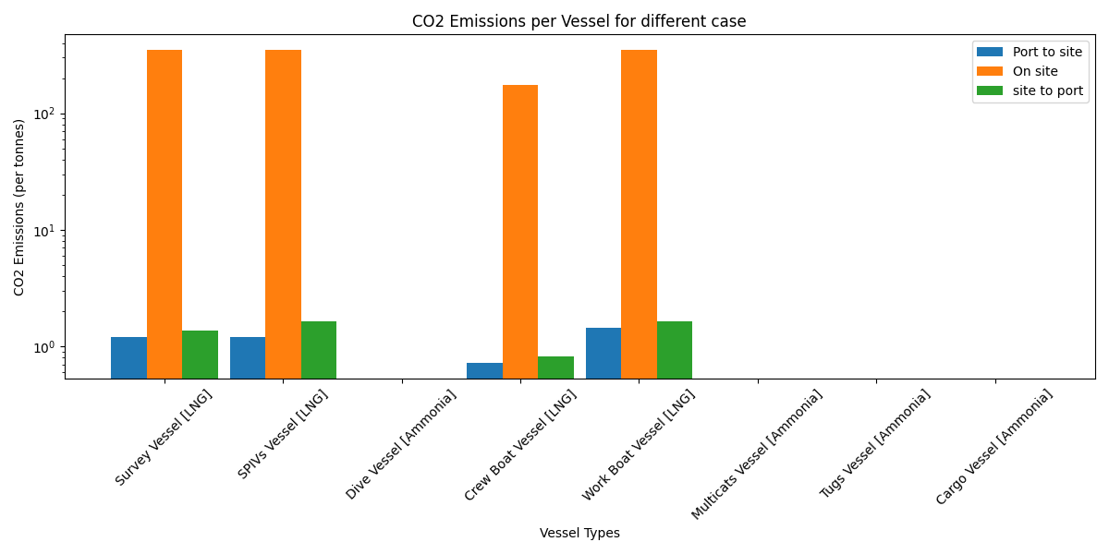
7. Results
Figure 7.1: Vessel Types Vs Co2 emissions for different case [own drawing]

Slide 21
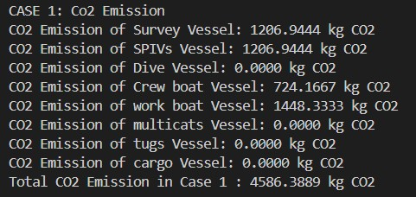
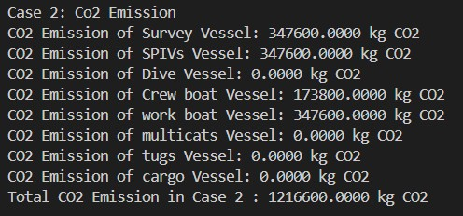
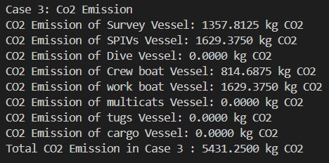

7. Results
Figure 7.2: Script output [own Script]

Slide 22
7. References
[1] Clara Ruiz,25.01.2019. “Decommissioning of offshore Wind turbine” Escola de Camins. TFG_Decommissioning_Clara Ruiz.pdf, 15.11.2024.
[2] Fugro, Creating a Safe and Liveable World | | Fugro , 15.11.2024.
[3] Geoquip Elena, Geoquip Elena + Deep-Push Cpt | Geoquip Marine, 15.11.2024.
[4] Edda Wind, Home - Edda Wind, 15.11.2024.
[5] Taken data from present work, rasant, 15.11.2024.
[6] Nunzia Capobianco - Vincenzo Basile - Francesca Loia Roberto Vona, 27.July.2022. ”End-of-life management of oil and gas offshore platforms: challenges and opportunities for sustainable decommissioning.” 14-capobianco-et-al.-118-2022.pdf, 17.11.2024.
[7] Briefing, March,2021. https://theicct.org/wp-content/uploads/2021/06/Well-to-wake-co2-mar2021-2.pdf 15.11.2024.

