Slide 1


Wind Farm Project Development, WiSe 2024/25
Team 3: Wind Farm Project in Gujarat, India
Presented by: Matriculation No.
Mozafary Mostafa 750247
Patil Rahul 750532
Soni Karan 760153
Guided by: Prof. Marina Blohm
Date : 15.01.2025
Place: Flensburg

Slide 2
Overview
Overview of wind farm development in Gujarat
Requirement and Criterial
Wind Area selection
Grid infrastructure and cable routing
Project development timeline
Rotor bearing applicability
Strategies community engagement
Summary and outlook
Land Leasing
Addressing conflicting Interests
11. Logistics and Transformation
12. Profitability Analysis
13. Results
14. Long Term Strategy
15. Barriers and Obstacles
16. Conclusion
17. References

Slide 3
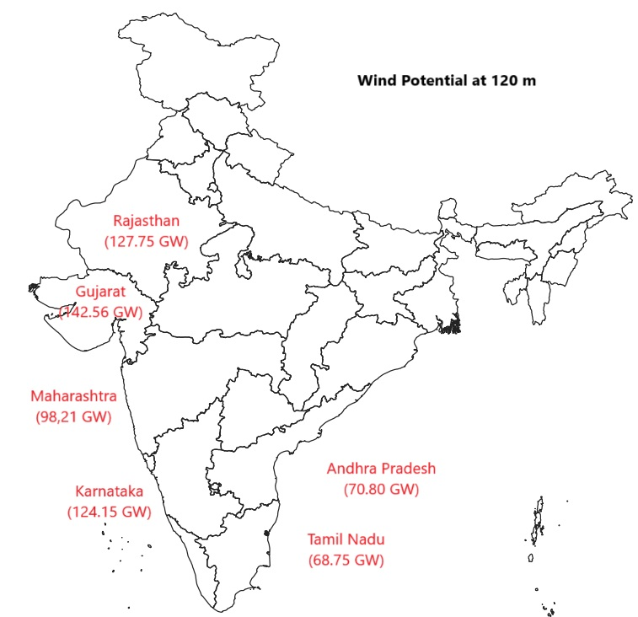
1. Overview of wind farm development in Gujarat
India:
India ranks fourth in terms of installed wind power capacity.
Several Large Wind Farm: Tamil Nadu, Gujarat, Maharashtra.
Gujarat:
As May 2024, makes it the leading state in India for wind energy.
11,823 MW installed wind power capacity
Second rank, Tamil Nadu 10,743 MW
Why?
Geographic advantages, Government supports, Land policy, Tax benefits.

