Slide 1


Wind Farm Project Development, WiSe 2024/25
Team 3: Wind Farm Project in Gujarat, India
Presented by: Matriculation No.
Mozafary Mostafa 750247
Patil Rahul 750532
Soni Karan 760153
Guided by: Prof. Marina Blohm
Date : 15.01.2025
Place: Flensburg

Slide 2
Overview
Overview of wind farm development in Gujarat
Requirement and Criterial
Wind Area selection
Grid infrastructure and cable routing
Project development timeline
Strategies community engagement
Land Leasing
Addressing conflicting Interests
9. Logistics and Transformation
10. Profitability Analysis
11. Results
12. Long Term Strategy
13. Barriers and Obstacles
14. Conclusion
15. References

Slide 3
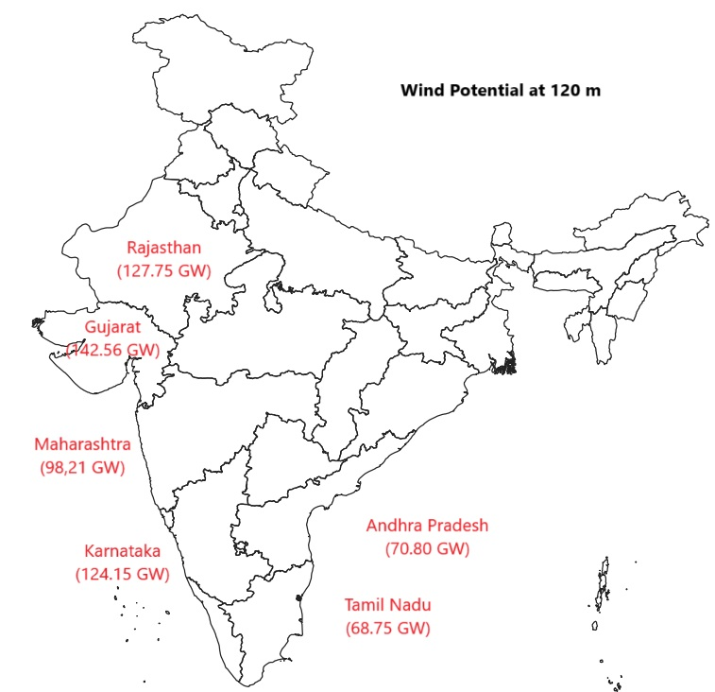
1. Overview of Wind Farm Development in Gujarat
India:
India ranks fourth in terms of installed wind power capacity.
Several Large Wind Farm: Tamil Nadu, Gujarat, Maharashtra.
Gujarat:
As May 2024, makes it the leading state in India for wind energy.
11,823 MW installed wind power capacity
Second rank, Tamil Nadu 10,743 MW
Why?
Geographic advantages, Government supports, Land policy, Tax benefits.

Slide 4
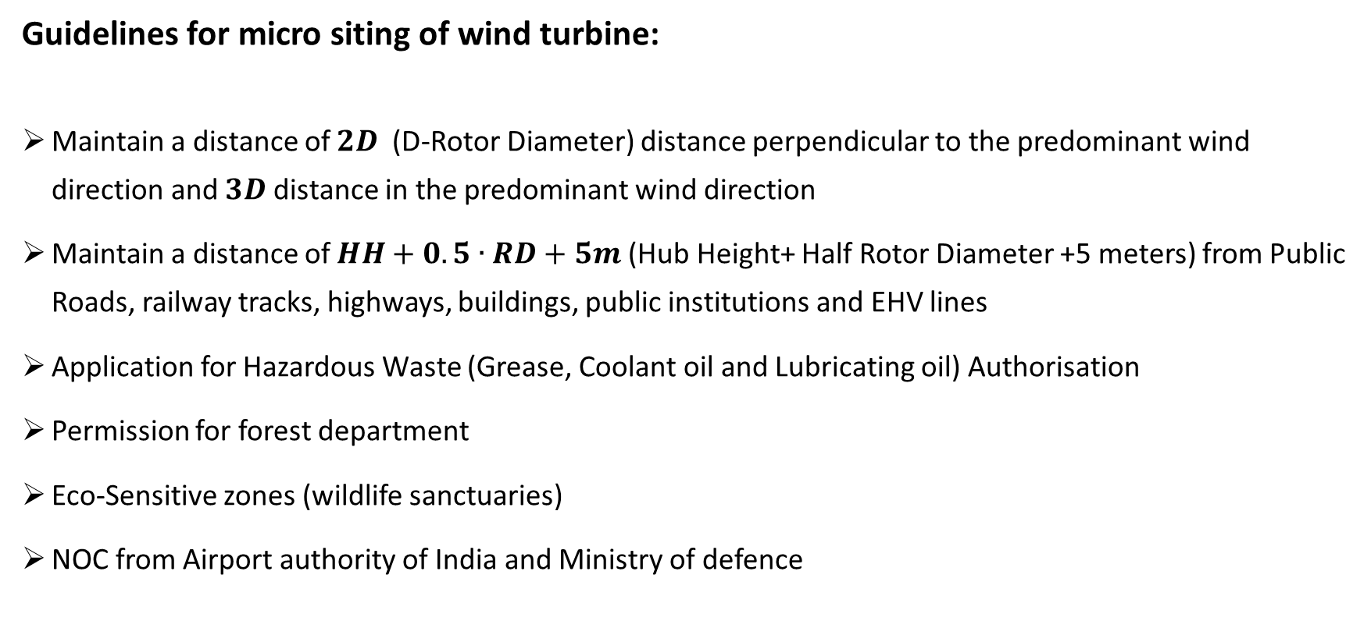
2. Requirement and Criterial
Guidelines for micro siting of wind turbine:
Maintain a distance of $2D$(D-Rotor Diameter) distance perpendicular to the predominant wind direction and $3D$ distance in the predominant wind direction
Maintain a distance of $HH+0.5∙RD+5m$(Hub Height+ Half Rotor Diameter +5 meters) from Public Roads, railway tracks, highways, buildings, public institutions and EHV lines
Application for Hazardous Waste (Grease, Coolant oil and Lubricating oil) Authorisation
Permission for forest department
Eco-Sensitive zones (wildlife sanctuaries)
NOC from Airport authority of India and Ministry of defence

Slide 5
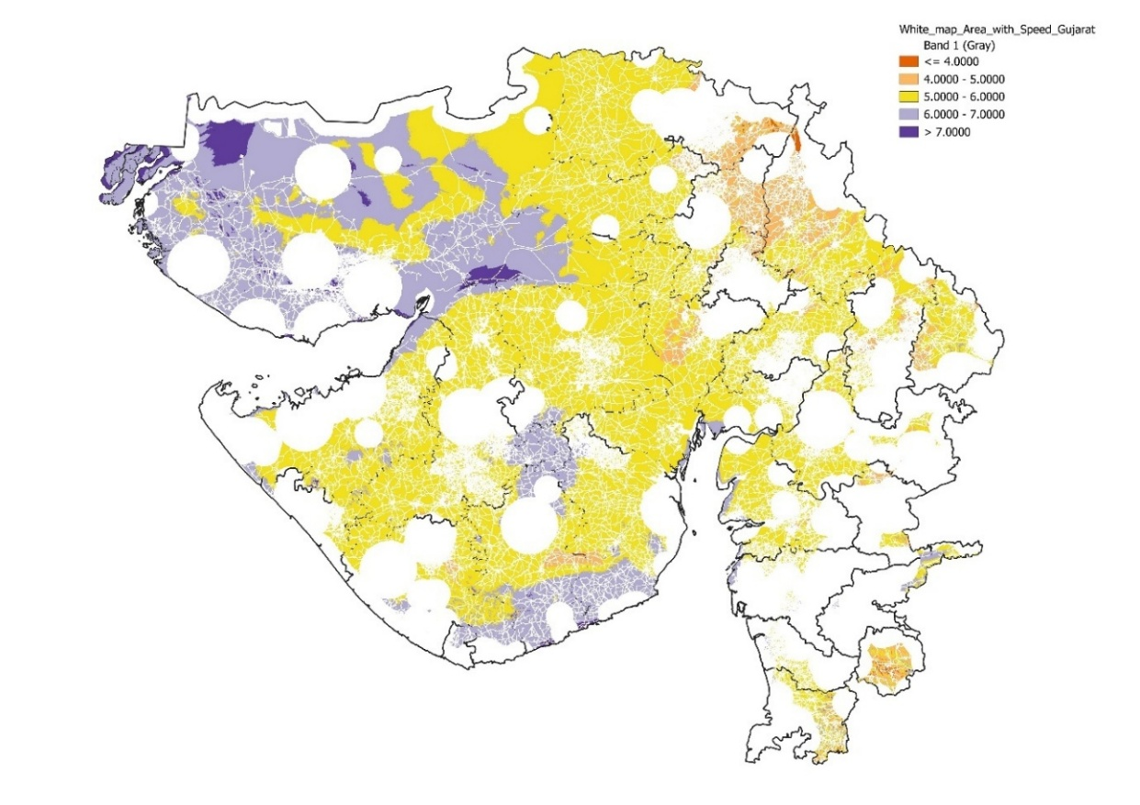
3. Wind Area Selection
Analyse Wind Farm:
Wind speed data at 100m height
Coordinate Reference System: WGS 84/ UTM zone 43N, Authority ID: EPSG:32643
Integrated wind speed data onto the white map layer [Use the clip Raster by Mask Layer Tool]
GIS Layers | Distances [m]
Buildings | 250
Forests | 10,000
Military Areas | 10,000
Railways/ Industrial | 250
Roads | 250
Airports/ Airfields | 20,000
Rivers | 250

Slide 6
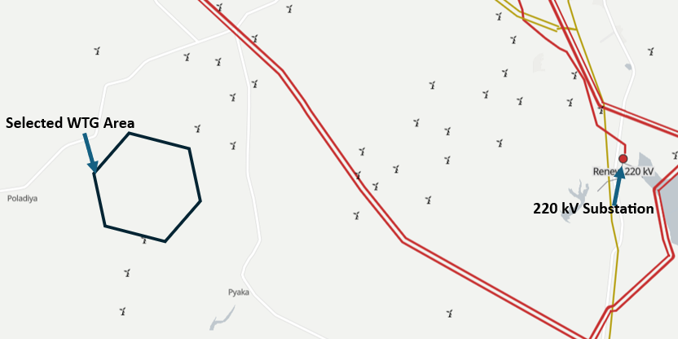
3. Wind Area Selection

Slide 7
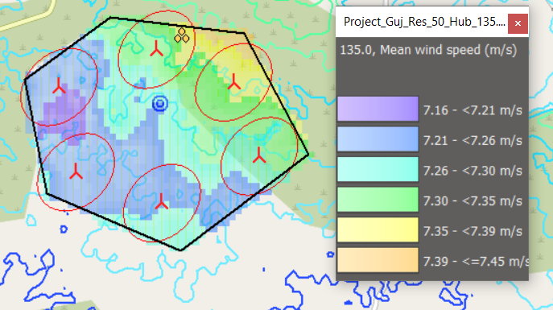
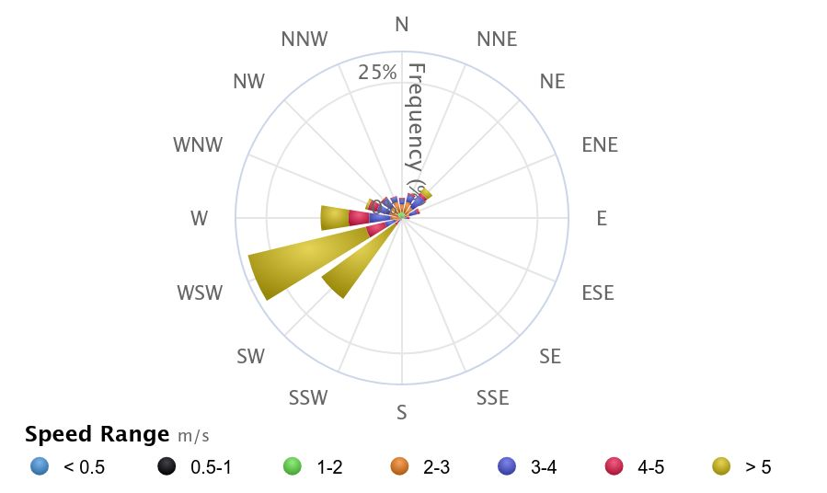
3. Wind Area Selection

Slide 8
4. Grid Infrastructure and Cable Routing

Slide 9
5. Project Development Timeline

Slide 10
6. Strategies of Community engagement
Community Meeting
Transparency
Engage Local Leaders
Benefit Sharing
Regular Updates
Community Feedback
Raise Awareness
Long Term Engagement

Slide 11
7. Land Leasing

Slide 12
8. Addressing Conflicting Interests

Slide 13
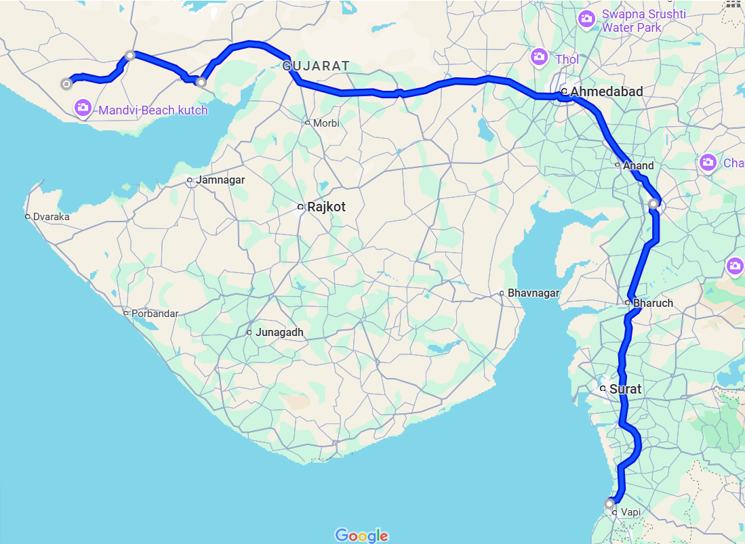
9. Logistics and Transformation
754k
3
Location: Poladia, Gujarat, India
Why Suzlon company wind turbine?
Manufacturing in Gujarat
Government provides incentives (Made in India)
4
NH27
NH64
NE1
2
NH4
Wind Turbine Manufacturing components | Manufacturing Locations | Distance between Manufacturing location to Wind farm [km]
Nacelle | Daman, Gujarat, India | 743
Nacelle Cover | Daman, Gujarat, India | 743
Hub | Daman, Gujarat, India | 743
Rotor Blades | Bhuj, Gujarat, India | 57
Tower | Gandhidham, Gujarat, India | 136
Electrical | Vadodara, India | 544
NH48
1

Slide 14
10. Profitability Analysis

Slide 15
10. Profitability Analysis

Slide 16
10. Profitability Analysis

Slide 17
11. Results
 | Value | Unit
NPV | 42,64,328 | EUR
NPV costs | -58,77,099 | EUR
NPV kWh | 57,22,36,284 | EUR
IRR | 19.362 %
LEC | 0.0289 | EUR
Min. DSCR | 1.64
ADSCR | 1.70
Positive NPV
Impressive IRR
Project promises cost efficiency and financial stability
Highly profitable project
NPV = Net Present Value, IRR = Internal Rate of Return, LEC = Levelized Cost of Energy, Min. DSCR = Minimum Debt Service Coverage Ratio, ADSCR = Average Debt Service Coverage Ratio

Slide 18
12. Long Term Strategy
Vision and Goals:
By 2030:
Achieve an installed wind energy capacity of 15 GW.
Increase the share of wind energy to 20% of the state's total energy mix.
Launch the first phase of offshore wind projects.
By 2050:
Establish Gujarat as a global leader in wind energy.
Fully integrate smart grid solutions for efficient energy distribution.
Achieve a 50% reduction in carbon emissions from energy production.
Strategy to achieve goal:
Improve Policy support
Advanced turbine technologies
Upgrade infrastructure
Integrating smart grid
Encouraging community engagement
Spend more money in research and development of wind turbine
Energy storage system

Slide 19
13. Barriers and Obstacles
High Initial Costs
Standardization and Quality Control
Maintenance Issues
Land Use Conflicts
Limited Awareness
Grid Integration
Environmental Concerns
Preference for Solar Energy

Slide 20
14. Conclusion
Location of Wind farm Perspective:
Taking advantage of Gujarat favourable policy environment
Manufacturing location of Suzlon company
Profit Perspective:
Project Achieves a positive NPV
Impressive IRR
Economic Perspective:
Reducing carbon emissions
Job creation
Local manufacturing

Slide 21
15. References

