Slide 1
Determining the Likelihood of Defaulting on Student Debt Using CART and Linear Regression by Zach Quinn
Data:
U.S. Department of Education College Score Card
National Center for Education Statistics

Slide 2
Preface: The Data Science Process – Revising an Approach
Initial goal: A dashboard to help students choose their ideal college
Initial audience: Transfer students 25+
Initial iteration of project lacked application without interactive features that were beyond this project
Revised approach: Visualizations with predictive modeling to determine which students are at-risk for defaulting on student debt

Slide 3
The Project at a Glance
Goal: To help adult transfer students understand loans, tuition costs and salaries
Unpredictable job and asset market in 2020
Data: U.S. Department of Education Score Card & National Center for Education Statistics
Methodology: CART and linear regression
Hypothesis: Can we leverage federal education data to fuel a predictive model that determines whether transfer students would be at risk of defaulting on debt?

Slide 4
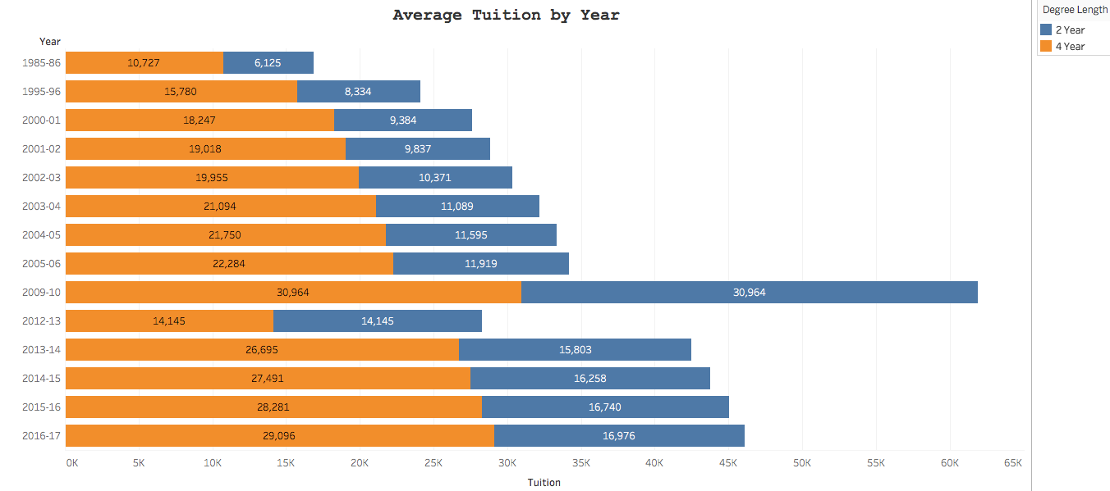
Rising Costs in Higher Education
45% of students turned down first choice school for financial reasons (Seltzer, 2017)
Opted for in-state and junior colleges (Market, 2019)
93% of students surveyed during 2020 school year believe online tuition should be reduced (Hess, 2020)
Student outcry reveals colleges’ lack of cost transparency in marketing materials

Slide 5
Business Problem
Target audience: Independent, 25+, 30,000 – 48,000 dollars per year
Do students who have had education benefits reduced continue education or seek other options?
Debt-to-income ratio: 28/36 (Kagan, 2020)
Avoid default to maintain credit scores for future asset purchases

Slide 6
Exploratory Visualizations

Slide 7
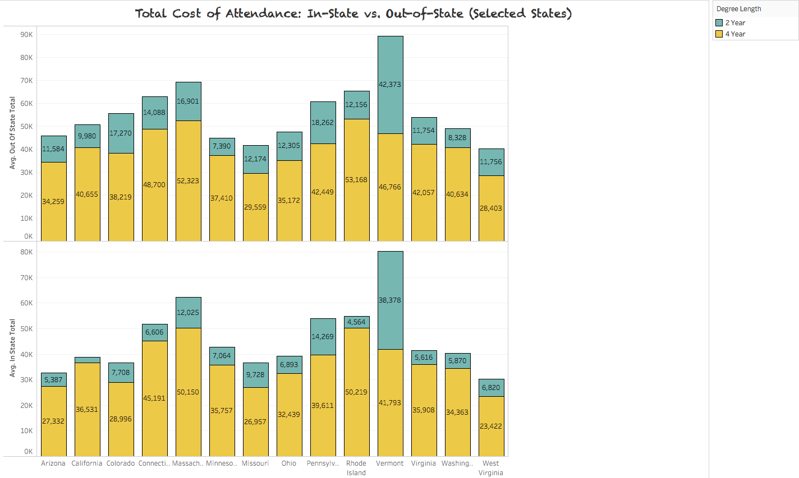
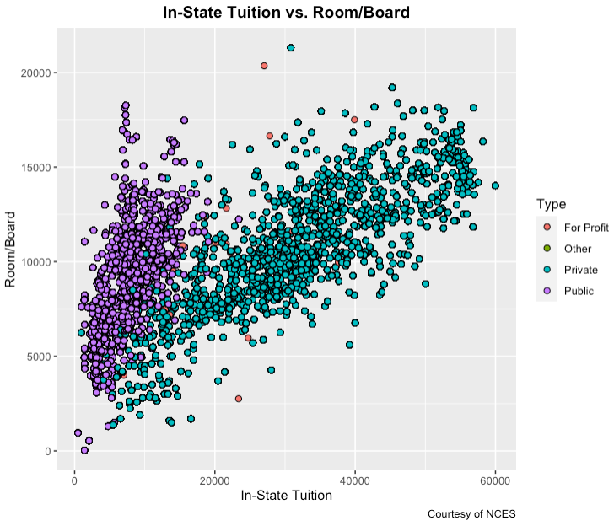
Cost of Attendance

Slide 8
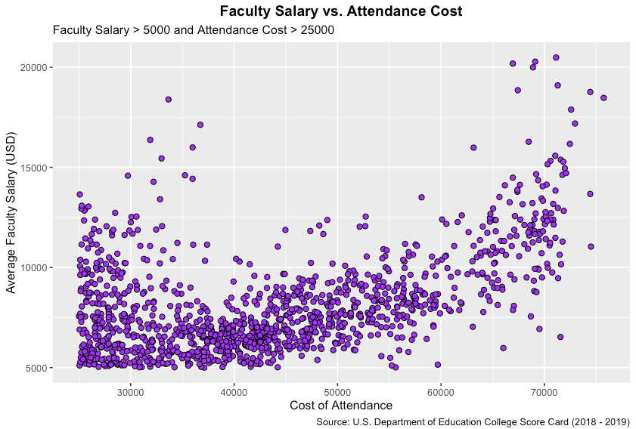
Institution Costs

Slide 9
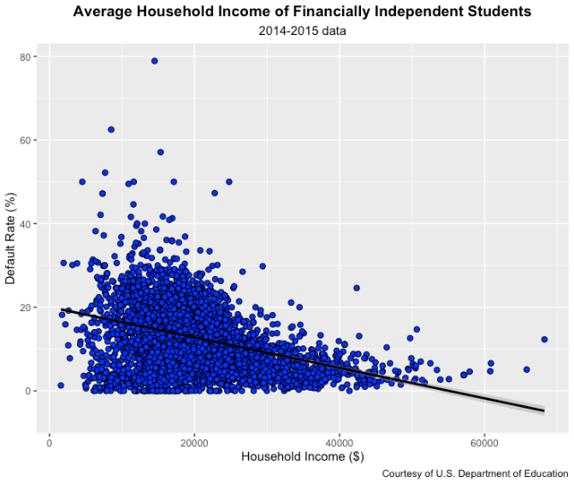
Income: Financially Independent Students

Slide 10
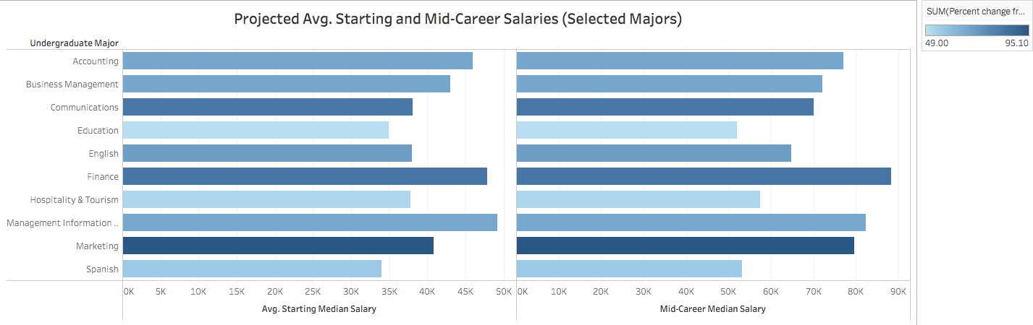
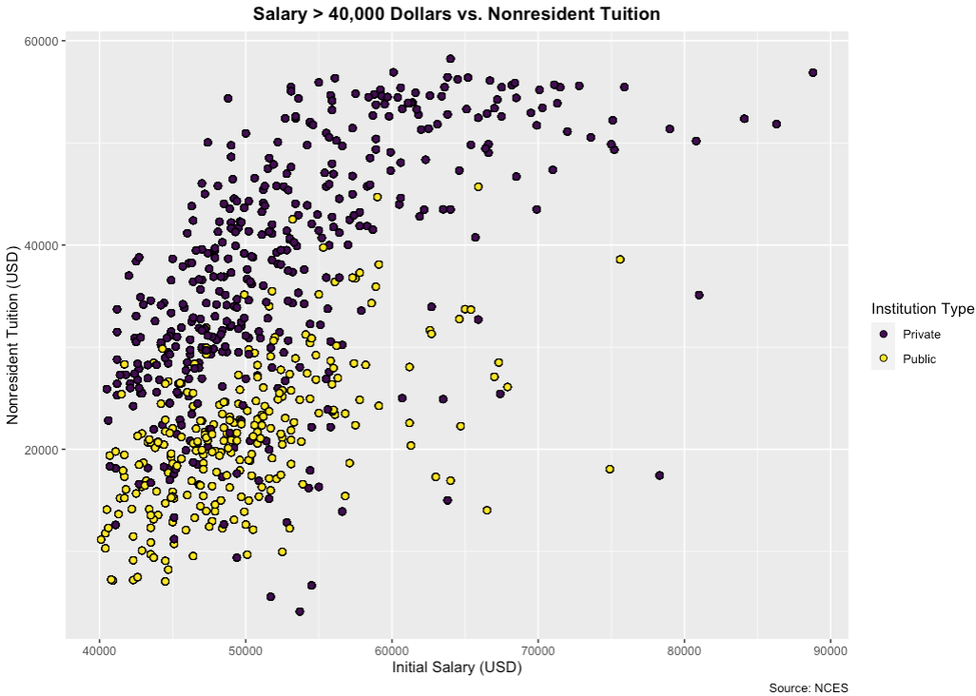
Projected Post-Graduate Earnings

Slide 11
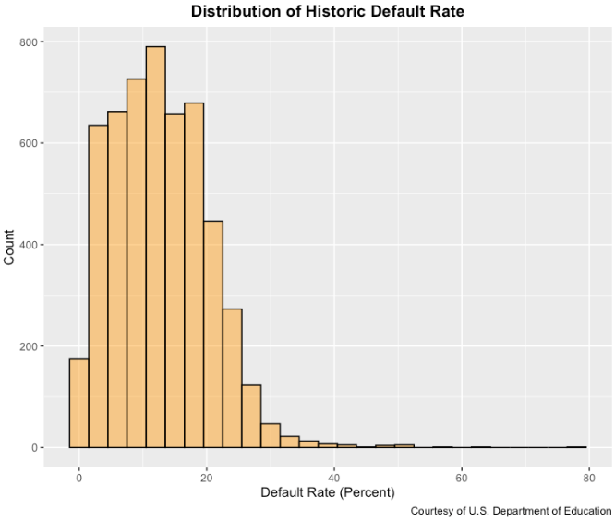
Default Rate: Distribution

Slide 12
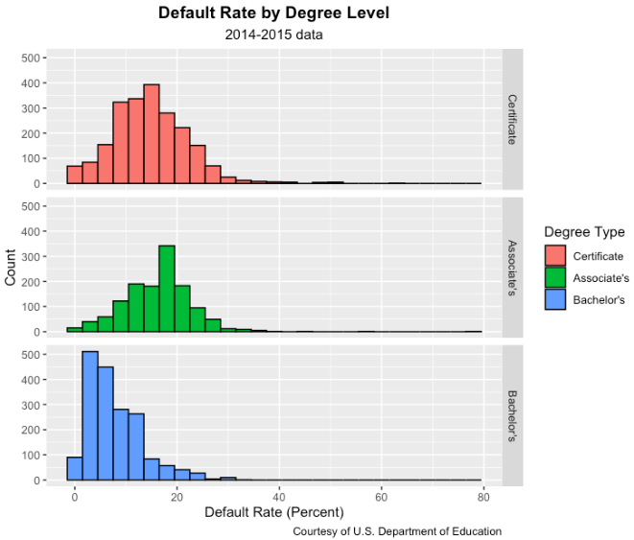
Default Rate: Degree Level

Slide 13
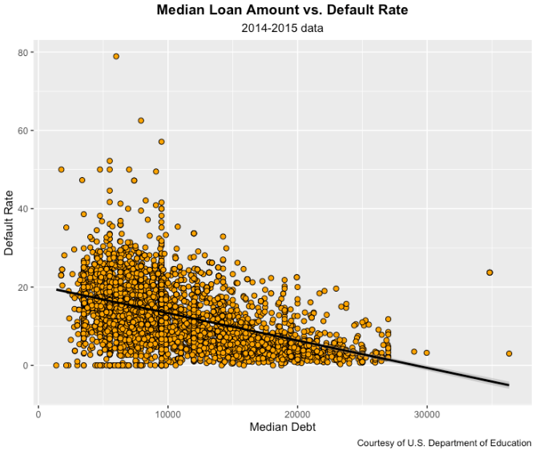
Default Rate: Median Debt vs. Loan Amount

Slide 14
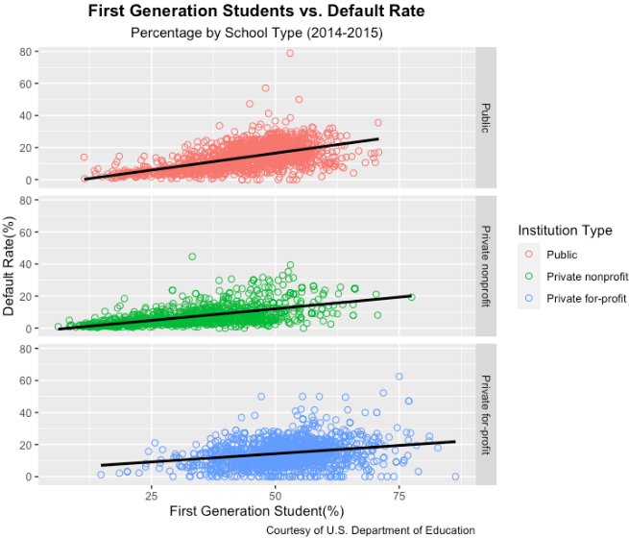
Default Rate: First Generation

Slide 15
Modeling

Slide 16
Model Preprocessing
19 features
Default rate as a function of (not an exhaustive list):
Percentage awarded Pell Grant
Debt at graduation
Degree type
First generation student

Slide 17
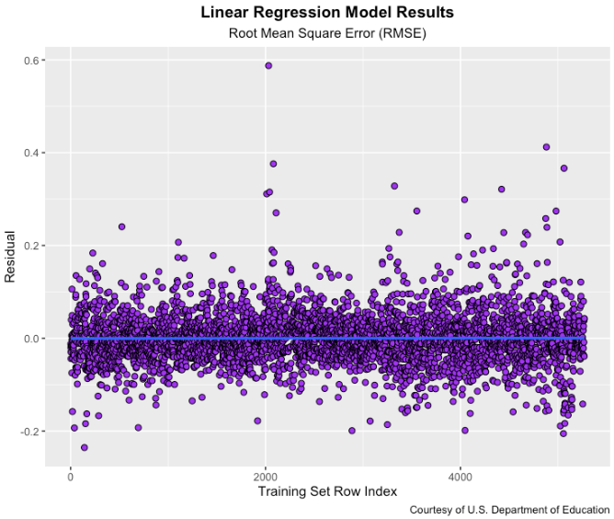
Results (Linear Regression)
RMSE: 0.052
RMSE close to zero
Model fairly precise and not over-fitted
Majority of residuals fell along line of best fit (regression line)

Slide 18
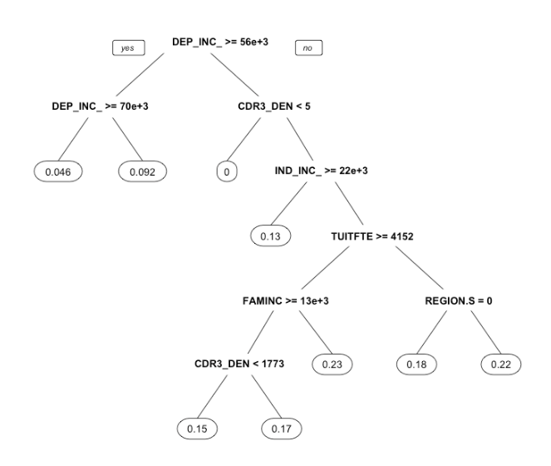
Results (CART)
Four input variables:
Average family income (dependents)
Average family income (independents)
Net tuition revenue per full-time student
Median debt for students who have completed academic program
RMSE: 0.053

Slide 19
Applications
It is recommended that the target audience:
Examine data to decide to finish at current institution, transfer or forgo higher education
Data age: Even though data is five years old, the trends are startling, especially regarding more advanced degree holders
Recommendation for low-income transfer students: Choose major, institution and lender that helps maintain favorable credit and DTI

Slide 20
References (Data)
U.S. Department of Education Score Card:
https://collegescorecard.ed.gov/data/
National Center for Education Statistics (via Kaggle):
https://www.kaggle.com/jessemostipak/college-tuition-diversity-and-pay?select=historical_tuition.csv
Wall Street Journal (via Kaggle):
https://www.kaggle.com/wsj/college-salaries

Slide 21
References (Academic)
Hess, A. (2020). More than 93% of U.S. College Students Say Tuition Should Be Lowered if Classes are Online. CNBC. https://www.cnbc.com/2020/07/27/93percent-of-college-students-say-tuition-should-be-cut-for-online-classes.html
Kagan, J. (2020). 28/36 Rule. Investopedia. https://www.investopedia.com/terms/t/twenty-eight-thirty-six-rule.asp
Market, J. (2019). Twitter Poll: Cost is top factor when choosing a college. https://www.usatoday.com/story/sponsor-story/college-ave-student-loans/2019/05/30/twitter-poll-cost-top-factor-when-choosing-college/1290536001/
Seltzer, R. (2017). Turning Down Top Choices. Inside Higher Ed. https://www.insidehighered.com/news/2017/03/23/study-shows-how-price-sensitive-students-are-selecting-colleges

