Slide 1

DEPARTMENT OF COMPUTER SCIENCE AND ENGINEERING
Project name : Smart India Restroom Team name : Proj_224780_Team_2 Team members :
MOHITHA N S (113321104062) MONIKA D (113321104063)
NAGALAKSHMI M (113321104064)
NAIDU K SUJITHA S KUMAR (113321104065)

Slide 2
Project Definition:
The project aims to enhance public restroom management by installing IoT sensors to monitor occupancy and maintenance needs. The goal is to provide real-time data on restroom availability and cleanliness to the public through a platform or mobile app.
This project includes defining objectives, designing the IoT sensor system, developing the restroom information platform, and integrating them using IoT technology and Python.

Slide 3
Objectives:
Improved Hygiene and Sanitation.
Reduced Environmental Impact
Enhanced Accessibility
User Convenience and Experience
Maintenance Efficiency
Energy-Efficient Lighting and Ventilation
Cost Savings
Safety and Security
Data Collection and Analytics

Slide 4
IoT Sensor Design:
There are several IoT sensors and components that are used in the smart public restroom system using IoT. Some of them are as follows.
User Counter
Smell Sensor
Water Level Sensor
User Feedback Machine
Star Light Display

Slide 5
Real-Time Transit Information Platform:
Here's a high-level overview of how you can build such a platform:
Define the Scope and Objectives: Clearly define the goals of your platform, such as providing transit information, promoting smart public restrooms, or enhancing the overall user experience.
Data Sources: Identify and integrate data sources that provide real-time transit information.
User Interface (UI) and User Experience (UX):Design an intuitive and user-friendly interface for the platform, which can be displayed on digital screens inside the smart public restroom.
Hardware Setup: Ensure that the hardware is durable, weather-resistant, and tamper-proof.
Content Management System (CMS):Implement a CMS to update and manage the content displayed on the platform, including transit information, restroom promotions, and emergency notifications.
Maintenance and Support: Establish a plan for ongoing maintenance, updates, and technical support for the platform and hardware.
Testing and Quality Assurance: Thoroughly test the platform before deploying it in public restrooms to identify and resolve any issues.
Deployment and Promotion: Deploy the platform in selected smart public restrooms.

Slide 6
Integration Approach:
Integrating smart technology into public restrooms involves connecting various components and systems to enhance functionality, user experience, and efficiency. Here's an integration approach for creating a smart public restroom:
Define Objectives and Features
Select Appropriate Hardware and Sensors
IoT Sensors and Automation
Smart Toilet Technologies
Cleaning and Maintenance
Quality Air Management
Accessibility Features

Slide 7
Integration Benefits:
The benefits can enhance the overall restroom experience, improve hygiene, and streamline maintenance. Here are some key advantages of integrating smart features into public restrooms:
Improved Hygiene and Sanitation:
Touchless Fixtures: Smart restrooms can incorporate touchless faucets, soap dispensers, and flush mechanisms and reducing the risk of germ transmission.
Automatic Door Openers: These can be triggered by motion sensors or buttons.
Water Conservation: Water-efficient toilets and urinals can be equipped with sensors to determine the appropriate flush volume, reducing water wastage.
Maintenance Efficiency: Sensors can help predict when fixtures may need servicing, reducing downtime and unexpected failures.
Sustainability: Implementing smart technologies can contribute to a facility's sustainability goals by reducing resource consumption and waste generation.
User Experience: These sensors can provide real-time information about restroom occupancy. Features like
music, air fresheners, or occupancy-controlled ventilation can improve the experience.
Compliance and Safety: Smart restrooms can be equipped with features like emergency call buttons or anti-vandalism measures to enhance safety and security.

Slide 8
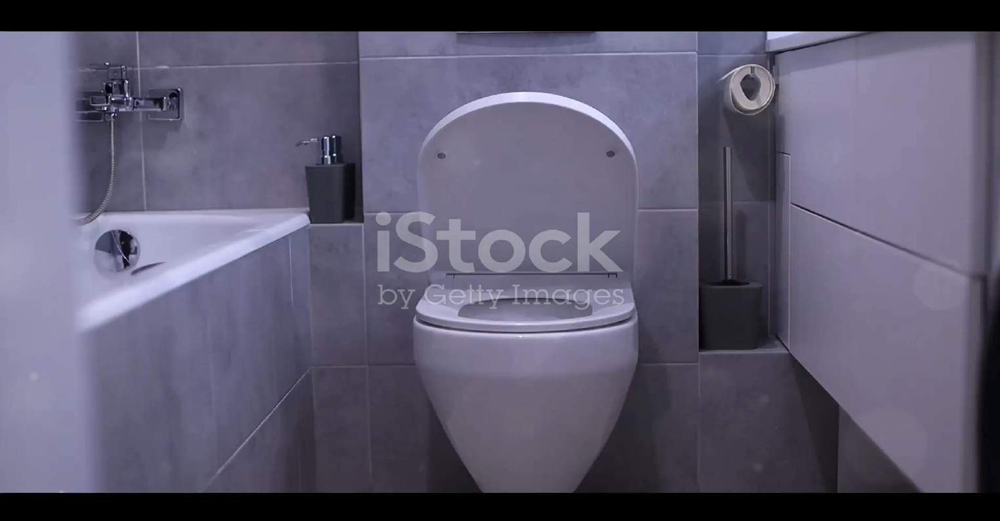
Sample Prototypes:

Slide 10
Conclusion:
In conclusion, smart technologies have the potential to revolutionize public rest rooms by improving hygiene, efficiency, user experience. While there are challenges to overcome, the
benefits and future prospects are promising. By embracing these innovations, we can create public
restrooms that are not functional but also sustainable, accessible, and user-friendly.

Slide 11
THANK YOU!

