Slide 1
Iris Recognition Challenge Supplement
v1 2025.05.09

Slide 2
Outline
Schedule
Data
Evaluation
Code Submission
Report Submission
Grading

Slide 3
Schedule
Evaluation server open
2025/05/11 00:00
Evaluation server close
2025/06/01 23:59
Oral presentation
2025/06/06 14:20~15:50 (Tentative)
Code submission
2025/06/8 23:59
Report submission
2025/06/8 23:59

Slide 4
Outline
Schedule
Data
Evaluation
Code Submission
Report Submission
Grading

Slide 5
Data
Please download all the required files from Ganzin_supplement4student.

Slide 6
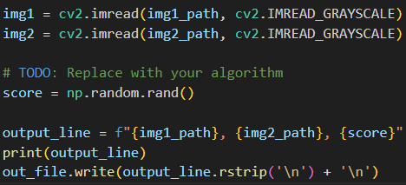
Data
In run.py, replace the TODO part by your algorithm
Run the following script to get the output list of predictions
$ python3 run.py --input <path to your input list> --output <path to your output list>

Slide 7
Data
Released Data: Thousand, Lamp, Gaze
You are encouraged to
Use any iris recognition method or pretrained model on external datasets
Train from scratch or fine-tune on external datasets
You are not allowed to
Directly using pretrained models already trained on released data
Train from scratch or fine-tune on testing set of released data

Slide 8
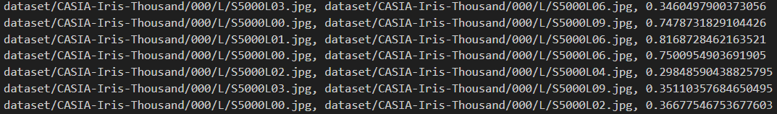
Data
In list_*.txt, each line contains the filenames of a comparison pair

Slide 9
Data
In list_*.txt, each line contains the filenames of a comparison pair
Append the dissimilarity score at the end of each line (by your algorithm)

Slide 10
Outline
Schedule
Data
Evaluation
Code Submission
Report Submission
Grading

Slide 11
Evaluation
Run the following script to get the d’score of your predictions
$ python3 eval.py --input <path to your output list>

Slide 12

Evaluation
Our project would be held on Codabench
Competition Link
Note that you don’t need to submit the results of bonus testing list to Codabench
Registration Flow
Sign up an account on Codabench
Email TA (mplin@media.ee.ntu.edu.tw) with the account name of your team
We would only approve registration request once you email us
The competition is available from 05/11 0:00 to 06/01 23:59

Slide 13
Code Submission
Schedule
Data
Evaluation
Code Submission
Report Submission
Grading

Slide 14
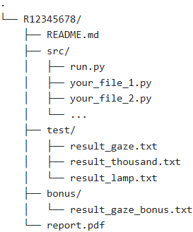
Code Submission
R12345678/
README file
Source code (which can reproduce the result on the leaderboard)
Output list of predictions
Name your result with the specified format
Put them under “test” folder
Output list of predictions (bonus)
Name your result with the specified format
Put them under “bonus” folder
Brief description of models and your method(pdf file; content is not restricted; serve just as a reference for the selection of teams for oral presentations)
Compress all the files in a zip file named StudentID.zip (e.g. R12345678.zip)
Upon extraction, only one directory named R12345678 should be generated

Slide 15
Code Submission
Only the team leader need to upload the code to NTU COOL
Clearly describe how to set up the environment in the README file
Provide steps by steps instruction (ideally a bash script) to build the environment
So that TA can reproduce the result
If we can not reproduce your result on the leaderboard….
You will receive 0 point in the performance part
However, minor errors are acceptable
We will excute your code on Linux system
Make sure your code can be excuted on Linux system before submission
Deadline: 2025/06/08 23:59

Slide 16
Report Submission
Schedule
Data
Evaluation
Code Submission
Report Submission
Grading

Slide 17
Report Submission
Only the team leader need to upload the code to NTU COOL
For presentation teams…
Upload your presentation slide in ppt format
For other team…
Upload your report in pdf format
Deadline: 2025/06/08 23:59

Slide 18
Grading
Schedule
Data
Evaluation
Code Submission
Report Submission
Grading

Slide 19
Grading
Performance (60%)
CASIA-Iris-Thousand (20%)
CASIA-Iris-Lamp (20%)
Ganzin-J7EF-Gaze (20%)
Report (40%) (For Top 10 Teams)
Novelty and technical contribution (15%)
Experiment completeness (15%)
Oral Presentation (10%)
Report (40%) (For Others)
Novelty and technical contribution (20%)
Experiment completeness (20%)
Bonus (10%)
The d’score on bonus testing list
The baseline would be announced later
Points (For each Metric) | # of Teams
20% | 1
19% | 2
18% | 2
16% | The rest teams / 4
15% | The rest teams / 4
14% | The rest teams / 4
13% | The rest teams / 4

Slide 20
Reminder
Please start working on the project as early as possible.
Please read and follow the rules carefully.
Taking any unfair advantages (e.g., plagiarism) over other class members is strictly prohibited.
Violating university policy would result in F for this course.
If you have any problems on the project …
Issue it on the NTU COOL forum
Send email to mplin@media.ee.ntu.edu.tw (林孟平)

