Slide 1
A brief introduction of human activity recognition (HAR)
ZHANG Yujia

Slide 2
Outline
1
ILOs
2
What is HAR?
3
The levels of HAR
4
Popular methods to achieve HAR
5
Application scenarios of HAR
6
Preparation for studying in HAR

Slide 3
1. ILOs
Intended Learning Outcoms (ILOs)
-- What you should master in this lecture
1. Explain the meaning of HAR in your own words
2. Depict all the levels of HAR
3. Recite popular ways to achieve HAR
4. Identify a new scenario for using HAR

Slide 4

2. What is HAR
What is Human Activity Recognition?
Wikipedia: Activity recognition aims to recognize the actions and goals of one or more agents from a series of observations on the agents' actions and the environmental conditions.
Wikipedia: Activity recognition aims to recognize the actions and goals of one or more people from a series of observations on the people's actions and the environmental conditions.

Slide 5
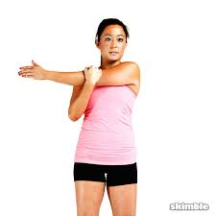
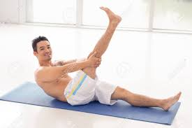
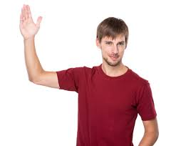
3. The levels of HAR
(1) Gestures -- bottom level
Those atomic actions at the limb level, which is performed by the action of a specific part of the human body. For example, streching the left arm and raising the right leg.

Slide 6

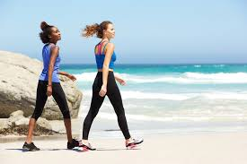
3. The levels of HAR
(2) Actions/Activities -- second level
Actions and activities are used referring to the whold-body movements composed of several gestures in temporal sequential order and performed by a single person with no more person or addtional objects. For example, running and walking.

Slide 7

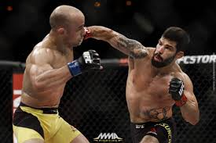
3. The levels of HAR
(3) Interactions -- third level
Interactions are human activities that involve person-object interactions and person-to-person interactions. Such cooking for person-object interactions and fighting for person-to-person interactions.

Slide 8

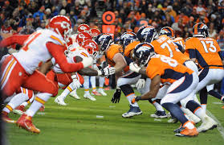
3. The levels of HAR
(4) Group activities -- top level
The activities performed by conceptual groups composed of multiple persons and/or objects. Such as a group having a meeting and two groups football competition.

Slide 9
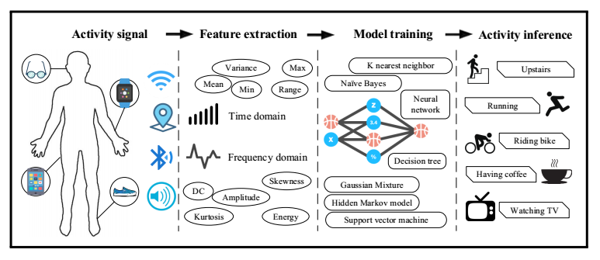
4. Popular methods to achieve HAR
(1) Sensor-based method
Sensor-based HAR integrates the emerging area of sensor networks by mobile devices with novel data mining and machine learning techniques to model a wide range of human activities. Such as WeChat walking counting.

Slide 10
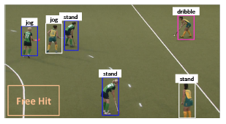
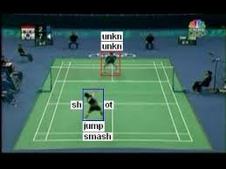
4. Popular methods to achieve HAR
(2) Vision-based method
Vision-based HAR analysis a complex scenorio of video by vision facilities with novel image processing and machine learning techniques to model a wide range of human activities. Such as players monitoring and analysis.

Slide 11
5. Application scenario of HAR
(1) Sensor-based HAR
1. Hearth care -- Feeding back of patients' behavior
2. Monitoring -- Daily training monitoring
3. Behavior analysis for advanced assistance
(2) Vision-based HAR
1. Security-related applications -- Elder danger prevention
2. Surveillance -- Crime surveillance
3. Human-computer interaction -- Somatosensory game

Slide 12
6. Preparation for HAR
What you should master before researching in HAR
1. Advanced mathematics
2. Probability theory
3. Optimization theory
4. Programming, python is recommanded
5. Image processing methods
6. Mechine learning

Slide 13


Slide 14


Slide 15
THANK YOU!

