Slide 1
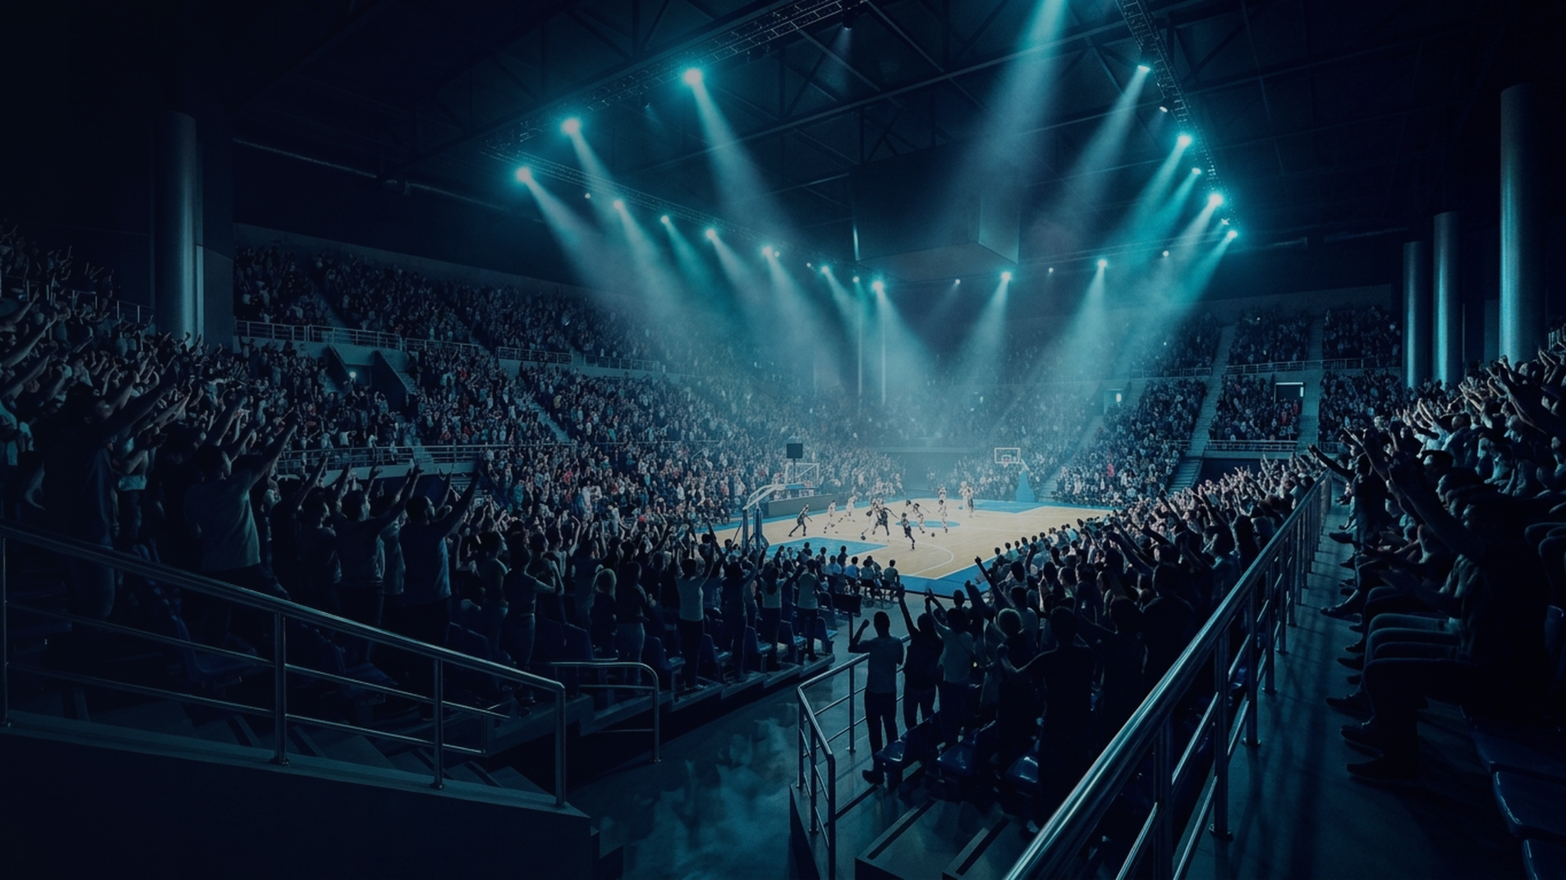
GAMEDAY INTELLIGENCE PLATFORM
Kinetic FanLab
Turning Stadium Crowd Noise into Quantified Defense & Peak-Moment Sponsor Value
Troy Resendez • IBM Bob IDE • watsonx Orchestrate
Notes:
Welcome to Kinetic FanLab. We turn unmeasured stadium crowd noise into a quantified defensive weapon and a high-margin, localized sponsor engine for collegiate and pro venues. Sources: facts.md; https://github.com/KTAR69/Kinetic_FanLab.

Slide 2
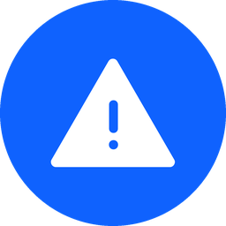

THE MARKET GAP
Closing the Gameday Engagement Gap
Today's Broken Gameday
Kinetic FanLab Solution
High-Friction Apps: Click-heavy menus fail fans holding food in loud arenas
Blind Operations: Coaches lack live section-level noise and disruption telemetry
Static Ad Waste: Generic national banners miss peak moments and local markets
One-Tap Defense: Single-thumb surge fuses decibels, cadence, and urgency
Quantified Impact: Real-time Calculated Momentum Index (0–100) per section
Peak-Moment ROI: Instant regional sponsor drops triggered at 105+ dB
Notes:
Three stakeholder groups lose out in today's arenas: fans get friction, teams get zero acoustic visibility, and sponsors pay for static impressions. Kinetic FanLab closes all three loops in one tap. Sources: facts.md.

Slide 3
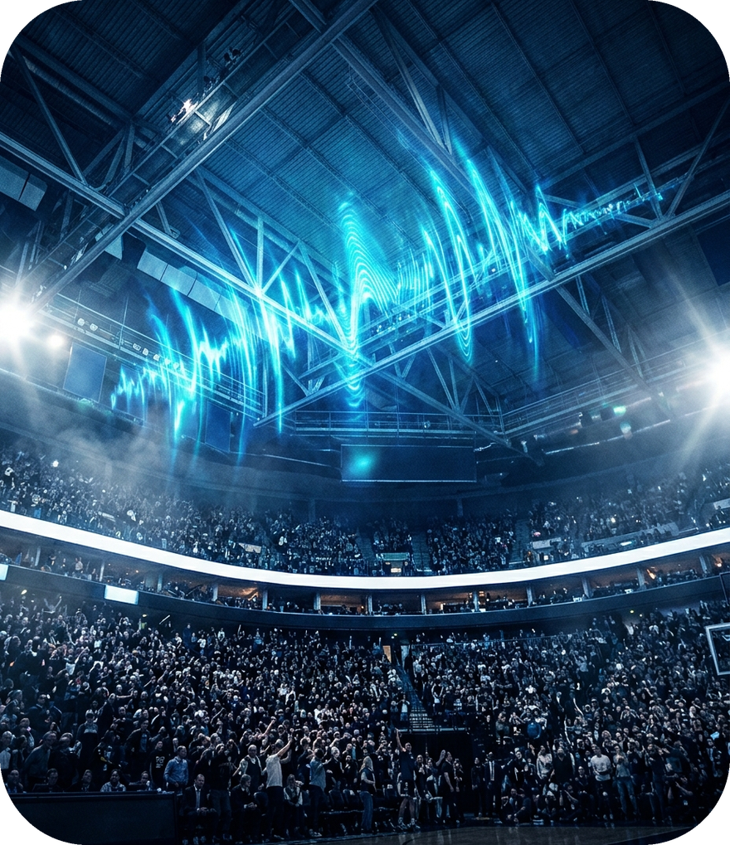
IN-ARENA DEFENSE
Quantified Crowd Energy Moves the Odds
Real-time acoustic telemetry across NCAA D1, NBA, and NFL
Multi-Modal Fusion: Combines live decibels, heart rate, tap cadence, and vocal urgency into a 0–100 CMI score
Clutch Disruption: Crossing 105+ dB models an opponent shot-conversion drop from 78% to 41%
Live ESPN Sync: Autonomous schedule and score polling across 8 collegiate and pro teams
105+ dB
78% → 41%
Clutch trigger threshold
Simulated shot odds drop
Notes:
Our core feature converts stadium noise into a measurable Calculated Momentum Index. At 105+ decibels, the app models a drop in opponent conversion odds from 78% down to 41% while syncing live with ESPN. Sources: facts.md.

Slide 4

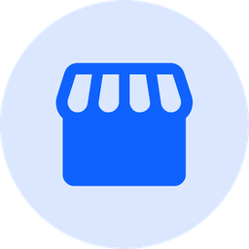

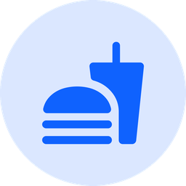
MARKET LOCALIZATION
Four Regional Sponsors Matched to Home Fans
Bojangles® — Duke Blue Devils
North Carolina
Whataburger® — Spurs, Longhorns & Cowboys
Texas
Cajun Filet Biscuit & Sweet Tea drops triggered when Cameron Indoor surges past 105 dB.
Honey Butter Chicken Biscuit rewards unlocked during fourth-quarter defensive stands.
Dunkin'® — Boston Celtics
New England
Culver's® — Michigan & Green Bay
Midwest
Iced Coffee & Munchkins perks activated during TD Garden clutch free-throw sequences.
ButterBurger & Fresh Frozen Custard drops localized for Big Ten and Lambeau crowds.
Notes:
A North Carolina Duke fan shouldn't see a Texas-only Whataburger ad. Kinetic FanLab dynamically binds each team to its authentic regional food partner so every peak-decibel drop converts. Sources: facts.md.

Slide 5
COMMERCIAL VIABILITY
99.72% Gross Margin per Engaged Seat
Partner lead value vs. cloud compute cost (USD per seat)
$4.85
Partner lead value per seat
$0.0137
Cloud compute cost per seat
99.72%
Gross margin ($4.84 net)
Notes:
The unit economics are built for stadium scale: $4.85 in verified partner lead value against just 1.37 cents in cloud compute delivers a 99.72% gross margin. Sources: facts.md.

Slide 6
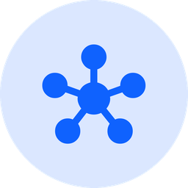
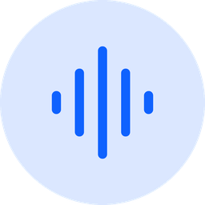
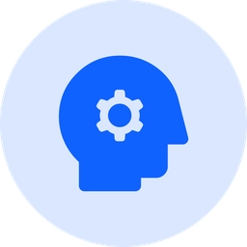
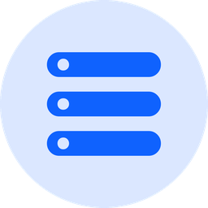
TECHNOLOGY STACK
IBM Bob & 16-Agent watsonx Orchestrate
Full-stack orchestration, edge DSP, and enterprise persistence
16-Agent Theatre Cast
Edge Acoustic DSP
Declarative YAML agents across 4 tiers implement all 8 IBM Agentic AI Archetypes.
Hampel 3-sigma filter (99.4% noise rejection) + 50-seat BLE mesh (98.0% backhaul savings).
IBM Granite Synthesis
Cloudant & COS S3
granite-3-8b-instruct powers post-play narratives, chants, and 5 live squad personas.
Sub-50ms hot state in us-south plus immutable Parquet receipts with SHA-256 in eu-de.
Notes:
Architected in IBM Bob IDE with Pyright static typing, the backend pairs 16 watsonx Orchestrate agents with Hampel 3-sigma acoustic filtering, IBM Granite synthesis, Cloudant, and Cloud Object Storage. Sources: facts.md.

Slide 7
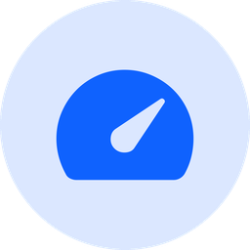
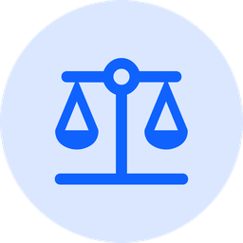


VERIFIED RELIABILITY
Enterprise Scale & Responsible AI
1.322s
0.95–1.0
21 Rules
100%
50-Fan Burst SLA
DIR AI Fairness
Injection Shield
Automated Suites
26.44 ms P95 latency
EEOC 4/5ths compliant
100% PII redaction
Zero Pyright errors
watsonx.governance enforces dialect fairness (0.953–1.00 DIR), prompt-injection defense, and PII scrubbing on every fan interaction.
Notes:
Under a 50-fan concurrency burst, the platform completes in 1.322 seconds with 26.44 ms P95 latency, while watsonx.governance maintains a 0.953 to 1.00 Disparate Impact Ratio. Sources: facts.md.

Slide 8
USER JOURNEY
Four-Stage 36-Hour Gameday Loop
Sustaining fan retention before, during, and after the final whistle
1
2
3
4
PRE-GAME
TIP-OFF
CLUTCH
POST-GAME
Holographic Pass
Rivalry War Room
Bleacher Surge
Living Trophy Case
Dynamic seat credential synced to live ESPN schedules.
One-tap toggle predictions mint Gameday Oracle NFTs.
105+ dB defense unlocks localized sponsor rewards.
IBM Granite StoryCards sealed with SHA-256 receipts.
Notes:
Fans engage across a continuous 36-hour loop from pre-game predictions through in-arena defense to post-game collectible StoryCards. Sources: facts.md.

Slide 9
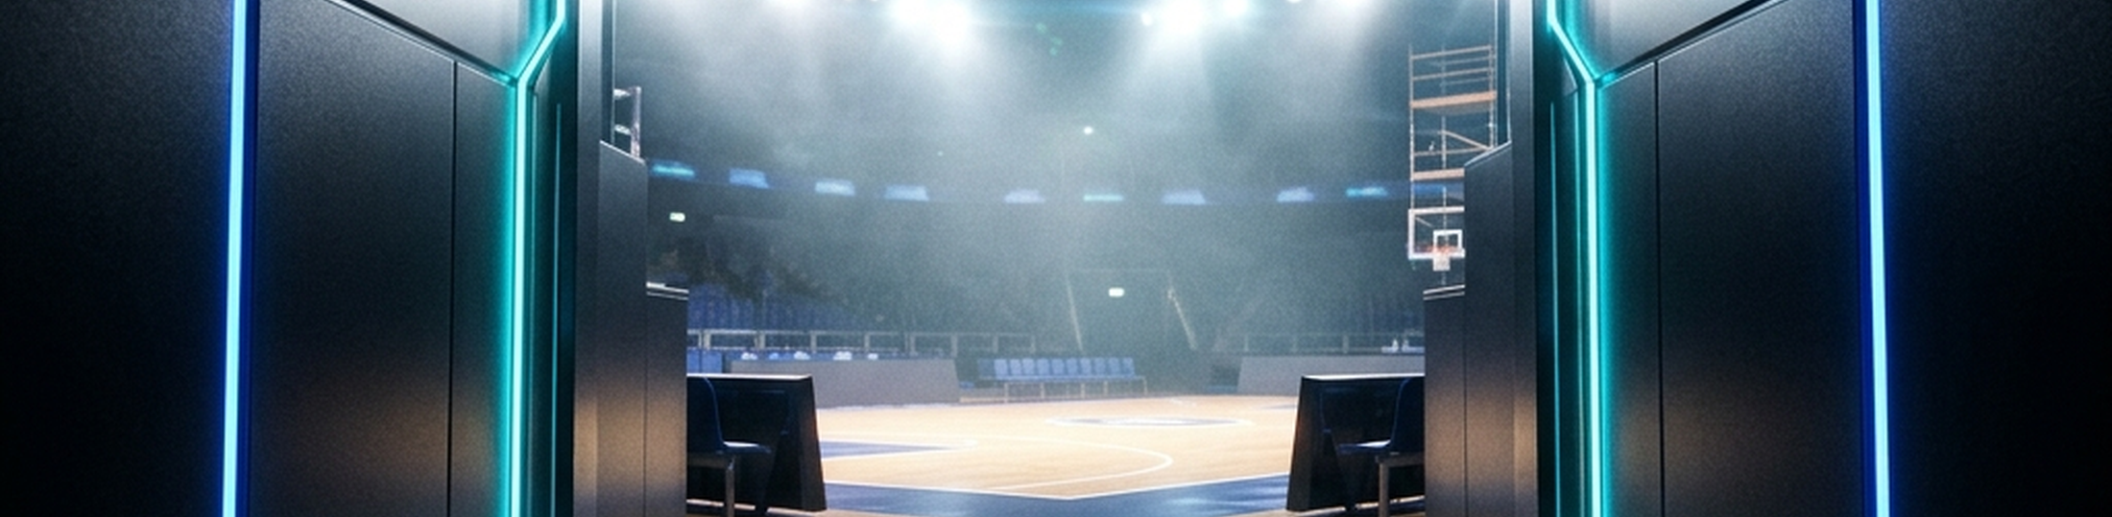
Bring Kinetic FanLab to Your Arena
Deploy one-tap crowd telemetry and localized sponsor drops for your next home game.
LAUNCH A STADIUM PILOT
EXPLORE LIVE TELEMETRY
PARTNER WITH US
TROY RESENDEZ • T.A. RESENDEZ INC.
Notes:
Thank you for exploring Kinetic FanLab. Teams, venues, and regional sponsors can launch a pilot or test live telemetry at https://kineticfanlab-ff8r8uefl7hbmak7awskq4.streamlit.app/. Sources: facts.md.

Slide 10
REFERENCES
Sources & Production Links
Live Application: https://kineticfanlab-ff8r8uefl7hbmak7awskq4.streamlit.app/
GitHub Repository: https://github.com/KTAR69/Kinetic_FanLab
Demo Video (YouTube): https://youtu.be/H1XWpE-eAdY
Architecture & Engineering Contracts: AGENTS.md, Design.md, and app.py
Performance & Governance Metrics: Kinetic FanLab Automated Test Suites & watsonx.governance Audit
Notes:
Sources: facts.md.

