Slide 1


WebGIS Lab 3
DEBAYAN MANDAL

Slide 2
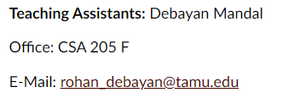
Lab Hours
Notes:
Please mail me before. Don’t wait till the submission date.

Slide 3
Learning Outcomes
Obtain Industry Standards Tutorial Badge
Build HTML
Build CSS
Achieve Professional Resume Site

Slide 4
What is HTML?
HTML stands for Hyper Text Markup Language
HTML describes the structure of web pages using markup
HTML elements are the building blocks of HTML pages
HTML elements are represented by tags
HTML tags label pieces of content (elements) such as heading, paragraph, table, and so on
Browsers do not display the HTML tags; they use them to render the content of the page

Slide 5
HTML Elements
Tags are the elements that create the components of a page
Tags surrounded by angle brackets < >
Usually come in pairs (Example: opening tag <h1> and closing tag </h1>)
Tags are not case sensitive. New standard is to use lower case

Slide 6
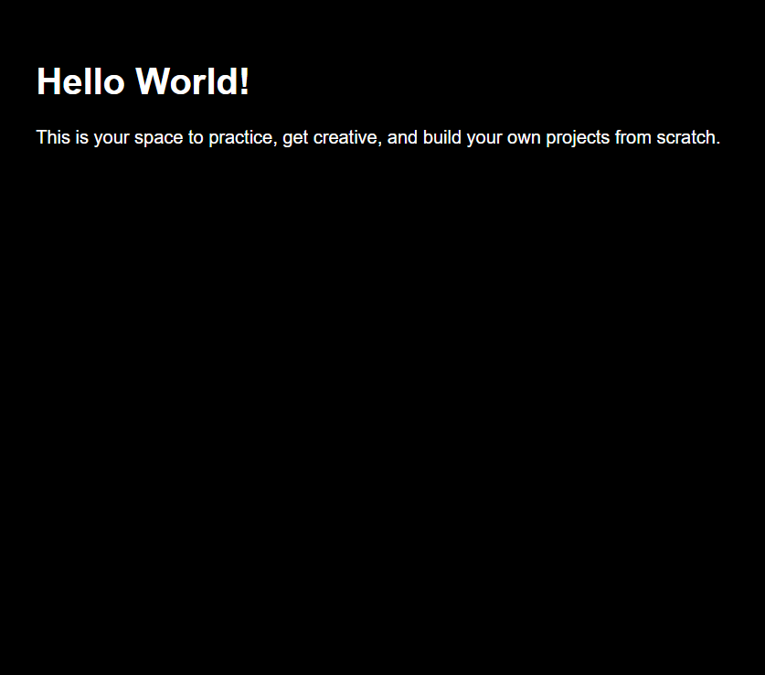
Page Basic Components
<!DOCTYPE html>
<html>
<head>
<title>Basic Web Page</title>
<meta name="viewport" content="width=device-width,initial-scale=1" >
<link href='style.css' rel='stylesheet'>
</head>
<body>
<script src='script.js'></script>
<h1>Hello World!</h1>
<p>This is your space to practice, get creative, and build your own projects from scratch.</p>
</body>
</html>

Slide 7
Page Basic Components
The !DOCTYPE html declaration defines this document to be HTML5
The html element is the root element of an HTML page
The head element contains meta information about the document
The title element specifies a title for the document
The body element contains the visible page content

Slide 8

Basic Tags
Headings: -
<h1>…</h1> to <h6>…</h6>
Paragraph: -
<p>… </p>
Link: -
Anchor tag <a>…</a>. There are 3 kinds of links:
Link to page in same folder
Link to page in different folder
Link to outside webpage on the Internet

Slide 9

Basic Tags
Image Source Tag: -
Image source tag is a self-closing tag (no closing tag).
There are two components of Image tag:
url = point to the location of your image file
alt = describes image for screen readers
List Tag: -
The <ul> tag defines an unordered (bulleted) list.
The <ol> tag defines an ordered (numbered) list.
Use the <ul> / <ol>tag together with the <li> tag to create list items.

Slide 10
What is CSS?
CSS stands for Cascading Style Sheets.
It is a style sheet language used for describing the presentation of a document written in a markup language.
It is used to style and lay out web pages —
For example: -
to alter the font, color, size and spacing of your content, split it into multiple columns, or add animations and other decorative features.

Slide 11
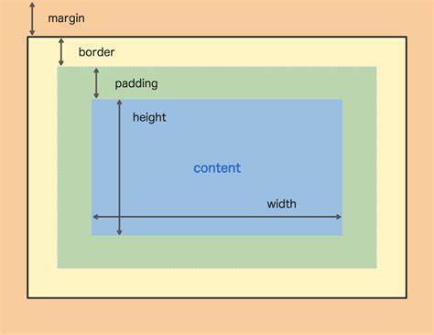
The Box Model

Slide 12
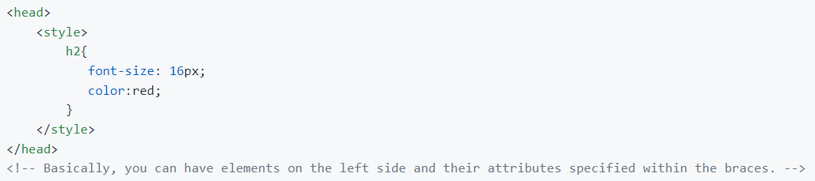
CSS can be added to HTML elements in 3 ways:
Inline – (by using the style attribute in HTML elements)
Internal – (by using a <style> element in the <head> section An internal CSS is used to define a style for a single HTML page)

Slide 13
CSS can be added to HTML elements in 3 ways:
External – (by using an external CSS file An external style sheet is used to define the style for many HTML pages. With an external style sheet, you can change the look of an entire web site, by changing one file!)
Next bits will be from: -
https://www.codecademy.com/learn/learn-html (Finish lesson 1 and 2)
https://www.codecademy.com/learn/learn-css (Finish lesson 1 and 2)
Screenshot the completions.
Notes:
https://www.codecademy.com/workspaces/62004547169761e773404989

Slide 14
At the end of the lessons
https://www.codecademy.com/workspaces/62004547169761e773404989
https://www.codecademy.com/workspaces/6200550a2fa67f2527380c58
https://www.codecademy.com/workspaces/6200f503169761e77340facc
Useful Extension: -
Name: Live Server
Id: ritwickdey.liveserver
Description: Launch a development local Server with live reload feature for static & dynamic pages
Version: 5.7.4
Publisher: Ritwick Dey
VS Marketplace Link: https://marketplace.visualstudio.com/items?itemName=ritwickdey.LiveServer

Slide 15
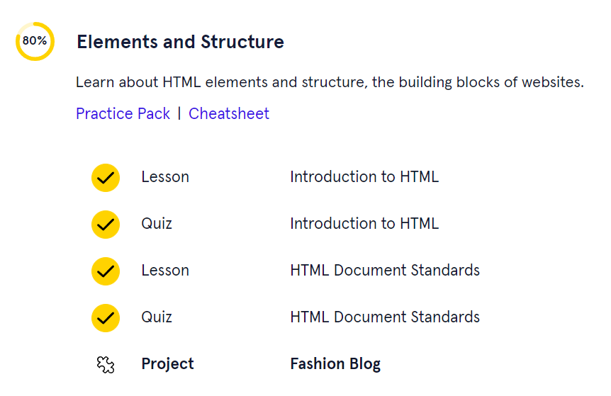
Screenshot Example
Quiz need not be done
Notes:
Quiz need not be done.

Slide 16
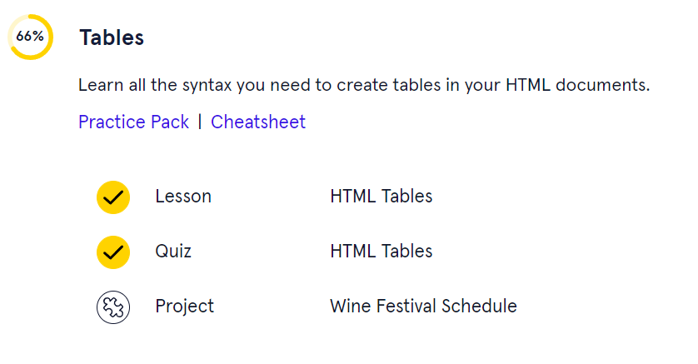
Screenshot Example
Quiz need not be done
Notes:
Quiz need not be done.

Slide 17
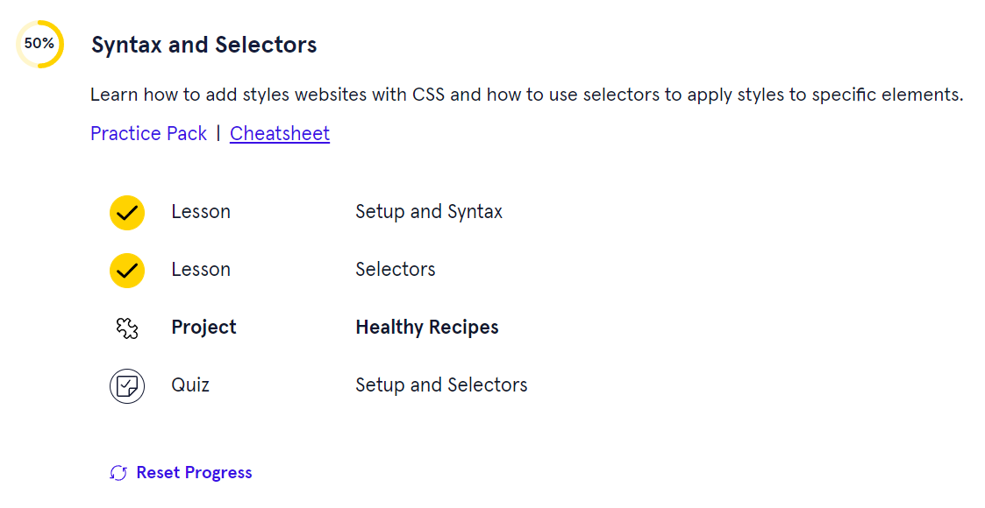
Screenshot Example
Quiz need not be done
Notes:
Quiz need not be done.

Slide 18
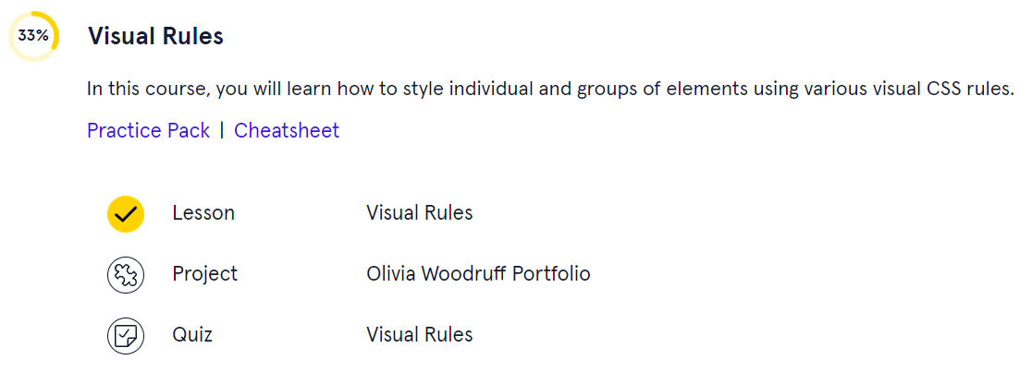
Screenshot Example
Quiz need not be done
Notes:
Quiz need not be done.

Slide 19
To Hand In
Required Screenshots of the courses
A Professional Resume using HTML, CSS files made from scratch.
Check Rubric to include all elements
Upload all files to GitHub. Update ReadMe.md of week03 accordingly
Submit GitHub link to Canvas

Slide 20
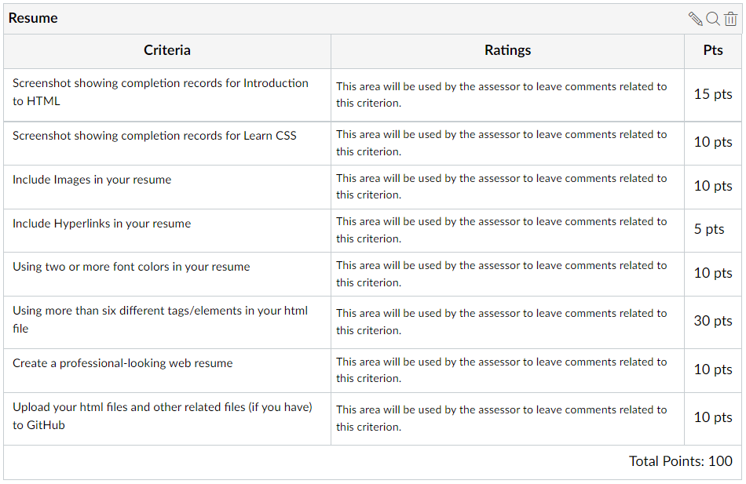
Rubric

Slide 21
Thank You
Any Questions?

