Slide 1


WebGIS Lab 4
DEBAYAN MANDAL

Slide 2
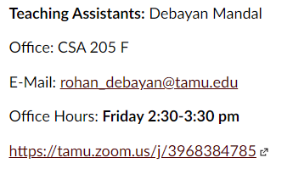
Lab Hours
Notes:
Please mail me before. Don’t wait till the submission date.

Slide 3
Learning Outcomes (JS)
Build interactive web pages (JavaScript button clicks)
Create and utilize JSON objects
Make arrays
Apply basic JavaScript control structure (loops, if/else)

Slide 4
What is JSON?
JSON (JavaScript Object Notation) is the base object structure which powers almost all of JavaScript.
Everything in JavaScript is an object
If you need an object, you make it
If someone else (or a server spitting out data) makes or give you objects, you can use them.

Slide 5
What is JSON?
You can access all attributes and methods of a JSON object with dot and array notation
Most of the time, you will be sending JSON objects to a server to process, and it will be sending you back JSON objects in response
GeoJSON is a special variant of JSON (i.e., a special JavaScript object) which encodes geographic information into a JavaScript object
ArcGIS and most other geo-related servers and API's (MapBox, Google Maps, etc.) can understand GeoJSON, and it's the preferred way to send and receive geographic data

Slide 6
Assignment Components
HTML Files:
index.html –
The HTML page you will create in order to have a button displayed which does things
Javascript Files:
script.js –
The Javascript file where you will do your actual programming

Slide 7
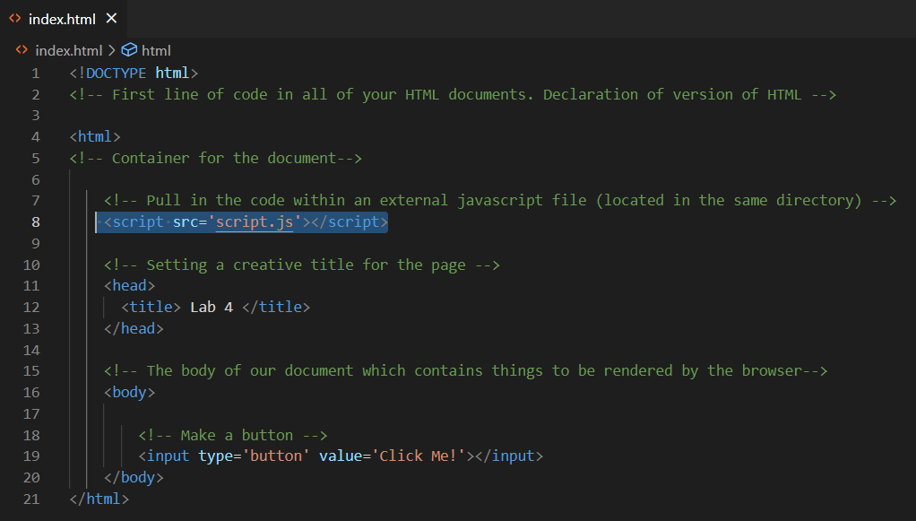
HTML Page Components

Slide 8
The script element is where we write our JavaScript: -
In this case, we are writing our JavaScript in a separate file in the same directory, script.js
So, we add the src attribute to specify the external JavaScript file that we would like to import into this HTML document
The input element specifies that you would like to gather user input: -
Setting the input element's type attribute specifies that the input should be a button (other options include radio buttons, checkboxes, text boxes, etc.)
Setting the input element’s value attribute specifies what should be displayed as text on the button

Slide 9
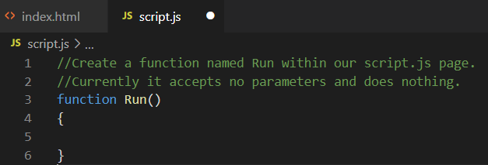
JavaScript Page Components
Inside of our JavaScript file (script.js), we create a function named run
Comments are anything which starts with two slashes \\

Slide 10
Call the JavaScript function when a user clicks the button
By setting the onclick attribute of our button, we can make the browser execute some JavaScript code
In this case, we are running JavaScript code which pops up an alert box.
To call the Run() method located in our JavaScript file, we call that function instead of our alert box.

Slide 11
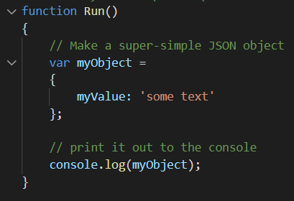
Let's make an object
In JavaScript, you can make an object at any time simply by using JavaScript object notation (JSON)
All JSON objects are wrapped inside of curly brackets { ... }
JSON uses attribute: value syntax to create object properties and assign them values

Slide 12
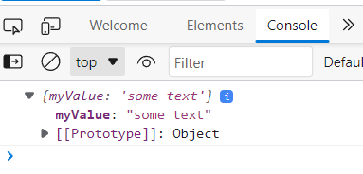
Let's make an object
Here, we are making a variable named myObject and setting it equal to a new JSON object.
The JSON object have one property, named myValue which is assigned a text (string) value.
When we log the variable myObject to the console (i.e., print it out), we see that we have an object with a property inside which has our value.
To Open Console: -
Right Click => Inspect

Slide 13
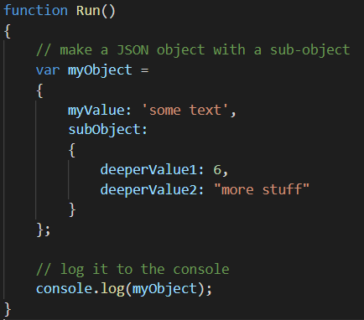
Let's make a more complicated object
JSON objects can contain other JSON objects, simply by setting the value of a property to be a full JSON object. It should start and end with curly brackets and contain attribute: value pairs.

Slide 14
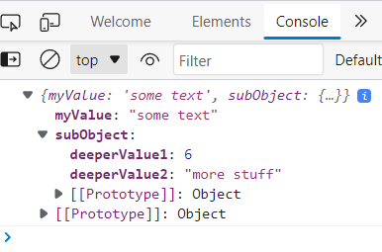
Let's make a more complicated object
Here we have created more properties on our myOject JSON object.
To add properties past the first one, you separate them with commas.
We add a second property subObject, which is itself a JSON object with two properties
deeperValue1 with an integer value of 6
deeperValue2 with a string value of "more stuff"

Slide 15
Let's code like a normal person
Don’t hard-code object properties
Let’s create a single function which builds and returns functions based on parameters which we send in.

Slide 16
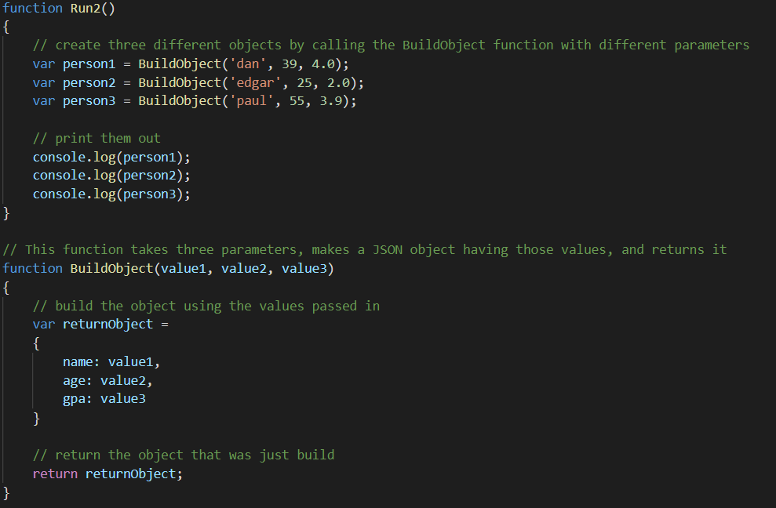
Let's code like a normal person

Slide 17
Let's code like a normal person
Here, we create another JavaScript function in our JavaScript file named BuildObject to handle the creation of our objects, rather than doing them one by one via cut/paste.
The function takes three parameters: value1, value2, and value3.
These names specific names are garbage and could be anything you want them to be which makes more sense. Whatever you name them in the function definition, you just must make sure to use them wit the right name in your code.
Within the function, we create a variable named returnObject which is a JSON object.
We add three properties to the object: name, age, and gpa.
The values for each of these properties are set to the three parameters which we pass into the function.
At the end of the function, we use the return keyword to pass the object that we created inside the function back to whoever called the function.

Slide 18
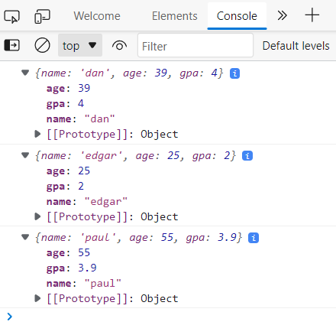
Let's code like a normal person
To make use of our new BuildObject function, we update our Run() function to call it.
We create three new variables person1, person2, and person3 and set their values to be objects returned from the BuildObject function.
Each of these variables is set by passing in different parameter values to the BuildObject function.
Each of these objects is logged to the console, and each of them have the properties which we passed in.

Slide 19
Let’s finally do something
Now that we can create objects, we should do something with them. Let's make another function which loops through them and computes and prints out the person with the lowest GPA.

Slide 20
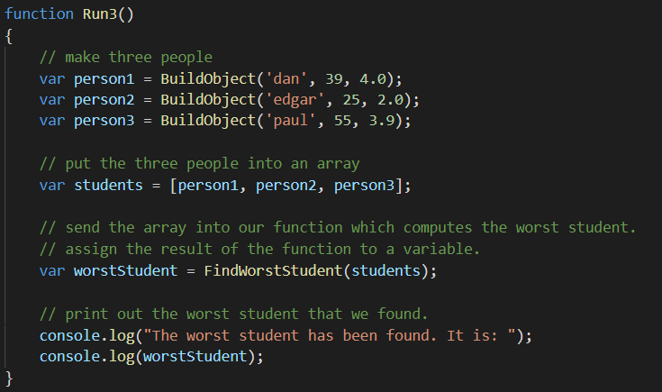

Slide 21
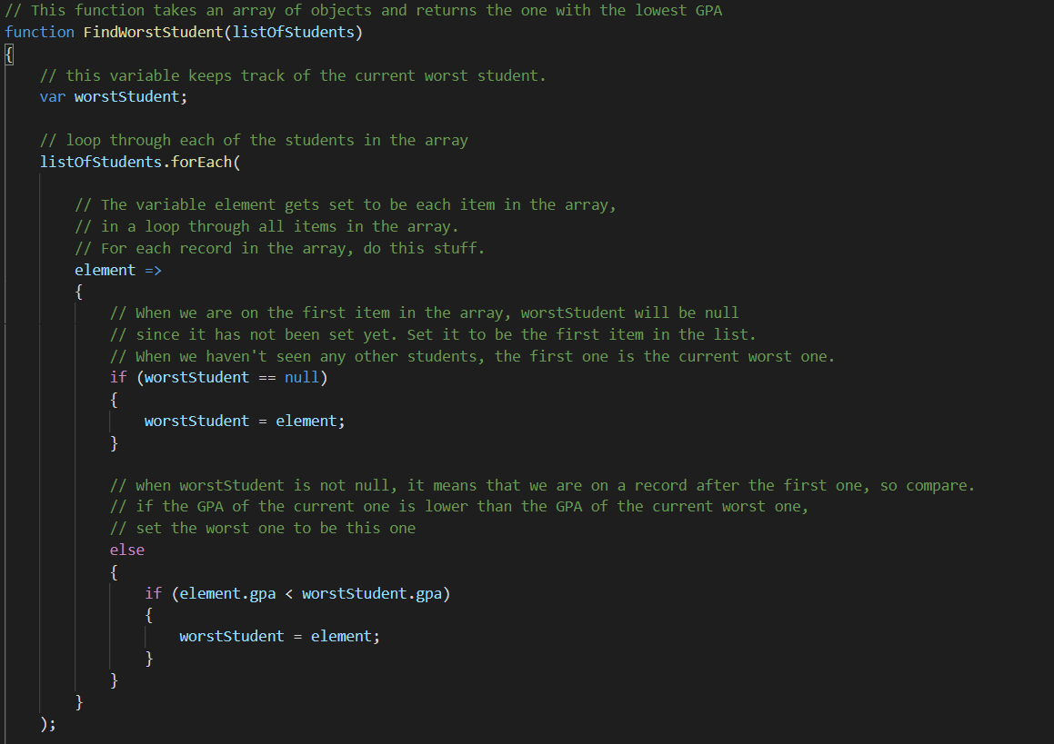

Slide 22
Let’s finally do something
Using our function to create objects based on parameters we pass in (BuildObject), we can make a bunch and then do some computations.
Here, we create three JSON objects using our BuildObject function and add them all to an array.
We pass that array into a new FindWorstStudent function which loops through all of the items in the array and computes the one with the lowest GPA, and returns it.
We do our looping through the array using the Javascript built-in forEach() function.

Slide 23
Let’s finally do something
The forEach loops through all items in the array and assigns the temporary variable element each time, which we use to determine if a specific array item has the lowest GPA.
Everything after the => (arrow) gets called for each item in the list. This is where we do our computation.
We keep track of the item with the lowest GPA that has been seen so far using the variable worstStudent, which we update each time that we see an item with a lower GPA.
After we loop through all items and have set the one with the lowest GPA to be worstStudent, we return worstStudent and print it out to the console

Slide 24
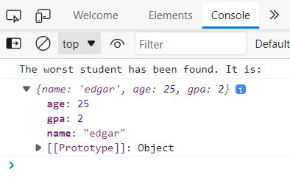
Let’s finally do something

Slide 25

External Data Source
Objects from data source, like an ArcGIS server, or some other data file.
To make use of JSON objects from another location (meaning, not ones that you create yourself), you just must load them like any other JavaScript file.
We tell our browser to pull a JSON object from a file (which is different than a URL source), by adding the file to our HTML document via a script tag and setting the source attribute be the name of the file which contains the JSON.

Slide 26
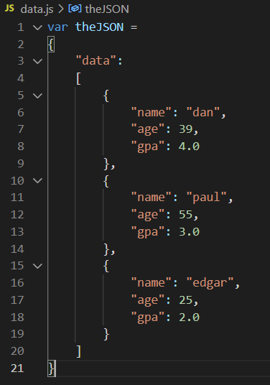
data.js
We create a variable named theJSON and set it to be a JSON object.
The JSON object starts and ends with curly brackets { }
At the root level, the JSON object has one property named data
The value of the property data is an Array of objects. It starts and ends with square brackets [ ]
Each item in the Array is a full JSON object
It starts and ends with curly brackets
Each property of an item in the Array is written in JSON attributeName : attributeValue format
All attribute names are wrapped in double quotes (attribute names in JSON must be strings)
The attribute values can be any data type, including sub objects. In this case they are strings, integers, and floats.

Slide 27
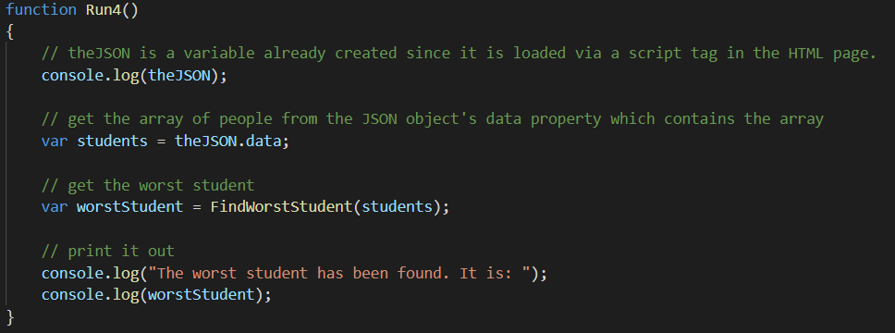
Updating the Run function

Slide 28
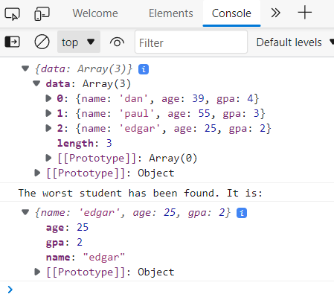
Results:

Slide 29
Task 1: Create and link the HTML and JavaScript pages for this assignment - 20 points
Create your index.html page
Create your script.js page
Add a script tag to include your JavaScript page within your HTML page.
Add a script tag to include the data for this assignment datas.js (download from Module).

Slide 30
Task 2: Create an HTML button which calls your JavaScript function Run() when it is clicked - 5 points
Inside of your HTML document:
Create a button input
Make the onclick action of the button call a Run() JavaScript function

Slide 31
Task 3: Create the Run function inside of your JavaScript file - 5 points
Inside of your JavaScript file, create a new function named Run()

Slide 32
Task 4: Create JavaScript functions to calculate the bounding box of the data file - 20 points
Create one or more functions which selects the points from the data file which are the top left, top right, bottom left, and bottom right corners of the data set.
Top Reft = Max Lat and Min Lon
Top Right = Max Lat and Max Lon
Bottom Left = Min Lat and Min Lon
Bottom Right = Min Lat and Max Lon

Slide 33
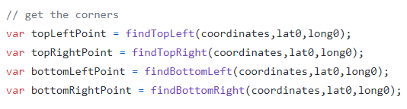
Task 5: Make your Run function call your function(s) that find the corners - 20 points

Slide 34
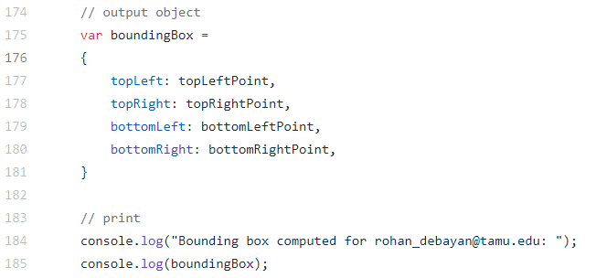
Task 6: Create an output object from your corners - 20 points
Task 7: Print out your result, along with your email - 5 points

Slide 35
Task 7: Take a screenshot of the console showing your email and your bounding box - 2.5 points

Slide 36
Task 8: Upload your code to your GitHub account - 2.5 points
Upload your .html and .js files to your GitHub repository labs\04\ folder

Slide 37
To Hand In
GitHub:
Upload your .html and .js files to your GitHub repository labs\04\ folder
Canvas:
Create and submit a screenshot of your console output showing your email address and output object to Canvas.
Submit to Canvas the link of your GitHub lab\04\folder.

Slide 38
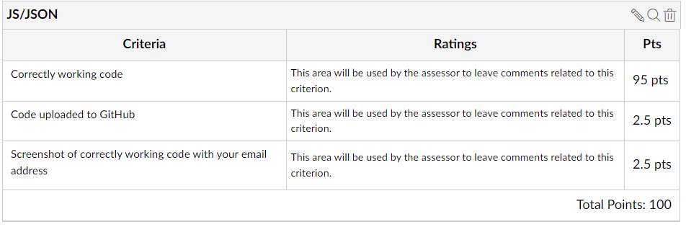
To Hand In

Slide 39
Thank You
Any Questions?

