Slide 1


WebGIS Lab 6
DEBAYAN MANDAL

Slide 2
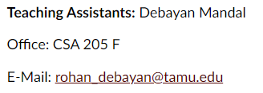
Lab Hours
Notes:
Please mail me before. Don’t wait till the submission date.

Slide 3
Learning Outcomes (JS)
Setting up a Leaflet map
Working with GeoJSON data
More Advanced functions with Leaflet

Slide 4
What is GEOJSON?
GeoJSON is an open standard format designed for representing simple geographical features, along with their non-spatial attributes.
The features include points (therefore addresses and locations), line strings (therefore streets, highways and boundaries), polygons (countries, provinces, tracts of land), and multi-part collections of these types.

Slide 5
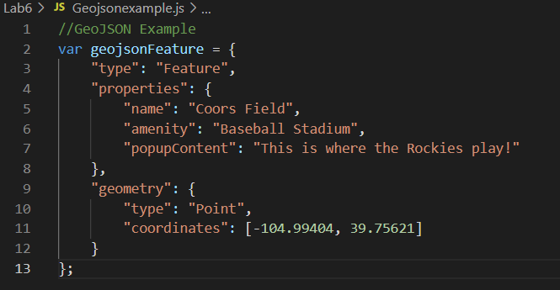
GEOJSON Example

Slide 6
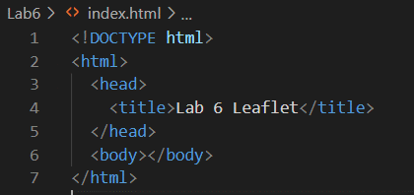
Preparing your page
Create a new html file with basic components

Slide 7
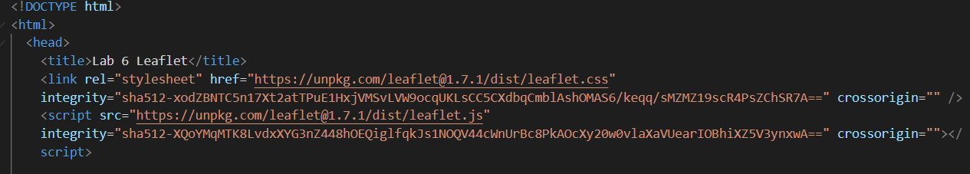
Preparing your page
Include Leaflet CSS and JavaScript file in the head section of your document:

Slide 8
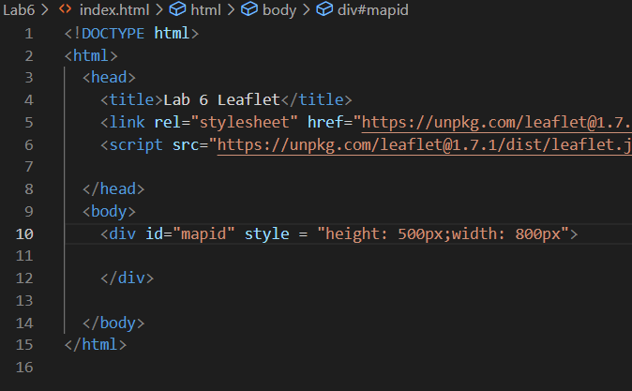
Preparing your page
Put a div element with a certain id where you want your map to be:

Slide 9

Setting up the map
Let’s create a map of the center of London with pretty Mapbox Streets tiles. First, we’ll initialize the map and set its view to our chosen geographical coordinates and a zoom level:

Slide 10
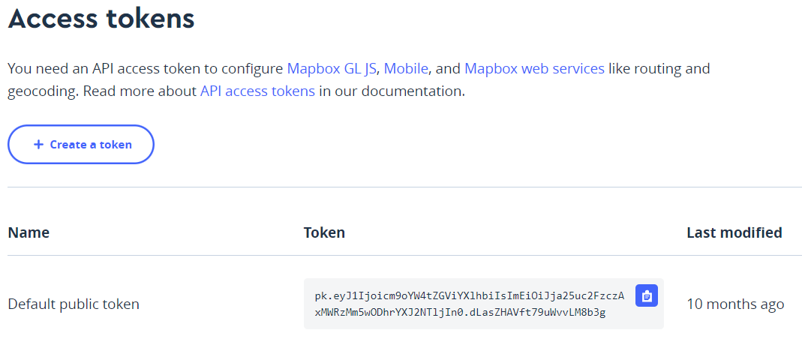
Setting up the map
In this example we’ll use the mapbox.streets tiles from Mapbox’s Streets (in order to use tiles from Mapbox, you must also request an access token).
Account | Mapbox
Notes:
Streets Map Style | Mapbox
Gallery (mapbox.com)

Slide 11
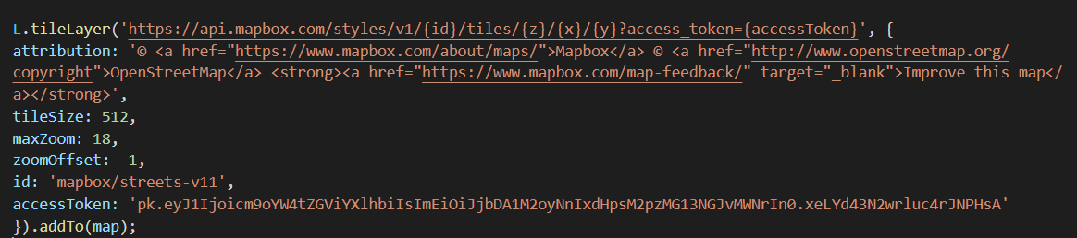
Setting up the map
Next, we’ll add a tile layer to add to our map, in this case it’s a Mapbox Streets tile layer. Creating a tile layer usually involves setting the URL template for the tile images, the attribution text and the maximum zoom level of the layer.

Slide 12
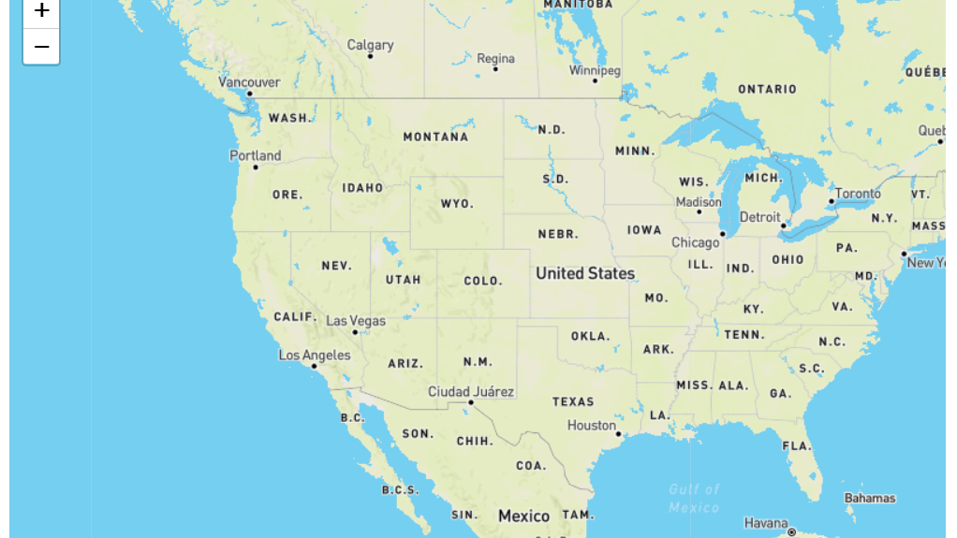

Slide 13
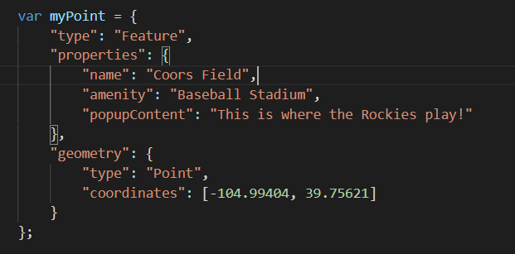
Adding GeoJSON Features (Point/Line/Polygon) into Your Map
Point:

Slide 14
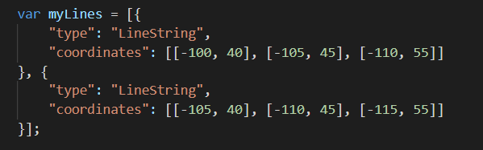
Adding GeoJSON Features (Point/Line/Polygon) into Your Map
Line:

Slide 15
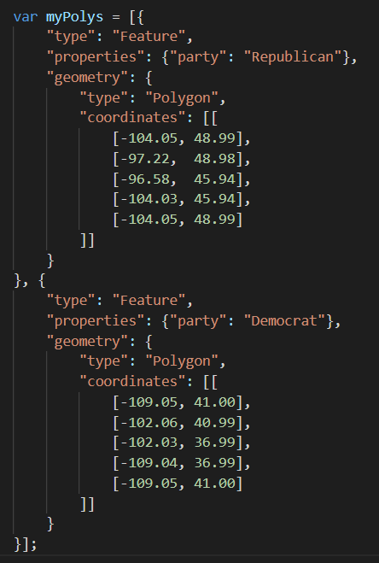
Adding GeoJSON Features (Point/Line/Polygon) into Your Map
Polygon:

Slide 16

Adding GeoJSON Features (Point/Line/Polygon) into Your Map
Adding them:

Slide 17
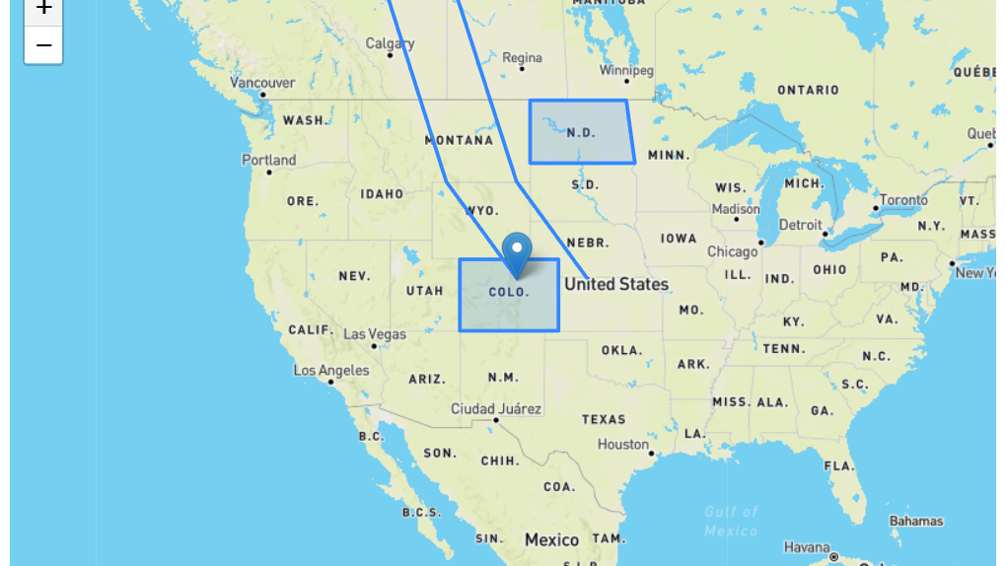
Don’t leave your heart here

Slide 18
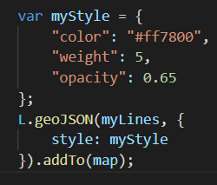
Styling Your Feature
The style option can be used to style features two different ways. First, we can pass a simple object that styles all paths (polylines and polygons) the same way:

Slide 19
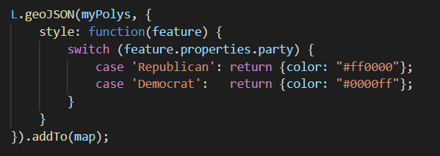
Styling Your Feature
Alternatively, we can pass a function that styles individual features based on their properties. In the example below we check the "party" property and style our polygons accordingly:

Slide 20
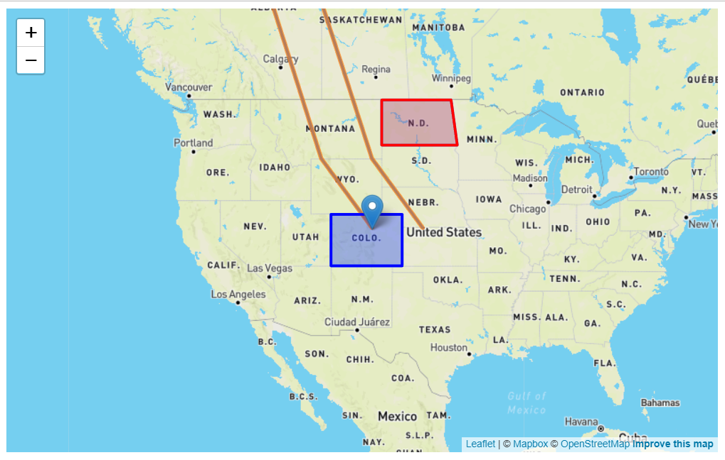

Slide 21

Adding External GeoJSON File
Step 1: Link your webpage with the external GeoJSON data; Include this code snippet after your map
Step 2: Add GeoJSON File into Your Map
Alternatively, we can directly copy the external GeoJSON code, and save it inside of your html file.

Slide 22
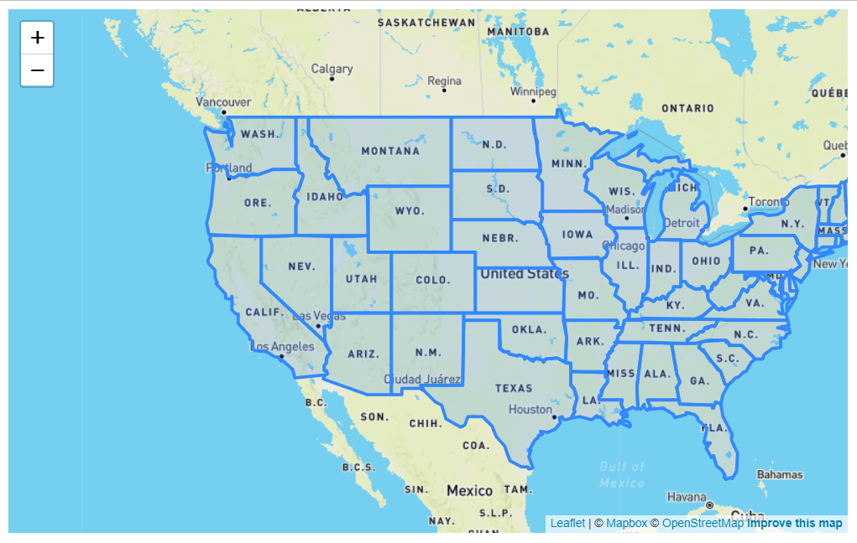

Slide 23
Task 1: -
Finish the fourth and fifth online Leaflet tutorials - create working HTML pages in your repo for each of the tutorials
Tutorial 1: Using GeoJSON with Leaflet
Tutorial 2: Interactive Choropleth Map

Slide 24
Task 2: -
Build a custom web map that integrates each of the tutorials
give your webpage a title e.g., "Your name TAMU Map"
zoom the map view to TAMU Campus with an appropriate zoom level 10pt.
add external TAMU Building GeoJSON (download from Modules) into your Map 10pt.
change your building color to "Maroon" or any color you like 10pt.
make the buildings highlighted visually in some way when they are hovered with a mouse 10pt.
define a click listener that zooms to the building 10pt.
custom an Info Control to show the building's name and abbr. when they are hovered with a mouse 10pt.

Slide 25
To Hand In
GitHub - 3 html files
Upload 3 html files (one for each tutorial and one for custom web map) to your lab06 folder
Canvas - 3 screenshots and a link
Open the Custom_Map.html you created, and the web maps you created from tutorials in a browser and take a screenshot for each web map and upload them.
Submit your GitHub link.

Slide 26
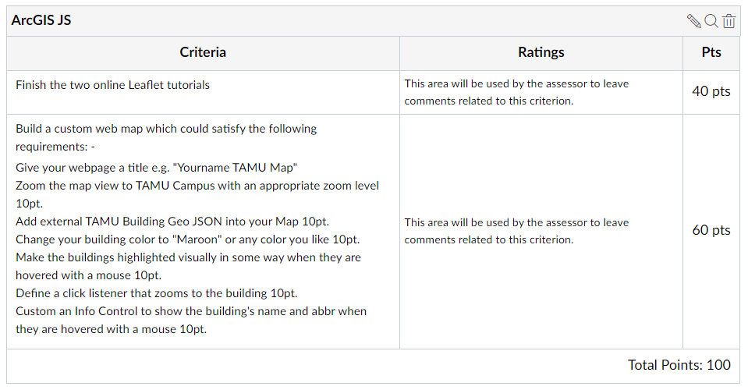
To Hand In
Notes:
All tasks, including labs, homework, and reports will have 5% point reduction for the late submission.

Slide 27
Thank You
Any Questions?

