Slide 1
Monitoring of the ExPECA Testbed
Gathering and Displaying Testbed Status and Performance

Slide 2

What and Why
Collect and display performance metrics, info about system state, and important events
Quickly detect faults, resource shortages, system changes, etc
Save time and effort for testbed administrators
Increase confidence in the testbed as platform for experiments
Helps anticipation of actions (e.g. upgrades) for testbed improvement

Slide 3


Overview
Testbed
Prometheus
Grafana
Node 1
Metrics Scraping
(HTTP)
Exporter 1
Exporter 2
Metrics Query (HTTP)
(Could be HTTPS if necessary)
Node 2
Panels
Dashboards
Exporter 1
Exporter 2

Slide 4
Prometheus
Application to gather and store time series metrics
”Scrapes” metrics from exporters’ exposed ports
Already included in the testbed as a container service
Exposes port to display applications (e.g. Grafana) for metrics query
Has alerting functionality

Slide 5
Prometheus Exporters
Applications that gather metric data from co-located systems
Exposes ports to Prometheus for metrics collection
Some exporters already exist on testbed as container services, like node exporter, which can give node related information (CPU load, memory usage, etc), and Openstack exporter (Openstack service information)

Slide 6
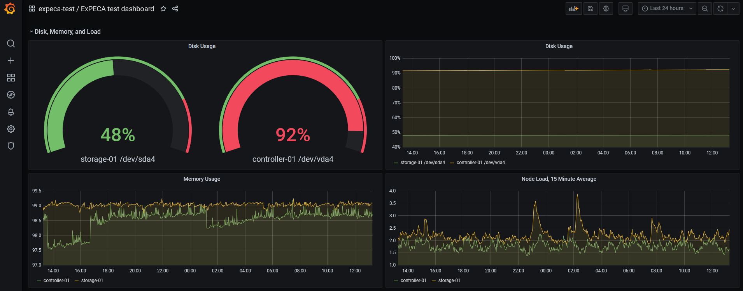
Grafana
Application to query and display data (panels, dashboards), plus alerting
Can be installed on external server, on testbed server (e.g. controller), or cloud

Slide 7
Customized ExPECA Exporter
Collect data we need, and expose to Prometheus
Exporter loaded on various nodes in the system
Collectors can be developed and plugged in as we need them
Collector
Exporter
Collector
Collector
Collector

Slide 8
Customized ExPECA Exporter: expeca-exporter.py
This script is an exporter for Prometheus metrics
It takes metrics from "collector" scripts in JSON format, and exposes them on a specific port so that Prometheus can "scrape" the metrics into its database
A config file in YAML format defines the collector scripts (separate Python scripts) and their corresponding metrics, so that new collectors and/or metrics can be added easily
Usage: python3 expeca-exporter &

Slide 9
Customized ExPECA Exporter: expeca-exporter.yml
Configuration file for expeca-exporter.py
Defines polling interval – time interval between gathering of metrics data
Defines port to expose to Prometheus
Defines which collector scripts to call, and which metrics will be obtained from each

Slide 10
Customized ExPECA Exporter: expeca-scan-collector.py
This script is called by the expeca-exporter.py
Via SSH from controller, it runs scan.py on mgmt switch to collect status of ExPECA devices, checked through ping

Slide 11
Customized ExPECA Exporter: expeca-serverscan-collector.py
This script is called by the expeca-exporter.py
It checks connection with storage and worker nodes, through ping and SSH connection, and reports status

Slide 12
Current Situation
Prometheus server included as chi-in-a-box container, executing on controller node
Some exporters included as chi-in-a-box containers, executing on controller node
Open source node exporter also executes on worker nodes
Custom built exporter / collectors are executing on the controller node, to collect equipment status and Ericsson Private 5G metrics
Communication Prometheus ↔ Exporters on internal network
Communication Prometheus ↔ Grafana on public network
Grafana Cloud service is used for metrics display at expeca.grafana.net

Slide 13
Proposed Way Forward
We all pitch in with suggestions for metrics / data that would be useful to display
Alerts can be defined, to notify us about system degradation and changes (both Prometheus and Grafana have alert capabilities)
Brick by brick, we build a better monitoring solution

Slide 14
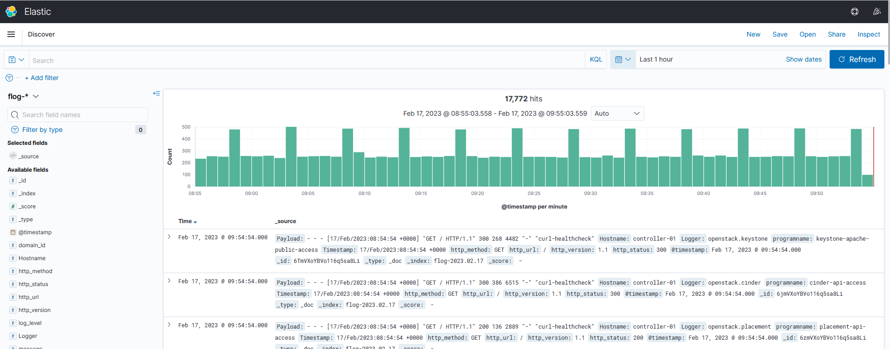
More to look into…
Elasticsearch / Kibana – already on the testbed
Log collection and analysis

