Slide 1
GNSS / PTP Sync of the ExPECA Testbed

Slide 2
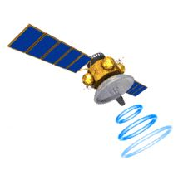
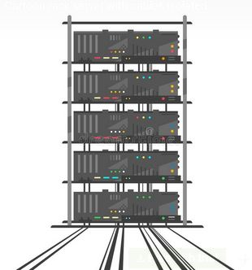
What and Why
GPS / GNSS
Synchronize network elements, both with regards to clocking of communications as well as with precise time reference. GPS / GNSS is used as source for such synchronization
Ericsson Private 5G needs high quality GPS / GNSS based sync for operation
Time Sensitive Networking (TSN) needs high quality sync (within a few nanoseconds)
Many other fields of research require high precision timestamping
ExPECA
GNSS / PTP Sync of the ExPECA Testbed

Slide 3
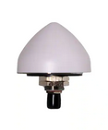
Overall Architecture
GNSS Antenna
Coaxial
50 m
The GNSS antenna provides signal, via GNSS splitter, to Ericsson Private 5G system and to a PTP (Precision TimeProtocol) Grandmaster clock
The GM clock provides, via a PTP enabled switch, sync to TSN devices, using PTP protocol
One of the two GNSS receivers connected to the splitter will provide power to the active GNSS antenna. In our case, it is the Ericsson 5G GNSS receiver
GNSS Splitter
2 m
2 m
Ericsson
5G
PTP GM
Clock
Ethernet
PTP
Transparent
Clock / Switch
TSN Devices
GNSS / PTP Sync of the ExPECA Testbed

Slide 4
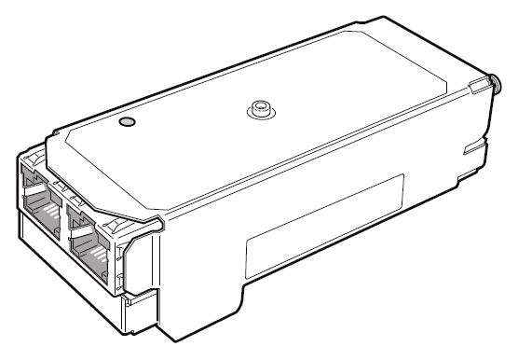
Ericsson Private 5G Sync
GNSS
The GNSS receiver gets GNSS signal from the active antenna via coaxial cable
The receiver then passes 1PPS (1 Pulse Per Second) and TOD (Time Of Day) to the 5G Baseband (part of the RAN Processor)
The baseband has a period (holdover) where it can hold sync if the GNSS signal is temporarily lost. Unclear for how long
GNSS
Receiver
5G Baseband
GNSS / PTP Sync of the ExPECA Testbed

Slide 5
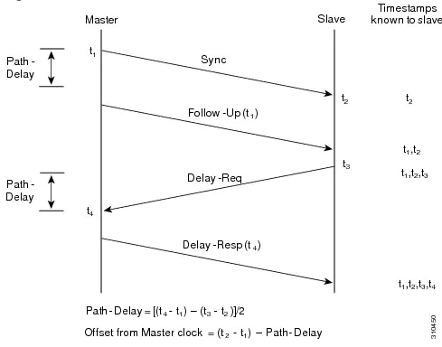
Precision Time Protocol (PTP)
A slave synchronizes its clock to a master clock
A switch between the Master and Slave can be a Transparent Clock, and we are using such a switch
A Transparent Clock is not really a clock, but allows for switching delays to be accounted for in the synchronization equation and requires hardware timestamping
GNSS / PTP Sync of the ExPECA Testbed

Slide 6
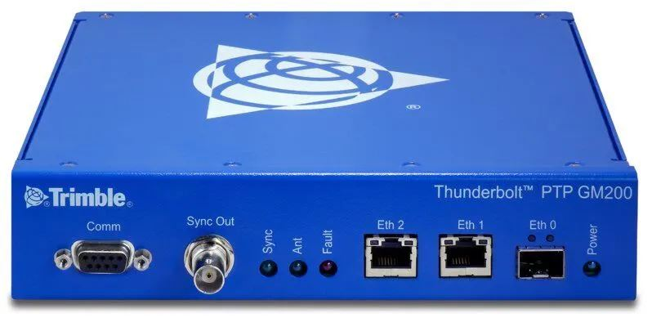
Trimble GM200 PTP Grandmaster Clock
Takes sync input from GNSS
Provides PTP sync to slaves via Eth 1 port, which is connected to a transparent clock / switch
A separate port, Eth 2, is used for management, with its own IP address
GPS and GLONASS satellites are accepted for input
251 ns delay is configured, based on active antenna delay and delay due to 52 meter GNSS coaxial cable. This will have to be adjusted when we use longer cables to reach the new server room in R1
If GNSS signal is lost, it has holdover ± 1.5us for > 12h @ 25 °C (after seven days locking)
GNSS / PTP Sync of the ExPECA Testbed

