Slide 1
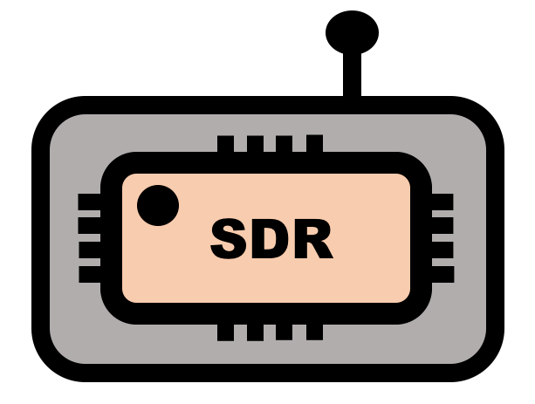
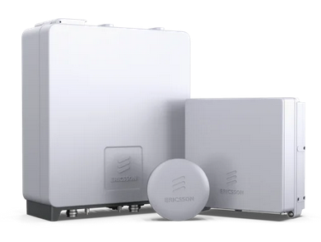

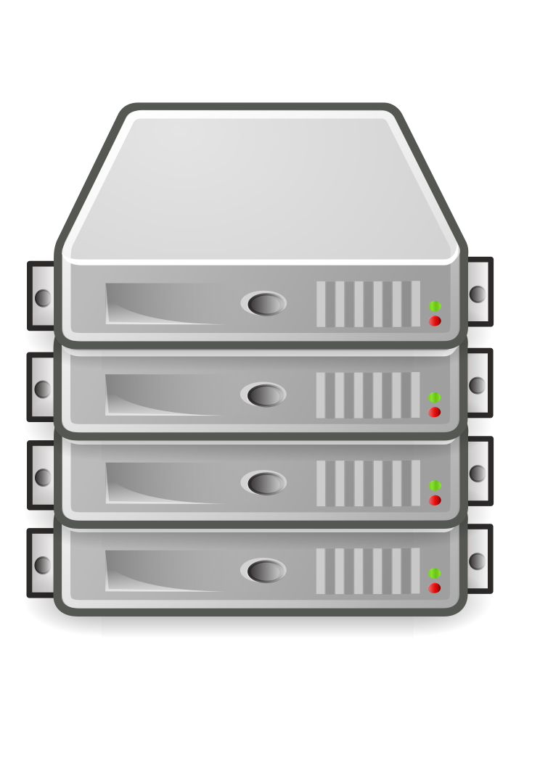
Software Defined Radios
Internet
User-defined Networking
Ericsson Private 5G
5G Routers
Compute / Worker Nodes

