Slide 1
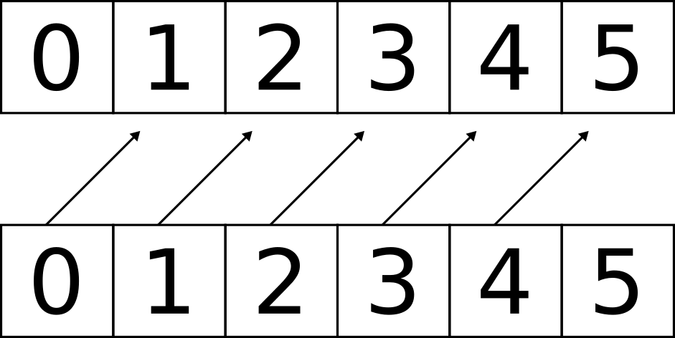
Forward LSTM

Slide 2
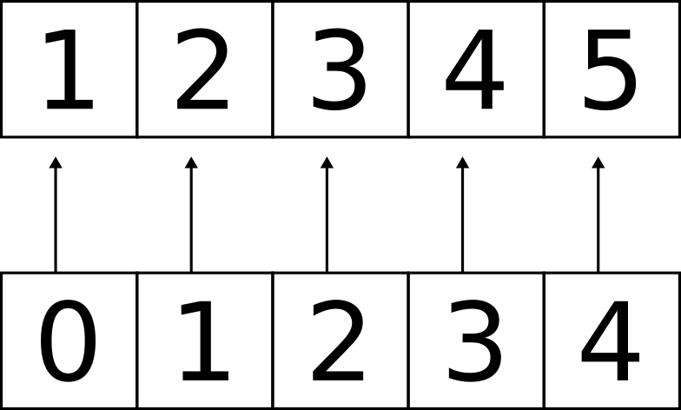
Align Labels

Slide 3
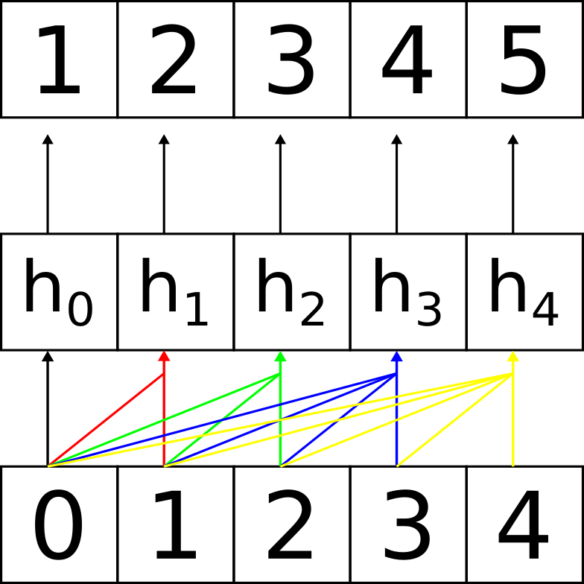
Hidden Units
&
Loss Calculation

Slide 4
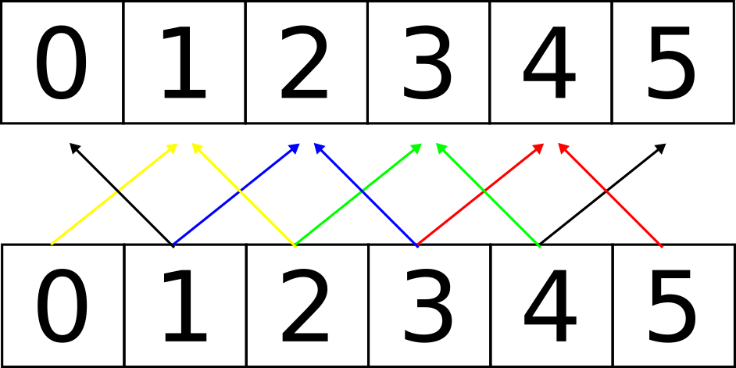
Bidirectional LSTM

Slide 5
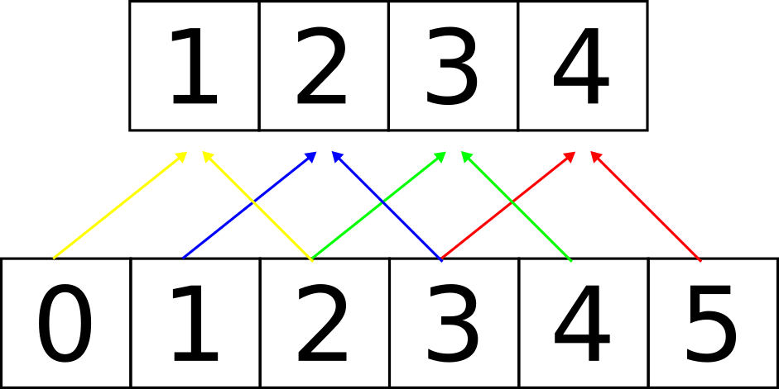
Remove Unidirectional Labels

Slide 6
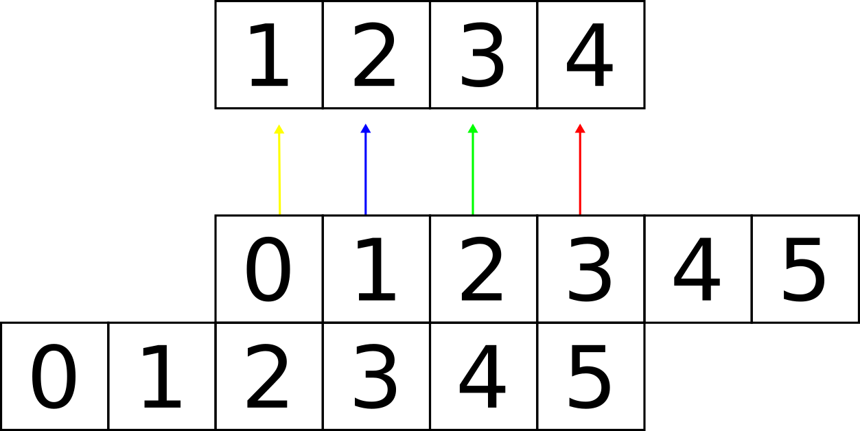
Token Alignment

Slide 7
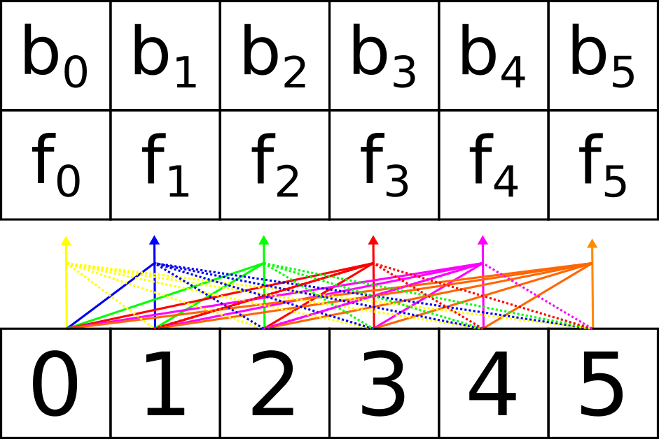
Hidden Units

Slide 8

Hidden Unit Alignment

Slide 9
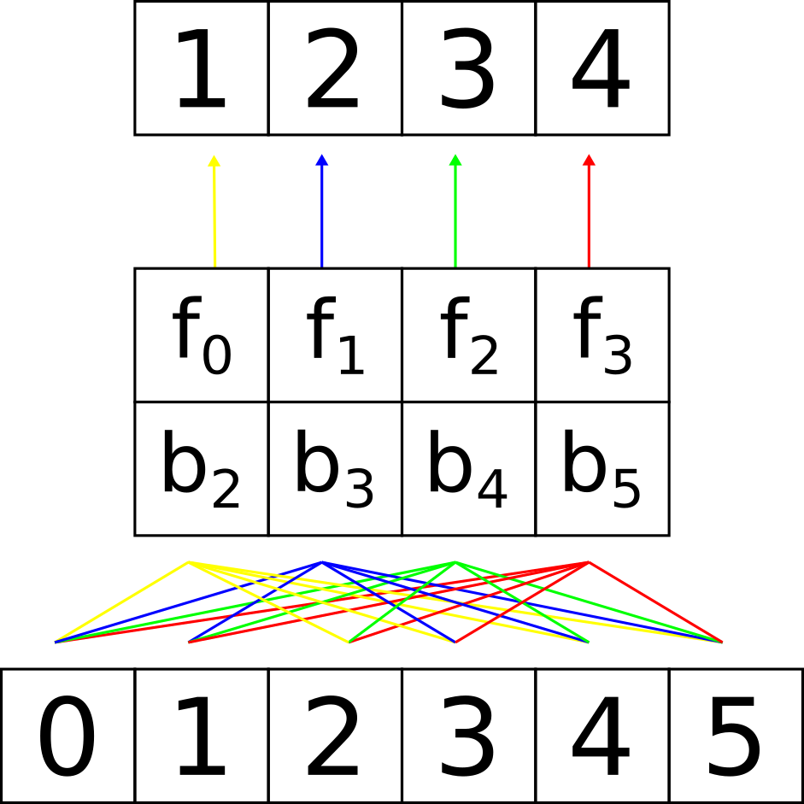
Loss Calculation

