Slide 1
Introduction to Energy Systems Modelling
Francesco Gardumi
gardumi@kth.se
MJ2380/MJ2381 – Introduction to Energy Systems Analysis and Applications
Lecture 1
2020-01-17
Notes:
Presentation, title, me, Youssef
Contact info for any issue regarding the course
All access to Canvas and read docs? Please do!!!
Please subscribe to a group – all - asap
If any issue re registration or so, come after lecture / write to me

Slide 2
Big and small text
Small text
Big text

Slide 3
Learning outcomes
By the end of this course, students will be able to:
ILO 1: Describe common energy systems modelling and scenario analysis approaches and identify their key strengths and limitations;
ILO 2: Write a basic linear energy system optimization problem in GNU MathProg modelling language;
ILO 3: Apply a selected energy systems modelling tool in the analysis of stylized long-term energy planning problems;
ILO 4: Analyze various sample energy system situations and appropriately distill insights, given limited and uncertain information;
ILO 5: Include a basic representation of the links between climate, water, land use and energy into an energy system model;
ILO 6: Undertake a thorough and detailed analysis of a selected national energy system, including independent data gathering, problem definition, model choice, generation of solutions and interpretation.
Notes:
- Phrasing is a bit different from what you find on the course website on KTH (under update). So please for any kind of info refer to the docs I put on Canvas! That must be your bible.

Slide 4
Building on MJ2413 Energy and Environment
Continuity:
Course content
Same starting point: what is an energy system
Course deliverables
For MJ2380 students: Similar structure for the final report (context, literature, data search...)
Notes:
- Who has attended MJ2413?

Slide 5
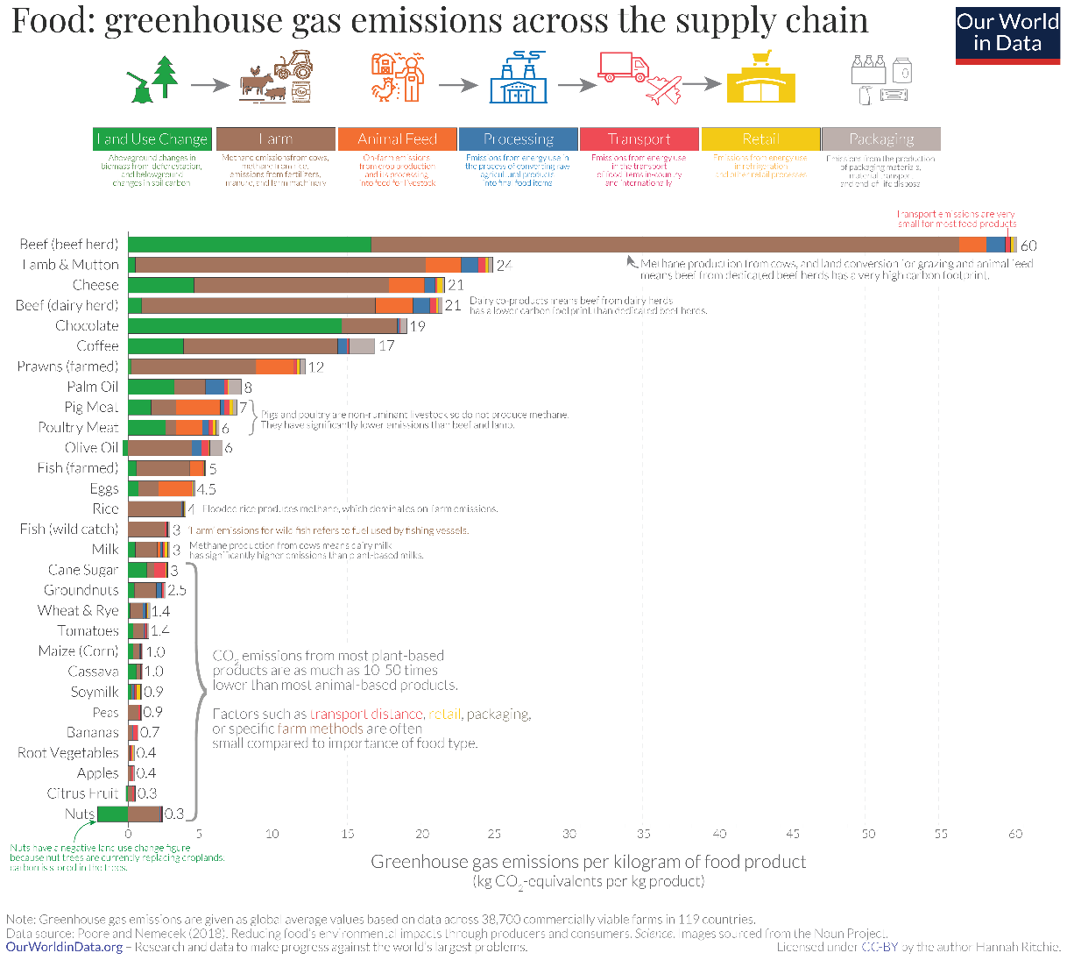
A slide with one Figure

Slide 6
Figure + text
Text on the right of the picture,
Might be difficult to make it show in the slide
Second text box next to the picture

Slide 7
Figure + text
Text on top of figure
Second text box on bottom and bigger

Slide 8
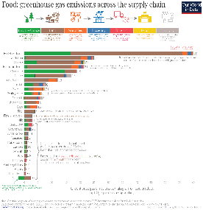
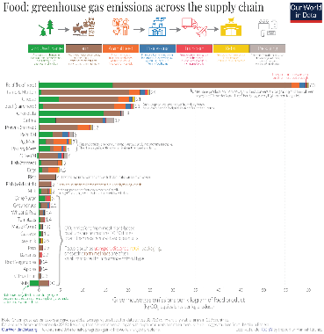
Figure + text
Text left of figure
Second text box on right and bigger
Third text box on right and bigger

Slide 10
A slide with one table
 | Col 1 | Col 2 | Col 3 | Col 4
Row 1 | 1 | 2 | 3 | 4
Row 2 | 5 | 6 | 7 | 8
Some text below the table
Some smalle text in italic

Slide 11
Slide with one Smart art
first
secont
third

Slide 12
Slide with one graph

Slide 13
Some text and one shape
Some text and one arrow on the right:

Slide 14
Special characters minus -
Special characters
3 dots ...
3 apostrophes '''
minus –
u ü

Slide 15
Key take away messages
The energy system is a complicated network of processes and flows
Models are a useful tool to understand the energy system and formulate sound energy policies
Energy models provide insights for energy policies, not numbers
Modelling tools can be categorized into top-down and bottom-up. We will look at one type of bottom-up tools: optimization tools

Slide 16
Reading material
Modelling for insights, not numbers - Huntington et al. (1982): https://www.sciencedirect.com/science/article/pii/0305048382900020
Categorisation of modelling tools – Herbst et al. (2012): https://link.springer.com/content/pdf/10.1007%2FBF03399363.pdf
Review of different categorisation methods – Müller et al. (2018): https://www.sciencedirect.com/science/article/pii/S2211467X18300154

Slide 17
Thank you
For questions: gardumi@kth.se

