Slide 1
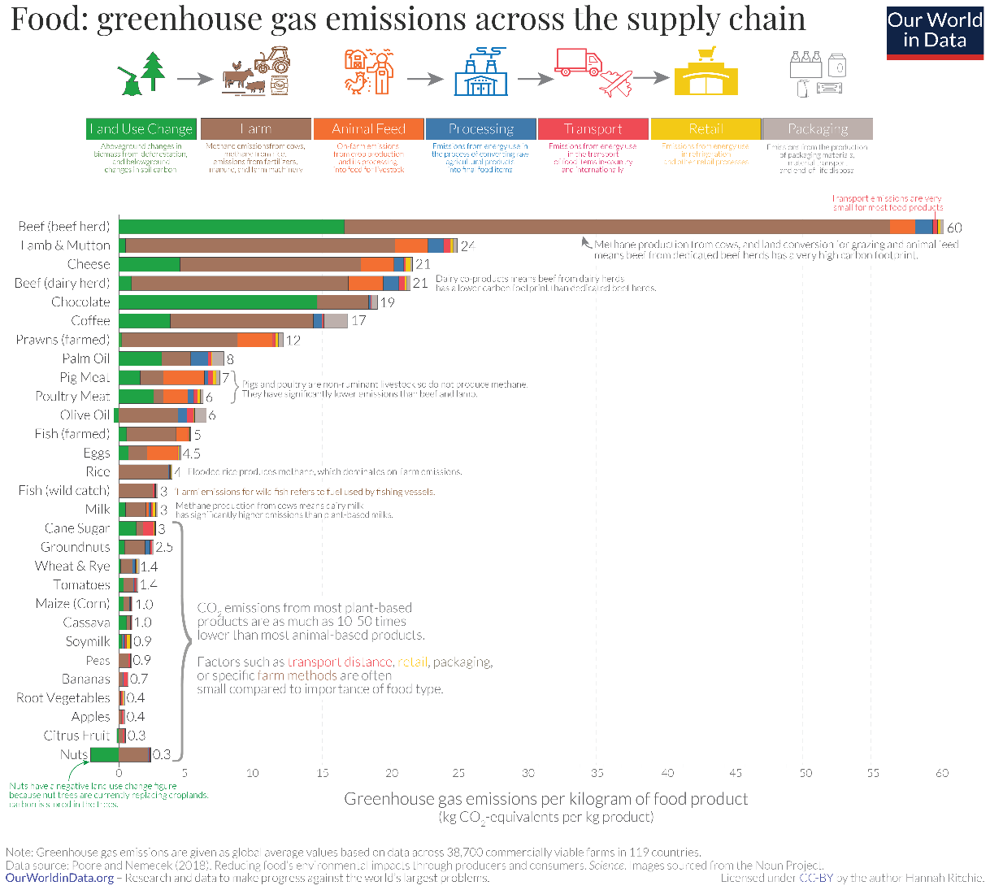
A slide with one Figure

Slide 2
A slide with a different picture

Slide 3
Slide with one graph

Slide 4
One smart art
Block 1
Block 2
Block 3

