Slide 1
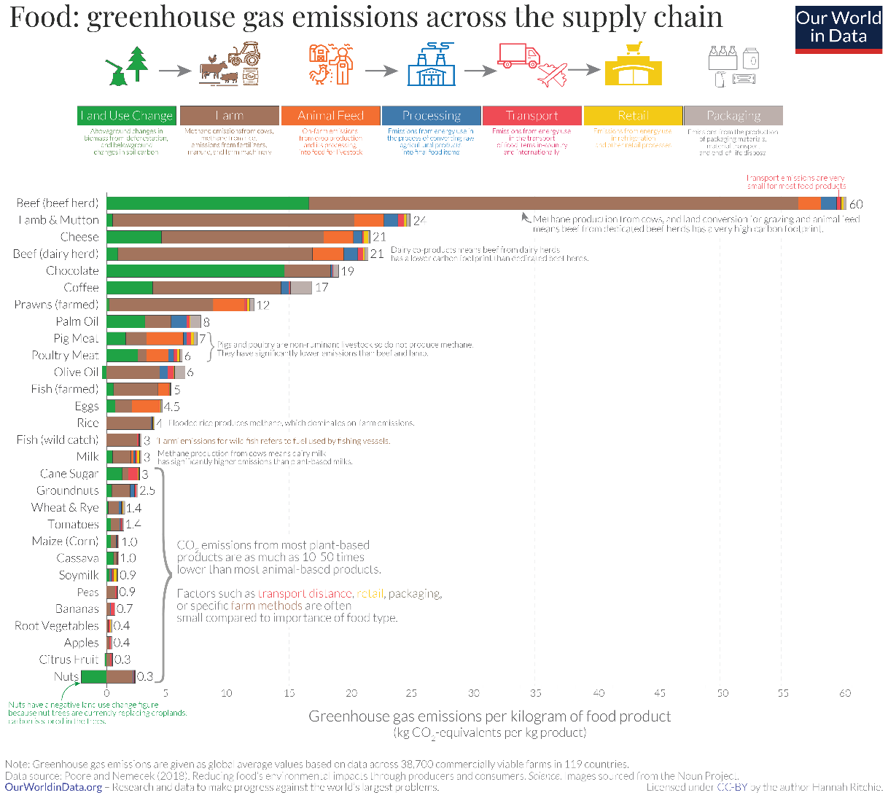
A slide with one Figure

Slide 2
Slide with one graph

Slide 3
One smart art
Block 1
Block 2
Block 3

