Slide 1
Introduction to Energy Systems Modelling
Francesco Gardumi
gardumi@kth.se
MJ2380/MJ2381 – Introduction to Energy Systems Analysis and Applications
Lecture 1
2020-01-17
Notes:
Presentation, title, me, Youssef
Contact info for any issue regarding the course
All access to Canvas and read docs? Please do!!!
Please subscribe to a group – all - asap
If any issue re registration or so, come after lecture / write to me

Slide 2
Learning outcomes
By the end of this course, students will be able to:
ILO 1: Describe common energy systems modelling and scenario analysis approaches and identify their key strengths and limitations;
ILO 2: Write a basic linear energy system optimization problem in GNU MathProg modelling language;
ILO 3: Apply a selected energy systems modelling tool in the analysis of stylized long-term energy planning problems;
ILO 4: Analyze various sample energy system situations and appropriately distill insights, given limited and uncertain information;
ILO 5: Include a basic representation of the links between climate, water, land use and energy into an energy system model;
ILO 6: Undertake a thorough and detailed analysis of a selected national energy system, including independent data gathering, problem definition, model choice, generation of solutions and interpretation.
Notes:
- Phrasing is a bit different from what you find on the course website on KTH (under update). So please for any kind of info refer to the docs I put on Canvas! That must be your bible.

Slide 3
Building on MJ2413 Energy and Environment
Continuity:
Course content
Same starting point: what is an energy system
Course deliverables
For MJ2380 students: Similar structure for the final report (context, literature, data search...)
Notes:
- Who has attended MJ2413?

Slide 4
Building on MJ2413 Energy and Environment
Moving beyond:
Course content
Deeply changing approach: from physical world to models
Diving into the analyst’s world: concepts, terminology, methodology, tools
Course deliverables
For MJ2380 students: also focus on applications in lit. review, use OSeMOSYS, larger array of scenarios, apply theory!

Slide 5
Throughout the course
Please read carefully the following documents on Canvas
MJ2380/MJ2381 - Course description deliverables and grading
MJ2380/MJ2381 - Course schedule
MJ2380 - Project description
Please keep the Canvas notifications on
Always check the Files section on Canvas – documents there are your reference
If after having done (1) and (2) you still have questions, please contact:
Francesco Gardumi – gardumi@kth.se

Slide 6
Your feedback is important
Right at the end of each lecture, there will be a very quick evaluation on Canvas with only two subjects
Rate the lecture (from 1 to 5)
Comment (if you have any points) on the content and the lecturer
Notes:
We are far from perfect
Feedback is important: we are now applying also suggestions we received in MJ2413

Slide 7
A slide with one table
 | Col 1 | Col 2 | Col 3 | Col 4
Row 1 | 1 | 2 | 3 | 4
Row 2 | 5 | 6 | 7 | 8
Some text below the table

Slide 8
Slide with one Smart art
first
secont
third

Slide 9
Slide with one graph

Slide 10
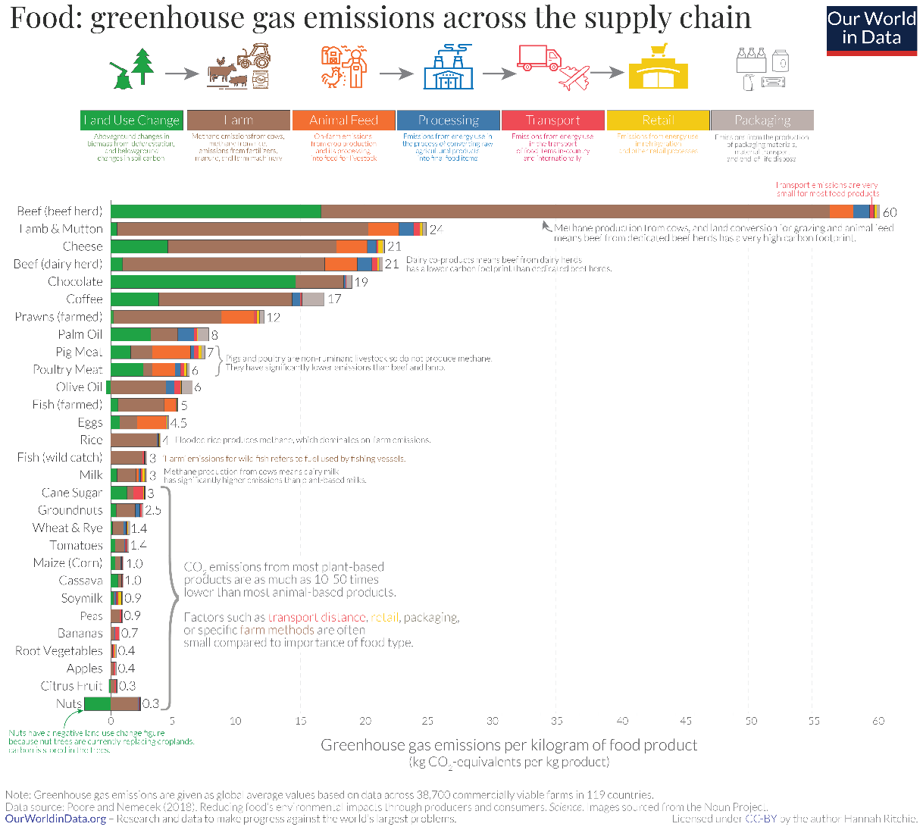
A slide with one Figure

Slide 11
Key take away messages
The energy system is a complicated network of processes and flows
Models are a useful tool to understand the energy system and formulate sound energy policies
Energy models provide insights for energy policies, not numbers
Modelling tools can be categorized into top-down and bottom-up. We will look at one type of bottom-up tools: optimization tools

Slide 12
Reading material
Modelling for insights, not numbers - Huntington et al. (1982): https://www.sciencedirect.com/science/article/pii/0305048382900020
Categorisation of modelling tools – Herbst et al. (2012): https://link.springer.com/content/pdf/10.1007%2FBF03399363.pdf
Review of different categorisation methods – Müller et al. (2018): https://www.sciencedirect.com/science/article/pii/S2211467X18300154

Slide 13
Thank you
For questions: gardumi@kth.se

