Slide 1
Introduction to linear optimisation and OSeMOSYS
Francesco Gardumi and Youssef Almulla
almulla@kth.se
MJ2380/MJ2381 – Introduction to Energy Systems Analysis and Applications
Lecture 2
2020-01-20

Slide 2
Course overview
Introduction
Model development
Beyond the energy system
Scenario analysis
Applications
Lec1: Intro to Energy Systems Analysis and modelling tools
Lec2: Optimisation models and OSeMOSYS
Lec4: Normative, descriptive, explorative scenarios
Lec5: Energy systems analysis in real life
Lec3: Modelling aspects of CLEWs
Lab 1:
Basics of linear programming
Lab 3, 4 and 5:
Structuring a Simple Model
Lab 6:
Adding elements of CLEWs
Lab 2:
RES and temporal representation
PRO 1
PRO 2
PRO 3
PRO 4
P/F quiz
PRO 5
Notes:
Structure of the course
Lectures and labs are not mandatory, but you are warmly advised to attend them, because: 1) content of the lectures is important for labs + it is object of the final quiz (you must pass the quiz to pass the course); 2) labs are a space you get to work on the PROs (deliverables) and where you can ask us any questions at any moment

Slide 3
Throughout the course
Please read carefully the following documents on Canvas
MJ2380/MJ2381 - Course description deliverables and grading
MJ2380/MJ2381 - Course schedule
MJ2380 - Project description
Please keep the Canvas notifications on
If after having done (1) and (2) you still have questions, please contact:
Francesco Gardumi – gardumi@kth.se

Slide 4
Your feedback is important
Right after each lecture, there will be a quick evaluation on Canvas with only two subjects
Rate the lecture
Comment on the content and the lecturer

Slide 5
Contents
Optimisation models
OSeMOSYS: the Open Source energy Modelling System
Interfaces for OSeMOSYS
Interpreting modelling results

Slide 6
Types of modelling tools
Draw on macroeconomic relationships and cross-sectoral dependencies.
MODELLING TOOLS
TOP-DOWN
ECONOMETRIC
INPUT/OUTPUT
CGE
BOTTOM-UP
ACCOUNTING
SIMULATION
OPTIMISATION
HYBRID MODELS
statistical analysis of historical time-series
interrelations between various sub-sectors of the economy
economy wide general equilibrium between sectoral demands and supplies
Projections based on socio-economic, technology and demographics
Accounting + rules (for dispatch, investments, …)
Calculate energy systems attributes driven by an objective function.
Provide a more detailed technological representation of the system.
Resource – to –use representation.
Mix of two or more of the above.

Slide 7
Optimisation models
Study of decision problems in which one seeks to minimise or maximise a function by systematically choosing the values of variables within their allowed sets.
Basic variables
Decision: describe alternative courses of action and are determined by decision makers (e.g. investments in new power plants);
Parameters: factors that affect the results. They are determined by the elements of the system and can be called “constraints of the problem” if they limit decision makers (e.g. O&M costs, emission caps, max capacity additions, fuel reserves).
Result: represent model outputs; they are frequently described by objective functions, such as profit (max) and cost (min or least-cost).

Slide 8
Characteristics of optimisation models
Common (but not exclusive!) characteristics:
Perfect competition: all players in the market compete against each other and supply their electricity at their marginal cost (”price takers”);
Perfect information: the market players make decisions with perfect information about parameters influencing them (e.g. all costs of all power plants known);
Perfect foresight: sub-set of the above; market players are assumed to know everything that will happen in the future (e.g. how demand evolves);
Dynamic: it gives solutions for different points in time (i.e. not only a snapshot);
Economically-rational consumer behaviour: technologies with the cheapest life-cycle costs are invested in.

Slide 9
Characteristics of optimisation models
One category is Partial Equilibrium models: they calculate the economic equilibrium of supply and demand within the sector being modelled (e.g. energy and power sectors).

Slide 10
Types of optimisation models
Linear programming (LP)
Type of optimisation in which the objective function and constraints are all linear. It is the base of other optimisation models. Mixed-Integer Linear Programming (MILP) is a subset.
Nonlinear programming (NLP)
Similar to LP, but where some of the constraints and/or the objective function are nonlinear.
Multi-objective programming (MOP)
Process in which two or more conflicting objectives are optimised subject to certain constraints.
Bi-level programming (BLP) and multi-level programming (MLP)
Complex optimisation problems where one problem is embedded in another one (a BLP is a two-level MLP).

Slide 11
Why using linear optimisation models in energy systems analysis?
to identify least-cost energy systems
to identify cost-effective responses to restrictions on emissions
to perform prospective analysis of long-term energy balances under different scenarios
to evaluate new technologies and priorities for R&D
to evaluate the effects of regulations, taxes, and subsidies
to project inventories of greenhouse gas emissions
to estimate the value of regional cooperation
Investigate scenarios (possible futures);
Explore alternatives to business as usual practices;
Inform decisions (policy and strategic planning)

Slide 12
Examples of energy modelling tools (model generators) using linear optimisation
MARKAL
(MARKet ALlocation)
Technology explicit, dynamic partial equilibrium models of energy markets.
Differ in technical features and properties (time length, timeslices definition, etc)
MARKAL and TIMES are developed by IEA-ETSAP.
TIMES
(The Integrated MARKAL-EFOM System)
Flexible framework for the comprehensive assessment of energy challenges
Development of energy scenarios and identification of socioeconomic and technological response strategies
The mathematical formulation ensures that the flows are consistent: demand is met, inflows equal outflows and constraints are not exceeded.
MESSAGE is developed by IIASA/IAEA.
MESSAGE
(Model for Energy Supply System Alternatives and their General Environmental Impacts)
OSeMOSYS
(Open Source Energy Modelling System)
Open source long-term energy model generator based on LP principle
Flexible and organised in blocks; user has access to the code and can implement changes to fit its problem
Developed by KTH-dESA and partners

Slide 13
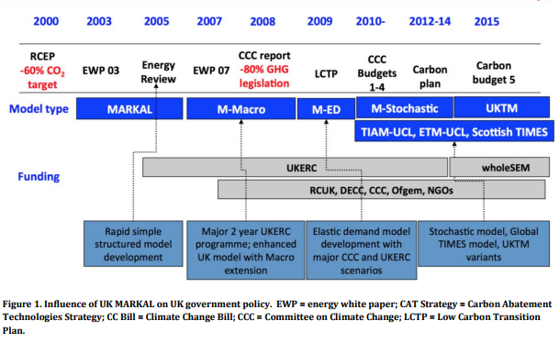

Examples of the use of model generators
MARKAL: UK MARKAL
TIMES: UKTM-UCL
TIMES is now preferred as a model generator (more flexible and internationally developed)
Opportunity to undergo a comprehensive review and revision of UK MARKAL’s design, underlying data and assumptions.
UKTM-UCL introduction video
https://youtu.be/tOV5Q0e_RW0

Slide 14
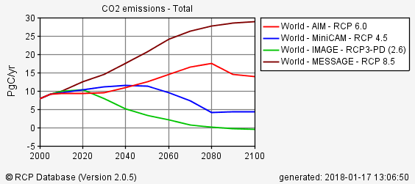
Examples of the use of model generators
MESSAGE
Among others, MESSAGE is used in the assessments and special reports of the IPCC and the Global Energy Assessment (GEA).
Used to generate one of the four Representative Concentration Pathways (RCPs). RCP8.5 is being used to estimate future climate change in the context of the IPCC 5th Assessment Report (AR5).
RCP Database - Comparison of RCP world CO2 emissions (MESSAGE - RCP8.5).
(source: http://tntcat.iiasa.ac.at/RcpDb/dsd?Action=htmlpage&page=compare)

Slide 15




OSeMOSYS Applications
OSeMOSYS
IRENA African Power Pools: Planning and Prospects of Renewable Energy
IEA WEO 2014 – Africa Energy Outlook
WB – Enhancing the Climate Resilience of African Infrastructure
UNECE transboundary nexus assessments
(Sava and Drina)

Slide 16
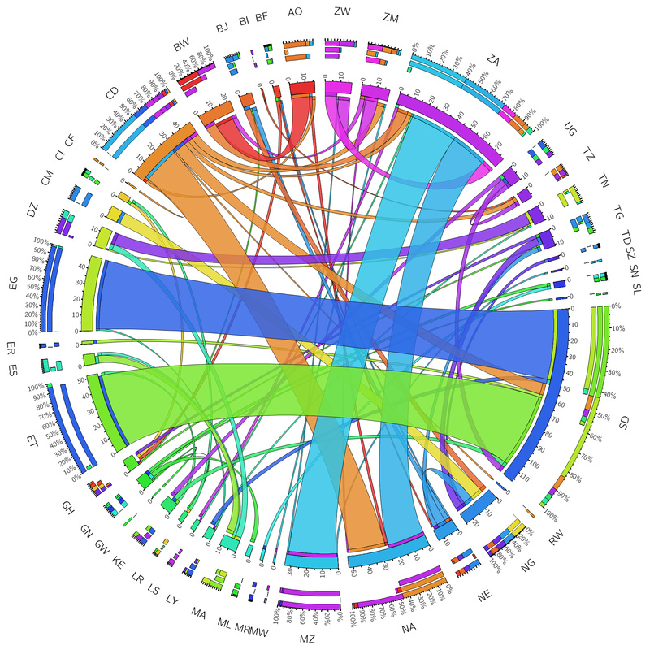

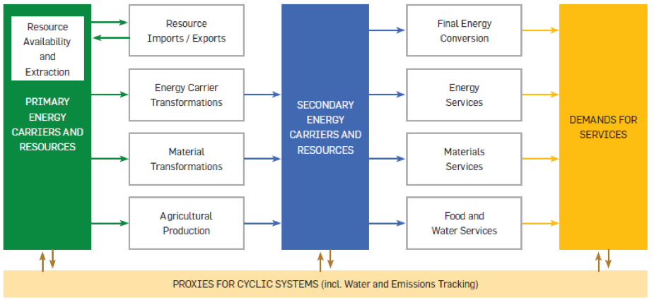
OSeMOSYS Applications
OSeMOSYS
TEMBA – The Energy Model Base for Africa
SAMBA – South America Model Base
CLEWS applications (GLUCOSE, Uganda, Nicaragua, Zimbabwe, Mauritius, Kenya, Bolivia, …)
Among UNDESA modelling tools for sustainable development policies.

Slide 17
OSeMOSYS the Open Source energy MOdelling SYStem

Slide 18
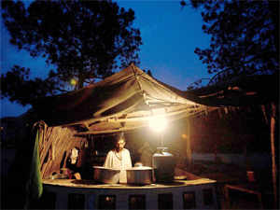
Imagine yourselves in the shoes of...

Slide 19
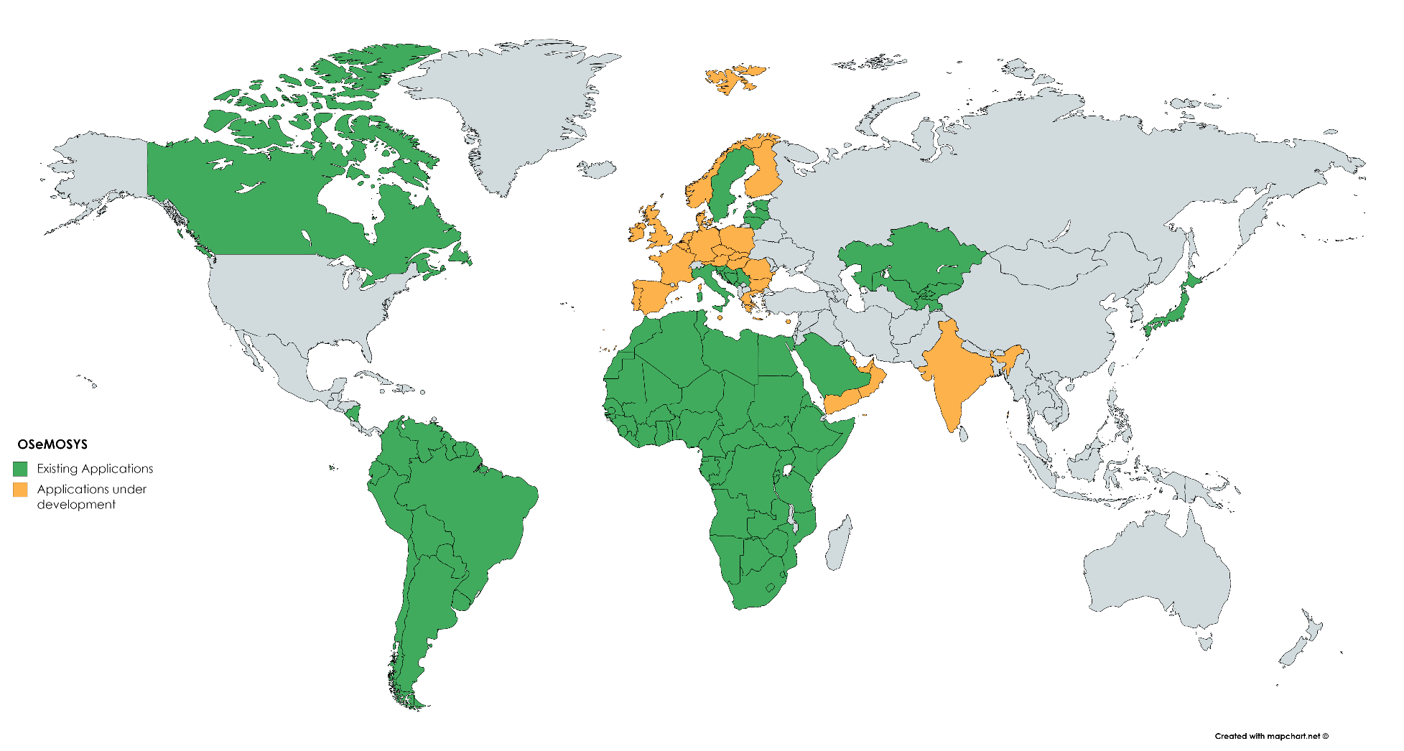
OSeMOSYS Applications

Slide 20
OSeMOSYS in the modelling suite
Now
2030
2040
2050
2100

Slide 21

OSeMOSYS
www.osemosys.org
Howells, M., et al. (2011). OSeMOSYS: The Open Source Energy Modeling System: An introduction to its ethos, structure and development, Energy Policy, 39(10), p.5850-5870.
Model generator converting the energy system structure represented by equations into a matrix to be solved by specific solvers
Linear optimisation
Freely available and Open source
Deterministic
Dynamic
Perfect foresight
Paradigm comparable to MESSAGE and TIMES

Slide 22
What does OSeMOSYS do?
It determines the energy system configuration with the minimum total discounted cost for a time domain of decades, constrained by:
Demand for energy (e.g. electricity, heating, cooling, km-passengers, etc.) that needs to be met
Available technologies and their techno-economic characteristics
Emission taxations and generation targets (e.g. renewables)
Other constraints (e.g. ramping capability, availability of resources, investment decisions, etc.)

Slide 23
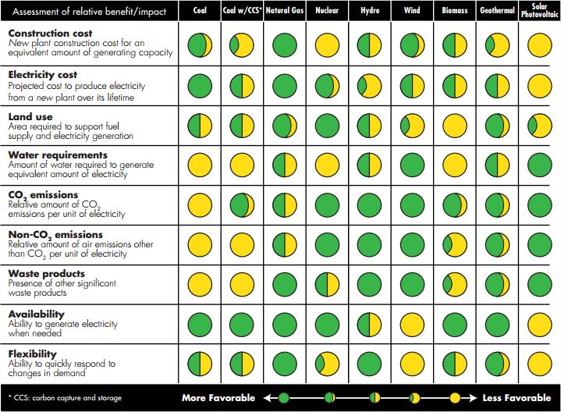
What does OSeMOSYS do?
Technologies compete to gain a share in the energy supply, based on:
a)their characteristics (e.g. cost, life time, efficiency etc);
b) other constraints (e.g. demand, min renewable generation, emissions, use of resources, etc).

Slide 24
OSeMOSYS Structure – Blocks of functionality
Three levels of abstraction: Plain English description, Mathematical formulation and Code formulation
Ref: OSeMOSYS Manual - https://osemosys.readthedocs.io/en/latest/
Objective
To estimate the lowest Net Present Value (NPV) of an energy system to meet given demand(s) for energy
Costs
Account for the costs incurred by each technology in each year and in each region
Capacity adequacy
There must be enough capacity for each technology in order to meet its energy use or production requirements:
Capacity adequacy A: Each time slice / Capacity adequacy B: Each year
Storage
It adds independent energy balances and constraints for storage options.

Slide 25
OSeMOSYS Structure – Blocks of functionality
Energy balance
Operation levels are calculated for each time slice and each year. The production, use and demand must be feasible at each timeslice and annually
Energy balance A: Each time slice / Energy balance B: Each year
Constraints
Maximum/minimum limit on capacity of a technology allowed for a year or total period and a region
Maximum/minimum limit on new capacities of a technology for a year and a region
Maximum/minimum limit on activity of a technology for a year or total period and a region
There must be enough capacity to provide a reserve margin (for specified technologies)
Emissions
The extent to which pollutants are emitted is determined by multiplying “emissions per unit of activity” and the annual activity of a technology

Slide 26
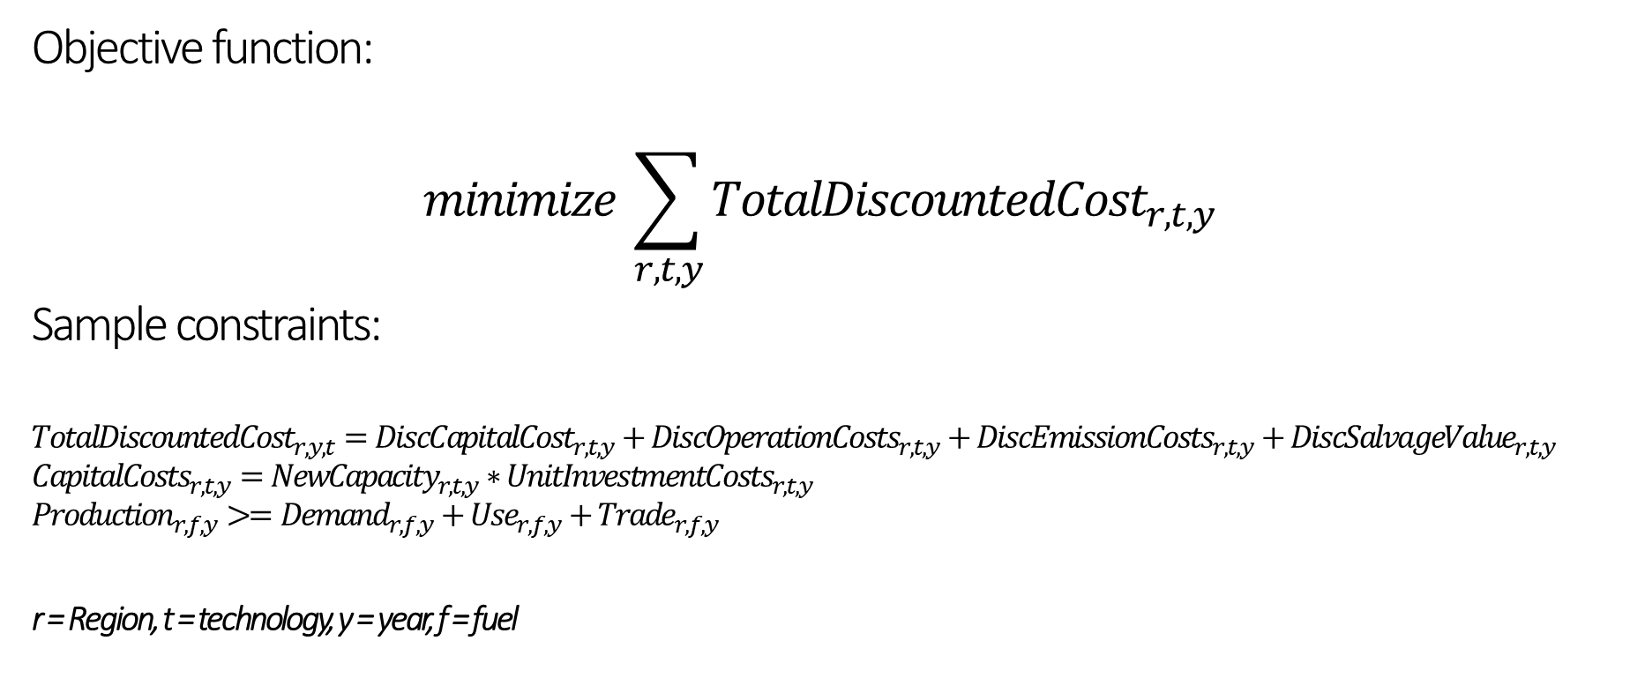
Mathematical Formulation of OSeMOSYS
Objective function:
$$minimize \sum_{r,t,y}{{TotalDiscountedCost}_{r,t,y} }$$
Sample constraints:
$${TotalDiscountedCost}_{r,y,t}={DiscCapitalCost}_{r,t,y}+{DiscOperationCosts}_{r,t,y}+{DiscEmissionCosts}_{r,t,y}+{DiscSalvageValue}_{r,t,y}$$
$${CapitalCosts}_{r,t,y}={NewCapacity}_{r,t,y}∗{UnitInvestmentCosts}_{r,t,y}$$
$${Production}_{r,f,y}>={Demand}_{r,f,y}+{Use}_{r,f,y}+{Trade}_{r,f,y}$$
r = Region, t = technology, y = year, f = fuel

Slide 27
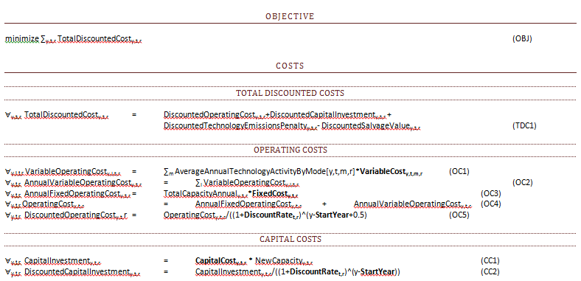
Example of Mathematical Formulation of OSeMOSYS

Slide 28
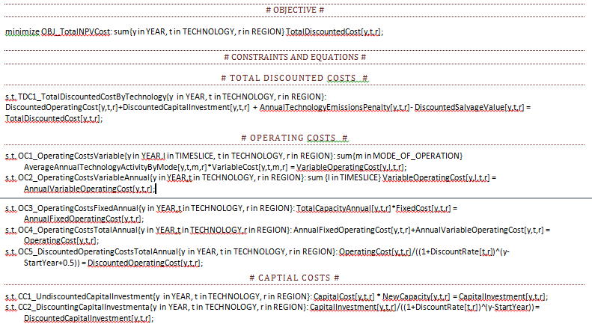
Example of Code of OSeMOSYS

Slide 29
OSeMOSYS – Key terms
Five key terms in OSeMOSYS:
Sets: Input, constant for all scenarios
Parameters: Input, can differ between scenarios
Variables: Modelling outputs
Constraints: can be equalities or inequalities the limit the solution space and should be satisfied all the time.
Objective Function: of the linear programing problem (to minimize cost)
Two versions of the code:
Long code: easy to read but requires larger matrix size and computational time.
Short code: combines some of the intermediate equations to reduce the matrix size and computational time.

Slide 30
Interfaces for OSeMOSYS

Slide 31
Interfaces for OSeMOSYS
MoManI – Model Management Infrastructure
LEAP – the Long-range Energy Alternatives Planning system
Run an input file directly on the command line, e.g, using Notepad++ to write input file and a compatible solver

Slide 32
Interfaces for OSeMOSYS
MoManI – Model Management Infrastructure
LEAP – the Long-range Energy Alternatives Planning system
Run an input file directly on the command line, e.g, using Notepad++ to write input file and a compatible solver

Slide 33
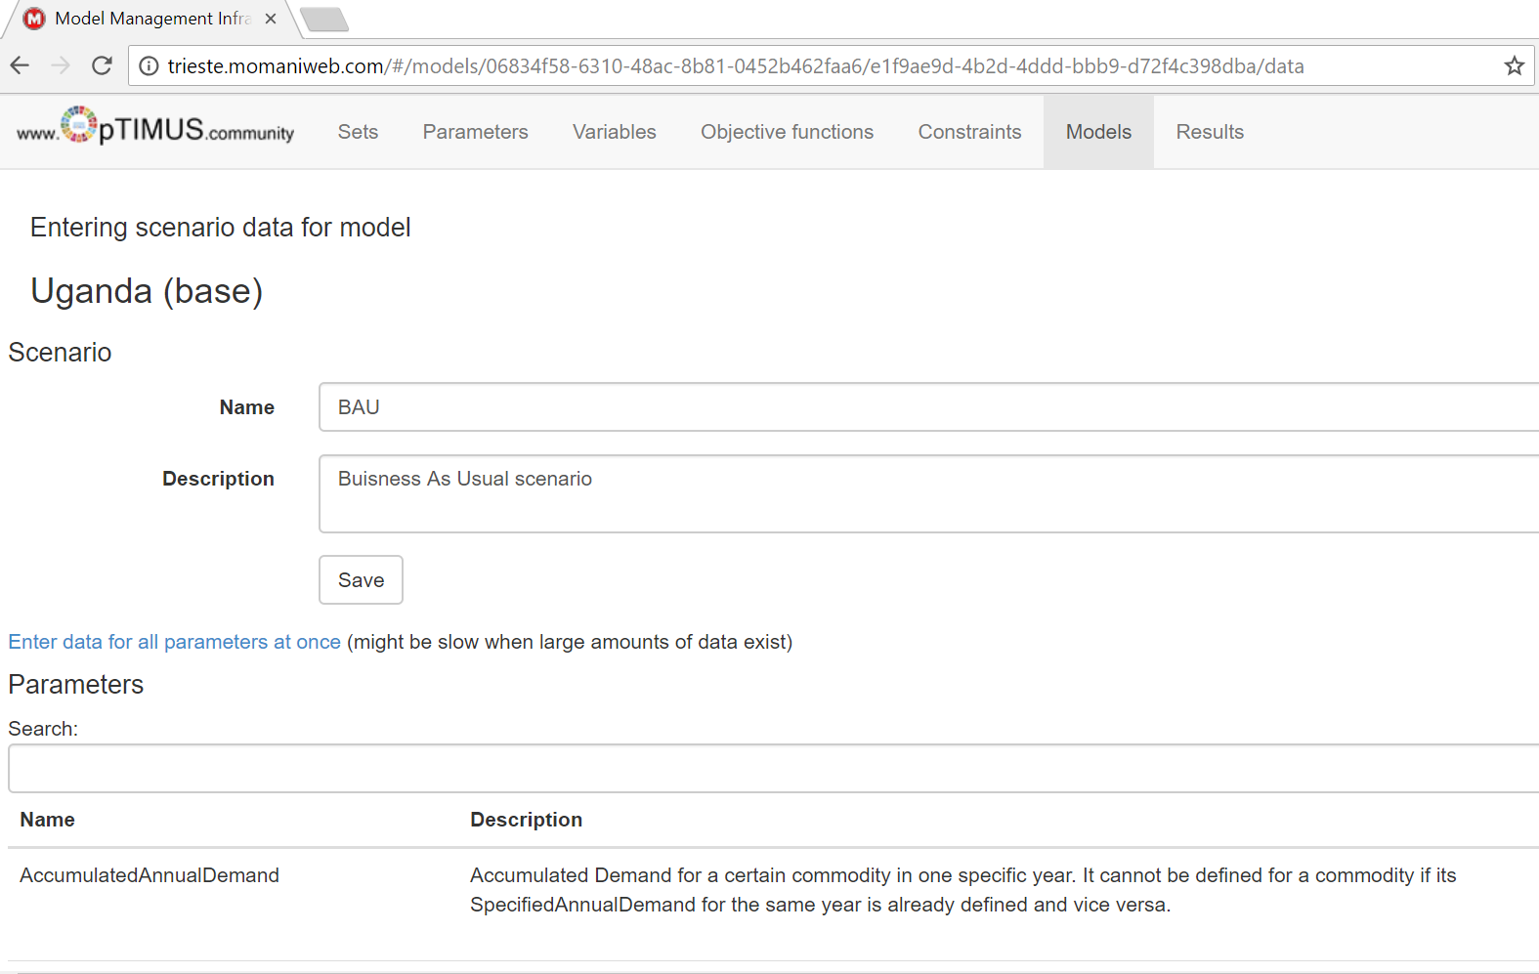
Interfaces for OSeMOSYS: MoManI
http://courses.momaniweb.com/#/models

Slide 34
Input parameters
Electricity demand projections
Primary resources potentials
Existing capacity
Technology costs and characteristics
Country/region specific constraints
Fuel prices
Data collection
Discretization of demand curves
Regression analyses where projections are not available
Etc…
Data pre-processing
I.e. set the starting year of the model as a past year for which actual data is available. From this starting point all that follows depends!
Model calibration

Slide 35
Interpreting modelling results

Slide 36
Interpreting modelling results
The results provide insights on questions such as:
Which technologies are phasing out? By when?
What are the optimal investments in new technologies to meet the demand in the future? When is it best to invest?
What are the key generation technologies in the total energy mix?
Which capacities are NOT being utilized? Why?
What costs will the energy system incur?

Slide 37
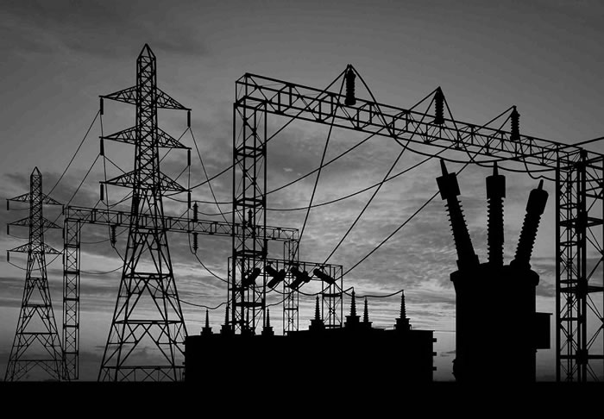

Interpreting modelling results
What needs to be done and what will be the costs to supply modern energy sources to remote areas?
What if environmental regulations are made more stringent?
What needs to be done to increase the share of renewable technologies?
Should the electricity import be allowed?
Should the existing nuclear facilities be closed down?
Can energy conservation program help in reducing cost of energy supply?

Slide 38
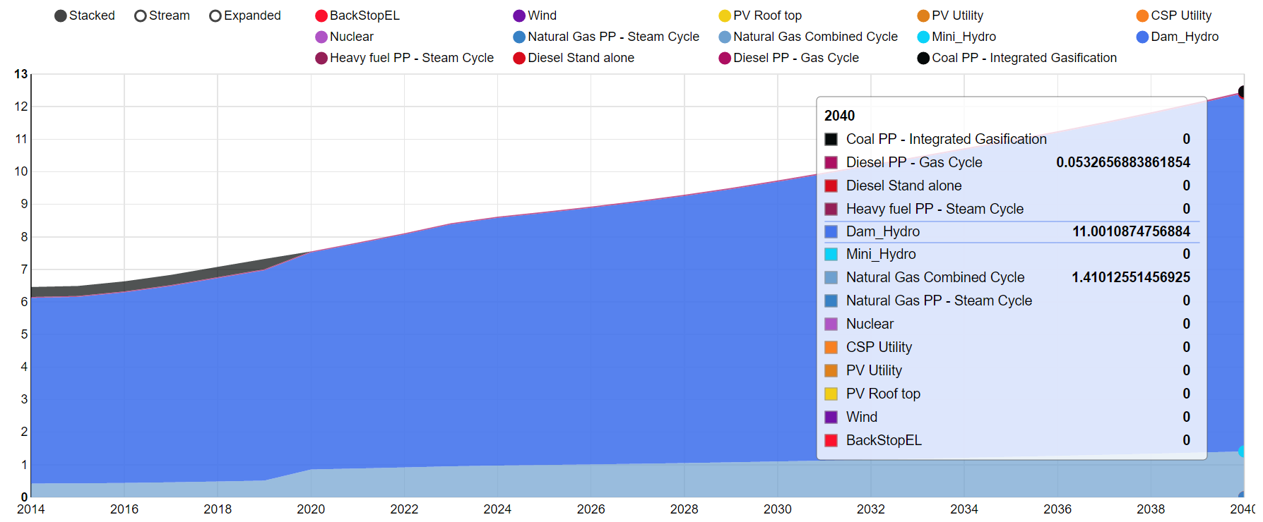
Representative OSeMOSYS results
Hydro and CCGT most competitive
Electricity Generation (PJ)
Initial capacity of COAL PP phased out at end of life
Year

Slide 39
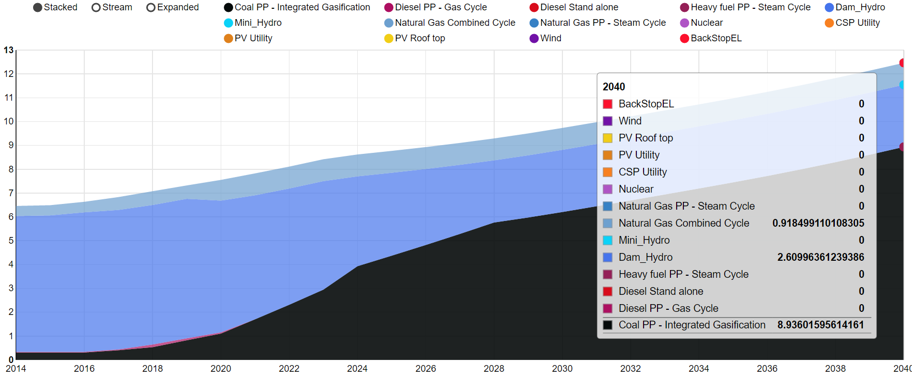
Representative OSeMOSYS results
What happens in a climate ‘water scarcity’ scenario?
Electricity Generation (PJ)
More generation from COAL PP, less reliance on HYDRO
Year

Slide 40
Key take away messages

Slide 41
Key take away messages
Keywords
Optimisation, Model generator, Linear Programming, OSeMOSYS, MoManI
Messages
Different optimisation techniques, e.g. LP, MILP, NLP
Common characteristics of optimisation model generators: perfect competition, information and foresight; dynamic; rational behaviour
Sub-set: partial equilibrium models
OSeMOSYS is a long-term, perfect foresight, dynamic cost-optimisation (not simulation!) model generator
Inputs to OSeMOSYS are: Sets and Parameters while outputs are called variables.
MoManI is an interface used for OSeMOSYS. Do not confuse the two!

Slide 42
Reading material
OSeMOSYS structure (Howells et al., 2011): https://www.sciencedirect.com/science/article/pii/S0301421511004897
OSeMOSYS code: https://github.com/KTH-dESA/OSeMOSYS/tree/master/OSeMOSYS_GNU_MathProg
OSeMOSYS user manual: https://osemosys.readthedocs.io/en/latest/
MoManI user manual: http://www.osemosys.org/uploads/1/8/5/0/18504136/momani_training_manual-_rev180601.pdf

Slide 43
Thank you
Francesco Gardumi and Youssef Almulla

