Slide 1
Introduction to Energy Systems Modelling
Francesco Gardumi
gardumi@kth.se
MJ2380/MJ2381 – Introduction to Energy Systems Analysis and Applications
Lecture 1
2020-01-17
Notes:
Presentation, title, me, Youssef
Contact info for any issue regarding the course
All access to Canvas and read docs? Please do!!!
Please subscribe to a group – all - asap
If any issue re registration or so, come after lecture / write to me

Slide 2
Learning outcomes
By the end of this course, students will be able to:
ILO 1: Describe common energy systems modelling and scenario analysis approaches and identify their key strengths and limitations;
ILO 2: Write a basic linear energy system optimization problem in GNU MathProg modelling language;
ILO 3: Apply a selected energy systems modelling tool in the analysis of stylized long-term energy planning problems;
ILO 4: Analyze various sample energy system situations and appropriately distill insights, given limited and uncertain information;
ILO 5: Include a basic representation of the links between climate, water, land use and energy into an energy system model;
ILO 6: Undertake a thorough and detailed analysis of a selected national energy system, including independent data gathering, problem definition, model choice, generation of solutions and interpretation.
Notes:
- Phrasing is a bit different from what you find on the course website on KTH (under update). So please for any kind of info refer to the docs I put on Canvas! That must be your bible.

Slide 3
Building on MJ2413 Energy and Environment
Continuity:
Course content
Same starting point: what is an energy system
Course deliverables
For MJ2380 students: Similar structure for the final report (context, literature, data search...)
Notes:
- Who has attended MJ2413?

Slide 4
Building on MJ2413 Energy and Environment
Moving beyond:
Course content
Deeply changing approach: from physical world to models
Diving into the analyst’s world: concepts, terminology, methodology, tools
Course deliverables
For MJ2380 students: also focus on applications in lit. review, use OSeMOSYS, larger array of scenarios, apply theory!

Slide 5
Throughout the course
Please read carefully the following documents on Canvas
MJ2380/MJ2381 - Course description deliverables and grading
MJ2380/MJ2381 - Course schedule
MJ2380 - Project description
Please keep the Canvas notifications on
Always check the Files section on Canvas – documents there are your reference
If after having done (1) and (2) you still have questions, please contact:
Francesco Gardumi – gardumi@kth.se

Slide 6
Your feedback is important
Right at the end of each lecture, there will be a very quick evaluation on Canvas with only two subjects
Rate the lecture (from 1 to 5)
Comment (if you have any points) on the content and the lecturer
Notes:
We are far from perfect
Feedback is important: we are now applying also suggestions we received in MJ2413

Slide 7
A slide with one table
 | Col 1 | Col 2 | Col 3 | Col 4
Row 1 | 1 | 2 | 3 | 4
Row 2 | 5 | 6 | 7 | 8
Some text below the table

Slide 8
Slide with one Smart art
first
secont
third

Slide 9
Slide with one graph

Slide 10
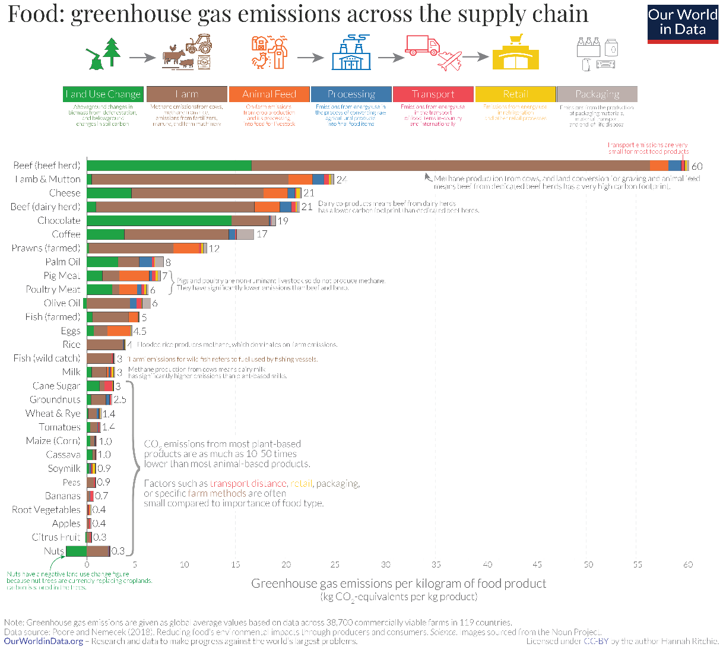
A slide with one Figure

Slide 11
Figure + text
Text on the right of the picture,
Might be difficult to make it show in the slide
Second text box next to the picture

Slide 12
Key take away messages
The energy system is a complicated network of processes and flows
Models are a useful tool to understand the energy system and formulate sound energy policies
Energy models provide insights for energy policies, not numbers
Modelling tools can be categorized into top-down and bottom-up. We will look at one type of bottom-up tools: optimization tools

Slide 13
Reading material
Modelling for insights, not numbers - Huntington et al. (1982): https://www.sciencedirect.com/science/article/pii/0305048382900020
Categorisation of modelling tools – Herbst et al. (2012): https://link.springer.com/content/pdf/10.1007%2FBF03399363.pdf
Review of different categorisation methods – Müller et al. (2018): https://www.sciencedirect.com/science/article/pii/S2211467X18300154

Slide 14
Thank you
For questions: gardumi@kth.se

