Slide 1
How SCM tools work
Gustav Dowling

Slide 2
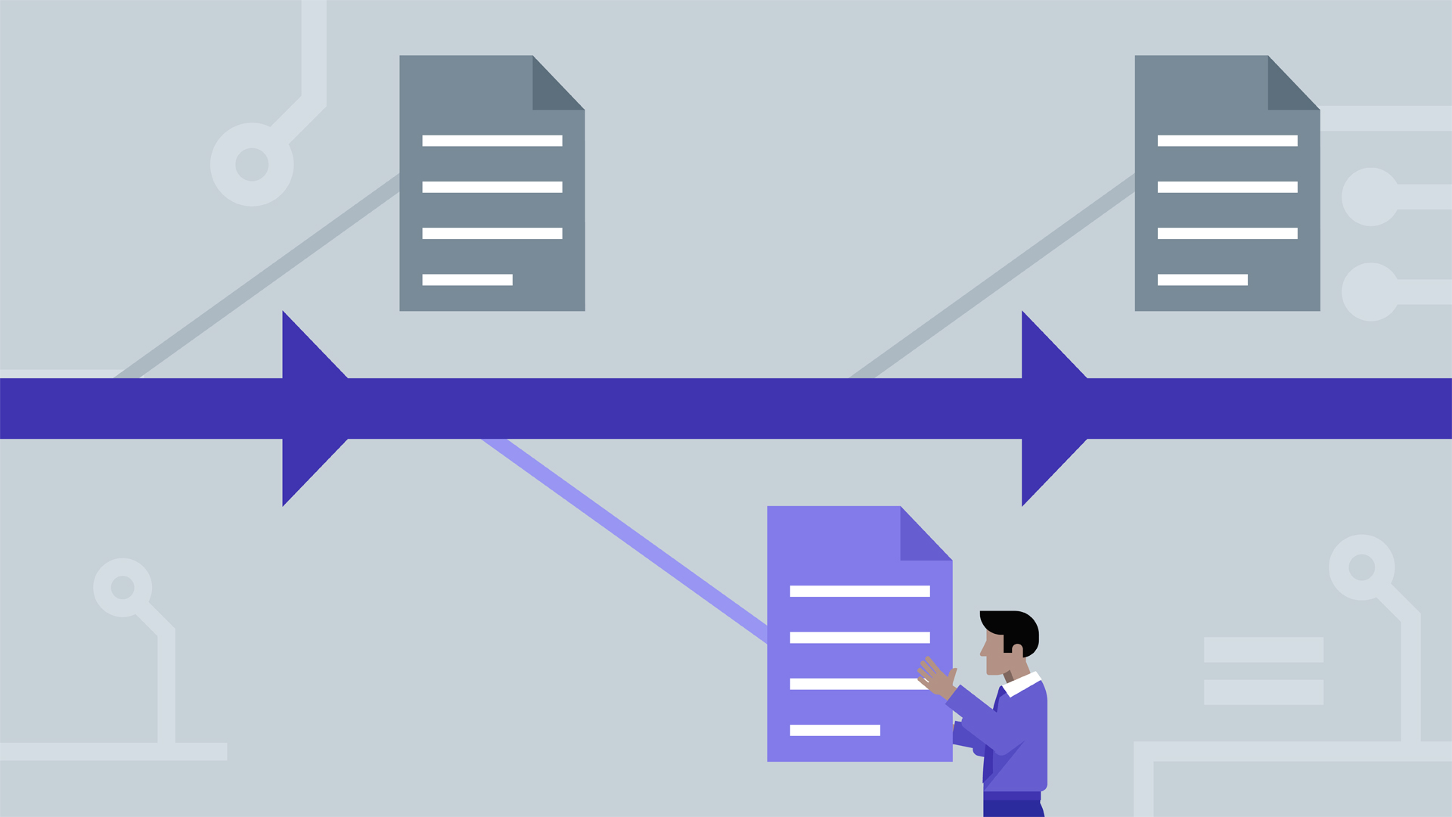
What is SCM?
Source Control Management / Version Control
Records changes to data over time

Slide 3


How SCM tools Relate to DevOps
Stability of software projects
Enables paralell workflows
Increased creativity and experimentation of developers
CORE OF DEVOPS

Slide 4
In This Presentation
Explaining how SCM tools work
Knowing how programs work helps you use them more efficiently
Building your own SCM tools

Slide 5

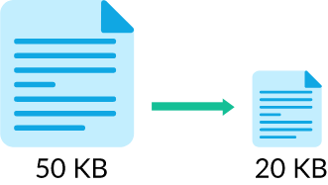

Challenges
Compressing previous versions
Accountability through authentication of history
Merging code (homework)

Slide 6
Delta Compression
Without Delta Compression:
Version 1: “Source control is cool”
Version 2: “Source control is kewl”
With Delta Compression:
Version 1: “Source control is cool”
Version 2: “coo” → “kew”
A lot more space efficient

Slide 7
Simple Authentication
Hashing every commit together with
previous hash
Repeat process to verify history
Guards against intentional and
unintentional corruption of history
data1
hash1 = H(data1)
data2
hash2 = H(data2
+ hash1)
data3
hash3 = H(data3
+ hash2)
commit
commit

Slide 8
Advanced Authentication
In Git, each commit is identified by a hash, this hash is both unique to the project (structure, timestamps, commit messages, etc...) and the data
Who is the parent of a merge commit?

Slide 9
Advanced Authentication
MASTER
data1
hash1
BRANCH
data2
hash2
MASTER
data1
hash1
BRANCH
data2
hash2
merge
merge
MASTER
data3 = data1+data2
hash3 = H(data3
+ hash1)
MASTER
data3 = data1+data2
hash3 = H(data3
+ hash1
+ hash2)

Slide 10
Conclusion
Now you know more about SCM tools like git work
Delta Compression
Authentication of files to prevent data corruption
One tool stands out

Slide 11


Slide 12
Sources:
ttps://git-scm.com/about/info-assurance
ttps://web.archive.org/web/20190530142357/https://insights.stackoverflow.com/survey/2018/#work-_-version-control
ttps://en.wikipedia.org/wiki/Version_control
ttps://en.wikipedia.org/wiki/Git

