Slide 1
RNN Machine Translation
Building an Encoder-Decoder Model for Swedish to English Translation

Slide 2
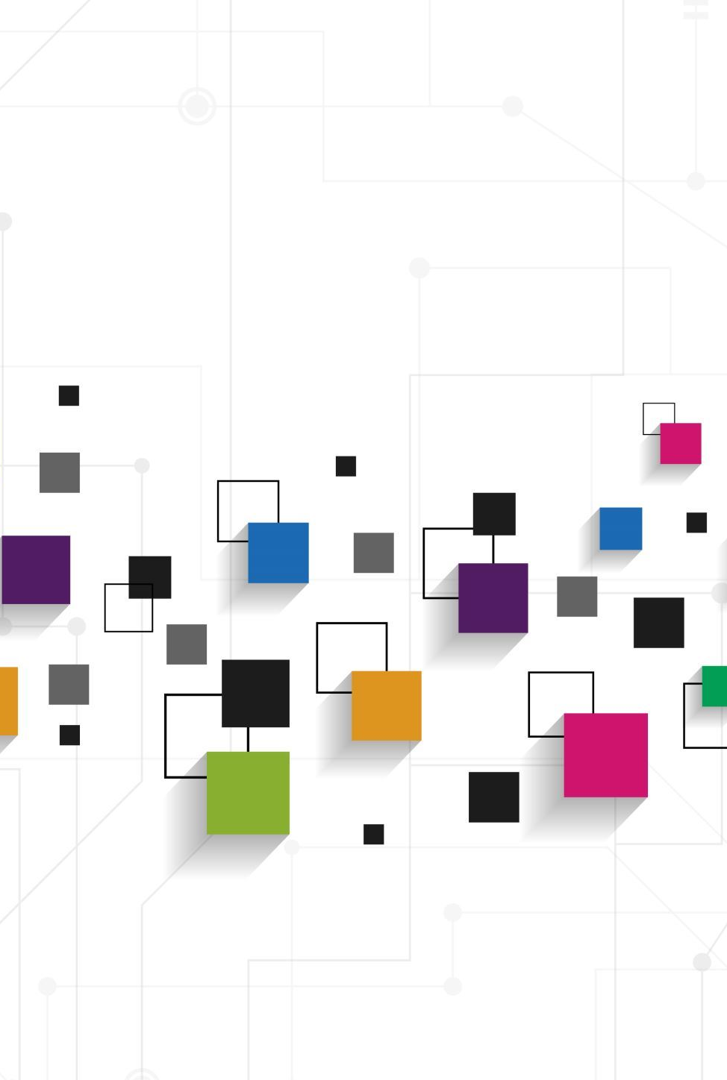
Seq2Seq Model: A Framework for Sequence Transformation
A general deep learning architecture used to map one sequence to another.
Widely Applied in: Machine Translation, Text Summarization, Speech Recognition, etc.
Core Components:
Encoder: Reads the input sequence (source language sentence).
Decoder: Generates the output sequence (target language sentence).
Connected by an intermediate representation (typically the encoder's final hidden state or a context vector).
Notes:
Input seq to output seq
Seq can be a piece of voice, and one sentence

Slide 3
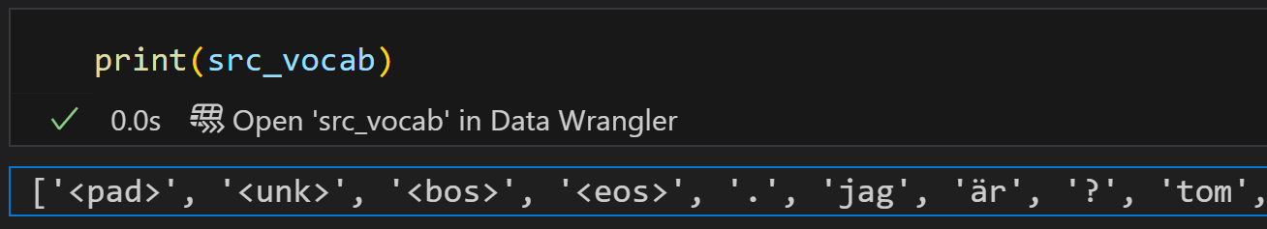
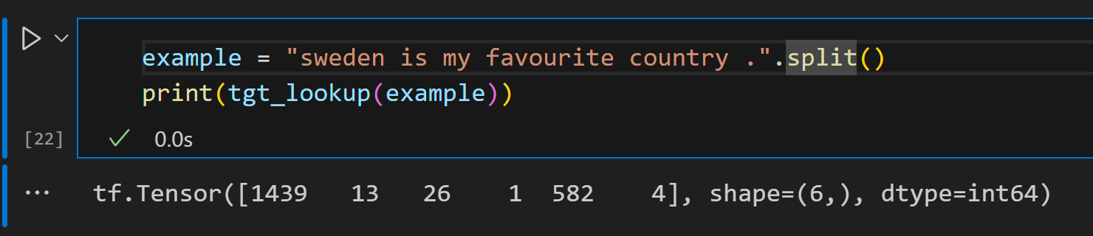
Build the vocabularies
count the frequency of every token across all input sentences.
Adds predefined special tokens (<pad>, <unk>, <bos>, <eos>) to the vocabulary list first
Selects the most frequent tokens from the counts (up to max_size minus the number of special tokens). (5000 in our case, 4 special)
Combines the special tokens and the most frequent tokens into a single ordered list. The first 4 four words are the special tokens
Notes:
Pad – for padding process
Most frequent toke is the point.

Slide 4
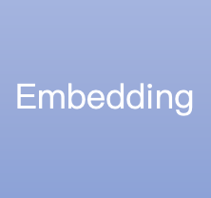

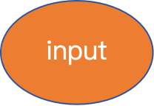
Encoder implementation
Input dim [1,6]
output dim [1,6,128]
Input dim [1,6,128]
output dim [1,6,512]
“sweden is my favourite country .”
Input dim [1,6]
Input dim [1,6,512]
output dim [1,6,256]
Dense(dim=256)
c
Final hidden state
Dense(dim=256)
Input dim [1,6,512]
output dim [1,6,256]
Encoder output
Notes:
With 1 row and 6 columns as input, 128 dim embedding layer.
GRU layer is set to have 256 dim but it forward, backward. Output 512 dim
For each time step, GRU returns hidden state output for attention implemention.
Besides, return the final hidden state after processing the whole seq.

Slide 5
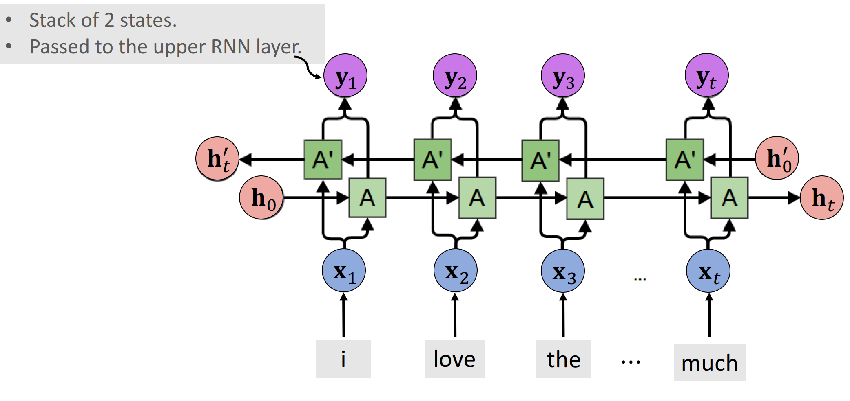
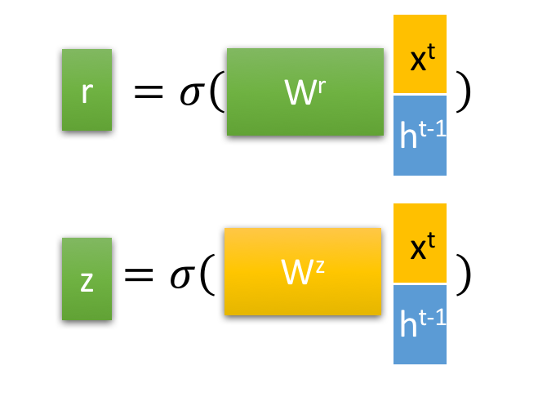
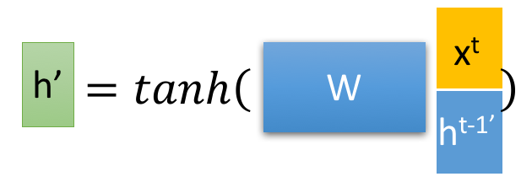
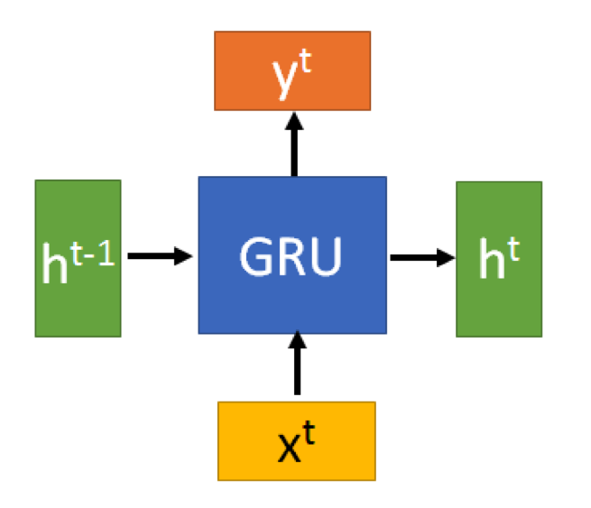


GRU implementation（bidirectional）
Source: https://github.com/wangshusen/DeepLearning/blob/master/Slides/9_RNN_4.pdf
Notes:
Start with some initiation for hidden state. Then have input for forward and backward propragation
Forward process has token input and last hidden state as input. Backward inverse
Both for and back combine to output for GRU layer.

Slide 6
Attention implementation
Uniform attention
Assigns equal weight to each position-specific representation in the output of the encoder
Bahdanau attention：
​​Encoder Hidden States​​: The encoder outputs all hidden states h1​,h2​,...,hT​ (from your GRU)
For each decoder step t, compute alignment scores between the decoder’s current state s_t−1​ and all encoder states
Attention Weights​​: Softmax and normalize scores to get weights α_ti​, indicating how much to focus on each h_i​
4. ​​Context Vector​​: Compute a weighted sum of encoder states, we call it context.
5. Decoder Integration​​: Feed context​ to the decoder to generate y_t​.

Slide 7
Decoder implementation
Encoder Final State
Decoder Initialization
initial state
GRU
Update initial state
Calculate the associate score
Next input
Encoder Output
The probability distribution of the output words
attention
context
Training purpose: embedding the real word ,not the output word of the model
Inference： embedding the highest probability word

Slide 8
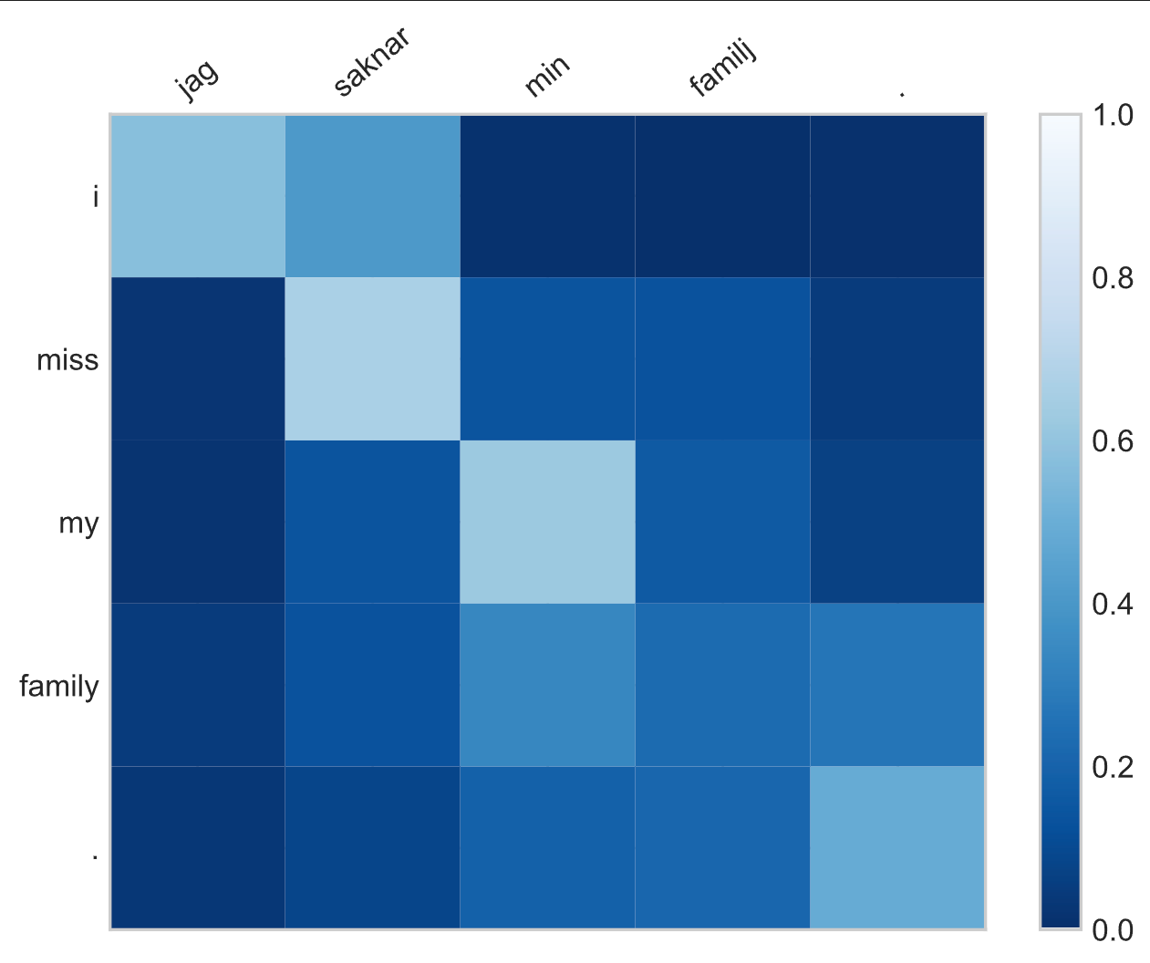
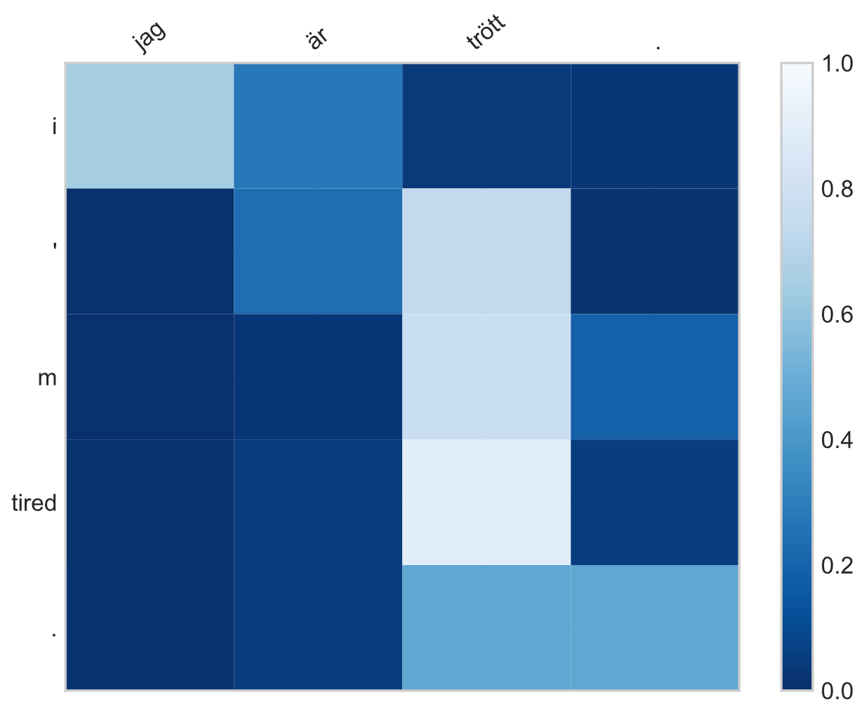
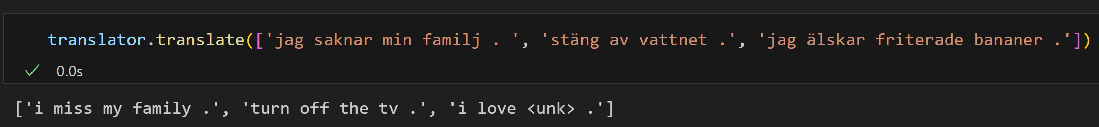
Results and evaluation
Evaluation by BLEU
BLEU score 26.1 >20 with 20 epochs
Heat map:
Diagonal aligenment observed for language with similar word order
Off-Diagonal alignment when word number is different
Improvement:
Complex model, increase the number of units in GRU layer
Complex dataset, include more rare or unknown words
LSTM (Long Short-Term Memory) might be a choice
Notes:
BLEU, Works by comparing the machine's output translation to one or more human reference translations. based on the overlap of N-grams (sequences of words) between the machine output and the references.
Score is between 0 and 1 (or 0-100); higher scores are better.
Random weight initialization
Data shuffling

Slide 9
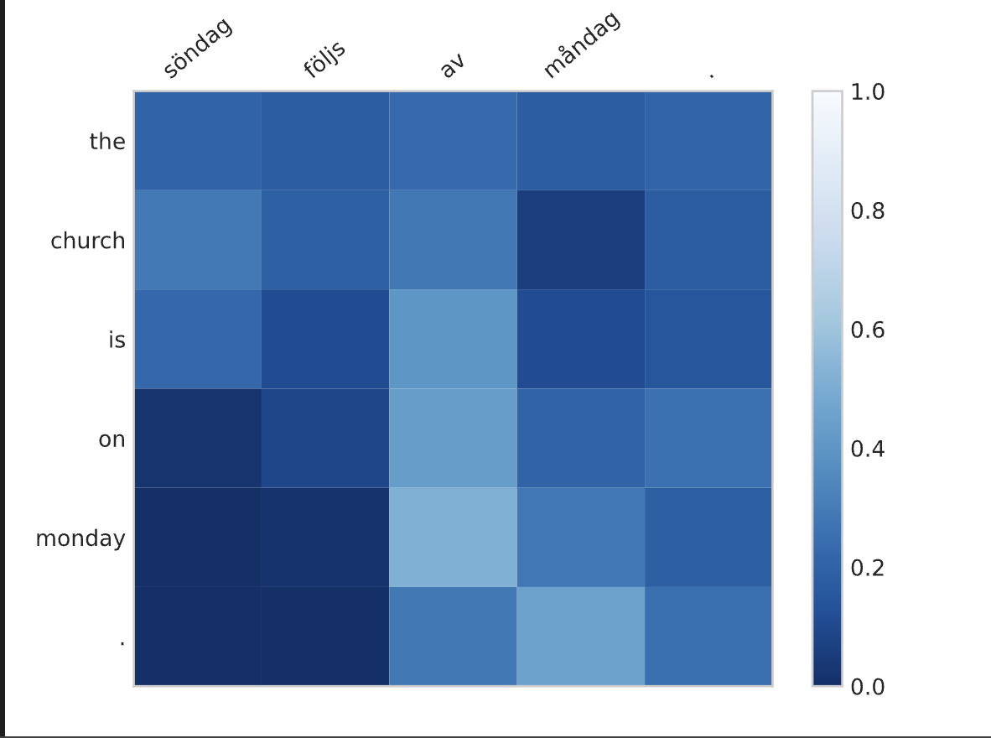
Results and evaluation
Surprise that the model could catch the key word like Monday even the the two sentences have different length, but the challenge is the indefinite article in English that is not exist in Swedish, so we need to improve the word dictionary to improve this situation, For example ,we could change the word Alignment into phrase Alignment.

