Slide 1
Device_FCT

Slide 2
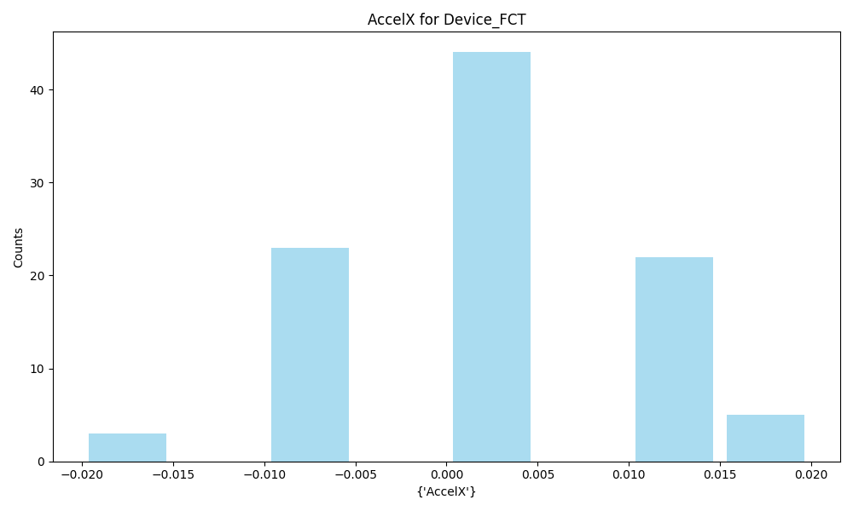
AccelX | Metric
Count | 97
Mean | 0.00
Std | 0.01
Min | -0.02
Max | 0.02

Slide 3
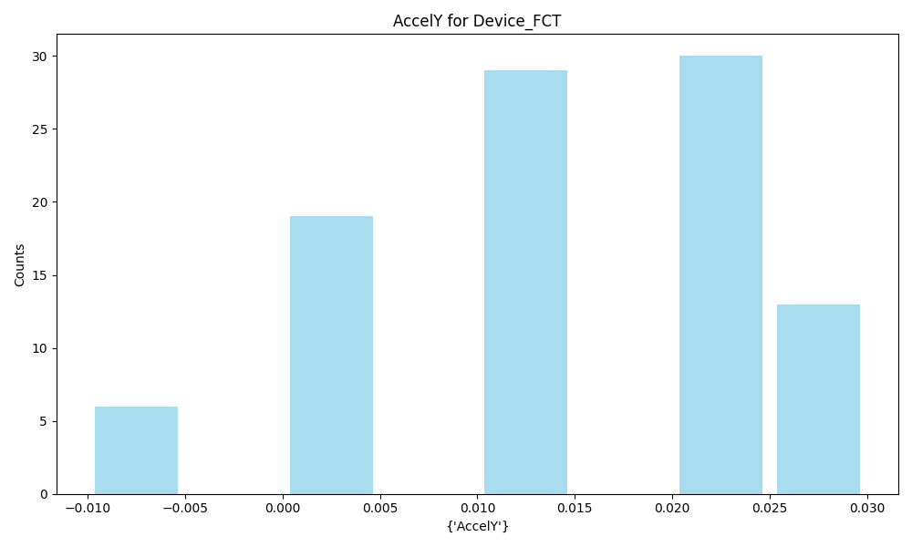
AccelY | Metric
Count | 97
Mean | 0.01
Std | 0.01
Min | -0.01
Max | 0.03

Slide 4
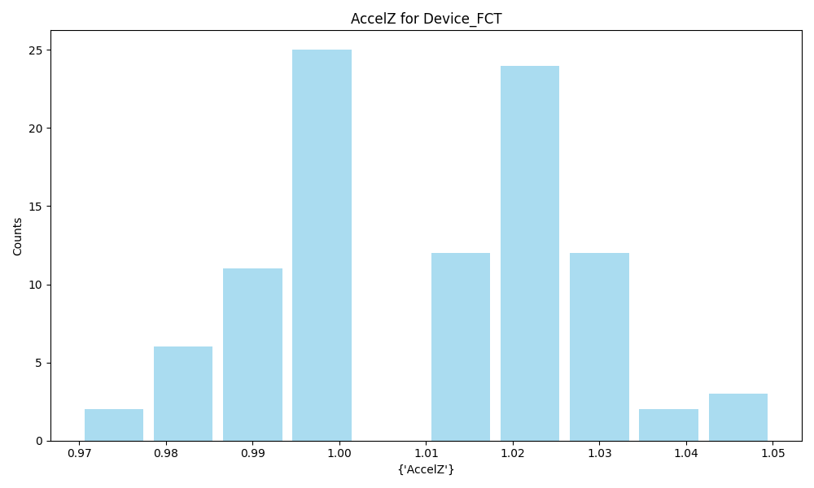
AccelZ | Metric
Count | 97
Mean | 1.01
Std | 0.02
Min | 0.97
Max | 1.05

Slide 5
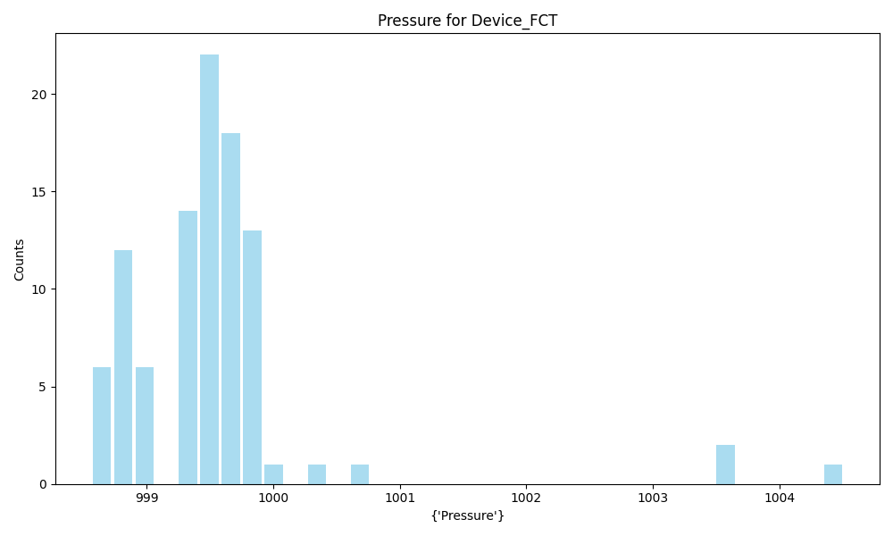
Pressure | Metric
Count | 97
Mean | 999.53
Std | 0.87
Min | 998.56
Max | 1004.51

Slide 6
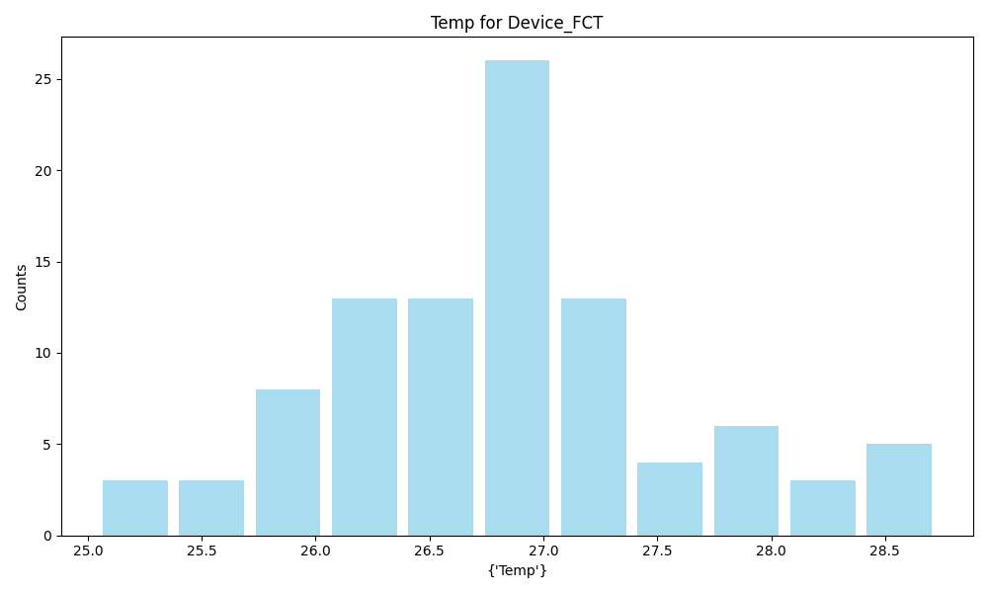
Temp | Metric
Count | 97
Mean | 26.82
Std | 0.78
Min | 25.04
Max | 28.73

Slide 7
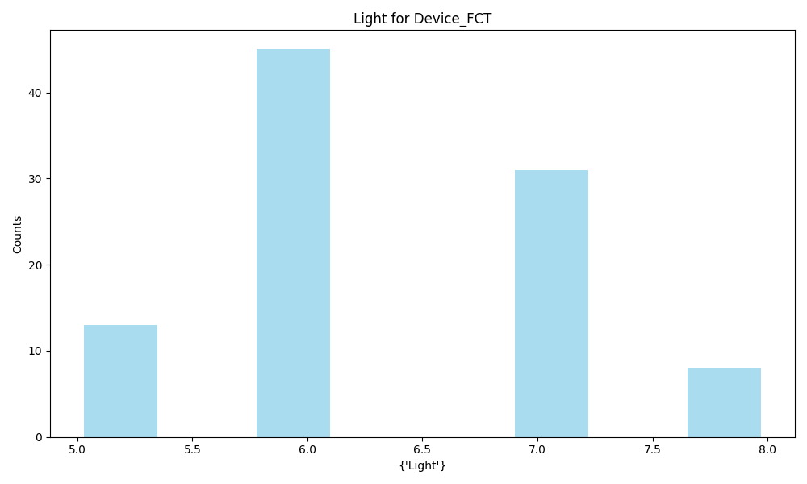
Light | Metric
Count | 97
Mean | 6.35
Std | 0.81
Min | 5.0
Max | 8.0

Slide 8
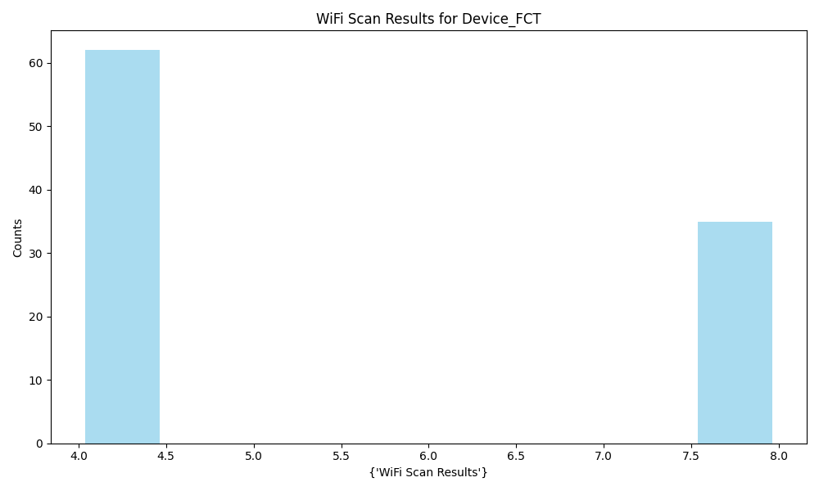
WiFi Scan Results | Metric
Count | 97
Mean | 5.44
Std | 1.92
Min | 4
Max | 8

Slide 9
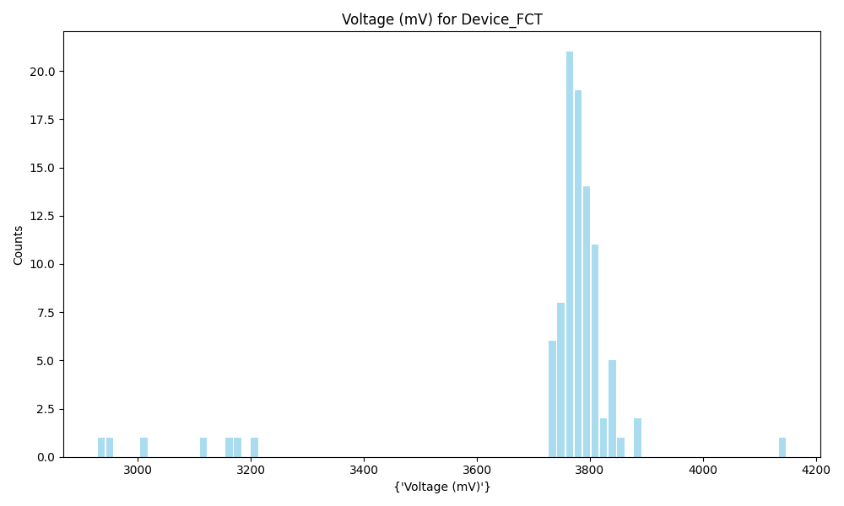
Voltage (mV) | Metric
Count | 97
Mean | 3736.66
Std | 192.64
Min | 2928.0
Max | 4148.0

Slide 10
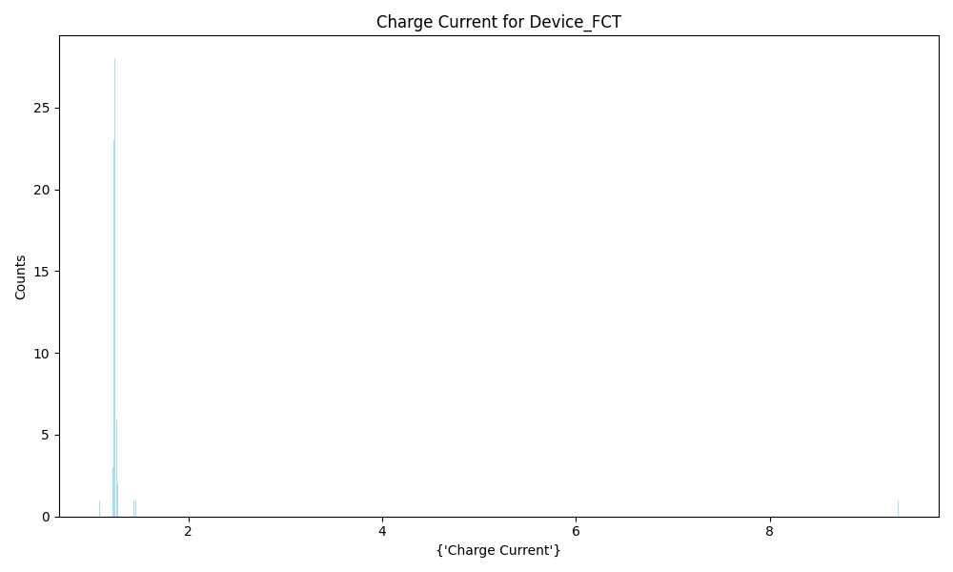
Charge Current | Metric
Count | 97
Mean | 1.36
Std | 0.85
Min | 1.078533
Max | 9.328884

Slide 11
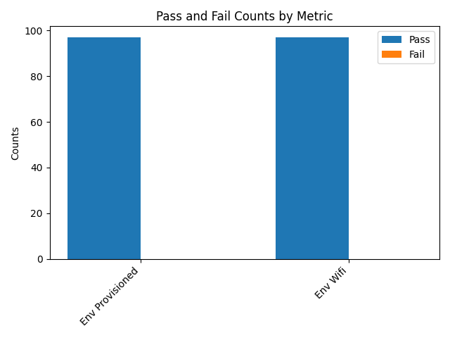
Metric | Env Provisioned | Env Wifi
Quantity | 97 | 97
Pass % | 100.00% | 100.00%
Fail % | 0.00% | 0.00%
Pass | 97 | 97
Fail | 0 | 0

Slide 12
PCBA_FCT

Slide 13
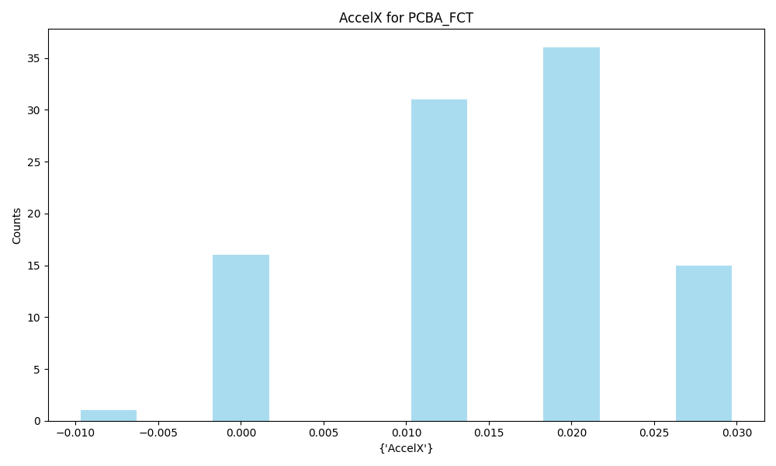
AccelX | Metric
Count | 99
Mean | 0.01
Std | 0.01
Min | -0.01
Max | 0.03

Slide 14
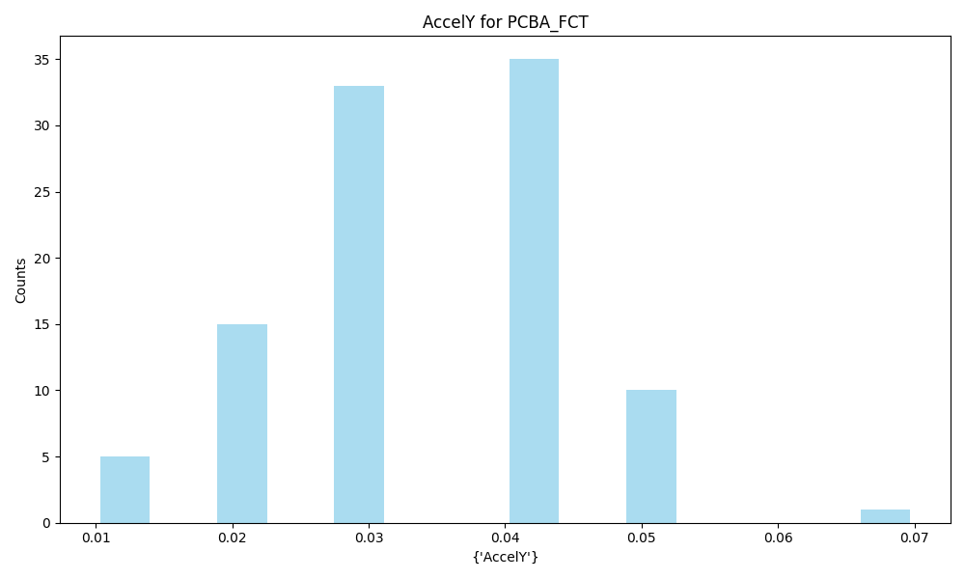
AccelY | Metric
Count | 99
Mean | 0.03
Std | 0.01
Min | 0.01
Max | 0.07

Slide 15
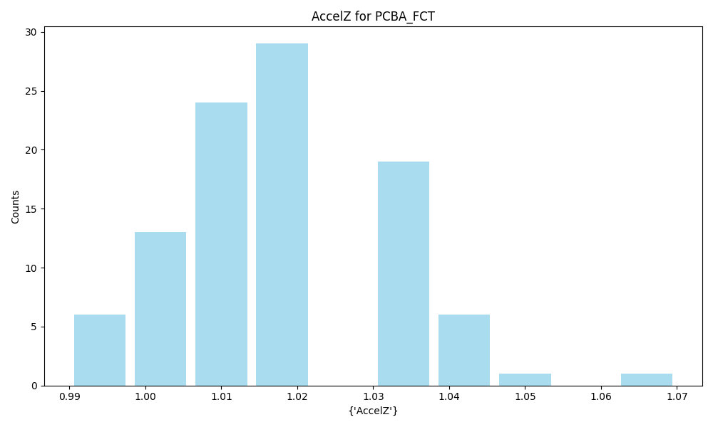
AccelZ | Metric
Count | 99
Mean | 1.02
Std | 0.01
Min | 0.99
Max | 1.07

Slide 16
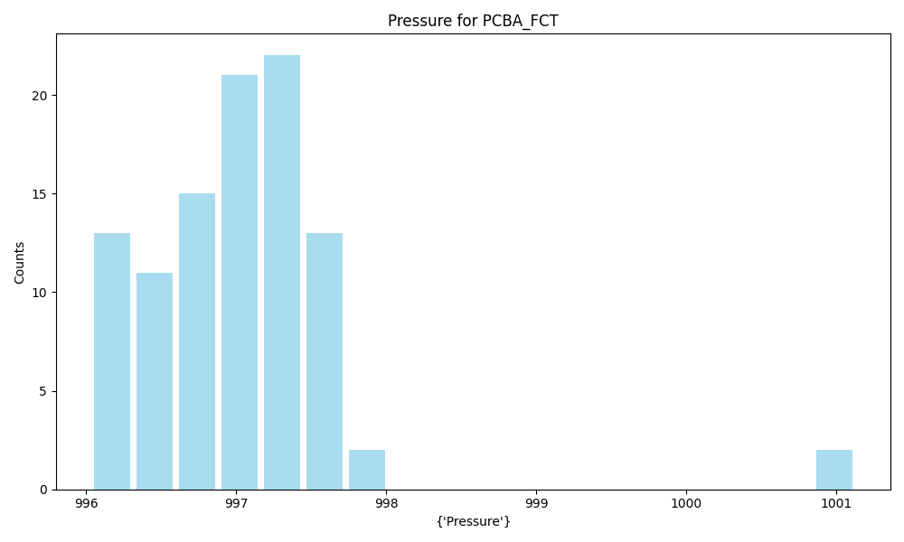
Pressure | Metric
Count | 99
Mean | 997.02
Std | 0.74
Min | 996.03
Max | 1001.13

Slide 17
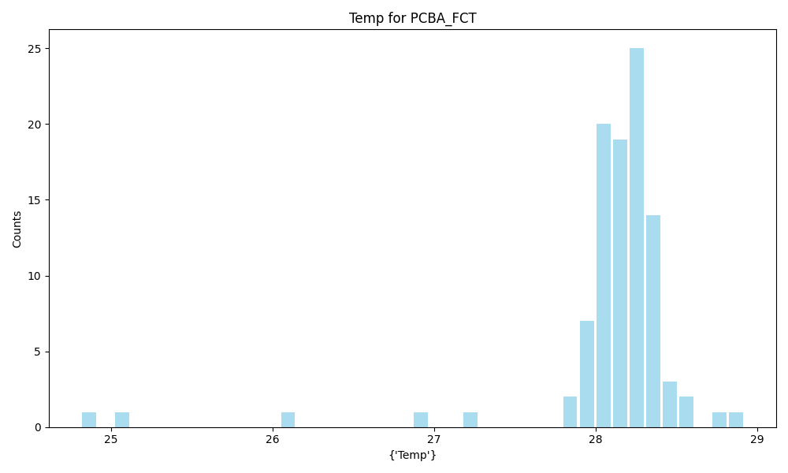
Temp | Metric
Count | 99
Mean | 28.08
Std | 0.55
Min | 24.81
Max | 28.92

Slide 18
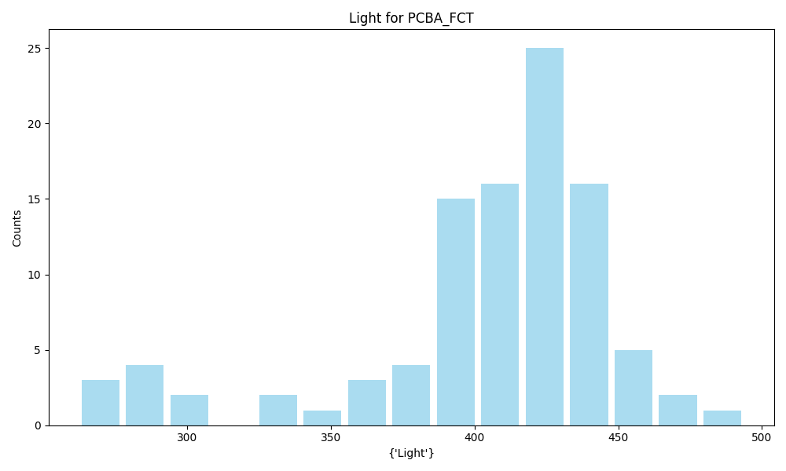
Light | Metric
Count | 99
Mean | 403.60
Std | 46.94
Min | 262.0
Max | 494.0

Slide 19
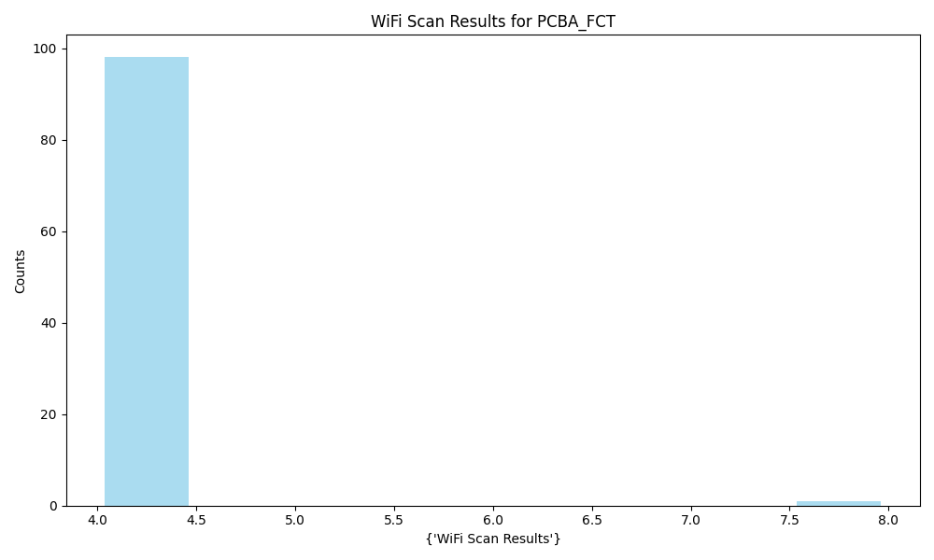
WiFi Scan Results | Metric
Count | 99
Mean | 4.04
Std | 0.40
Min | 4
Max | 8

Slide 20
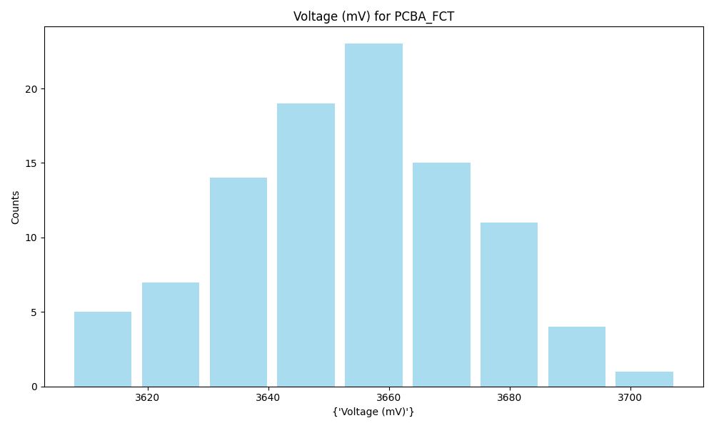
Voltage (mV) | Metric
Count | 99
Mean | 3653.24
Std | 19.99
Min | 3607.0
Max | 3708.0

Slide 21
PCBA_FT_Conducted

Slide 22
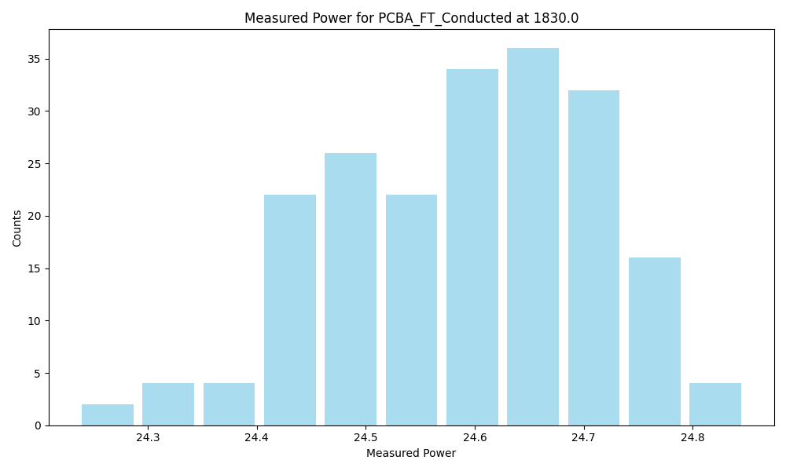
Frequency | 1830.0
Count | 202
Mean | 24.59
Std | 0.12
Min | 24.23505
Max | 24.84868

Slide 23
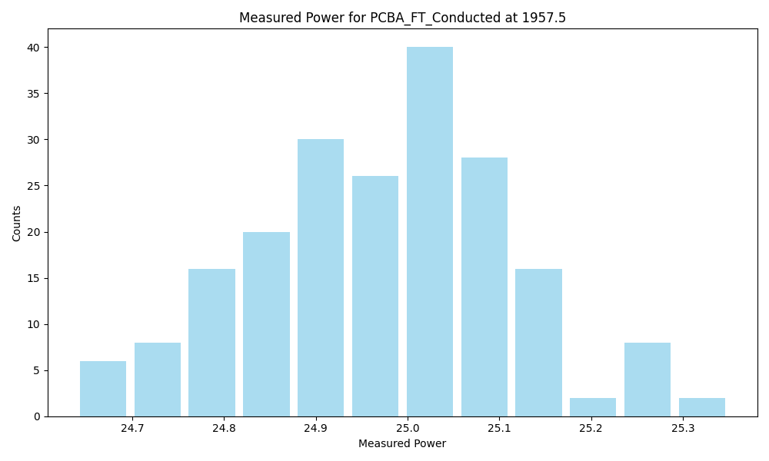
Frequency | 1957.5
Count | 202
Mean | 24.97
Std | 0.14
Min | 24.63852
Max | 25.3505

Slide 24
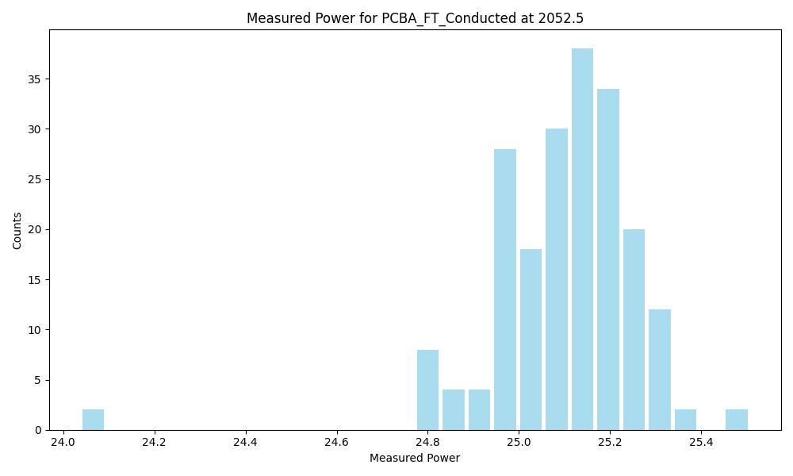
Frequency | 2052.5
Count | 202
Mean | 25.10
Std | 0.17
Min | 24.03788
Max | 25.50639

Slide 25
PCBA_FT_Coupling

Slide 26
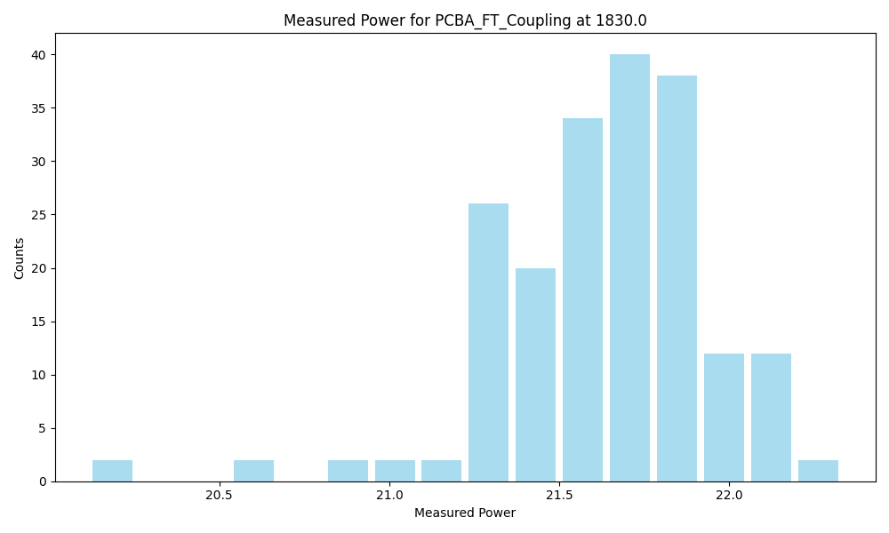
Frequency | 1830.0
Count | 194
Mean | 21.63
Std | 0.32
Min | 20.1162
Max | 22.33126

Slide 27
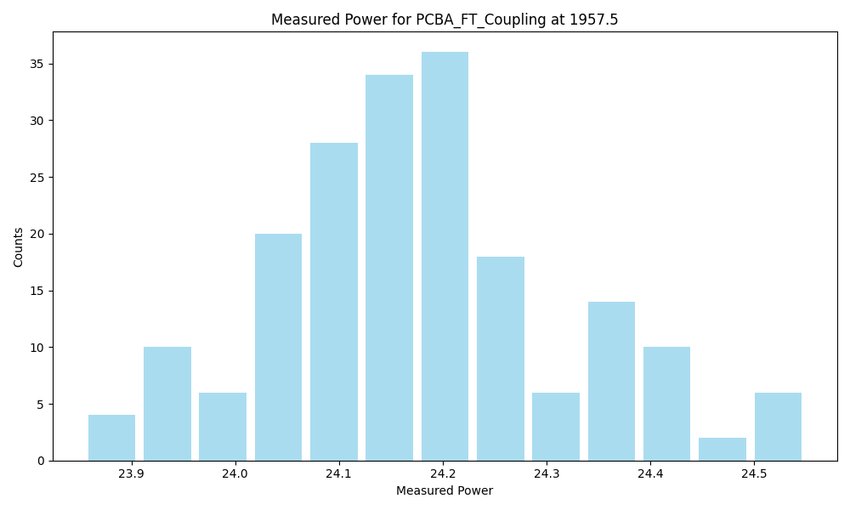
Frequency | 1957.5
Count | 194
Mean | 24.18
Std | 0.14
Min | 23.85431
Max | 24.54999

Slide 28
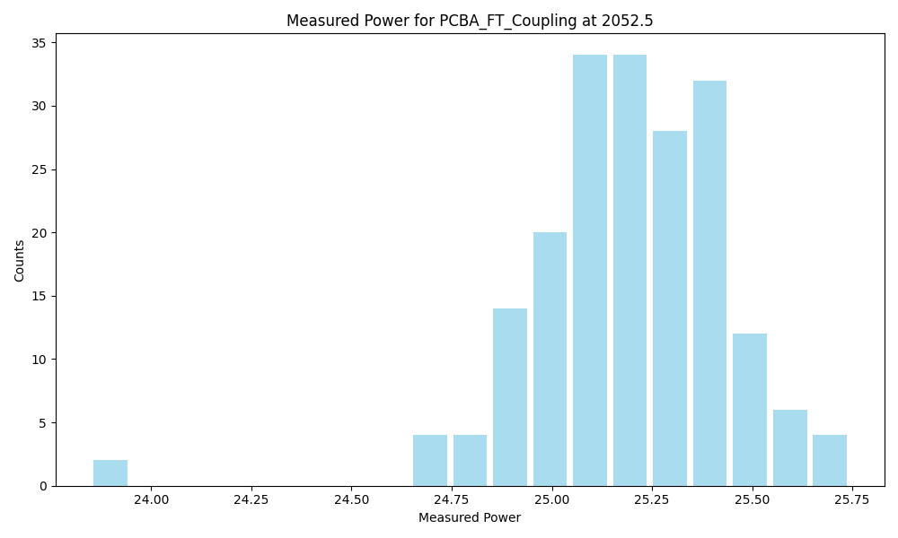
Frequency | 2052.5
Count | 194
Mean | 25.19
Std | 0.25
Min | 23.84784
Max | 25.74376

